Slide 1
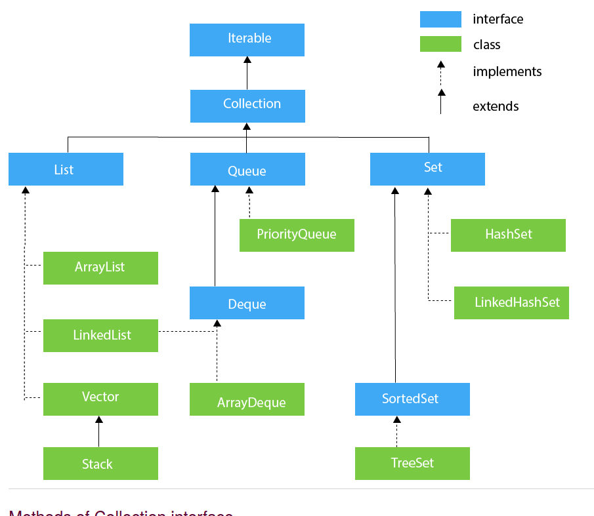

Slide 2
import java.util.*;
class ArrayList4{
public static void main(String args[]){
ArrayList<String> list=new ArrayList<String>();//Creating arraylist
list.add("Ravi");//Adding object in arraylist
list.add("Vijay");
list.add("Ravi");
list.add("Ajay");
System.out.println("Traversing list through List Iterator:");
//Here, element iterates in reverse order ListIterator<String> list1=list.listIterator(list.size());
while(list1.hasPrevious())
{
String str=list1.previous();
System.out.println(str);
}
System.out.println("Traversing list through for loop:");
for(int i=0;i<list.size();i++) {
System.out.println(list.get(i));
}
System.out.println("Traversing list through forEach() method:");
//The forEach() method is a new feature, introduced in Java 8.
list.forEach(a→ { //Here, we are using lambda expression
System.out.println(a);
});
System.out.println("Traversing list through forEachRemaining() method:");
Iterator<String> itr=list.iterator();
itr.forEachRemaining(a-> //Here, we are using lambda expression
{
System.out.println(a);
});
}

Slide 3
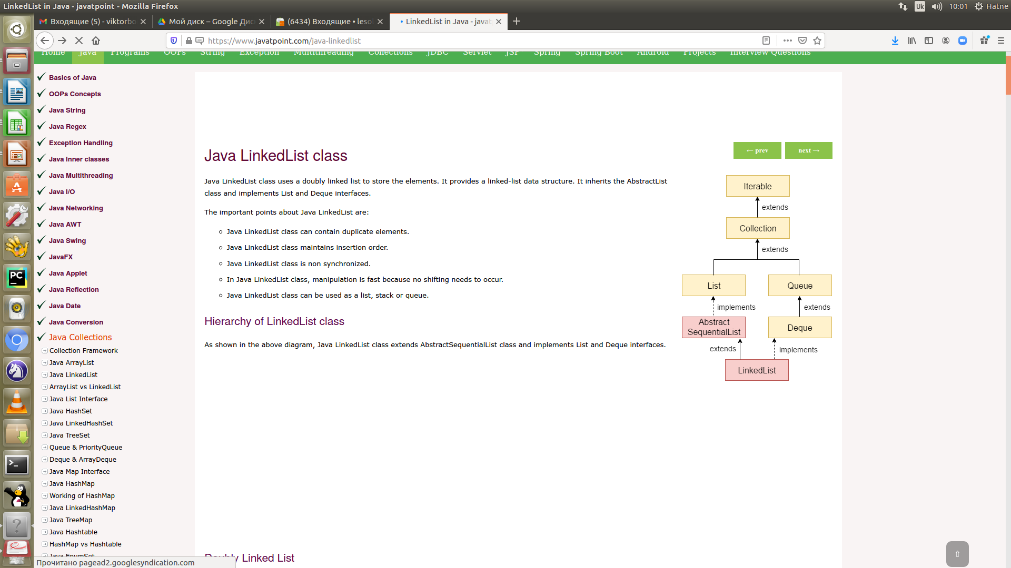

Slide 4
class Student{
int rollno;
String name;
int age;
Student(int rollno,String name,int age){
this.rollno=rollno;
this.name=name;
this.age=age;
}
}
import java.util.*;
class AgeComparator implements Comparator<Student>{
public int compare(Student s1,Student s2){
if(s1.age==s2.age)
return 0;
else if(s1.age>s2.age)
return 1;
else
return -1;
}
}

Slide 5
import java.util.*;
class NameComparator implements Comparator<Student>{
public int compare(Student s1,Student s2){
return s1.name.compareTo(s2.name);
}
}
System.out.println("Sorting by Name");
//Using NameComparator to sort the elements
Collections.sort(al,new NameComparator());
//Traversing the elements of list
for(Student st: al){
System.out.println(st.rollno+" "+st.name+" "+st.age);
}
System.out.println("sorting by Age");
//Using AgeComparator to sort the elements
Collections.sort(al,new AgeComparator());
//Travering the list again
for(Student st: al){
System.out.println(st.rollno+" "+st.name+" "+st.age);
}
}
}
//Java Program to demonstrate the use of Java Comparator
import java.util.*;
import java.io.*;
class TestComparator{
public static void main(String args[]){
//Creating a list of students
ArrayList<Student> al=new ArrayList<Student>();
al.add(new Student(101,"Vijay",23));
al.add(new Student(106,"Ajay",27));
al.add(new Student(105,"Jai",21));

Slide 6
class Student implements Comparable<Student>{
int rollno;
String name;
int age;
Student(int rollno,String name,int age){
this.rollno=rollno;
this.name=name;
this.age=age;
}
public int compareTo(Student st){
if(age==st.age)
return 0;
else if(age>st.age)
return 1;
else
return -1;
}
}
//Creating a test class to sort the elements
public class TestSort3{
public static void main(String args[]){
ArrayList<Student> al=new ArrayList<Student>();
al.add(new Student(101,"Vijay",23));
al.add(new Student(106,"Ajay",27));
al.add(new Student(105,"Jai",21));
Collections.sort(al);
for(Student st:al){
System.out.println(st.rollno+" "+st.name+" "+st.age);
}
}
}

Slide 7
le | Comparator
1) Comparable provides a single sorting sequence. In other words, we can sort the collection on the basis of a single element such as id, name, and price. | The Comparator provides multiple sorting sequences. In other words, we can sort the collection on the basis of multiple elements such as id, name, and price etc.
2) Comparable affects the original class, i.e., the actual class is modified. | Comparator doesn't affect the original class, i.e., the actual class is not modified.
3) Comparable provides compareTo() method to sort elements. | Comparator provides compare() method to sort elements.
4) Comparable is present in java.lang package. | A Comparator is present in the java.util package.
5) We can sort the list elements of Comparable type by Collections.sort(List) method. | We can sort the list elements of Comparator type by Collections.sort(List, Comparator) method.

Slide 8
ArrayList | LinkedList
1) ArrayList використовує dynamic array для зберігання елементів | LinkedList використовує doubly linked list для зберігання елементів
2) Маніпуляції з ArrayList повільні тому що він використовує масив. Видалення та додавання елементів - повільні | Маніпуляції з LinkedList швидші тому що використвується двозвязний список
3) ArrayList має функціонал Списку лише тому, що implements List. | LinkedList може бути list або queue тому що має List та Deque interfaces.
4) ArrayList кращий для зберігання та доступу. | LinkedList карщий для маніпуляцій з даними

Slide 9
