Slide 1

Homeowners vs Renters
Which one is STATISTICALLY fit for you?
Mecahel Demissie, Keith Bansa, Victor Adekola, Steve Scott II
March 2021
Bowie State University
CTEC 128

Slide 2
Table Of Contents
Introduction
Data Science Pipeline
Ingestion
Wrangling
Exploratory Data Analysis (EDA)
Visualization
Insights
Recommendations/Future Projects
Insights from the Semester

Slide 3

Introduction
Overview
What’s the difference?
Owning a Home
Renting a Home
Pay monthly mortgage for a house YOU own
Can personalize/decorate housing
If you want to sell, the value can increase/decrease
Pay monthly rent to live inside a home someone else owns
Cannot personalize living space
Rent price may increase

Slide 4
Introduction
Problem
The Problem of the Topic?
EVERYBODY IS DIFFERENT!

Slide 5
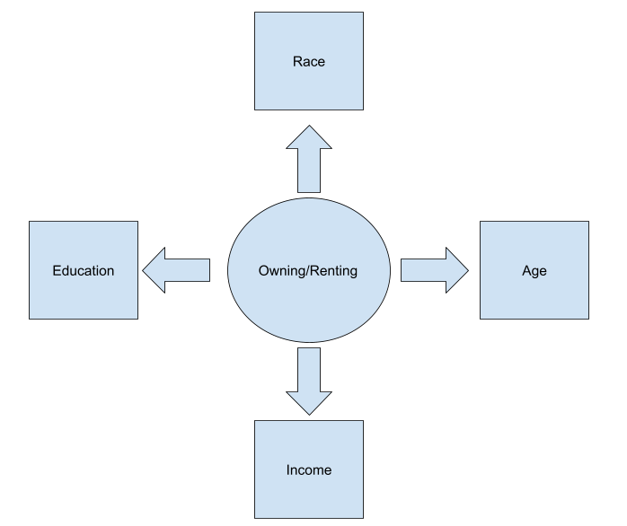
Introduction
Concept Map
Settle down for a house as you get older?
Enough money for down payment or monthly payments?
With higher education, does it help choose an option?
Are there trends that colored people are more likely to rent/buy homes?

Slide 6
Introduction
Outline
Project Objectives
Project Research Questions
Understanding the difference of trends between people buying/renting a house
Providing the reader with data on the demographics of who owns/rents a house
Finding out average income for homeowners and renters
What is the difference of genders being homeowners or renters?
Are people who graduate college more likely to own a home than people who didn’t graduate high school?
What is the average income for people renting homes vs buying one?
Which race of colored people are renting or owning homes the most?
What age group are buying homes the most?

Slide 7

Data Science Pipeline
Ingestion
Data Source: ACS 1-Year Estimates - Public Use Microdata Sample (2019)
Housing File: 1,548,187
Person File: 2,097,150
Over 3,645,000 before wrangling!
Variables Needed: Race, Age, Income, Tenure, Gender, School Attainment, Marital Status

Slide 8
Data Science Pipeline
Wrangling
Lots of wrangling with variables
Gender didn’t need to be wrangled
Only people who are single/never married counted
Age range from 22-82
Race groups from Black, White, Asian, Hispanic, Indian, and Others
Removed anything under 9th grade for School Attainment
Removed blanks, negatives, and 0s from Income
Owned with mortgage or loan/Owned free and clear = Homeowner
Rented/Occupied without payment of rent = Renter
From 3,650,000+ instances to 67073!

Slide 9
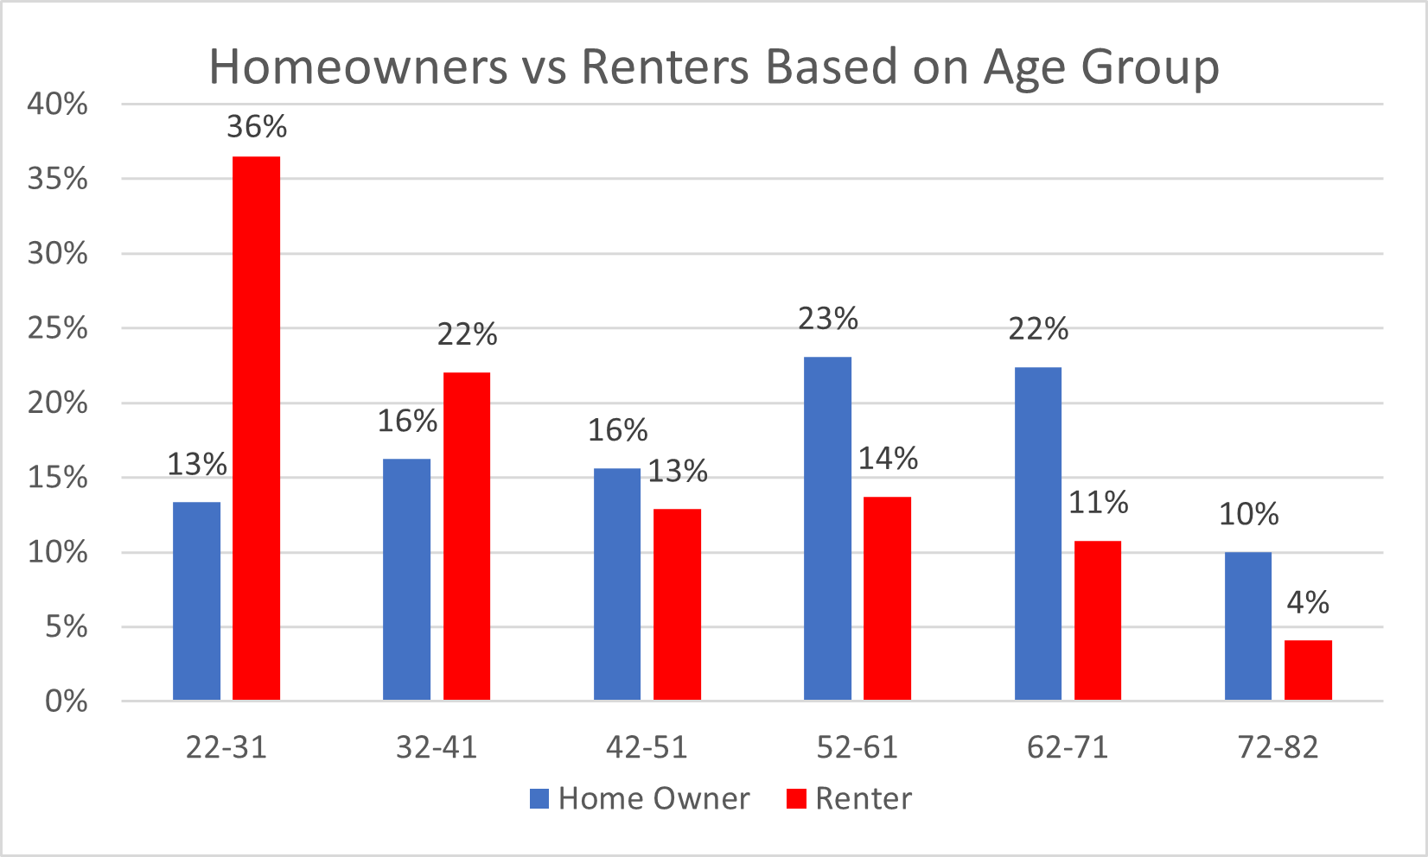
Data Science Pipeline
EDA
Figure 1.
A lot of renters at younger ages, more homeowners at older ages.
Correlation = -0.08

Slide 10
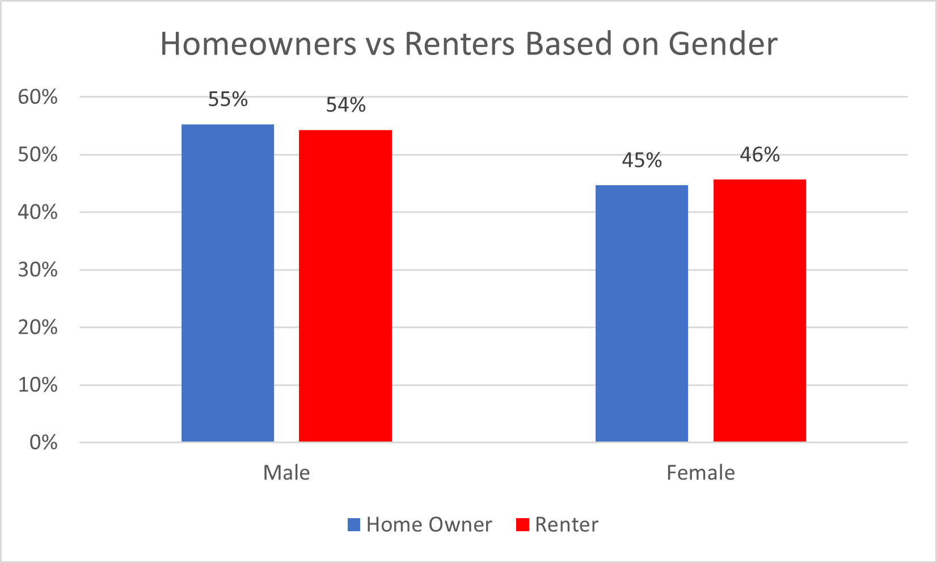
Data Science Pipeline
EDA
Figure 2.
Not much of a difference between the two.
Correlation = 1

Slide 11
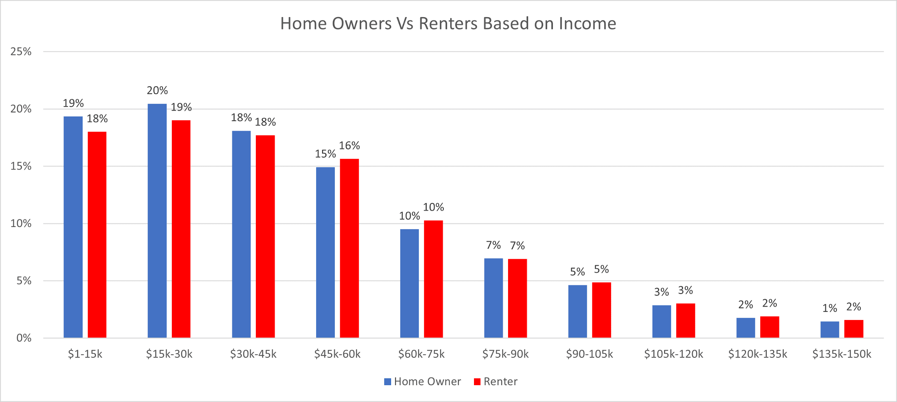
Data Science Pipeline
EDA
Figure 3.
Instances drop after $100,000+ income
Correlation = 0.99

Slide 12
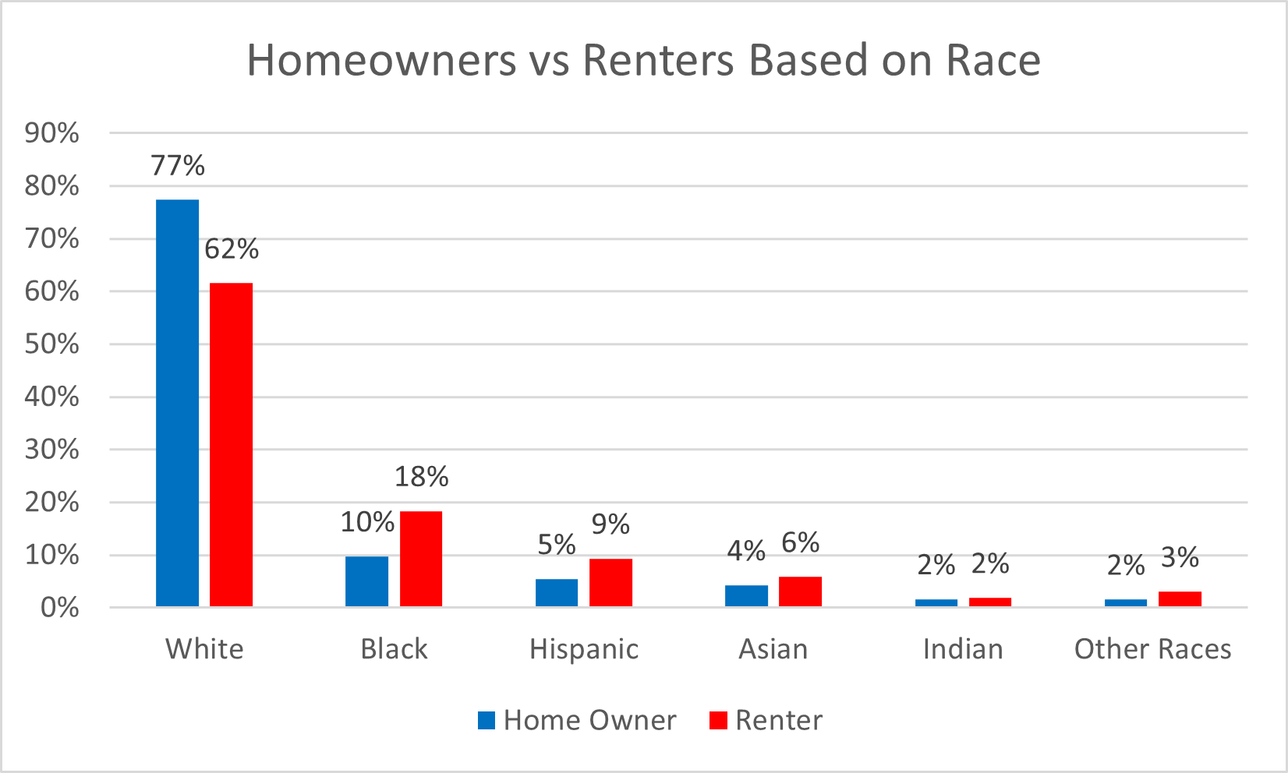
Data Science Pipeline
EDA
Figure 4.
Many instances of white people which influences the chart heavily, making up 70% of the data set
Correlation = 0.99

Slide 13
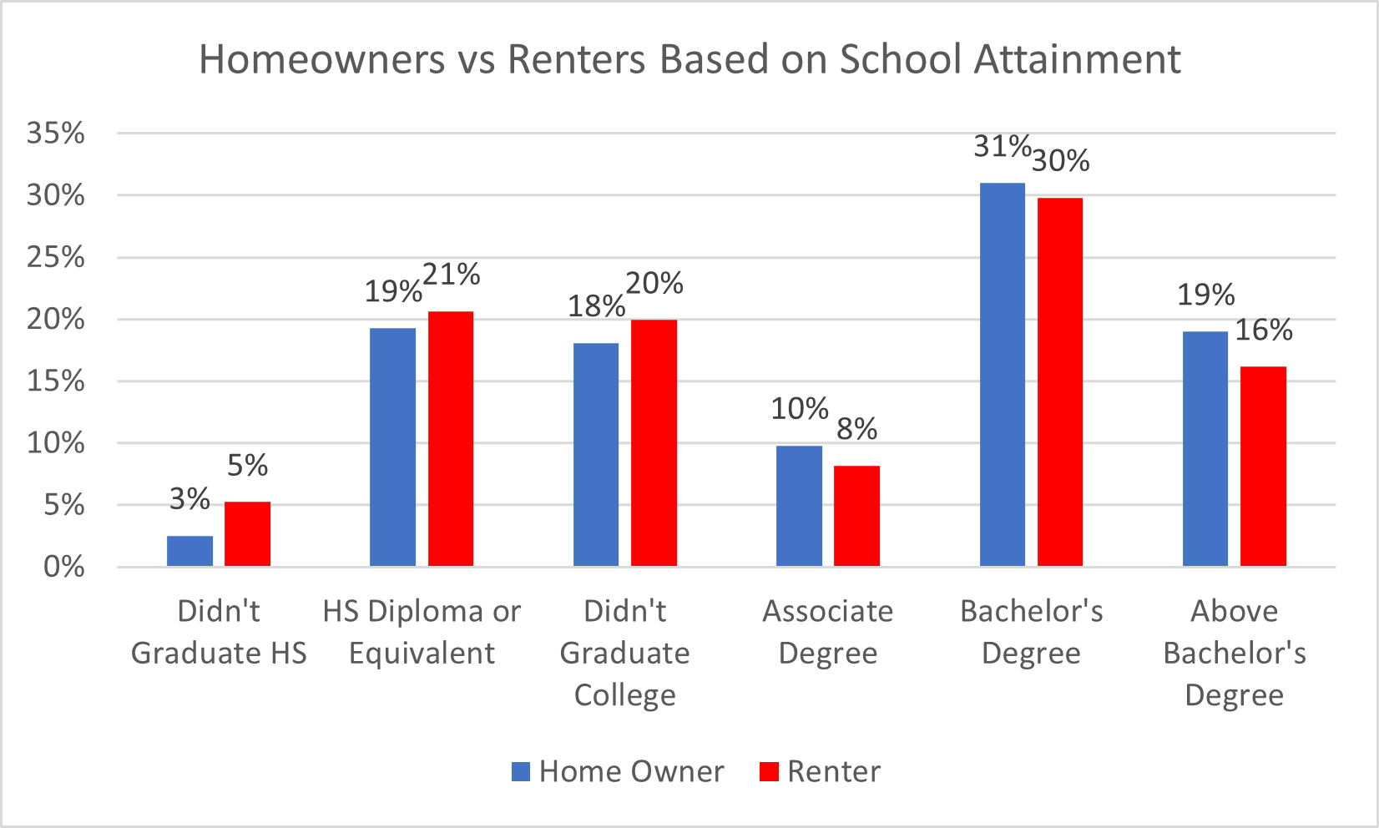
Data Science Pipeline
EDA
Figure 5.
More homeowners as school attainment increases
Correlation = 0.97

Slide 14
Data Insights
The data visualizations can be used to build some conclusions about the data. After considering the data, it can be concluded that 60-70% were White, and the rest of categories making up that remaining 30%. The biased representation of this data is a concern and must be quickly addressed rather than put aside, because if data isn’t processed correctly and accurately it is still just information and due to this we cannot be 100% sure the correlations, lower instances of income, and along with the rest of the data wrangling are accurate.
Overall, it would be safe to say there are more renters in the age group 22-31 as compared to the others and more homeowners in the age group 52-61 as compared to the rest of the age groups, more male homeowners and renters as compared to the opposite sex and also people who have attained a Bachelor’s degree tend more to be homeowners and renters.

Slide 15
Recommendations/Future Projects
Recommendations
Doing intensive research to come up with a comprehensive reason to use data only in specific states to reduce the number of instances for smooth and effective use in excel.
Would recommend taking time to learn programming languages applicable to excel, such as: Python, C++, and C# to ensure hassle free data wrangling and save a lot more time.
Taking time to read past data science reports in and out of the class to take note of do’s, donts, vocabulary words etc.
Future Projects
Why most smart wrist watch devices don't capture accurate data on darker skin tones.
The decrease or increase of homeowners and renters over the years.

Slide 16
Insight from the Semester
We learned how to use excel in many ways than one. From the intensive wrangling of data to the creation of data visualizations through pivot tables and recommended charts.
We learned how to analyze data from the perspectives of data analyzers and scientist to make it easier to finalize our datasheets, features, and instances to conduct a good report.
What we liked most about the course was the flexibility to come up with our own topics and the criticism and feedback to help steer us in the right direction.
What we liked least was excel not being able to handle a great amount of data, which ended up being time consuming and resulted in less productivity.
We also learned a lot of new things in CTEC 128. But the information we learned on the subject of data science was the most outstanding. Most of me and my team members had little to no experience in the topic of data science until this class. But afterwards we feel like we have a much better grasp of it.
This course has prepare us how to think like a data analyst, we learned about the 3 v’s of Big data which is very interesting. Overall this course was able to us with analyzing data.

Slide 17
Questions?

