Slide 1
Trends of Housing For Homeless
CTEC 426
Fall 2021

Slide 2
Data Source: Housing Inventory Count (HIC)
Administered by the U.S. Department of Housing and Urban Development (HUD)
Purpose of the collection is to examine housing need in America, improve communities, and enforce federal housing laws
The data is a count of sheltered and unsheltered people experiencing homelessness on a single night in January 2020
The has been collected every year since since 2007; the most recent update is 2020 which is used for this project
The data set includes 25,228 instances, each instance representing an organization

Slide 3
Data Wrangling (HIC)
Removed all variables in the data file except for the following:
States
Project Types
Emergency Shelter: Temporary shelter in case of hazardous weather or unsafe conditions
Safe Haven: For hard-to-reach people such as mental illness or roaming the streets
Permanent Housing: Only includes people with disabilities to live independently
Transitional Housing: Temporary housing that prepares people for permanent and affordable housing
Total Beds
Point-In-Time (PIT) Count
Demographics of beds in Housing
Homeless: People who experience homelessness for the first time, in a while
Veterans: People who have long experience in the military
Chronic Homeless: Person who has been homeless for more than a year, repeatedly experiencing homelessness
Youth: The age range of children to adults
Domestic Violence: Person who has experienced threatening behavior within past homes

Slide 4
Data Wrangling (HIC)
The original data file included all 50 states, but the final analytic data file included only the DMV
Feature engineering: Combined subtypes of Permanent Housing into one variable: Rapid Re-Housing, Other Permanent Housing, and Permanent Supportive Housing
Final analytic file included 1,228 instances

Slide 5
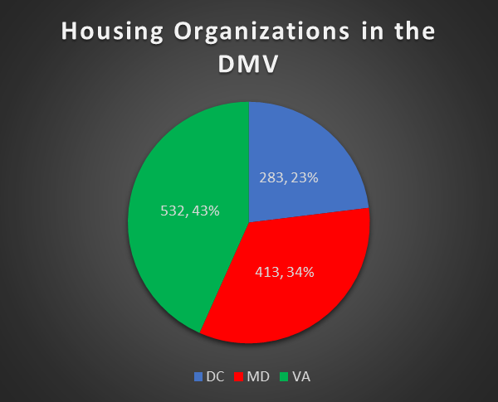
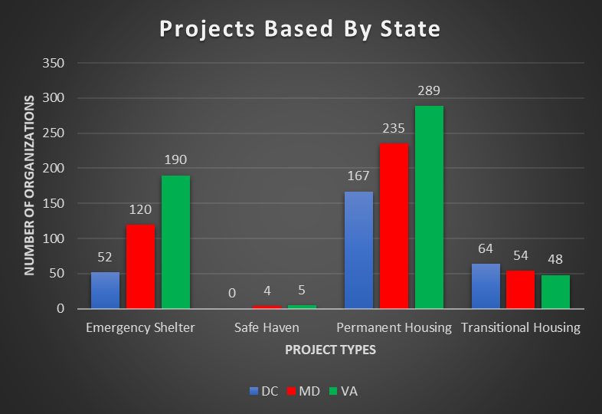
Exploratory Data Analysis (EDA) (HIC)
Figure 1.
Figure 2.
In 2020, there were 1,228 housing organizations in the DMV. Virginia had the majority (43%).
Across all three states, the most common type of housing project was permanent housing for people with disabilities to live independently. In MD and VA, emergency shelters were the second most common, and transitional housing in DC was second most common.

Slide 6
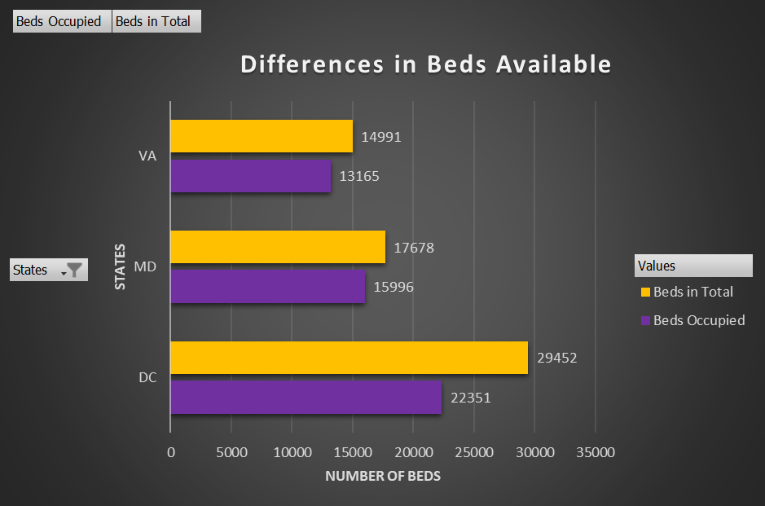
EDA (HIC)
Figure 3.
On a single night in January in 2020, VA had 1,826 free beds, MD had 1,682, and DC had 7,101.

Slide 7
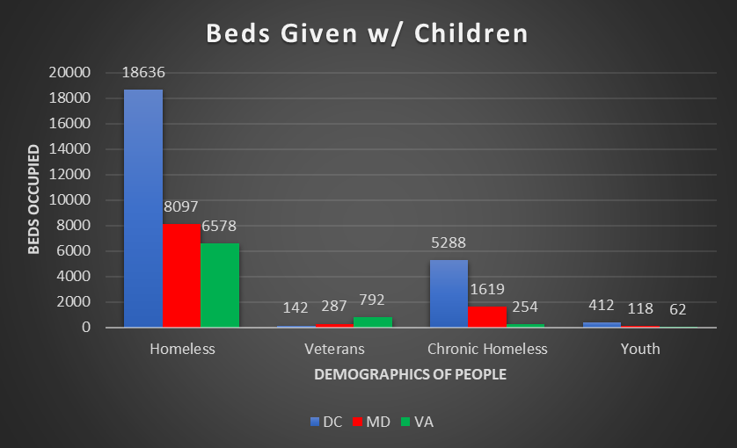
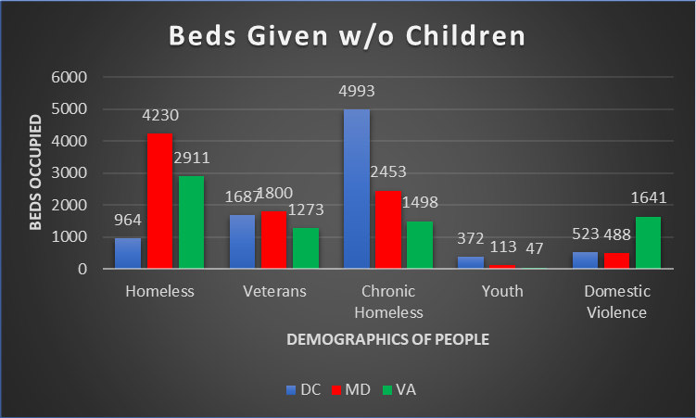
EDA (HIC)
Figure 4.
Figure 5.
On a single night in January 2020, DC provided the majority of beds to families with children. The majority of those families were classified as homeless (18,636), followed by chronically homeless (5,288).
On that same night, beds were also given to people without children. The majority of people without children who were given beds were classified as chronically homeless in DC (4,993), followed by homeless people in Maryland (4,230). In Virginia, the majority of people without kids who were given beds had experienced domestic violence (1,641).

Slide 8
Data Insights (HIC)
Virginia has the most housing organizations in the DMV, however DC offers the most beds in the area and typically has the most beds occupied on any given night.
On a single night in January 2020, 7,101 beds available, which may indicate that DC is not reaching all families and people that need housing.
The goal of most organizations in the DMV is to provide permanent housing for thsoe that need it.
If someone is chronically homeless without children, more than likely they can find space in DC as that group occupies the majority of beds.
People who experience domestic violence occupy a lot more beds in Virginia in comparison to DC and Maryland.

