Slide 1
Applied Mechanism Design For Social Good
John P Dickerson & Marina Knittel
Lecture #23 – 04/18/2022
Lecture #24 – 04/20/2022
CMSC498T
Mondays & Wednesdays
2:00pm – 3:15pm

Slide 2
Clustering Primer
Clustering is the problem of grouping data based off of the distance (or similarity score) between points.
k = 5
k-center: minimize the maximum distance from a point to its cluster center.
k-median: minimize the sum of distances from points to cluster centers.
k-means: minimize the sum of squares of distances from points to cluster centers.

Slide 3
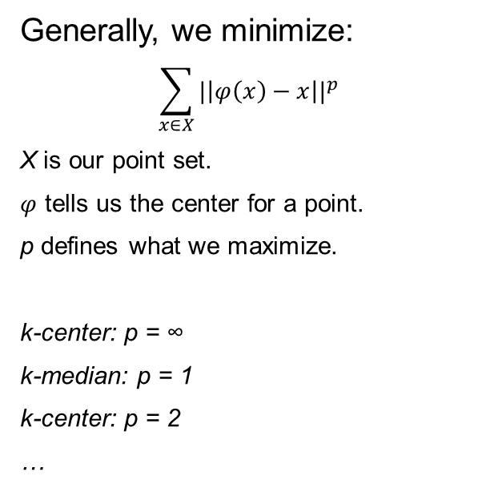
Clustering Primer
Clustering is the problem of grouping data based off of the distance (or similarity score) between points.
k = 5
Generally, we minimize:
$$\sum_{x∈X}{{|\left|φ\left(x\right)−x\right||}^{p}}$$
X is our point set.
$φ$ tells us the center for a point.
p defines what we maximize.
k-center: p = ∞
k-median: p = 1
k-center: p = 2
…

Slide 4
Clustering Primer
Clustering x poorly is only one of many costs in k-median since we sum over many points. But for k-center, since it is the furthest point from the cluster center, it is very costly, in fact it defines the k-center cost.
x

Slide 5
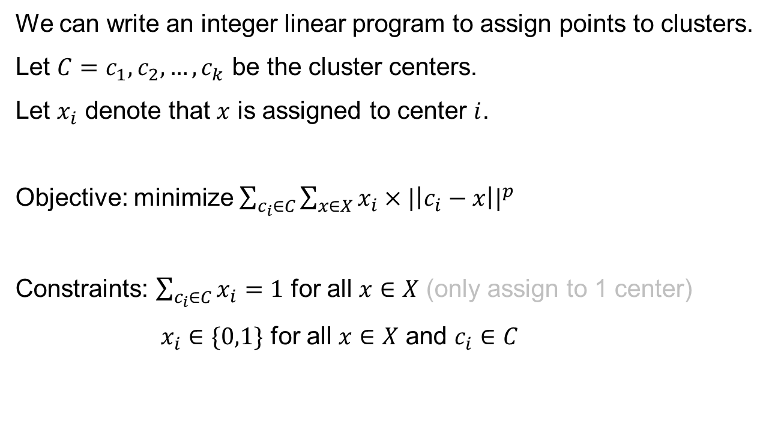
Clustering Primer
We can write an integer linear program to assign points to clusters.
Let $C=c_{1},c_{2},…,c_{k}$ be the cluster centers.
Let $x_{i}$ denote that $x$ is assigned to center $i$.
Objective: minimize $\sum_{c_{i}∈C}{\sum_{x∈X}{{x_{i}×|\left|c_{i}−x\right||}^{p}}}$
Constraints: $\sum_{c_{i}∈C}{x_{i}}=1$ for all $x∈X$ (only assign to 1 center)
$x_{i}∈\{0,1\}$ for all $x∈X$ and $c_{i}∈C$
This may look nonlinear, but it’s a constant!

Slide 6
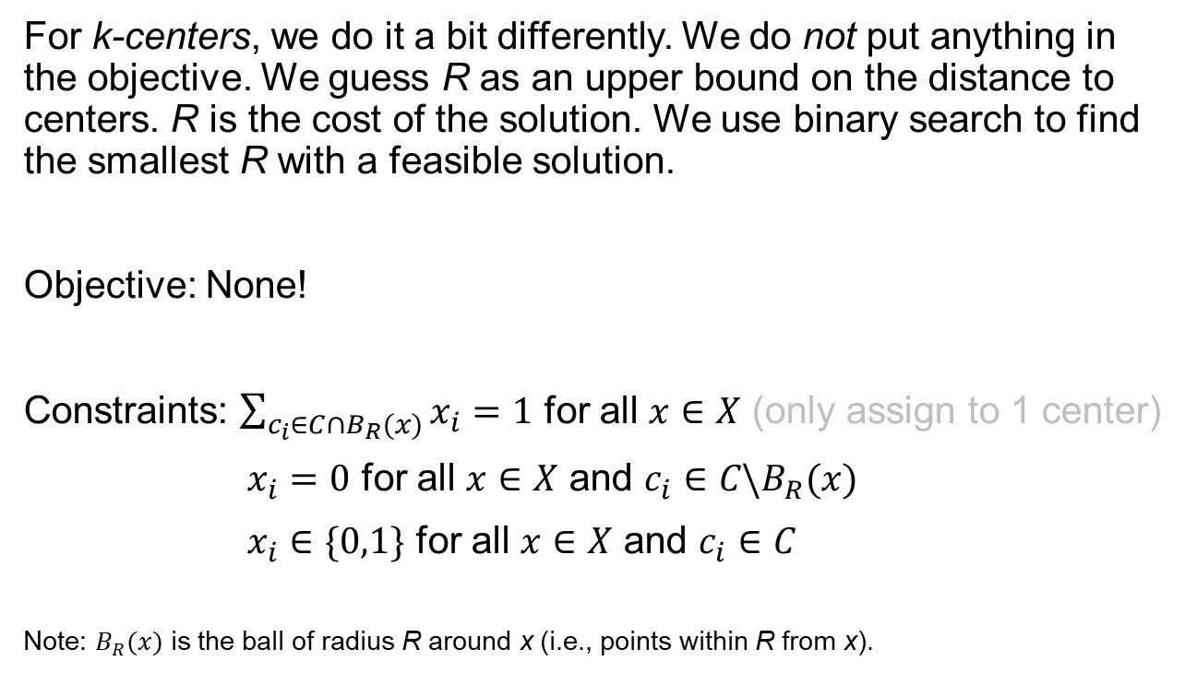
Clustering Primer
For k-centers, we do it a bit differently. We do not put anything in the objective. We guess R as an upper bound on the distance to centers. R is the cost of the solution. We use binary search to find the smallest R with a feasible solution.
Objective: None!
Constraints: $\sum_{c_{i}∈C∩B_{R}(x)}{x_{i}}=1$ for all $x∈X$ (only assign to 1 center)
$x_{i}=0$ for all $x∈X$ and $c_{i}∈C\backslash B_{R}(x)$
$x_{i}∈\{0,1\}$ for all $x∈X$ and $c_{i}∈C$
Note: $B_{R}(x)$ is the ball of radius R around x (i.e., points within R from x).
R

Slide 7
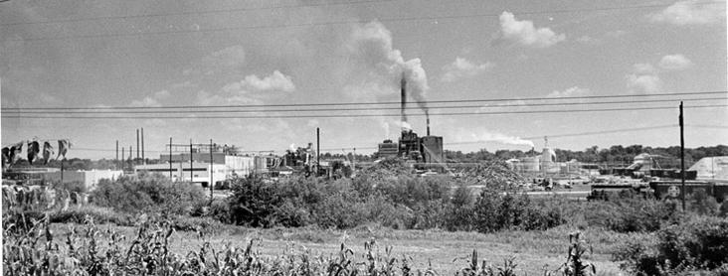
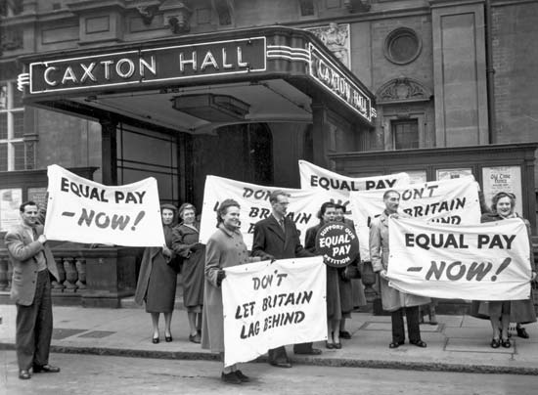
Disparate Impact
Griggs vs Duke Power Co:
North Carolina, 1970
Required high school diploma and standardized testing for promotion
Sued for discrimination
Ruled discriminatory by SC because it had “a disproportionate and adverse impact on certain individuals”
Notes:
1964 Civil Rights Act: banned the segregation of race or national origin in public places and by employers and labor unions (last two also were gender, religion, too)
At the time in the south, black americans did not generally receive the same quality of education as their white counterparts
District court and circuit appeals court: in favor of Duke Power Co

Slide 8
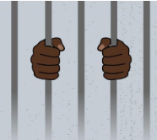
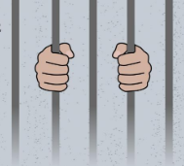
Disparate Impact in Clustering
Applying to ML: Ensure the impact of a system across protected groups is proportionate. “Group fairness.”
Applying to clustering:
How do we measure the impact of a system on a protected group?
How many individuals are in a cluster
How do we prevent disparate impact?
Ensure the number of individuals from any group in any cluster is proportionate to group size.

Slide 9

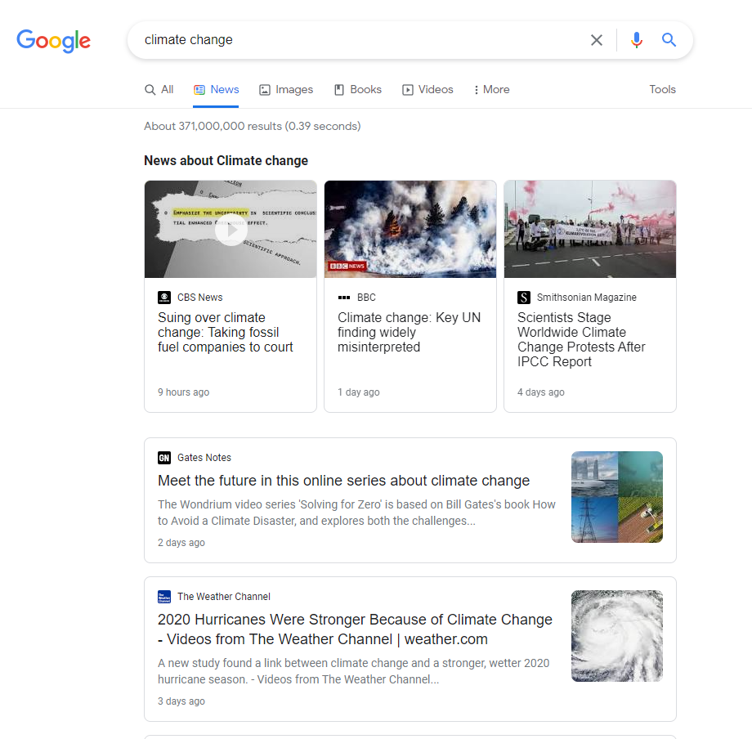

Clustering news Articles
Immigration
Student Debt
Global Warming
Health Care

Slide 10
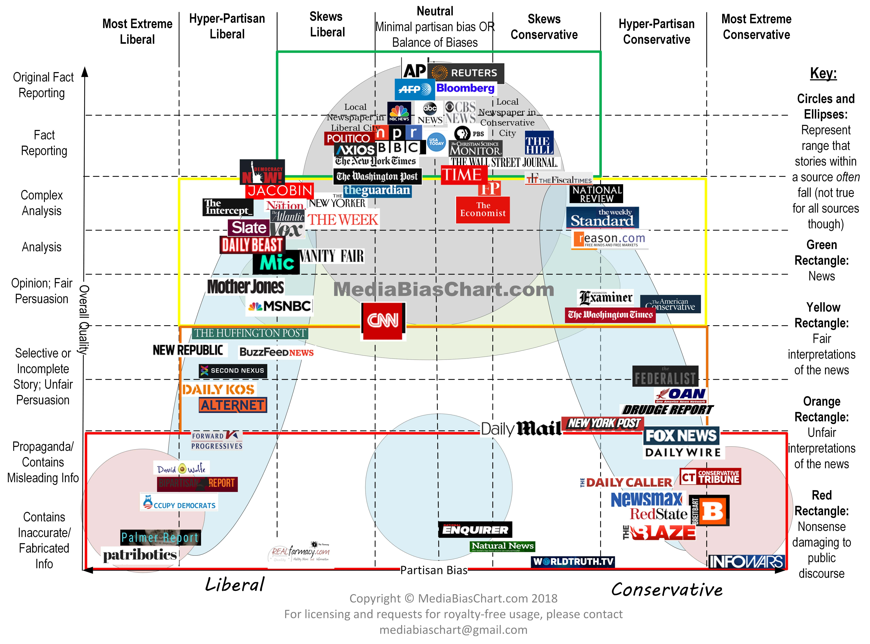
Running Example: news search
Notes:
When searching for new articles, you will be shown articles from a select few sources. How might this contribute to the growing problem of polarization in the US?

Slide 11


Clustering news Articles
Immigration
Student Debt
Some right-leaning article here.
Global Warming
Health Care

Slide 12

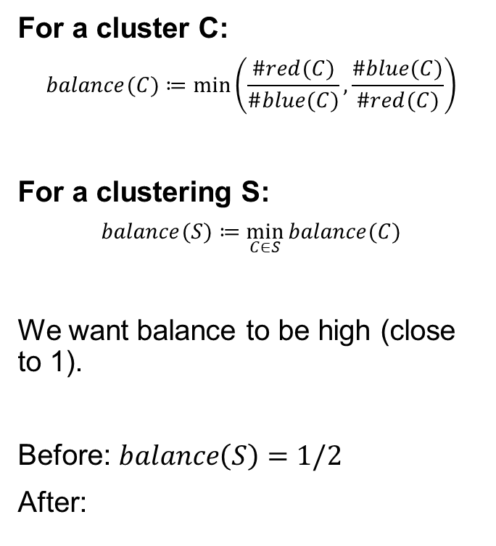



Group Fairness in Clustering: Formal
$$balance\left(C_{2}\right)=1$$
For a cluster C:
$$balance(C)≔\min_{}\left(\frac{\#red(C)}{\#blue(C)},\frac{\#blue(C)}{\#red(C)}\right)$$
For a clustering S:
$$balance(S)≔\min_{C∈S}{balance(C)}$$
We want balance to be high (close to 1).
Before: $balance\left(S\right)=1/2$
After:
$$balance\left(C_{1}\right)=1$$
$$balance\left(C_{3}\right)=1/2$$
$$balance\left(C_{4}\right)=1/2$$
KEY:
= Right-leaning article
= Left-leaning article

Slide 13
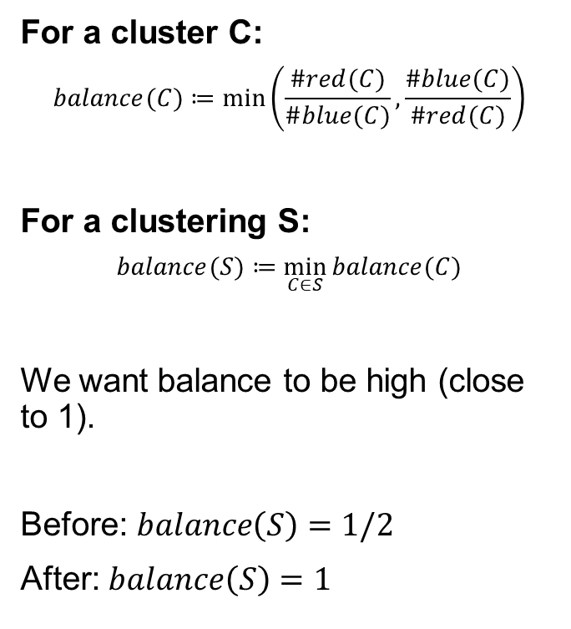


Group Fairness in Clustering: Formal
$$balance\left(C_{2}\right)=1$$
For a cluster C:
$$balance(C)≔\min_{}\left(\frac{\#red(C)}{\#blue(C)},\frac{\#blue(C)}{\#red(C)}\right)$$
For a clustering S:
$$balance(S)≔\min_{C∈S}{balance(C)}$$
We want balance to be high (close to 1).
Before: $balance\left(S\right)=1/2$
After: $balance\left(S\right)=1$
$$balance\left(C_{1}\right)=1$$
$$balance\left(C_{3}\right)=1$$
$$balance\left(C_{4}\right)=1$$
KEY:
= Right-leaning article
= Left-leaning article

Slide 14
Finding Fair Clusterings: Fairlets
This is
the best balance we can achieve
Let:
b/r = 1/3 is the minimum ratio between reds and blues
R = number of remaining reds = 10
B = number of remaining blues = 5
α = 1/3 is our fair parameter
Iteratively…
IF (R-B) ≥ (r-b): make a cluster of r reds and b blues.
ELSE: use (R-B)+b red and b blue points.
When r=b: simply match points

Slide 15
Finding Fair Clusterings: Fairlets
This is
the best balance we can achieve
Let:
b/r = 1/3 is the minimum ratio between reds and blues
R = number of remaining reds = 7
B = number of remaining blues = 4
α = 1/3 is our fair parameter
Iteratively…
IF (R-B) ≥ (r-b): make a cluster of r reds and b blues.
ELSE: use (R-B)+b red and b blue points.
When r=b: simply match points

Slide 16
Finding Fair Clusterings: Fairlets
This is
the best balance we can achieve
Let:
b/r = 1/3 is the minimum ratio between reds and blues
R = number of remaining reds = 4
B = number of remaining blues = 3
α = 1/3 is our fair parameter
Iteratively…
IF (R-B) ≥ (r-b): make a cluster of r reds and b blues.
ELSE: use (R-B)+b red and b blue points.
When r=b: simply match points

Slide 17
Finding Fair Clusterings: Fairlets
This is
the best balance we can achieve
Let:
b/r = 1/3 is the minimum ratio between reds and blues
R = number of remaining reds = 2
B = number of remaining blues = 2
α = 1/3 is our fair parameter
Iteratively…
IF (R-B) ≥ (r-b): make a cluster of r reds and b blues.
ELSE: use (R-B)+b red and b blue points.
When r=b: simply match points

Slide 18
Finding Fair Clusterings: Fairlets
This is
the best balance we can achieve
Let:
b/r = 1/3 is the minimum ratio between reds and blues
R = number of remaining reds = 0
B = number of remaining blues = 0
α = 1/3 is our fair parameter
Iteratively…
IF (R-B) ≥ (r-b): make a cluster of r reds and b blues.
ELSE: use (R-B)+b red and b blue points.
When r=b: simply match points
Idea: Find a “fairlet decomposition” with small fairlets. Find a way to merge them into a good, appropriately-sized clustering.

Slide 19
Fairlets when B/r=1
Say half of your points are red and half are blue.
Make a bipartite graph between red and blue points. Edge weights are distances.
Find a perfect, maximum weight matching.
Construct 2-sized fairlets made of the matches.
d(u,v)
u
v

Slide 20
Fairlets when b/r=1/t’
Let B be the number of blues, R be the number of reds. Assume B/R = 1/t’ for an integer t’.
Fairlets can be found using minimum cost flow (a network flow problem where edges are labeled with associated edge costs, edge flow capacities, and a flow supply/demand at vertices.
t’ = 2

Slide 21
Using Fairlets for Fair Clustering
Find a good fairlet decomposition.
Replace each fairlet with a single point. Duplicate that point according to the fairlet size.
Run a “vanilla” clustering on these points.
Apply this clustering to the original points.
x4
x4
x3
x2
x2

Slide 22
Using Fairlets for Fair Clustering
Let: Y be our fairlet decomposition, Y’ be our transformed point set, and S be our final clustering.
Theorem: for k-median and k-center: cost(S) = cost(Y) + cost(Y’)
x4
x4
x3
x2
x2

Slide 23
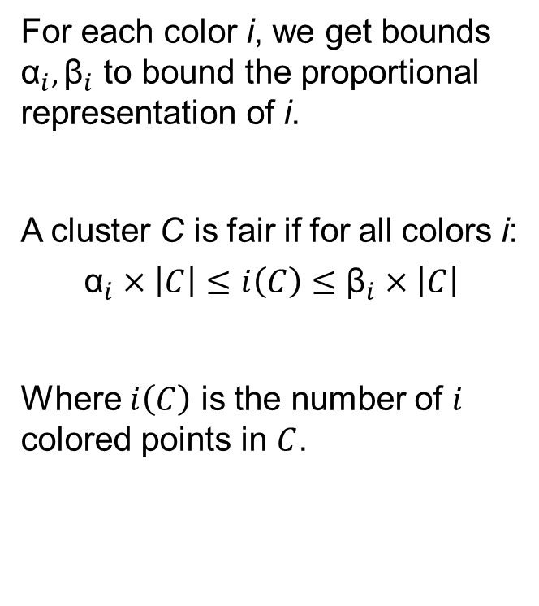
Generalizing to more colors
For each color i, we get bounds ${\text{α}}_{i},{\text{β}}_{i}$ to bound the proportional representation of i.
A cluster C is fair if for all colors i:
$${\text{α}}_{i}×\left|C\right|≤i\left(C\right)≤{\text{β}}_{i}×\left|C\right|$$
Where $i\left(C\right)$ is the number of $i$ colored points in $C$.
KEY:
= Right-leaning article
= Left-leaning article
= Green party-leaning article

Slide 24


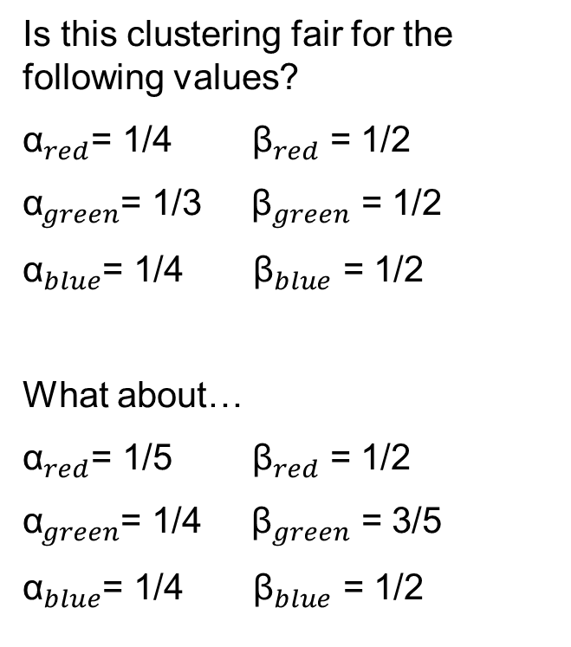
Generalizing to more colors
Is this clustering fair for the following values?
${\text{α}}_{red}$= 1/4 ${\text{β}}_{red}$ = 1/2
${\text{α}}_{green}$= 1/3 ${\text{β}}_{green}$ = 1/2
${\text{α}}_{blue}$= 1/4 ${\text{β}}_{blue}$ = 1/2
What about…
${\text{α}}_{red}$= 1/5 ${\text{β}}_{red}$ = 1/2
${\text{α}}_{green}$= 1/4 ${\text{β}}_{green}$ = 3/5
${\text{α}}_{blue}$= 1/4 ${\text{β}}_{blue}$ = 1/2
KEY:
= Right-leaning article
= Left-leaning article
= Green party-leaning article

Slide 25
ILP for Fair Clustering
For this approach, we will use a linear program as an intermediate step, but it will not be used to solve the whole problem.
Ignore fairness. Find a good vanilla clustering. This gives cluster centers.
Use a LP relaxation of an ILP to fairly assign points to centers.
Round the LP to an integer solution.

Slide 26
ILP for Fair Clustering Step 1
Step 1: Ignore fairness. Find a good vanilla clustering.

Slide 27
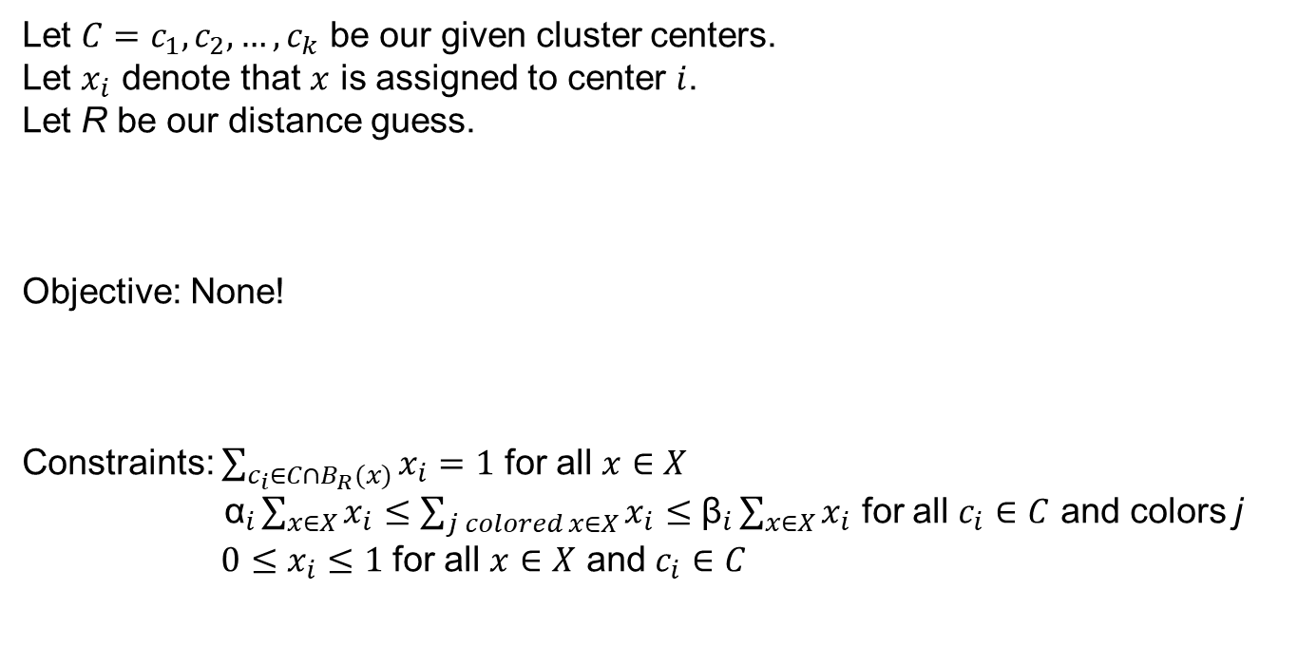
ILP for Fair Clustering Step 2
Step 2: Use a LP relaxation of an ILP to fairly assign points to centers.
Let $C=c_{1},c_{2},…,c_{k}$ be our given cluster centers.
Let $x_{i}$ denote that $x$ is assigned to center $i$.
Let R be our distance guess.
Objective: None!
Constraints: $\sum_{c_{i}∈C∩B_{R}(x)}{x_{i}}=1$ for all $x∈X$
${\text{α}}_{i}\sum_{x∈X}{x_{i}}≤\sum_{j colored x∈X}{x_{i}}≤$ ${\text{β}}_{i}\sum_{x∈X}{x_{i}}$ for all $c_{i}∈C$ and colors j
${0≤x}_{i}≤1$ for all $x∈X$ and $c_{i}∈C$

Slide 28




ILP For Fair Clustering Step 3
Now we have a set of cluster centers and a fair fractional assignment of points to centers.
In other words, x can be ½ assigned to one center and ½ assigned to another!
Step 3: Round these to whole numbers (i.e., a real assignment).
½
x
$$c_{1}$$
x
$$c_{1}$$
1
½
y
½
y
½
$$c_{2}$$
1
$$c_{2}$$
z
1
z
1

Slide 29

Fair Data Summarization
Data summarization: Select a subset of points that “represent” your data.
Method: Do a clustering, and select the cluster centers.
Fairness: for every color i, there must be at least k_{i} representatives of that color.
Say k_{red} = k_{blue} = k_{green} = 1

Slide 30
Fairness through Proportionality
Say you want to build parks 3 parks. You have two dense cities and 1 rural area. There are 6 park location options (blue-rimmed circles).
Blocking coalition: a set of n/3 people such that there is 1 park location that they all prefer to their given location.
Proportional clustering: one with no blocking coalition.

