Slide 1
Single-Agent Mechanism Design
Michael Curry
CMSC498T
4/25/22

Slide 2


Illustration of problem
Suppose you’re running a fruit stand on the side of the road, selling apples and oranges.
You want to put a sign up advertising your prices
People will drive by. If they like your prices, they’ll buy, otherwise they will keep driving.
What prices maximize expected revenue?
$0.50
$0.60
$0.95

Slide 3
Key aspects of this problem
For 1 good, just set a price (Econ 101 MR = MC)
For multiple goods, many more decisions
Discount for buying in bulk?
Discount for bundles?
Interesting history
early work by Adams and Yellen 1976
some progress in 2000s (Manelli-Vincent, Pavlov, Daskalakis et al.)
still not completely solved
We usually call the set of prices a “menu”

Slide 4


Alternative – direct revelation mechanism
You are going to ask a person how much they like apples and oranges.
Based on what they say, you are going to take some money out of their bank account and give them apples and oranges.
You don’t want people to lie
It’s just single-agent mechanism design.
=$0.55
You get
for $0.85
=$0.65

Slide 5
Review: Mechanism Design Setting
Private-value model – assume agent has private type x
Concretely: it is a vector saying how much each item is worth
Mechanism asks for x, chooses allocation a(x) and payment p(x)
Agents can lie about x, and we want to disincentivize this (strategyproof), and promise positive utility (individually rational)
We don’t know x, but we know it was drawn from a distribution P(x)
Goal: maximize expected revenue over P(x)

Slide 6
These are equivalent problems!
Recall the revelation principle: it tells us that menus can be transformed into truthful direct-revelation mechanisms
Less obviously, for single agents, every truthful direct revelation mechanism has a corresponding menu – this is known as the taxation principle
In fact, there is a relationship of duality between direct-revelation mechanisms and menus.

Slide 7
The Outline From Here
Motivation for problem: picking the optimal menu
Direct-revelation mechanisms
Mechanisms as utility functions
Properties of mechanisms ⬄ properties of their utility functions
Detour: convex functions
Convex sets and functions
Convex conjugate operation
Max-over-affine representation
Back to menus: conjugates of utility functions
Wednesday: review, examples of mechanisms, and ML for learning optimal mechanisms

Slide 8
Mechanisms as Utility Functions
The utility function maps a type (how much each good is valued) to how much utility a bidder with that type will get.
Two components:
You get positive utility for the items you receive
You get negative utility for paying money
Suppose we have any allocation and payment rule – these induce some utility function
Notes:
Incidentally, this is what is known as a Bregman divergence

Slide 9
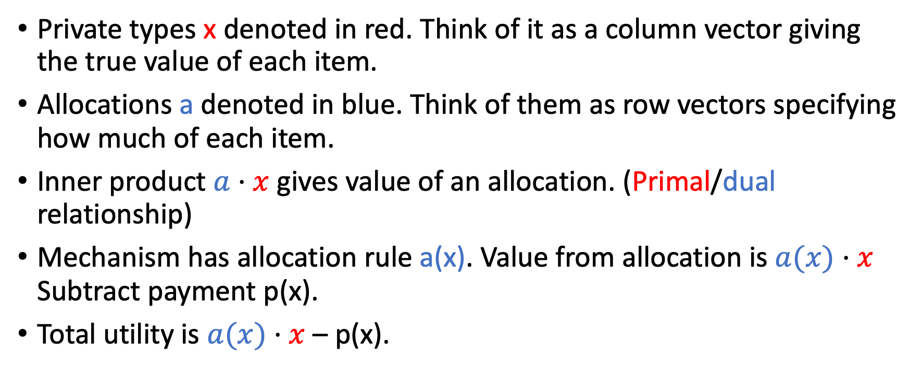
Formal Definitions
Private types x denoted in red. Think of it as a column vector giving the true value of each item.
Allocations a denoted in blue. Think of them as row vectors specifying how much of each item.
Inner product $a⋅x$ gives value of an allocation. (Primal/dual relationship)
Mechanism has allocation rule a(x). Value from allocation is $a(x)⋅x$ Subtract payment p(x).
Total utility is $a(x)⋅x$ – p(x).

Slide 10
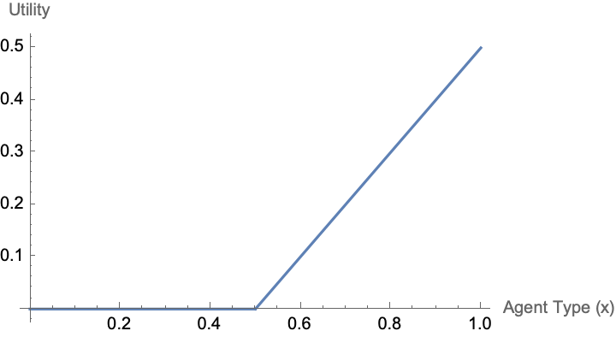
Concrete Example – 1D
$0.50

Slide 11
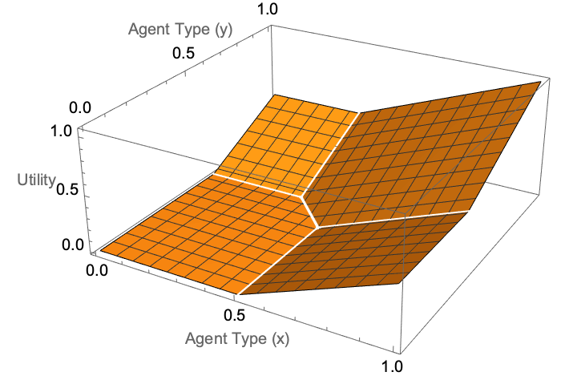
Concrete Example – 2D
$0.50
$0.60
$0.95

Slide 12
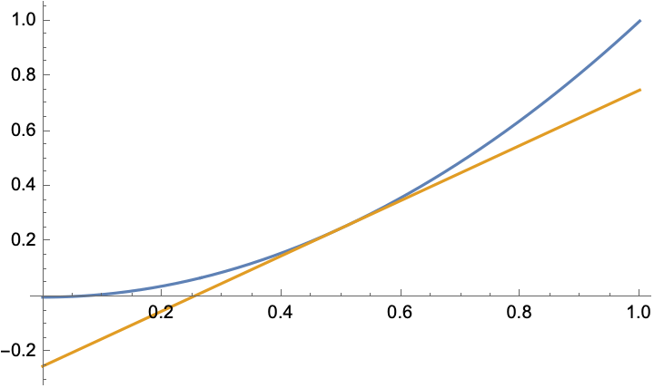
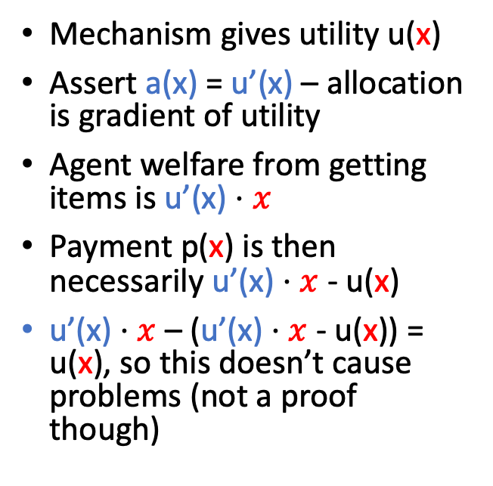
Every Valid Utility Function Gives Some a, p
Mechanism gives utility u(x)
Assert a(x) = u’(x) – allocation is gradient of utility
Agent welfare from getting items is u’(x) $⋅x$
Payment p(x) is then necessarily u’(x) $⋅x$ - u(x)
u’(x) $⋅x$ – (u’(x) $⋅x$ - u(x)) = u(x), so this doesn’t cause problems (not a proof though)
Slope of tangent line -- allocation
Y-intercept – payment charged
Notes:
Incidentally, this is what is known as a Bregman divergence

Slide 13
Properties of Utility Functions
Utility functions can be identified with mechanisms
Recall our mechanism design goal: truthfulness (aka DSIC, strategyproofness) and IR
Bidders have some value x but they are allowed to lie about it
We want no incentive to lie
We want no negative utility
What does this mean in terms of the utility function?

Slide 14
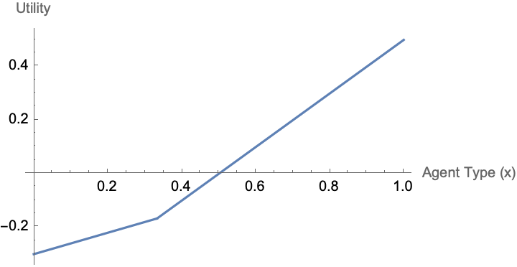
Individual Rationality
Individual rationality just means no negative utility
Literally – just make sure utility function is not negative
Intuitively, the buyer can always walk away

Slide 15
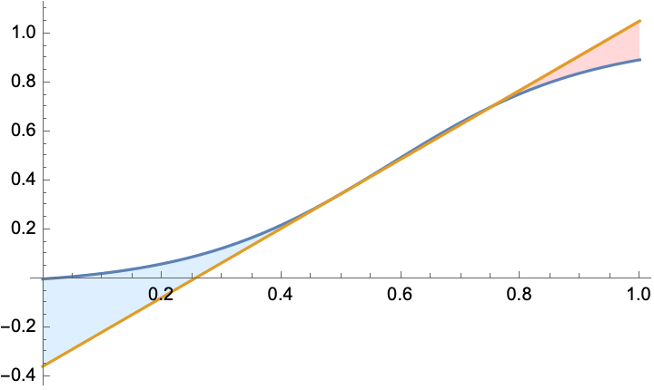
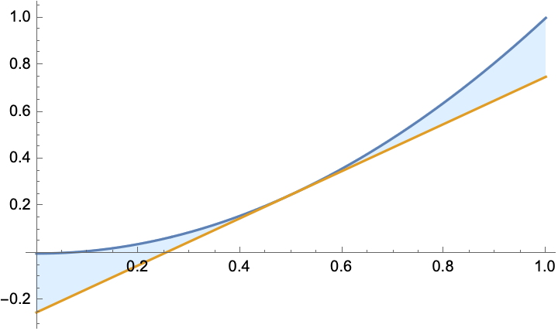
Truthfulness and Convexity
Blue line: mechanism utility u(x)
Bid is 0.5. Orange line: utility from untruthfully bidding 0.5, as your true type varies. Tangent to curve (allocation is u’(x))
If u(x) is non-convex, there is a region (red) where you can benefit from lying

Slide 16
Recap
Identify direct revelation mechanisms with utility functions
Properties we want as mechanism designers
IR – just make sure function is nonnegative
Strategyproof – make sure function is convex
Mechanism design is just choosing your favorite convex, nonnegative utility function (how to do that?)
Next: more detail on convexity

Slide 17
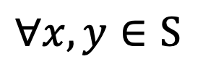


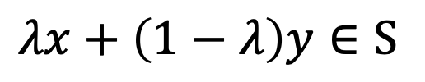

Convex Sets
$$∀x,y∈S$$
$$∀λ∈\left[0,1\right]$$
What makes a set convex? ”Draw a line and it stays in the set.”
$$λx+\left(1−λ\right)y∈S$$

Slide 18











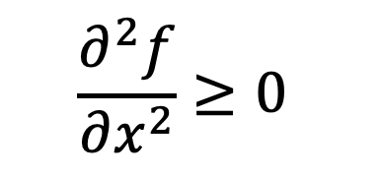



Convex Functions
What makes a function convex? “It curves up.”
Tangent line always beneath the function.
Derivative is increasing (second derivative positive)
Epigraph (set of all points above the function) is a convex set
Affine (including linear) functions are convex and concave
All of this generalizes to multiple dimensions
$$\frac{∂^{2}f}{∂x^{2}}≥0$$
$$∀x_{1},x_{2}$$
$$∀λ∈\left[0,1\right]$$
$$λf\left(x_{1}\right)+\left(1−λ\right)f\left(x_{2}\right)≤f(λx_{1}+\left(1−λ\right)x_{2})$$

Slide 19
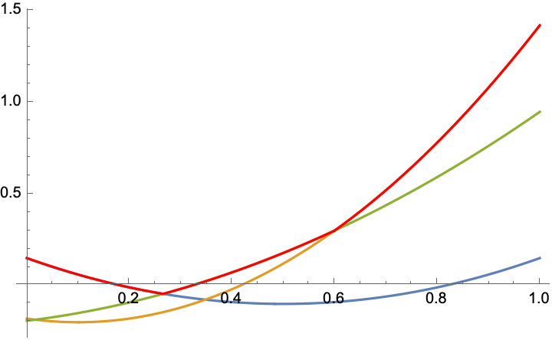
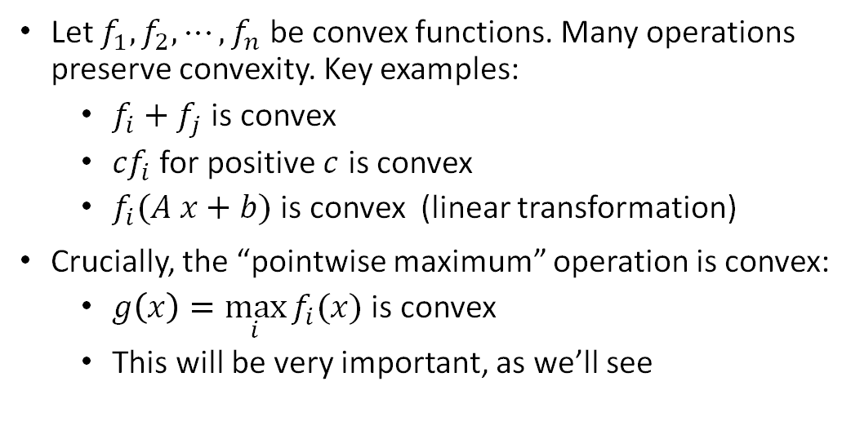
Convexity-Preserving Operations
Let $f_{1},f_{2},⋯,f_{n}$ be convex functions. Many operations preserve convexity. Key examples:
$f_{i}+f_{j}$ is convex
${cf}_{i}$ for positive $c$ is convex
$f_{i}(A x+b)$ is convex (linear transformation)
Crucially, the “pointwise maximum” operation is convex:
$g\left(x\right)=\max_{i}{f_{i}(x)}$ is convex
This will be very important, as we’ll see
Pointwise max of 3 convex functions (red) is also convex.

Slide 20
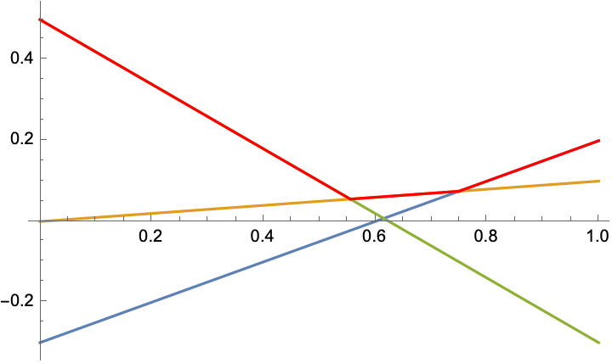
Pointwise Maximum of Affine Functions
$$f\left(x\right)=\max{(0.5x−0.3,−0.8x+0.5,0.1x+0)}$$
Affine functions are convex, so their pointwise maximum makes a convex function (drawn in red).
In fact, as we will see, this is an “if and only if” relationship – every convex function can be represented as a max over affine functions

Slide 21
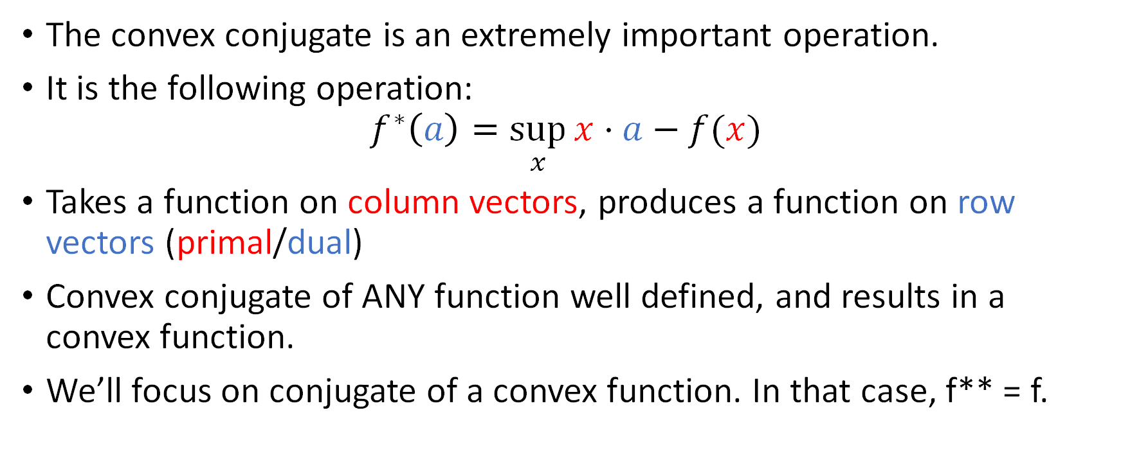
Convex Conjugate
The convex conjugate is an extremely important operation.
It is the following operation:
$$f^{∗}\left(a\right)=\sup_{x}{x⋅a−f(x)}$$
Takes a function on column vectors, produces a function on row vectors (primal/dual)
Convex conjugate of ANY function well defined, and results in a convex function.
We’ll focus on conjugate of a convex function. In that case, f** = f.

Slide 22
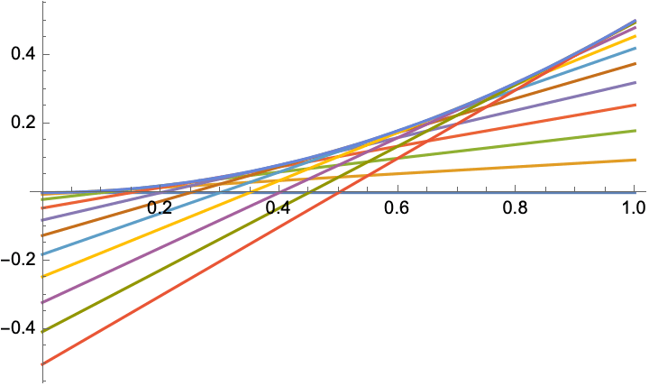
Tangent Lines and Convex Functions
Remember one definition of convexity – tangent lines always below function
Hand-waving argument: all the tangent lines, considered together, completely define your function
Convex conjugate f* defines concrete relationship between tangent lines and f

Slide 23




Geometric Intuition for the Convex Conjugate
$$f\left(x\right)=\max{(0.5x−0.3,−0.8x+0.5,0.1x+0)}$$
Given any possible slope of a tangent line, the conjugate is going to tell you which y-intercept to assign, to rebuild f.
$$f^{∗}\left(0.5\right)=0.3$$
$$f^{∗}\left(−0.8\right)=−0.5$$
$$f^{∗}\left(0.1\right)=0$$
Many slopes aren’t found, e.g. $f^{∗}\left(1\right)=∞$
Non-differentiable points have many other possible tangent lines (subgradients) – let’s just not worry too much about that.

Slide 24
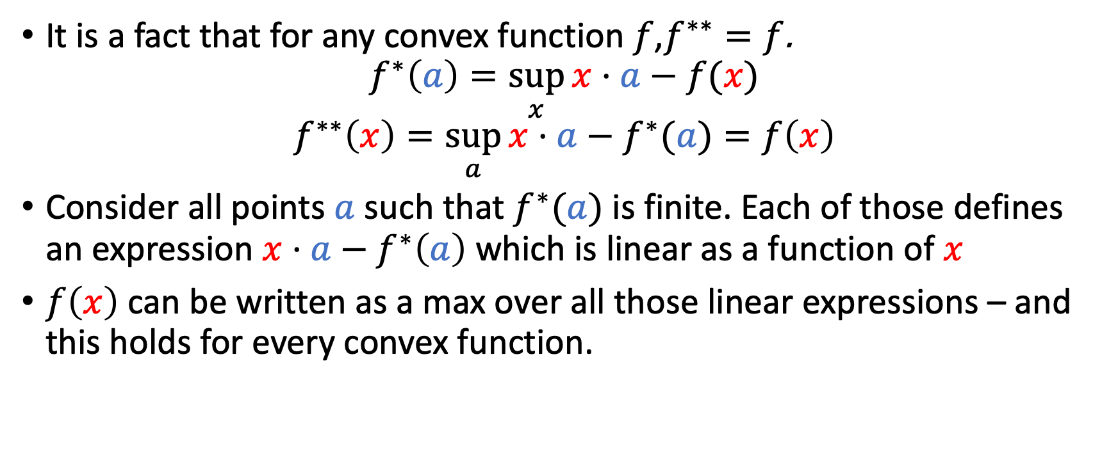
Max-over-affine representation is universal
It is a fact that for any convex function $f$,$f^{∗∗}=f$.
$$f^{∗}\left(a\right)=\sup_{x}{x⋅a−f(x)}$$
$$f^{∗∗}\left(x\right)=\sup_{a}{x⋅a−f^{∗}(a)}=f\left(x\right)$$
Consider all points $a$ such that $f^{∗}(a)$ is finite. Each of those defines an expression $x⋅a−f^{∗}\left(a\right)$ which is linear as a function of $x$
$f\left(x\right)$ can be written as a max over all those linear expressions – and this holds for every convex function.

Slide 25
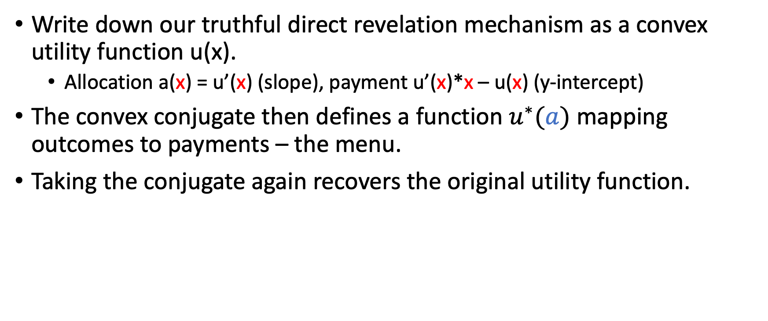
Back to mechanisms
Write down our truthful direct revelation mechanism as a convex utility function u(x).
Allocation a(x) = u’(x) (slope), payment u’(x)*x – u(x) (y-intercept)
The convex conjugate then defines a function $u^{∗}(a)$ mapping outcomes to payments – the menu.
Taking the conjugate again recovers the original utility function.

Slide 26

Concrete Example
$u\left(x\right)=\max\left(\left(1,0\right)∗x−0.5, \left(0,1\right)∗x−0.6, \left(1,1\right)∗x−0.95,0\right)$
$u^{∗}\left(\left(1,0\right)\right)=0.5$
$u^{∗}\left(\left(0,1\right)\right)=0.6$
$u^{∗}\left(\left(1,1\right)\right)=0.95$
$0.50
$0.60
$0.95

Slide 27
Conclusion
This always works, for any convex utility function.
So: direct revelation mechanisms have convex utility functions, which can be turned into menus
Menus have corresponding convex utility functions
Thus, we’ve completely characterized feasible mechanisms and connected them to feasible menus

Slide 28
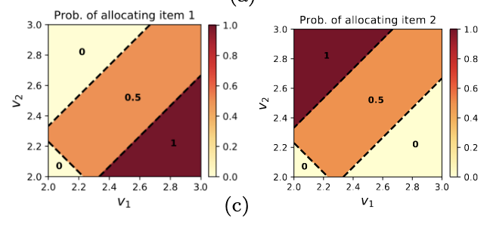
Optimal mechanism design
Next lecture – choosing optimal mechanisms
Mixed bundling is allowed, but is it necessary?
Menu-size complexity?
Checking optimality?
Machine learning for finding optimal mechanisms

