Slide 1
Applied Mechanism Design For Social Good
John P Dickerson & Marina Knittel
Lecture #14 – 04/20/2021
Lecture #15 – 04/22/2021
Lecture #16 – 04/27/2021
CMSC498T
Mondays & Wednesdays
2:00pm – 3:15pm

Slide 2
Announcements
Projects!
Due this Friday: a brief outline of what you would like to work on
We strongly encourage working in a group
Paper Presentations:
Due tonight: a brief written or recorded summary of a paper, book chapter, topic of interest, etc.
Check out our website for some examples

Slide 3
Check-in Survey
Two weeks ago, you guys filled out a survey about how we’re doing.
Takeaways
Marking questions you got wrong
Post readings and quiz solutions earlier
You guys like applications/programming
Where is this class going????

Slide 4
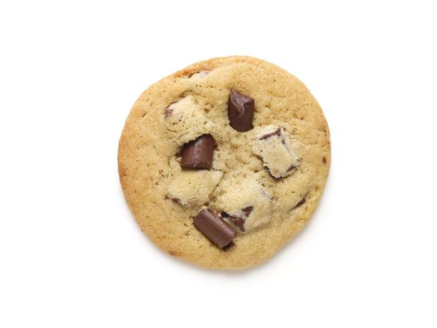

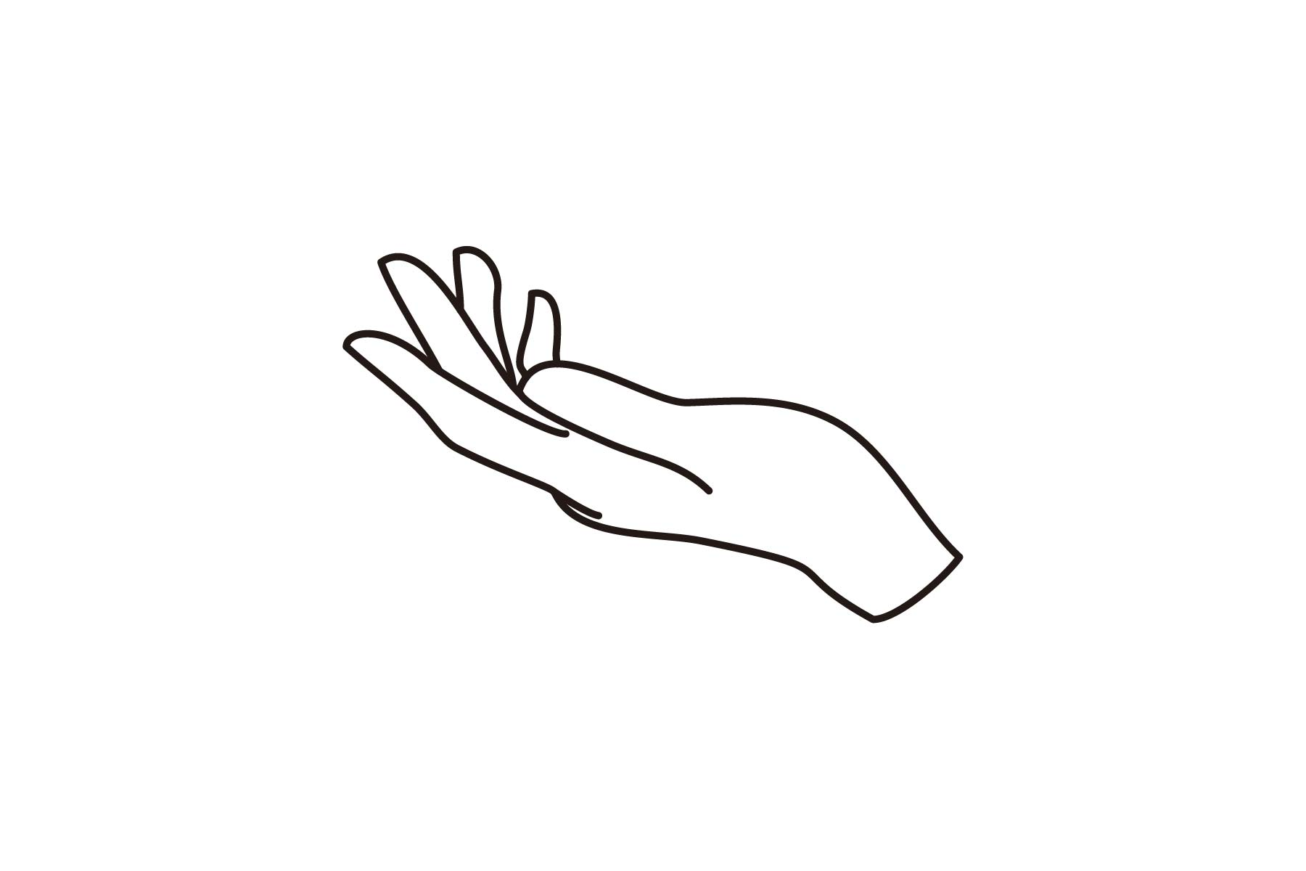

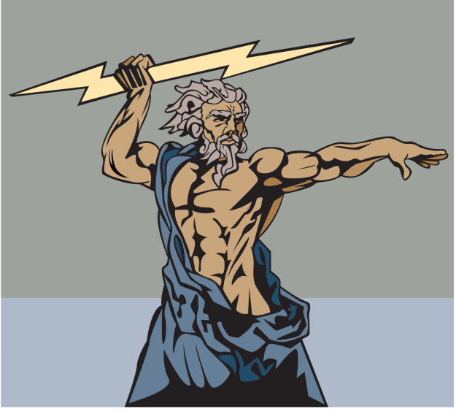
Fairly dividing a cookie
How should Alice and Bob divide a cookie?
How do know this will give each person half the cookie (assuming Alice is sufficiently dexterous)?
How do we know giving Alice and Bob half the cookie each is fair?
Alice
Bob
Alice
Bob

Slide 5

Fairly dividing a Sheet cake
The cake is a metaphor.
How should Alice and Bob divide a vanilla sheet cake?
u_{Alice}(vla) = 10
u_{Bob}(vla) = 20
Alice
Bob

Slide 6


Fairly dividing a Multi-flavor Sheet cake
How should Alice and Bob divide a multi flavored sheet cake?
u_{Alice}(vla) = 10 u_{Alice}(chc) = 10 u_{Alice}(str) = 30
u_{Bob}(vla) = 20 u_{Bob}(chc) = 20 u_{Bob}(str) = 20
Bob gets more utility than Alice.
Bob strictly favors his piece.
Alice weakly favors her piece.
Is this fair???
Alice could lie knowing Bob’s utilities.
u_{Alice}(left) = 10 * ½ + 10 * ¼ = 7.5
u_{Alice}(right) = 30 * ¼ = 7.5
u_{Bob}(left) = 20 * ½ + 20 * ¼ = 15
u_{Bob}(right) = 20 * ¼ = 5
Alice
Bob

Slide 7
Treating Players equally
This is another algorithm for dividing divisible goods (say, a sheet cake) between two players.
A referee moves the knife along the cake. Once either Alice or Bob views the slices as fair, they say “stop” (say in this example, Alice says stop).
A second knife is placed. Move the knives in parallel, keeping the cut in between them proportional according to Alice. Once Bob views the middle slice as proportional, he says “stop”.
Randomly assign one of them the outer slices and one of them the inner slice.

Slide 8
Treating Players equally
This is another algorithm for dividing divisible goods (say, a sheet cake) between two players.
A referee moves the knife along the cake. Once either Alice or Bob views the slices as fair, they say “stop” (say in this example, Alice says stop).
A second knife is placed. Move the knives in parallel, keeping the cut in between them proportional according to Alice. Once Bob views the middle slice as proportional, he says “stop”.
Randomly assign one of them the outer slices and one of them the inner slice.
Both Bob and Alice get what they perceive as exactly ½ the utility of the cake.

Slide 9
How do we quantify fairness?
There are n players.
Proportionality (Prop): All players get what they perceive as 1/n of the total available value.
Envy-freeness (EF): No player thinks that another player received a better share than they did.
Pareto-optimality (PO): There is no other allocation that pareto dominates it
Pareto-dominance: An allocation pareto dominates another if it is strictly better for at least one player and at least as good for all others

Slide 10
Fairly dividing a Multi-flavor Sheet cake
How should Alice and Bob divide a vanilla sheet cake?
u_{Alice}(vla) = 10 u_{Alice}(chc) = 10 u_{Alice}(str) = 30
u_{Bob}(vla) = 20 u_{Bob}(chc) = 20 u_{Bob}(str) = 20
Prop? Yes.
EF? Yes.
PO? Yes, but not generally.
u_{Alice}(left) = 10 * ½ + 10 * ¼ = 7.5
u_{Alice}(right) = 30 * ¼ = 7.5
u_{Bob}(left) = 20 * ½ + 20 * ¼ = 15
u_{Bob}(right) = 20 * ¼ = 5
Alice
Bob

Slide 11
Prop and EF on 2 players
P1 = Player 1
P2 = Player 2
A1 = P1’s allocation
A2 = P2’s allocation
M = the entire cake
Is one stronger than the other? Are they equivalent? Are they incomparable?
Prop => EF:
Assume P1 gets what they perceive to be a proportional allocation. u_{P1}(A1) ≥ u_{P1}(M)/2. Note that u_{P1}(A1) + u_{P1}(A2) = u_{P1}(M). Thus u_{P1}(A2) ≤ u_{P1}(M)/2. Thus P1 cannot envy P2. The same argument can be made for P2.
EF => Prop:
Assume P1 does not envy P2. Then u_{P1}(A1) ≥ u_{P1}(A2). Since u_{P1}(A1) + u_{P1}(A2) = u_{P1}(M), then u_{P1}(A1) ≥ u_{P1}(M)/2. Thus P1 gets a proportional allocation. The same argument can be made for P2.

Slide 12
Prop and EF on n>2 players
Pi = Player I
Ai = Pi’s allocation
M = the entire cake
Does the equivalence hold when n>2?
Prop DOES NOT IMPLY EF:
Consider 3 agents. Say, from P1’s perspective, u_{P1}(A1) = 1/3, u_{P1}(A2) = 1/2, and u_{P1}(A3) = 1/6. Clearly P1 views their share as proportional, but they envy P2.
EF => Prop:
Assume P1 does not envy P2. Then u_{P1}(A1) ≥ u_{P1}(Ai) for all i. Since u_{P1}(A1) + … + u_{P1}(An) = u_{P1}(M), then u_{P1}(A1) ≥ u_{P1}(M)/n. Thus P1 gets a proportional allocation. The same argument can be made for Pi for all i.

Slide 13
Proportionality for N>2 via Knife moving
A referee moves the knife along the cake. Once any player views the slices as a proportional slice, they say “stop”. They then take the piece.
Repeat this procedure until all slices are allocated.

Slide 14
Proportionality for N>2 via Knife moving
A referee moves the knife along the cake. Once any player views the slices as a proportional slice, they say “stop”. They then take the piece.
Repeat this procedure until all slices are allocated.

Slide 15
Proportionality for N>2 via Knife moving
A referee moves the knife along the cake. Once any player views the slices as a proportional slice, they say “stop”. They then take the piece.
Repeat this procedure until all slices are allocated.

Slide 16
Proportionality for N>2 via Knife moving
Quick proof:
Say the order of calling “stop” is P1, P2, … Pn.
P1 obviously gets a proportional slice.
According to player to P2, P1 got at most u_{P2}(A1) ≤ u_{P2}(M)/n. Thus the amount left is at least (n-1) * u_{P2}(M)/n according to P2.
When P2 says stop, they get a 1/(n-1) fraction of the remaining value. That is [(n-1) * u_{P2}(M)/n ]/(n-1) ≥ u_{P2}(M)/n. Therefore, P2 gets a proportional allocation.
A similar argument can be made going down the line of players.
Also: Notice that we made n-1 cuts. This is the minimum possible number of cuts to divide it into n pieces.
But: This is not envy-free. It also prefers later players.

Slide 17
Greedy algs aren’t Envy-free
Assume we have any greedy algorithm for dividing a cake. That is, an agent P1 gets assigned a piece and then has no influence on the division of the rest of the cake.
If P1 gets less than half the cake, they have no idea how the rest could be allocated. Maybe P2 gets practically the rest of the cake. Thus, they envy P2.
P1
P2
P3

Slide 18
An Envy-Free Protocol for n=3
1. P1 cuts into 3 proportional pieces.
2. P2 “trims” the largest piece only if one is the largest. Set aside trimmings, L.
3. P3, then P2, then P1 choose their favorite pieces. If P2 “trimmed” they must pick the trimmed piece if free. If no trimming happened, we stop here.
NOTE: P2 or P3 got the trimmed part. We say Pi (P2 or P3) got it, Pj (the other) did not.
4. Pj cuts L into 3 proportional pieces.
5. Pi, then P1, then Pj choose their favorite pieces.
NOTE: Each player may have 2 pieces.

Slide 19
Envy-Freeness beyond n=3
It’s um… well it’s complicated. And we don’t need to discuss it.
In some ways it is an extension of the n=3 algorithm, with a fair amount of added steps. See: reading on course website (Brams and Taylor) for the n=4 version.
Notable difference: the number of cuts is unbounded, whereas the n=3 algorithm only ever requires 5 cuts.
But hey! At least it means that envy-freeness always exists ☺ (this was shown non-constructively much earlier)

Slide 20
Or does it….?
Guess you’ll have to wait until after Spring Break…

Slide 21
What do we know about divisible goods?
When n=2: EF ⬄ Prop
When n>2: EF => Prop
There exist EF and Proportional algorithms for any n agents.
Other notions to consider:
Tractability: how efficient is the algorithm?
Truthfulness: is it strategy-proof?
For each player, the cake can be segmented finitely such that its value over a single segment is uniform
Assuming that the agents have piecewise uniform valuations, then there is a deterministic algorithm that is truthful, proportional, envy-free, and polynomial-time.

Slide 22
Social Welfare and Fairness
4
P2
Utility
density
2
P3, P4
P1
Place on cake
Allocation social welfare: 1.5
Best solution social welfare: 2
P1
P3
P4
P2
An envy-free allocation
Fairness ≠ Maximum Utility

Slide 23
The Price of Fairness In Cake Cutting
Given an instance:
max welfare using any division
PoF =
max welfare using fair division
utilitarian
Price of equitability
Price of envy-freeness
Price of proportionality
egalitarian
(= minimum of players’ utilities)

Slide 24
Social Welfare and Fairness
4
P2
Utility
density
2
P3, P4
P1
Place on cake
Allocation social welfare: 1.5
Best solution social welfare: 2
P1
P3
P4
P2
An envy-free allocation
Utilitarian Price of Envy-Freeness: 4/3

Slide 25
“Price Of” Bounds
[Aumann & Dombb]
Price of … | Proportionality | Envy freeness
Utilitarian
Egalitarian | 1

Slide 26
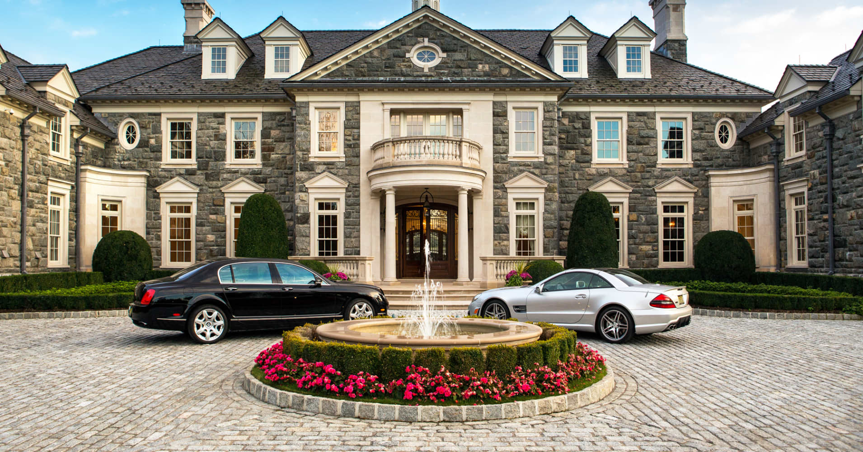
Applications: Estate Division
River is a rich person with two children, Dave and Alex. In their will, River wishes to leave a fair allocation of their assets to their children. Their assets are as follows:
A large mansion in upstate NY
A second home in Florida
A small café in Manhattan
2 Teslas
13 rare guitars
Note: these items are indivisible, whereas cakes are divisible. However, ilquidation of one large asset can make many of our algorithms work to fairly divide these assets.

Slide 27
Applications: Estate Division
River is a rich person with two children, Dave and Alex. In their will, River wishes to leave a fair allocation of their assets to their children. Their assets are as follows:
A large mansion in upstate NY - liquidate
A second home in Florida - A
A small café in Manhattan - D
2 Teslas - A
13 rare guitars - D
Note: these items are indivisible, whereas cakes are divisible. However, liquidation of one large asset can make many algorithms work to fairly divide these assets.

Slide 28
Applications: Land Reform
Land reform: government-initiated property redistribution of (generally agricultural) land either between property holders or from individual ownership to collective ownership (or vice versa).
Relevant instances
Egypt, 8th century BCE
Irish Land Acts, 19th century
Chinese Revolution, 1949
Zimbabwe, 1980
Much, much more
“At least 1.5 billion people today have some farmland as a result of land reform, and are less poor, or not poor, as a result.”

Slide 29
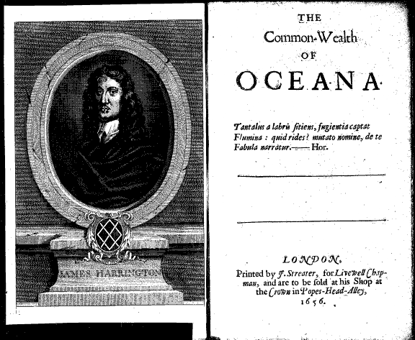
Applications: Legislation
1656: James Harrington wrote the Commonwealth of Oceana in an attempt to argue political philosophy for use in English government.
Oceana government: (1) Senate of Knights, (2) House of deputies.
Passing bills: Senate proposes a legislation, and the house passes it. Divide and choose!
Note: this isn’t division in the same sense,
but it is a highly related problem.

