Slide 1
Applied Mechanism Design For Social Good
John P Dickerson & Marina Knittel
Lecture #22 – 04/12/2022
CMSC498T
Mondays & Wednesdays
2:00pm – 3:15pm

Slide 2
Announcements
Due tonight: Fair Allocation Quiz
Due on Monday, 4/25: Project Checkup
Kind of like the project proposal, but regarding the current state of things
Will be graded in a similar manner
Remember that proposal comments are up!

Slide 3
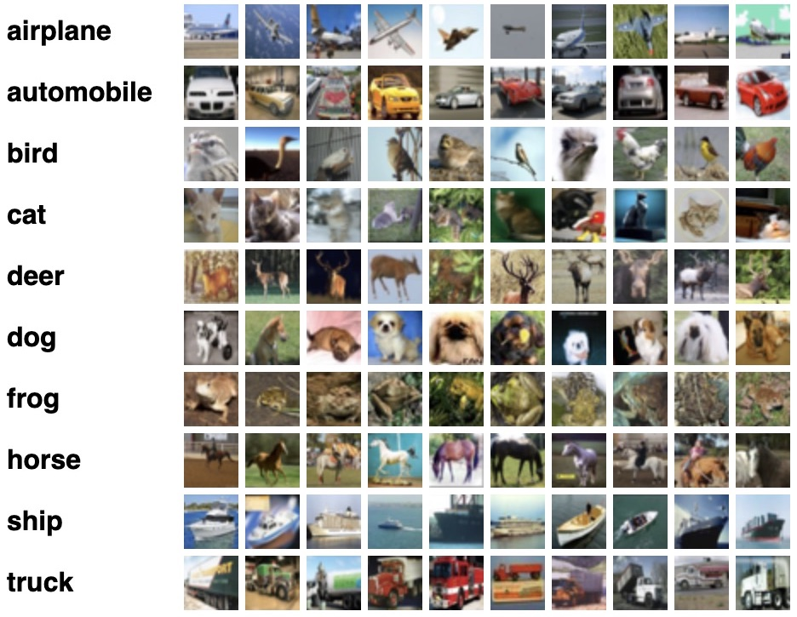
What is Machine Learning?
“The study of computer algorithms that can improve automatically through experience and by the use of data.”
Wikipedia
Let P be data. Let A be a set of labels.
Find a mapping M : P → A in an attempt to most accurately identify the labels.
We want to estimate the label as best as possible under constraints.
A:
P:

Slide 4
Constraint: Linear separator
A constraint is any restriction on the solution map M.
Example: M must be a linear separator.
False Positives:
1
False Negatives:
2
This may be the best linear separator
+
+
+
+
-
+
-
+
-
-
-
Positive
-
-
+
Negative

Slide 5
Loss Function and Linear programs
Loss function: A function L : P x A → R which tells you “how far away you are from a solution.
Say L(p, a) is 0 if x’s label is a, 1 otherwise (0-1 loss).
L(x, +) =
x:
+
+
+
+
-
+
-
y:
+
-
-
-
Positive
-
-
+
Negative

Slide 6
Loss Function and Linear programs
Loss function: A function L : P x A → R which tells you “how far away you are from a solution.
Say L(p, a) is 0 if x’s label is a, 1 otherwise (0-1 loss).
L(x, +) = 0
L(y, +) =
x:
+
+
+
+
-
+
-
y:
+
-
-
-
Positive
-
-
+
Negative

Slide 7
Loss Function and Linear programs
Loss function: A function L : P x A → R which tells you “how far away you are from a solution.
Say L(p, a) is 0 if x’s label is a, 1 otherwise (0-1 loss).
L(x, +) = 0
L(y, +) = 1
Thus y is a bad label, x is a good label.
Goal: minimize total loss.
x:
+
+
+
+
-
+
-
y:
+
-
-
-
Positive
-
-
+
Negative

Slide 8

If it ain’t broke, don’t fix it
Unfortunately, it is broken

Slide 9
If it ain’t broke, don’t fix it
Unfortunately, it is broken in lots of ways.
But let’s focus on a few.
Many machine learning projects that we rely on today discriminate against real people.
Credit card advertisements
Google Ad selection
Google name advertisements
Recidivism risk
Others: hiring decisions, school admission, etc.

Slide 10
Group Fairness
“Group fairness” or “statistical parity”: demographics in the positive group and negative group are the same as the whole distribution.
Say our demographics are blue and red points.
50% of the points are red, 50% are blue.
To be fair, 50% of the positive points must be red, 50% must be blue. Same with negative points.
This is not fair.
-
-
-
-
+
+
+
-
-
+
+
Negative
+
+
+
Positive

Slide 11
Group Fairness
“Group fairness” or “statistical parity”: demographics in the positive group and negative group are the same as the whole distribution.
Say our demographics are blue and red points.
50% of the points are red, 50% are blue.
To be fair, 50% of the positive points must be red, 50% must be blue. Same with negative points.
This is fair.
-
-
-
-
+
+
+
-
-
+
+
+
+
+
Negative
Positive

Slide 12
Example: Loan Decisions
http://research.google.com/bigpicture/attacking-discrimination-in-ml/

Slide 13

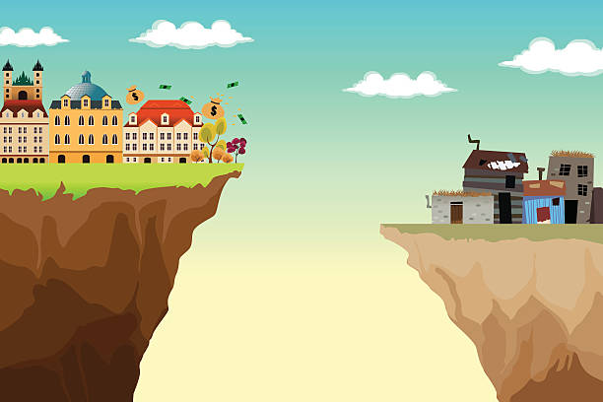


Discriminatory practices
We are running a classification task on a point set P with labels A. Say S is a protected class (i.e., a racial minority).
Discriminatory practices:
Blatant discrimination: membership in S is explicitly used to give a worse outcome.
Redundant encoding: blatant discrimination but you use a “proxy” metric.
Redlining: discriminating against neighborhoods because occupants are mostly minorities and/or low-income
Notes:
you can’t ignore race and assume your algorithm doesn’t discriminate against race, study done about gaydar thru gay friends

Slide 14
Discriminatory Practices
We are running a classification task on a point set P with labels A. Say S is a protected class (i.e., a racial minority).
Discriminatory practices:
Disproportionate discrimination: discriminating against groups because occupants are disproportionately minorities and/or low-income.
Self-fulfilling prophecy: deliberately choosing a specific subset of S to discriminate against S.
Reverse tokenism: excusing discrimination against S by citing a “good” member of S^{c} who is denied service.
Notes:
Reverse tokenism allows you to sacrifice one person in S^c to allow you to discriminate against all of S.

Slide 15
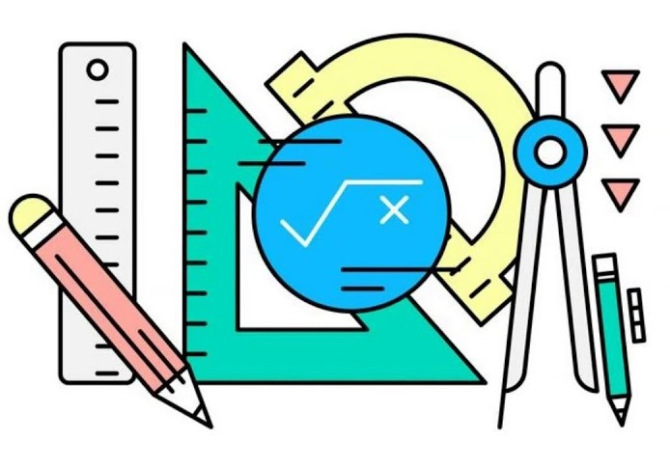




Limitations of Group Fairness
Reduced utility: statistical parity can yield low-utility solutions.
Self-fulfilling prophecy: you can select sub-optimal example and use that as a basis to discriminate.
Subset targeting: you can target irrelevant individuals in S, thereby catering more to S^{c}.
Kent
IQ: 145
Mark
IQ: 115
Zak
IQ: 95
Kate
IQ: 145
Eve
IQ: 115
Rose
IQ: 95
Dog owners
Upper class
Lower and middle class
Puppy Chow Ads
Notes:
demographics are students from finance school and students from engineering school, outcomes are finance and engineering jobs
interviewing minorities, could just invite interview to fill a quota, but might not invite the best
an ad might be targeted to members in S more likely to click on it, and targeted to members in S^c that are less likely to click on it

Slide 16
Individual fairness
“Lipschitz fairness” or “individual fairness”: The closer two points are together, the closer their labels should be.
Recall our classifier is M, and M(x) is the label of a point x. Let d,D be a distance function. M is Lipschitz if for any x,y in P:
d(x,y) ≤ D(M(x), M(y))
x
M(x)
d(x,y)
D(M(x), M(y))
y
M(y)
Point space, distance function: d
Label space, distance function: D

Slide 17
Why We Like Individual Fairness
Theorem: In certain circumstances (i.e., certain distance measures), individual fairness implies group fairness.
In other cases, you can force group fairness while retaining some individual fairness.
Property: Individual fairness is a generalization of differential privacy.
Property: Individual fairness prevents reverse tokenism, the self-fulfilling prophecy, and redundant encodings.

Slide 18




Example: Ad Network
>
>
>
“Sal and Sally are similar, but Sal is white picket fencer”
Sal
Sally
Individual fairness guarantees that Sally and Sal are expected to have similar classifications. Prevents reverse tokenism and self-fulfilling prophecy (have them guess!)
Notes:
Self-fulfilling prophecy: deliberately choosing a specific subset of S to discriminate against S.
Reverse tokenism: excusing discrimination against S by citing a “good” member of S^{c} who is denied service.

Slide 19
Example: Ad Network
>
>
>
“Sal and Sally are similar, but Sal is white picket fencer”
Sal
Sally
Individual fairness guarantees that Sally and Sal are expected to have similar classifications. Prevents reverse tokenism and self-fulfilling prophecy (have them guess!)
Notes:
Self-fulfilling prophecy: deliberately choosing a specific subset of S to discriminate against S.
Reverse tokenism: excusing discrimination against S by citing a “good” member of S^{c} who is denied service.

Slide 20
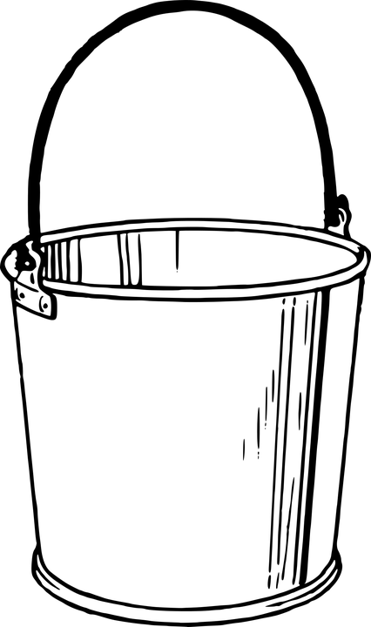
Risk Assignments
Warning: For simplicity purposes, this uses binary gender labels, which may not reflect all possible groups in the data. The issue of datasets using binary gender labels is common and a current topic of interest in fair data collection.
We can also quantify fairness through risk assignments.
Task: output a probability someone is a jedi. Protect for gender.
Individual
Feature Vector
Height, Weight, Age
Risk Bins
With “scores” v
Classification
+ Jedi, - Not Jedi
66
130
19
Luke (M, +)
v₁=.5
+
50%
61
105
19
50%
Leia (F, -)
0%
-
100%
73
179
29
v₂=0
Score buckets according to positive rate
Map feature vectors to risk buckets
Han (M, -)

Slide 21
Fairness By Risk Assignment
Calibration within groups: in any bin, men and women have the same chance of jedi classification.
Negative class balance: the average scores of non-jedi men and women are equal
Positive class balance: the average score of jedi men and women are equal.
40%
+
Women
40%
Men
60%
60%
-
v_{b}=.4
Leia (F, -)
Average Scores
Women: 0.5
Men: 0.5
Padme (F, -)
0.6
Han (M, -)
Chewie (M, -)
0.4
0.8
Average Scores
Women: 0.6
Men: 0.6
Ahsoka (F, +)
Rey (F, +)
0.6
Luke (M, +)
0.4

Slide 22
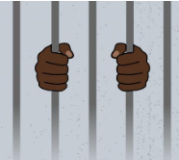
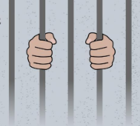
A Perplexing Case: Recidivism Prediction
COMPAS risk tool: an intelligent system used by the criminal justice system to assign an estimated chance of convicted criminals to commit reoffenses.
Angwin et al.: claimed that COMPAS discriminated against race because it failed to achieve both negative class balance and positive class balance.
Counter: claimed COMPAS does not discriminate because it achieves calibration within groups.
Does that mean it’s okay or bad?
Notes:
One of the first motivations for fairness discussion, basically deemed unfair
Who is right? Should they have to satisfy all conditions, or which conditions should they satisfy?

Slide 23
How many conditions can we get simultaneously?
Perfect prediction: We are given who is a jedi.
Equal base rates: Men and women are equally likely to be jedis.
Luke (M, +)
Luke (M, +)
1
+
+
Leia (F, -)
Leia (F, -)
.5
0
-
-
Han (M, -)
Han (M, -)
Group cailbration:
Negative class balance:
Positive class balance:
Group calibration:
Negative class balance:
Positive class balance:
Ahsoka (F, +)

Slide 24
Beyond special cases
Theorem: group calibration, negative class balance, and positive class balance can be achieved all together if and only if there is perfect prediction or equal base rates.
COMPAS: Never could have achieved all 3! But maybe could have done 2.
Luke (M, +)
.5
+
Leia (F, -)
0
-
Han (M, -)

Slide 25
Ethical Guide to Fair Machine Learning
Keep in mind: algorithmic fairness inherently interacts with vulnerable and marginalized communities.
Big question: How do we ensure that we serve and give back to these communities
Do not exploit fair algorithms
Other big question: How do we avoid harming these communities?
Some groups have codes for this, including the AAAI code of ethics.
Notes:
Exploit: research, notoriety, monetary gain

Slide 26
Fair Algorithms can cause harm!
Consider: We know employers discriminate against applicant’s criminal history. Since the criminal justice system exhibits racial discrimination, this issue can propagate to hiring.
Solve this by banning employers from asking about criminal history?
No: we know that employers then use race as a proxy for unknown criminal history. This increases racial discrimination.
“Imposing a fairness constraint can make the disadvantaged group worse off if the fairness constraint and utilities of the population mismatch.”

Slide 27
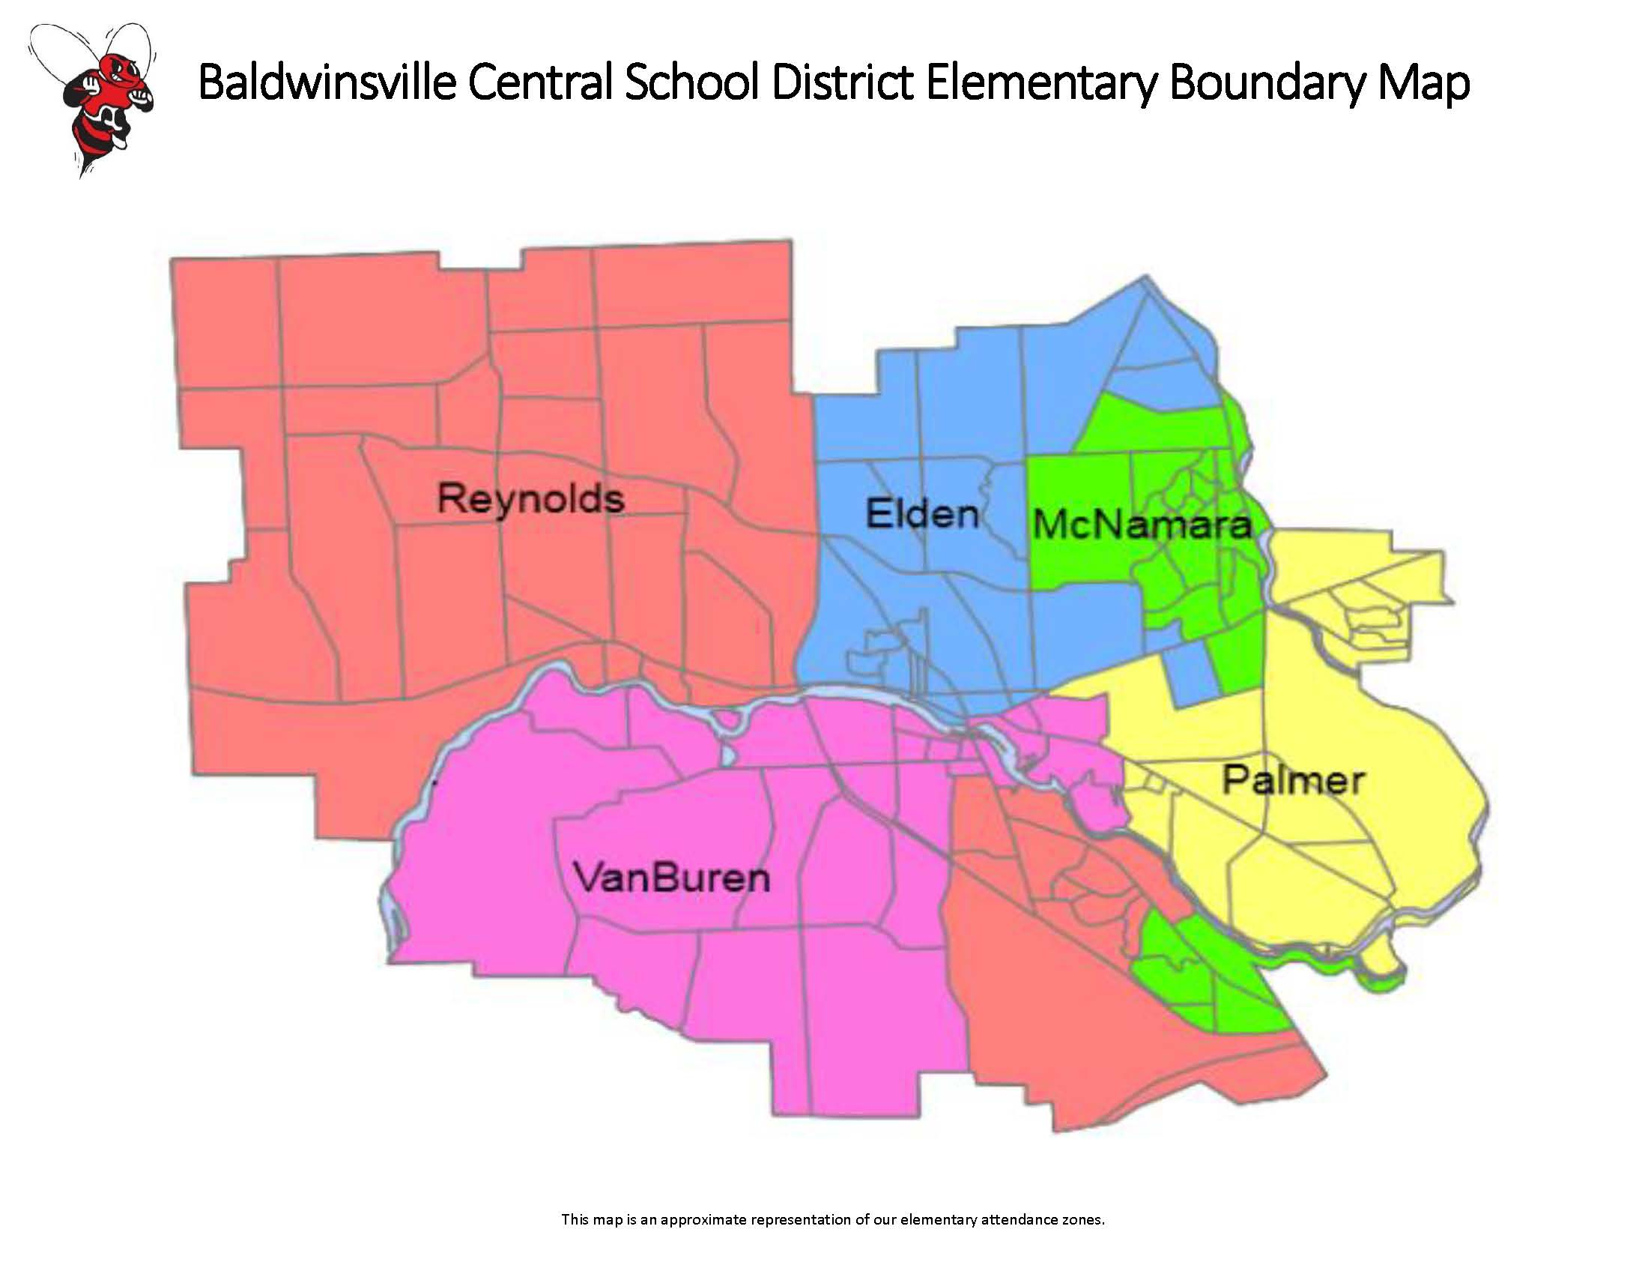
Example: School districting
In the US, the population is divided (“clustered”) into geographic districts. People in the same district use the same school system.
Funding and resources are not distributed equitably
Districts are segregated
Notes:
Segregation demographics: race, income level, etc.
Property taxes!

Slide 28
Example: School districting
What if we impose fairness on this clustering problem?
Ensure the clustering is group fair
Consider: Who are we serving, and how does this impact them?
Notes:
What are the limitations of this approach?
Are we serving all the wants/needs of residents? Maybe some communities don’t want to be split or combined.

Slide 29
Example: School districting
Important considerations:
Logistics and cost
People move for schools!
Notes:
Move away from bad districts
Move to good districts
Move away from demographics
Brown vs Board of education 1954: school segregation is illegal.
Bussing: reassign students to better balance racial demographics, which is like group fairness
Milliken v Bradley 1974: can you force bussing across district lines? NO. allowed people to avoid schools by moving

Slide 30
When you are trying to apply Fairness…
Applications and context matter
Define and model fairness for specific social problems
General abstractions are useful but often over-sold
Use caution mapping ideas from fair classification to other fair problems (i.e., fair clustering…)
Fairness interventions do not act in a vacuum
Broader context and upstream/downstream effects are important
Different bad inputs require different fair algorithms
How the algorithm’s output is used must also be considered

Slide 31
When you are trying to apply Fairness…
Interdisciplinary research is the best way to use fairness well
Know your limitations as a researcher, programmer, etc.
Know relevant work in related areas
Understand what compromises are most acceptable when ideals can’t be achieved
Establish what is/isn’t allowed in practice (i.e., code of ethics)
Real people are involved!
Who is this for?
Who are we being fair to?
What do they want?
How do they want fairness defined?

