Slide 1


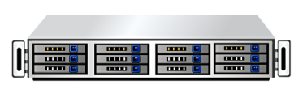

Autofailover HA_Version1.0 From Datatrend.inc
Type=Shared
_{Server_1=Alpa}
_{Server_2=Beta}
_{Active Server}
VIP_1
_{Standby Server}
_{Heartbeat}
_{VIP_1=192.168.1.X}
_{VIP_2=}
DB
_{DB=Oracle}
_{APP=}
_{Disk_1=D:}
_{Disk_2=}
D:
Server_1
Server_2
_{Share Disk}
Type=Shared
_{Active Server}
_{Active Server}
VIP_1
VIP_2
_{Server_1=Alpa}
_{Server_2=Beta}
_{Heartbeat}
_{VIP_1=192.168.1.X}
DB
APP
_{VIP_2=192.168.1.X}
_{DB=Oracle}
_{APP=Notepad.exe}
_{Disk_1=D:}
_{Disk_2=E:}
E:
D:
Server_1
Server_2
_{Share Disk}
₆

Slide 2

Autofailover HA_Version1.0 From Datatrend.inc
Type=Mirrored
_{Active Server}
VIP_1
_{Standby Server}
_{Server_1=Alpa}
_{Server_2=Beta}
_{Heartbeat}
_{VIP_1=192.168.1.X}
_{VIP_2=}
DB
_{DB=Oracle}
_{APP=}
_{Disk_1=D:}
_{Disk_2=}
D:
_{Share Disk}
Server_1
Server_2
CMD=경로명 입력칸=

