Slide 1
Fungsi Non Linear
Eps. 1

Slide 2
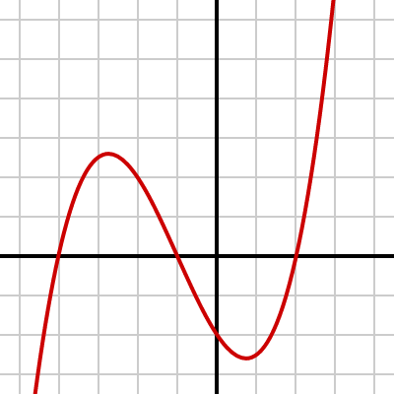
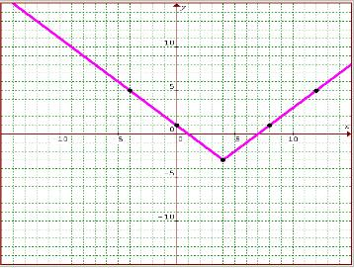
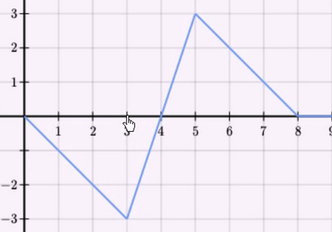
Fungsi yang bukan garis lurus

Slide 3
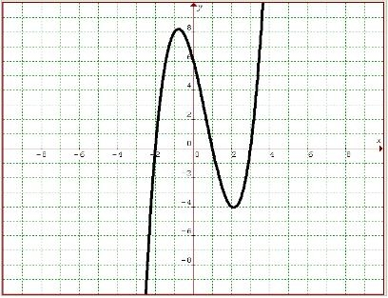
Ada perubahan kemiringan

Slide 4
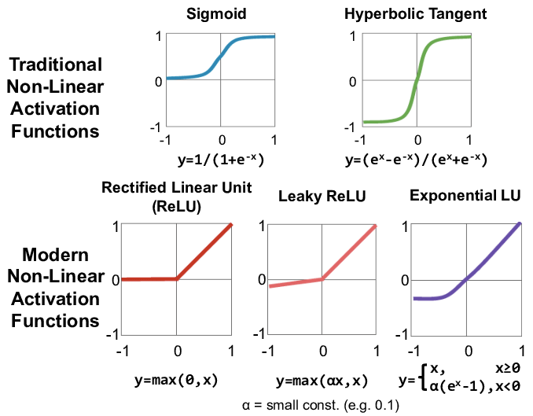
Contoh fungsi non linear
https://www.researchgate.net/publication/315667264_Efficient_Processing_of_Deep_Neural_Networks_A_Tutorial_and_Survey/figures?lo=1&utm_source=google&utm_medium=organic

Slide 5
Sources
https://www.khanacademy.org/math/cc-eighth-grade-math/cc-8th-linear-equations-functions/linear-nonlinear-functions-tut/v/linear-and-nonlinear-functions-example-3
https://www.mathplanet.com/education/pre-algebra/graphing-and-functions/the-slope-of-a-linear-function
https://courses.lumenlearning.com/boundless-algebra/chapter/nonlinear-systems-of-equations-and-inequalities/
https://www.researchgate.net/publication/315667264_Efficient_Processing_of_Deep_Neural_Networks_A_Tutorial_and_Survey/figures?lo=1&utm_source=google&utm_medium=organic

