Slide 1

Final Project Chess Comment Transformer
Kazan, Kerem
CSCI E-104 Advanced Deep Learning, 2025
Harvard University Extension School

Slide 2
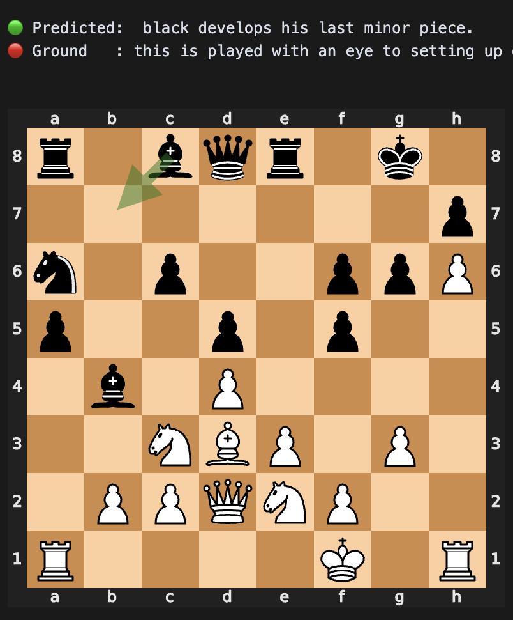
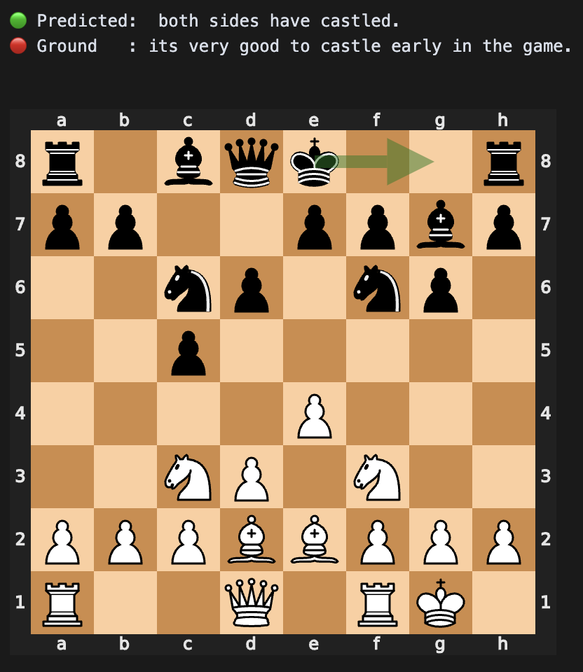
Introduction
This is a transformer model that comments on chess moves. Given a board and a move, it can offer insights such as “White controls the center and attacks the king”. The purpose is to enhance numerical chess analysis engines such as “Stockfish” with natural language commentary.

Slide 3
Dataset
In order to train a transformer model that can comment on a Board and a Move, we need a dataset that has the following structure: (Board, Move, Comment)
Unfortunately this dream dataset either doesn’t exist, or it’s hidden somewhere unreachable. This is why this project has a significant Data Mining and Data Preprocessing effort.
The result is about 300,000 lines of (Board, Move, Comment) pairs. Upon sanitization and outlier elimination, we end up with more than 250,000 rows of data. I have made a 500-line sample available here. I can provider the entire dataset upon request: https://docs.google.com/spreadsheets/d/1U_yUzUpn3PKREU6L0h5ixjgGPh3RDrTm4RnLjg7HrBA/edit?usp=sharing
Our raw dataset is in PGN format. The good news is we can use a very popular library called `python-chess` to parse PGNs, extract the moves, and convert back and forth between PGN and FEN notations. This will make our data more portable and easier to work with.

Slide 4
Chess Notation
FEN notation: A cryptic string that describes the board state. For example: "rnb1kbnr/ppp2ppp/8/3qp3/8/5N2/PPPP1PPP/RNBQKB1R w KQkq - 0 4". This string not only contains where each piece is, but also the side to move, castling rights, en passant target, halfmove clock, and fullmove number.
SAN notation: Standard Algebraic Notation - a verbose notation for moves. For example: "1. e4 e5 2. Nf3 Nc6 3. Bb5 a6 0-0-0". This notation is used to describe a sequence of moves in a game: A "full move number" is written first, followed by a list of moves - first white, then black.
PGN notation: Portable Game Notation - a standard notation for games. Contains a series of SAN notations, but also contains comments.
UCI notation: A compact notation for moves. For example: "e2e4". This notation is used to describe that a piece moved from the e2 square to the e4 square - which is likely a pawn move - but it could also be a rook move or a queen move. It all depends on the current board state.
In this project, we parse through about 12,000 PGN files to produce 250,000 (Board,Move,Comment) tuples.

Slide 5
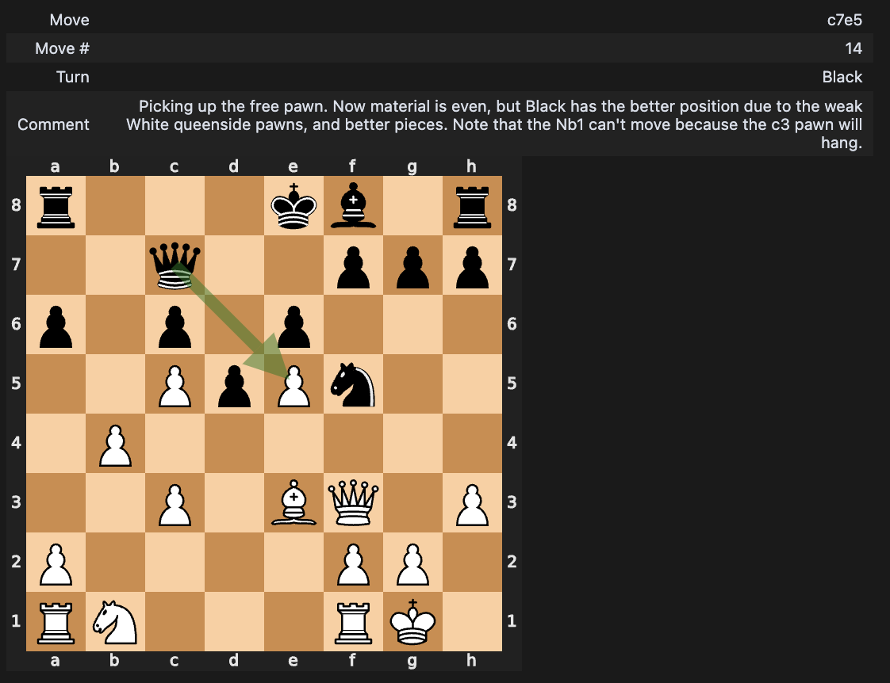
Visualization
It’s easy to get lost while training a model - and it’s extremely helpful to have visual help. We make extensive use of the python-chess library in this project.
Below is a visualization example that came in very handy throughout the project:

Slide 6
Data Sanitization
In the raw scraped dataset, many comments were unusable. A couple of examples:
“The French Defence happens to be the only opening I have a book on, and there is a rather nice story behind it. I am a supply teacher - what our American cousins would call a substitute teacher. I go round all sorts of schools and colleges. I was in a staff room, browsing at this book, and someone said that the owner of the book had left, so if I wanted I could have it. At that time my girlfriend lived in London, and phoned her and mentioned that I had been given a book on The French Defence. The football world cup finals had just started and she said 'Isn't there anything about the French midfield or the French attack?' She shared by love of football, but not of chess!”
“Und auf einmal taucht auch die Dame auf.”
“Can you believe? :-)”
We employ manual regex and filters to remove these bad rows. Language detection often produces false positives - which sometimes removes good rows - but we have too much data to worry about that.

Slide 7
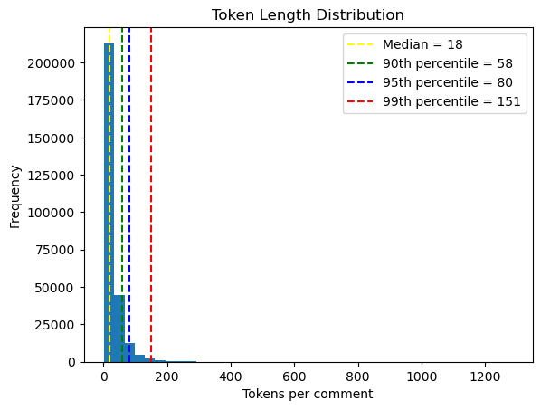
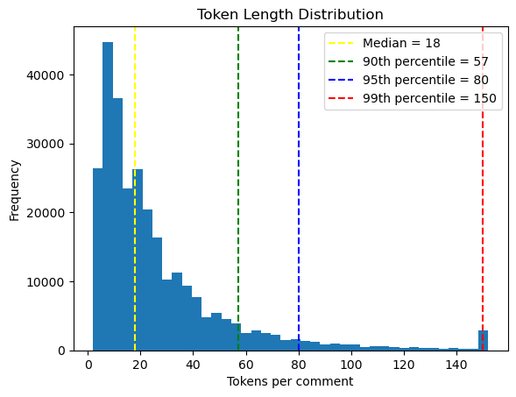
Outlier Elimination
Most comments that were longer than 2-3 sentences were non-sequiturs.
Since we will feed these comments into transformers, it makes sense to take a look at their tokenized length distributions. Below is a before & after of tokenized comment lengths after outlier (above 99th percentiles) elimination
You can see that basically nothing below p99 changed, meaning we really did remove outliers that would make our life harder.

Slide 8
Serialization
The input is a (Board,Move) tuple. In the standard data format, it looks like this:
board: r1bqk2r/ppp1b1pp/2n2p2/3pB2n/3P4/P1N2N2/1P2PPPP/R2QKB1R w KQkq - 0 9
move: e5g3
When we directly tokenize these with an off-the-shelf encoder tokenizer such as “bert-base-uncased”, the transformer had a hard time picking up on patterns.
So we do a serialization pass before tokenizing. The tuple above becomes: [CLS] WHITE_BISHOP ON SQUARE_E5 MOVES_TO SQUARE_G3 [SEP] WHITE_BISHOP ATTACKS BLACK_PAWN ON SQUARE_C7 [SEP] WHITE_BISHOP DEFENDS WHITE_PAWN ON SQUARE_F2 WHITE_PAWN ON SQUARE_H2 [SEP] WHITE_BISHOP CONTROLS SQUARE_F2 SQUARE_H2 SQUARE_F4 SQUARE_H4 SQUARE_E5 SQUARE_D6 SQUARE_C7 [SEP] WHITE_ROOK ON SQUARE_A1 WHITE_QUEEN ON SQUARE_D1 WHITE_KING ON SQUARE_E1 WHITE_BISHOP ON SQUARE_F1 WHITE_ROOK ON SQUARE_H1 WHITE_PAWN ON SQUARE_B2 WHITE_PAWN ON SQUARE_E2 WHITE_PAWN ON SQUARE_F2 WHITE_PAWN ON SQUARE_G2 WHITE_PAWN ON SQUARE_H2 WHITE_PAWN ON SQUARE_A3 WHITE_KNIGHT ON SQUARE_C3 WHITE_KNIGHT ON SQUARE_F3 WHITE_PAWN ON SQUARE_D4 BLACK_PAWN ON SQUARE_D5 WHITE_BISHOP ON SQUARE_E5 BLACK_KNIGHT ON SQUARE_H5 BLACK_KNIGHT ON SQUARE_C6 BLACK_PAWN ON SQUARE_F6 BLACK_PAWN ON SQUARE_A7 BLACK_PAWN ON SQUARE_B7 BLACK_PAWN ON SQUARE_C7 BLACK_BISHOP ON SQUARE_E7 BLACK_PAWN ON SQUARE_G7 BLACK_PAWN ON SQUARE_H7 BLACK_ROOK ON SQUARE_A8 BLACK_BISHOP ON SQUARE_C8 BLACK_QUEEN ON SQUARE_D8 BLACK_KING ON SQUARE_E8 BLACK_ROOK ON SQUARE_H8 WHITE_HAS_KINGSIDE_CASTLING_RIGHTS WHITE_HAS_QUEENSIDE_CASTLING_RIGHTS BLACK_HAS_KINGSIDE_CASTLING_RIGHTS BLACK_HAS_QUEENSIDE_CASTLING_RIGHTS [SEP]
We achieve this by processing the board + move tuple via python-chess, and extracting additional information about the board such as: What’s the color of the piece that just moved, what’s the type, did it just capture a piece? If so, what? What square did it move to? What squares is it controlling now? Was this a checkmate?

Slide 9
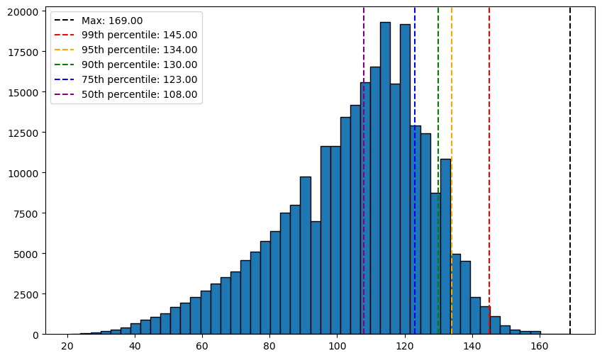
Tokenization
Using the encoder serialization outlined in the previous slide, we are able to create a tokenizer with a vocabulary size of just 100, which is incredibly compact. So instead of “bert-base-uncased”’s 30k tokens, we only need 100. And normally a smaller vocabulary size means longer encodings, but our encoded input lengths are perfectly acceptable. Below is the tokenized input length distribution:

Slide 10
Model
We use BERT as our encoder, and GPT2 as our decoder. Both are imported directly from the huggingface transformers library.
This is not fine-tuning, we are training from scratch. This is one of the down-sides of using our own encoder tokenizer. But it’s worth it, because our network can stay much more nimble, and get trained much faster.
The total parameter size is: 11,485,440. We can consider it “tiny” by modern standards.

Slide 11
Training
Using Seq2SeqTrainer from transformers.
Best performing model was trained with a batch size of 64.
Warmup set to 2000 steps to prevent early memorization.
Trained on A100 via Google Colab.

Slide 12
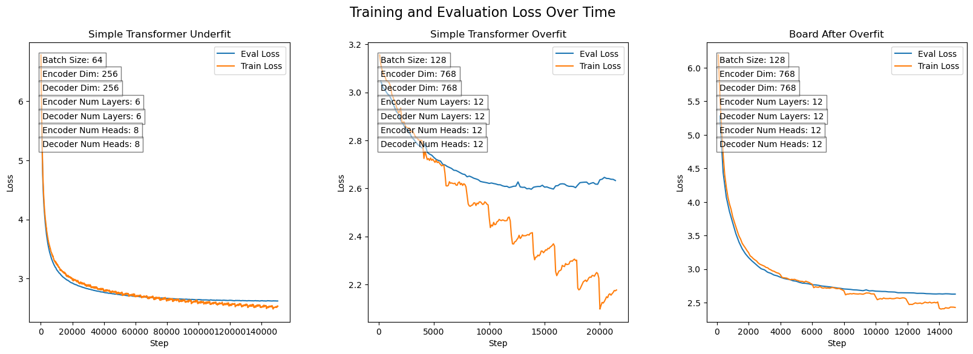
Post Analysis
Here are 3 training runs of similar models with either different network sizes, or different tokenization schemes. The middle one shows clear signs of overfitting, whereas the first one shows an overall healthy picture. The third one was collapsing into an overfit as well.

Slide 13
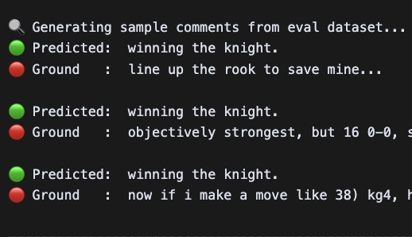
Critical Takeaway #1
Don't just count on training loss and eval loss to tell you if your model is learning. Transformers can be very deceptive. There were many cases where the training loss approached 0 during my sanity-check training runs - but the model was still producing garbage. This is why it's important to have a mechanism to clearly show the output of the model - during training.
Huggingface trainer library has a callback mechanism that allows you to run custom code at certain points in the training process. Here’s an example where the network has clearly collapsed, and this visual aid was critical in detecting the issue fast.

Slide 14
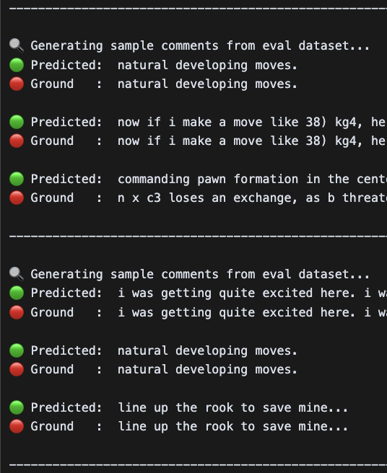
Critical Takeaway #2
In the earlier iterations of this project, my transformer would very quickly collapse and keep generating the same output - like "A very good move" - regardless of the input. It's much easier to debug issues like tensor size mismatches - the runtime will error and print the error message and a stack trace. But this is one of those more Byzantine issues that are hard to debug. Training a model is no easy task - especially for a beginner. You need to be patient and keep fixing issues one by one. That's why it's extremely important to have mental checkpoints and sanity checks that gradually become more complex.
Here's a very useful tool: Create a super small training dataset and attempt to overfit it. If your model can't even memorize a dataset of 10 rows, no amount of hyperparameter tuning will help. You have a systemic issue, and likely a bug. This was the case for me. And this technique helped me gradually pinpoint where my issue was. Once I fixed my issues, I was able to see the output to the right. We’re still far from learning, but at least we can memorize.

Slide 15
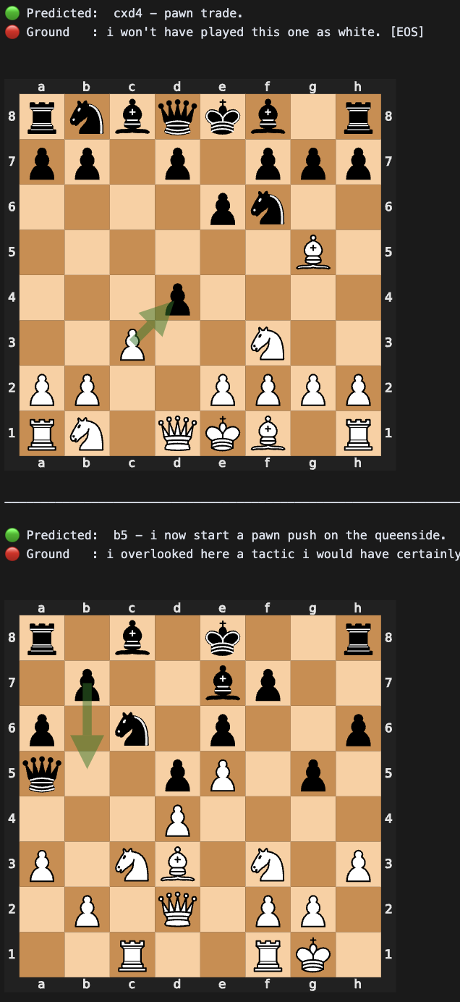
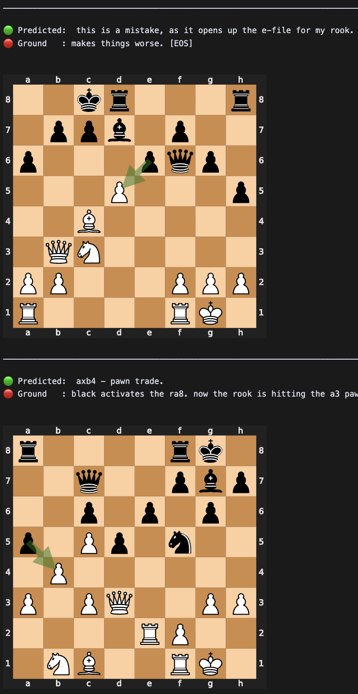
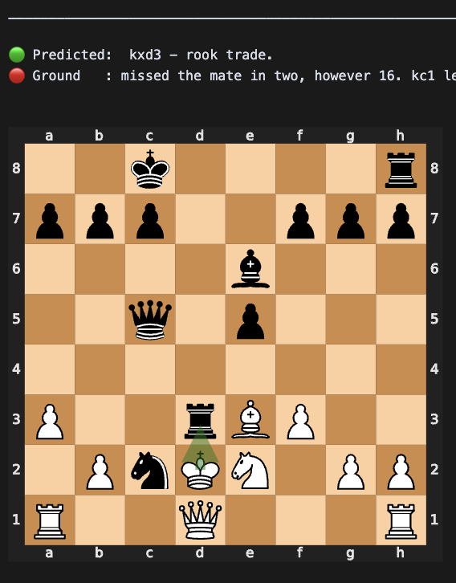
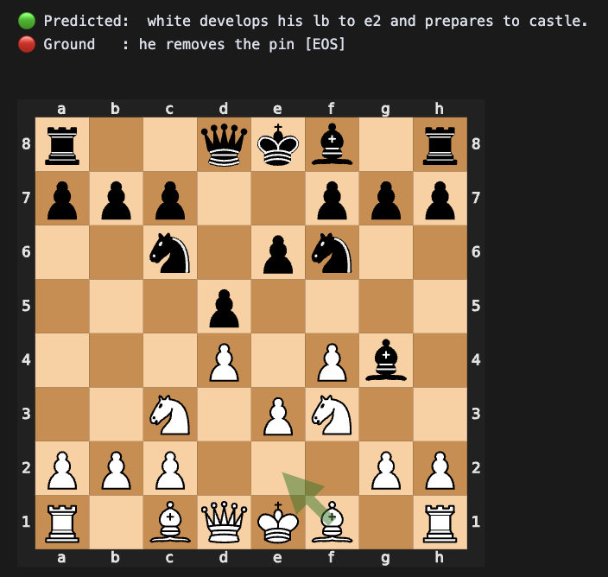
Demonstrations (The Good)

Slide 16
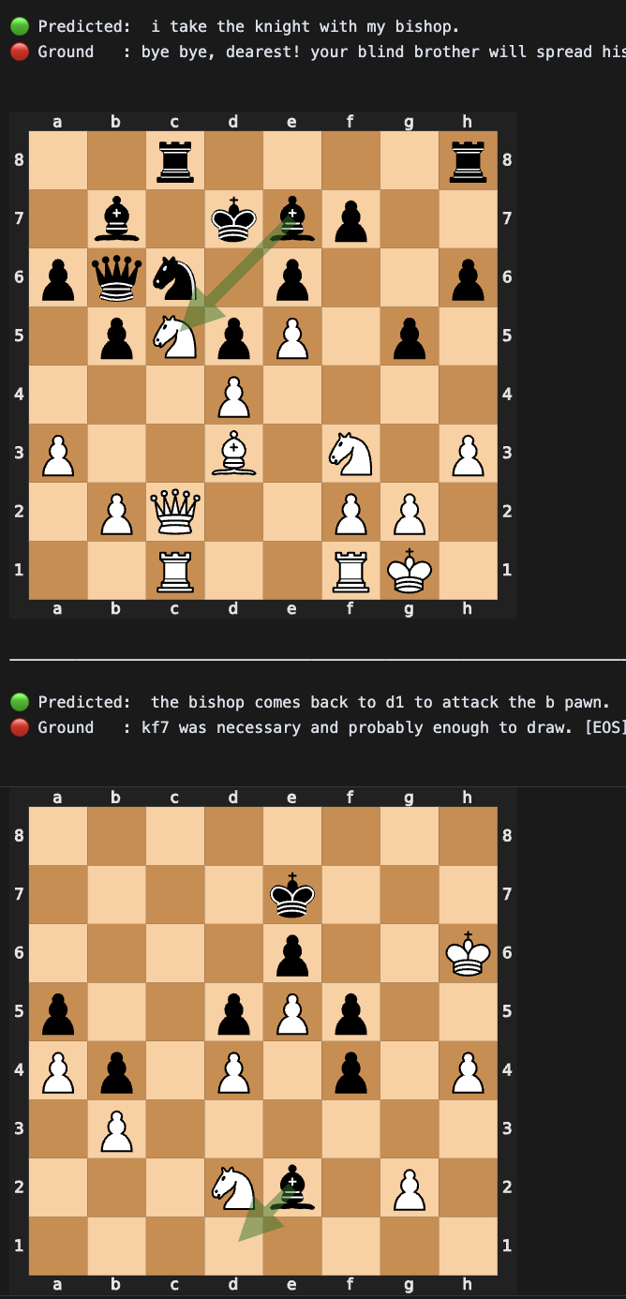
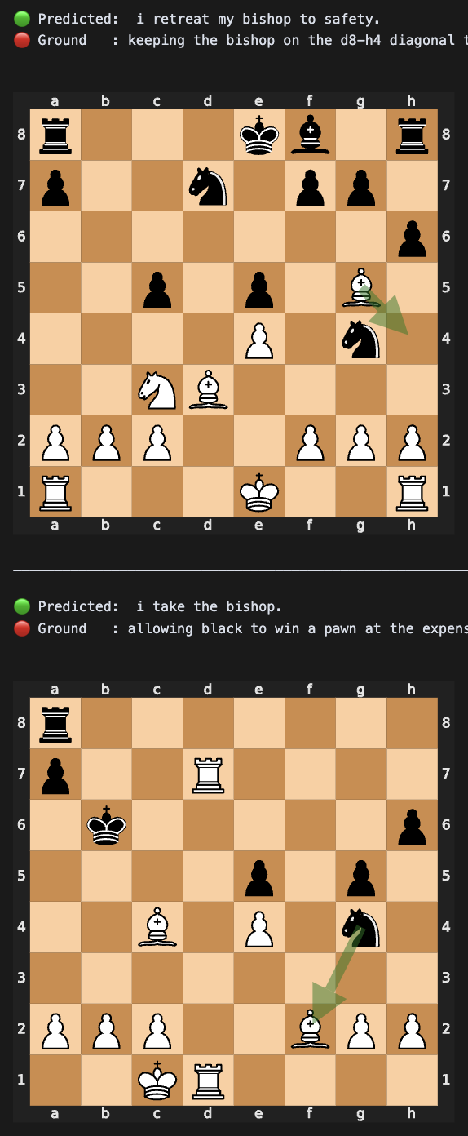
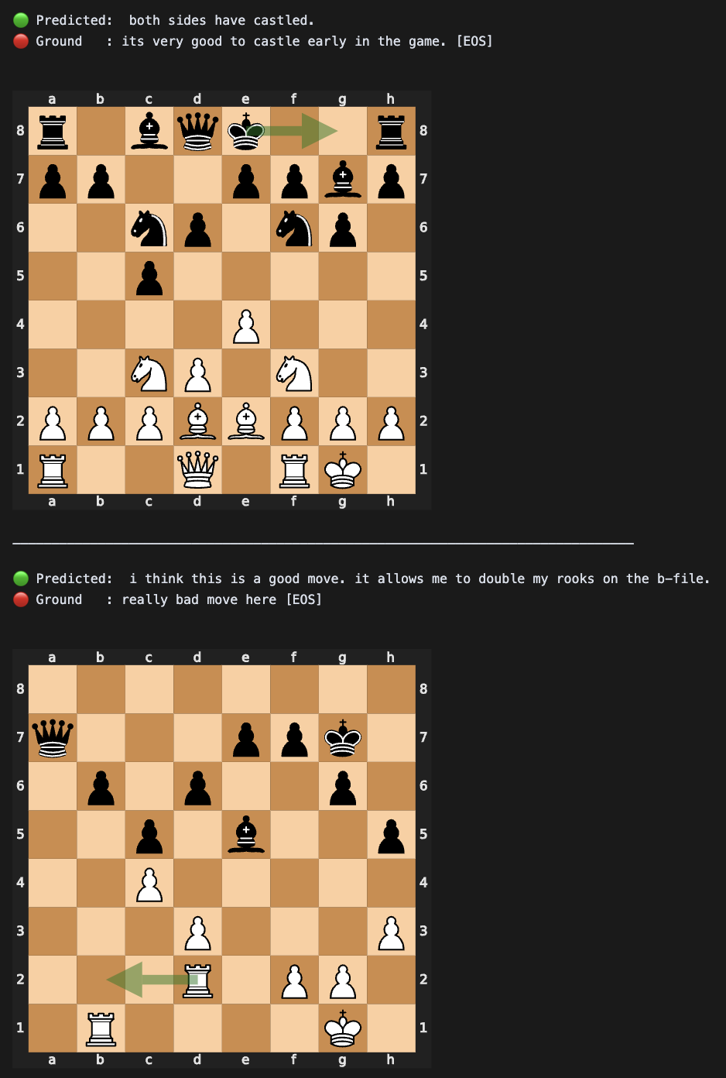
Demonstrations (The Good Continued)

Slide 17
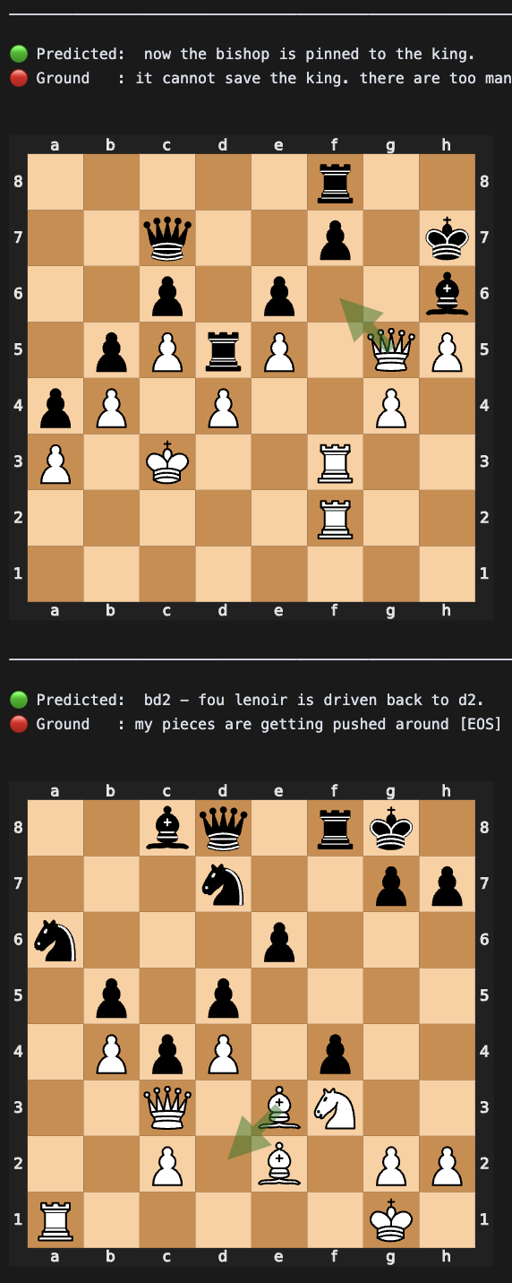
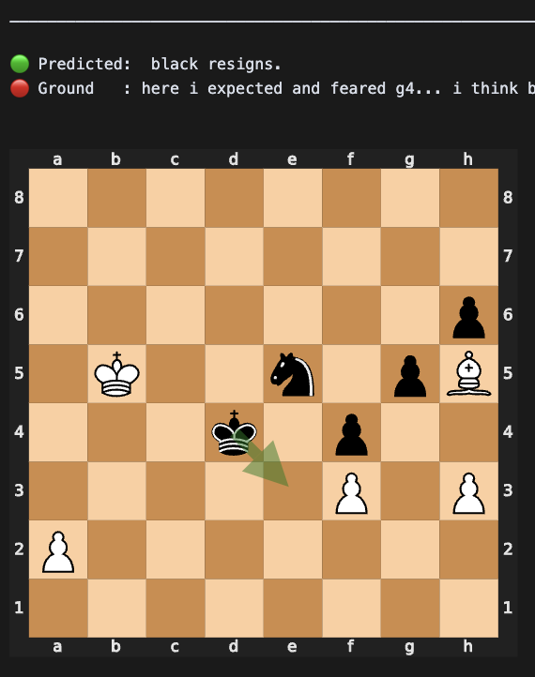
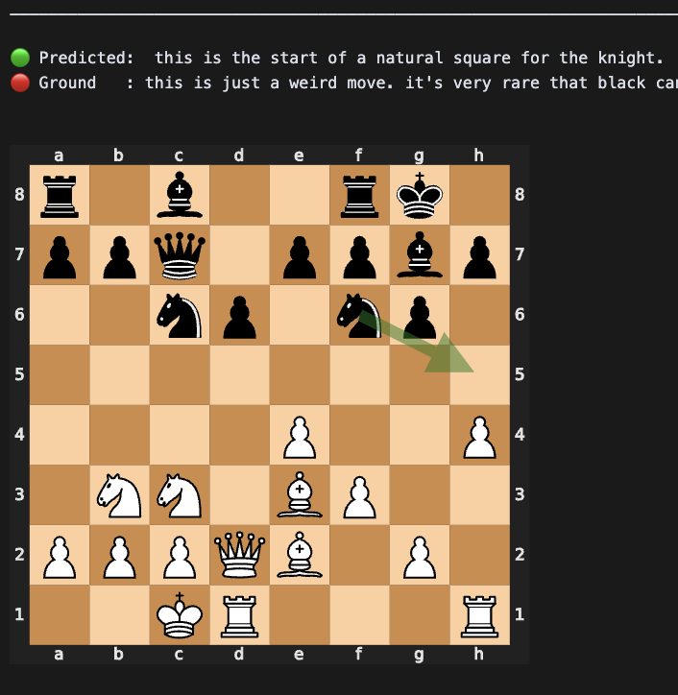
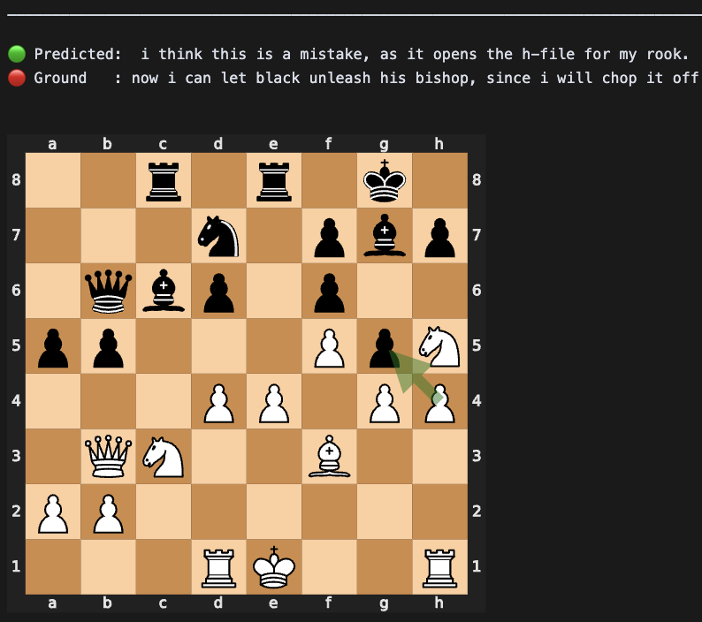
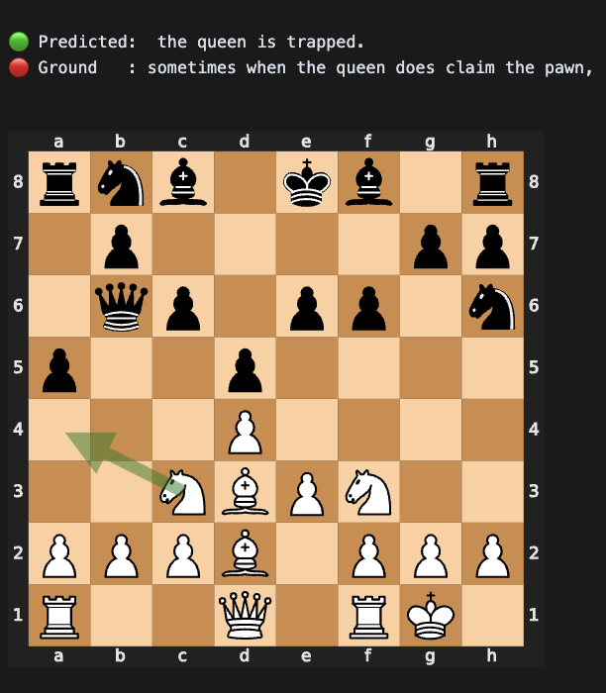
Demonstrations (The Bad)

Slide 18
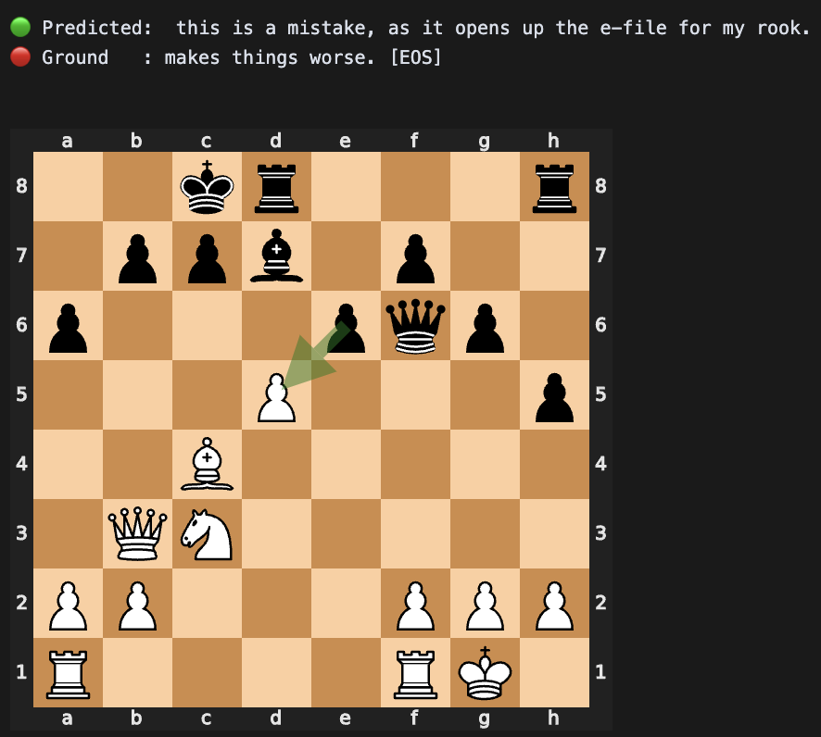
Conclusion
The best performing model was able to produce comments that were both syntactually, but more importantly, semantically correct - on data it has never seen before. So a meaningful amount of learning must have occured.
The predictions don’t always match the ground truth in terms of vocabulary, formatting and syntax. But they are correct and insightful nevertheless. In fact, they sometimes do a better job than ground truth in explaining the situation. For example the ground truth here only mentions that this move makes things worse, whereas the prediction offers a correct insight as to why it’s a bad move.

Slide 19
YouTube URLs, Last Page
2 minutes video URL (short): https://youtu.be/fw4TVnBHX3U
15 minutes video URL(long): https://youtu.be/TRrfl2bLbKY

