Slide 1
Let’s Learn Python!
Young Coders at PyCon 2016
Notes:
(Leave this screen up before the class begins, as the kids are coming in. Use this as an opportunity to pass out name tags, if you have them, and collect any paperwork, such as photo releases. This is also a good time to help the kids boot up their Raspberry Pis and get logged in.)

Slide 2
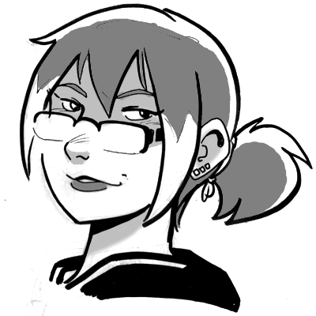
Meet your teachers:
Katie Cunningham
Barbara Shaurette
Notes:
(Each teacher should introduce herself/himself and talk about how they use programming - in their jobs or just to create cool things.)

Slide 3
What is programming?
A problem to solve
A solution to the problem
The solution translated into a language the computer can understand
Notes:
Before we start learning about the Python programming language, let's talk a little about what programming is.
So what do we mean when we talk about programming? Well, every program starts with a problem you want to solve. The solution to that problem is referred to as an algorithm (and we'll talk about that more in a few minutes). And finally, that solution is translated into a programming language, like Python, that the computer can understand. That package of code that's run on a computer is called a program.

Slide 4
A computer is a machine that stores pieces of information.
A computer also moves, arranges, and controls that information
(or data).
A program is a detailed set of instructions that tells a computer what to do with data.
Notes:
So what about computers? You probably already have a good idea of what they are and what they can do.
A computer is a kind of machine, and what it does basically breaks down to two simple things.
It stores pieces of information, which we call data.
And it does things with that data, using programs.
Computers come in a lot of different forms. You might have a laptop, or a PC. But did you know that your phone might also be a computer? Or maybe you have a game console - that's a computer too.

Slide 5
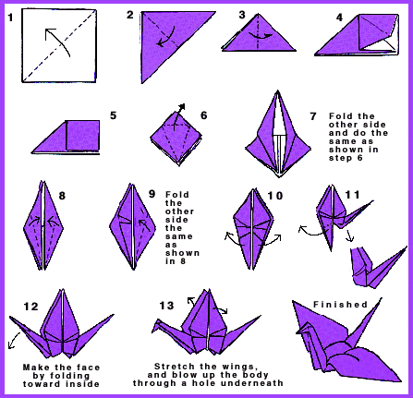
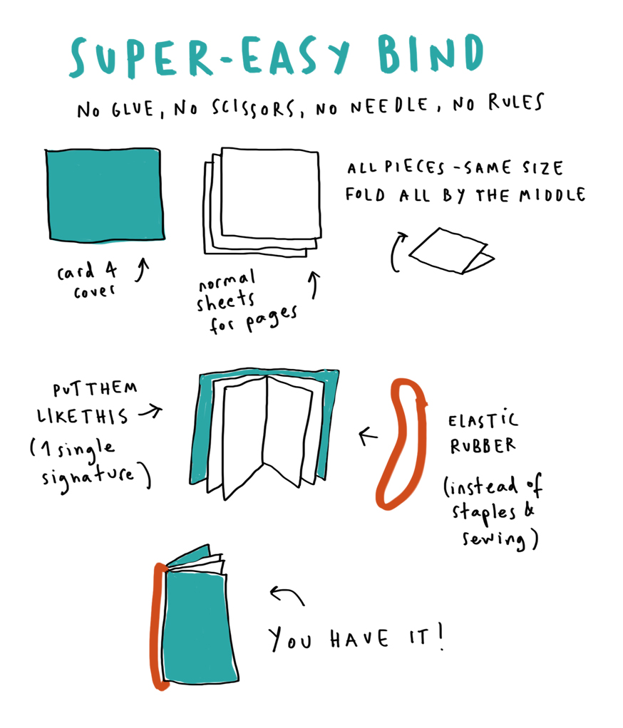
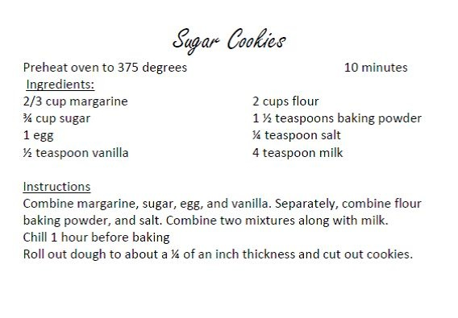
Notes:
But there's something you should know about computers.
They're not very smart.
On their own, computers don't really know how to do much. They can really only do what you tell them to do.
So you have to write good instructions for them. And that's what we're going to learn how to do here today.
Here are some examples of instructions you might use for people:
1. Suppose you want to make an origami crane - that's the 'problem' you want to solve. Well, here's a step-by-step guide.
2. Or maybe you need something to write on? Well, there's a diagram - follow all the steps and you'll have yourself a notebook.
3. And what if you're hungry after all that paper folding? Well here's a recipe - just some instructions for making cookies.

Slide 6
Algorithms
Notes:
And all of those instructions we just saw are like what we call algorithms.
The word 'algorithm' is really just a fancy name for the instructions we give to computers.
They're a lot like recipes, with specific steps to follow.
There are some differences though - algorithms usually have a lot more steps than cookie recipes.
And algorithms are written using special languages - programming languages, like Python.

Slide 7
97 Simple Steps to a PB&J
Is making PB&J difficult?
How many steps does it feel like?
Notes:
First, let's try creating a set of instructions of our own.
Have you ever made a peanut butter and jelly sandwich before? How many steps do you think it takes?
Let's try it out.
(Demonstration: Go through the steps of making a peanut butter and jelly sandwich. One teacher guides the class by asking students to call out each step, and the other teacher follows the instructions exactly, acting as the ‘computer’, until the sandwich is completed. The results are usually hilarious, and this exercise teaches the kids about how important it is to be specific. Keep a rough count of how many steps it took - at the end, ask the students how many steps they thought it took.)

Slide 8
Let’s talk to Python!
Notes:
And now it’s time to start writing some instructions for computers.
There are many languages that we use to talk to computers, but the one we’re going to learn about today is called Python.
(Have the students open Idle at this point. Let them know that what they’re seeing is sometimes called a shell or interpreter. Introduce the term prompt.)
Idle is a program that's also a programming environment. This is where we're going to write our Python code.
It works a lot like a program called a terminal, something you might use to log in to a server. We'll see what that looks like a little later on.
For now, let's talk about some things you might notice here:
At the very top you'll see the word 'Python' followed by some numbers. Those numbers mean the version of Python that you have installed on your computer. Yours might be a little different than mine, but as long as it starts with a 2 or 3, you should be okay.
The other important thing is the three arrows at the bottom. You might see a flashing cursor next to the arrows, but you might not.
We call this a 'prompt', and this is where we're going to type our code.
Idle is also what we call an INTERPRETER. Now in real life we know what an interpreter is - it's a person that translates from one language to another. Well in the computer world, we need a program like Idle to translate our Python code into another language that the computer can understand.
So when we type something at the prompt and hit Enter, Idle is
- translating what we've typed
- talking to the computer
- then getting an answer from the computer and sending it back to us in a language that WE can understand

Slide 9
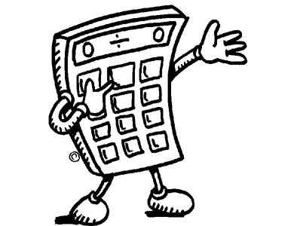
Math
Try doing some math at the prompt:
>>> 1 + 2
>>> 12 - 3
>>> 9 + 5 - 15
Operators:
add: +
subtract: -
Notes:
Finally! Let's get started with some very simple math.
Go ahead and type these expressions one at a time. After each one, hit the Enter key and see what happens.
We're using some symbols you probably already know - the plus and minus signs. In the programming world, we call these symbols "operators".
By the way, you have just started writing Python.

Slide 10
Math
More operators:
divide: /
multiply: *
>>> 6 * 5
>>> 6 / 2
>>> 10 * 5 * 3
Notes:
Here are some more symbols, or operators.
For division, we use that slanted line, called a forward slash.
And for multiplication, we use a star symbol, called an asterisk.
Let's try a few of these expressions and see what happens. While I'm typing these examples, feel free to try some of your own, using different numbers and operators.

Slide 11
Math
Try some more division:
>>> 8 / 4
>>> 20 / 7
>>> 10 / 3
Are you getting the
results you expected?
Notes:
Let's try some more division.
Are you getting the results you expect?
Are your answers all coming back as decimal numbers?

Slide 12
Math
  Floats (decimals):
  10.0
  17.31
  >>> 10/3
  3.3333333333333335
  >>> 10/2
  5.0
  Integers:
  9,
  -55
  >>> round(10/3)
  3
  >>> round(10/2)
  5
Notes:
Here we're learning something new about how Python works with numbers.
In Python, and in many other programming languages, a decimal number is called a 'float'.
On the left are some examples of decimal numbers, or floats. And on the right, you can see some examples of integers - or whole numbers.
When we type a math expression using division, Python gives a float back to us as a response - the answer will always be some sort of decimal number. Python uses floats by default because it wants to give us the most accurate answer possible.
If we want an integer instead, we have to use this built in Python function, round(). Type the word ‘round’, and then inside parentheses type one of the division expressions, then tap the Enter key.
Go ahead and try a few more expressions using different numbers. You might notice a few things:
So the rule we've learned here is that if you want Python answers with floats - if you want to get integers, you have to use the built-in function round().
Before we move on to the next thing, let's take a quick minute to mention some words I've been using.
When I say that Python 'returns' something, I'm talking about the answers that Python gives you. When you type something at the prompt and hit Enter, you're asking Python a question. Then Python gives back, or returns, an answer to you.
I've also been using this word 'expression' - you'll hear that a lot more as we go on. So far the expressions we've seen have been math problems, but expressions can be a lot more. We're also going to see expressions that use words and other kinds of symbols.

Slide 13
Math
Comparison operators:
== Equal to
!= Not equal to
< Less than
> Greater than
<= Less than or equal to
>= Greater than or equal to
Notes:
In Python, we can do a lot of things with numbers besides just adding or dividing.
What if we need to find out if one number is larger than another? Or if one number is equal to another? Suppose you're making a video game with Python - you might want to do something like this to compare scores between two players, for example.
Well, here are some more symbols (or operators) that we can use. These are called COMPARISON operators.
(read through the list)
Later on, you'll see some examples of how these can be used in programming. But for now, let's look at how these comparisons work.

Slide 14
Math
  Practice:
>>> 5 < 4 + 3
>>> 12 + 1 >= 12
>>> 16 * 2 == 32
>>> 16 != 16
>>> 5 >= 6
== Equal to
!= Not equal to
< Less than
> Greater than
<= Less than or equal to
>= Greater than or equal to
Notes:
Let's practice with a few examples so you can see what kinds of answers you get.
Type each of these expressions at the prompt and hit the Enter key after each one.
Over on the right side of the screen is a guide to help you remember what each of the comparison operators mean.
Take your time, and try a few other expressions if you feel like it.
What happens if you use floats? Does it make a difference?

Slide 15
Math
  Practice:
>>> 5 < 4 + 3
True
>>> 12 + 1 >= 12
True
>>> 16 * 2 == 32
True
>>> 16 != 16
False
>>> 5 >= 6
False
Notes:
(Explain the first few expressions: identify the comparison operator in each expression, and talk about the ‘order of operations’)
So here are the answers you should have gotten.
Probably the first thing you noticed is that the answers you got back aren't numbers.
Well that makes sense, right? If we're asking if one number is greater than another, the answer is going to be either True or False, something we call a Boolean. We'll talk about Booleans in just a few minutes.
One other thing I want to talk about here is something called the 'order of operations'.
Let's look at the first expression - five less than four plus three.
When the computer reads the expression, do you think it sees:
"Is five less than four? Then add 3."
Hopefully not, because the answer to "Is five less than four?" is False, and you can't add 3 to that.
Instead, Python does the adding first. Four plus three. And four plus three is seven, so what this expression is really asking is whether five is less than seven.
So there's another rule about doing math with Python: simple expressions like adding or multiplying will always be calculated before any of the comparisons.

Slide 16
Strings
Notes:
We’ve just covered the basics of using math in Python, so now it’s time to talk about a new kind of data, called STRINGS.
When we use the word 'string' in programming, we're talking about characters, like letters or symbols, or a bunch of characters put together, like words.
But maybe the best way to explain what a string is would be to show some examples.

Slide 17
Strings
Examples:
Try typing one without quotes:
What’s the result?
Rule:
A string must be in quotes
>>> "garlic breath"
>>> "Hello!"
>>> apple
>>> "apple"
>>> "What's for lunch?"
>>> "3 + 5"
Notes:
Try typing the first two examples exactly as they're written, with quotes around them, and see what you get.
Now try typing the third example and hit Enter.
Did you get an error message?
We'll talk about these error messages a little later on, but for now we've learned a new rule about Python:
If you want Python to read a string, it must be inside quotes.
Look at some of those other examples at the bottom. It looks like numbers, or math expressions, can also be strings - as long as they're inside quotes!
There's one other thing you might have noticed. See that second-to-last example, the one asking "What's for lunch?" ?
That string has a single quote, or an apostrophe, inside it. And that's fine, because the quotes on the outside are double quotes.
But you can also put single quotes inside a string - as long as there are no single quotes inside it.
(talk about escaping quotes?)

Slide 18
Strings
String operators:
concatenation: +
multiplication: *
Try concatenating:
Try multiplying:
>>> "Hi" + "there!"
>>> "HAHA" * 250
Notes:
Remember those operators we used for doing math? Well, we can also use some of them to do things with strings.
And here's a new word: concatenate. Concatenation is a little bit like adding - we use it to put words together, but side to side.
And multiplying controls how many times we show a string.
So try these examples and see what Python gives you.

Slide 19
Strings: Indexes
Strings are made up of characters:
>>> "H" + "e" + "l" + "l" + "o"
'Hello'
Each character has a position called an index:
H e l l o
0 1 2 3 4
In Python, indexes start at 0
Notes:
We talked earlier about how strings can be made up of characters, like letters or numbers, or even punctuation marks.
Well each of those characters has a position in the string, and that position is called an INDEX.
Let's look at the example we have here. This string is the word "hello", and it's made up of five characters - five letters.
We could start counting to identify the position of each letter. But here's something interesting to know about Python - instead of counting from one, we're going to start counting from zero.
So in our example, the letter 'H' has an index of zero, the letter 'e' has an index of one, and so on.

Slide 20
Strings: Indexes
>>> print("Hello"[0])
H
>>> print("Hello"[4])
>>> print("Hey, Bob!"[4])
>>> print("Hey, Bob!"[6-1])
Notes:
It's pretty easy to figure out indexes when we can count by hand. Now let's try doing it programmatically (that is, using Python).
Try the first example. At your prompt, type the word 'print', then inside parentheses, the word "Hello" in quotes, and finally these “square brackets” with the number zero inside. Then hit Enter.
Since we're asking for the character in this string with an index of zero, Python returns the letter 'H'.
Now let's try the second example, asking Python for the character with an index of four. Did you get the letter 'o'? Let's see why.
If we start at the beginning of the string, the letter 'H' has an index of zero. Then index one is the letter 'e', indexes two and three are 'l'. And index four is the letter 'o'.
Okay, let's try some longer examples. Let's type the word 'print', then in quotes "Hey", comma, space, "Bob", exclamation point. Then right next to that, inside square brackets, type the number four and hit Enter.
Did Python return anything? Are you sure? Let's count by hand and see what the character at index four is. Remember to start with zero - that's the letter 'H'. Index one is the letter 'e', two is the letter 'y', three is the comma, and four is the space. Is that what Python returned?
Okay, one last example. We already know that we can enter an index number inside the square brackets to find its matching character in the string.
But we can also do math inside the square brackets. Here we're subtracting one from six, which is ... five. So what is the character at the fifth index in this string?
Go ahead and type this expression to find out.

Slide 21
Strings: Indexes
Rules:
Each character’s position is called its index.
Indexes start at 0.
Spaces inside the string are counted.
Notes:
Here are the rules to remember about indexes of strings.
We now know that each character in a string has a position, and that position is called an index.
We also know that in Python - and in many other programming languages - we start counting for indexes at zero instead of one.
And finally we've seen that all the characters in a string are counted - even spaces.

Slide 22
Variables
Notes:
So far we've learned a bit about computer basics, and we've used Python to work with numbers and strings.
Now let's look at another way of working with data in Python - something called a variable.

Slide 23
Variables
Calculate a value:
Give the value a name:
>>> 12 * 12
144
>>> donuts = 12 * 12
>>> donuts
144
How can you save that value?
Notes:
Suppose you use a math expression to calculate a value. We've done this already. It's pretty simple, right?
Let's do the first one at the top. Type twelve times twelve and hit Enter. The value you get back should be ... one hundred and forty-four.
But what if you want to use that value again?
You could type twelve times twelve again, but if you're writing a program you might have to type that a lot.
Luckily Python gives us an easier way to do it. You can give your value a name, then you can use that name over and over again.
Take a look at our second example. Here we're using the name 'donuts' then saying that donuts is equal to twelve times twelve. We're ASSIGNING the value of twelve times twelve to the variable 'donuts'.
Go ahead and type the second example exactly as it's written here - donuts equals twelve times twelve - and hit Enter.
You shouldn't get any answer back - we haven't asked for one yet. But type the word donuts again and hit Enter. Do you see your value this time?
Go ahead and type and enter the word donuts a few times. You should always get the same answer back.
Notice that the words 'donuts' does not have any quotes around it. If it had quotes around it, Python would treat it like a string. Without quotes, Python knows that it's a variable.

Slide 24
Variables
Create a variable and give it a value:
Now assign a
new value:
>>> color = "yellow"
>>> color
'yellow'
>>> color = "red"
>>> color
'red'
>>> color = "fish"
>>> color = 12
Notes:
And once you make a variable, you can give it a new value.
Try typing the example at the top. You're making a variable with the name 'color', then giving it the string 'yellow' as a value.
Next, when you type the word 'color' and press Enter, Python should return the value of your variable, 'yellow'.
Now let's give 'color' a new value. Go ahead and type the second example as it's written - remember that the variable doesn't have quotes around it, but the new value, 'red', does have quotes because it's a string.
When you enter the variable name again, you should see the new value.
Go ahead and try giving your variable some other new values, like different strings or even some numbers.

Slide 25
Variables
Calculate once, keep the result to use later
Keep the same name, change the value
Notes:
Here are some of the rules to remember about variables.
The first thing is that you can use them to store values. You only have to do the calculation once, but you can keep the result around to use later.
The second thing is that you can keep the same name for your variable, but give it different values.

Slide 26
Variables
Some other things we can do with variables:
Math operations
>>> donuts = 12 * 12
>>> fishes = 3
>>> fishes + donuts
>>> color = "yellow"
>>> day = “Monday”
>>> color + day
>>> color * fishes
>>> color + day * fishes
String operations
Notes:
We can also use variables to do some of the same things we do with numbers and strings.
Let's create a couple of variables and give them numeric values. We can use our donuts example from earlier, and also create one new variable. I'm going to give that new variable a value of three.
Now what happens if we add the two variables? Is the answer what you expect?
Go ahead and try some other math operations with these two variables. You can subtract, divide, multiply, even compare them.
And we can do some of the same things with variables that have string values.
Let's create two more variables - color equals yellow and day equals Monday.
The first thing we'll do is put them together with a plus sign. Do you remember what the plus sign does for strings? It concatenates them.
And what happens if we multiply a variable with a string value by a variable with a number value?
Now let's look at this expression where we add and multiply. What do you think Python will return here? Let's type this at our prompt and find out.
Was that the answer you expected? Okay, let's break this down and see what happened. Our expression is color plus day times fishes. We know that color is yellow, day is Monday, and fishes is three.
So when we asked Python to calculate - or EVALUATE - this expression, what did it return? Let's take a look.
('yellowMondayMondayMonday')
You might have been expecting Python to concatenate color and day first, and then multiply those strings times three.
Do you remember when we talked about order of operations earlier? Maybe not? Okay, let's recap that then. "Order of operations" is a rule that determines which parts of an expression are calculated first. In most programming languages, multiplication is always done before adding or subtracting. So in this case, Python did the multiplication side of the operation first - so you got the word Monday three times - and then concatenated that with the word yellow.
But if you wanted the addition to be done first, there is a different way you could write this expression. You could put parentheses around "color plus day".
>>> (color + day) * fishes
In that case, the string "yellow" would be concatenated with the string "Monday" first, and then the whole thing would be multiplied by three. So instead of yellowMondayMondayMonday, you'd end up with yellowMondayyellowMondayyellowMonday.

Slide 27
Variables
More things we can do with variables:
Get an index
from a string:
Do some math
to get the index:
>>> fruit = "watermelon"
>>> print (fruit[2])
>>> mynumber = 3
>>> print (fruit[mynumber-2])
Notes:
Let's look at just a couple more things you can do with variables.
Remember when we were looking at strings, and we talked about indexes? An INDEX is the position of a character in a string. Well, if a variable has a value that's a string, we can get an index from it as well.
Let's go ahead and try this first example. You might already have created a variable named fruit from earlier in this lesson. Now let's find the character that's at the index of two in that variable's string value.
Type the print command, the variable, and then a number inside the square brackets. When you hit Enter, did you get the character you were expecting?
And here's one last easy example. We've already seen a few ways we can use variables to do math. Well here's one more way - we can use a variable inside those square brackets to calculate a number.
Go ahead and type this example - create the variable 'mynumber', then use it to get an index from the 'fruit' variable.

Slide 28
Variables
Assigning values or making comparisons?
>>> fruit = "watermelon"
>>> 5 = 6
>>> fruit == "watermelon"
>>> 5 == 6
Notes:
Here's one last thing I want to add before we move on - and this doesn't just apply to variables, but to strings and numbers as well.
When we create a variable and give it a value, we use a single equals sign to assign that value.
But remember earlier when we were working with numbers and we used the double equals sign to do comparisons?
One equal sign or two? How can you remember which one to use?
Well here's how I remember.
When we're assigning a value, we're just saying "this equals that". That's a short sentence, so it only gets one equal sign.
But when we're comparing values, we're asking "is this thing equal to that thing?". And that's a longer sentence, so it gets two equal signs.

Slide 29
Errors
Notes:
Now we’re going to talk about something that’s really important in programming - errors and error messages.
Error messages are our friends - they’re a good thing, because they tell us what went wrong. Without error messages, it’s hard to fix something that’s broken.

Slide 30
Errors
>>> "friend" * 5
‘friendfriendfriendfriendfriend’
>>> "friend" + 5
Error
Traceback (most recent call last):
File "<stdin>", line 1, in <module>
TypeError: Can't convert 'int' object to str implicitly
What do you think ‘str’ and ‘int’ mean here?
Does this error message tell you what’s wrong?
Notes:
Try entering these expressions and see what answers Python gives you. The first expression multiplies the word ‘friend’ and prints it 5 times.
What is the second expression supposed to do? Should it concatenate “friend” and 5? What happens instead?

Slide 31
Errors
>>> "friend" + 5
Traceback (most recent call last):
File "<stdin>", line 1, in <module>
TypeError: Can't convert 'int' object to str implicitly
^ ^ ^ ^
‘int’ is an integer
‘str’ is a string
Python cannot concatenate objects
of different types
Notes:
Now let’s take a look at that error message and see what it’s really telling us.
The first two lines are pretty common to all error messages, so they won’t really help us much here. But the last line gives us some valuable information.
We tried to concatenate two pieces of data - which Python calls ‘objects’ - the string “friend” and the number 5. But Python isn’t able to concatenate those two objects because they’re of different types. And so we get what’s called a “TypeError”.

Slide 32
Errors
How can we fix this error?
Concatenation won’t work.
What if we make 5 a string?
What’s another way that we could fix this error?
Let’s do something new with the print command:
>>> "friend" + 5
Error
>>> "friend" + "5"
friend5
>>> print("friend", 5)
friend 5
Notes:
(point out the comma used with the print command, and how it adds a space between the two objects)

Slide 33
Types of data

Slide 34
Data types
We already know about three types of data:
        “Hi!” string
        27 integer
        15.238 float
Python can tell us about types using the type() function:
>>> type("Hi!")
<class 'str'>
Can you get Python to output int and float types?
Notes:
Just like ‘print’, ‘type’ is a built-in function that comes with Python.
Python has a lot of built-in functions, which we’ll learn about later.

Slide 35
Data type: Booleans
Notes:
Now let’s talk about another new type that you’ll work with in Python.

Slide 36
Booleans
A Boolean value can be:
Is 1 equal to 1?
Is 15 less than 5?
True or False
>>> 1 == 1
True
>>> 15 < 5
False
Notes:
A boolean only has two possible values - it can either be True or False.
Booleans are a pretty simple idea, but they’re very important - we use them in programming a lot when we need to make decisions about what to do in our code. For example, ‘If an expression is True, do something; if that expression is False, do something else instead’.
Notice that we’re also using some of our comparison operators here - equal to and less than.

Slide 37
Booleans
What happens when we type Boolean values in the interpreter?
When the words ‘True’ and ‘False’ begin with upper case letters, Python knows to treat them like Booleans instead of strings or integers.
>>> True
>>> False
>>> true
>>> false
>>> type(True)
>>> type(“True”)

Slide 38
Booleans
and
If both are True:
If only one is True:
If both are False:
>>> 1==1 and 2==2
True
>>> 1==1 and 2==3
False
>>> 1==2 and 2==3
False
Notes:
Here’s an interesting way that we can use some of those ‘comparison’ operators we talked about earlier.
Let’s see what happens when we use the word ‘and’ between two comparisons. If both comparisons are True, then the whole expression will be true. But what happens if one of the expressions is False?
(use the example of purchasing fish from a pet store - you must have an id card AND an aquarium to put it in - if you have both of those things, you can buy a fish)

Slide 39
Booleans
or
If both are True:
If only one is True:
If both are False:
>>> 1==1 or 2==2
True
>>> 1==1 or 2!=2
True
>>> 1==2 or 2==3
False
Notes:
When we use the word ‘and’ between two comparisons, we get different answers.
With ‘or’, as long as at least one comparison is True, the whole expression is considered True.
But if both are False, then the whole thing is False.
(extend the example of purchasing fish from a pet store - you can pay with cash OR a credit card OR a check - as long as you have one of those things, you can make your purchase)

Slide 40
Booleans
not
You can use the word not to reverse the answer that Python gives:
Any expression that is True can become False:
>>> 1==1
True
>>> not 1==1
False
>>> not True
False
Notes:
So what do you think happens when we use the word ‘not’ in front of a comparison?

Slide 41
Booleans
You can also use booleans in their own expressions:
>>> True and True
>>> True and False
>>> False and False
>>> True or True
>>> False or True
>>> False or False
>>> not True and True
>>> not True or True

Slide 42
Booleans: Practice
Try some of these expressions in your interpreter.
See if you can predict what answers Python will give back.
>>> True and True
>>> False and True
>>> 1 == 1 and 2 == 1
>>> "test" == "test"
>>> 1 == 1 or 2 != 1
>>> True and 1 == 1
>>> False and 0 != 0
>>> True or 1 == 1
>>> "test" == "tests"
>>> 1 != 0 and 2 == 1
Notes:
(In case we want to send them online later: http://bit.ly/boolean-practice )

Slide 43
Data type: Lists

Slide 44
Lists
List: a sequence of objects
>>> fruit = ["apple", "banana", "grape"]
>>> numbers = [3, 17, -4, 8.8, 1]
Guess what this will output:
>>> type(fruit)
>>> type(numbers)

Slide 45
Lists
List: a sequence of objects
>>> fruit = ["apple", "banana", "grape"]
>>> numbers = [3, 17, -4, 8.8, 1]
Guess what this will output:
>>> type(fruit)
<class 'list'>
>>> type(numbers)
<class 'list'>

Slide 46
Lists
Index: Where an item is in the list
>>> fruit = ["apple", “banana", "grape"]
>>> fruit[0]
'apple'
['apple', 'banana', 'grape']
0 1 2
Python always starts at zero!

Slide 47
Lists
Make a list of three of your favorite colors.
Use an index to print your favorite color’s name.
Notes:
(Give the students a few minutes to work out the solution for themselves, then switch over to Idle and demonstrate the solution as seen in the next slide.)

Slide 48
Lists
Make a list of three of your favorite colors.
Use an index to print your favorite color’s name.
>>> colors = ["red", "orange", "purple"]
>>> print(colors[1])
Notes:
(If there’s time and interest, this is a good place to switch over to Idle and demonstrate .append() to add items to the list.)

Slide 49
Logic
Notes:
When we talk about logic, we’re talking about making decisions about what to do next in our code.

Slide 50
if Statements
Notes:
One of the ways we do that is with “if statements”.

Slide 51
if Statements
Making decisions:
If a condition is met,
perform an action:
"If you're hungry, let's eat lunch."
"If the trash is full, go empty it."
>>> name = "Katie"
>>> if name == "Katie":
print("Hi Katie!")
Hi Katie!
Notes:
Here are some examples of some ‘if statements’ that you might use in real life, and an example of how you might use that in code.
(Explain indentation here - Idle should automatically indent for them, but they need to know that in most Python interpreters they will need to indent 4 spaces themselves)

Slide 52
if Statements
Adding a choice:
Adding a choice in our code with the else clause:
"If you're hungry, let's eat lunch.
Or else we can eat in an hour.”
"If there's mint ice cream, I'll have a scoop.
Or else I'll take vanilla."
>>> if name == "Katie":
print("Hi Katie!")
else:
print("Impostor!")
Notes:
Now let’s add one extra choice.

Slide 53
if Statements
Adding many choices:
Adding more choices in our code with the elif clause:
"If there’s mint ice cream, I'll have a scoop.
Or else if we have vanilla, I'll have 2!
Or else if there’s chocolate, give me 3!
Or I’ll just have a donut.”
>>> if name == "Katie":
print("Hi Katie!")
elif name == "Barbara":
print("Hi Barbara!")
else:
print("Who are you?")
Notes:
But what if we have many options to choose from?

Slide 54
if Statements
if/elif/else practice
Write an if statement that prints "Yay!" if the
variable named color is equal to "yellow".
Add an elif clause and an else clause to print two different messages for other values of the variable.
(Here’s our last example)
>>> name = "Katie"
>>> if name == "Katie":
print("Hi Katie!")
elif name == "Barbara":
print("Hi Barbara!")
else:
print("Who are you?")

Slide 55
if Statements
if/elif/else practice
Write an if statement that prints "Yay!" if the
variable named color is equal to "yellow".
Add an elif clause and an else clause to print two different messages for other values of the variable.
>>> color = "blue"
>>> if color == "yellow":
print("Yay!")
elif color == "purple":
print("Try again!")
else:
print("We want yellow!")

Slide 56
Loops

Slide 57
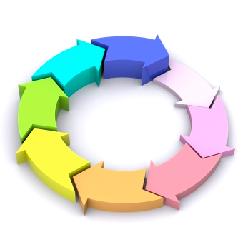
Loops
Loops are chunks of code
that repeat a task over and over again.
Counting loops repeat a
certain number of times.
Conditional loops keep
going until a certain thing happens
(or as long as some condition is True).

Slide 58
Loops
Counting loops repeat a certain number of times -
they keep going until they get to the end of a count.
>>> for mynum in [1, 2, 3, 4, 5]:
print("Hello", mynum)
Hello 1
Hello 2
Hello 3
Hello 4
Hello 5
The for keyword is used to create this kind of loop,
so it is usually just called a for loop.
Notes:
(Break down the “for” statement - for each element in the list)

Slide 59
Loops
Conditional loops repeat until something happens (or as long as some condition is True).
>>> count = 0
>>> while (count < 4):
print("The count is:", count)
count = count + 1
The count is: 0
The count is: 1
The count is: 2
The count is: 3
The while keyword is used to create this kind of loop,
so it is usually just called a while loop.
Notes:
(Point out how the counter is increasing each time we go through the loop. Talk about infinite loops.)

Slide 60
Functions

Slide 61
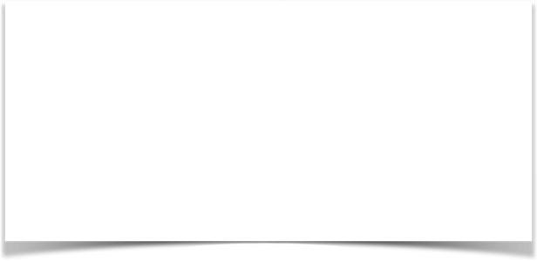

Remember our PB&J example?
Functions
Which looks easier?:
1. Get bread
2. Get knife
4. Open peanut butter
3. Put peanut butter on knife
4. Spread peanut butter on bread
5. ...
1. Make PB&J
Functions are a way to group instructions.

Slide 62
Functions
What it's like in our minds:
“Make a peanut butter and jelly sandwich.”
In Python, you could say it like this:
    make_pbj(bread, pb, jam, knife)
^ ^ ^ ^ ^
function name function parameters
Notes:
We all know how to make a PB&J.
But we don’t have to think about all the steps it takes every time, because the steps are already grouped together in our minds as “make a peanut butter and jelly sandwich”.

Slide 63
Functions
What if we wanted to make many kinds of sandwiches?
“Make a peanut butter and jelly sandwich.”
“Make a cheese and mustard sandwich.”
In Python, it could be expressed as:
make_sandwich(bread, filling, toppings)
^ ^-----^-------^
function name function parameters

Slide 64
Functions
Let's define a function in the interpreter:
>>> def say_hello():
print("Hello")
Now we'll call the function:
>>> say_hello()
Hello
Notes:
Let’s put together some of the things we’ve already learned and write some functions.
This function doesn’t have any parameters, but it still does something - that ‘something’ that it does is called the body of the function.
(Reinforce the idea of indentation, make sure the students are checking that each time they enter a line.)
(Emphasize the difference between defining and calling the function.)

Slide 65
Functions
Let's define a function with parameters:
>>> def say_hello(myname):
print("Hello", myname)
>>> say_hello("Katie")
Hello Katie
>>> say_hello("Barbara")
Hello Barbara
Notes:
(Reinforce the notion of indentation, make sure the students are checking that each time they enter a line.)
See how we can make our function do different things just by passing in different arguments?
(Reinforce the difference between defining and calling a function)

Slide 66
Functions
A few things to know about functions ...
>>> def say_hello(myname):
print("Hello", myname)
def
myname
print(…)
This is a keyword
This is a parameter (and a variable).
This is the body
We use this to let Python know that we’re defining a function.
We use this to represent values in the function.
This is where we say what the function does.
Notes:
(Emphasize that the ‘myname’, and that it can be named anything as long as it matches what’s in the body of the function)

Slide 67
Functions: Practice
1. Work alone or with a neighbor to create a function that doubles a number and prints it out.
(Here’s our last example)
>>> def say_hello(myname):
print("Hello", myname)
Notes:
(Give the students some time to work it out for themselves, then move to Idle and demonstrate the solution for them.)

Slide 68
Functions: Practice
1. Work alone or with a neighbor to create a function that doubles a number and prints it out.
>>> def double(number):
print(number * 2)
>>> double(14)
28
>>> double("hello")
hellohello

Slide 69
Functions: Practice
2. Work alone or with a neighbor to create a function that takes two numbers, multiplies them together, and prints out the result.
(Here’s our last example)
>>> def double(number):
print(number * 2)
>>> double(14)
28
Notes:
(Give the students some time to work it out for themselves, then move to Idle and demonstrate the solution for them.)

Slide 70
Functions: Practice
2. Work alone or with a neighbor to create a function that takes two numbers, multiplies them together, and prints out the result.
>>> def multiply(num1, num2):
print(num1 * num2)
>>> multiply(4, 5)
20
>>> multiply("hello", 5)
hellohellohellohellohello

Slide 71
Functions: Output
print displays something to the screen.
We call the function, passing it the number 12:
We call the function again, passing it the number 12 and assigning it to the variable new_number:
But what happens here?
>>> def double(number):
print(number * 2)
>>> double(12)
24
>>> new_number = double(12)
24
>>> new_number
Notes:
We’ve worked with the ‘print’ function in a few of our examples, so we know what it does - we give it a value and it shows that value in our interpreter. But all it does is display that value - the value isn’t saved.
Let’s look at our example. We’ve defined a function called ‘double’ that takes a number and multiplies it by two. The first time we call that function and assign its value to the variable ‘new_number’, it will return the number 24.
But the next time you enter ‘new_number’, it doesn’t have that value (24) anymore - the value hasn’t been saved.

Slide 72
Functions: Output
This time let’s use return instead of print.
We call the function, passing it the number 12:
We call the function again, passing it the number 12 assigning the value to the variable new_number:
Now what happens?
>>> def double(number):
return number * 2
>>> double(12)
24
>>> new_number = double(12)
>>> new_number
Notes:
This time when you give ‘new_number’ a value from the function, it will return that value (24), and now the value is saved.
When you type ‘new_number’ again, you’ll see the same value (24) until you decide to change it.

Slide 73
Functions
Functions are defined using def.
Functions are called using parentheses.
Functions take parameters and can return outputs.
print displays information, but does not give a value
return gives a value to the caller (that’s you!)
Notes:
We’ve learned a lot about functions in Python - let’s go over some of the rules.

Slide 74
Input

Slide 75
Input
Input is information we pass to a function so that we can do something with it.
In this example, the string “Katie” is the input, represented by the variable myname.
>>> def hello_there(myname):
print("Hello", myname)
>>> hello_there("Katie")
‘Hello there Katie’

Slide 76
Input
The input() function takes input from the user - you give that input to the function by typing it.
>>> def hello_there():
print "Type your name:"
name = input()
print("Hi", name, "how are you?")
Notes:
Here’s another way to pass input to a function - ‘raw_input’ is a built in Python function that let’s us interact with our function in a different way.

Slide 77
Input
>>> def hello_there():
print "Type your name:"
name = input()
print("Hi", name, "how are you?")
>>> hello_there()
Type your name:
Barbara
Hi Barbara how are you?

Slide 78
Input
A shortcut:
>>> def hello_there():
name = input("Type your name: ")
print ("Hi", name, "how are you?")
>>> hello_there()
Type your name: Barbara
Hi Barbara how are you?

Slide 79
Modules

Slide 80
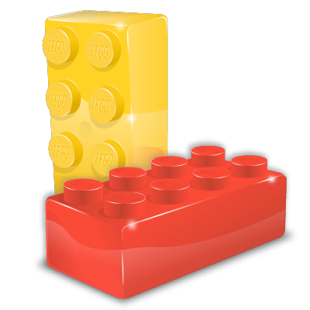
Modules
A module is a block of code that can be combined with other blocks to build a program.
You can use different combinations of modules to do different jobs, just like you can combine the same LEGO blocks in many different ways.
Notes:
We’ve learned about how to define some functions of our own.
But Python has a lot of functions that come built in - let’s learn how to use a few of them.

Slide 81
Modules
Lots of modules are included in the Python Standard Library.
Here’s how you can use a few of these modules:
Generate a random number between 1-100:
>>> import random
>>> random.randint(1,100)
>>> import time
>>> time.tzname
>>> import calendar
>>> calendar.prmonth(2016, 6)
What timezone does your computer think it’s in?:
Print a calendar for this month!:
Notes:
When you ‘import’ a module, you can use all the functions inside that module.
(New term: “dot notation”)
(Emphasize the distinction between the module name and the function name.)

Slide 82
Modules
Print the names of all the files in a directory:
>>> import os
>>> for file in os.listdir("/home/pi"):
print(file)
Open a web page
and read it:
>>> import urllib.request
>>> myurl = "http://www.google.com"
>>> data = urllib.request.urlopen(myurl).read()
>>> print(data)
Notes:
(Talk about how many other modules can be found in the standard library.)

Slide 83
Modules
Turtles!
>>> import turtle
>>> turtle.reset()
>>> turtle.forward(20)
>>> turtle.right(20)
>>> turtle.forward(20)
>>> turtle.bye()
You can find out about other modules at: http://docs.python.org
Notes:
Talk about how many other modules can be found in the standard library.

Slide 84
Let’s make a game!
Notes:
(Go over the guessing game examples.)

Slide 85
Games!
Open a new window (File > New File) and type these lines:
secret_number = 7
guess = input("What number am I thinking of? ")
if secret_number == guess:
print("Yay! You got it.")
else:
print("No, that's not it.")
Choose Run > Run Module. Save to Desktop as ‘guess.py’.
Notes:
In Idle, open a new window. Type the code, then choose Run > Run Module. If Idle asks you to save, just press OK and then give the file a name like 'guess.py' and press enter.
Now you should be back in your interpreter - what do you see there? Let's walk through the code and see if we can tell what it's doing.

Slide 86
Games!
Open a new window (File > New File) and type these lines:
from random import randint
secret_number = randint(1, 10)
while True:
guess = input("What number am I thinking of? ")
if secret_number == guess:
print("Yay! You got it.")
break
else:
print("No, that's not it.")
Choose Run > Run Module. Save to Desktop as ‘guess2.py’.
Notes:
Let’s change our game a little bit. Open a new window, type this code, then choose Run > Run Module. If Idle asks you to save, just press OK and give the file a name like 'guess2.py'.
What do you see in your interpreter this time? (Walk through the code and have the students explain what it’s doing.)

Slide 87
Games!
Open a new window (File > New File) and type these lines:
from random import randint
secret_number = randint(1, 10)
while True:
guess = input("What number am I thinking of? ")
if secret_number == guess:
print("Yay! You got it.")
break
elif secret_number > guess:
print("No, that's too low.")
else:
print("No, that's too high.")
Choose Run > Run Module. Save to Desktop as ‘guess3.py’.
Notes:
Let’s change our game even more. Open another new window, type this code, then choose Run > Run Module. This time, give the file the name 'guess3.py'.
What do you see in your interpreter this time? (Walk through the code and have the students explain what it’s doing.)

Slide 88
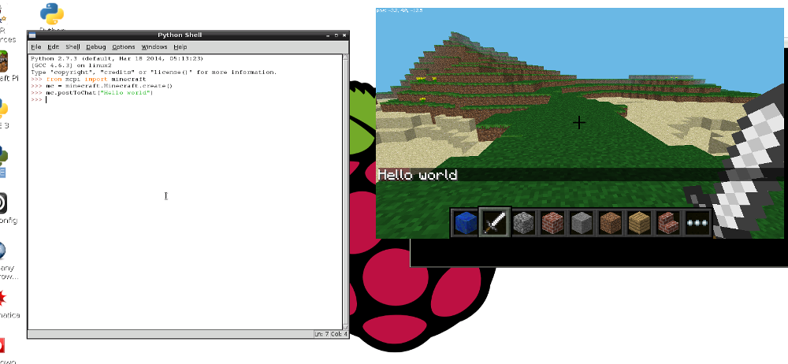
Minecraft!
Notes:
(Put this slide up at the end so that students know they where to get help setting up their Raspberry Pis once they’re home.)

Slide 89
Minecraft!
>>> from mcpi import minecraft
>>> mc = minecraft.Minecraft.create()
>>> mc.postToChat("Hello world")
>>> pos = mc.player.getPos()
>>> print pos.x, pos.y, pos.z
>>> mc.player.setPos(pos.x, pos.y+100, pos.z)
>>> mc.setBlock(pos.x+1, pos.y, pos.z, 1)
(Air: 0, Grass: 2, Dirt: 3)
Notes:
(Put this slide up at the end so that students know they where to get help setting up their Raspberry Pis once they’re home.)

Slide 90
Minecraft!
>>> from mcpi import block
>>> dirt = block.DIRT.id
>>> mc.setBlock(x, y, z, dirt)
>>> stone = block.STONE.id
>>> mc.setBlocks(x+1, y+1, z+1, x+11, y+11, z+11, stone)
>>> tnt = 46
>>> mc.setBlocks(x+1, y+1, z+1, x+11, y+11, z+11, tnt)
>>> mc.setBlocks(x+1, y+1, z+1, x+11, y+11, z+11, tnt, 1)
Notes:
(Put this slide up at the end so that students know they where to get help setting up their Raspberry Pis once they’re home.)

Slide 91
Congratulations!
You’re now a Pythonista!
Notes:
(Optional - if you have extra time to use up, send the kids here to take a quiz and test their new programming knowledge: http://tinyurl.com/yc-quiz )

Slide 92
What can YOU do with Python?
Make more games
Edit music and videos
Build web sites
Write a program that does your homework for you ...
What are some other ideas?
Notes:
Now that you’ve learned the basics of Python, and even written a few programs of your own, what new programs would you like to write?
(Use this slide to open up some discussion at the end of the class, especially if you have extra time to fill.)

Slide 93
Raspberry Pi
Help setting up your new computer:
http://www.raspberrypi.org/quick-start-guide
Minecraft on your new Raspberry Pi:
https://www.raspberrypi.org/learning/getting-started-with-minecraft-pi/worksheet/
http://www.stuffaboutcode.com/p/minecraft-api-reference.html
Notes:
(Put this slide up at the end so that students know they where to get help setting up their Raspberry Pis once they’re home.)

