Slide 1



Slide 2

TEA-REX

Slide 3
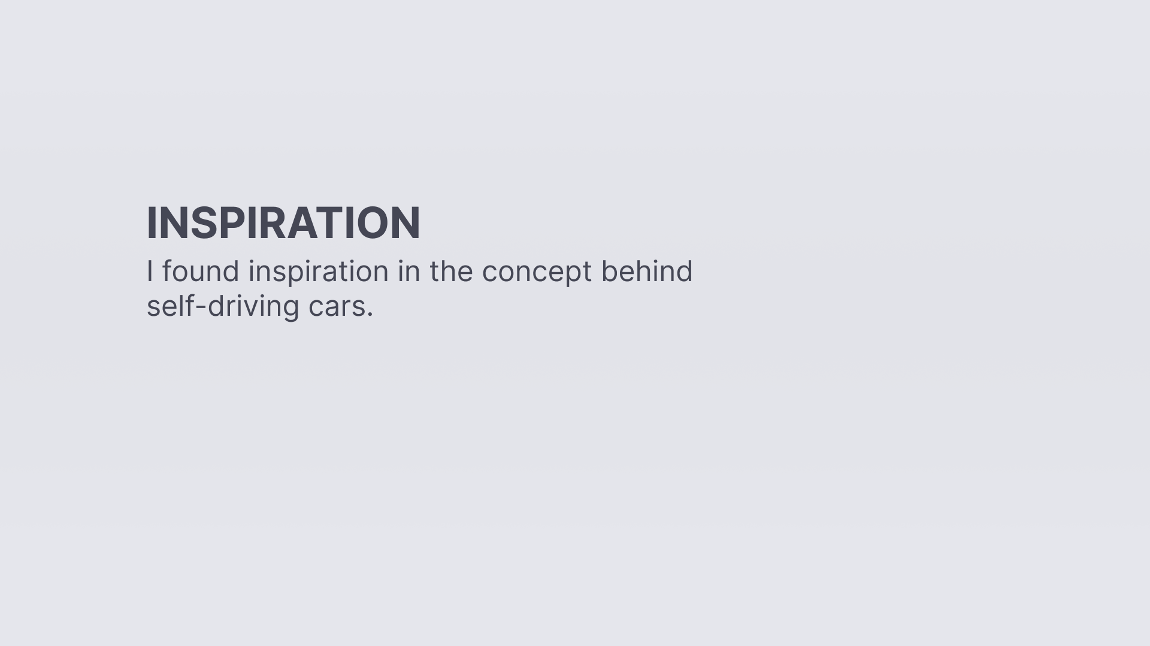

Slide 4
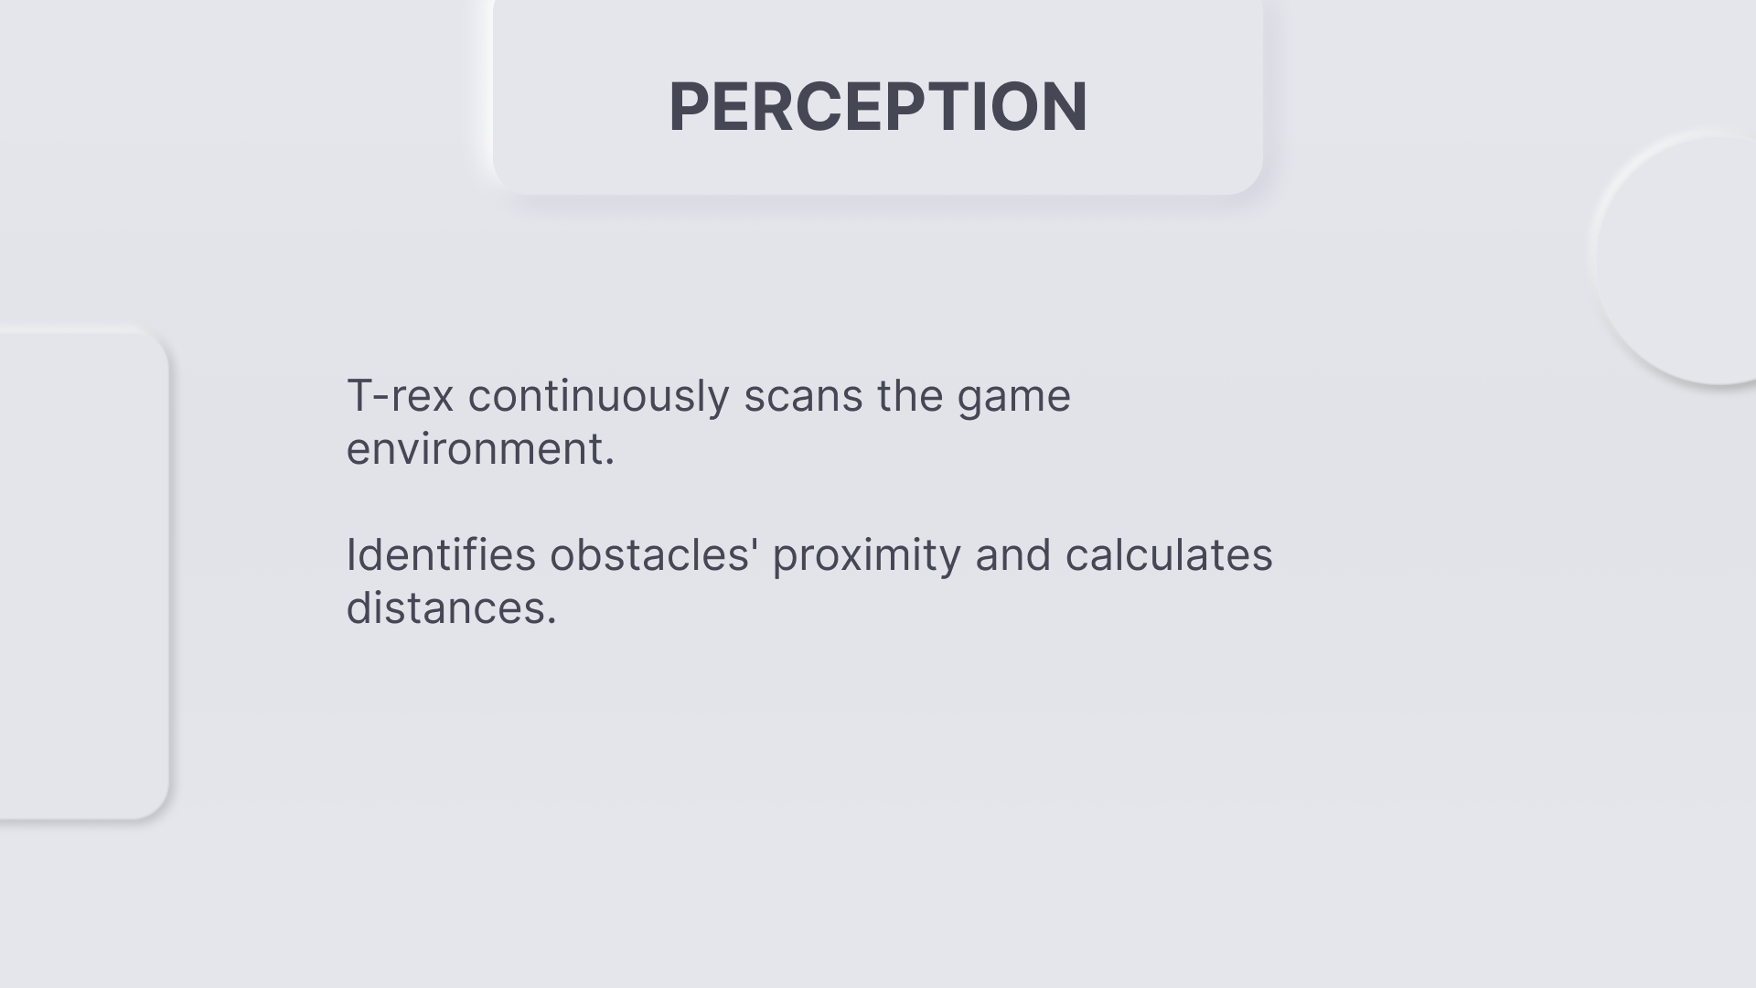

Slide 5
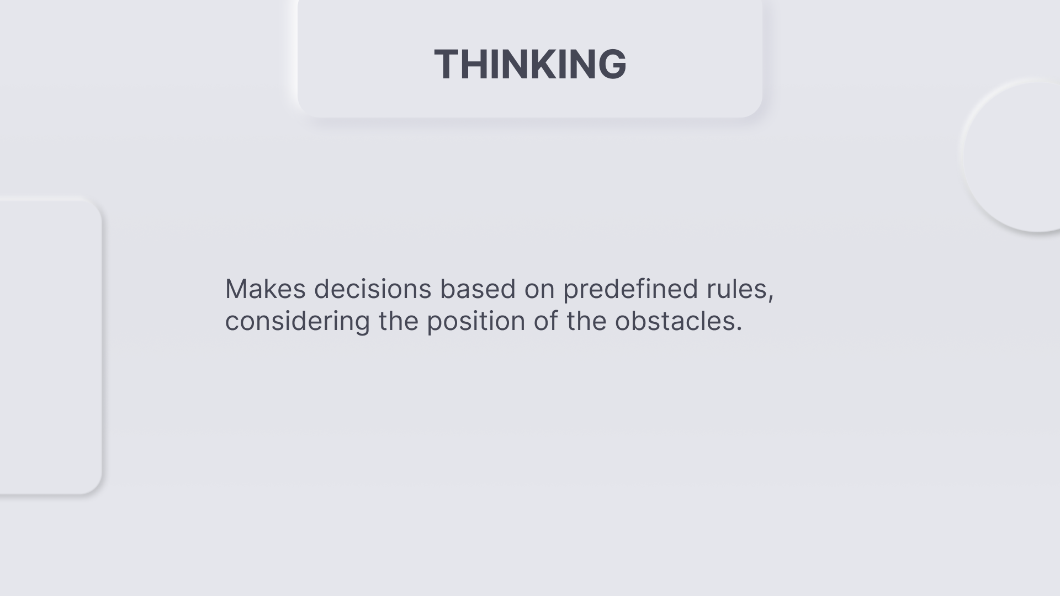

Slide 6
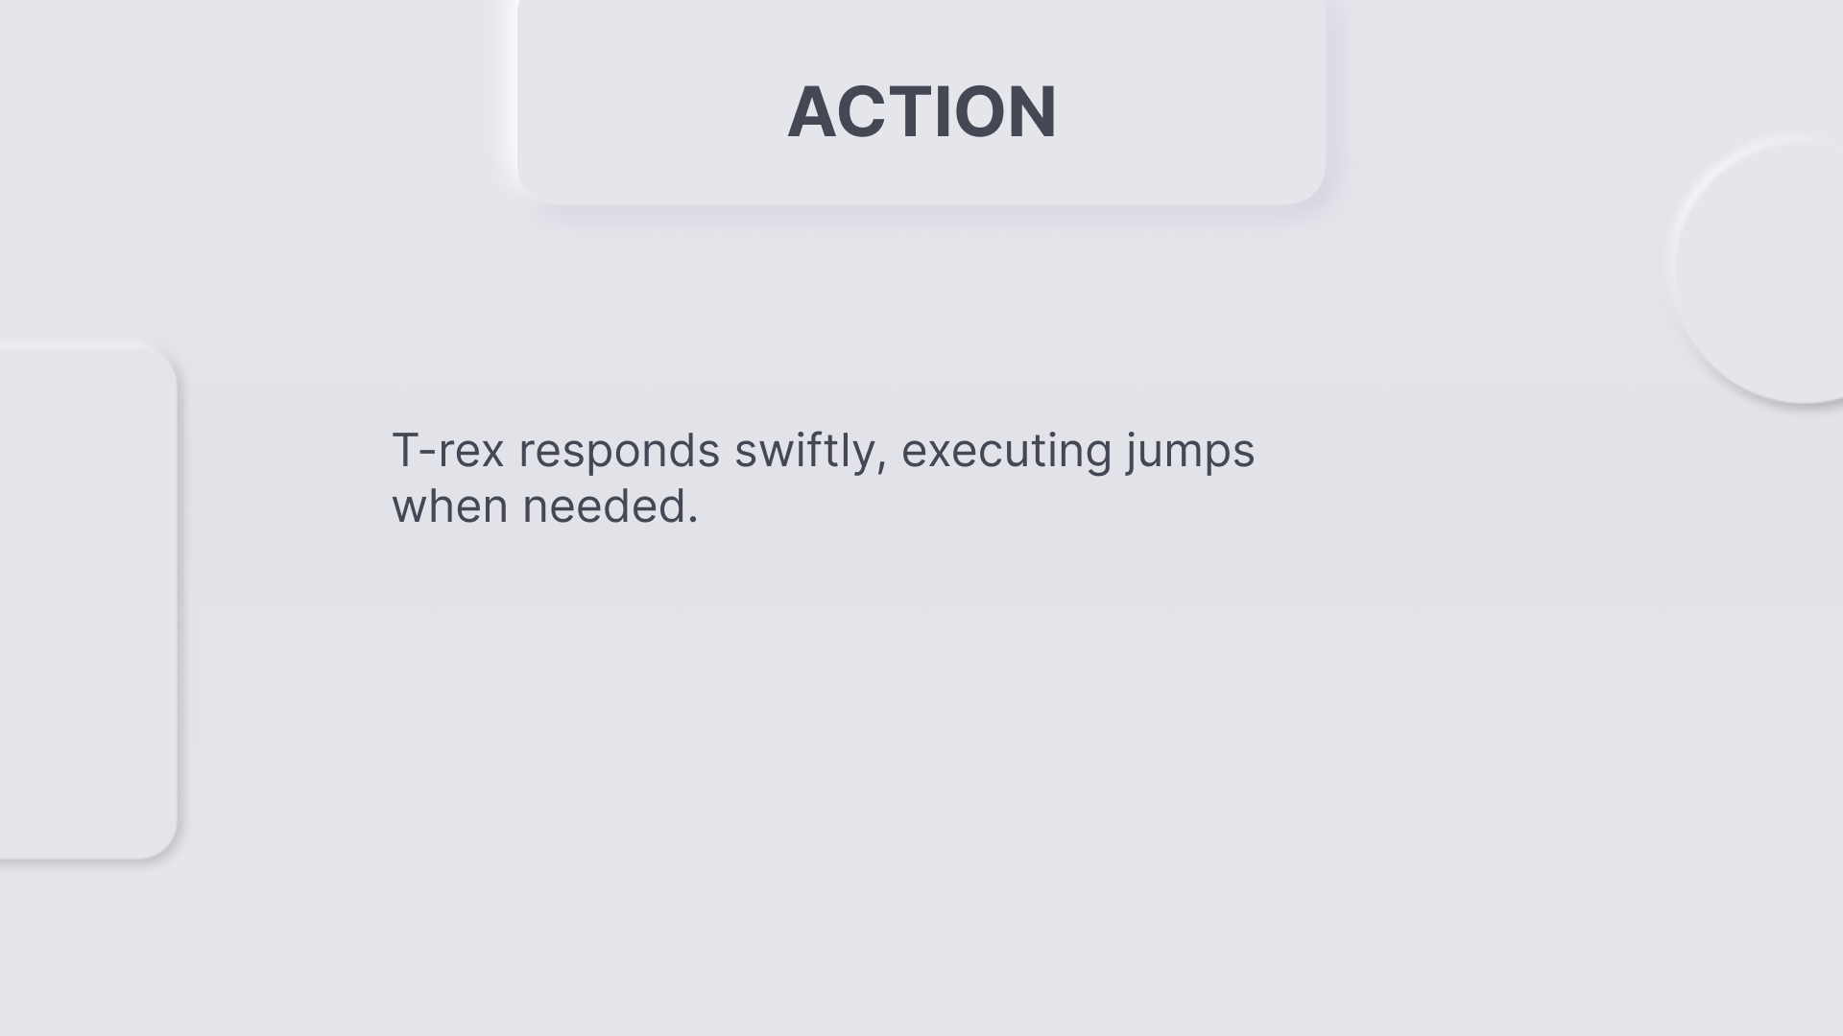

Slide 7


Slide 8
How is your Intelligent System (IS) modeled?
Notes:
Learning Reinforcement Model
The self-running T-rex game you provided is not based on a traditional machine learning or AI model. Instead, it relies on predefined rules and algorithms to control the T-rex character's behavior.
The simple intelligent system is basically a T-rex as a character that jumps independently over obstacles to avoid collision with the cacti
Mention that you used a combination of object-oriented programming (C#) and game development principles to create the system.
Describe the key components of your system, such as the T-rex character, obstacles, and the game loop.

Slide 9
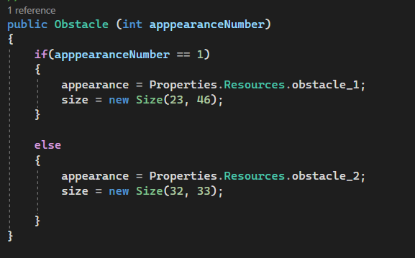
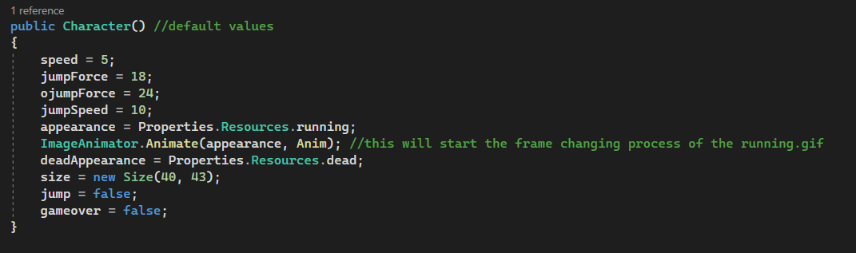
Notes:
The simple intelligent system is basically a T-rex as a character that jumps independently over obstacles to avoid collision with the cacti
CODE: public Character()
{
}
This code defines the initial state and attributes of the game character, providing a foundation for character behavior and interactions within the game.
class Character: This line defines a class named Character, which represents the main character in the game.
Private Fields (Attributes): These are the characteristics or attributes of the character. They include:
speed: The character's movement speed.
jumpForce: The force applied during a regular jump.
ojumpForce: The initial force applied during a high jump.
jumpSpeed: The speed at which the character jumps.
locationY and locationX: The current vertical and horizontal positions of the character.
score: The character's score in the game.
size: The size of the character's image.
appearance: The image representing the character when it's running.
deadAppearance: The image representing the character when it's "dead."
jump: A flag indicating whether the character is in a jumping state.
gameover: A flag indicating whether the character's game is over.
Constructors:
public Character(): This is the default constructor for the Character class. It initializes the character's attributes with default values. These values determine the character's starting state in the game.
speed = 5: The character's initial movement speed.
jumpForce = 18: The initial force applied during a regular jump.
ojumpForce = 24: The initial force applied during a high jump.
jumpSpeed = 10: The speed at which the character jumps.
appearance = Properties.Resources.running: The initial appearance of the character is set to a running animation.
ImageAnimator.Animate(appearance, Anim): This line starts the animation process for the character's running image.
deadAppearance = Properties.Resources.dead: The image representing the character when it's "dead."
size = new Size(40, 43): The size of the character's image.
jump = false: The character starts not in a jumping state.
gameover = false: The character's game is not over at the beginning.

Slide 10
How was the inference/learning conducted?
Notes:
The inference in this system is the T-rex making decisions based on the proximity of obstacles.
The system detects and calculates the nearest obstacle.
If an obstacle is within a certain distance, the T-rex performs a jump.

Slide 11
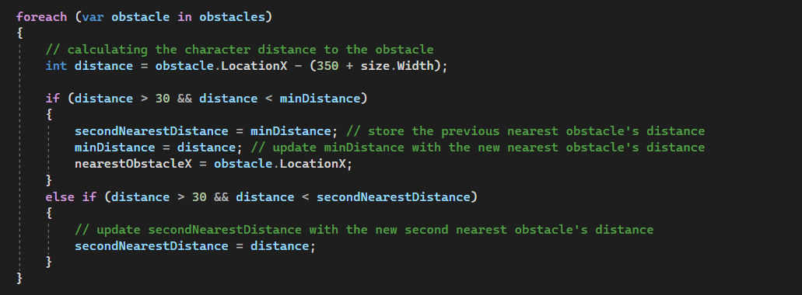
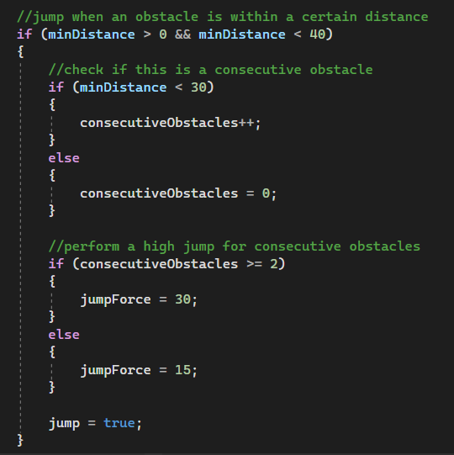
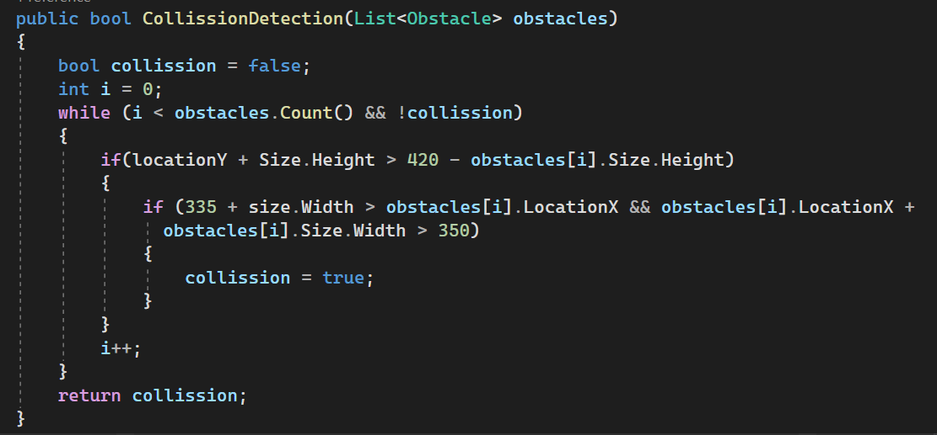
Notes:
The inference in your system involves the T-rex making decisions based on the proximity of obstacles.
The system detects and calculates the nearest obstacle.
If an obstacle is within a certain distance, the T-rex performs a jump.

Slide 12
How do you perform the generation and testing?
Notes:
In generating new obstacles in the game:
I randomly generated obstacles with varying positions in x-axis
I ensure that obstacles do not overlap or appear too close to each other.
Based on the newly generated obstacles, the t-rex
-------------------------
In the "test" phase, which involves testing the T-rex's performance:
Explain how the T-rex interacts with obstacles by continuously checking for collisions.
Describe how the T-rex's jump behavior is evaluated based on the proximity of obstacles.
For consecutive close obstacles, a high jump is performed, while for single obstacles, a regular jump is executed.
Mention the threshold distances and jump forces you've set to determine the jump type.
Mention that the game tracks the T-rex's score as an indicator of its performance.

Slide 13
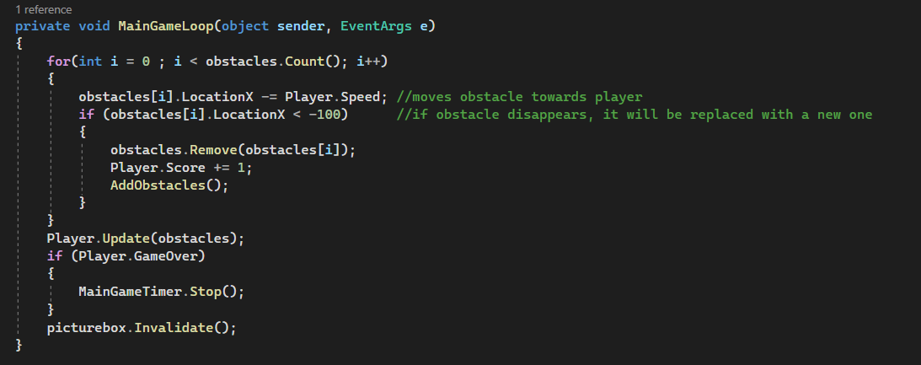
Notes:
The inference in your system involves the T-rex making decisions based on the proximity of obstacles.
The system detects and calculates the nearest obstacle.
If an obstacle is within a certain distance, the T-rex performs a jump.

Slide 14
