Slide 1
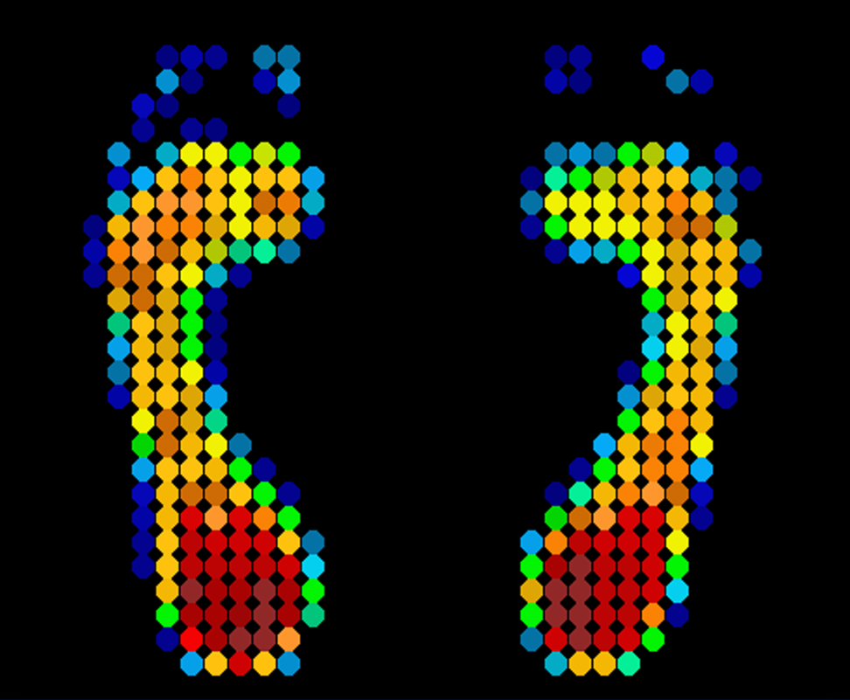
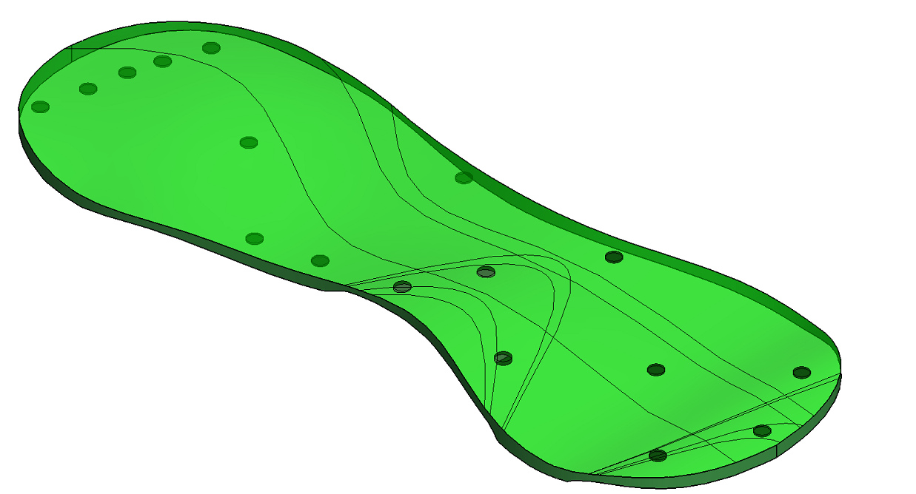
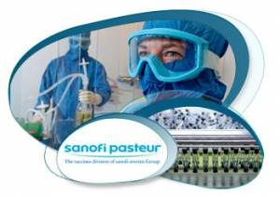

What are orthotics?
-specialized insoles to fix gait abnormalities
-if left untreated, results in…
Current orthotics
-too expensive
-not dynamic
What to solve
-cheaper by being dynamic
-no recurring cost
Solution
-cheaper by being dynamic

Slide 2
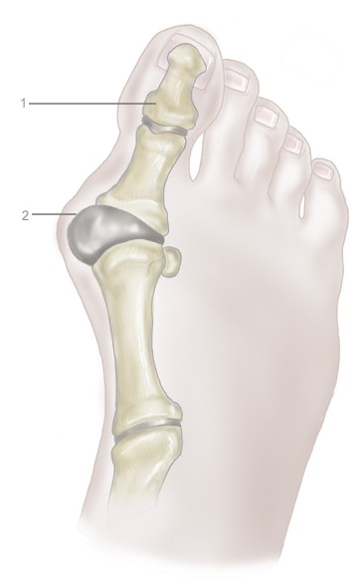
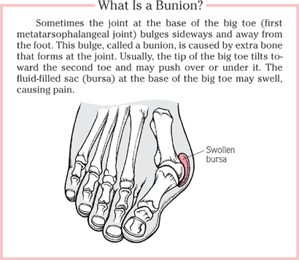
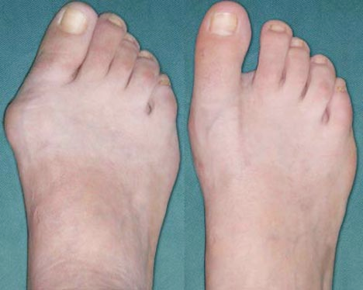
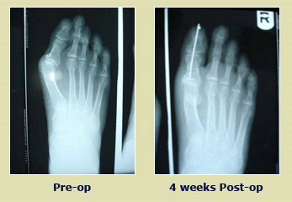
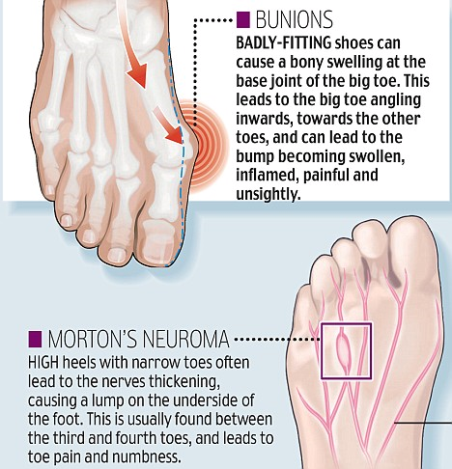
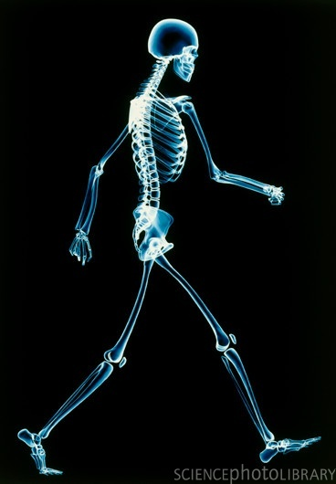
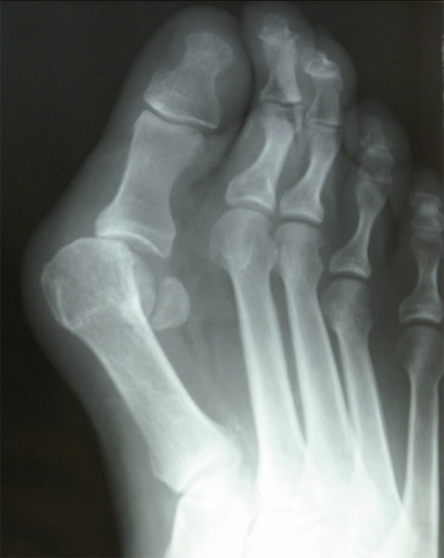
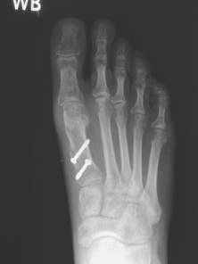
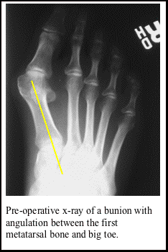
The overall area or background of the problem.
Custom orthotics, uncorrected gait results in…, cost & static nature, trips to pedorthist & delay in adjustments
The particular design problem solved within the general area.
make it dynamic, reduce cost,
The alternatives considered for the design.
4 alternatives
The prototype design's inputs, outputs and/or principle of operation.
2 parts: platform/shoe, adjusts foot orientation, I/O flowchart
The theory underlying the design and its implementation.
Biomechanics, screwjack, PC interfacing, UI design, foot scan analysis algorithms
The main advantages of the design over major alternatives.
The sponsors, consultants, and references for the design.
Bill Owen, Kim Rao, Naveen, Kulic, Bedi, Eric Kubica, Behrad Khamesee etc.
Foot
Shoe
Walking
Foot scan
http://www.pacificcoastfoot.com/sub.php?page=care_bunion1517
http://www.feelinghershoes.com/wp-content/uploads/2009/07/Bunions1.jpg
design ideas copied and WHAT IS NEW
-what is our product and WHO is it focused at?
-need, why do we need it?
References
http://www.immediart.com/catalog/product_info.php?cPath=61_63&products_id=286
http://www.drchiodo.com/Pages/disorders/bunions.php
http://www.icbmedical.com/assets/uploads/images/cond-bunion-l.jpg

