Slide 1
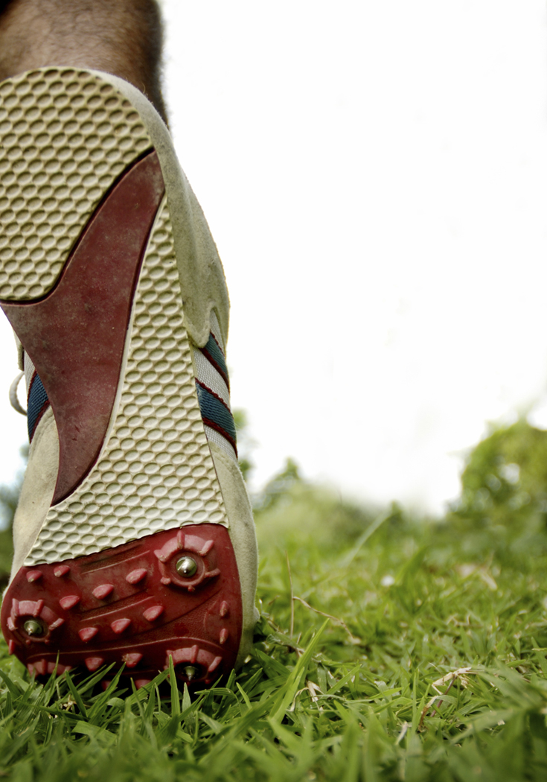

Smart Orthotics
Group 16
Ali Saeed
Usman Ali
Gordon Lam
Tony Marissen
Jeff Gorchynski

Slide 2
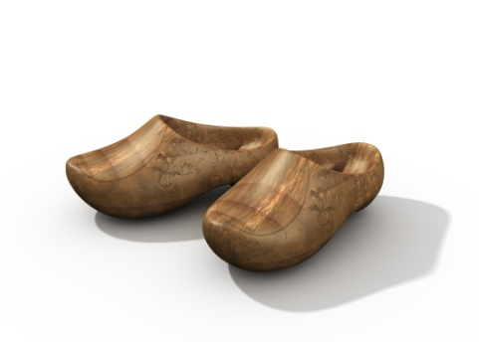

Review of Problem
Current Pedorthotic Solutions are expensive and do not actively adjust to changes in improper gait.
Useless upon Weight or Gait change
$500/2yrs
Design a long-lasting system to economically correct improper gait by actively manipulating the pressure distribution and orientation of the foot that is comfortable and easy to use.

Slide 3
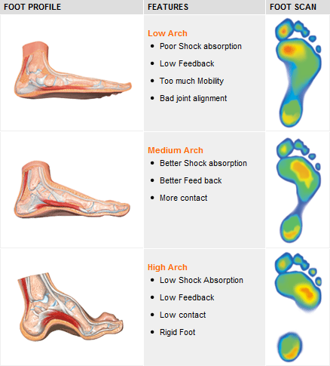
Design Areas We managed to identify some VERY important areas in our design
Precision measurements of areas that vary
Heel is key to foot orientation, needs high actuation
Arches (both longitudinal and lateral) for gait and posture

Slide 4
Modified Objectives
Long lasting
at least 2 year lifespan
Same price/cheaper than typical orthotics
$500 or less
Dynamic adjustment of pressure distribution and orientation
responds within a minute
Comfortable
Does not strain the foot any more than a regular shoe
User-friendly
Intuitive and easy to use (learning operation takes <5 min)

Slide 5
Modified Constraints
Must last at least 2 years
Must cost the same as typical orthotics ($500) or less
Must respond to changes in gait within a minute
Must not strain the foot any more than a regular shoe
Learning its operation must not take more than 5 minutes

Slide 6
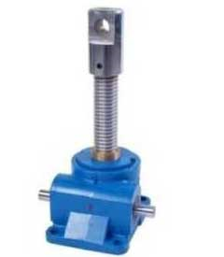
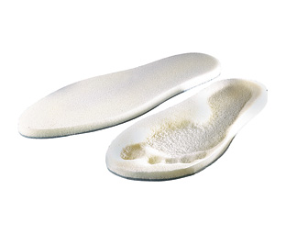
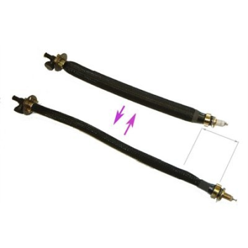
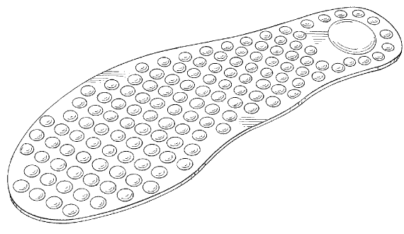
Concept Designs
Memory Foam Insole
Miniature
Motorized
ScrewJacks
Heat coils deform the memory foam – sinking the foot at desired locations to correct foot orientation
Tiny screwjacks line the underneath of the sole. Pressure points are manipulated by adjusting screw heights
Air Muscles
Air muscles are connected to both ends of an elastic insole. When air is pumped, they contract & bend the insole in desired shape
Air Bubble-wrap Insole
Air bubbles are spread over the entire area of the insole. Foot posture is modified by deflating/inflating key bubbles

Slide 7
Decision Matrix
 | Cost | Weight | Durability | Response Time | Safety/Ergonomics | Aesthetics | Total
 | [Cdn $] | [Kg] | [Yrs of use] | [Sec] | [Hrs of use] | [Size]
Weight | 0.3 | 0.1 | 0.3 | 0.1 | 0.1 | 0.1 | 1
Memory Foam | 1 | 1 | 4 | 2 | 1 | 2 | 1.9
Screw-Jack Nail-bed | 3 | 2 | 1 | 2 | 1 | 2 | 1.7
Hydroven FPR | 5 | 5 | 3 | 5 | 1 | 5 | 3.5
Shape-memory Alloy | 2 | 4 | 2 | 4 | 1 | 2 | 1.9
Electro-Active Polymers | 7 | 1 | 2 | 3 | 1 | 2 | 3.1

Slide 8

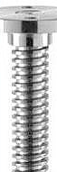
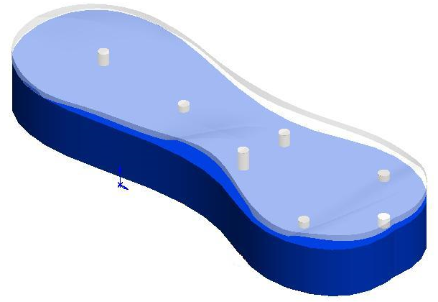
Preferred Design
Modified Screw-Jack Design
A flexible insole is bent at desired angles when threaded rods push at it. Motors located in the adjustment platform connect to these rods through holes in the bottom of the shoe.
insole
Threaded rods

Slide 9
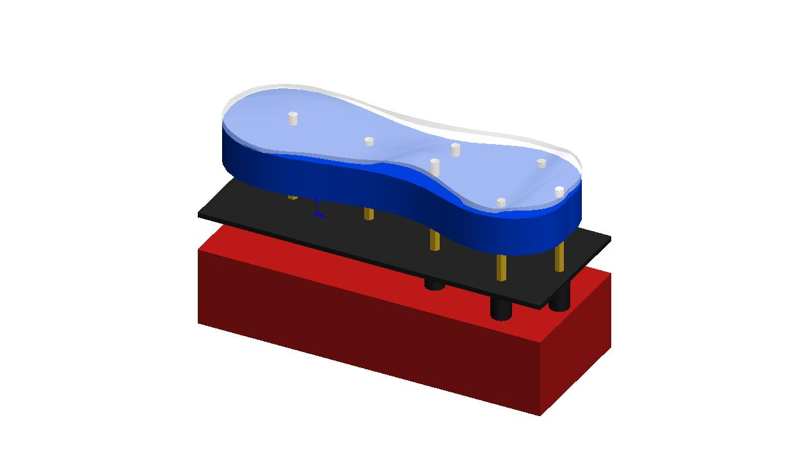
Design Breakdown
Material
Sensing
Actuation
Controller
insole
shoe
motors

Slide 10
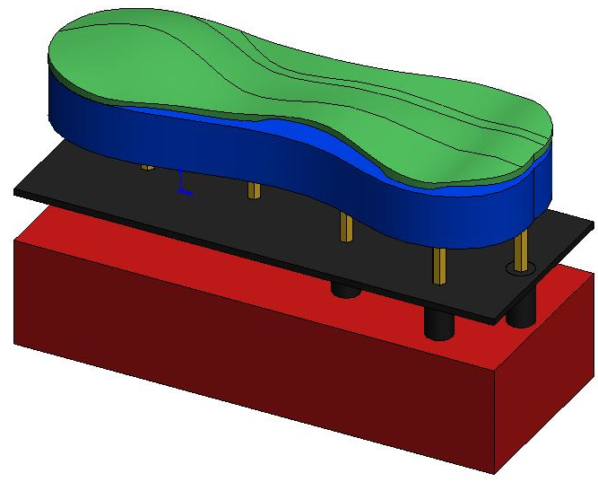
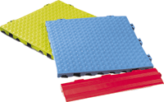
Insole
Elastic rubber sheet that morphs when pressure is applied from the threaded rods beneath
Material: ½” rubber sheet
Insole attached to the shoe at perimeter

Slide 11
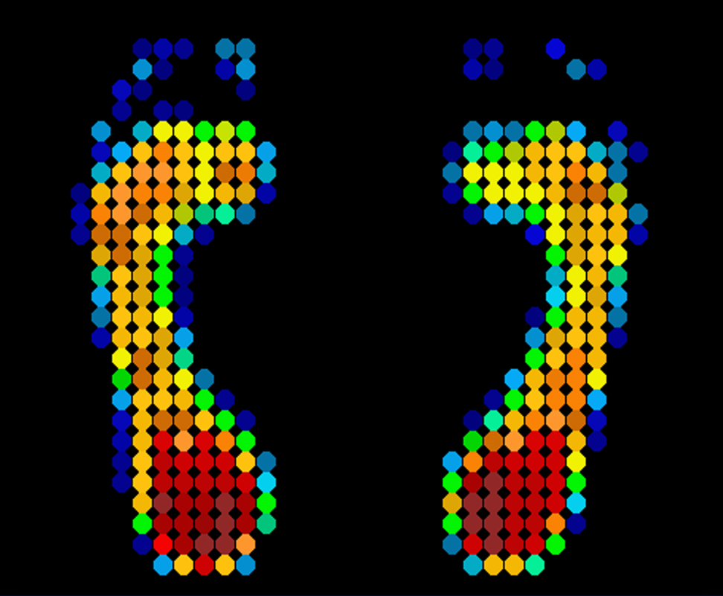
Sensing
Requirements
Understand the orientation of the foot, how to correct for proper gait
Solutions
Force sensors
Strain gauge

Slide 12
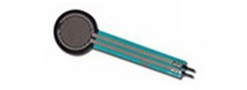
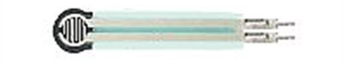
Force Sensing
Multiple small sensors
At least 8
4 around the heel
4 around lateral arch
Measure areas of high variability
Larger sensors at the heel
Analog output
Interlink Electronics 0.2” Circular FSR
Size Range = 0.2” x 0.2” – 20” x 24”
Device thickness: 0.20 to 1.25 mm
Force Sensitivity Range: 100 g to 10 kg
Pressure Sensitivity Range: 1.5psi to 150psi

Slide 13
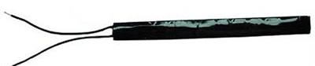
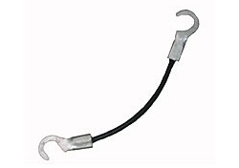
Flex Sensing
Provides general, qualitative measurements' about shape of foot
Measure arch curvature
Provides direct feedback for arch-actuation
Analog output

Slide 14
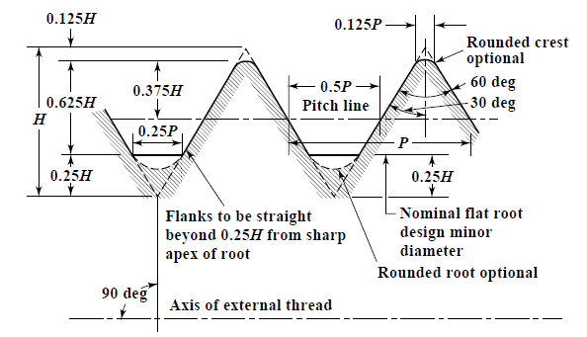
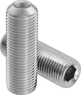

Threaded Rods
Location | Rods
Heel | 3
Arch | 2
Metatarsals | 1
Proximal Phalanges | 1
Part Number: 93225A914
Inch Thread Size | 5/16"-18
Overall Length | 1-1/4"
Minimum Tensile Strength | 42,000 psi
Location of threaded rods beneath the sole

Slide 15
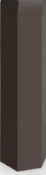
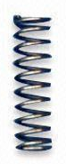
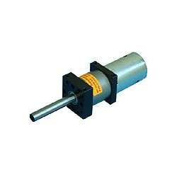
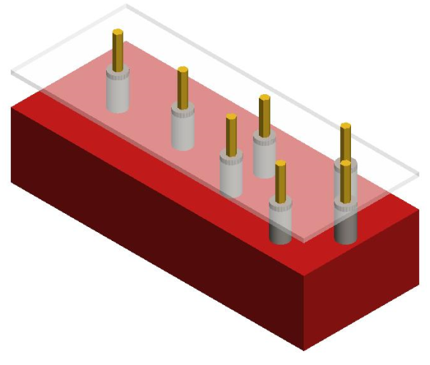
Motors
Allen key
All motors are installed in the adjustment platform with their shafts revealed. Allen keys are attached to the end of the shafts with a spring that constantly pushes on the threaded rods.
Spring
Voltage: 12vdc RPM: 263 Torque: 2527oz.in (181.96 Kg-cm) Reduction: 64:1 Shaft length: 55mm 36mm Gearbox
Motor
Banebots 12V 263RPM 2527oz-in Planetary Gearmotor w/RS-540 Motor
Threaded Rods

Slide 16
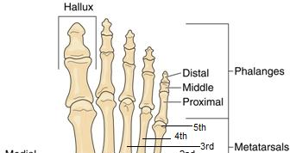
Proximal Phalange Sliding Arc
To distribute the force beneath the front arch, a sliding arc mechanism is used. When thread rises, the arc opens up, otherwise it closes to change the effective height.
The two pieces of the arch are free to move to conform to the foot while the screw controls the height.

Slide 17
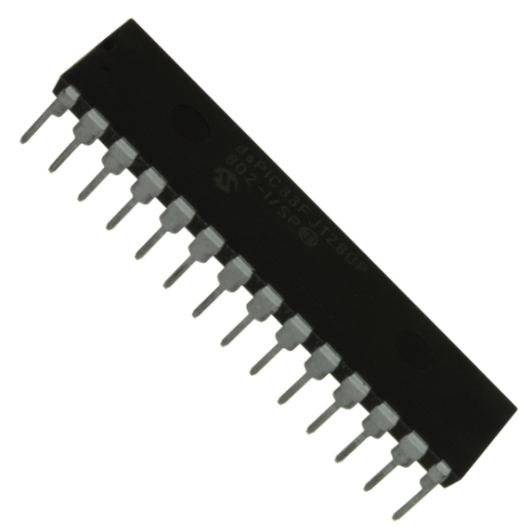
Controller
dsPIC33FJ128GP802 µC
40MIPS, 128kB program mem, 16kB RAM
19 available I/O, 16 re-mapable pins
2x UART, 2x SPI, 1x I2C
10x ADC’s @ (1.1msps 10-bit) or (500ksps 12-bit)
4x DAC’s @ 100ksps, 16-bit
External ADC will link to µC via SPI bus
External motor controller for DC-motor control via DAC or (if more than 4) UART

Slide 18
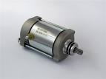
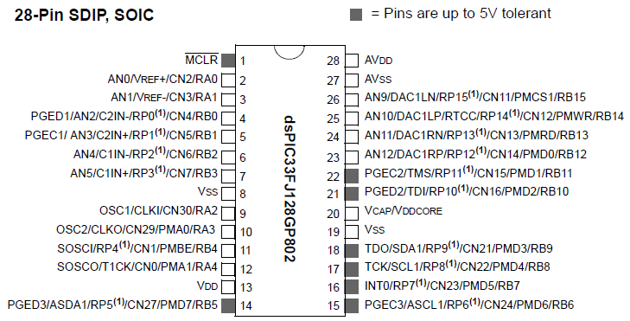




Controller Layout
Motor Controller
Accelerometer
ADC
Force & Stretch
Sensors

Slide 19
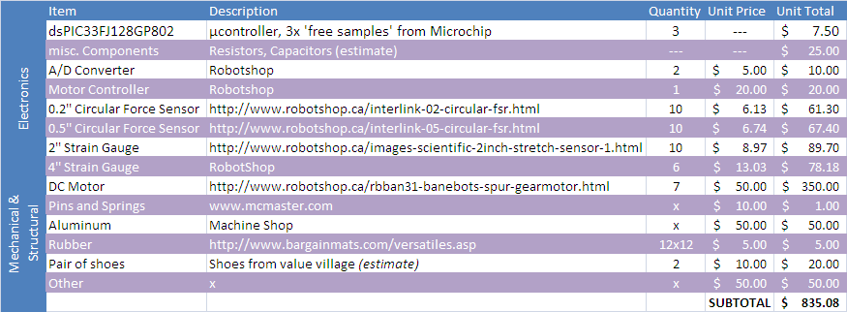
Bill of Materials

Slide 20
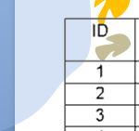
Timeline

Slide 21

Manufacturing/Commissioning
Most manufacturing for the platform will be done in the Student Machine shop
Sensors and Controller implementation will be done in Church Lab
We have allowed for a 2 week test period before we can finalize/commission the design

Slide 22
Mass Production
Prototype Cost | Mass Production Cost
$1000 | $500
Manufacturing will be outsourced to save costs
Injection moulding will be used for metal replacements in the shoe to reduce cost
Bulk purchasing for Electronic components will reduce cost

Slide 23
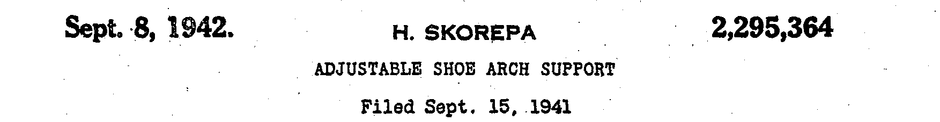
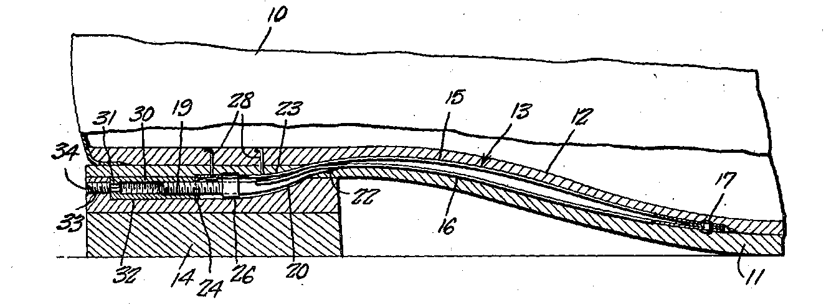
ADJUSTABLE SHOE ARCH SUPPORT
Inventors: H.Skorepa Assignees: Preventive Medical Technologies, Inc.
Date of Issue: Sep 8, 1942
Description: Screw is longitudinally aligned to foot - translates horizontal screw movement to vertical arch movement.
Similarities-differences: Our screw is vertically placed - screw moves vertically to produce vertical arch movement - The net effect is the same - adjustable arch radius of curvature

Slide 24
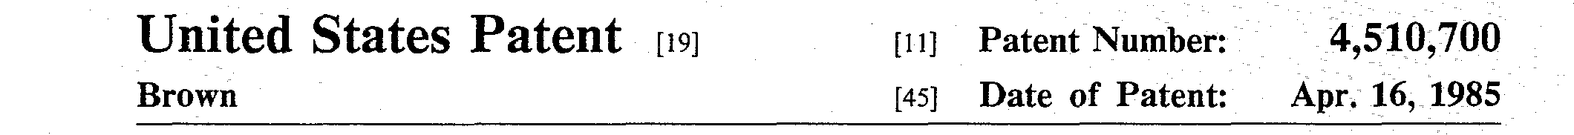
VARIABLY ADJUSTABLE SHOE INSERTS
Inventors: Dennis N. Brown Assignees: Preventive Medical Technologies, Inc.
Date of Issue: Apr 16, 1985
Description: The insert (one piece) adapts to the foot to maintain foot orientation. Length is adjustable, but no minor adjustments possible.
Similarities-differences:
Our system has many small adjustment points using screws.

Slide 25
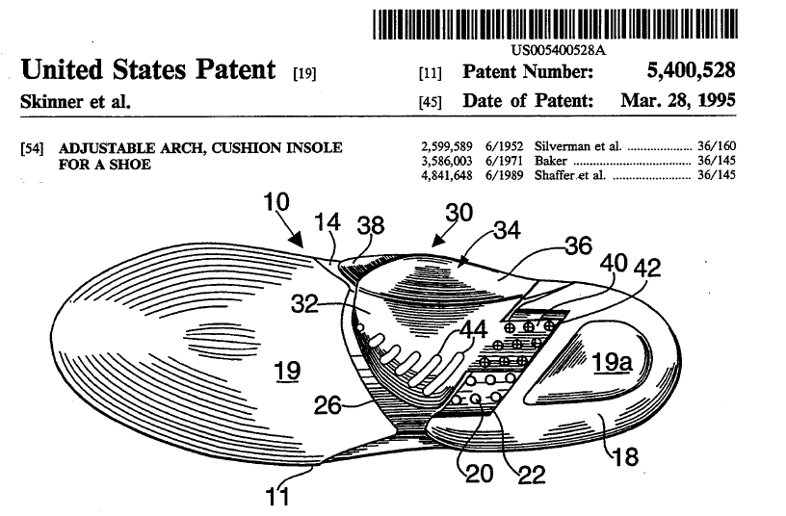
ADJUSTABLE ARCH, CUSHION INSOLE FOR A SHOE
Inventors: Skinner et. all. Assignees: Preventive Medical Technologies, Inc.
Date of Issue: March 28, 1995
Description:
A static system, with only one adjustment point - the location of the arch. Arch shapes must be varied by using different arch pieces.
Similarities-differences:
Our system has adjustable arch shape and multiple adjustment points.

Slide 26
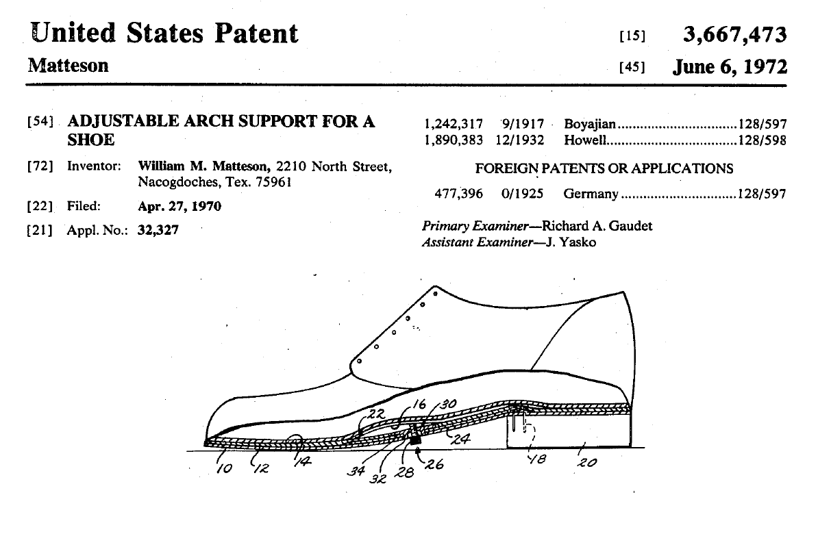
ADJUSTABLE ARCH SUPPORT FOR A SHOE
Inventors: William M. Matteson Assignees: Preventive Medical Technologies, Inc.
Date of Issue: Jun 6, 1972
Description: Uses screw to push up on arch via pressure distribution plate. Requires manual screw adjustment.
Similarities-differences: Our arch uses a two-leaf bridge in which the two leaves slide inside each other laterally to create variable height. The actuation in our design is a motorized screw with feedback control.

Slide 27
Patentable Items
Motorized actuation at multiple points
Two leaf bridge for adjustable arch support
Strain gauge sensors at key points to determine resulting pressure distribution – allows for adjustment and feedback control

Slide 28
Summary and Questions
Problem Review
Design a long-lasting economically correct improper gait by actively manipulating the pressure distribution and orientation of the foot that is comfortable and easy to use.
Conceptual Designs
Miniature Motorized Screw Jacks
Air Muscles
Memory Foam Insole
Air Bubble-wrap Insole
Design Details
Rubber Insole
Force, Strain Sensors and Controller
Two Leaf Arch Support
Miniaturized Screw Jack
Design Details
Rubber Insole
Force, Strain Sensors and Controller
Two Leaf Arch Support
Miniaturized Screw Jack
Manufacturing and Commissioning
Prototype made in University
Mass Manufacturing with cheaper materials to reduce cost
Patents
Adjustable Shoe Arch
Variable Adjustable
Cushion Insole
Support for a Shoe
Patentable Aspects

