Slide 1

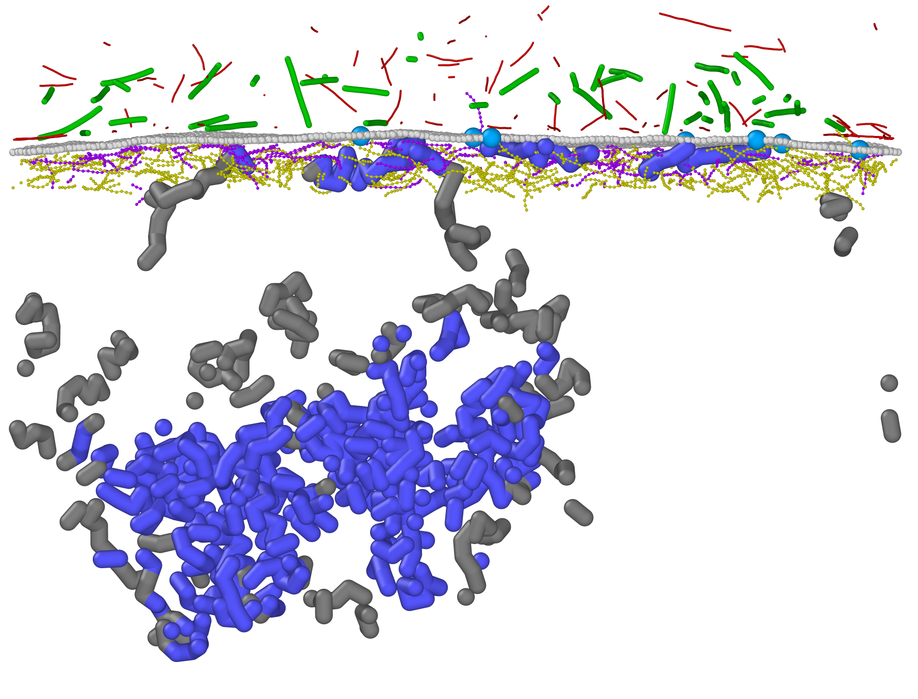
Coarse Grained Nuclear
Periphery Simulator
Filamentous Actin | Microtubule | Nuclear Membrane | Nuclear Pore Complex
| A-type Nuclear Lamina | B-type Nuclear Lamina | Euchromatin | Heterochromatin

