Slide 1



Conservatory Catch
Conservatory Catch
Group 9: Jose Cuellar-Aguirre, Marcos Echevarria, Christian Garcia, Nick Tryba

Slide 2

Project Overview
Realtime collect-a-thon game for the benefit of Garfield Park Conservatory
Travel around the park and find different plant species on the map.
Learn about different plant species while playing the game
Great for students, teachers, visitors, and gamers
Play with friends while at the conservatory

Slide 3

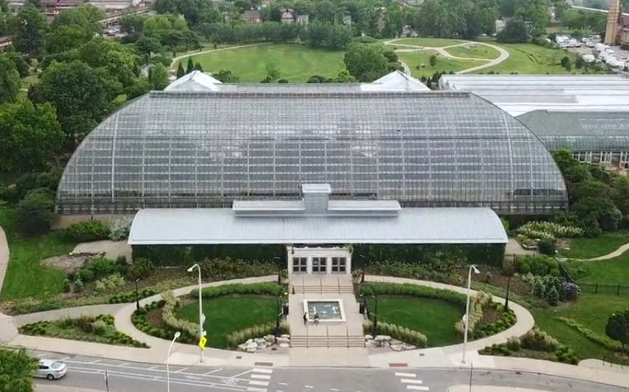

Measurement and Goals
Project Goals:
Increase number of park visitors and park donations.
Offer an exciting alternative means of learning about plant species.
Measured by:
Number of visitors / month
Number of donations / month
Total $ amount of donations / month

Slide 4
Requirements
Functional: Core elements of CC that need to work/be in place (rewards system, GPS tracking) before working on anything else
Data: Covers any data that needs to be collected and preserved for CC to work
Performance: Minimum requirements that our product satisfies for a smooth experience for users
Dependability: Safeguarding against any issues that may arise while using CC, be it affecting in-game events or the user
Maintainability and Supportability: Focused on giving CC the ability to be maintained, supported, and ultimately expanded upon after its release

Slide 5
Requirements
Security: Heavily linked to data section, protecting it and backing it up in case anything happens while also letting users know what data is stored
Usability and Humanity: Lots of options provided to the user to configure their experience to be more suited towards their needs
Operational and Environmental: Makes sure the application is able to be used for its specific function, and ties to maintainability to maintain future operations
Cultural, Political, and Legal: Checks to make sure the product adheres to a variety of rules and standards to both provide users an enjoyable experience and protect our product

Slide 6
Design Goals
Seamless integration of new minigame types
Fast and accurate storage of newly collected rewards into a Player’s collection
Reliable/Consistent representation of players on Overworld map

Slide 7
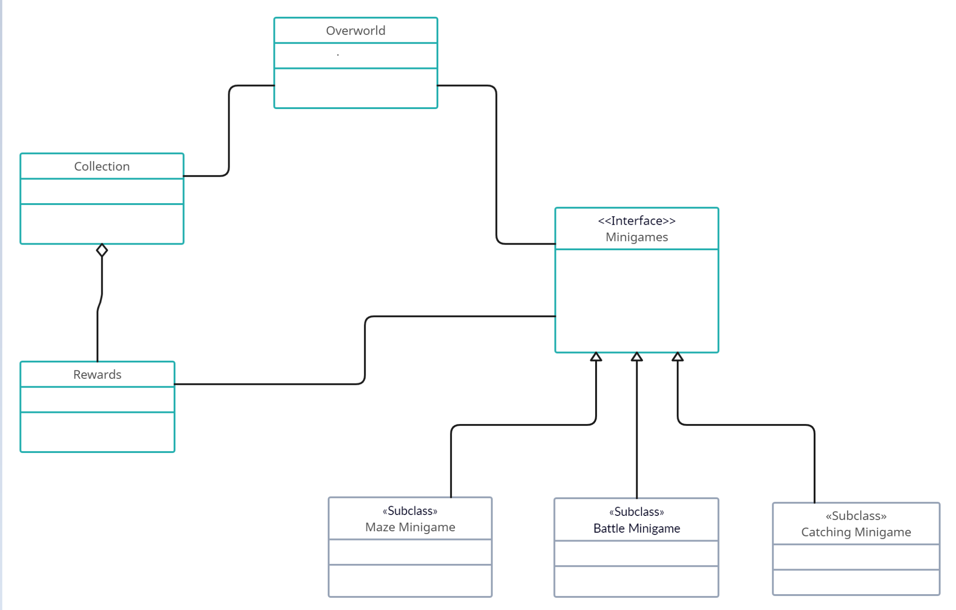
Proposed System Design

Slide 8
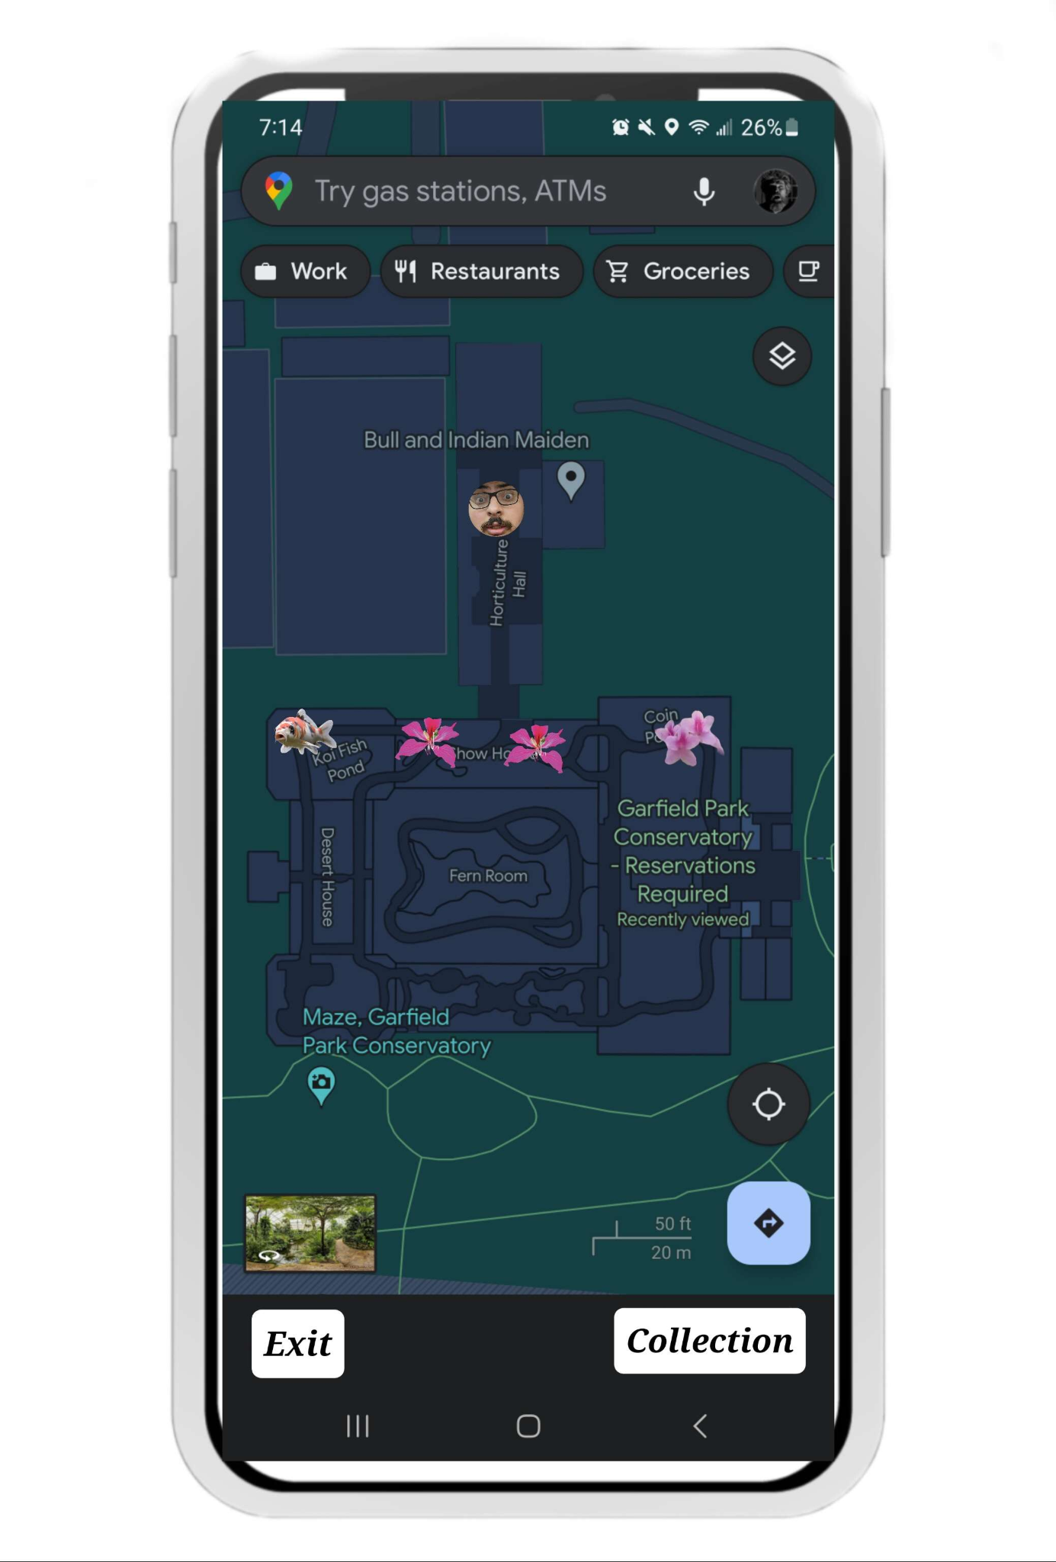
Mock UI Design
User Location
Randomly generated Encounters
Collection Access

Slide 9


Project Issues
Privacy Policy- Safeguarding player information and ensuring compliance with privacy regulations is essential. Any breaches or concerns related to data security could harm the reputation of the game and the conservatory.
Mapping Accuracy: Any changes to the conservatory route will have to be have updated to reduce the risk of trespassing. This is essential for the safety of both the conservatory and the players as it reduces the risk of players going to restricted areas to continue playing the game.

Slide 10


Project Issues
Network Stability- Multiple players will require the conservatory to have a stable network connection for the game servers. Addressing potential issues related to latency is essential to provide a smooth multiplayer experience.
Data Storage- Fast and accurate storage of newly collected rewards into a Player's collection might face challenges, particularly if there are large amounts of data to be handled. Database optimization and data management strategies will be crucial.

