Slide 1


Android Security Analysis
Presented By
Gosavi Chinmay Nilesh
Enrolment No. - 2405454002001
Under Guidance of
Under Guidance of
Ms. Meena Lakshmi
Mr. Rijvan Beg
Assistant Professor
Assistant Professor
School of Cyber Security and Digital Forensics
MSc. Cyber Security Semester - II
National Forensic Sciences University, Bhopal

Slide 2


Overview
Introduction
Objective
Methodology
Experiments and Results
Future Work and Conclusion

Slide 3
Introduction
This project, Android Security Analysis, investigates how effectively the Android operating system defends against modern spyware and remote access threats. By developing custom malware and testing known RAT tools in controlled environments, the study evaluates Android’s permission model, sandboxing, and runtime protections under real-world attack scenarios.

Slide 4
Motivation
Objectives
1) Android’s widespread usage makes it a prime target for malware and spyware.
1) To analyze Android’s security architecture through the lens of custom-developed malware
2) Most users unknowingly grant dangerous permissions to malicious apps.
2) To simulate real-world spyware behaviors such as camera access, usage tracking, and icon hiding.
3) The open-source nature and flexible app ecosystem of Android invite both innovation and exploitation.
3) To identify existing loopholes and suggest improvements in permission control and user awareness.

Slide 5

Methodology
Methodology is divided into 3 Parts, they are:
1)Custom Malware with single Activity
2)Custom Malware with Multiple Activities
3) Ahmyth RAT(Random Access Trojan)
Part 1
Part 2
Part 3
MainActivity class-
Used for gaining permissions,
getting camera access and,
storing it locally to exfiltrate the captured photos later
Activities included -
MainActivity
Overlay Service,
SilentCapture Service
Boot Reciever,
AppTracker Service,
Tried to escalate privileges by using overlays, added icon hiding technique for persistence
Usage of Ahmyth tool,
Bound Malicious code into Google Play Service apk,
Leveraged Camera, Location, Call Logs, SMS etc

Slide 6
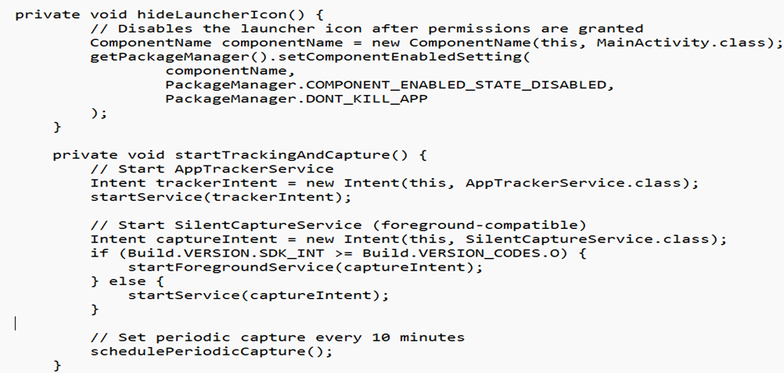
Snippet of Icon Hiding Functionality

Slide 7
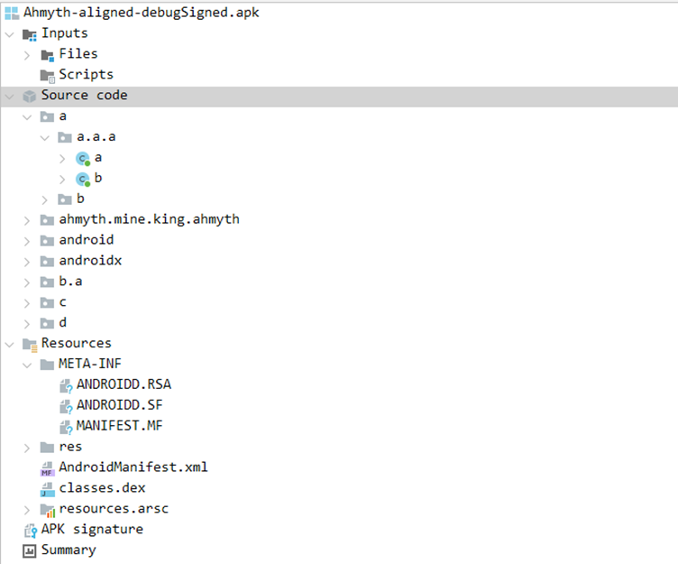
Experiments And Results
File Structure of Ahmyth apk as seen in reverse engineering using JADX

Slide 8

DATA EXFILTRATION: Spyware successfully exfiltrated GPS, device data, and camera streams via secure tunnels—silently in the background after user consent, without OS alerts—showing that once permissions are granted, malicious activity can proceed with minimal interference.
01
Malware used RECEIVE_BOOT_COMPLETED and background services to persist after reboots. While newer Android versions limit background execution, persistence remained achievable via foreground services or user-visible activity.
Results Seen
02
Abuse of SYSTEM_ALERT_WINDOW enabled deceptive overlays to intercept input or hide activity. On older Android versions and some devices, overlays ran silently, revealing flaws in Android’s UI defenses.
03

Slide 9
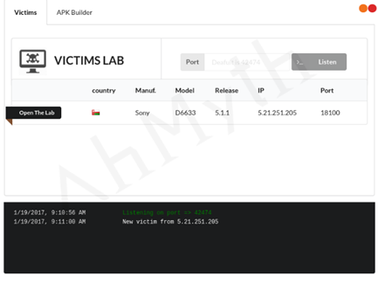
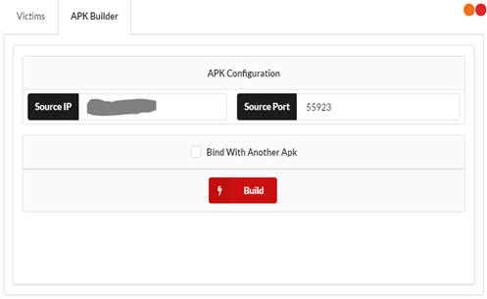
Victim’s Lab - AhMyth
APK Builder - AhMyth

Slide 10
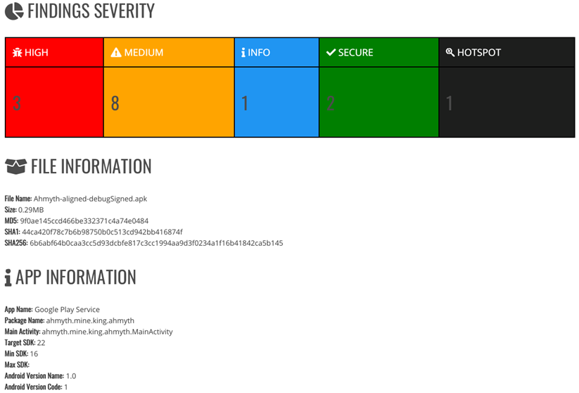
MobSF Report
High- Dangerous Permissions
Medium- Other Permissions
Dangerous Permissions Examples:
android.permission.CAMERA
android.permission.ACCESS_FINE_LOCATION
android.permission.WRITE_EXTERNAL_STORAGE

Slide 11
Conclusion
1) Tested Android security using custom spyware and tools like AhMyth and ngrok.
2) Core defenses like sandboxing and Play Protect blocked basic threats.
3) Highlights the need for better post-install monitoring, contextual warnings, and user awareness.
4) Boot persistence was achievable but limited by new OS constraints on background services.

Slide 12

FUTURE WORK
1) Development of Root Level and Kernel Level Malware
2)Anomaly Detection using Behaviour Analysis:
3) Incorporating Accessibility Service Abuse
4) Testing with Encrypted Payloads and Obfuscation Techniques
5) Post-Quantum Cryptography for Android Security

Slide 13
THANK YOU!

