Slide 1

FEA For Circular Plate Under Point Load

Slide 2
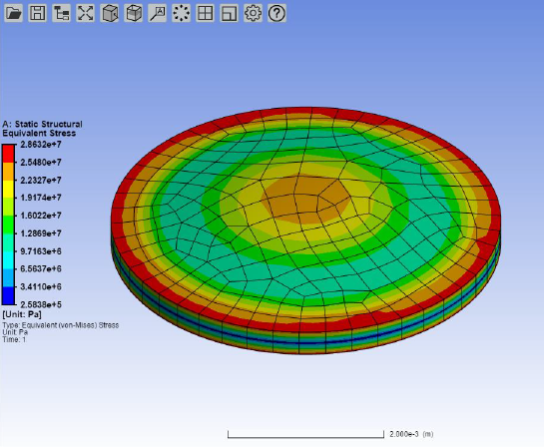
Stresses

Slide 3
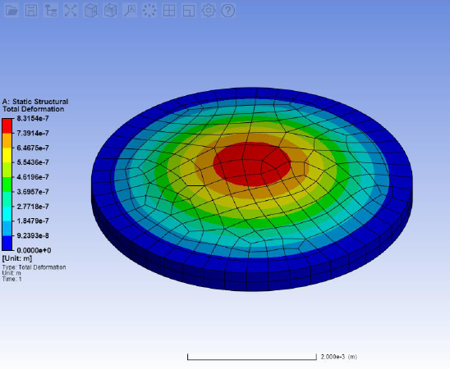
Deformations

