Slide 1
ICACM 2010
Scale transition in crystal plasticity.
From experiment to numerical modeling
Paris, 2-4 June 2010

Slide 2
Background of ICACM
ICACM 2007
ICACM 2008
ICACM 2009
ICACM 2010
  Date, place, organizers
  Topics (tentative list)
  Committees (tentative list)
  Speakers (tentative list)
  Costs

Slide 3
International Center For Applied Computational Mechanics
ICACM is a partnership between several French and American Universities with the scope of promoting joint research at the forefront of computational mechanics.
Initial discussions: 2005
Academic partners
US :
-University of Florida -REEF
-University of Michigan
France:
-University Paris 13-LPMTM
-University of Lille-LML
-University of Grenoble-L3S-R
-University of Savoie-LAMA

Slide 4
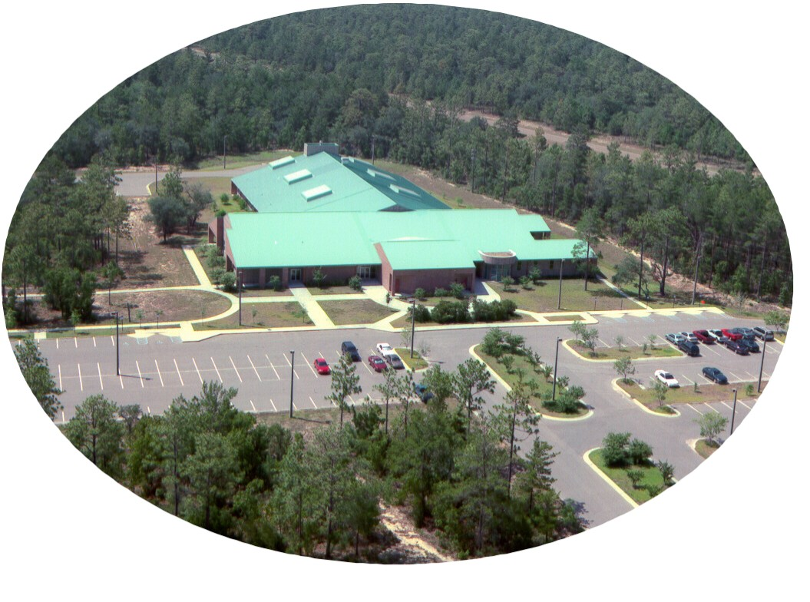
Established by University of Florida in 1969
Present REEF Campus: opened 1995
Mission: graduate education and research needs of the Eglin AFB
Departments of University of Florida involved in the REEF:
-Electrical and Computer Engineering
-Industrial and Systems Engineering
-Mechanical and Aerospace Engineering

Slide 5
ICACM symposia
  2007 - Shalimar, organized by University of Florida -REEF
  Advances in Bridging Scales in Computation.
  From Microstructure to Macro-Scale Properties of Heterogeneous Materials
  2008 - Rocamadour, organized by DGA, CE Gramat
  Materials under extreme loadings. Application to penetration and impact
  2009 -Shalimar, organized by University of Florida -REEF
  Damage and fracture in heterogeneous materials and structures
  2010 - Paris, organized by University Paris 13 - LPMTM
  Scale transition in crystal plasticity. From experiment to numerical modeling
  2011 - Shalimar, IUTAM Symposium organized by University of Florida -REEF
  Linking scales in computation. From microstructure to macroscale properties

Slide 6

ICACM 2007
1st US-FR Symposium:
Advances in Bridging Scales in Computation.
From Microstructure to Macro-Scale Properties of Heterogeneous Materials
March 28-30, 2007 - Shalimar, FL
organized by University of Florida -REEF
• 40 participants
• 28 presentations, 12 keynote speakers (18 French presentations)
• Keynote speakers: 45 minutes, Invited speakers: 30 minutes
• Registration, banquet, breakfast, lunch, lodging free
• Funding: AFOSR (Computational Mathematics)
ICACM 2007 Book: Multiscale Modeling of Heterogenous Materials
From microstructure to macro-scale properties
Wiley, August 2008 Hardback 368 pp.

Slide 7
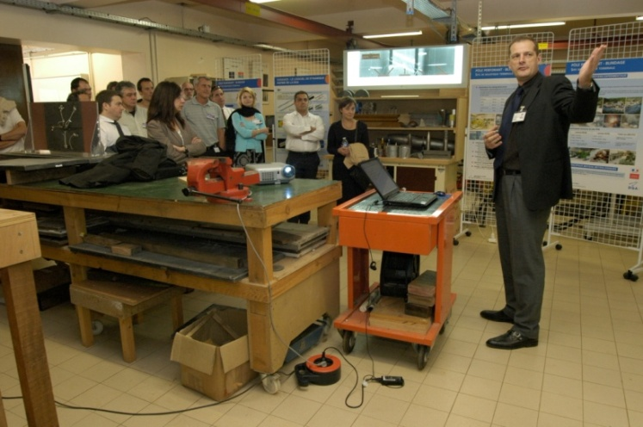
ICACM 2008
2nd US-FR Symposium:
MATERIALS UNDER EXTREME LOADINGS.
APPLICATION TO PENETRATION AND IMPACT
28-30 May 2008, Rocamadour, France
organized by DGA, CE Gramat
Funding: DGA, CE Gramat + DYMAT + CNRS
61 participants
29 presentations, 10 keynote speakers (12 French talks)
Keynote speakers: 40 minutes Invited speakers: 25 minutes
Registration, welcome reception, banquet, breakfast, lunch, lodging: free
ICACM 2008 CD-ROM : participants, presentations, photos
ICACM 2008: BOOK (in preparation)

Slide 8
ICACM 2009
3rd US-FR Symposium:
DAMAGE AND FAILURE IN HETEROGENEOUS MATERIALS AND STRUCTURES
April 22-24, 2009 - Shalimar
organized by University of Florida -REEF
Funding: AFOSR+AFRL,
60 participants (expected)
25 presentations, 12 keynote speakers (14 French talks)
Keynote speakers: 40 minutes Invited speakers: 25 minutes
Registration, welcome reception, banquet, breakfast, lunch, lodging: free
Notes:
$300 registration fee to cover banquet, reception, 3 lunches, 3 breakfasts, snacks.
Lodging for French speakers to be covered by US (4 nights).
Need $ for DOCE fee.

Slide 9
ICACM 2010
Scale transition in crystal plasticity. From experiment to numerical modeling
Paris, 2-4 June 2010
Date, place, organizers
Where ?
tentative place:
Paris, 5ème
When ?
tentative date:
2-4 June 2010
Organized by : LPMTM (UPR 9001 du CNRS), University Paris 13
Co-organizers: ………………………………………………..
ICACM parteners : University of Florida, University of Michigan,
INP de Grenoble (INPG), University of Lille, University of Savoie

Slide 10
ICACM 2010
Scale transition in crystal plasticity. From experiment to numerical modeling
Paris, 2-4 June 2010
Topics (tentative list)
*Innovative characterization technics
-Multiscale characterization: SEM-MET coupling, MET-Microdiffraction coupling, …
-In-situ mechanical tests: recrystalization process, shear band localization, …
-Image correlation, ……
-……………
*Computational crystal plasticity
-Dislocation dynamics and ab-initio calculations
-Microstructure evolution of polycrystals (e.g. comparison
between FE, Fast Fourier transform approaches, self-consistent approaches, …….)
-Intra-granular slip heterogeneities
-…………………
*Computational design of material
-Virtual micro-structures and related properties
-Phase arrangements, ductility and hardening, ……
-……..
*…………

Slide 11
ICACM 2010
Scale transition in crystal plasticity. From experiment to numerical modeling
Paris, 2-4 June 2010
Committees (tentative list)
Local organizing committee:
*Prof. S. Bouvier,
*Dr. P. Franciosi,
*Prof. I.R. Ionescu,
………………………….
ICACM Executive Advisory Board:
* Dr. E. Buzaud (DGA; Fr Ex-Officio)
*Prof. F. Darve (INP Grenoble, France)
* Prof. F. Fahroo (AFOSR, US; Ex-Officio)
* Dr. P. Franciosi (Univ. Paris 13, France)
* Prof. J. Rogacki (Univ. Florida, US)
* Prof. Wei Shy (Univ. Michigan, US)
* Prof. J.F. Shao (Univ. Lille, France)
ICACM Scientific Committee
Prof. O. Cazacu (Univ. of Florida)
Prof. Ioan. R. Ionescu (Paris 13)
Prof. D. Kondo (Université de Lille)
……………..

Slide 12
ICACM 2010
Scale transition in crystal plasticity. From experiment to numerical modeling
Paris, 2-4 June 2010
Speakers (tentative list)
30 presentations, 12 keynote speakers
Keynote speakers: 40 minutes, Invited speakers: 25 minutes
France: US:
-Forest (Paris Tech) -Beaudouin (Illinois)
-Cailletaud (Paris) -Hutchinson (Harvard)
-Fressengeas (Metz) -Cazacu (Florida)
-Fivel (Grenoble) -Belytschko (Northwestern)
-Monnet (EDF) -Needleman (Brown)
-Kubin (ONERA) -Picu (Rensselear)
-Daniel (LGEP) -Kysar (Columbia)
-………………. -Tomé (Los Alamos)
-Beyreim (Los Alamos)
-………………………

Slide 13
ICACM 2010
Scale transition in crystal plasticity. From experiment to numerical modeling
Paris, 2-4 June 2010
Depenses
Hôtel: 4 nuits X 120€ X 20 US participants = 9.600 €
Repas : 4 repas X 25€ X 60 participants= 6.000 €
Coffe-Break: 6 X 10€ X 60 participants = 3.600€
Banquet : 100€ X 60 participants= 6.000€
Welcome reception : 50€ X 60 participants = 3.000€
Location salle IHP : 300€ X 6 half-days= 1.800€
Programme+ résumés+pochette : 20€ X 60 participants= 1.200€
Affiches, poster, webpage : = 3.800€
Publications des actes : =10.000€
Total =45.000€

