Slide 1

Help to help
food made available for everyone
SLID E
Mecline Jose

Slide 2

Challenge or Problem Overview
The NGO's like old age homes and orphanages are facing difficulties in getting day to day food for the in house persons. On the other side many restaurants are encountering the issue of food wastage the ( surplus food ). To solve the issue of both if there is a proper chain of connection between two of both and a mutual understanding in buying and selling of food in nominal costs can help many people suffering and surviving without getting food. We want to create a way to connect the NGO's and restaurants.
We are mostly concerned with NGO’s that have severe inabilities in getting food. Also restaurants near by them with surplus food production. So this is what let to the opportunity.
To create a means by which we can connect the both of them.

Slide 3
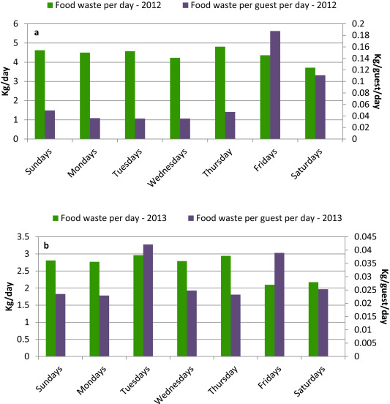
Discovery: Research & Analysis
First of all I needed to understand how a Restaurant functions(generally). Then I had to inquire how a excess food is treated, what are the key information the hotel tries to have when they meet with excess food situation. I assisted to numerous meeting across different restaurant in different areas.
I needed this to make the designs for an interface so as to facilitate the data transfer between the NGO's and the
restaurant.
I discovered the avg number of excess food wastage by a restaurant does per day.

Slide 4
Design: Concepts & Sketching
Anything that helped you explore ideas, possibilities, and possible solutions may be included here.
Since I found out that many NGO's couldn’t able to get to their day to day food for in house person’s and I had in mind to design a digital system that would help Ngo’s to have their food requirement online. That is an interface that would NGO's and restaurants to have their sessions smoothly.
From the chart above we saw that the number of food wastage increases with time.
So for a start we designed a mobile app interface with login credentials so that the they could log in, just a measure to keep user data safe.

Slide 5
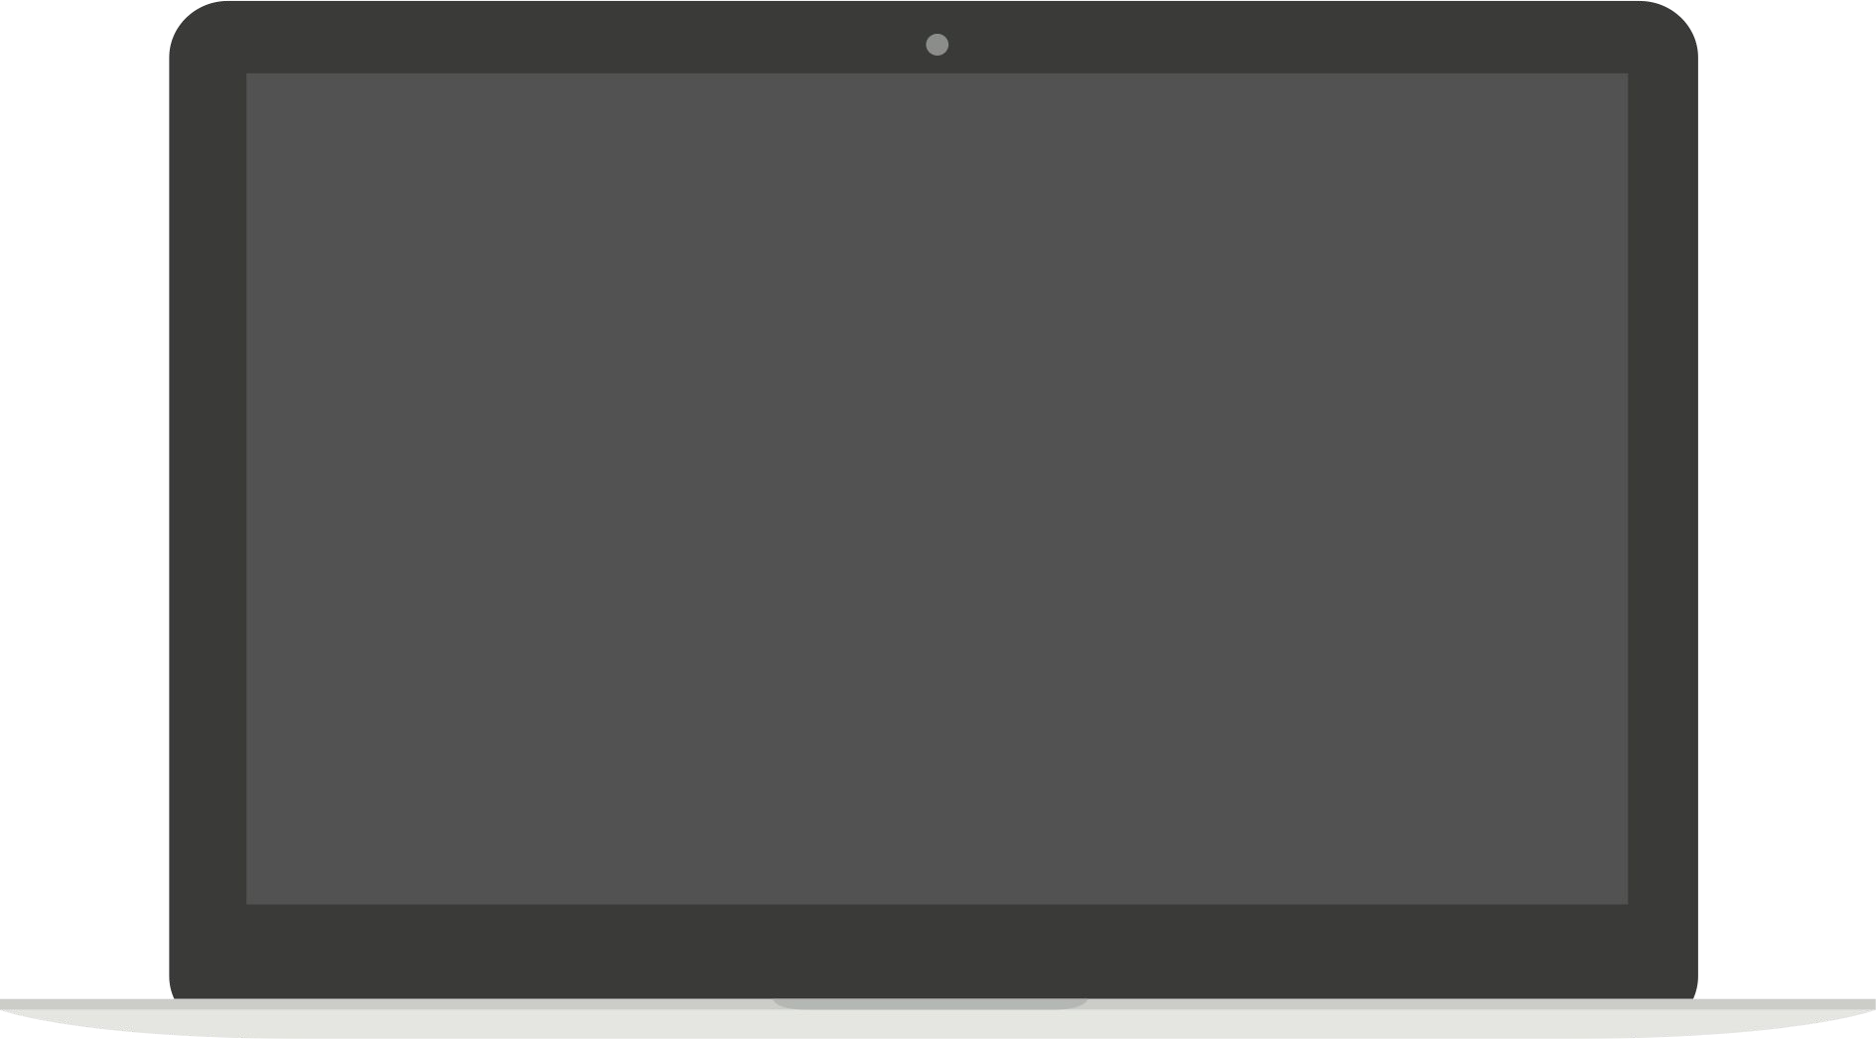
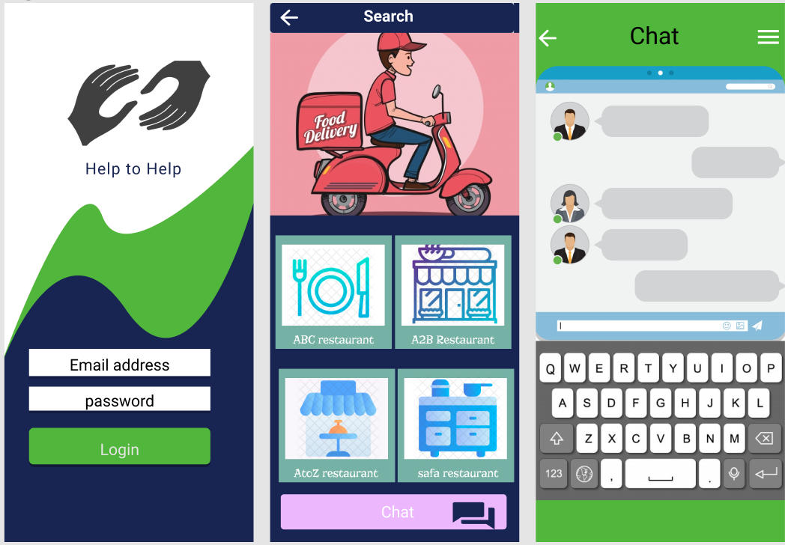
Develop: Prototyping
For this part I actually developed a prototype of figma with the below link
https://www.figma.com/proto/TNRCHOhX8ElMwLvfHcKm7O/UXcapstone?node-id=1%3A9&scaling=scale-down

Slide 6
Test: Validation, Usability, Feedback
I conducted surveys with Restaurants and NGO's directors, data from this research was organized and store for further analysis. Below is a summary of the key major points we noted during our data analysis;
88% of the NGO’S directors possess smart devices like computers, smart phones, and tablets(meaning that they have the required
devices to use our system)
75% of participants will opt for an online food ordering service if nominal cost is available.
12% Don’t want to have their food order online
63% of the participants are willing to migrate from traditional to a digital consultation service
100
%
Note:
It is important to take into account that half of our participants where people from the restaurant personnel and were ngo’s with no distinction of their connection.
%
25% 25%

Slide 7
Design Iteration :
From the feedback gotten during the survey, some participants made the following suggestions in order to improve on the quality of our product and our solution;
They requested for a log out feature
Others opted for a change in color(didn’t appreciate the look and feel)
Required a map feature to locate the nearest restaurant.
Suggested the inclusion of chat services, so that they could keep in touch with restaurants.
Note:
It is important to take into account that half of our participants where people from the restaurant personnel and the other half were Ngo’s with no distinction of their connection.

Slide 8
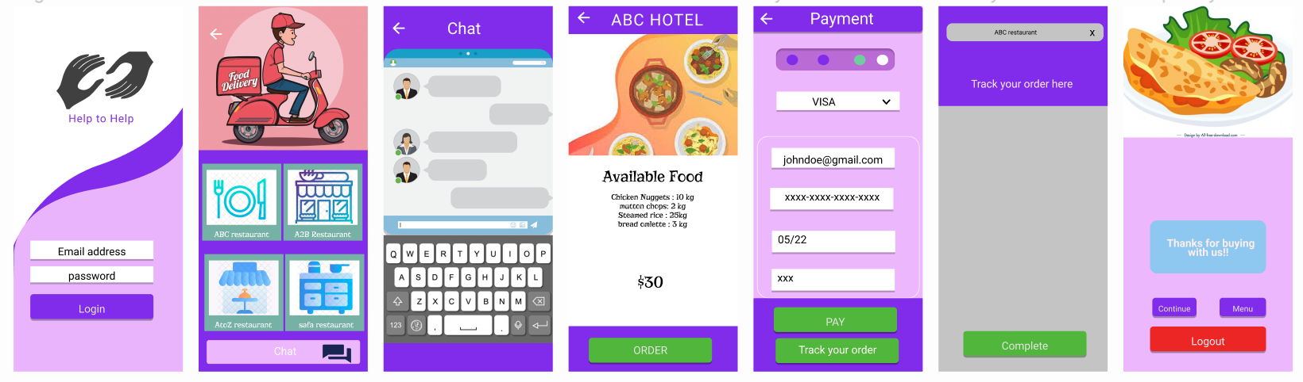
Solution & Impact Overview
Given all the suggestions given to me by my participants, I went forward and included all this changes into my prototype and it can be accessed through the below link.
https://www.figma.com/proto/TNRCHOhX8ElMwLvfHcKm7O/UXcapstone?node-id=323%3A124&scaling=scale-down

Slide 9
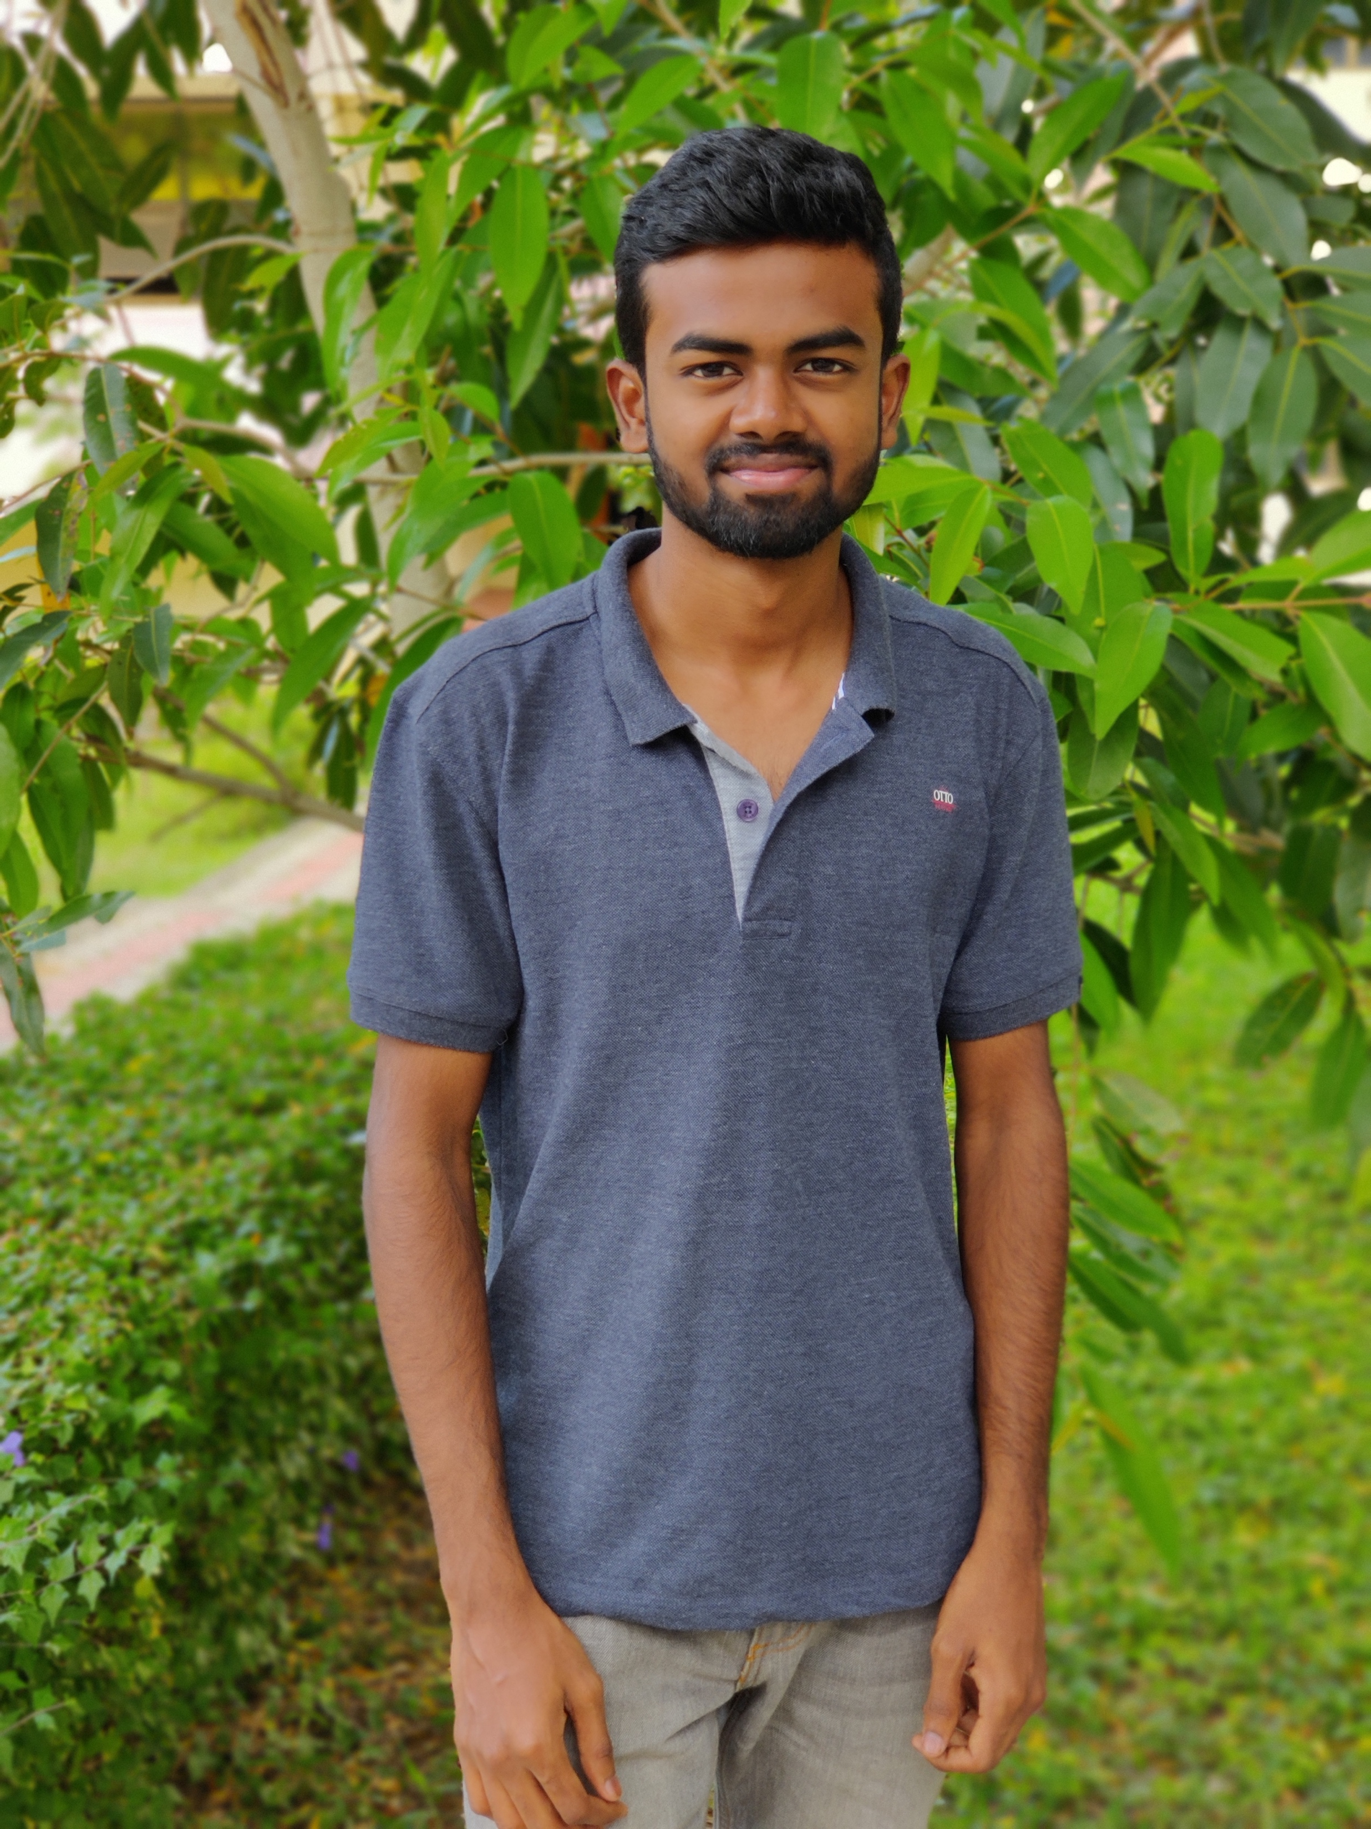
About Me
I am UX designer for over 2 months and a web developer for 2 years, I particularly appreciate interactive design techniques and research . I have mastery over popular design tools like figma. Also I have skills and aptitudes in machine learning.
I hold a bachelor in Engineering from the Karunya institute Of Technology in India. Currently I am a freelancer in Coimbatore. I’ll like to build my own design company in order to promote my vision in the User Experience domain.
I personally love cricket and like spending time with my friends
and loved ones.

