Slide 1



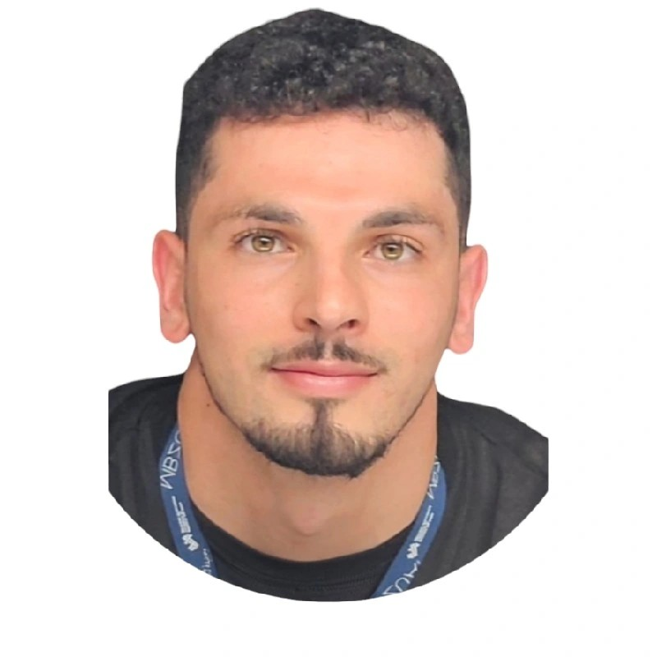
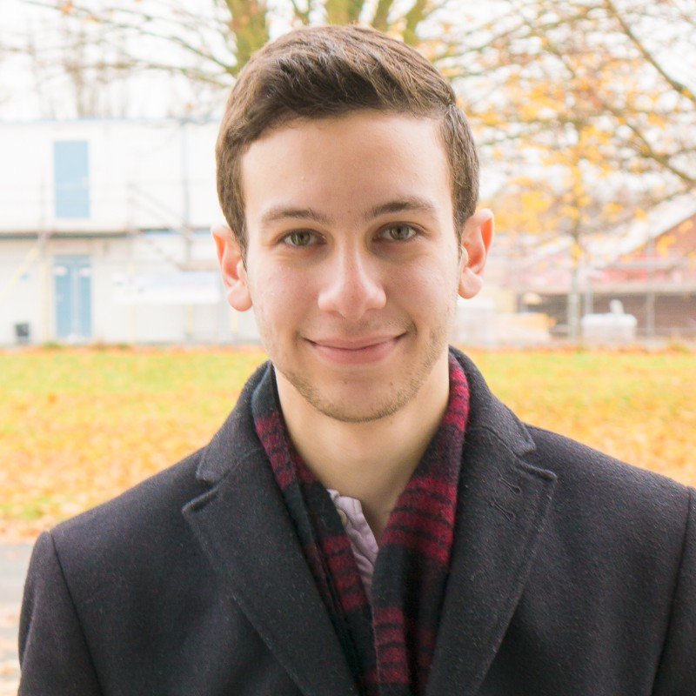

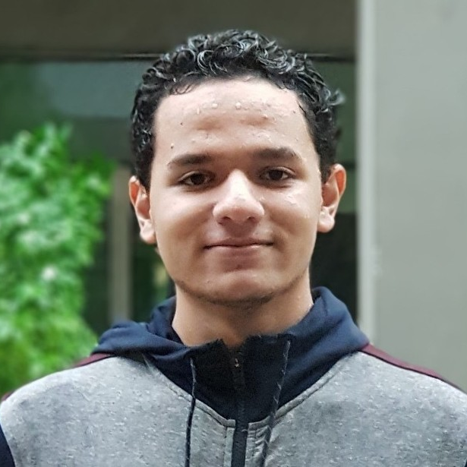



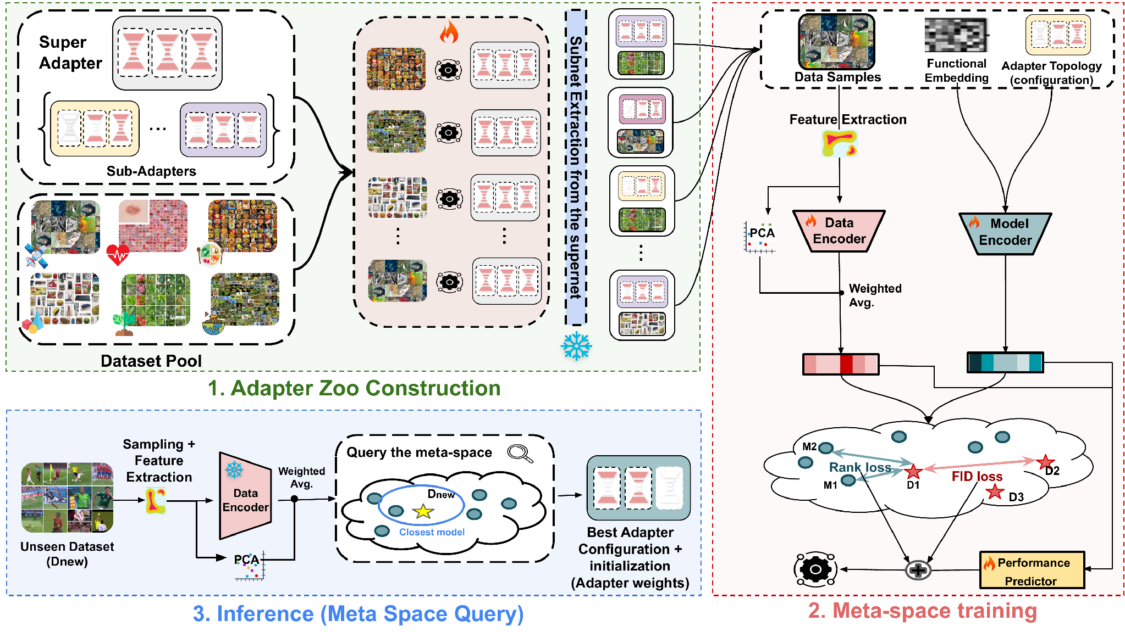
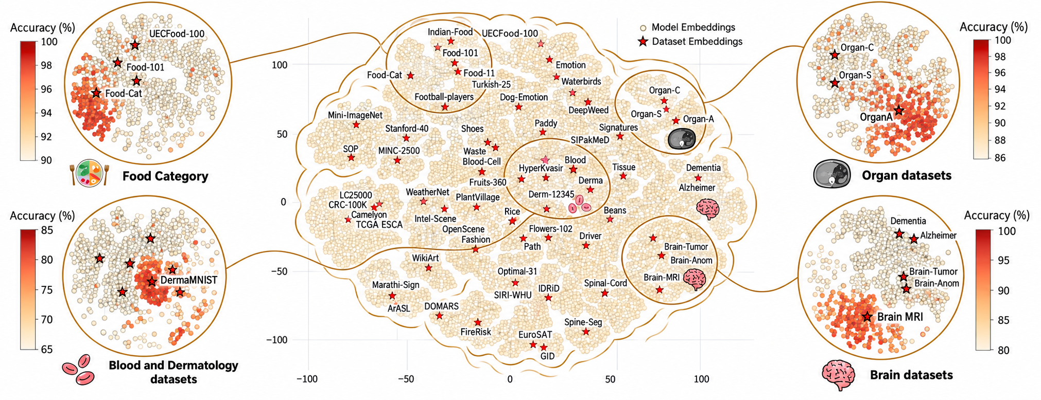

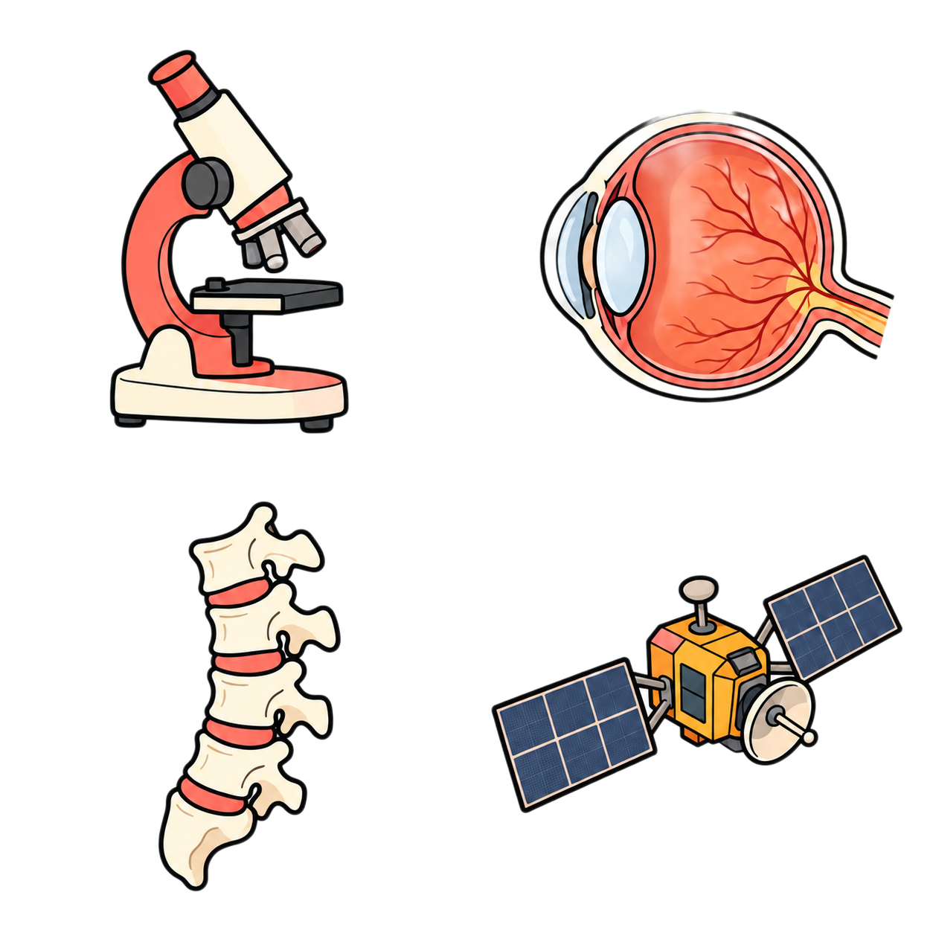

Meta-VFM
Meta-Learned Efficient Adaptation of Vision Foundation Models for Medical Imaging
Division of Computing and Mathematical Sciences
Mohamed bin Zayed University of Artificial Intelligence (MBZUAI), Abu Dhabi, United Arab Emirates
Lotfi Abdelkrim Mecharbat
Ibrahim Almakky
Abdelrahman
El Sayed
Hazem Lashen
Alya Almsouti
Martin Takac
Mohammad Yaqub
01
Motivation
02
The Meta-VFM framework
Adapter placement and rank change accuracy across tasks.
A weight-sharing Super-Adapter builds the zoo. Joint dataset and adapter embeddings enable budget-feasible retrieval for a new task.
LoRA configuration sensitivity
Breast
DTD
RetinaMNIST
HAM10000
Modules
4
8
16
32
4
8
16
32
4
8
16
32
4
8
16
32
Q
K
V
P
F1
Q,K
Q,V
F1,F2
Q,K,V
P,F1,F2
Q,K,V,P
Q,K,V,P,F1,F2
81
88
80
83
43
52
69
84
03
Accuracy (%)
Meta-space analysis
04
Accuracy and parameter budget
05
Convergence Speed
Top-1 accuracy (%), DINOv2 ViT-B, 100 epochs
Meta-VFM at 5 epochs meets or exceeds LoRA at 10 on 3 of 4 datasets.
Dataset | LoRA | AdaptFormer | APLA | … | Meta-VFM-T5
ISIC2019 | 86.5 | 85.6 | 88.2 | … | 87.8
APTOS2019 | 91.1 | 90.8 | 92.1 | … | 92.3
DDSM | 95.1 | 97.3 | 97.2 | … | 97.7
Colorectal | 97.4 | 97.4 | 98.4 | … | 98.7
Pneumonia | 98.9 | 98.6 | 99.5 | … | 99.5
Medical mean | 93.8 | 93.9 | 95.1 | … | 95.2
… | … | … | … | … | …
All 17 mean | 90.1 | 91.0 | 91.6 | … | 91.8
Dataset | LoRA @10 | Meta-VFM @5
Breast | 85.0 ± 0.7 | 85.5 ± 0.5
DTD | 81.7 ± 0.5 | 82.1 ± 0.2
Pneumonia | 90.2 ± 0.7 | 91.8 ± 2.1
CUB-200 | 89.6 ± 0.5 | 88.6 ± 0.5
Reported trainable parameters
Gain over LoRA at the same 10-epoch budget (pp)
Meta-VFM
1.4K–3M
Breast | DTD | Pneumonia | CUB-200
+3.0 | +1.0 | +3.3 | 0.0
APLA
7M
06
Conclusions
No per-task search
Highest accuracy
2–3× faster convergence
Predicts adapter placement,
rank and initialization.
Evaluated on 17 datasets.
Reported under a fixed epoch budget.
Meta-space learned across 90+ datasets.
Top-1 or top-2 on nearly all tasks.
Particularly strong medical-domain gains.
Notes:
Current paper: Meta_adapters_MICCA_2026 (14).pdf, local Downloads. Title and all seven authors transcribed from page 1, in original order. Affiliation copied from page 1. The method is Meta-VFM; the legacy method name is removed throughout this poster. Portraits and MBZUAI logo are original embedded assets from Poster_MedNNS_MICCAI2025.pptx: image7.jpg (Lotfi Abdelkrim Mecharbat), image3.jpg (Ibrahim Almakky), image1.jpg (Martin Takac), image2.jpg (Mohammad Yaqub), image28.png (MBZUAI). The source poster supplies four original portraits. Added Alya Almsouti from the verified BioMedIA alumni portrait, https://mbzuai-biomedia.com/team/Alya.jpg, and Hazem Lashen from the official NYU Abu Dhabi 2022–2023 research fellowship profile. LinkedIn presented an authentication wall, so these are verified university/lab portraits rather than claimed LinkedIn downloads. The remaining co-author portrait is pending identity confirmation because the manuscript gives Elsayed Abdelrahman while the matching MBZUAI researcher uses Abdelrahman Elsayed. Photo sources: https://mbzuai-biomedia.com/alumni and https://nyuad.nyu.edu/en/academics/undergraduate/undergraduate-research/tamayyuz-research-fellowship/2022-2023-research-fellowship-recipients.html. All seven names appear in the full byline. MICCAI 2026 uses the current official France logo from https://conferences.miccai.org/2026/files/images/layout/en/miccai2026-logo-france.png, accessed September 19, 2026. Brand graphics and portraits retain original colors and native transparency. The white university logo sits on the orange masthead; the transparent conference mark sits on white. The full method figure is the same diagram as Figure 2 of the compiled paper, preserved in full. The four accuracy heatmaps are rebuilt as native editable tables from Figure 1, page 2, of the current compiled paper. All 192 mean and SD pairs are retained exactly. Matrix orientation is transposed to put target modules in rows and LoRA rank in columns. Each dataset uses an independent orange scale over its observed accuracy range. The parameter-count panel from the paper is not repeated inside this heatmap; the separate results section reports trainable-parameter comparisons. Top claims paraphrase the current paper abstract: no per-task search, a meta-space trained across 90+ datasets, highest average accuracy over 17 datasets with top-1/top-2 ranks on nearly all tasks, and reported 2–3× faster convergence under a fixed epoch budget. Meta-space analysis uses Figure 3, page 8, restyled with built-in ImageGen; Food Category (90–100%), OrganA (86–100%), DermaMNIST (65–85%), Brain MRI (80–100%). This restyling is illustrative rather than a numerical replot. Results are verified against Tables 1–2 of the compiled paper. Medical means are 95.2 for Meta-VFM-T5 and 95.1 for APLA. Trainable parameters are 1.4K–3M across tasks for Meta-VFM and 7M for APLA, stated on page 6; the chart shows 3M maximum versus 7M and does not imply an exact per-dataset pairing. Convergence compares Meta-VFM epoch 5 with LoRA epoch 10 and preserves standard deviations. It meets or exceeds LoRA on 3 of 4 datasets; CUB remains below. Equal 10-epoch gains: Breast 3.0, DTD 1.0, Pneumonia 3.3, CUB 0.0 percentage points. No wall-clock or statistical significance claims are added. Tables and chart remain native and editable.

