Slide 1
Water Medium Test System - Progress Report
Date: 2026-05-19

Slide 2
Project Goal and Status
Goal: deliver Terminal-Station distributed architecture for multi-station operation
Status: main framework completed and integration fixes are ongoing
Progress: critical control and monitoring chains are available

Slide 3
Recent Completed Fixes
Unified relay labels with displayed glyph names on Station 1
Corrected Valve 3/4 PLC mapping and relay-glyph binding
Added missing Valve 4 static check and 3-valve linkage test
Fixed pressure change wording and absolute-delta judgment logic

Slide 4
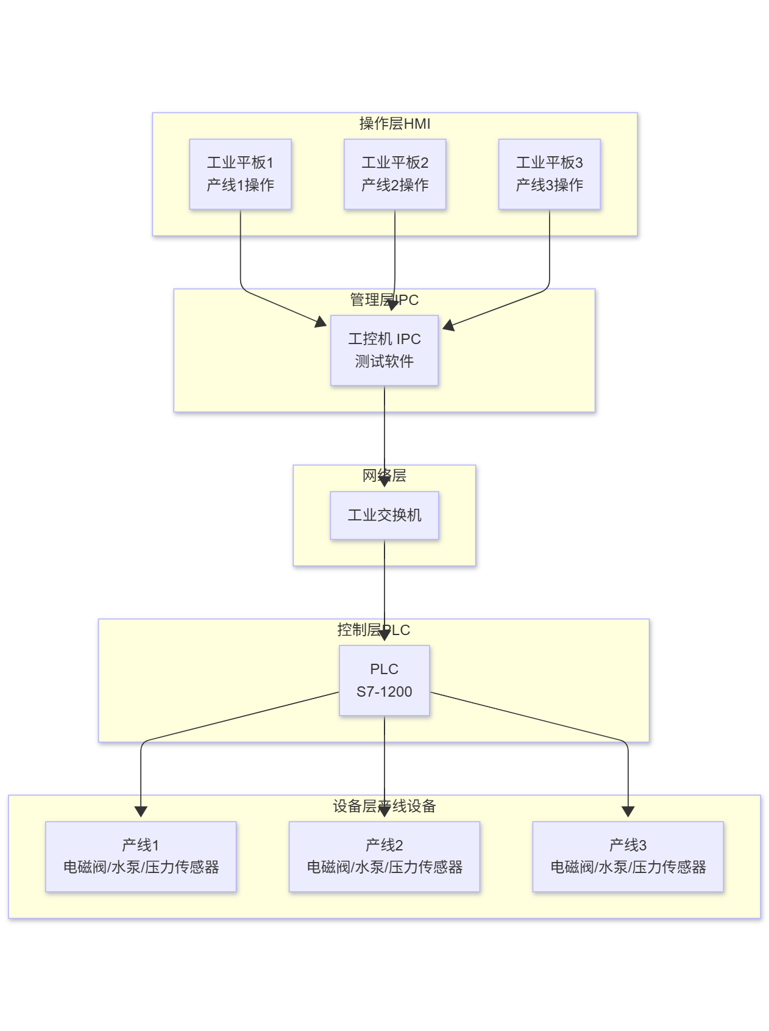
UI and Architecture Reference
Figure: industrial control UI reference

Slide 5
Wiring and Deployment
Figure: wiring diagram for deployment and commissioning

Slide 6
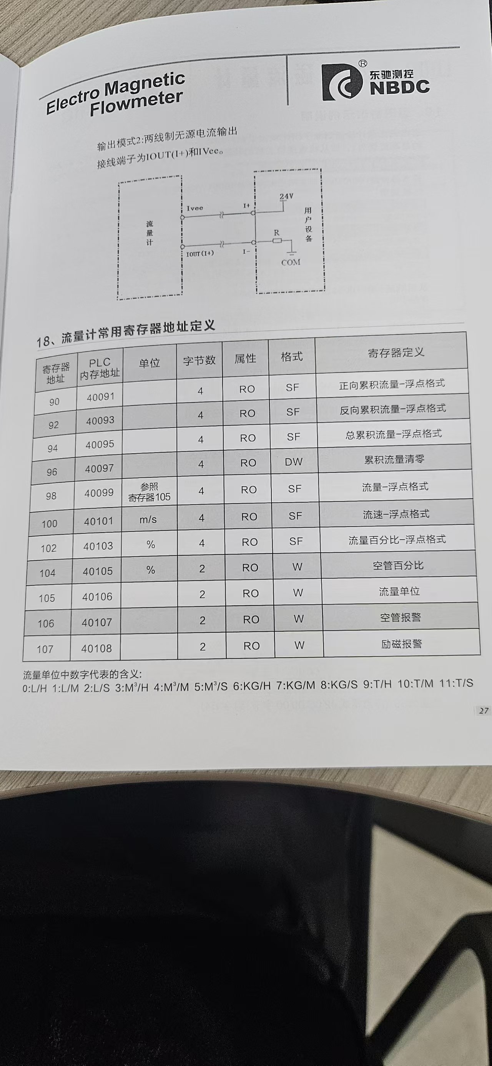
Field Device Verification - Flowmeter 1
Figure: on-site device image

Slide 7
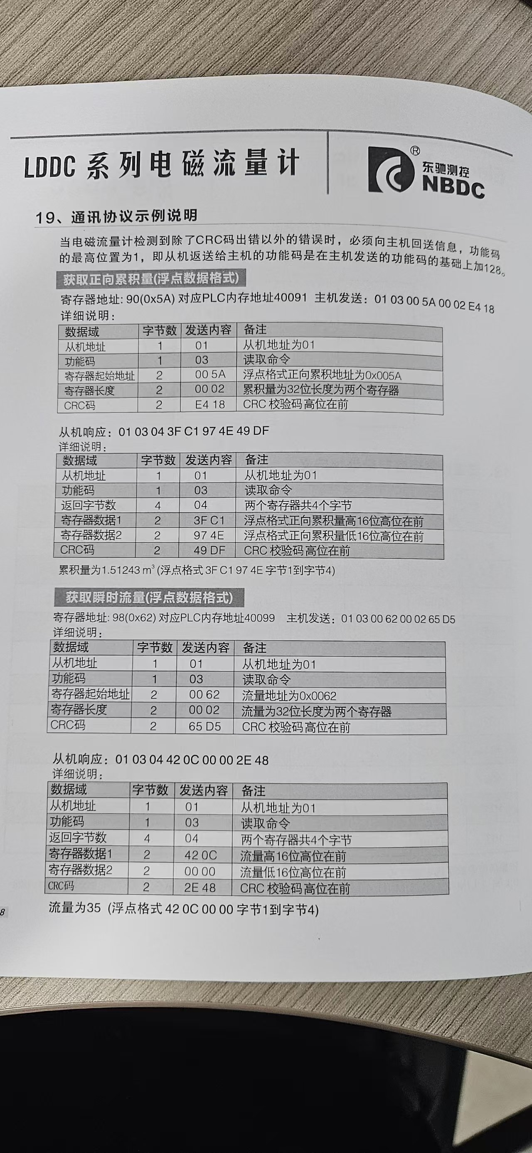
Field Device Verification - Flowmeter 2
Figure: on-site device image

Slide 8
Next Stage Plan (2-6 weeks)
Complete usable versions of Dashboard, PLC Connection, and Station Manager pages
Finish real-time data chain integration and action logging traceability
Run stability tests including reconnect and long-running verification
Prepare trial-run and acceptance deliverables

Slide 9
Conclusion
Project is moving forward with the planned architecture direction
Key integration issues are being closed in a stable feedback loop
Next focus: feature completeness and operational stability

