Slide 1
Habit Tracker
A CLI application to manage & track your habits

Slide 2















Modules
User Module
Habit Module
Analysis Module

Slide 3
Modules
User Module
Habit Module
Analysis Module

Slide 4

User Module
You can:
display your account info
change your name
change your email
change your password
display your activity in the app
delete your activity
delete your account
You can also:
list user commands

Slide 5
Habit Module
You can:
create a habit
display a habit
edit a habit
complete a habit
delete a habit
You can also:
list habit commands

Slide 6


Analysis Module
You can:
list your habits
list your habits with periodicity (daily | weekly)
display which habit of yours has the longest streak
display the longest streak of a habit
display your activity on a habit
You can also:
list analysis commands

Slide 7

Interactive Menu
Welcome & Login | Register Screen
User Module Screen
Habit Module Screen
Analysis Module Screen

Slide 8
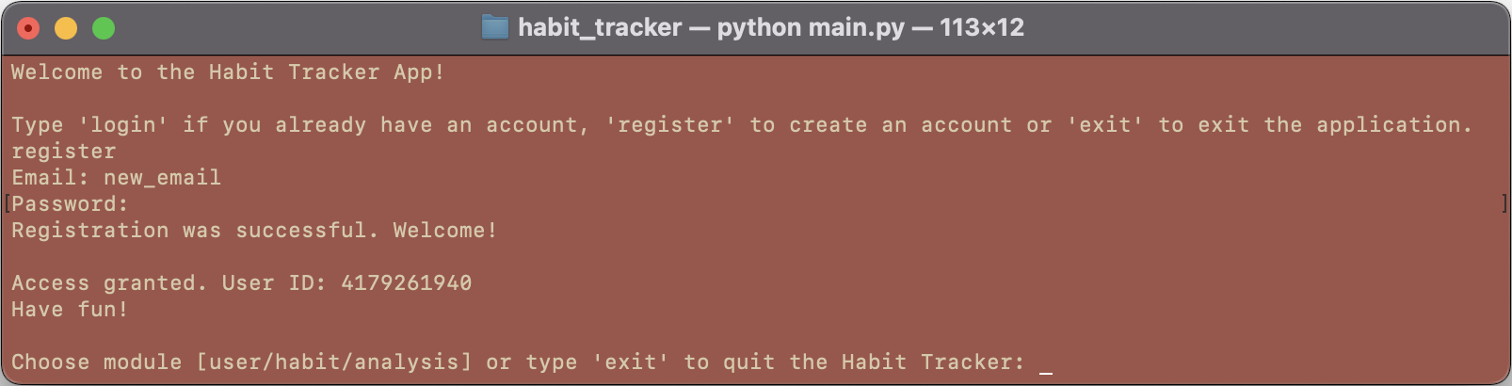
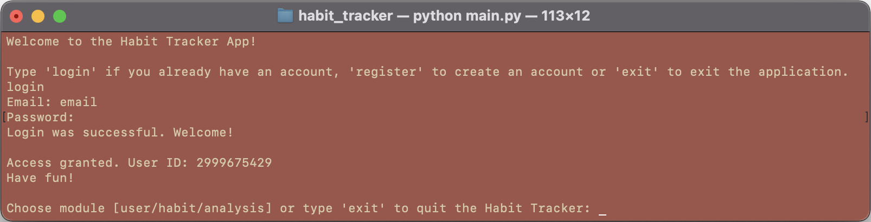
Interactive Menu
Welcome & Register | Login Screen
******
******

Slide 9
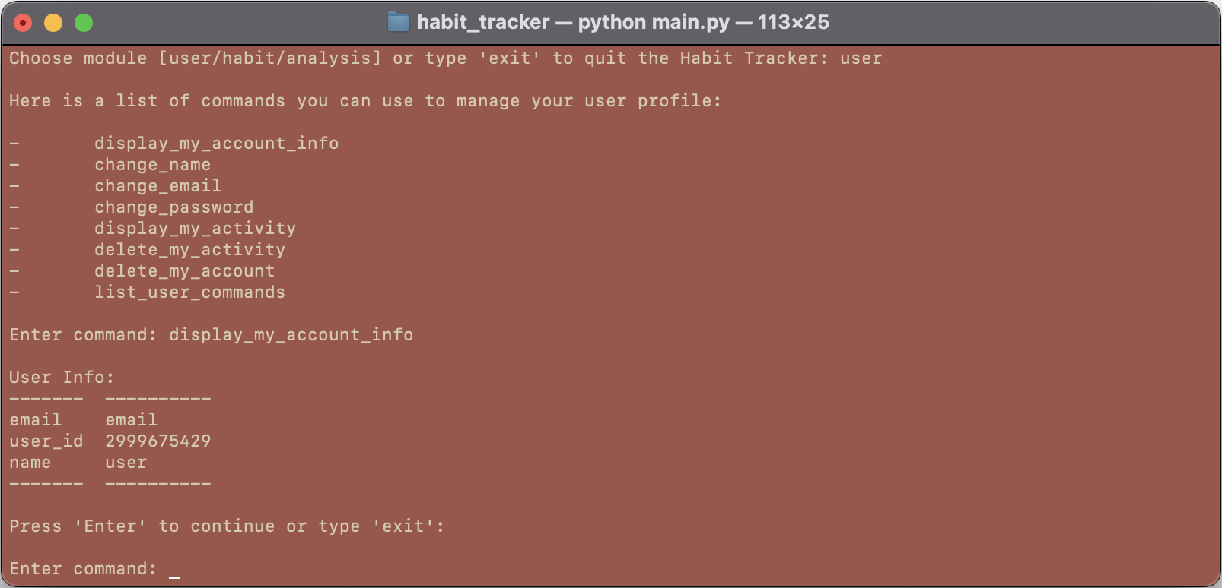

Interactive Menu
User Module Screen

Slide 10
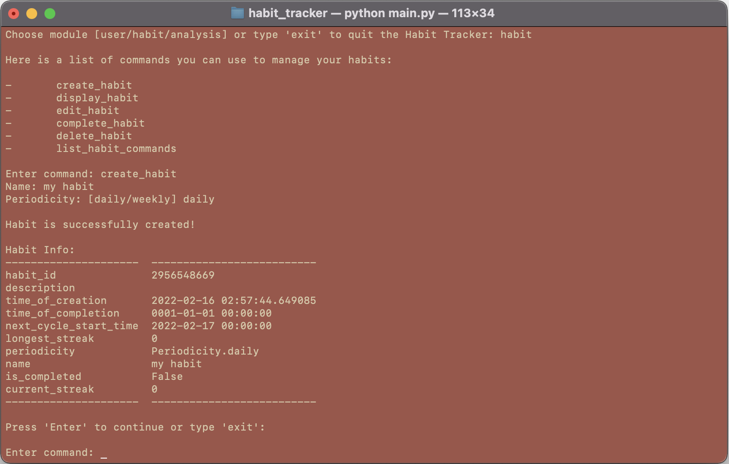

Habit Module Screen

Slide 11
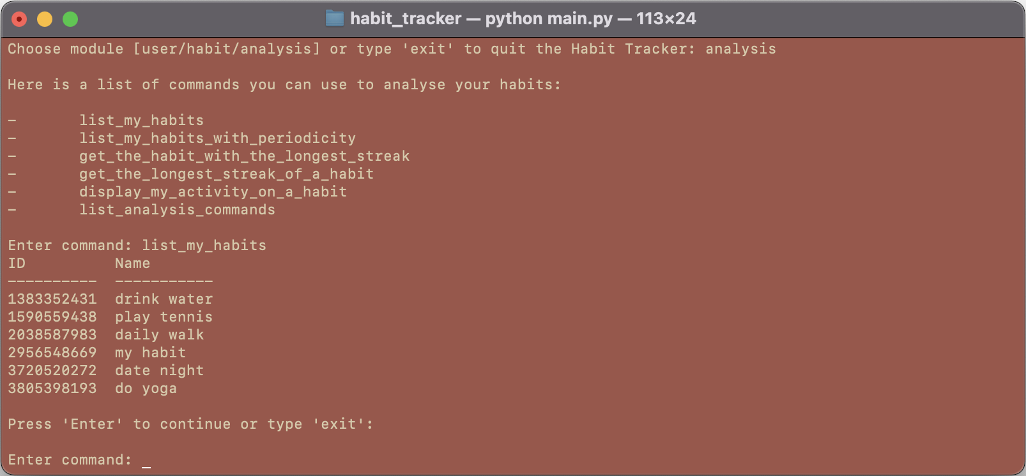
Interactive Menu
Analysis Module Screen

Slide 12










Powered by:
Development
Package Management & Deployment
Object Relational Mapping
Database Engine
Task Scheduler
Testing Framework
IDE

Slide 13

Meltem Eren Copur
IU Akademie
Python Object Oriented Programming Portfolio Project

