Slide 1
stmtList
_____________________________________________________________________________________________________________________________________________________________________________________________________________________________________________________________________________________________________________________________________________________________________________________________________________________|_____________________________________________________________________________________________________________________________________________________________________________________________________________________________________________________________________________________________________________________________________________________________________________________________________________________
| | | | | | | | |
funcDec funcDec varDec varDec forBlock varDec forBlock varDec funcDec
________________________________|________________________________ _______________________________________________________________________________|_______________________________________________________________________________ ______|______ _____|______ __________________|___________________ ______|______ _____________________________________________|_____________________________________________ ______|_______ _____________________________|______________________________
| | | | | | | | | | | | | | | | | | | | | | | | | | | |
int gcd defParamList stmtList int binarySearch defParamList stmtList int idList int idList varDec lt sp stmtList int idList varDec lt sp stmtList int idList int find defParamList stmtList
_____|______ __________________________|__________________________ ______|______ ___________________________________________________________________|___________________________________________________________________ | | ____|____ __|__ | | | ____|____ __|__ | _________________________________________________________|__________________________________________________________ | | ___________________|___________________
| | | | | | | | | assign assign | | | | i assign assign | | | | i | | | assign defParam | |
defParam defParam varDec whileBlock return defParam defParam forBlock ifElseBlock _______|________ _____|______ int idList i n _________|__________ _______|________ int idList i m varDec assign ifElseBlock _______|_______ __|___ whileBlock return
__|___ __|___ ____|____ __________|___________ | ___|___ ___|___ ________________________________________|_________________________________________ _____________|_____________ | | | | | | | | | | _______|________ _________|__________ ____________________________|____________________________ | | | | _________|_________ |
| | | | | | | | b | | | | | | | | | | | n functionCall arr newArr assign getitem functionCall m functionCall assign | | | | | | | par newArr int i | | i
int a int b int idList b stmtList int arr int val varDec lt none stmtList eq stmtList elseBlock _______|________ _____|_____ __|__ __|___ _______|________ _______|________ __|__ int idList result functionCall eq stmtList elseBlock ________|________ ne stmtList
| __________|__________ ______|_______ __|__ __________________________|___________________________ ____|_____ | | | | | | | | | | | | | | | | | _______|_______ ___|____ | | | | ___|____ |
temp | | | | | | | | | | | return stmtList parseInt parameterList int dimensions i 0 arr i parseInt parameterList parseInt parameterList i 0 assign | | | | functionCall stmtList int dimensions | | assign
mod assign assign int idList l r varDec ifElseBlock getitem val | | | | | | ________|_________ binarySearch parameterList result -1 _________|_________ | | i getitem ______|_______
___|____ __|__ ___|___ ______|______ _____|_____ _______________________|________________________ __|___ l return functionCall n functionCall functionCall | | ___|____ | | functionCall functionCall __|___ | |
| | | | | | | | | | | | | | | | ______|______ ______|______ ______|______ query functionCall | | print parameterList __________|___________ _______|________ | | i assign
assign b a b b temp assign assign int idList eq stmtList ifElseBlock arr l -1 | | | | | | _______|________ arr query | | | | | par i ______|_______
__|___ __|__ _____|_____ | ____|_____ | ______________|______________ input parameterList input parameterList input parameterList | | "Key not found in array." print parameterList parseInt parameterList | |
| | | | | | assign | | assign | | | parseInt parameterList | | getitem getitem
temp a l 0 r functionCall ____|_____ getitem val ___|___ lt stmtList elseBlock | add functionCall __|___ ____|____
_____|______ | | ___|___ | | ____|_____ | | functionCall ________|_________ ______|______ | | | |
| | mid add | | l assign | | add stmtList ______|______ | | | | par i par getitem
len parameterList ____|_____ arr mid __|___ getitem val ___|____ | | | "Key found at " functionCall input parameterList __|___
| | | | | ___|___ | | assign input parameterList _____|______ | |
arr l div r mid | | assign 1 __|___ | | par i
___|___ arr mid __|___ | | str parameterList
| | | | mid r |
sub 2 mid l query
__|__
| |
r l
if (0 <= nx and 0 < n and 0 <= ny and ny < m and maze[nx][ny] == '.' and not vis[nx][ny]) {
vis[nx][ny] = true;
dfs(nx, ny);
}
stmtList
|
ifBlock
______________________|_______________________
| |
and stmtList
________________|________________ ________|________
| | | |
and not assign functionCall
______________|______________ | _____|_____ _____|______
| | getitem | | | |
and eq ____|____ getitem true dfs parameterList
________|_________ ____|_____ | | ____|____ __|___
| | | | getitem ny | | | |
and lt getitem '.' ___|___ getitem ny nx ny
______|_______ __|__ ____|____ | | ___|___
| | | | | | vis nx | |
and le ny m getitem ny vis nx
____|_____ __|___ ___|___
| | | | | |
le lt 0 ny maze nx
__|___ __|__
| | | |
0 nx 0 n

Slide 2
A;
if (c0) {
B;
} else if (c1) {
C;
} else if (c2) {
D;
} else {
E;
}
F;
A:
jmp B
B:
cmp c0, 0
jz C
...
jmp B
C:
A;
while (c0) {
B;
}
C;

Slide 3
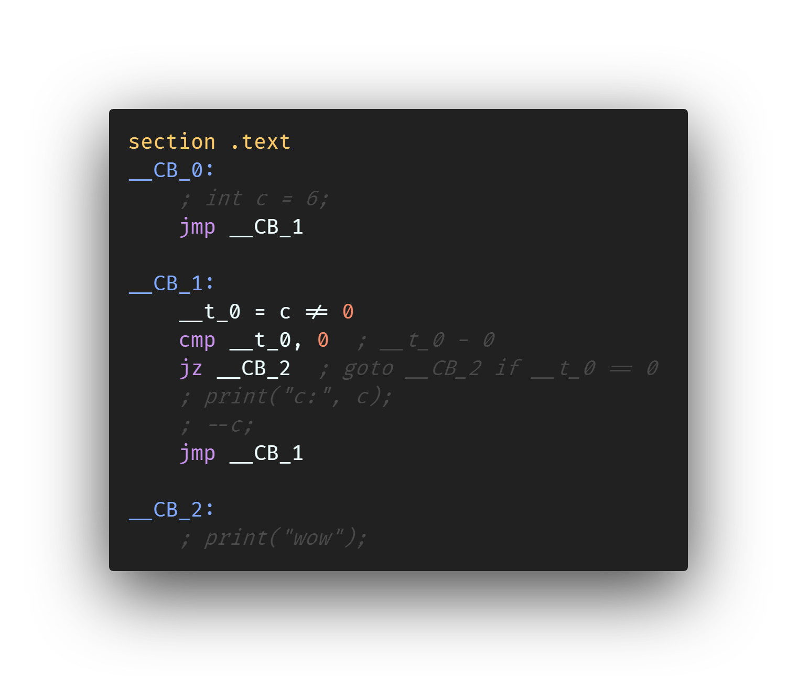
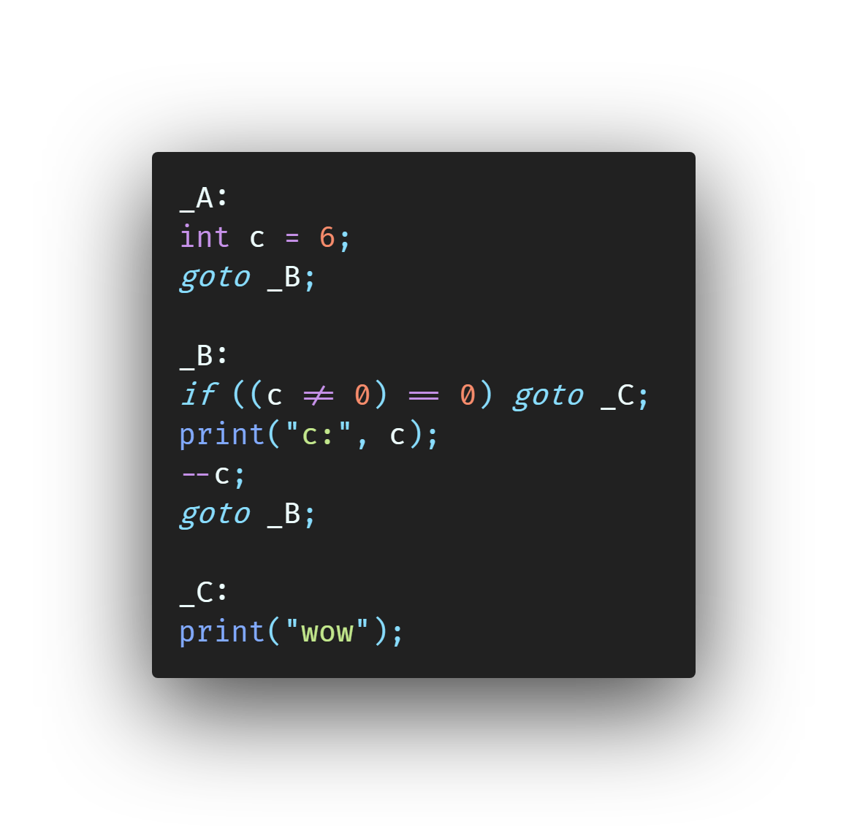
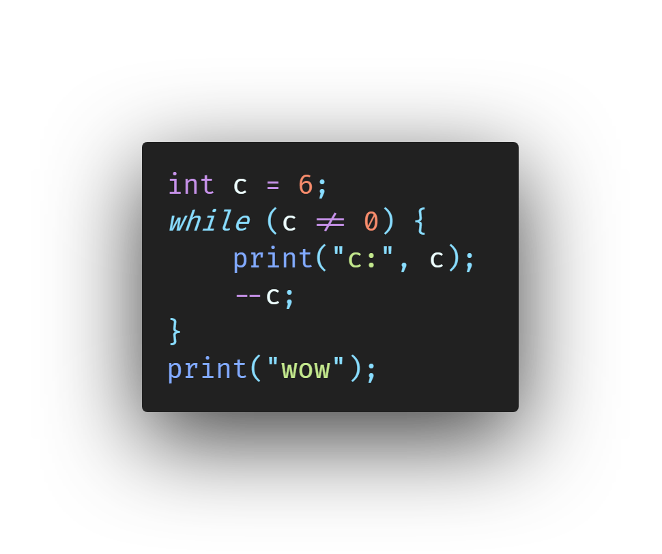

Slide 4
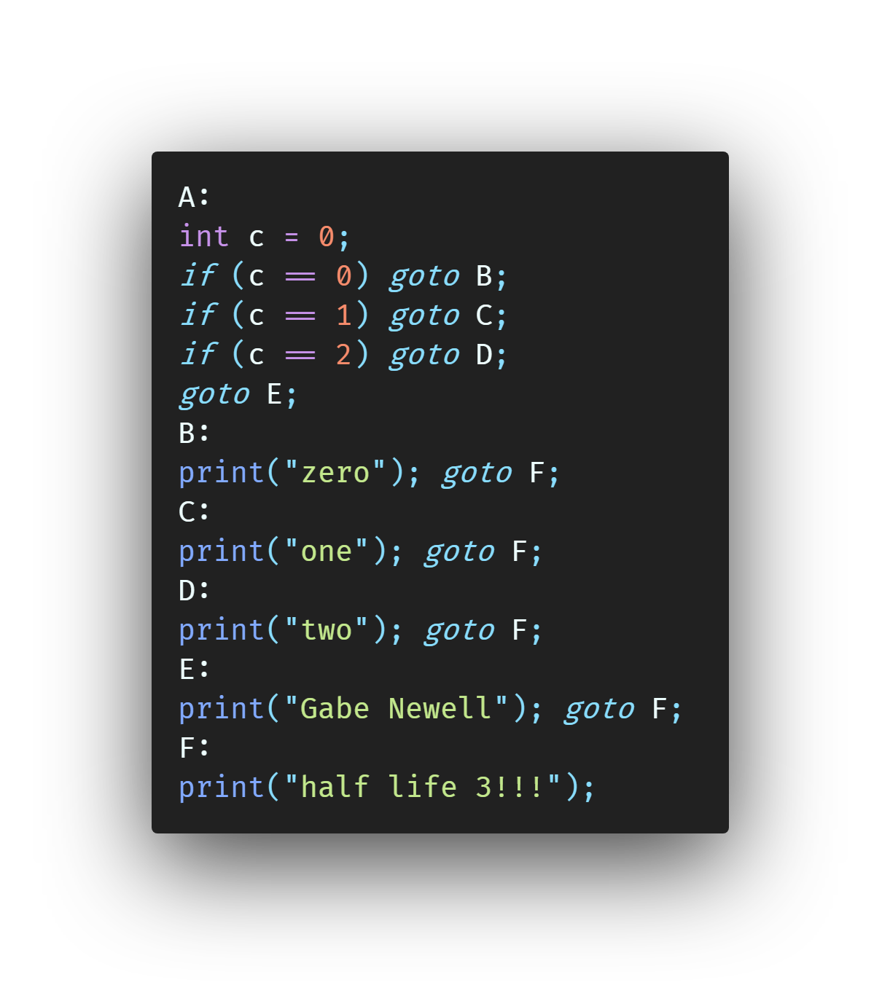
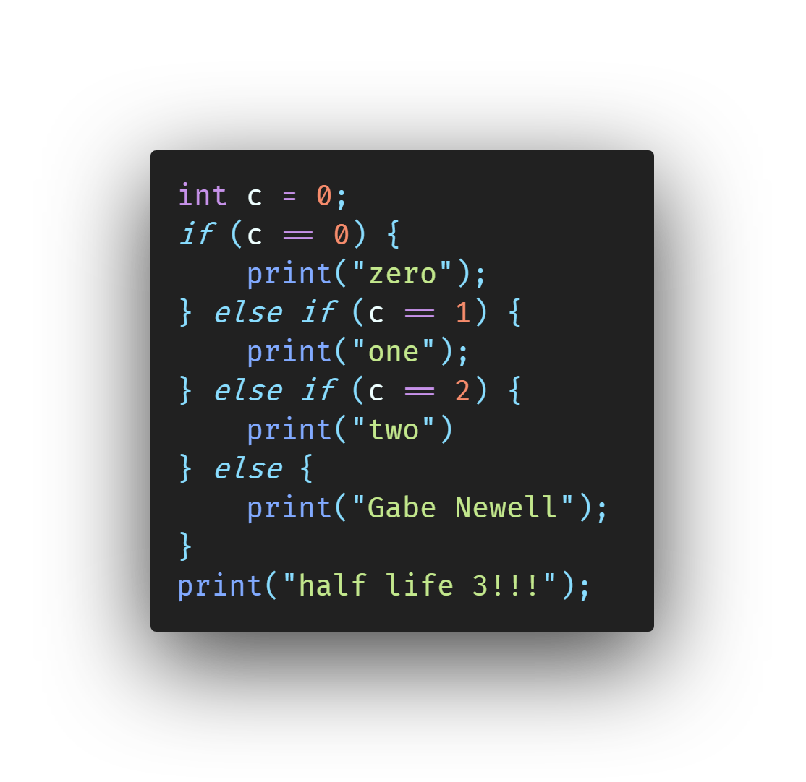

Slide 5
stmtList
_________________________________________________________________________|__________________________________________________________________________
| | |
varDec whileBlock functionCall
____|____ _____________________________|______________________________ ______|______
| | | | | |
int idList lt stmtList print parameterList
| __|__ | |
assign | | ifBlock "..."
__|__ c 6 ___________________________________________________|___________________________________________________
| | | | | | | | |
c 0 eq stmtList eq stmtList eq stmtList stmtList
__|__ | __|__ | __|__ | |
| | functionCall | | functionCall | | functionCall functionCall
c 0 ______|______ c 1 ______|______ c 2 ______|______ ______|______
| | | | | | | |
print parameterList print parameterList print parameterList print parameterList
| | | |
"zero" "one" "two" "gabe!!!"
stmtList
________________________________________________________________________________________________________________________________________________________________________|_________________________________________________________________________________________________________________________________________________________________________
| | | | |
funcDec funcDec varDec functionCall forBlock
_________________________________|_________________________________ _____________________________________|_____________________________________ _______|_______ ______|_______ _______________________________________|_______________________________________
| | | | | | | | | | | | | | | |
int gcd defParamList stmtList int coPrime defParamList stmtList int idList coPrime parameterList varDec lt stmtList sp
_____|______ ____________________________|____________________________ _____|______ _______________________________|_______________________________ ______|______ __|__ ____|____ __|___ | |
| | | | | | | | | | | | | | | | | forBlock i
defParam defParam varDec whileBlock return defParam defParam varDec ifBlock assign assign a b int idList i 10 _______________________|________________________
__|___ __|___ ____|____ ___________|___________ | __|___ __|___ _____|______ _______________________________|________________________________ ___|___ ___|___ | | | | |
| | | | | | | | a | | | | | | | | | | | | | assign varDec lt stmtList sp
int a int b int idList ne stmtList int a int b int idList ne stmtList stmtList a 73872 b 5728 __|__ ____|____ __|___ | |
| __|__ ___________|___________ | __|___ | | | | | | | | functionCall j
temp | | | | | assign | | functionCall functionCall i 5 int idList j 10 ______|_______
b 0 assign assign assign _____|______ val 1 ____________|____________ ________|_________ | | |
___|____ __|__ ___|___ | | | | | | assign coPrime parameterList
| | | | | | val functionCall print parameterList print parameterList __|__ __|__
temp mod a b b temp _____|______ _______________|_______________ ___________|____________ | | | |
__|__ | | | | | | | | | | | | j 5 i j
| | gcd parameterList "gcd(" a ", " b ") =" val a "and" b "are co-prime!"
a b __|__
| |
a b

Slide 6
stmtList
_____________________________|_____________________________
| | |
varDec whileBlock functionCall
____|____ ___________|____________ ______|______
| | | | | |
int idList ne stmtList print parameterList
| __|__ _________|_________ |
assign | | | | "wow"
__|__ c 0 functionCall sm
| | ______|______ |
c 6 | | c
print parameterList
__|___
| |
"c:" c

Slide 7
Function Call
New Array
Function Name
Parameter List
Basic Type
Dimensions
…
…
…
…
…
…

Slide 8
Statement List
While Block
VarDeclaration
…
…
…
Expr
Statement List
Type
ID List
If Block
Expr
Statement List
Expr
Statement List
...
Statement List
For Block
FuncDec
ForInit
ForExpr
Statement List
ForExpr
Type
id
ParamList
Statement List

Slide 9
Heap
0x00004000
Stack
Stack
push 893
Stack
Main
Main
_add
ESP
Main
0x00008000
893
ESP, EBP
EBP

Slide 10
Stack
Main
ESP
0x159E29E8
EBP

Slide 11
Heap
0x00004000
Stack
dfs
dfs
dfs
dfs
dfs
dfs
dfs
dfs
dfs
dfs
Main
0x00008000

Slide 12
'%'
0x00404004
's'
'H'
0x00404007
'e'
'l'
'l'
'o'
0
...
0x00404004
ESP: 0x0061FF24
printf("%s", "Hello");
0x00404007
OLD_ESP: 0x0061FF2C
EBP: 0x0061FF50

