Slide 1
🪐 Exoplanet Detection
with Kepler Light Curves
AstroNet-Inspired 1D CNN · Computer Vision ITAI 1378
Francisco Medina · San Antonio College · med27-coder
github.com/med27-coder/cv-project-kepler-exoplanet-detection-inventory

Slide 2
Project Overview
The Challenge
The Approach
When the Kepler telescope detects a star dimming, it could mean a planet passed in front — or it could be a false alarm (eclipsing binary, instrumental noise, etc.).
Manual review can't keep up with the scale of data. Machine learning can.
1
Download KOI catalog
NASA Exoplanet Archive API
2
Fetch light curves
NASA MAST via lightkurve
3
Phase-fold & normalize
201-bin time series
4
Train 1D CNN
AstroNet-inspired architecture
5
Evaluate & predict
Confusion matrix, ROC, PR curve
1,000
201
>80%
4-Layer
KOIs Processed
Flux Bins / Sample
Accuracy Target
CNN Architecture

Slide 3
Original Plan — Version 1
V1 / Initial Design
📦 Dependencies
📥 Dataset
fsspec pin + lightkurve + scikit-learn
200 CONFIRMED + 200 FALSE POSITIVE = 400 total
🔭 Light Curves
🧠 Architecture
Sequential download, single-threaded tqdm loop
Conv1D ×4 → Dense(512) → Dense(256) → sigmoid
📊 Evaluation
💾 Output
Confusion matrix · ROC curve · PR curve
Save .h5 model + download plots via google.colab.files
This was the baseline design. Most steps worked as intended, but several practical constraints led to improvements in V1.5.

Slide 4
Changes Implemented — Version 1.5
V1.5 / Final
Dataset ×2.5
Google Drive Checkpoints
What: 200 → 500 per class (1,000 total)
What: Cache arrays to Drive after download
Why: MAST servers stable; more data, better generalization
Why: Colab session timeouts killed 30-min downloads
Parallel Downloads
EDA Added (Step 2.5)
What: ThreadPoolExecutor, 10 workers, 15s timeout
What: Period · Duration · Depth distribution plots
Why: Sequential loop was ~4× slower for 1,000 KOIs
Why: Visual justification for CNN approach
Gradio Web App
Before/After Comparison
What: Live KOI lookup + CNN prediction UI
What: Untrained vs. trained model side-by-side
Why: Interactive demo extends the project's usability
Why: Concrete proof that learning happened

Slide 5
CNN Architecture & Data Pipeline
KOI
Catalog
Phase
Fold
Normalize
Flux
1D CNN
Binary
Output
NASA Archive
5,000+ entries
lightkurve
201 bins
z-score
norm
4 Conv blocks
+ Dense head
Planet or
False Positive
CNN Layers
Training Config
Conv1D(16, k=5) + MaxPool
Input: (201, 1)
Optimizer:
Adam (lr = 1e-4)
Conv1D(32, k=5) + MaxPool
→ (100, 16)
Loss:
Binary Cross-Entropy
Conv1D(64, k=5) + MaxPool
→ (50, 32)
Epochs:
50 + Early Stopping
Conv1D(128, k=5) + MaxPool
→ (25, 64)
Batch Size:
32
Dense(512, relu) + Drop 50%
→ (12, 128) → Flatten
Split:
80% train / 20% test
Dense(256, relu) + Drop 30%
→ (512,)
Val Split:
15% of train set
Dense(1, sigmoid)
→ (256,) → Planet / FP
Hardware:
Google Colab T4 GPU

Slide 6
Results & Performance
✅
✅
✅
✅
Test Accuracy
AUC (ROC)
Precision
Recall
Target: > 80%
Target: > 0.85
Target: > 80%
Target: > 80%
V3: 97.2% (V1.5: 70.4%)
V3: 0.994 (V1.5: 0.771)
V3: 95.7% (V1.5: 72.7%)
V3: 96.7% (V1.5: 73.6%)
Evaluation Outputs
Confusion Matrix —
ROC Curve —
True/false planet counts on test set
AUC measures overall discrimination ability
Precision-Recall Curve —
Phase-folded Predictions —
PR-AUC — best for class-imbalanced scenarios
Visual: correct vs. incorrect per light curve
Before vs. After Training —
Train/Val/Test Overlay —
Untrained (~50%) → trained model comparison
Accuracy, AUC, and loss across epochs + test line

Slide 7
Version 3 — Star Gazer
V3 / Star Gazer
1
All ~17 quarters
2
Global + local views
3
Eclipsing-binary checks
4 years per star, stitched; known transits masked before detrending
Whole orbit (2,001 bins) and transit close-up (201 bins)
Odd vs even transits, secondary eclipse, centroid shift
Long-period planets transit at least once
AstroNet (Shallue & Vanderburg 2018)
The common false-positive signatures (ExoMiner-style)
4
Catalog features
5
Fair split + ensemble
6
Explainable
NASA's transit fit and stellar parameters in their own branch
No star in two splits; 5 networks averaged
Occlusion saliency: which part of the light curve mattered
Radius, SNR and density separate planets from binaries
Planets on one star can't leak into the test set
Shown in the web app for any KOI
7,586
6,640
97.2%
0.994
labelled KOIs with views
stars, grouped splits
test accuracy (5-net ensemble)
test AUC
Notes:
V3 rebuilt the data and the model. Test numbers are on held-out stars that never appear in training; cross-validation confirms them across five different splits.

Slide 8
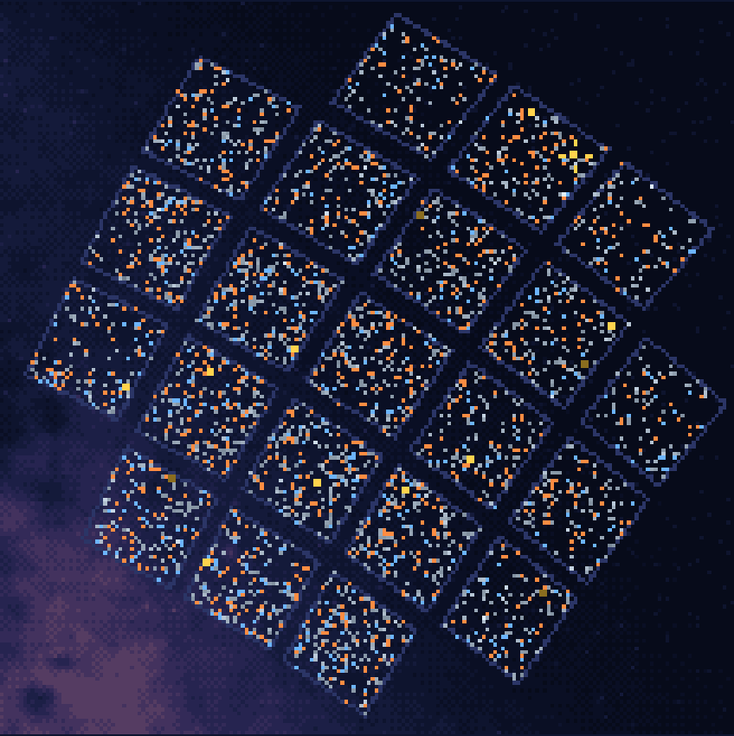
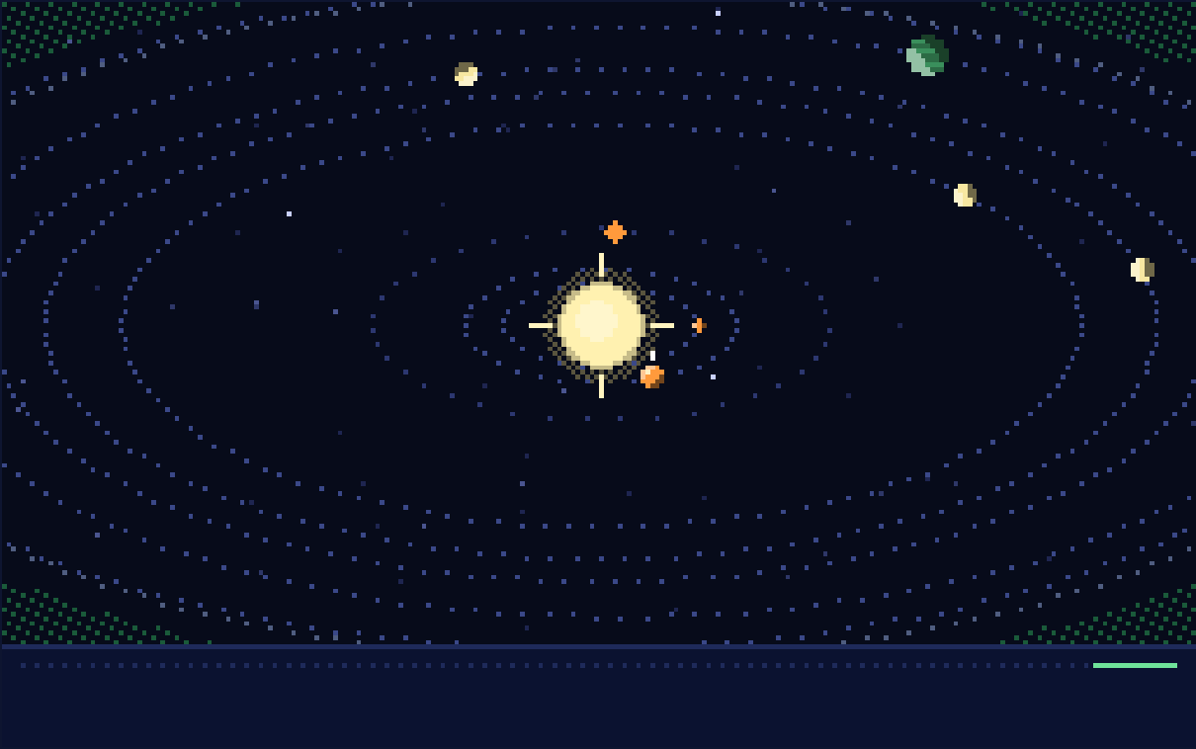
The Kepler Star Map
LIVE / WEB
Every one of 3,611 Kepler stars with a planet or candidate, drawn as pixel art from NASA and Gaia data. Search a system, watch its planets orbit and the light dip as they cross.
Live: med27-coder.github.io/cv-project-kepler-exoplanet-detection-inventory
Behind the map: the real Milky Way (ESA Gaia DR3) and Kepler's 21 CCD modules. Free static site: no server, no tracking.
Notes:
Left: the Kepler field, one pixel per star, over the Gaia Milky Way. Right: Kepler-90, eight planets, with the live light-curve strip.

Slide 9
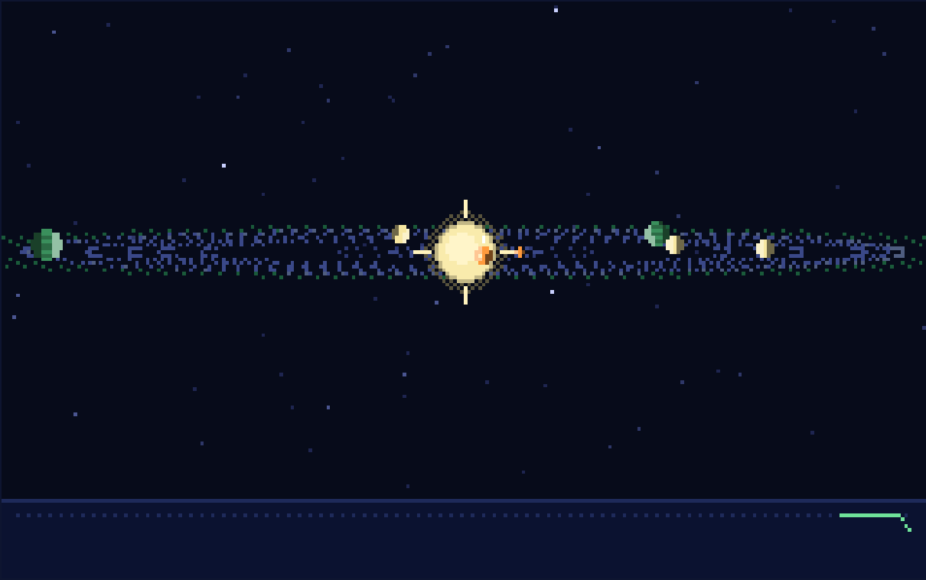
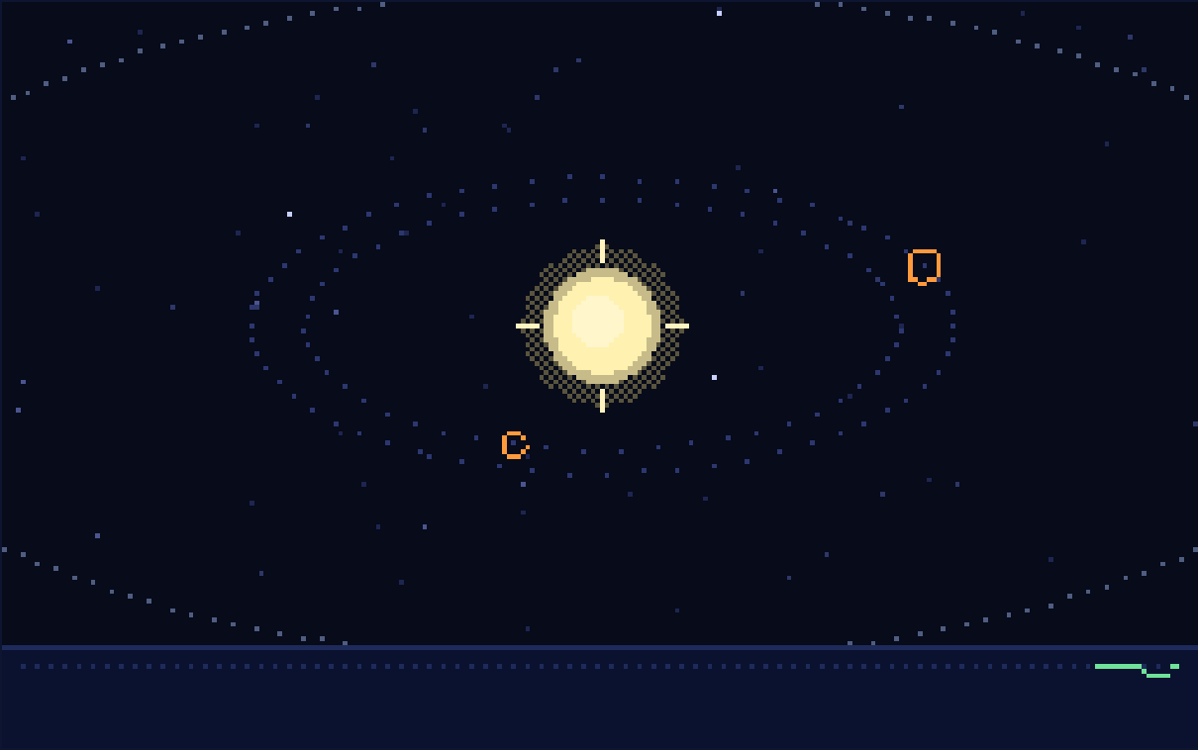
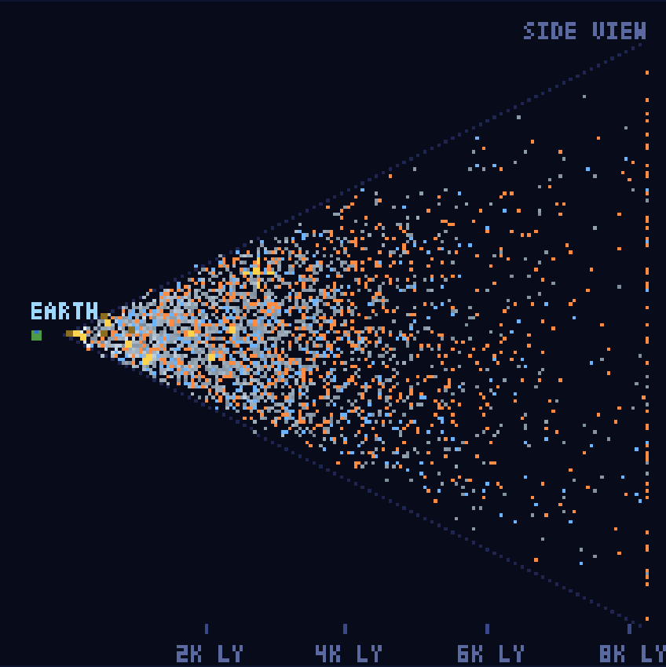
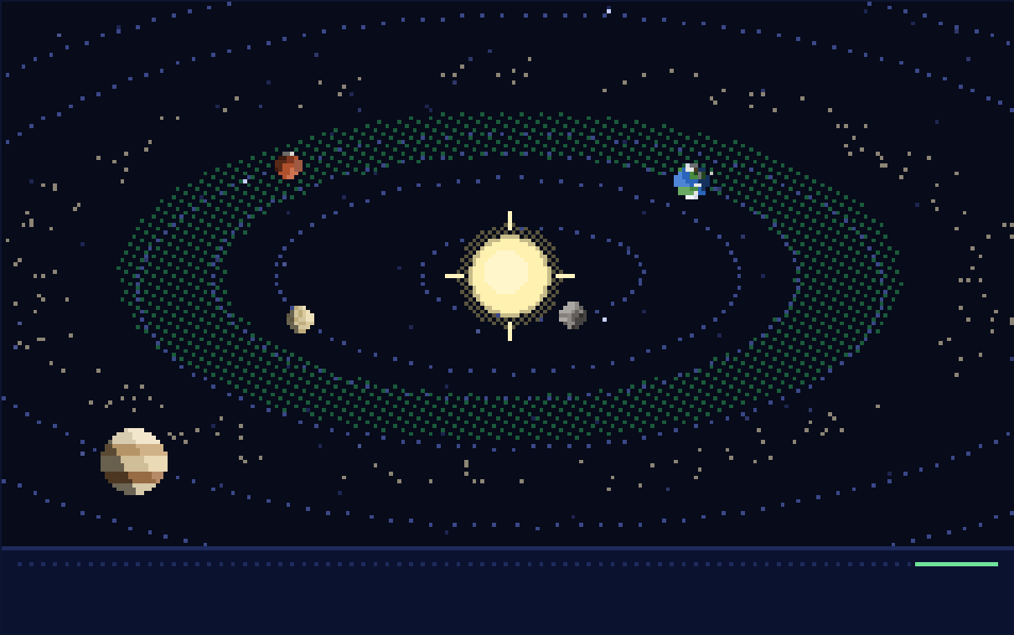
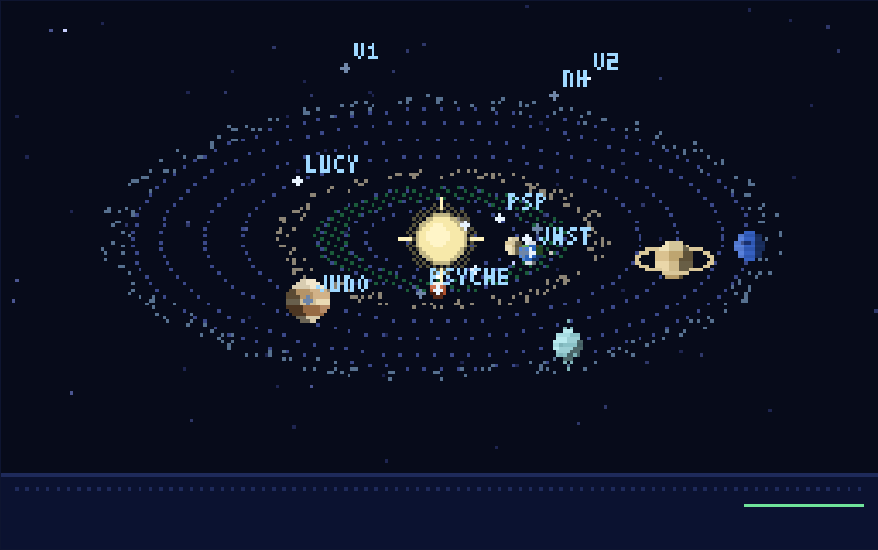
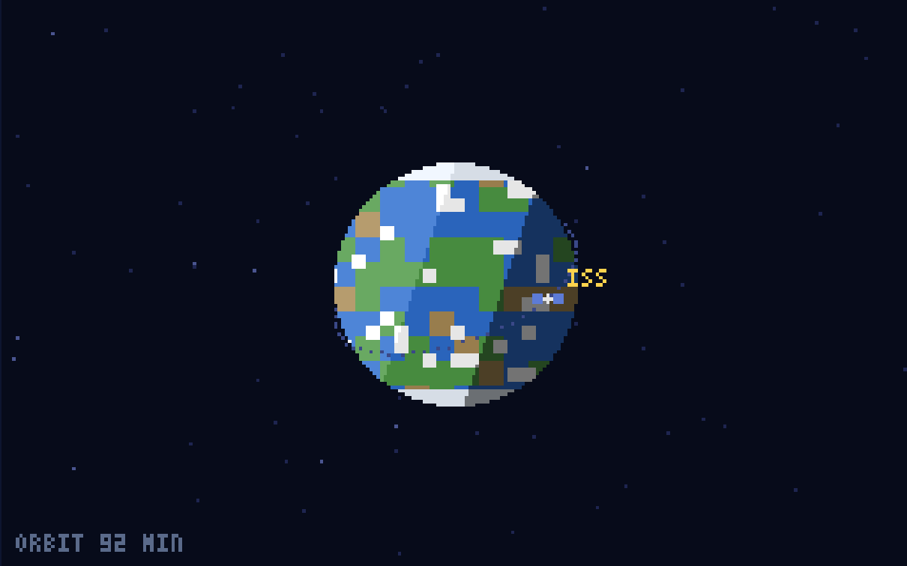
Explore the Field
EASTER EGGS
Kepler's view
Unconfirmed candidates
Side view from Earth
Edge-on, as Kepler saw it: planets cross the star when the light dips
Drawn as ghosts, with a case file for each candidate
Every star at its real distance: the cone Kepler looked down
Our Solar System
Our spacecraft
The space station
Hidden: search "home". NASA facts and real pixel planets
19 probes at their real positions (NASA JPL Horizons)
A to-scale orbit and NASA's facts about the ISS
Notes:
Interactive extras: zoom and true scale, the depth view, and easter eggs for the Solar System, spacecraft beyond Earth orbit, and the ISS.

Slide 10
Engineering & Security
BUILT RIGHT
1
Encrypted model
2
Locked-down website
3
Supply chain
AES-256-GCM, split under GitHub's size limit; verify, rotate, passphrase
Strict Content Security Policy, escaped data, clickjacking guard
SHA-pinned Actions, hash-locked dependencies, CodeQL, pip-audit, Scorecard
Public repo, private trained model
No inline code, no tracking, no cookies
Tampered packages are refused
4
110 automated tests
5
Resumable pipeline
6
Always fresh
Including the real page in a headless browser and a colour-blind check
Catalog checks, checkpointed training, one command end to end
Monthly NASA / Gaia / JPL refresh as a pull request; weekly schema check
Run on every push
A PC restart no longer costs a run
Nothing merges without review
Lesson: treat a student project like production. Checks that run on every push caught real problems: colours some readers couldn't tell apart, a "transit" longer than its orbit, a canvas wiped in background tabs.
Notes:
Security and reliability work that keeps the project trustworthy.

Slide 11
Data Sources & Key Methods
01
NASA Exoplanet Archive
02
NASA MAST Archive
Labels / Metadata
Time-Series Photometry
exoplanetarchive.ipac.caltech.edu
mast.stsci.edu (via lightkurve)
KOI Cumulative Table downloaded via the NStED REST API. Provides kepid, orbital period, epoch, and disposition (CONFIRMED / FALSE POSITIVE) for ~9,000 Kepler Objects of Interest.
Long-cadence Kepler light curves fetched on-demand per star using the lightkurve Python library. Each light curve is flattened, phase-folded by orbital period, binned to 201 samples, and z-score normalized.
Key Methods
Phase Folding
Flux Normalization
Data Quality Filters
Class Balancing
Aligns transit signals by orbital period for a clean dip shape
Z-score removes stellar variability; isolates transit depth
<10% NaN bins, std > 1e-4; rejects corrupted curves
Equal confirmed vs. FP samples prevents class bias

Slide 12
Reflection & Next Steps
What I Learned
Next Steps
Real-world data is messy — quality filters are as important as the model
1
Cross-validation & scoreboard
5 grouped folds; check predictions as NASA decides candidates
Checkpoint long jobs: resume after a timeout or restart, never start over
2
TESS transfer test
Score Kepler planets TESS re-observed, using TESS light curves
Parallel downloads cut pipeline time by ~4× with minimal added complexity
3
Gaia stellar features
EDA before training builds intuition for what the model should learn
Ablation: do Gaia radii, masses and ages help?
4
Real transit sparklines
AstroNet-style phase-folding turns a raw time series into a learnable signal
Each planet's own folded Kepler light curve on the map
5
Public demo
Gradio app on Hugging Face Spaces (encrypted model)
Francisco Medina · ITAI 1378 Computer Vision · San Antonio College
github.com/med27-coder

