Slide 1

VEOLIA Challenge
Elaborated By : Mohamed-Ali BOUCHHIOUA

Slide 2

Introduction
Multi-out regression task with small dataset.
Ideal for NN and RNN models.
Data Preprocessing
Kfold Cross Validation
Tabnet attentive interpretable tabular learning
CV Score : 11.4592
Public Score : 46.6593
Private Score : 31.2254
TabNet: Attentive Interpretable Tabular Learning (2019) : https://arxiv.org/abs/1908.07442

Slide 3
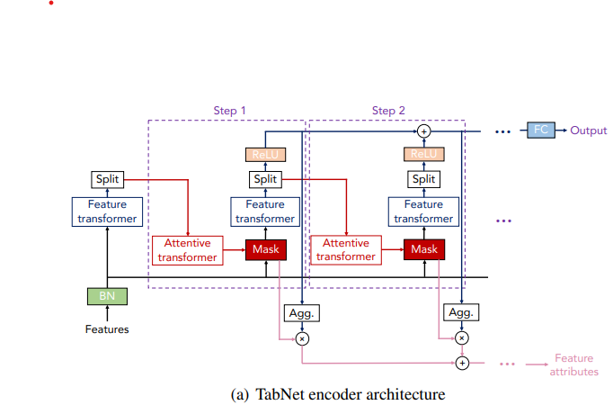
Model Architechture

Slide 4
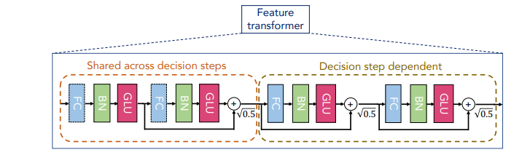
Feature Transformer
Example of 4 consecutive GLU blocks
GLU block: Fully Connected – Batch Norm – GLU
Example of 2 shared blocks and 2 independent blocks
Skip connections between two consecutive blocks
Input size = n_features, output size = n_d + n_a
The more steps the bigger your model is
Each step has a specific mask and select its own features

Slide 5
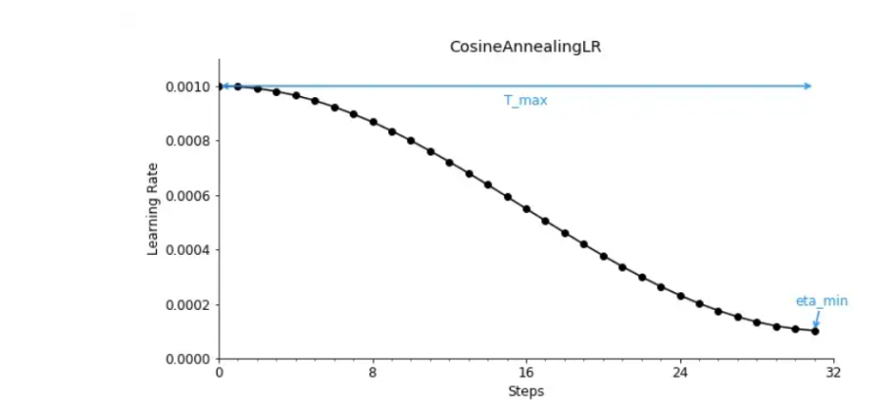
Architecture Tricks
Cosine anealing Learning rate
Decay the learning rate over half a period for the maximum number of iterations
Then increase the learning rate in the second half to escape saddle points
Others “regularization” techniques
Due to the size of train and test dataset, the network tends to overfit very quickly
Remove features that have one unique values (std= 0)
Kfold random train test split (size of folds : (n_rows = 244, n_cols = 1104)
Small Neural Net to reduce overfitting (small n_d, n_a values)
Apply weight decay on Adam optimizer

Slide 6
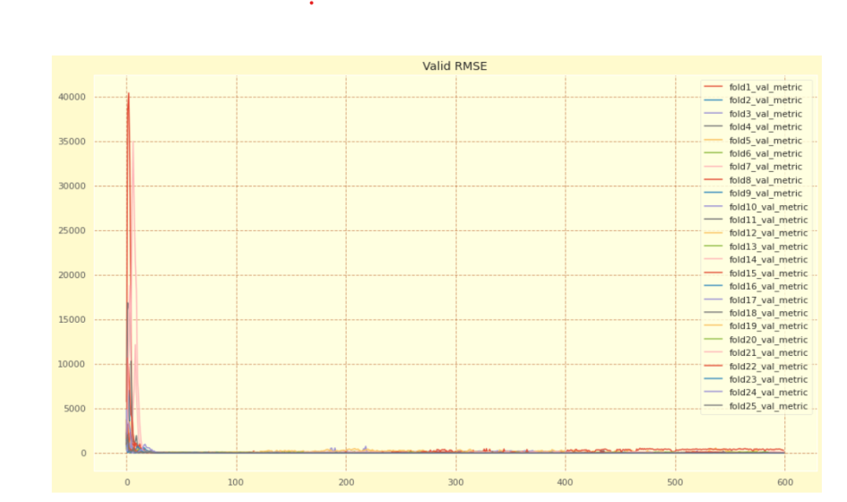
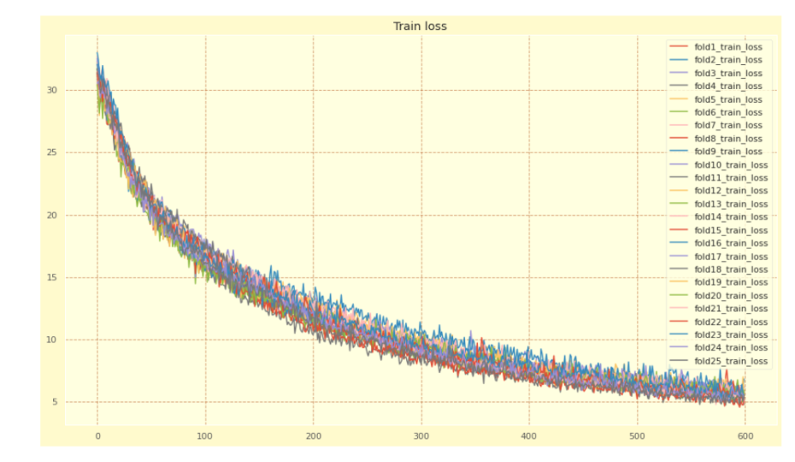
Train Loss and Validation Metric

Slide 7
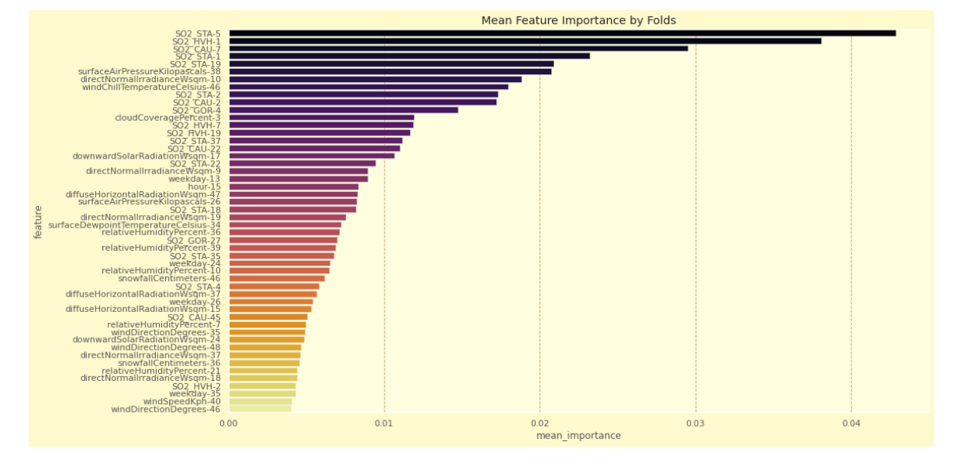
Feature Importance

Slide 8
Other Used Techniques
Attention Models
Good results but too much time consuming (x5)
Temporal Convolution Nets (~ WaveNets)
Worse results when tried, seems to be more adapted for longer time series
Xgboost
Very poor results, not adapted for this challenge

Slide 9
Further Improvements
Resnet Like architecture
After RNN Net, addition/multiplication layer
Try FCN Networks
More time consuming, but Conv. Layer should be able to get more insights
about interaction between variables
Time-series Extreme Event Forecasting with Neural Networks
LSTM Autoencoder approach to create features from time serie.
Self Supervised Tabnet
Pretrain Tabnet by trying to predict randomly masked features
Useful for small dataset

Slide 10
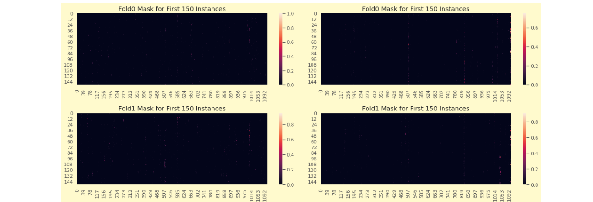
Mask Feature Importance

Slide 11
Thank You for Your Attention

