Slide 1
Mouhamed Amine Mbarek
Databases NoSQL SQL.

Slide 2
What is SQL?
SQL is a domain-specific language used to query and manage data. It works by allowing users to query, insert, delete, and update records in relational databases. SQL also allows for complex logic to be applied through the use of transactions and embedded procedures such as stored functions or views.
What is NoSQL?
NoSQL stands for Not only SQL. It is a type of database that uses non-relational data structures, such as documents, graph databases, and key-value stores to store and retrieve data. NoSQL systems are designed to be more flexible than traditional relational databases and can scale up or down easily to accommodate changes in usage or load. This makes them ideal for use in applications

Slide 3
Which is better SQL or NoSQL?
The decision of which type of database to use - SQL or NoSQL - will depend on the particular needs and requirements of the project. For example, if you need a fast, scalable, and reliable database for web applications then a NoSQL system may be preferable. On the other hand, if your application requires complex data queries and transactional support then an SQL system may be the better choice. Ultimately, there is no one-size-fits-all solution - it all comes down to what you need from your database and which type of system can provide that in the most efficient manner. It's best to research both options thoroughly before making a decision.
Below, learn in-depth about the most important distinctions between SQL vs NoSQL databases and the best systems available on the market.

Slide 4
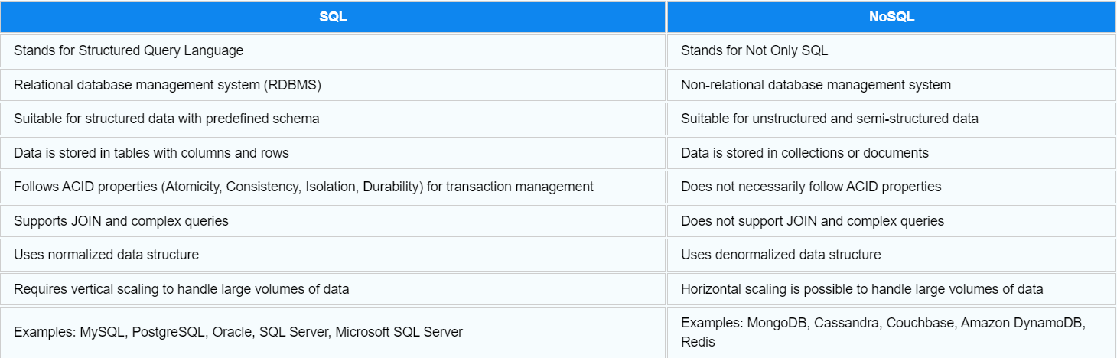
Comparison of SQL vs NoSQL
With a basic understanding of what SQL vs NoSQL is, let's take a look at this quick comparison chart to see what sets the two apart:

Slide 5
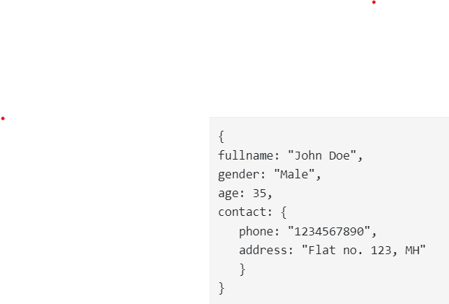
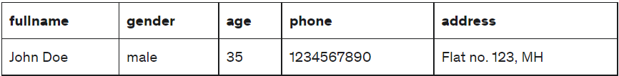
The difference between MongoDB and SQL
Schemas
In SQL, the data must follow predefined schemas. For example, while creating a table, we must define data columns and data types. While storing the data, it should match the table structure. But, in MongoDB, we don’t need to define any schema. A collection can store any document type, which acts as a sort of dynamic schema rather than a rigid one. This has been frequently used in applications such as machine learning and AI.
Data storage
The SQL databases store data in tables. The table columns are data attributes and rows contain actual data records. In MongoDB, collections store the data. A collection stores JSON-like key-value pairs.
An example of a MongoDB document:
An example of a SQL database record / row

Slide 6
Reliability and availability
Reliability and availability are most important to understand if a database system is robust. Almost every DBMS works on standalone servers. To manage the risk of failures, SQL databases use distributed database architecture. The databases running on clusters of nodes increase resilience. In case of one node failure, the database will work on other nodes.
MongoDB runs on a cluster of commodity hardware. And for high reliability and availability, it replicates the data across the nodes. Hence, MongoDB fail-over is less complex and quicker.
Performance
As the number of queries grows, SQL takes more time to execute. But MongoDB performance is better in such scenarios. As NoSQL doesn’t use joins and indexing, it performs better compared to SQL databases.
Query language
Most popular relational databases use structured query language (SQL) to interact with databases. While MongoDB uses MongoDB Query Language (MQL).
Scaling
Most SQL databases need to scale up vertically. The vertical scaling means migrating to a larger server with more memory, disk, and computing.
MongoDB or NoSQL databases support horizontal scaling. It means we can add cheaper commodity servers. This process is known as Sharding.

Slide 7
