Slide 1
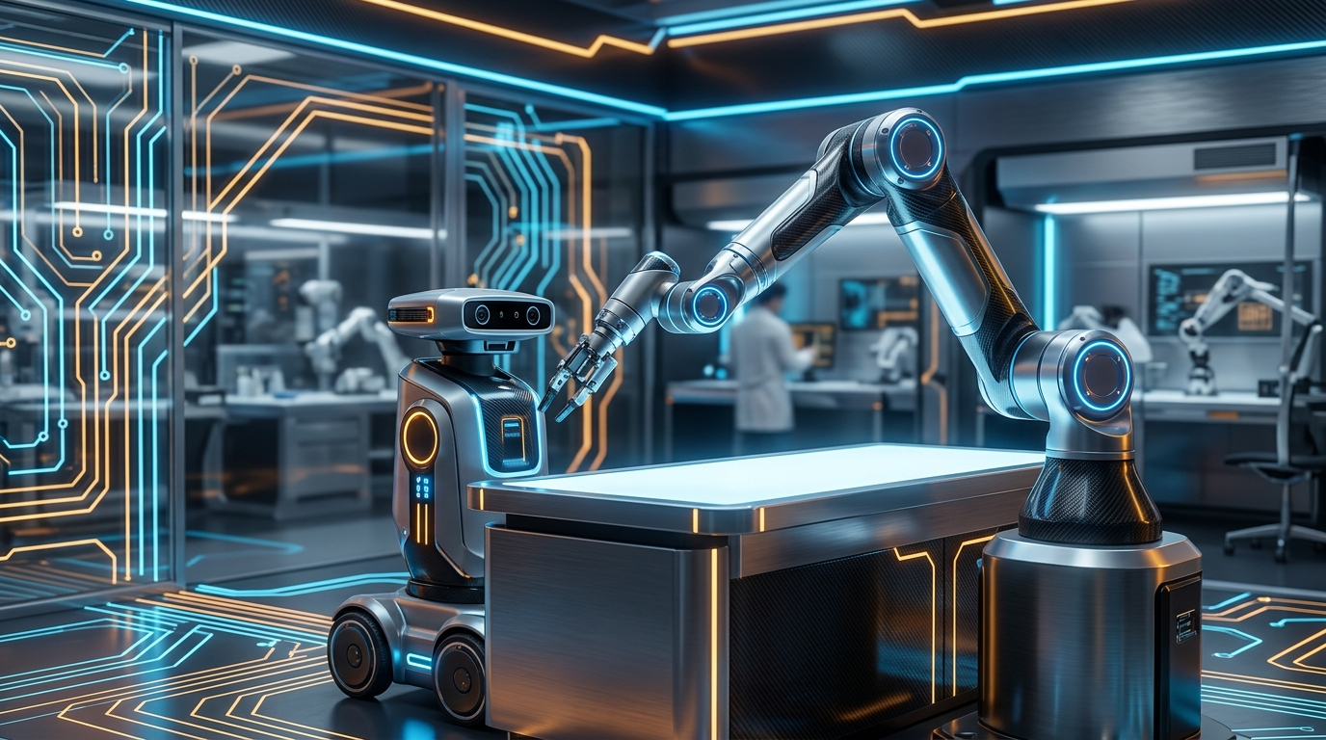
ENGINEERING DEEP DIVE • 2026 EDITION
FUNDAMENTALS
OF ROBOTICS
Architecture, Kinematics, Actuation & Autonomous Control Systems
• Perception & Sensor Fusion (Sense)
• Kinematic Chains & Jacobians (Think)
• High-Torque Actuators & Drivers (Act)
• ROS 2 Autonomous Middleware

Slide 2
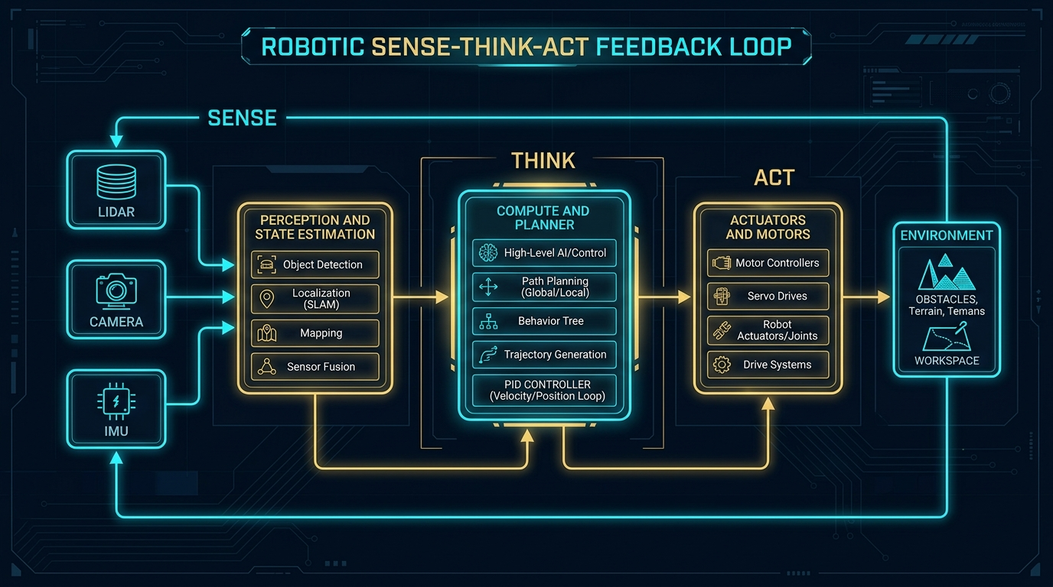
ROBOTICS ENGINEERING FOUNDATIONS
The Robotic Core: The Sense-Think-Act Paradigm
System Dynamics Breakdown
1. SENSE (Perception Layer)
Transducing physical reality via LiDAR, stereo cameras, optical encoders, and IMU units into calibrated digital point clouds.
2. THINK (Planning & State Estimation)
Extended Kalman Filters (EKF) fuse noisy measurements. Global planners (A*/Dijkstra) and local planners (TEB/DWA) generate collision-free trajectories.
3. ACT (Physical Execution)
Field-Oriented Control (FOC) commutates BLDC motors. PWM duty cycles drive H-bridge MOSFETs to apply exact Newton-meter joint torques.
Deterministic Real-Time Requirement:
The closed loop frequency determines stability. Low-level motor FOC loops run at 20 kHz, joint position loops at 1 kHz, and high-level trajectory/vision planning at 30-50 Hz.

Slide 3
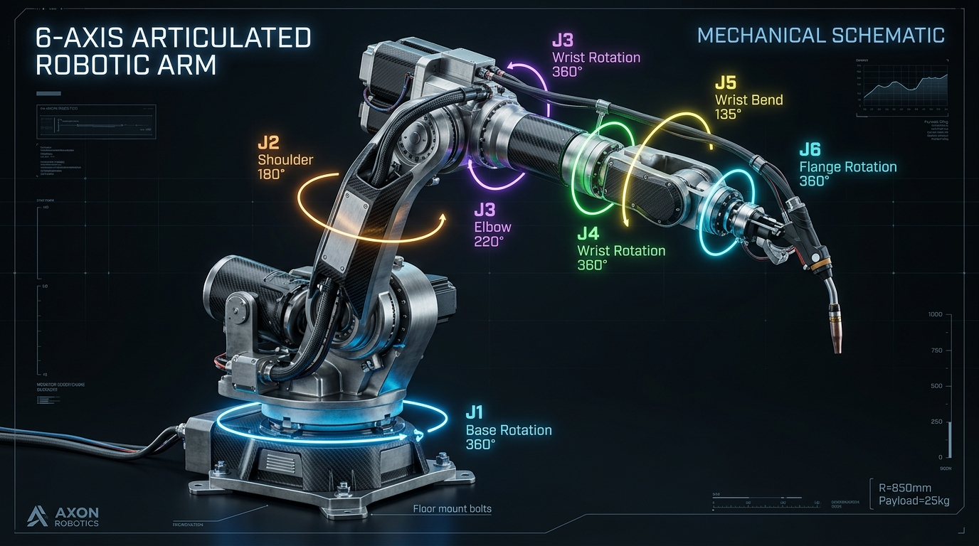
ROBOTICS ENGINEERING FOUNDATIONS
Kinematics: Forward, Inverse & Coordinate Frames
Forward vs. Inverse Kinematics
• Forward Kinematics (FK): Solves end-effector pose [X, Y, Z, Roll, Pitch, Yaw] given joint angles θ₁..θ₆ using Denavit-Hartenberg (D-H) transformation matrices. Always has a unique solution.
• Inverse Kinematics (IK): Solves required joint angles given target tool pose. Often has multiple mathematical solutions or singular deadlocks.
The Jacobian Matrix & Singularities
• The Jacobian (J) maps joint velocities (θ̇) to Cartesian tool velocity (v):
v = J(θ) · θ̇
• Kinematic Singularity: Occurs when det(J) = 0. The arm loses one or more degrees of freedom, requiring infinite joint velocity for Cartesian motion.

Slide 4
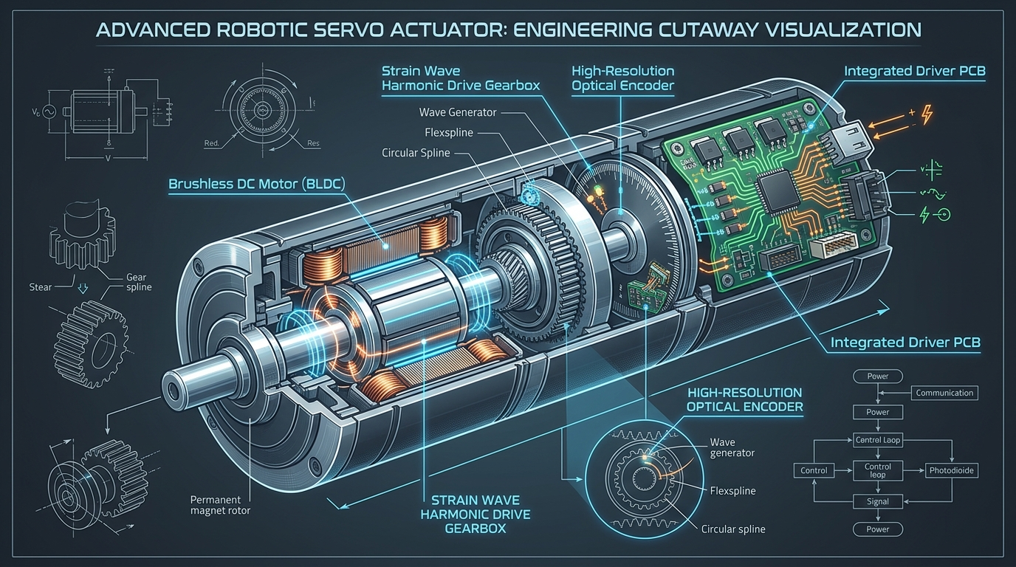
ROBOTICS ENGINEERING FOUNDATIONS
Actuators: BLDC Motors, Strain Wave Gears & Drive Electronics
Strain Wave (Harmonic) Gearing
• Zero Backlash: Crucial for sub-millimeter robotic repeatability.
• High Reduction Ratio: 50:1 up to 160:1 in a single compact inline stage.
• 3 Components: Elliptical Wave Generator, flexible external-tooth Flexspline, rigid internal-tooth Circular Spline.
Integrated Smart Actuator Stack
• Brushless DC (BLDC) Motor: Frameless outrunner design maximizing torque density (Nm/kg).
• Dual Encoders: Motor-side for commutation; output-side for deflection compensation.
• Field-Oriented Control (FOC): Clarke & Park transforms regulate Id/Iq current vectors with zero torque ripple.

Slide 5

ROBOTICS ENGINEERING FOUNDATIONS
Software Architecture: ROS 2, DDS & Real-Time Frameworks
ROS 2 & DDS Middleware
• Decentralized Architecture
No single point of failure; discovery via OMG DDS protocol.
• QoS Policies
Configurable reliability, transient local durability, and deadline profiles.
• Multi-Platform
Native Linux (Ubuntu), Windows, and RTOS micro-ROS endpoints.
Motion & Path Planning
• Nav2 Stack
Global costmaps, BT navigators, and dynamic obstacle avoidance.
• MoveIt 2
Collision-free motion planning with OMPL, TrajOpt, and CHOMP.
• Kinematics Solvers
KDL, TRAC-IK, and BioIK with real-time collision checking.
Control & Hardware Abstraction
• ros2_control
Unified hardware interfaces (Command / State) via shared memory.
• Real-Time Kernel
PREEMPT_RT patched Linux ensures jitter < 50 microseconds.
• Hardware Buses
CAN FD, EtherCAT, and RS-485 running deterministic packets.
Standardized Industrial Interoperability: ROS 2 enables seamless bridging between low-level microcontrollers (STM32, ESP32, Arduino) and high-level compute (NVIDIA Jetson, Intel x86) with zero glue code.

Slide 6
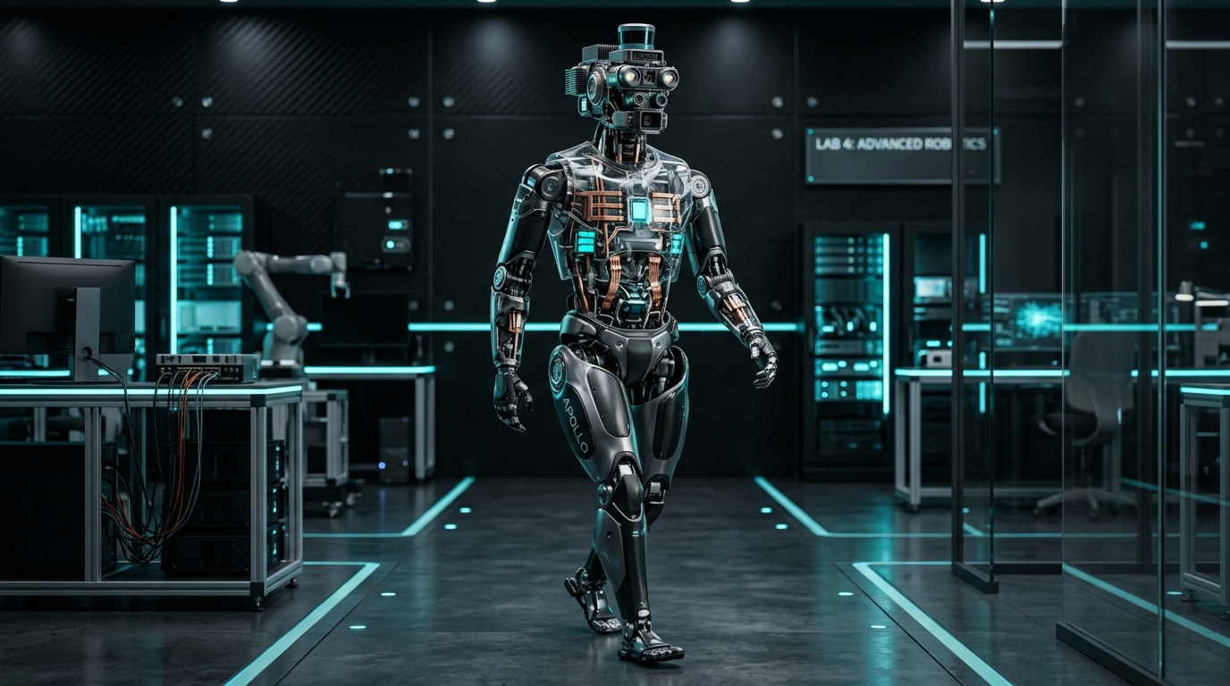
ROBOTICS ENGINEERING FOUNDATIONS
The Next Frontier: Embodied AI & Bipedal Humanoid Systems
From Scripted Control to Embodied Intelligence
1. Vision-Language-Action (VLA) Models
Models like RT-2 and OpenVLA map multimodal internet-scale vision and natural language prompts directly into 6-DoF joint token trajectories.
2. Dynamic Bipedal Locomotion
Zero Moment Point (ZMP) has been superseded by Model Predictive Control (MPC) and Deep Reinforcement Learning trained inside GPU physics simulators (Isaac Gym).
3. Sim-to-Real Domain Randomization
Varying friction coefficients, motor latencies, and sensor noise across millions of parallel simulation instances yields robust zero-shot physical deployment.

Slide 7
ROBOTICS ENGINEERING FOUNDATIONS
Engineering Summary: Core Design Rules of Robotics
1. Perception
Never rely on a single sensor modality. Fuse optical cameras with LiDAR and wheel odometry using Kalman filters to overcome sensor blindness and drift.
2. Kinematics
Use closed-form analytical IK for high-speed 6-axis arms; utilize numerical Damped Least Squares (DLS) Jacobians when avoiding singularities.
3. Actuation
Match motor inertia to load inertia. Strain wave gears eliminate backlash; integrated dual absolute encoders ensure repeatable sub-millimeter precision.
4. Autonomy
Standardize on ROS 2 with deterministic QoS. Decouple real-time motion controllers (micro-ROS) from asynchronous high-level vision and AI planners.

