Slide 1
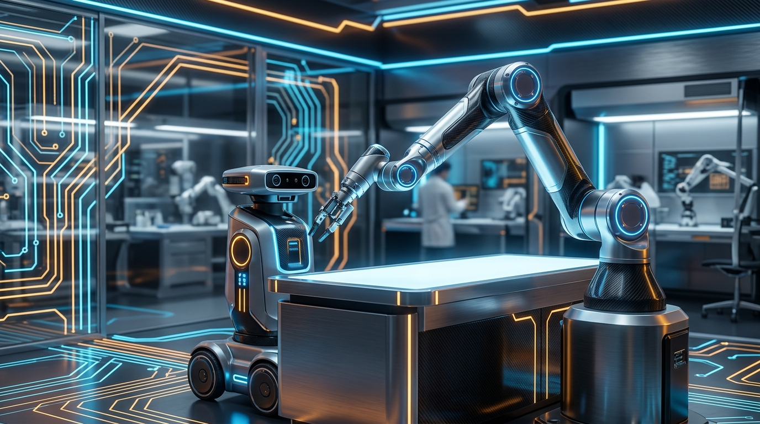
ROBOTICS SESSION SERIES • SESSION 01 / 04
ROBOTICS
FUNDAMENTALS
Mechanical, Electrical Systems & Design
How a robot becomes a real, functioning physical system.
Links • Motors • Power • Structure • Testing
THURSDAY • 10 SEPTEMBER 2026 • 20:00 GMT+3
ONLINE INTERACTIVE WORKSHOP FOR BEGINNERS & MAKERS
Notes:
PRESENTER NOTES:
1. Welcome & Icebreaker:
- "Good evening everyone and welcome! Whether you are a student, hobbyist, or aspiring engineer, tonight we break down robotics from the ground up."
- "No dry university calculus tonight. We are focusing on intuition: how robots move, how parts connect, and why they fail."
2. Audience Check:
- "Type in the chat: Have you built a robot before, or is this your very first workshop?"
3. Transition:
- "Let's start with a simple question that surprises almost everyone."

Slide 2
ROBOTICS FUNDAMENTALS • SESSION 01/04
⚡ INTERACTIVE POLL
WHAT ACTUALLY MAKES A ROBOT MOVE?
Think of a Robot Like a Human Body:
🧠 SOFTWARE — The Brain
Decides where to reach and plans the path.
⚡ ELECTRONICS — The Nerves
Carries high-power signals to where they are needed.
💪 MOTORS — The Muscles
Converts electric energy into pulling/turning force.
🦴 MECHANICS — The Skeleton
Bones and joints that give the arm reach and stiffness.
🎯 MOTION — The Action
The hand finally arrives at the target!
LIVE AUDIENCE POLL
Which one is the MOST important for a great robot?
[A — The Motors]
Super strong & fast muscles
[B — The Electronics]
Clean power & reliable cables
[C — The Software]
Smart algorithms & AI
[D — The Mechanical Skeleton]
Stiff frame & precise joints
👉 Drop your vote (A, B, C, or D) in chat right now!
Notes:
PRESENTER NOTES:
1. Interaction:
- "Type A, B, C, or D in chat! Which part is the most critical?"
2. The Big Reveal:
- "Almost every beginner votes Software (C).
- But think about it: if your muscles are strong and your brain is smart, but your bones are made of cooked spaghetti, can you write your name with a pen?
- In robotics, all 4 layers must work in harmony. You are building an integrated system."
3. Transition:
- "Let's formalize this into the Four Pillars of Robotics."

Slide 3
ROBOTICS FUNDAMENTALS • SESSION 01/04
ROBOTICS = INTEGRATION (The Four Pillars)
01. MECHANICS
The Physical Skeleton
Bones (Links), Hinges (Joints), and Gears. Gives the robot reach, strength, and structural stiffness.
02. ELECTRONICS
The Power & Nerves
Wires, motor drivers, and batteries. Converts gentle digital commands into heavy physical muscle power.
03. CONTROL
The Reflexes
The math that keeps the robot stable, corrects errors, and stops it from shaking or oscillating.
04. SOFTWARE
The Mind
High-level navigation, reading sensors, and making decisions: 'Where do I go next?'
Notes:
PRESENTER NOTES:
1. Simplifying the 4 Pillars:
- "Notice the subtitles: Skeleton, Nerves, Reflexes, and Mind."
- "When people say 'I want to learn robotics', they usually mean only Software. But real robotics magic happens at the boundaries."
2. Anecdote:
- "If a robot shakes violently, is it bad code (Control)? A loose screw (Mechanics)? Or noisy power cables (Electronics)? Usually all three!"
3. Transition:
- "How do these four pillars talk to each other in real time?"

Slide 4
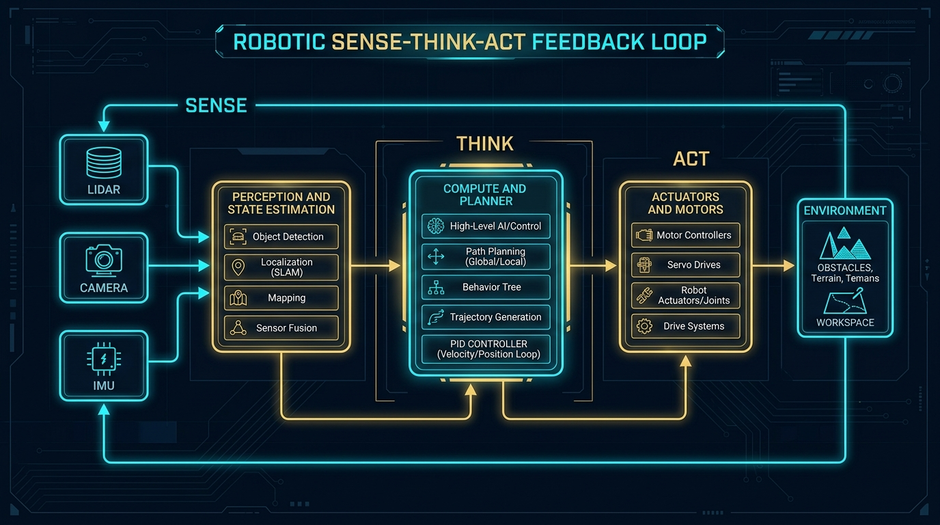
ROBOTICS FUNDAMENTALS • SESSION 01/04
THE ROBOTIC SYSTEM: SENSE → DECIDE → ACT
How Every Robot Works:
1. SENSE (The Senses)
Cameras, distance sensors (LiDAR), and joint encoders tell the robot where it is.
2. DECIDE (The Brain)
A computer compares where the robot IS with where it WANTS TO BE.
3. ACT (The Muscles)
Motors spin to move the arm or wheels closer to the goal.
💡 The Feedback Secret
This loop runs dozens or hundreds of times every second. If your senses are slow or noisy, the robot reacts too late and stumbles.
Notes:
PRESENTER NOTES:
1. Intuition:
- "Think about catching a ball. Your eyes see the ball (Sense), your brain calculates where your hand needs to go (Decide), and your arm moves (Act)."
- "Every robot runs this exact loop continuously."
2. Transition:
- "Before you buy a single screw, what 3 questions must you answer?"

Slide 5
ROBOTICS FUNDAMENTALS • SESSION 01/04
BEFORE BUILDING A ROBOT: THREE SIMPLE QUESTIONS
01
WHERE DOES IT REACH?
Workspace & Geometry
• How far does the arm need to stretch?
• Does it only work on a flat table, or reach all 3D space?
• Fewer joints = simpler, cheaper build!
02
HOW HEAVY IS THE LOAD?
Torque & Strength
• Are you lifting a 10g feather or a 2kg bottle of water?
• What kind of motor can lift that weight?
• Don't forget: The arm must also lift its OWN weight!
03
WHAT IS STOPPING IT?
Real-World Roadblocks
• Will the battery die in 5 minutes?
• Will the plastic links bend like rubber?
• Will the gears have loose play (backlash)?
Notes:
PRESENTER NOTES:
1. Beginner Rule:
- "Notice what is NOT on this slide: 'Which code language should I learn?'"
- "Start with the physics: Reach, Load, and Limits. That defines your robot."
2. Transition:
- "Now, what happens if you take away the robot's senses? Let's see."

Slide 6
ROBOTICS FUNDAMENTALS • SESSION 01/04
⚡ INTERACTIVE QUESTION
CLOSED LOOP VS. OPEN LOOP
How Feedback Keeps You On Target
1. You Command: 'Move arm to 90 degrees.'
2. Motor Turns: Starts rotating.
3. Sensor Checks: 'We are currently at 88 degrees.'
4. Controller Corrects: Pushes a tiny bit more to hit 90° exactly!
This is CLOSED-LOOP: The sensor closes the loop by checking the actual result.
WHAT HAPPENS WITHOUT SENSORS?
If you remove the sensor, you are running OPEN-LOOP.
🚶‍♂️ The Human Analogy:
• Closed Loop = Walking to your door with eyes wide open.
• Open Loop = Closing your eyes, taking 10 steps, and HOPING you don't hit a wall!
💡 Inside Joke:
'Hope is not a control strategy.' If your robot doesn't measure its position, errors build up until it crashes.
Notes:
PRESENTER NOTES:
1. The Human Analogy:
- "Ask the audience: Have you ever tried walking across your dark bedroom at night? You count your steps (open loop), but you usually bump your knee."
- "With sensors (eyes open), you constantly steer around obstacles. That's closed-loop control!"
2. Transition:
- "Now let's start Part 01: The Mechanical Skeleton of the robot."

Slide 7
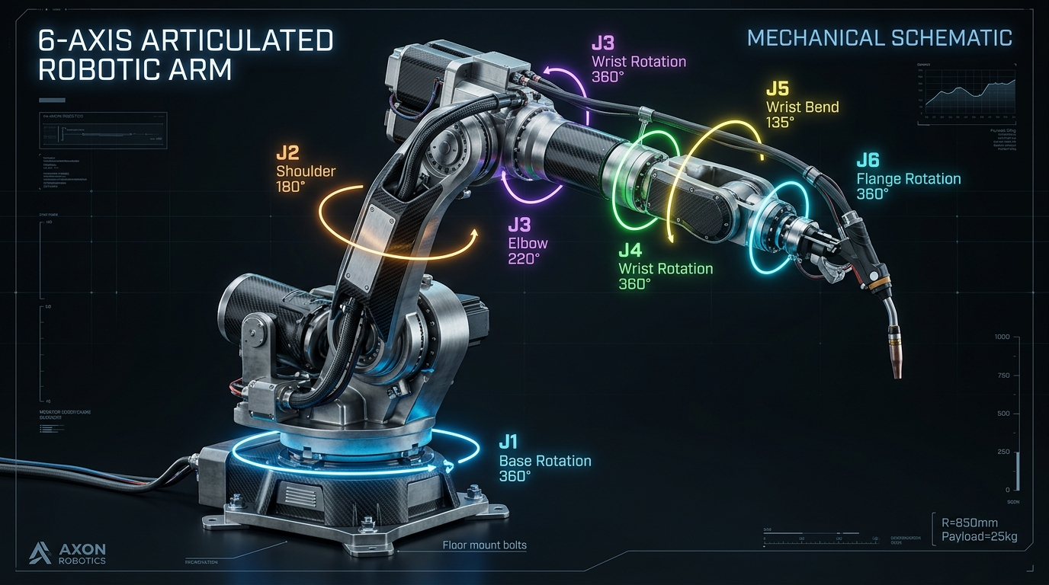
PART 01
THE MECHANICAL
SKELETON
Bones (Links) • Hinges (Joints) • Degrees of Freedom
Notes:
PRESENTER NOTES:
1. Section Intro:
- "Welcome to Part 1. We start with the mechanical skeleton: links, joints, and freedom of motion."

Slide 8
ROBOTICS FUNDAMENTALS • SESSION 01/04
LINKS & JOINTS: SKELETON & HINGES
THE LINK (The Bone)
A Rigid Structural Bar
• What it does: Connects two joints and holds its shape under load.
• Think of it like: Your forearm or your thigh bone.
• Goal: Stiff and light. If the link bends, your robot loses accuracy!
THE JOINT (The Hinge)
Allows Controlled Motion
• What it does: Connects two links and lets them move relative to each other.
• Think of it like: Your elbow or your knee hinge.
• Goal: Smooth rotation with zero wobble or loose slop.
💡 The Golden Formula: Link + Joint + Link = Mechanism
A robot arm is just bones and hinges chained together. Every joint needs a motor; every link gives you reach.
Notes:
PRESENTER NOTES:
1. Point to your own arm:
- "Your bicep bone is a link. Your elbow is a joint. Your forearm is another link."
2. Transition:
- "What kinds of joints exist in real robots? There are basically just TWO!"

Slide 9
ROBOTICS FUNDAMENTALS • SESSION 01/04
THE TWO FUNDAMENTAL JOINTS: SPIN OR SLIDE?
REVOLUTE JOINT (R)
Pure Rotation (Spinning)
• Motion: Spins around a center pivot (Angle θ).
• Examples: Door hinge, bicycle wheel, robot shoulder & elbow.
• Why we love it: Easy to build using standard ball bearings and round motor shafts.
PRISMATIC JOINT (P)
Pure Translation (Sliding)
• Motion: Slides along a straight track (Distance d).
• Examples: 3D printer gantry, elevator, drawer slides, car jack.
• Why we use it: Perfect for straight-line plunging or sliding motions.
Almost EVERY robot in the world is built from just Revolute (R) and Prismatic (P) joints!
A 3D printer is 3 Prismatic joints (X, Y, Z). A classic factory arm is 6 Revolute joints (6R). That's it!
Notes:
PRESENTER NOTES:
1. Simplicity:
- "Don't overcomplicate joints. You either spin (Revolute) or you slide (Prismatic)."
2. Question:
- "What joint does your 3D printer use? Prismatic (slides on rods)."
3. Transition:
- "How many independent directions can a robot move? That's called DOF."

Slide 10
ROBOTICS FUNDAMENTALS • SESSION 01/04
WHAT IS DOF? (DEGREES OF FREEDOM)
1 DOF
One Way to Move
A door hinge or train on a track. Can only go forward/backward along one coordinate.
2 DOF
Two Ways to Move
A mouse on a mousepad, or a toy drawing on paper (X and Y coordinates).
6 DOF
Full 3D Freedom!
Your hand in free space. You can move Up/Down, Left/Right, Forward/Back AND tilt Pitch, Roll, Yaw.
Notes:
PRESENTER NOTES:
1. Physical Demonstration:
- "Show your hand: moving in space is 6 DOF. 3 positions (X,Y,Z) and 3 tilts (Roll, Pitch, Yaw)."
2. Transition:
- "Should we just add 10 or 12 DOF to every robot? Let's find out."

Slide 11
ROBOTICS FUNDAMENTALS • SESSION 01/04
⚡ DESIGN TRADE-OFF
MORE DOF ≠ AUTOMATICALLY BETTER
THE GOOD STUFF (+)
Why Add More Joints?
• Reach Around Obstacles: You can weave your arm around a barrier.
• Human-Like Motion: Smoother gestures and flexible tool angles.
• Redundancy: If one joint reaches its limit, others can take over.
THE PENALTIES (−)
The Cost of Extra Joints
• Heavy: Every extra motor adds weight that the base motors must carry!
• Expensive: More motors, drivers, and precision gears.
• More Cables to Break: Extra wires flexing and fatiguing.
💡 Engineering Joke & Golden Rule
"More DOF = More capability... and more ways to fail!"
Golden Rule: Use the MINIMUM degrees of freedom needed to do the job well.
Notes:
PRESENTER NOTES:
1. Beginner Trap:
- "Beginners always want 7 or 8 axes. Then they realize their base motor is struggling just to lift the other 6 motors!"
2. Transition:
- "Why is 6 the magic number for factory arms?"

Slide 12
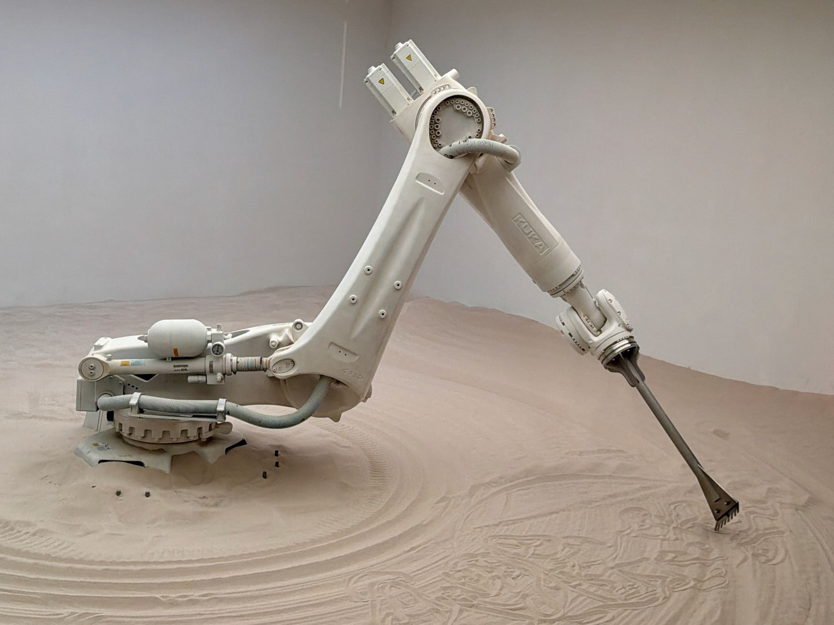
ROBOTICS FUNDAMENTALS • SESSION 01/04
REAL ROBOT ANATOMY: WHY 6 AXES?
Why 6 is the Magic Number:
📍 3 Axes to POSITION the tool (X, Y, Z)
• Joint 1 (Waist), Joint 2 (Shoulder), Joint 3 (Elbow)
• Gets the tool to any point in 3D space.
🔄 3 Axes to ORIENT the tool (Roll, Pitch, Yaw)
• Joint 4 (Wrist roll), Joint 5 (Wrist bend), Joint 6 (Tool spin)
• Points the screwdriver or welder in any direction.
3 Position + 3 Orientation = 6 DOF.
This lets a robot reach any point from any angle!
Notes:
PRESENTER NOTES:
1. Real Robot Visual:
- "Look at the real industrial KUKA arm on the right. Notice how the first three joints are big and heavy (they position the arm)."
- "The last three joints at the wrist are compact (they only tilt and rotate the tool)."
2. Transition:
- "Let's test your eye on a real robot schematic!"

Slide 13
ROBOTICS FUNDAMENTALS • SESSION 01/04
⚡ YOUR TURN
YOUR TURN: AUDIT THIS ROBOTIC ARM
BE THE QUALITY INSPECTOR
Look at the schematic on the left and drop answers in chat:
1. Can you count the 6 rotation axes (J1 to J6)?
2. Which joint carries the most weight? (Hint: Base or Wrist?)
3. Where is the most vulnerable cable flex point?
💡 Quality Hint:
Joint J1 at the base holds the entire arm. Joint J5/J6 flexes the wiring harness millions of times until wires fatigue!
Notes:
PRESENTER NOTES:
1. Quick Chat Exercise:
- "Drop in chat: Which joint carries the most load? (Base J1!)."
- "Where do cables break most often? (Wrist J5!)."
2. Transition:
- "Now let's examine what powers these joints: Part 02: Actuators and Motors."

Slide 14
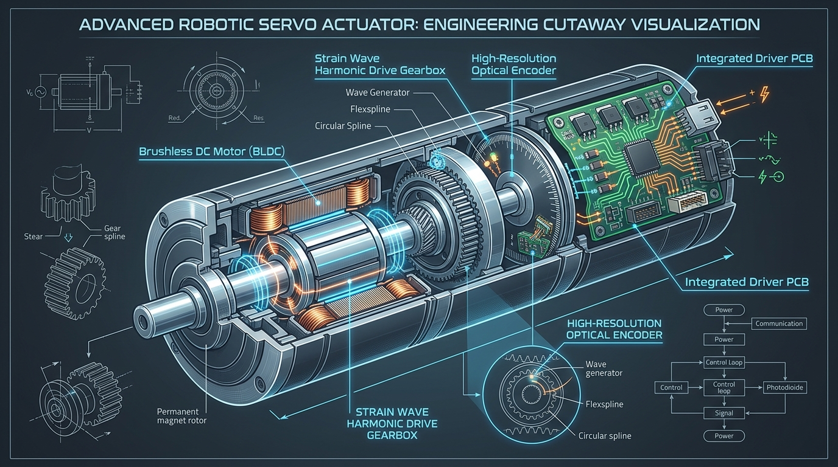
PART 02
ACTUATORS & MOTORS
THE ROBOT'S MUSCLES
Motors • Torque • Gears • Speed • Precision
Notes:
PRESENTER NOTES:
1. Section Intro:
- "Part 2: Actuators. How do we turn battery power into controlled mechanical motion?"

Slide 15
ROBOTICS FUNDAMENTALS • SESSION 01/04
WHICH MOTOR SHOULD YOU CHOOSE?
DC BRUSHED
Wheels & Fans
• Cheap & simple (2 wires)
• Spins fast, but low torque
• No built-in position feedback
RC SERVO
Budget Starters
• Easy Arduino plug-and-play
• Holds an angle (0-180°)
• Plastic gears strip easily!
STEPPER
3D Printers
• Moves in tiny exact steps
• Great holding strength
• Skips if overloaded
BRUSHLESS (BLDC)
Drones & Arms
• Extreme power density
• High efficiency & speed
• Needs smart motor driver
LINEAR ACTUATOR
Heavy Lifting
• Massive pushing force
• Doesn't back-drive
• Slower linear speed
Notes:
PRESENTER NOTES:
1. Beginner Motor Guide:
- "RC Servo: Good for learning with an Arduino."
- "Stepper: Perfect for 3D printers and CNCs."
- "Brushless (BLDC): What Boston Dynamics and modern quadrupeds use."
2. Transition:
- "What gives a motor the strength to lift something? The word is TORQUE."

Slide 16
ROBOTICS FUNDAMENTALS • SESSION 01/04
⚡ INTUITIVE MATH
TORQUE: THE SHOPPING BAG PRINCIPLE
Torque = Force × Distance
τ = F × r (Force in Newtons, Distance in meters)
THE 2× SAFETY FACTOR RULE
Beginner Mistake:
'My math says I need 2 N·m, so I bought a 2 N·m motor.'
🚨 Why that motor will stall:
1. The Arm Weighs Something! The aluminum links and motors have mass.
2. Acceleration Takes Extra Force: Starting from a dead stop needs sudden peak torque.
3. Bearing Friction: Real joints have friction.
👉 Golden Rule: Always multiply your static torque by at least 2.0×!
💡 The Heavy Shopping Bag Test
Hold a 2 kg bag against your hip: It feels easy.
Now hold that exact same bag straight out in front of you: Your shoulder burns within seconds!
The weight didn't change... the DISTANCE changed! Distance multiplies the rotational effort.
Quick Example Calculation:
1 kg payload (~10 N) at 20 cm reach (0.2 m) = 2.0 N·m torque.
At 40 cm reach (0.4 m) = 4.0 N·m torque (Doubled!)
Notes:
PRESENTER NOTES:
1. Physical Demonstration:
- "Hold your water bottle close. Easy. Hold it outstretched. Hard. That is Torque."
2. Safety Margin:
- "Always double the motor torque you calculate on paper."
3. Transition:
- "What other motor specifications matter? Let's check."

Slide 17
ROBOTICS FUNDAMENTALS • SESSION 01/04
A MOTOR IS MORE THAN JUST TORQUE
TORQUE — How heavy can it lift?
Stall torque vs continuous torque. Running at stall burns out coils!
SPEED — How fast can it get there?
Measured in RPM (revolutions per minute). Gearboxes make it stronger but slower.
RESOLUTION — How tiny is its smallest step?
Number of encoder ticks per turn. Like pixels on a high-res screen.
REPEATABILITY — Can it hit the same spot twice?
Returning to the exact same position over and over.
⚠️ And then there is BACKLASH (mechanical play in the gears) which can ruin everything!
Notes:
PRESENTER NOTES:
1. Walkthrough:
- "Don't just ask 'Is it strong?' Ask: How fast? How repeatable? And how much loose play?"
2. Transition:
- "Let's clear up the biggest confusion in robotics: Accuracy vs Repeatability."

Slide 18
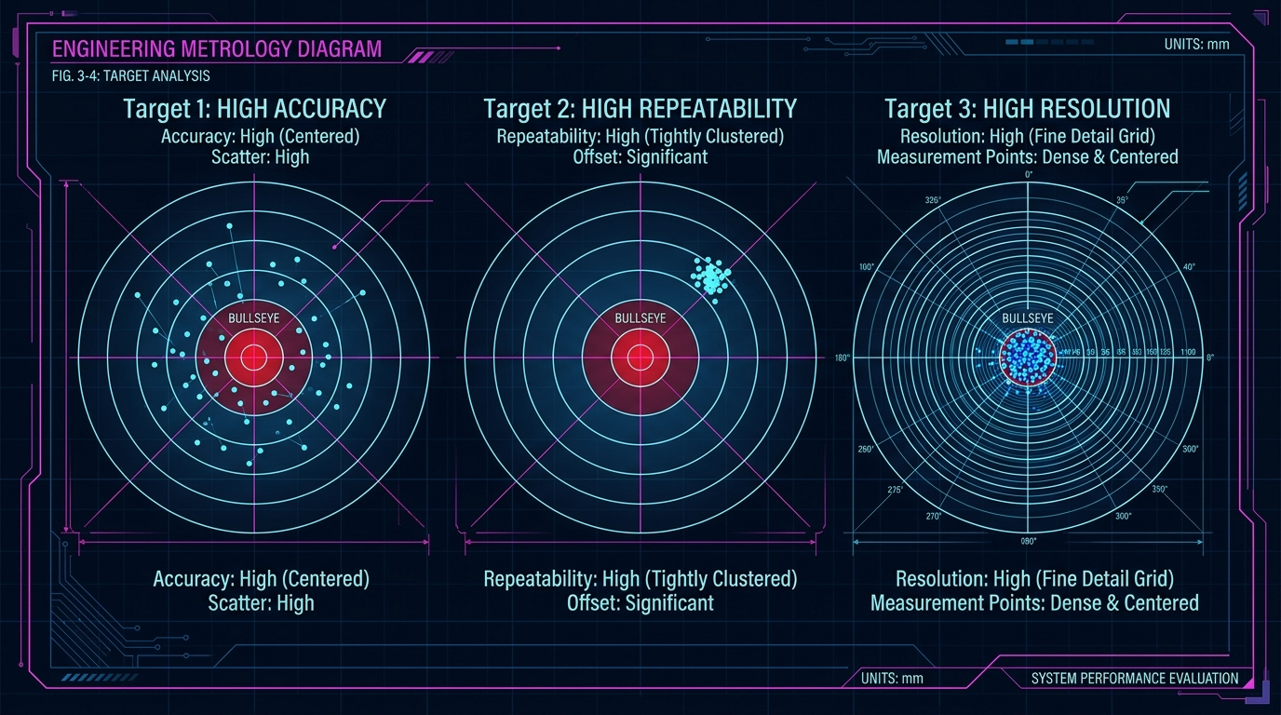
ROBOTICS FUNDAMENTALS • SESSION 01/04
ACCURACY VS. REPEATABILITY: THE ARCHER METAPHOR
🎯 THE ROBOTICS SECRET:
In robotics, REPEATABILITY is what you pay for!
Why? Because if your robot hits the exact same spot every time (Target 2), you can easily fix the offset in code! But if it's random (Target 1), no software can save you.
Notes:
PRESENTER NOTES:
1. Target Metaphor:
- "Look at Target 2: The arrows are clustered tightly, but 2 inches to the right."
- "Is that bad? NO! In code, you just subtract 2 inches! High repeatability means predictability."
2. Transition:
- "Now let's look at the mechanical problem that ruins repeatability: Backlash."

Slide 19
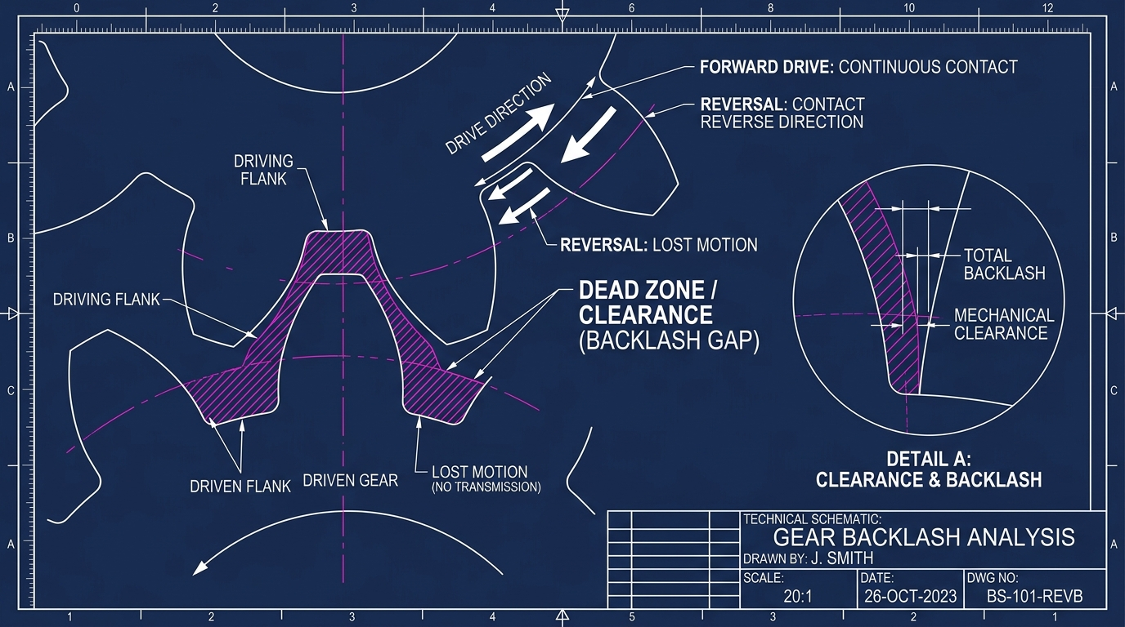
ROBOTICS FUNDAMENTALS • SESSION 01/04
⚡ INTERACTIVE
BACKLASH: MECHANICAL SLOP IN GEARS
THE STEERING WHEEL ANALOGY
Have you ever driven an old car with a loose steering wheel?
You can wiggle the wheel 2 inches before the car starts turning!
That is BACKLASH: the clearance gap between gear teeth.
❓ Question: If your motor reverses 0.1°, does the arm move?
👉 NO! The motor spins across the gap while the arm sits still!
💡 Engineering Joke & Fix
"Backlash is mechanical lag: the hardware equivalent of 'I'll respond later.'"
How do factory robots eliminate it? They use zero-backlash Strain Wave (Harmonic) gears or belt drives!
Notes:
PRESENTER NOTES:
1. Steering Wheel Analogy:
- "Everyone understands steering wheel play. That's backlash."
2. Inside Joke:
- "Mechanical lag: the hardware equivalent of 'I'll respond later'."
3. Transition:
- "Now let's do a quick motor selection puzzle."

Slide 20
ROBOTICS FUNDAMENTALS • SESSION 01/04
⚡ TRICK QUESTION
WHICH MOTOR WOULD YOU CHOOSE?
MOTOR A
• Torque: 2.0 N·m
• Speed: 300 RPM
• Price: €20
MOTOR B
• Torque: 8.0 N·m
• Speed: 50 RPM
• Price: €80
MOTOR C
• Torque: 4.0 N·m
• Speed: 1000 RPM
• Price: €60
TRICK QUESTION! None of them until you know your task!
Before buying a motor, you must answer:
1. How heavy is the load? (If you need 5 N·m, Motor A is useless!)
2. How fast must it move? (If you are building a high-speed fan, Motor B is too slow!)
3. What voltage battery do you have?
👉 Lesson: Define the load first, then buy the motor!
Notes:
PRESENTER NOTES:
1. Vote in chat:
- "A, B, or C?"
2. The Reveal:
- "Don't fall in love with motor specs. Fall in love with your project requirements."
3. Transition:
- "Now let's build Part 03: Mechanical Design and Structural Stiffness."

Slide 21
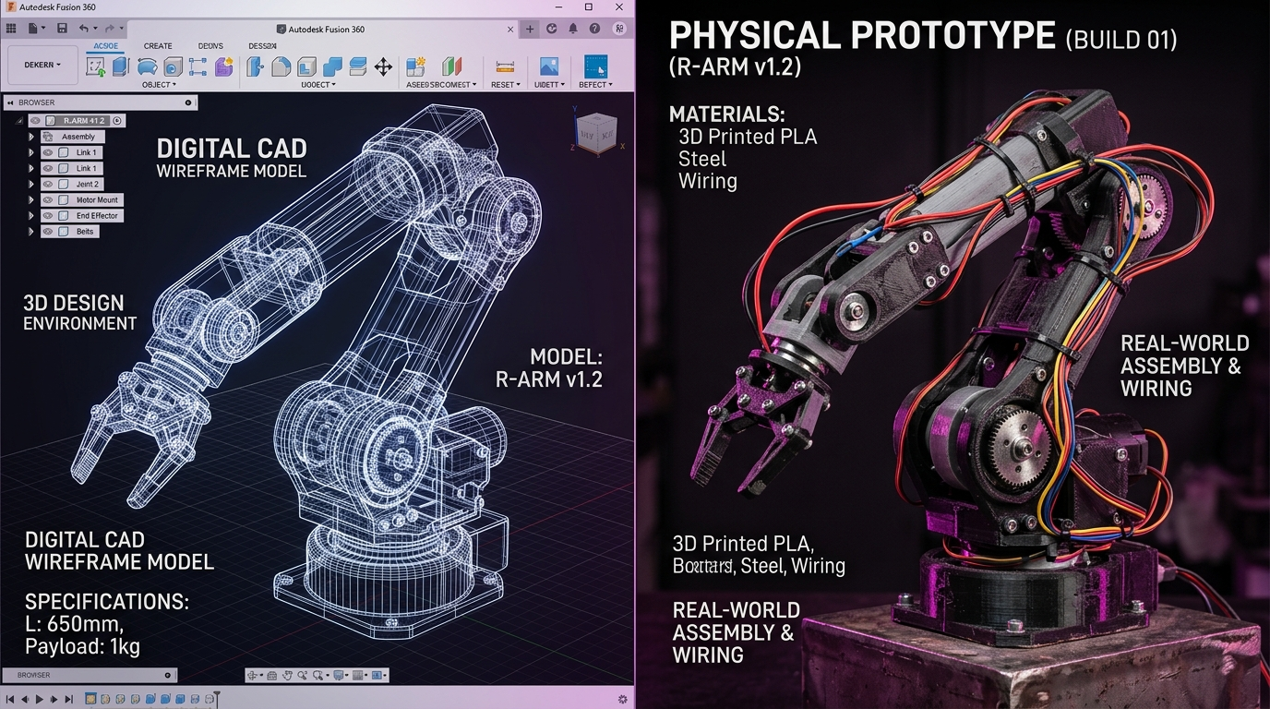
PART 03 • MECHANICAL SYSTEMS
MECHANICAL DESIGN
& RIGID STRUCTURES
The Robot's Skeleton • Stiffness • Materials • Real-World Trade-Offs
Notes:
PRESENTER NOTES:
1. Welcome to Part 3:
- "Welcome to Part 03! We've talked about motors, gears, and encoders. Now let's answer a fundamental question: What actually holds the robot together under heavy loads?"
2. The Core Philosophy:
- "A common beginner mistake is thinking the motor is the robot. But if your mechanical skeleton flexes or twists, even the most expensive motor won't put your gripper where you want it."
3. Transition:
- "Let's trace where the force actually flows through the physical robot."

Slide 22
ROBOTICS FUNDAMENTALS • SESSION 01/04
⚡ CORE CONCEPT
THE LOAD PATH: WHERE DOES THE FORCE REALLY GO?
THE PHYSICAL FORCE CHAIN:
MOTOR ROTOR ➜ GEARS ➜ BEARINGS ➜ ARM LINKS ➜ GRIPPER ➜ OBJECT
01. THE MOTOR
Torque Only!
Generates spinning force (torque). It is NOT designed to support bending forces or side weight! Never mount an arm directly to a bare motor shaft.
02. THE BEARINGS
The Unsung Heroes
Bearings absorb heavy radial bending loads so the motor shaft doesn't snap. They keep joints spinning smoothly under severe leverage.
03. THE STRUCTURE
The Rigid Bones
Hollow metal tubes, brackets, and gussets. If your arm bends even 2 millimeters under load, your gripper misses its target.
💡 Human Body Analogy: Muscles vs Bones
Think of lifting a heavy 10 kg grocery bag. Your bicep muscle (the motor) pulls the tendon, but your elbow joint cartilage and forearm bones (the bearings and structure) take the entire physical bending load! A motor without structural bearings is like a muscle with no bones to hold it.
Notes:
PRESENTER NOTES:
1. Golden Workshop Rule:
- "Never, ever mount an arm link directly onto a bare motor output shaft. Motor internal bearings are tiny and meant only to keep the rotor centered."
2. The Human Analogy:
- "Use the arm analogy: Muscles create pull, but bones carry weight. If you tried to carry groceries with muscles alone and no bones, you'd fail instantly."
3. Transition:
- "What happens when your structure isn't stiff enough? You experience the infamous Diving Board Effect!"

Slide 23
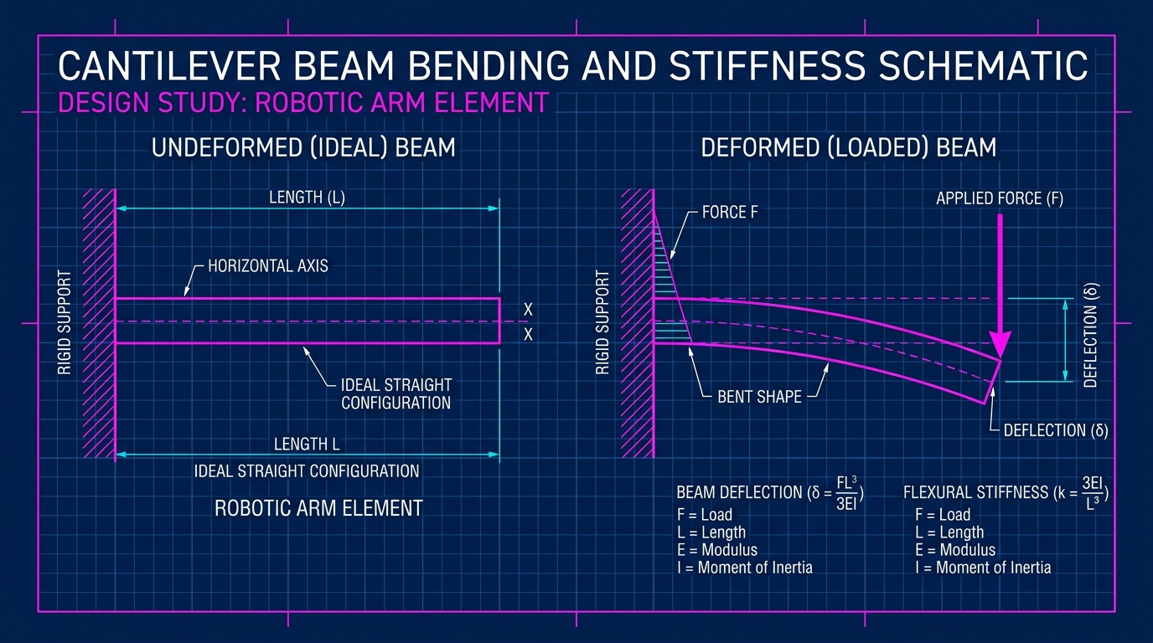
ROBOTICS FUNDAMENTALS • SESSION 01/04
⚡ PHYSICAL INTUITION
WHY DO ROBOT ARMS BEND? (THE DIVING BOARD EFFECT)
Deflection ∝ (Force × Length³) / Stiffness
• Force = Weight of payload & arm links
• Length = Arm reach (Notice Length is CUBED: L³!)
• Stiffness = Material rigidity & tube cross-section shape
💡 The Diving Board Analogy
Stand at the edge of a swimming pool diving board. Near the wall, it feels solid. Walk out to the tip, and it bounces dramatically! Robot arms behave the exact same way.
⚠️ THE L³ DANGER: DOUBLE THE LENGTH = 8× THE WOBBLE!
If your 30 cm robot arm deflects 1 mm under load, making it 60 cm (2× longer) doesn't just double the bend to 2 mm...
Because of (2)³ = 8, the tip will sag by EIGHT MILLIMETERS (8 mm)!
👉 Pro Solution: Use hollow square tubes or cylindrical extrusions. Placing material far from the center axis gives 10× more stiffness without adding weight!
Notes:
PRESENTER NOTES:
1. Emphasize the L³ Surpise:
- "Look at that formula. You don't need to do tensor calculus. Just remember one thing: L is CUBED."
- "Every beginner says: 'My arm works great at 30 cm, let me just double it to 60 cm to reach further!' And suddenly their robot shakes uncontrollably."
2. The Tube Secret:
- "Ask the audience: Why are bicycle frames hollow tubes instead of solid steel bars? Because hollow tubes maximize stiffness with minimum weight."
3. Transition:
- "Speaking of materials, what should you build your robot out of?"

Slide 24
ROBOTICS FUNDAMENTALS • SESSION 01/04
⚡ MATERIAL GUIDE
CHOOSING MATERIALS: WHAT SHOULD YOU BUILD WITH?
PLA (3D PRINT)
Rapid Prototyping
• Super cheap, prints in hours
• Perfect for checking fit & shapes
• ⚠️ Softens at 55°C (car in sun!)
• Creeps & sags under constant load
PETG / ABS
Functional Prints
• Higher temperature resistance (80°C)
• Tougher impact strength
• Great for sensor brackets & gears
• ⚠️ Still too flexible for long arms
ALUMINUM 6061
The Industry Standard!
• 20× STIFFER than plastic!
• Lightweight, strong, affordable
• Dissipates motor heat easily
• Clean tapped threads hold bolts
CARBON FIBER
Ultra-Light & Rigid
• Supreme stiffness-to-weight ratio
• Zero bending under fast moves
• ⚠️ Expensive & brittle on crash
• Dust is conductive and hazardous
💡 The Beginner's Winning Hybrid Strategy
Don't build 100% out of 3D printing, and don't spend €1,000 machining solid metal! The winning recipe for student robotics: 3D print your motor brackets, sensor mounts, and custom clips on your home printer, but bolt them onto off-the-shelf hollow aluminum tubes for your structural arms. Maximum stiffness, minimum cost!
Notes:
PRESENTER NOTES:
1. Practical 3D Printing Advice:
- "3D printing is wonderful for iterating on Friday night. But do NOT print long arm structural beams in PLA. After 2 weeks under belt tension, PLA will permanently deform."
2. The Winner for 90% of Robotics:
- "Aluminum 6061-T6. Stiff, cheap, conducts heat away from hot motors, and easy to drill with handheld tools."
3. Transition:
- "Every design choice has a trade-off. Let's look at the classic Engineering Triangle."

Slide 25
ROBOTICS FUNDAMENTALS • SESSION 01/04
⚡ ENGINEERING REALITY
THE ENGINEERING TRIANGLE: PICK ANY TWO!
▲ HIGH PRECISION
Sub-Millimeter Repeatability
Rigid machined aluminum or steel, zero-backlash harmonic gearboxes, preloaded bearings, absolute encoders.
▲ LIGHT WEIGHT
Fast & Agile Dynamics
Carbon fiber composites, hollow aerospace links, high-power-density motors, ultra-compact batteries.
▲ LOW COST
Budget Friendly (< €300)
Off-the-shelf stepper motors, 3D printed brackets, hobby timing belts, standard hardware store fasteners.
💡 THE GOLDEN RULE OF ENGINEERING COMPROMISE:
You CANNOT have NASA precision, featherweight agility, and a €100 price tag simultaneously! Great engineering isn't spending infinite money—it's picking the two that truly matter for your mission.
Notes:
PRESENTER NOTES:
1. The Real Discussion:
- "Every client and beginner comes in saying: 'I want an industrial surgical robot made of carbon fiber for under 200 dollars.' That robot does not exist."
2. The Challenge:
- "If you need low cost and light weight (like an educational drone), you must accept lower precision."
- "If you need sub-millimeter precision and low cost (like a 3D printer), you must accept heavy steel rails that move slowly."
3. Transition:
- "Let's see this trade-off in action: what happens when we double arm reach?"

Slide 26
ROBOTICS FUNDAMENTALS • SESSION 01/04
⚡ SIDE-BY-SIDE
WHAT HAPPENS WHEN YOU DOUBLE THE ARM LENGTH?
ARM A: 25 cm Reach (Compact)
• Target Payload: 1.0 kg
• Motor Torque Needed: 2.5 N·m (Small, cheap motor!)
• Tip Deflection: 1.0 mm (Barely noticeable sag)
• Rotational Inertia: Low (Easy to accelerate & stop)
• Settling Time: 0.15s (Rock steady position!)
• Total Joint Cost: ~€45
ARM B: 50 cm Reach (2× Doubled Length!)
• Target Payload: 1.0 kg (Exact same payload!)
• Motor Torque Needed: 5.0 N·m (2× bigger, hotter motor!)
• Tip Deflection: 8.0 mm! (8× worse sag due to L³! 🚨)
• Rotational Inertia: 4× Higher (Mass × Radius²)
• Settling Time: Vibrates for 1.5s like a tuning fork!
• Total Joint Cost: ~€180 (Needs heavy harmonic gearbox)
💡 Mechanical Design Rule of Thumb
Never make a robot arm longer than it strictly needs to be! Every extra 10 centimeters demands a significantly larger motor, heavier bearings, and thicker links to avoid ringing oscillations.
Notes:
PRESENTER NOTES:
1. Dramatic Comparison:
- "Look at that comparison: Same 1 kg payload. But Arm B needs twice the motor torque, quadruples rotational inertia, and flexes EIGHT times more!"
2. The Tuning Fork Effect:
- "When Arm B reaches its destination and stops, it doesn't just stop. It rings and wobbles like a guitar string for 1.5 seconds. You have to wait for the vibration to die before you can grip anything."
3. Transition:
- "Now put your engineering hats on! Let's do our first breakout design sprint."

Slide 27
ROBOTICS FUNDAMENTALS • SESSION 01/04
⚡ 5-MIN SPRINT
DESIGN CHALLENGE: SPECIFY THIS ROBOT ARM!
THE CLIENT'S SPECS
• Task: Pick up 2.0 kg metal parts on an assembly line
• Required Reach: 60 cm (0.60 m)
• Accuracy Goal: Within 1.5 mm
• Maximum Parts Budget: €400
👉 YOUR DECISIONS IN CHAT:
1. Material: 3D printed plastic vs Aluminum vs Carbon?
2. Motor: Stepper vs Hobby Servo vs Geared DC / BLDC?
3. Transmission: Direct drive shaft vs Timing belt vs Gears?
BEWARE BEGINNER TRAPS!
❌ Rookie Mistake 1: 'I'll 3D print the 60 cm arm in PLA!'
→ At 60 cm, plastic will sag 12 mm under 2 kg. Disqualified!
❌ Rookie Mistake 2: 'I'll connect directly to a hobby servo!'
→ 2 kg at 0.6 m = 12 N·m torque! Plastic gears will strip instantly.
✅ The Professional Answer:
• Extruded hollow aluminum square tubes
• NEMA 23 stepper or BLDC with 10:1 planetary gearbox
• Dual ball bearings supporting the main shoulder pivot!
⏱️ YOUR TURN: Drop your proposed material + motor choice in the chat now!
Notes:
PRESENTER NOTES:
1. Breakout Interaction:
- "We are pausing for 3 minutes! Read the specs on the left: 2 kg payload at 60 cm reach for 400 euros. What material and motor do you choose?"
2. Call Out Chat Responses:
- "Alex says: 3D printed arm! Alex, look at Trap 1: 60 cm of PLA holding 2 kg will bend like a banana!"
- "Sarah says: Aluminum tube with geared stepper! Ding ding ding! Sarah wins the engineering contract."
3. Transition:
- "Now that our arm has strong bones and motors, what feeds them? Welcome to Part 04: Power & Electrical Systems."

Slide 28
PART 04 • ELECTRICAL SYSTEMS
POWER & ELECTRICAL
SYSTEMS
Voltage • Current • Batteries • The Dreaded Brownout Mystery
Notes:
PRESENTER NOTES:
1. Intro to Electrical Systems:
- "Part 4: Power and Electricity. A robot without stable electrical power is nothing more than an expensive paperweight."
2. The Big Surprise:
- "Power issues cause over 60% of mysterious robot bugs during competitions. The robot reboots randomly, sensors freeze, or wheels twitch. Today we demystify why."
3. Transition:
- "Let's start with the most intuitive way to understand electricity: The Water Pipe Analogy."

Slide 29
ROBOTICS FUNDAMENTALS • SESSION 01/04
⚡ INTUITIVE PHYSICS
ELECTRICAL FUNDAMENTALS: THE WATER PIPE ANALOGY
VOLTAGE (Volts)
Water Pressure
• The electrical pressure pushing electrons through the wires
• Higher Voltage = Higher maximum motor RPM!
• Standard robot rails: 5V (sensors), 12V (motors), 24V/48V (industrial)
CURRENT (Amps)
Water Flow Volume
• The physical amount of electrons flowing per second
• More Current = STRONGER MOTOR TORQUE!
• Current creates heat: Wires need to be thick enough to avoid melting!
POWER (Watts)
Total Work Rate
• Power = Voltage × Current (P = V × I)
• Example: 12V motor drawing 2A consumes 24 Watts (12 × 2 = 24W)
• 1 Horsepower = 746 Watts of electrical power
💡 Think of a High-Pressure Garden Hose
Voltage is how hard the water pressure pushes at the nozzle. Current is how many gallons of water pour out every minute. If you have high pressure (Voltage) and huge water volume (Current), you have massive power washing force (Watts)! In motors: Voltage gives you SPEED, while Current gives you STRENGTH (Torque).
Notes:
PRESENTER NOTES:
1. Simplify V and I:
- "If you remember only one sentence from this slide: Voltage gives your motor SPEED, and Current gives your motor TORQUE."
2. The Heating Risk:
- "When a motor works extra hard to lift a heavy load, it draws more Amps. More Amps means more heat in your motor drivers and wires. This is why proper wire gauge is critical."
3. Transition:
- "Now let's see what happens when we scale from 1 motor to 4 motors on a mobile robot chassis."

Slide 30
ROBOTICS FUNDAMENTALS • SESSION 01/04
⚡ CRITICAL GOTCHA
THE 4-MOTOR TRAP: WHY DO ROBOTS SHUT DOWN ON STARTUP?
THE ROOKIE CALCULATION (On Paper)
• 1 Motor: 12V × 2A normal driving = 24 Watts
• 4 Motors: 4 × 24W = 96 Watts
Naive Conclusion:
'A 100W power supply or small battery pack will be plenty!'
🚨 WHAT HAPPENS IN REALITY:
The robot sits on the carpet. You push the joystick forward. The motors emit a tiny click, and the entire robot instantly reboots and shuts off!
THE REALITY: MOTOR STARTUP SURGE
• At 0 RPM, a stationary motor acts like a direct short circuit!
• To accelerate from a dead stop, each motor draws STALL CURRENT (5× to 6× rated current!).
💥 THE REAL POWER SPIKE:
• 4 Motors × 10A stall spike = 40 AMPS peak!
• 12V × 40A = 480 WATTS of instantaneous power!
• Your 100W battery's voltage collapses instantly.
💡 The Golden Power Sizing Rule
Always size your batteries, wires, motor controllers, and fuses for PEAK STARTUP SURGE (400W+), never for average cruising speed (96W). If your power system cannot deliver the 0.5-second acceleration burst, your robot will never drive forward!
Notes:
PRESENTER NOTES:
1. The Real Story:
- "Every robotics competition has at least three teams sitting on the floor scratching their heads because their robot boots up on the workbench, but as soon as they place it on the floor and accelerate, it immediately resets."
2. The Short Circuit Secret:
- "Why? Because before a motor begins spinning, back-EMF is zero. The motor coils are basically just a copper wire connecting positive to ground! That startup current spike is massive."
3. Transition:
- "How do we size a battery so our robot actually lasts through a mission?"

Slide 31
ROBOTICS FUNDAMENTALS • SESSION 01/04
⚡ REAL RUNTIME
BATTERY RUNTIME: WHY DOES 1 HOUR BECOME 35 MINUTES?
THE THEORETICAL MATH (Watt-Hours)
• Battery Capacity: 12 Volts × 10 Amp-hours (Ah)
• Total Energy = 120 Watt-Hours (Wh)
• Robot Power Draw: 120 Watts continuous
Ideal Paper Runtime:
120 Wh ÷ 120 W = Exactly 1.0 Hour (60 Minutes)!
Seems simple, right? Let's meet reality...
THE 4 RUNTIME THIEVES
1. Safety Reserve: Draining lithium batteries below 20% ruins them. Real usable capacity is ~80%!
2. Heavy Load Sag: High currents create internal heat, losing ~10% of battery capacity.
3. DC-DC Converter Losses: Stepping down 12V to 5V for computers wastes 12% as heat.
4. Sensor Overhead: Cameras, LiDAR, and microcontrollers consume continuous base power.
💡 The 70% Real-World Derating Rule
Rule of Thumb for Robotics: Take your ideal textbook runtime and multiply it by 0.65× to 0.70×. If your math predicts 60 minutes, expect around 38 to 42 minutes in actual field operation. Always plan battery swaps or charging stations around real runtime, not datasheet marketing!
Notes:
PRESENTER NOTES:
1. The Battery Lesson:
- "Sales brochure says: '2 hours of runtime!' Engineering lab test: 45 minutes before safety shutoff."
2. Depth of Discharge:
- "Never design a robot that drains its battery to 0%. Lithium batteries die permanently if overdischarged. Protect your investment by setting your cut-off threshold at 20% remaining capacity."
3. Transition:
- "What happens when your battery voltage drops while the motors are running? The famous Brownout!"

Slide 32
ROBOTICS FUNDAMENTALS • SESSION 01/04
⚡ DEBUGGING DETECTIVE
THE BROWNOUT MYSTERY: WHY DID MY ROBOT REBOOT?
THE BROWNOUT CHAIN REACTION
1. Robot accelerates forward or turns hard.
↓ Motors draw a large current spike (30A+)
2. Battery terminal voltage droops (12V drops to 9V)
↓ DC-DC voltage regulator for brain can't cope
3. 5V logic rail drops below 4.5V for just 2 milliseconds!
↓ Microcontroller triggers 'Brownout Reset' (BOR)
4. Brain shuts down & reboots → Motors freeze dead!
HOW TO FIX IT (3 PRO HABITS)
✅ 1. ISOLATE POWER RAILS:
Use a separate small battery for your computer/brain, or use an isolated buck-boost regulator that stays at 5V even if input drops to 6V!
✅ 2. ADD BULK CAPACITORS:
Place a fat 1000 µF capacitor right at each motor driver to absorb instantaneous current spikes.
✅ 3. SEPARATE SIGNAL & POWER GROUNDS:
Star-grounding prevents motor noise from confusing sensors.
💡 Inside Engineering Joke
"It worked perfectly on my desk!" — Every robotics student right before putting their robot on the carpet. On the desk, wheels spin in mid-air with zero resistance. On the carpet, friction demands full motor torque, triggering the brownout! Always test power systems under real floor loads.
Notes:
PRESENTER NOTES:
1. Explain Brownout:
- "A brownout is not a blown fuse. It's when voltage drops just low enough for 2 milliseconds that the microprocessor thinks the power was unplugged."
2. The Fix:
- "Never power a Raspberry Pi or Arduino directly from the same 5V line driving your high-power motors without a good regulator and filter capacitors."
3. Transition:
- "Now that our robot has strong bones, strong motors, and stable power... what controls the whole machine? Welcome to Part 05: Software, Tools & Simulation."

Slide 33

PART 05 • SOFTWARE ARCHITECTURE
SOFTWARE STACKS
& SIMULATION
CAD • Free Tools • Firmware • ROS 2 • Where Does Code Live?
Notes:
PRESENTER NOTES:
1. Intro to Software:
- "Part 5: Software & Tools. When beginners hear 'robotics software', they often imagine one giant Python file doing everything. Today, we look at the layered architecture used by real robotics companies."
2. Key Philosophy:
- "Separation of concerns. Low-level motor pulses belong in microcontrollers; high-level path planning belongs in ROS 2."
3. Transition:
- "Let's look at the layers of a robot's brain from the ground up."

Slide 34
ROBOTICS FUNDAMENTALS • SESSION 01/04
⚡ ARCHITECTURE
THE SOFTWARE STACK: LAYERS OF THE ROBOT BRAIN
05. AI & AUTONOMY [High-Level Decisions] — • 'Deliver coffee to Room 204' • Object detection (YOLO) • Semantic voice understanding
04. ROS 2 MIDDLEWARE [The Telephone Network] — • Connects independent software nodes cleanly using Publish / Subscribe messaging
03. MOTION PLANNING [Smooth Trajectories] — • Calculates smooth paths (Nav2, MoveIt) so wheels and arms avoid bumping into walls
02. EMBEDDED FIRMWARE [Real-Time Reflexes] — • C/C++ on microcontroller (STM32/ESP32) reading encoders and pulsing motor PWM every millisecond
01. PHYSICAL HARDWARE [The Real World] — • MOSFET drivers, motor coils, wheel traction, and floor physics
💡 Beginner Rule: Never try to run heavy AI models on an Arduino, and never pulse microsecond motor pins from desktop Python!
Notes:
PRESENTER NOTES:
1. Explain Separation:
- "Notice the hierarchy: Fast real-time reflexes at the bottom (microcontrollers in C/C++), and intelligent planning at the top (Linux/ROS 2/Python)."
2. Student Mistake:
- "Beginners often try to do everything in one Python script on a laptop connected over serial. If Python has a garbage-collection pause for 50 milliseconds, your balancing robot tips over!"
3. Transition:
- "What free software tools should you use to start building today?"

Slide 35
ROBOTICS FUNDAMENTALS • SESSION 01/04
⚡ TOOLBOX
YOUR FREE ROBOTICS STARTER KIT (ZERO LICENSING COST!)
3D MECHANICAL CAD
Fusion (Free) / FreeCAD
• Model your robot in full 3D
• Check clearances before printing
• Export STL files for 3D printers
• Check center-of-mass balance
ELECTRONICS & PCB
KiCad (100% Open-Source)
• Draw clean circuit schematics
• Design custom motor boards
• Order real printed circuit boards
• No part limits or paywalls
PHYSICS SIMULATION
Webots / Gazebo
• Simulate robot physics in 3D
• Test navigation & obstacle avoidance
• Break virtual robots without paying for repairs!
ROBOT MIDDLEWARE
ROS 2 (Humble / Jazzy)
• Industry-standard framework
• Pre-built SLAM navigation (Nav2)
• Arm motion planning (MoveIt)
• Used by NASA and Boston Dynamics
💡 Good News: You Don't Need Expensive Licenses!
Ten years ago, robotics software cost tens of thousands of dollars. Today, every single tool shown above is 100% free for students and makers. You can design an entire industrial-grade autonomous robot using open-source tools without spending a single dollar on software licenses!
Notes:
PRESENTER NOTES:
1. Empowering the Audience:
- "You don't need a $10,000 corporate SolidWorks or MATLAB license to build an incredible robot. KiCad, Fusion Hobbyist, Webots, and ROS 2 are all free."
2. The Learning Order:
- "Start with CAD and 3D printing. Then learn microcontroller C++ (ESP32). Then graduate to ROS 2 on Ubuntu Linux."
3. Transition:
- "Be careful not to mix up what each tool actually does!"

Slide 36
ROBOTICS FUNDAMENTALS • SESSION 01/04
⚡ WISDOM
THE ROOKIE TRAP: DON'T CONFUSE CAD, SIM & REALITY!
IN CAD DESIGN
The Ideal Fantasy
• Zero friction
• Zero thermal expansion
• Infinite structural stiffness
• Perfect zero-tolerance fits
• Everything looks gorgeous!
IN SIMULATION
The Math Approximation
• Physics is simulated
• Contact dynamics are modeled
• ⚠️ Friction is just a guessed number
• Wheels never get dust or hair wrapped around axles!
IN PHYSICAL REALITY
Where Truth Lives
• Screws vibrate loose
• Batteries lose voltage under load
• 3D prints flex and warp
• Carpet has 3× more drag than tile
• Wires get pulled during turns!
💡 Famous Robotics Quote
"Installing ROS doesn't make your robot autonomous — just like installing Photoshop doesn't make you Leonardo da Vinci!"
ROS is a powerful plumbing toolkit, not magic autonomy. A great robot requires sound mechanical physics, clean electronics, and real-world testing. Software cannot fix bad hardware physics!
Notes:
PRESENTER NOTES:
1. The Sim-to-Real Gap:
- "In simulation, your robot can drive perfectly for 100 hours. You deploy it on the physical floor, and within 30 seconds a wire catches in a wheel."
2. Hardware First:
- "Always remember: Software cannot magically overcome bad physics. If your arm is too weak to lift the payload, no amount of AI or ROS code will save it."
3. Transition:
- "Now we arrive at the grand finale: Part 06: From Idea to Working Robot!"

Slide 37
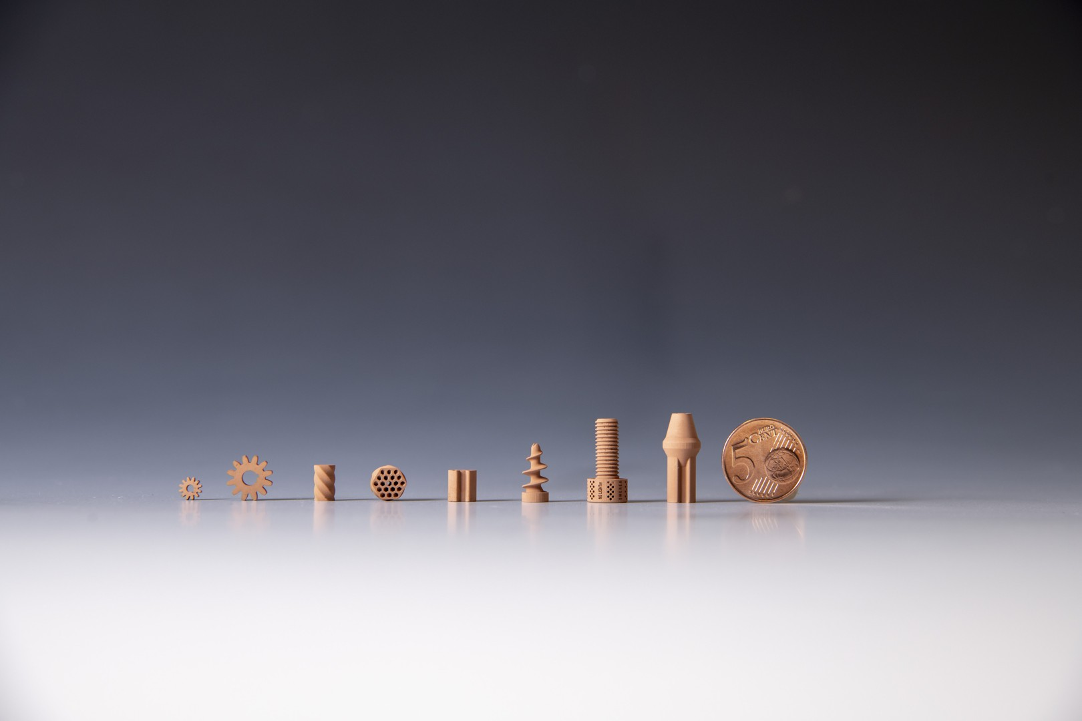
PART 06 • PROTOTYPING & REALITY
FROM IDEA TO
WORKING ROBOT
The Engineering Loop • Why Prototypes Fail • The Capstone Challenge
Notes:
PRESENTER NOTES:
1. Welcome to Part 6:
- "Part 6: From Idea to Working Robot. This is where theory meets reality, and where true robotics engineers are made."
2. Mindset Shift:
- "In school, you are taught that failure is an 'F'. In robotics engineering, failure is step 5 of the design process. If you don't break things, you aren't learning."
3. Transition:
- "Let's look at the real 6-step engineering cycle."

Slide 38
ROBOTICS FUNDAMENTALS • SESSION 01/04
⚡ MINDSET
THE REAL ROBOTICS LOOP: FAILURE IS A STAGE, NOT A MISTAKE
1. REQUIREMENTS
Define the payload, speed, and budget first.
2. CAD SKELETON
Model links, gear ratios, and bearings in 3D.
3. BENCH PROTOTYPE
3D print brackets and wire up motor controllers.
4. LOAD TESTING
Test with 100% full payload on the actual floor.
5. CATASTROPHIC BREAK! 💥
A plastic gear strips or motor controller browns out!
6. REDESIGN & WIN ↺
Reinforce the weak joint with metal and deploy V2!
💡 The Professional Maker Philosophy
If your first prototype doesn't break, you didn't test it hard enough! Breaking a 3D-printed gear on your workbench costs €2 and 20 minutes to fix. It reveals your exact weak spot so you can reinforce it before showing the robot to your client or professor. Celebrate the break, find the root cause, and iterate!
Notes:
PRESENTER NOTES:
1. Normalizing Failure:
- "I want everyone in this room to hear this: Elite robotics engineers fail constantly. The difference between a beginner and an expert is that an expert fails faster."
2. The 48-Hour Loop:
- "Build, test, break, analyze, redesign. If you can complete that loop in 48 hours, you will out-innovate teams that spend 6 months writing theoretical papers."
3. Transition:
- "Let's look at the classic meme that every single engineer experiences in real life."

Slide 39
ROBOTICS FUNDAMENTALS • SESSION 01/04
⚡ FUN MEME
"IT WORKED IN CAD!" — REALITY HAS ENTERED THE ROOM
LEFT: Clean CAD model (Zero gravity, perfect tolerances, zero wire clutter)
RIGHT: Physical reality (3D print layer lines, zip ties, hot glue, wire resistance, and real-world floor friction!) Always design with generous clearances and wire strain reliefs from day one.
Notes:
PRESENTER NOTES:
1. Laugh and Learn:
- "Look at this slide! On the left: Pristine Autodesk Fusion 360 rendering. Ambient temperature: 20.000°C. Zero friction. Infinite rigidity."
- "On the right: Physical reality. 3D print layer lines, zip ties holding wiring harnesses, hot glue, and loose M3 screws."
2. Takeaway:
- "Leave room for cables! The number one thing beginners forget in CAD is cables. Wires have volume and bend radius."
3. Transition:
- "Here is a real physical case study showing an actual failure and fix."

Slide 40
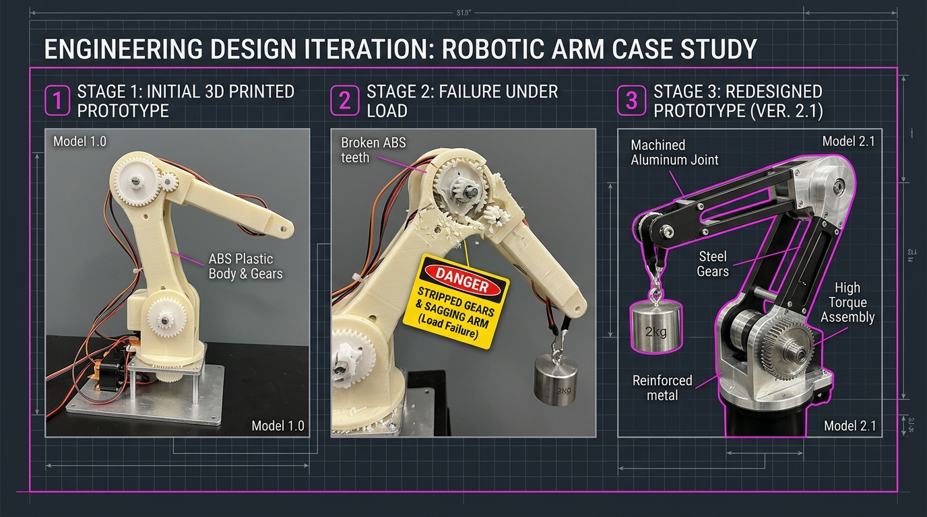
ROBOTICS FUNDAMENTALS • SESSION 01/04
⚡ CASE STUDY
CASE STUDY: 3D PRINTED V1 FAILURE ➔ METAL V2 REDESIGN
THE FAILURE BREAKDOWN
🔴 WHAT HAPPENED TO V1:
• The arm was 100% 3D-printed in ABS plastic.
• Under a 2.0 kg payload, the plastic gear teeth stripped clean off.
• The shoulder joint deflected 15° sideways because there was no supporting bearing!
🟢 THE V2 REDESIGN:
• Replaced stripped plastic gears with hardened steel planetary reduction (15:1).
• Replaced plastic arm joint with CNC aluminum bracket + dual ball bearings.
• RESULT: Easily holds 2.5 kg with zero sag and < 0.5 mm repeatability!
👉 Lesson: V1 failed so V2 could fly.
Notes:
PRESENTER NOTES:
1. Walk Through the Real Story:
- "Look at the diagram on the left: V1 was built entirely out of printed plastic. It looked awesome on Twitter. But as soon as it picked up a real 2 kg weight, SNAP! The gear teeth sheared right off."
2. The Engineering Fix:
- "Did the team give up? No. They kept the printed electronics enclosure, but replaced the high-stress joint with an aluminum plate and steel gears."
3. Transition:
- "Now it's time for our grand capstone challenge. You are the engineering leads!"

Slide 41
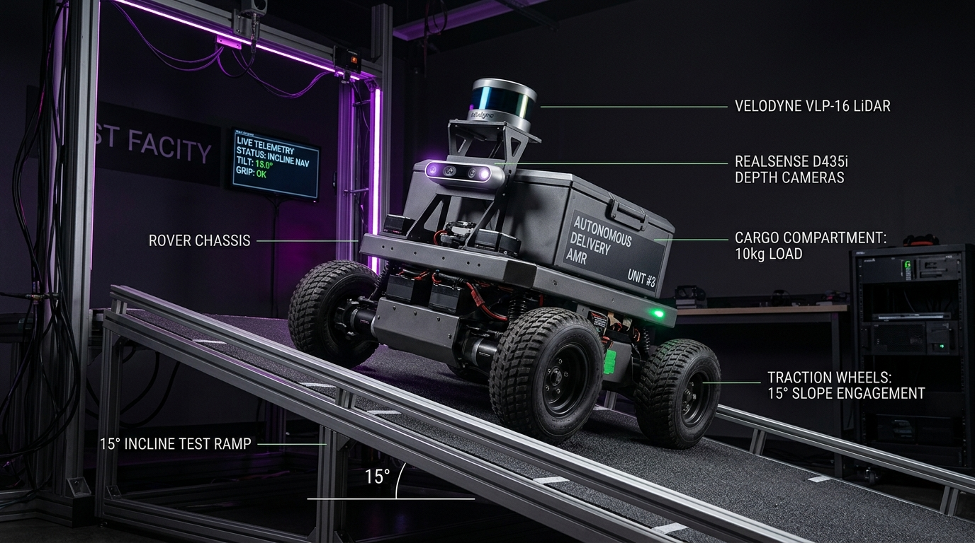
ROBOTICS FUNDAMENTALS • SESSION 01/04
⚡ DESIGN SPRINT
CAPSTONE CHALLENGE: DESIGN A CAMPUS DELIVERY ROBOT!
THE CLIENT MISSION BRIEF
• Mission: Autonomous food & book delivery on campus
• Target Payload: 5.0 kg package capacity
• Cruising Speed: 1.0 m/s (Brisk walking pace)
• Target Runtime: 1.0 Hour continuous driving
• Environment: Flat indoor linoleum hallways
• Parts Budget Limit: €300
👉 ASSEMBLE YOUR SYSTEM IN CHAT:
1. Drive: Differential 2WD + Caster vs 4WD Skid-Steer?
2. Motors: Geared DC vs Steppers vs Brushless?
3. Battery: 12V 5Ah vs 12V 10Ah LiFePO4?
4. Sensors: Ultrasonic bumpers vs 2D LiDAR?
⏱️ Post your team's spec in the chat right now!
Notes:
PRESENTER NOTES:
1. Team Setup:
- "You are the chief engineers of a new campus robotics venture. The university gave you €300 per robot."
- Give the audience 2 minutes to drop their specs in the chat.
2. Moderate Chat:
- "I see Differential Drive with 2 geared DC motors and 12V 10Ah battery. Very clean, very cost effective!"
3. The Dramatic Cliffhanger:
- "Everyone feels confident. The robot drives smoothly on flat hallway linoleum... and then the client calls with one tiny change."

Slide 42
ROBOTICS FUNDAMENTALS • SESSION 01/04
⚡ THE TWIST
NEW CLIENT REQUIREMENT: THE 15° RAMP TWIST! 🚨
THE CLIENT: "IT MUST CLIMB A 15° RAMP!"
💥 WHAT JUST BROKE ON YOUR €300 ROBOT:
1. GRAVITY PULLS BACKWARD:
Climbing a 15° slope adds 26% of your robot's total weight as direct backward drag! Flat-ground motors will stall out!
2. WHEEL SLIP & TRACTION:
Smooth plastic or omni-wheels will spin out without rubber grip!
3. BACKWARD TIP-OVER RISK:
If the heavy battery is mounted high or rearward, the robot flips backward down the ramp!
4. BATTERY CURRENT SURGE:
Climbing draws 3× more current → Runtime drops to 20 mins!
👉 FIX: Add rubber tires, mount battery low and forward, and increase motor gear ratio!
Notes:
PRESENTER NOTES:
1. The Lesson of the 15° Ramp:
- "A 15-degree ramp looks gentle to human legs. But to an electric vehicle, sine of 15° is 26% of your entire vehicle weight acting directly against motion!"
2. Systemic Ripples:
- "Notice how one simple change in the environment completely broke our motor sizing, battery runtime, wheel tread material, and chassis center-of-gravity balance."
- "This is why robotics is an integrated discipline."
3. Transition:
- "To ensure you avoid these pitfalls, let's review the 10 Golden Rules of Robotics."

Slide 43
ROBOTICS FUNDAMENTALS • SESSION 01/04
⚡ CHEATSHEET
SESSION SUMMARY: THE 10 GOLDEN RULES OF ROBOTICS
1. Define the task first
Never buy motors before knowing payload, reach, and speed.
6. Structure > Motor Size
A hollow aluminum tube beats solid plastic 3D prints every time.
2. Minimize DOF
Use the smallest number of joints strictly necessary.
7. Size for Peak Surge
Motors draw 5× stall current on startup; size batteries for peak surge.
3. 2× Safety Factor on Torque
Always multiply static torque calculations by 2× for acceleration.
8. Isolate Logic from Power
Separate computer power from noisy motors to prevent brownouts.
4. Resolution ≠ Accuracy
A high-count encoder does not fix mechanical flexing.
9. Test with Physical Loads
Simulation is great, but carpet friction and loose screws only happen in reality.
5. Beware Gear Backlash
Loose gear teeth destroy precision; use belts or zero-backlash gears.
10. Iterate Without Fear
Breaking V1 is step 5 of the design process. Learn, redesign, and win!
Notes:
PRESENTER NOTES:
1. The 10 Commandments:
- "Take a screenshot of this slide. Print it out and tape it above your workbench."
2. The Bottom Line:
- "These 10 rules will save you hundreds of dollars in burned motors and months of wasted debugging."
3. Transition:
- "And with that, we conclude Session 01 with our guiding motto."

Slide 44
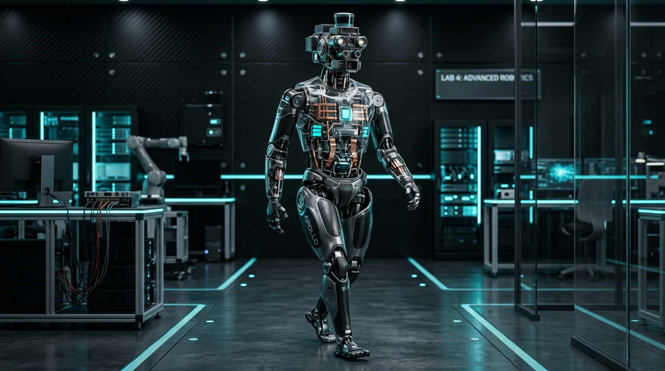
DEFINE
DESIGN
CALCULATE
BUILD
TEST
BREAK
IMPROVE
THAT'S ROBOTICS.
See you next Thursday for Session 02 / 04:
"Sensors, Perception & State Estimation"
Thank you for attending! Let's open the floor for Q&A.
Notes:
PRESENTER NOTES:
1. Closing Statement:
- "Define. Design. Calculate. Build. Test. Break. Improve. That is the journey of robotics."
2. Teaser for Session 02:
- "Next week in Session 02, we give our robot eyes and ears: LiDAR, depth cameras, sensor fusion, and Kalman filtering."
3. Open Q&A:
- "I'll now open the floor for Q&A. Type your questions in chat or unmute your mic!"

