Slide 1
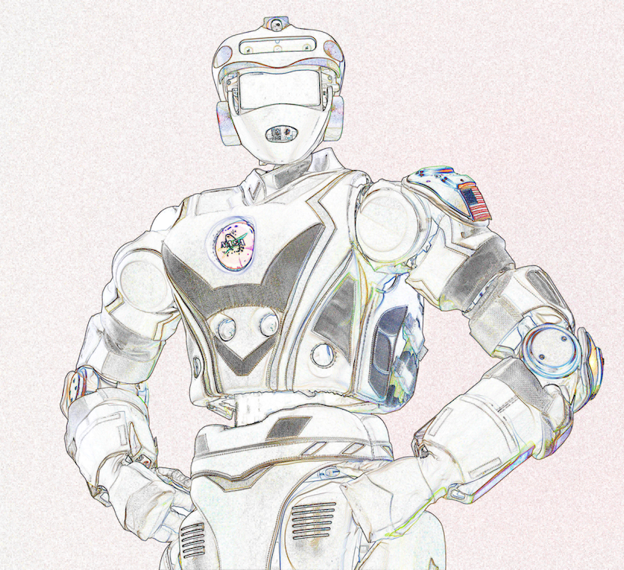
JARVIS ROBOTICS ENGINEERING ACADEMY
JARVIS ROBOTICS
ROBOTICS
FUNDAMENTALS
Session 01 / 04: Mechanical, Electrical Systems & Design
How a robot becomes a real, functioning physical system.
PRESENTER: MED BOUGHRARA
ONLINE WORKSHOP SERIES • 20:00 GMT+3
10.09.2026
ROBOTICS FUNDAMENTALS • SESSION 01 / 04 • THURSDAY, 10 SEPT 2026
Notes:
PRESENTER NOTES:
1. Welcome & Energy:
- "Good evening and welcome to Session 01 of Robotics Fundamentals!"
- "Whether you are an engineering student, an enthusiast, or a maker, this workshop is designed for YOU."
2. The Session Goal:
- "This is not a boring calculus lecture. We are here to understand how a robot actually becomes a working physical system—from the motors and bones to the batteries and code."
3. Logistics:
- "Keep your chat window open! We will have live polls, design sprints, and Q&A throughout."

Slide 2
COURSE BLUEPRINT • 4 FOUNDATIONAL PILLARS
JARVIS ROBOTICS
SESSION 01 ROADMAP
THE 4 PILLARS OF EMBODIED ROBOTICS ENGINEERING
MECHANICAL & ACTUATION
• 1. Robot Anatomy: Links, joints & 6 Degrees of Freedom
• 2. Motor Sizing: The Shopping Bag torque rule (τ = F × L)
• 3. Transmissions: Trading speed for torque with gearboxes
• 4. Structural Rigidity: Why hollow tubes beat solid bars
💡 Example: KUKA industrial arms lifting 500 kg car bodies.
[References: Prof. Jorge Angeles & SITAMS Unit 1-2]
ELECTRICAL & SOFTWARE
• 1. Actuators: Stepper vs Brushless DC vs Servos
• 2. Brain vs Reflexes: Arduino microcontrollers vs Linux SBCs
• 3. Power Electronics: H-bridges, MOSFETs & brownouts
• 4. Digital Twin: Testing in Gazebo before breaking hardware
💡 Example: NASA Mars rovers tested 10,000× in simulation.
[References: Prof. Jeff McGough Ch. 3 & 7]
ROBOTICS FUNDAMENTALS • SESSION 01 / 04 • THURSDAY, 10 SEPT 2026
Notes:
PRESENTER NOTES:
1. Audience Poll:
- "Vote in chat: A, B, C, or D! Which part is the most critical for a great robot?"
2. The Big Reveal:
- "Most people vote Software. But think about it: If your muscles are strong and your brain is a supercomputer, but your bones are made of wet spaghetti... can you sign your name with a pen?"
- "Robotics is the harmony of all four."

Slide 3
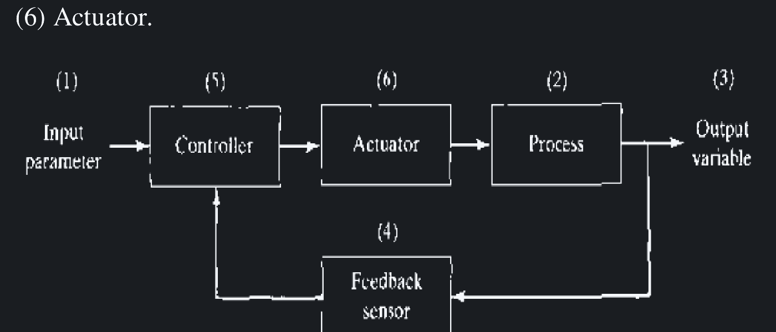
CORE CONCEPT • EMBODIED ARTIFICIAL INTELLIGENCE
JARVIS ROBOTICS
WHAT IS A ROBOT?
EMBODIED AI: CODE WITH PHYSICAL CONSEQUENCES
A robot is an intelligent physical machine that operates in the real world through a continuous loop: Sense → Think → Act.
• Screen AI vs Embodied AI: If an LLM chatbot makes an error, you get a typo on screen. If a robot makes an error, a 50 kg arm crashes into a wall or snaps a gearbox!
• The Feedback Reality: Robotics is where software algorithms collide with the unforgiving laws of gravity and friction.
💡 Real-World Example: A Roomba vacuum. Bump and IR sensors detect an obstacle (Sense), the onboard processor calculates a turn (Think), and dual wheel motors drive the change (Act).
[Reference: Jeff McGough, Robotics: Concepts & Simulation, Ch. 1-2]
ROBOTICS FUNDAMENTALS • SESSION 01 / 04 • THURSDAY, 10 SEPT 2026
Notes:
PRESENTER NOTES:
1. Human Body Metaphor:
- "Keep this metaphor in your head all evening: Skeleton, Nerves, Reflexes, and Mind."
- "Real robotics engineering happens at the intersections."
Reference: Jeff McGough (Release 1.4, 2019), "Robotics: Concepts, Simulation and System Integration", Ch. 1-2 (Terms and Basic Concepts of Embodied Systems). URL: https://visjasola-ucilnica.sclj.si/pluginfile.php/32773/mod_resource/content/1/Robotics.pdf

Slide 4
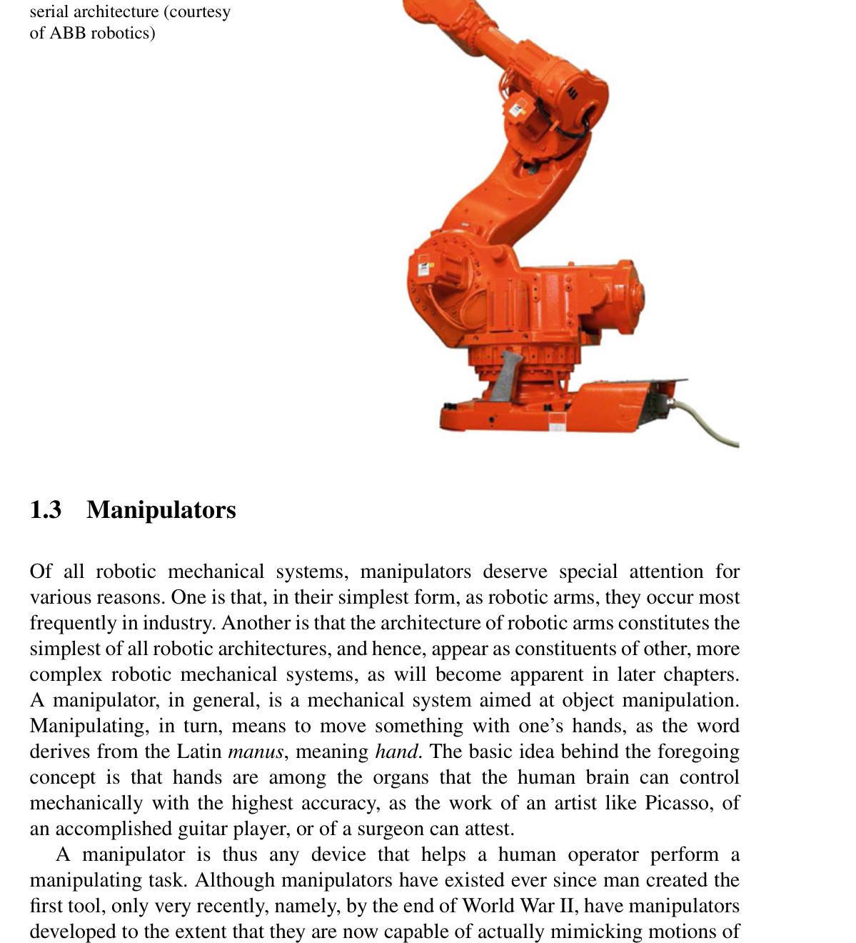
SYSTEM ARCHITECTURE • THE 4 SUB-SYSTEMS
THE 4 ROBOT SUBSYSTEMS
HOW EVERY FUNCTIONING ROBOT IS CONSTRUCTED
1. SKELETON (MECHANICAL)
2. MUSCLES (ACTUATORS)
Rigid links, bearings, chassis plates, and brackets that support weight and define reach.
💡 Example: Hollow aluminum tubes and steel base plates.
Motors, gear reductions, and belts converting electrical battery energy into mechanical torque.
💡 Example: NEMA steppers and planetary brushless motors.
3. BRAIN & NERVES (COMPUTE)
Sensors (IMU, encoders, LiDAR), real-time microcontrollers for PWM, and Linux SBCs for vision.
💡 Example: Arduino pulsing PWM + Jetson running YOLO.
Notes:
PRESENTER NOTES:
1. Walkthrough the Loop:
- "Sense, Decide, Act. If any one of these three steps breaks, the robot is blind, paralyzed, or out of control."
2. Speed Matters:
- "A quadcopter drone must run this loop at 500 Hz (500 times a second) or gravity wins."

Slide 5
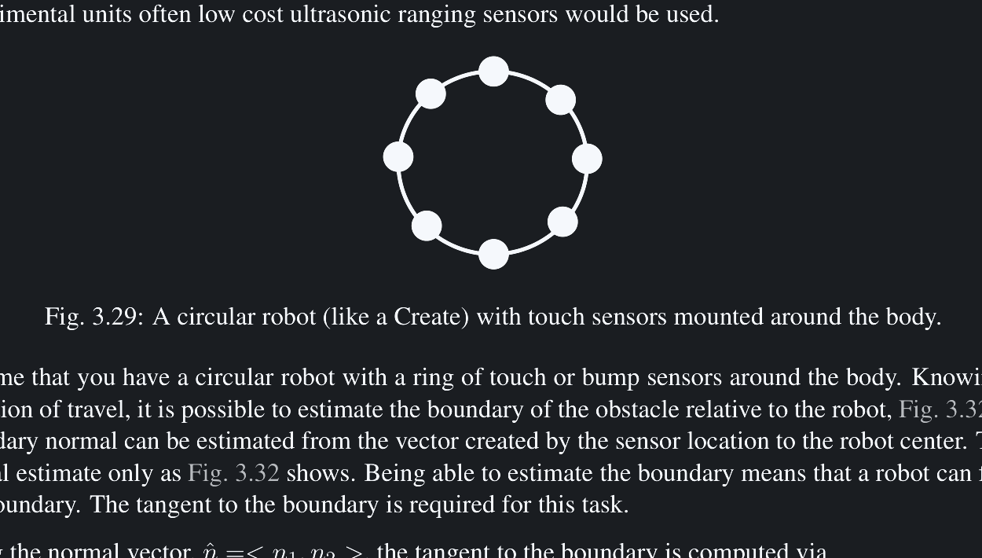
⚡ QUICK CHALLENGE 01 • REAL-WORLD SPECS
JARVIS ROBOTICS
DEFINING ROBOT SPECIFICATIONS
You are building an autonomous sidewalk parcel delivery robot (like Starship). What is the #1 reason pure open-loop motor control will fail outdoors?
[A] The battery has too many ampere-hours
[B] Pavement friction and sidewalk slopes cause heading drift without encoder feedback
[C] Linux cannot execute Python code outdoors
[D] Rubber tires block radio signals
✓ CORRECT ANSWER: [B]
Without wheel encoders to measure actual distance traveled (closed-loop), tiny variations in ground friction or slopes cause the robot to drift completely off course. [Ref: McGough Ch. 10]
ROBOTICS FUNDAMENTALS • SESSION 01 / 04 • THURSDAY, 10 SEPT 2026
Notes:
PRESENTER NOTES:
1. The First Principles:
- "Notice what is NOT on this slide: 'What programming language should I learn?'"
- "First define reach, payload, and physical constraints."

Slide 6
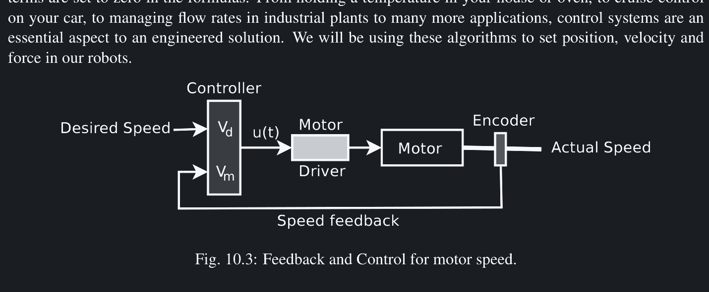
CONTROL ARCHITECTURE • SENSORY FEEDBACK
JARVIS ROBOTICS
FEEDBACK LOOPS
OPEN-LOOP VS CLOSED-LOOP CONTROL
Why do raw motor commands fail in reality? Pavement friction, payload weight changes, and battery voltage sag.
• Open-Loop (Blind): You command a motor: 'Spin for 2 seconds'. It has no sensor. If a payload is heavy, it stalls, and the controller never knows.
• Closed-Loop (Smart): The controller continuously reads an optical encoder. It compares Target vs Measured position (Error = Target - Measured) and adjusts power via PID.
💡 Real-World Example: Car Cruise Control. Driving uphill, the car automatically presses the gas pedal harder to maintain 65 mph. That is closed-loop feedback!
[Reference: Jeff McGough, Ch. 10 • Motion Control]
ROBOTICS FUNDAMENTALS • SESSION 01 / 04 • THURSDAY, 10 SEPT 2026
Notes:
PRESENTER NOTES:
1. Interaction:
- "Close your eyes and try to walk 10 steps in a straight line. You will inevitably drift. That is open-loop control."
2. Encoders:
- "Closing the loop with encoders is what separates an electric toy from a real robot."
Reference: Jeff McGough (2019), "Robotics: Concepts, Simulation and System Integration", Ch. 10 (Motion Control & Closed-Loop Sensory Feedback). Diagram: Fig. 10.3.

Slide 7
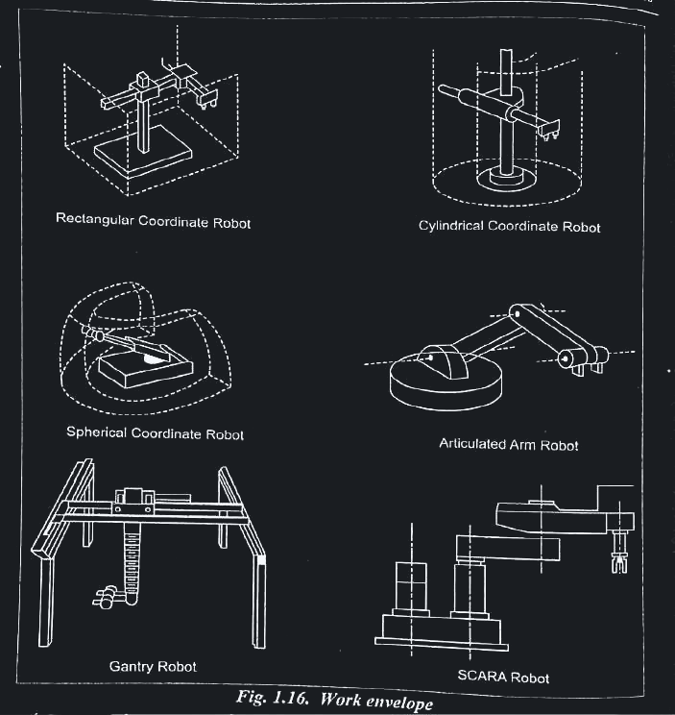
MODULE TRACK • 01 / 06
JARVIS ROBOTICS
MECHANICAL SYSTEMS & KINEMATICS
Links, joints, degrees of freedom, and spatial motion geometry.
• Anatomy of robot links and joints (Revolute vs Prismatic)
• Degrees of Freedom: What can your robot reach and point at?
• 4 Classic Industrial Configurations: Cartesian, SCARA, Cylindrical, Articulated
• Forward Kinematics: Motor Angles → Gripper 3D Position
• Inverse Kinematics: Desired 3D Target → Required Motor Angles
• Real work envelopes and workspace reach boundaries
[Ref: Jorge Angeles, 4th Ed., Springer, Ch. 3-4 & SITAMS Unit 1]
ROBOTICS FUNDAMENTALS • SESSION 01 / 04 • THURSDAY, 10 SEPT 2026
Notes:
PRESENTER NOTES:
1. Section Intro:
- "Part 01: Mechanical Fundamentals. How does geometry become movement?"
2. Takeaway:
- "Understand links, joints, and why 6 axes are the magic number."
Reference: Prof. Jorge Angeles (4th Edition, Springer, 2014), "Fundamentals of Robotic Mechanical Systems", Ch. 3-4 (Kinematics of Serial Manipulators). URL: https://asutp.org/Skills/ROBOT/FundamentalsOfRoboticMechanica.pdf

Slide 8
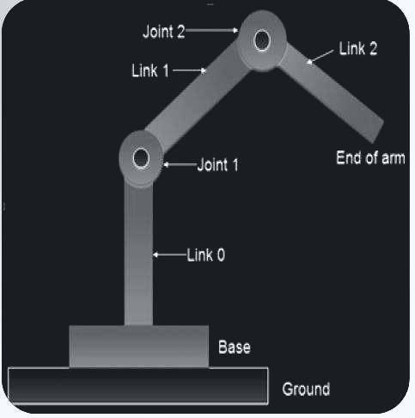
KINEMATICS • THE STRUCTURAL CHAIN
JARVIS ROBOTICS
LINKS AND JOINTS
THE SKELETON OF A ROBOT MANIPULATOR
Robotic manipulators are built by alternating rigid links and movable joints:
• 1. Links: Rigid structural beams (aluminum, carbon fiber) that maintain fixed spacing between joints.
• 2. Revolute Joints (R): Rotational hinges that measure angles (degrees or radians).
💡 Example: Your elbow joint and human shoulder.
• 3. Prismatic Joints (P): Linear sliding rails that measure travel distance (millimeters).
💡 Example: A 3D printer Z-axis lead screw or gantry rail.
Chain Rule: Base Link 0 → Joint 1 → Link 1 → Joint 2 → ... → End-Effector Tool.
[Reference: Jorge Angeles Ch. 3 & SITAMS Unit 1]
ROBOTICS FUNDAMENTALS • SESSION 01 / 04 • THURSDAY, 10 SEPT 2026
Notes:
PRESENTER NOTES:
1. Keep it Concrete:
- "Look at your own arm: Shoulder = Joint 1, Upper arm = Link 1, Elbow = Joint 2, Forearm = Link 2, Wrist = Joint 3, Fingers = End-Effector."
Reference: Prof. Jorge Angeles (2nd Edition, Springer-Verlag, 2002), "Fundamentals of Robotic Mechanical Systems", Ch. 3 (Serial Manipulator Anatomy & Revolute/Prismatic Joints). Ref: D:\down\252.pdf & SITAMS Unit 1.

Slide 9
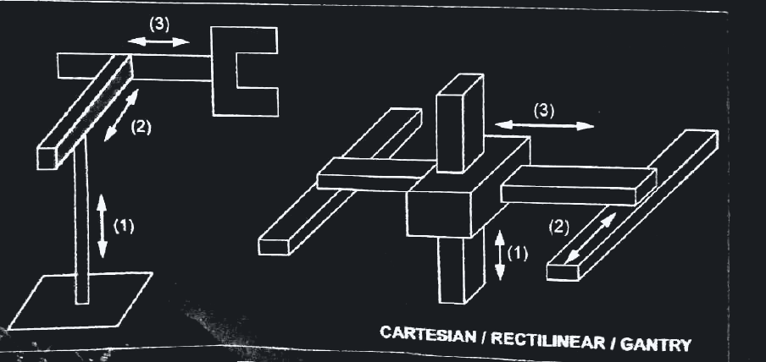
MECHANISMS • WORKSPACE MORPHOLOGY
3 ROBOT CONFIGURATIONS
MATCHING ARCHITECTURE TO THE MISSION
CARTESIAN (XYZ)
SCARA (RRP)
3 perpendicular linear sliding axes. Extremely rigid, high precision, simple math.
💡 Example: 3D Printers (Ender 3) and CNC gantry mills.
2 parallel rotary joints + 1 vertical slide. Ultra-fast pick-and-place, rigid vertically.
💡 Example: High-speed electronics PCB assembly.
ARTICULATED (6-AXIS)
6 revolute joints mimicking the human arm. Maximum 3D reach and dexterity.
💡 Example: Automotive factory welding robots (KUKA/ABB).
Notes:
PRESENTER NOTES:
1. Simplify Joints:
- "Almost every joint in the universe is either a Hinge (Revolute) or a Slider (Prismatic)."
- "Combine them, and you get Cartesian, SCARA, or articulated robot arms."
Reference: Prof. K. Santhosh Priya (2025), "Automation and Robotics (18MEC325 Course Lecture Notes)", Unit 1 (Robot Anatomy & Common Morphologies: Cartesian, SCARA, Articulated). URL: https://sitams.ac.in/wp-content/uploads/2025/02/11.18MEC325-Automation-and-Robotics-Lecture-notes.pdf

Slide 10
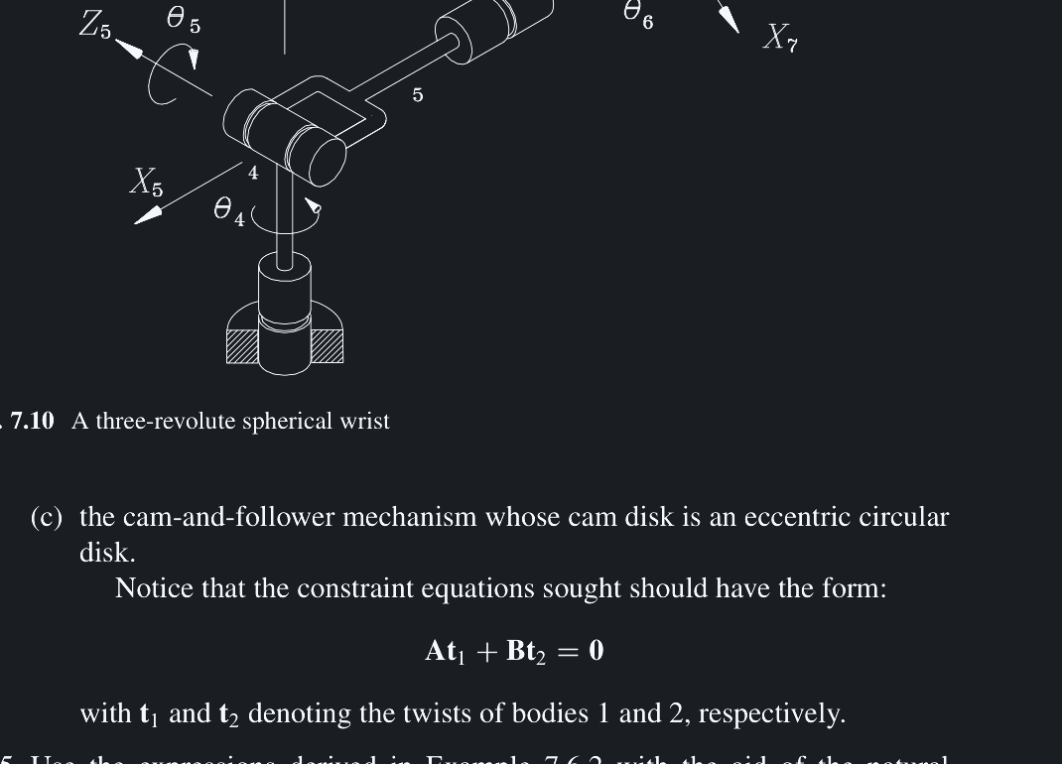
⚡ QUICK CHALLENGE 02 • SPATIAL DEXTERITY
JARVIS ROBOTICS
THE MISSING DEGREE OF FREEDOM
A 3-axis Cartesian robot moves a tool anywhere in 3D space (X, Y, Z), but it CANNOT insert a square peg into a 45° tilted hole. Why?
[A] The stepper motors lack holding torque
[B] 3 axes only control position (X,Y,Z); tilting requires rotary wrist orientation axes
[C] The computer lacks floating-point trigonometry
[D] Gravity disables tilted insertions
✓ CORRECT ANSWER: [B]
3 DOFs give position in 3D space, but 0 orientation dexterity. Matching a tilted surface requires rotary wrist joints (Roll, Pitch, Yaw). [Ref: Jorge Angeles Ch. 4 & SITAMS Unit 1]
ROBOTICS FUNDAMENTALS • SESSION 01 / 04 • THURSDAY, 10 SEPT 2026
Notes:
PRESENTER NOTES:
1. The 6-DOF Goal:
- "In 3D space, any rigid object has exactly 6 degrees of freedom: 3 to position it, and 3 to orient it."
Reference: Prof. Jorge Angeles (4th Edition, Springer, 2014), Ch. 4 (Orientation Kinematics and Spherical Wrist Decoupling).

Slide 11
MATHEMATICS • KINEMATIC TRANSFORMS
JARVIS ROBOTICS
FORWARD VS INVERSE KINEMATICS
TRANSLATING BETWEEN MOTOR ANGLES AND 3D WORKSPACE
FORWARD KINEMATICS (EASY)
• Input: Joint angles from encoders (θ1 = 45°, θ2 = 30°)
• Output: Gripper 3D tool position (X, Y, Z, Roll, Pitch, Yaw)
• Math: Matrix multiplication along the link lengths
• Solvability: Always fast, deterministic, single unique answer!
💡 Example: Reading motor sensors to display robot location on screen.
[Ref: Angeles 4th Ed. Ch. 4]
INVERSE KINEMATICS (HARD)
• Input: Desired gripper coordinate (X = 400, Y = 200, Z = 150 mm)
• Output: Required motor angles (θ1, θ2, θ3) to reach it
• Math: Non-linear trigonometry with multiple solutions
• Solvability: Multiple postures (elbow-up vs elbow-down) or unreachable singularities!
💡 Example: Video game character reaching out to grab a doorknob.
[Ref: Angeles 4th Ed. Ch. 4]
ROBOTICS FUNDAMENTALS • SESSION 01 / 04 • THURSDAY, 10 SEPT 2026
Notes:
PRESENTER NOTES:
1. The Golden Rule:
- "Use the MINIMUM number of joints to accomplish the mission. If your 3D printer only needs 3 axes, do not build a 6-axis arm!"
Reference: Prof. Jorge Angeles (4th Edition, Springer, 2014), Ch. 4 (Inverse Kinematics of 6-DOF Manipulators).

Slide 12
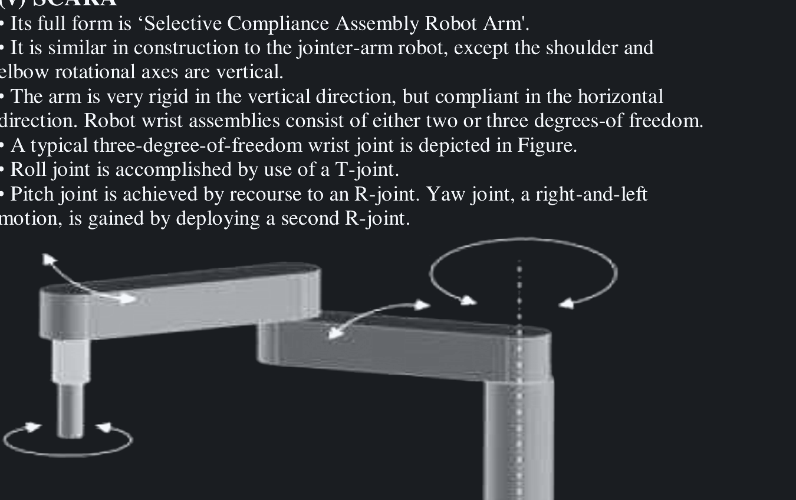
INDUSTRIAL ANATOMY • 6 DEGREES OF FREEDOM
JARVIS ROBOTICS
WHY 6 AXES?
TOTAL DEXTERITY IN THREE-DIMENSIONAL SPACE
Why do standard industrial robot arms (KUKA, ABB, Fanuc, Universal Robots) universally feature 6 rotary axes?
• 3 Axes for Position: Shoulder pan, shoulder lift, and elbow pitch place the wrist anywhere in the 3D sphere (X, Y, Z).
• 3 Axes for Orientation (The Spherical Wrist): Roll, pitch, and yaw rotate the gripper to match any surface angle.
💡 Real-World Example: Screwing in a Lightbulb:
• Moving your hand to the ceiling socket requires 3 position axes.
• Tilting the bulb straight and twisting the screw threads requires 3 orientation axes!
Takeaway: 6 DOFs is the exact mathematical minimum for total 3D spatial dexterity.
[Reference: Jorge Angeles, Ch. 5 • Spatial Dexterity]
ROBOTICS FUNDAMENTALS • SESSION 01 / 04 • THURSDAY, 10 SEPT 2026
Notes:
PRESENTER NOTES:
1. Industrial Arm Anatomy:
- "Axes 1 to 3 are the crane: they put the wrist in position."
- "Axes 4 to 6 are the hand: they orient the welding torch or spray gun."
Reference: Prof. Jorge Angeles (4th Edition, Springer, 2014), Ch. 5 (Workspace Boundaries and Spatial Dexterity of 6-Axis Arms).

Slide 13
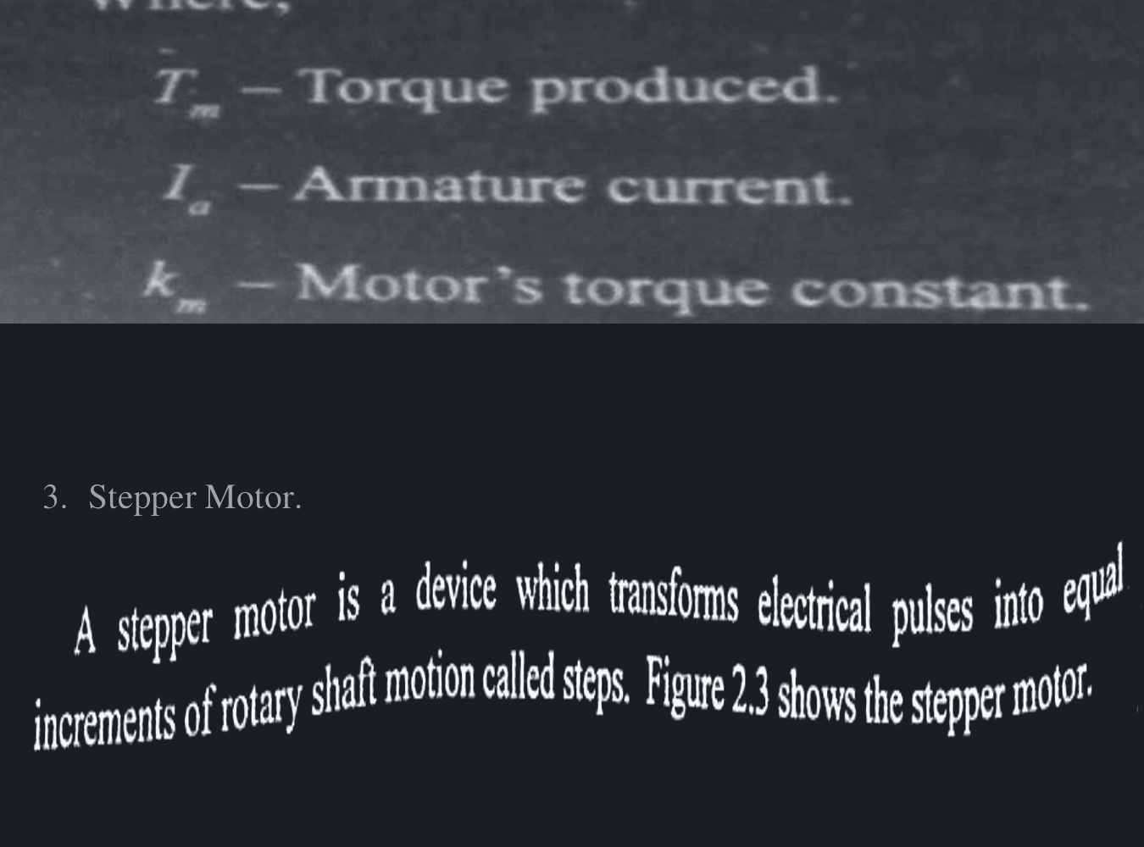
ACTUATION • CHOOSING THE RIGHT MOTOR
3 COMMON ROBOT MOTORS
CHOOSING THE MUSCLES FOR YOUR SYSTEM
STEPPER MOTORS
BRUSHLESS DC (BLDC)
Moves in discrete precise steps (1.8°/pulse). Massive holding torque at 0 RPM; simple open-loop control.
💡 Example: 3D printers & camera sliders.
High speed, 90%+ efficiency, light weight. Requires smart FOC driver and magnetic encoder feedback.
💡 Example: Quadruped robot legs & drones.
HOBBY SERVOS
All-in-one motor, gearbox, potentiometer & driver. Simple 50 Hz PWM control; very low cost ($10).
💡 Example: Small robotic grippers & gimbals.
Notes:
PRESENTER NOTES:
1. Interactive Exercise:
- "Look at any robot in your lab or online. Break it down using these 5 lenses."
- "Where do the wires bend? That's where it will fail in 6 months."

Slide 14
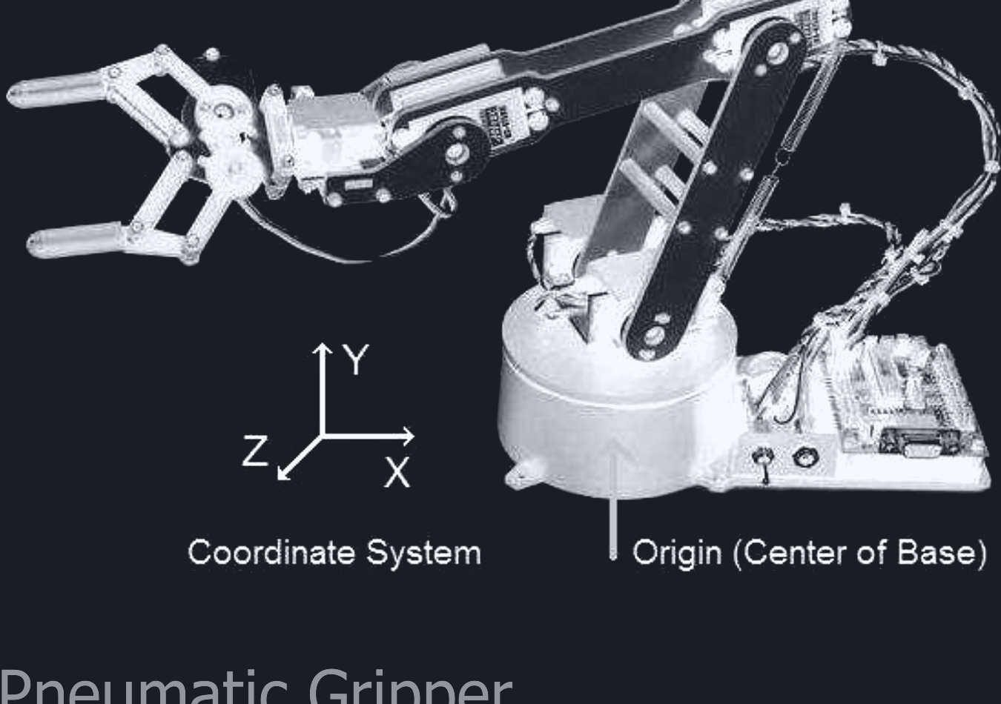
MODULE TRACK • 02 / 06
JARVIS ROBOTICS
ACTUATORS, TRANSMISSIONS & PHYSICS
Torque, gear reductions, efficiency, and mechanical sizing fundamentals.
• Torque = Force × Distance: Sizing motors for worst-case horizontal reach
• Gear Ratios: Trading motor rotational speed for lifting torque
• Transmission types: Timing belts, lead screws, and harmonic drives
• Efficiency losses: How heat and gear friction degrade power
• Backlash vs Pre-load: Eliminating deadband in gear teeth
• Motor thermal limits: Conduction and duty cycles
[Ref: SITAMS 18MEC325, Unit 2 & Angeles 2nd Ed. Ch. 8]
ROBOTICS FUNDAMENTALS • SESSION 01 / 04 • THURSDAY, 10 SEPT 2026
Notes:
PRESENTER NOTES:
1. Section Intro:
- "Part 02: Actuation and Power Transmission. The muscles of the robot!"
Reference: Prof. K. Santhosh Priya (2025), "Automation and Robotics (18MEC325)", Unit 2 (Drives & Actuators in Robotics).

Slide 15
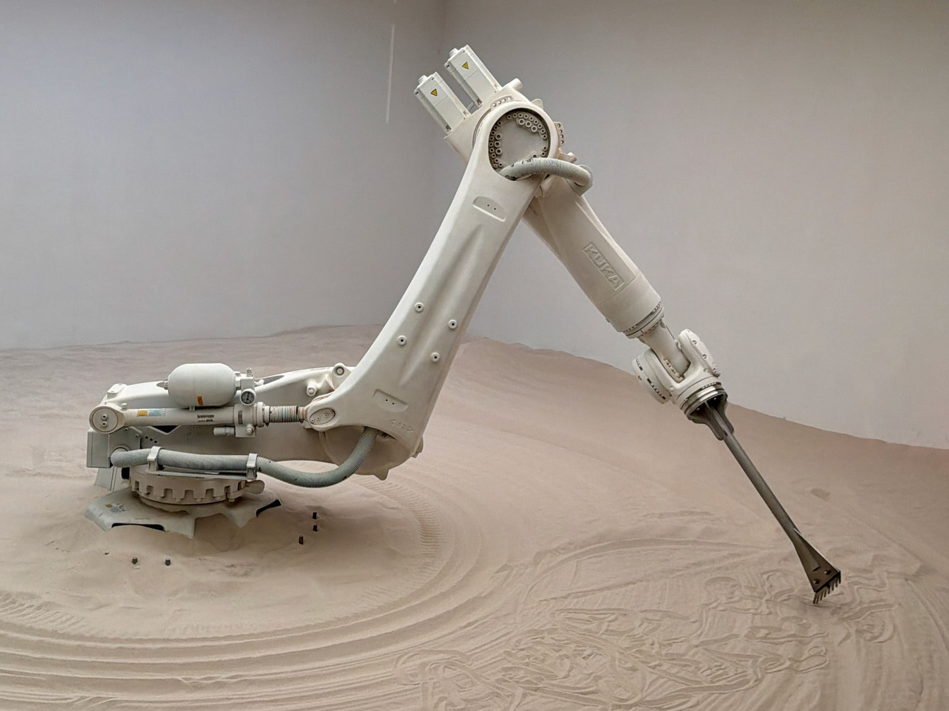
MECHANICAL ADVANTAGE • GEARBOX DESIGN
JARVIS ROBOTICS
GEAR RATIOS & SPEED
TRADING MOTOR RPM FOR LIFTING TORQUE
Electric motors naturally spin fast (3,000 RPM) with modest torque (0.2 N·m). Robots require high torque (20 N·m) at slow speed (30 RPM). Gearboxes solve this:
• Speed drops: Output Speed = Input Speed ÷ Gear Ratio (N)
• Torque multiplies: Output Torque = Input Torque × N × Efficiency (η ≈ 85%)
💡 Real-World Example: An 18-Speed Bicycle:
When pedaling uphill, you shift into lowest gear (large rear cog). You pedal fast, your bike moves slowly, but climbing the steep hill feels effortless!
Takeaway: A 10:1 planetary gearbox turns a 0.5 N·m motor into a powerful 4.2 N·m joint.
[Reference: Jorge Angeles, 2nd Ed., Ch. 8 • Ref: 252.pdf]
ROBOTICS FUNDAMENTALS • SESSION 01 / 04 • THURSDAY, 10 SEPT 2026
Notes:
PRESENTER NOTES:
1. Quick Guide:
- "Wheels? Geared DC. 3D printer? Stepper. High-performance arm? Brushless (BLDC)."
Reference: Prof. Jorge Angeles (2nd Edition, 2002), Ch. 8 (Mechanical Advantage, Angular Velocity Transmission, and Gear Trains). Ref: D:\down\252.pdf

Slide 16
PHYSICS PRINCIPLES • CANTILEVER LOADS
JARVIS ROBOTICS
TORQUE: THE SHOPPING BAG
INTUITIVE PHYSICS FOR SIZING ROBOT ARMS
Hold a heavy 5 kg shopping bag close to your chest: Easy.
Now stretch your arm straight out horizontally: Your shoulder muscles burn in 10 seconds!
• The Physics: The weight is still 5 kg (F ≈ 50 N).
• Close to chest (L = 0.05 m): Torque = 50 N × 0.05 m = 2.5 N·m
• Outstretched (L = 0.60 m): Torque = 50 N × 0.60 m = 30 N·m (12× more torque required!)
Golden Design Rule: Always size base and shoulder motors for full horizontal cantilever extension!
[Reference: Jorge Angeles, 2nd Ed., Ch. 8 • Statics & Cantilever Moments]
ROBOTICS FUNDAMENTALS • SESSION 01 / 04 • THURSDAY, 10 SEPT 2026
Notes:
PRESENTER NOTES:
1. Real-World Analogy:
- "Have everyone in the audience imagine holding that shopping bag. That burning feeling in your shoulder is what your joint motor feels every second."
Reference: Prof. Jorge Angeles (2nd Edition, 2002), Ch. 8 (Statics & Cantilever Torque Transmission). Ref: D:\down\252.pdf

Slide 17
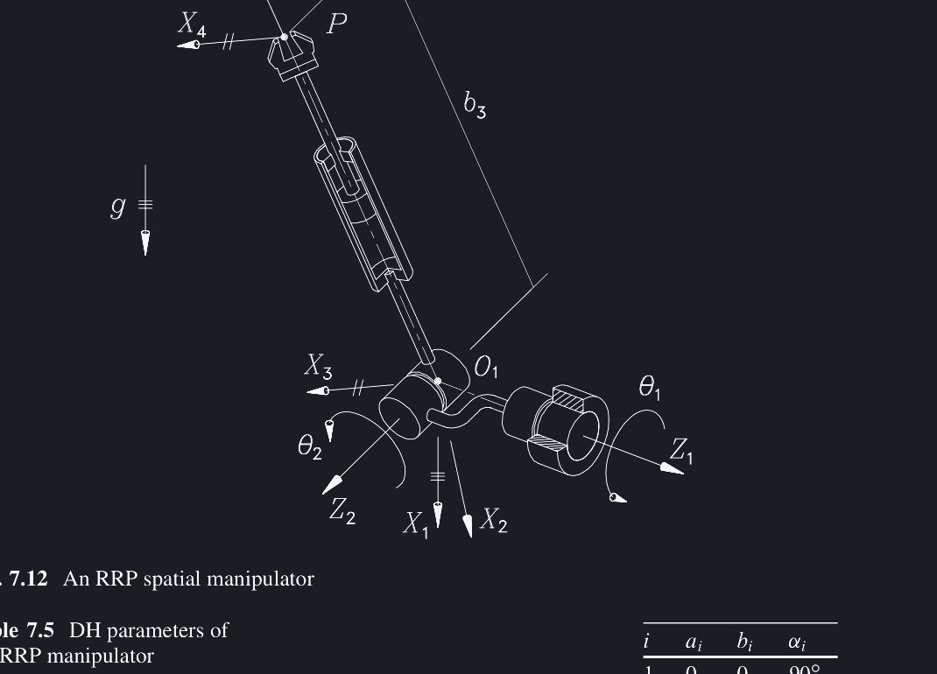
⚡ QUICK CHALLENGE 03 • MOTOR SIZING MATH
JARVIS ROBOTICS
MOTOR SIZING CALCULATION CHECK
A robot arm link is 0.5 meters long and holds a 2 kg payload (20 N) horizontally outstretched. With a 2× safety margin, what torque must the shoulder motor provide?
[A] 2.0 N·m (Force ÷ Distance)
[B] 5.0 N·m (Distance ÷ Force)
[C] 20.0 N·m (Torque = 20 N × 0.5 m × 2× Safety Factor)
[D] 50.0 N·m (Force × Mass)
✓ CORRECT ANSWER: [C]
Static torque τ = F × L = 20 N × 0.5 m = 10 N·m. Multiplying by a 2× engineering safety factor yields 20 N·m to overcome link weight, friction, and acceleration! [Ref: Angeles Ch. 8]
ROBOTICS FUNDAMENTALS • SESSION 01 / 04 • THURSDAY, 10 SEPT 2026
Notes:
PRESENTER NOTES:
1. Don't Just Look at Torque:
- "A winch motor has tons of torque, but takes 10 minutes to turn once. You need the right balance of torque and speed."

Slide 18
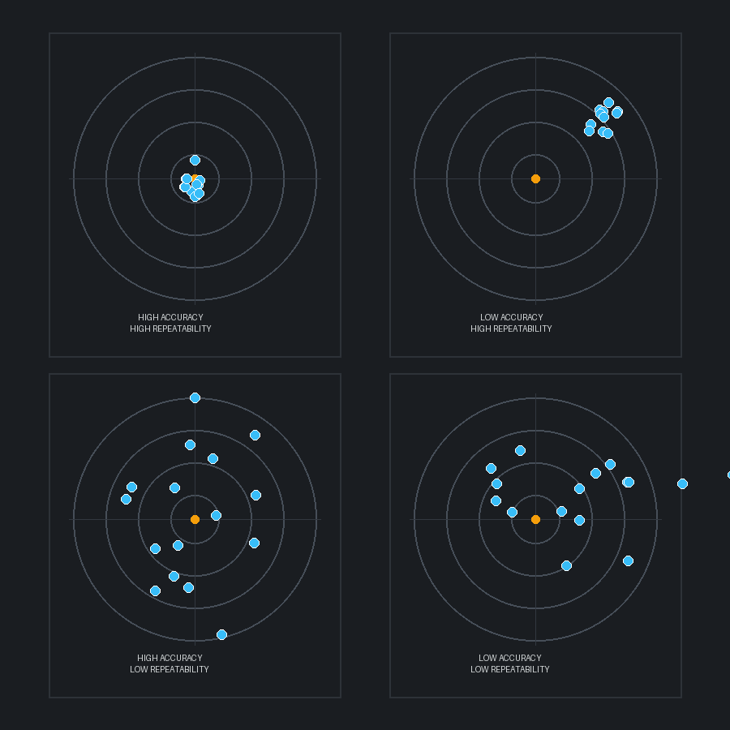
METROLOGY • PRECISION SPECIFICATIONS
JARVIS ROBOTICS
RESOLUTION VS ACCURACY
THE DARTBOARD ANALOGY FOR ROBOT PRECISION
Engineers often confuse these 3 critical metrology specifications:
• 1. Resolution: The smallest step the encoder or driver can detect.
💡 Example: The tiny millimeter tick marks on a ruler.
• 2. Accuracy: How close the gripper gets to the true world coordinate.
💡 Example: Throwing a dart and hitting the bullseye.
• 3. Repeatability: How consistently the robot returns to the exact same spot across 1,000 cycles.
💡 Example: Throwing 10 darts that all land in a tight 2mm cluster, even if slightly off-center.
Key Insight: In industrial robotics, repeatability is far more critical than accuracy. Offsets can be calibrated in software!
[Reference: SITAMS 18MEC325, Unit 1 • Metrology Specs]
ROBOTICS FUNDAMENTALS • SESSION 01 / 04 • THURSDAY, 10 SEPT 2026
Notes:
PRESENTER NOTES:
1. Archer Metaphor:
- "High resolution without repeatability is useless. Always check repeatability on robot datasheets."
Reference: Prof. K. Santhosh Priya (2025), Unit 1 (Robot Specifications: Resolution, Accuracy and Repeatability). Diagram: Fig. 1.12.

Slide 19
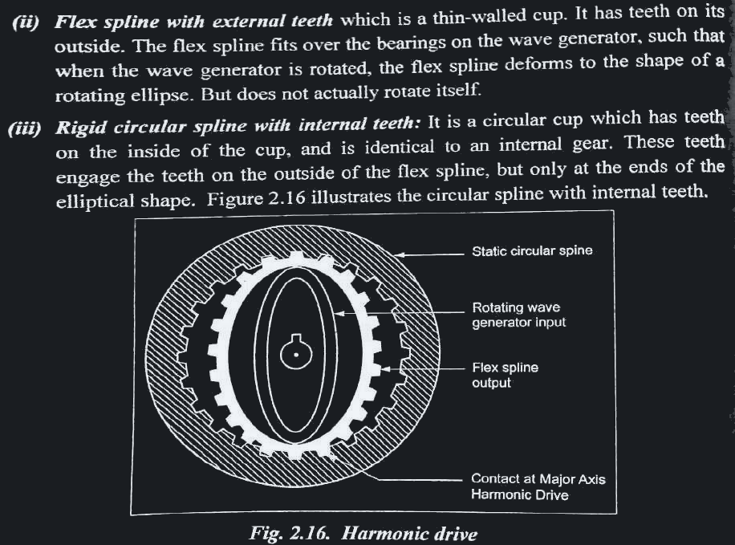
TRANSMISSIONS • POWER DELIVERY
3 COMMON TRANSMISSIONS
TRANSFERRING POWER FROM MOTORS TO JOINTS
GT2/HTD TIMING BELTS
LEAD & BALL SCREWS
Lightweight, quiet, zero backlash when pre-tensioned. Lets heavy motors sit near the base to reduce arm inertia.
💡 Example: 3D printer XY axes & robot wrists.
Converts rotary motor spin into massive linear push. High mechanical advantage, non-backdrivable.
💡 Example: CNC milling tables & car jacks.
HARMONIC (STRAIN-WAVE)
Compact flexible gear cup. 100:1 ratio in a single stage with true zero backlash!
💡 Example: Cobots (Universal Robots) & surgical arms.
Notes:
PRESENTER NOTES:
1. Steering Wheel Analogy:
- "Have you ever driven an old car where you turn the wheel 2 inches before the tires react? That is backlash."

Slide 20
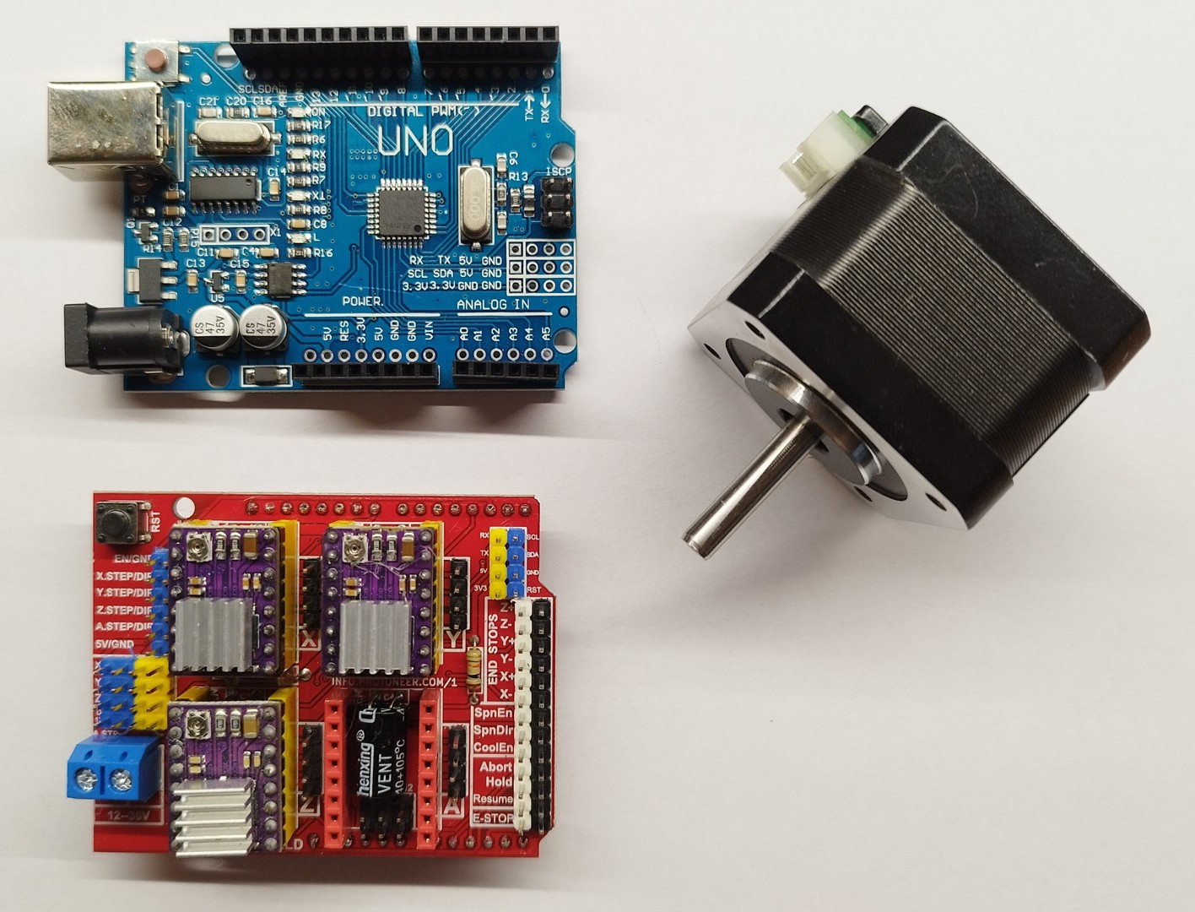
DESIGN CHECKLIST • DRIVE SIZING
DRIVE SELECTION CHECKLIST
3 CHECKS BEFORE BUYING MOTORS
1. CONTINUOUS VS PEAK
2. INERTIA MATCHING
Size motors for continuous holding load, not peak stall limit. Peak stall current will burn windings within seconds!
💡 Keep continuous load < 60% rated.
Keep payload inertia within 5:1 of motor rotor inertia.
💡 Prevents uncontrollable vibrations and violent overshooting during fast stops.
3. BACKLASH BUDGET
A tiny 1° gear play at the shoulder causes 17.5 mm of wobble at a 1-meter gripper!
💡 Use timing belts or harmonic drives on base joints.
Notes:
PRESENTER NOTES:
1. Trick Question Reveal:
- "Trick question! None of them until you know your task requirements!"
- "Never fall in love with motor specs before defining your payload."

Slide 21
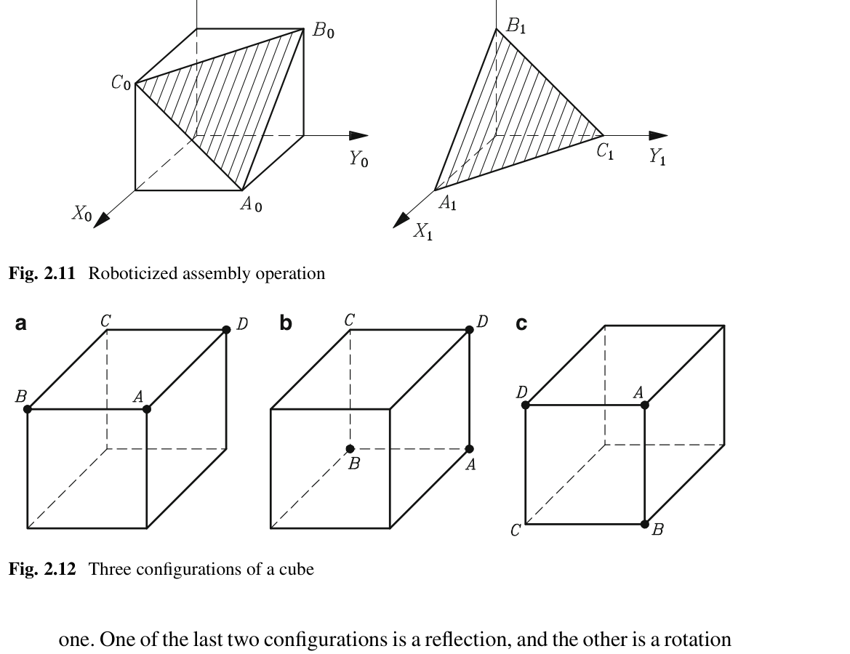
MODULE TRACK • 03 / 06
JARVIS ROBOTICS
MATERIALS, STRUCTURES & DYNAMICS
Structural stiffness, beam deflection, 3D printing limits, and thermal design.
• Materials: 6061-T6 Aluminum vs Carbon Fiber vs 3D printed plastic
• Cantilever Bending: The diving board effect (δ = F·L³ / 3·E·I)
• Geometry vs Material: Why hollow rectangular tubes beat heavy solid rods
• 3D Printing Weakness: Layer adhesion and Z-axis delamination
• Thermal Management: Motor heat dissipation and thermal creep
• Backlash elimination: Split gears, belt tensioners, and preloaded bearings
[Ref: Jorge Angeles, 4th Ed., Ch. 9 • Structural Rigidity]
ROBOTICS FUNDAMENTALS • SESSION 01 / 04 • THURSDAY, 10 SEPT 2026
Notes:
PRESENTER NOTES:
1. Section Intro:
- "Part 03: Mechanical Design. The skeleton that bears the load."
Reference: Prof. Jorge Angeles (4th Edition, Springer, 2014), Ch. 9 (Structural Stiffness and Dynamics of Flexible Manipulator Links).

Slide 22
MATERIAL SELECTION • STRUCTURAL RIGIDITY
JARVIS ROBOTICS
ALUMINUM VS 3D PRINTING
CHOOSING THE RIGHT MATERIAL FOR YOUR ROBOT
6061-T6 ALUMINUM (INDUSTRY STANDARD)
• Elastic Stiffness (E): 70 GPa (20× stiffer than plastic!)
• Machinability: Easy to mill, drill, tap threads, and bolt together
• Thermal: Excellent heat conductor (dissipates motor heat into chassis)
• Verdict: Premier choice for primary arm links and structural motor mounts
💡 Example: Combat robot chassis & commercial drone arms.
[Ref: Angeles 4th Ed. Ch. 9]
3D PRINTED PLA / PETG (RAPID PROTOTYPING)
• Elastic Stiffness (E): 3.5 GPa (Bends easily under load)
• Thermal: Softens at 60°C (Hot stepper motors melt PLA mounts!)
• Strength: Strong in compression, weak along horizontal layer seams
• Verdict: Great for prototypes, sensor clips, and cosmetic shells
💡 Example: Custom camera brackets and cable clips.
[Ref: SITAMS Unit 5]
ROBOTICS FUNDAMENTALS • SESSION 01 / 04 • THURSDAY, 10 SEPT 2026
Notes:
PRESENTER NOTES:
1. Human Bone Metaphor:
- "Muscles generate pull, but bones and cartilage take the load. Separate torque generation from structural load bearing."

Slide 23
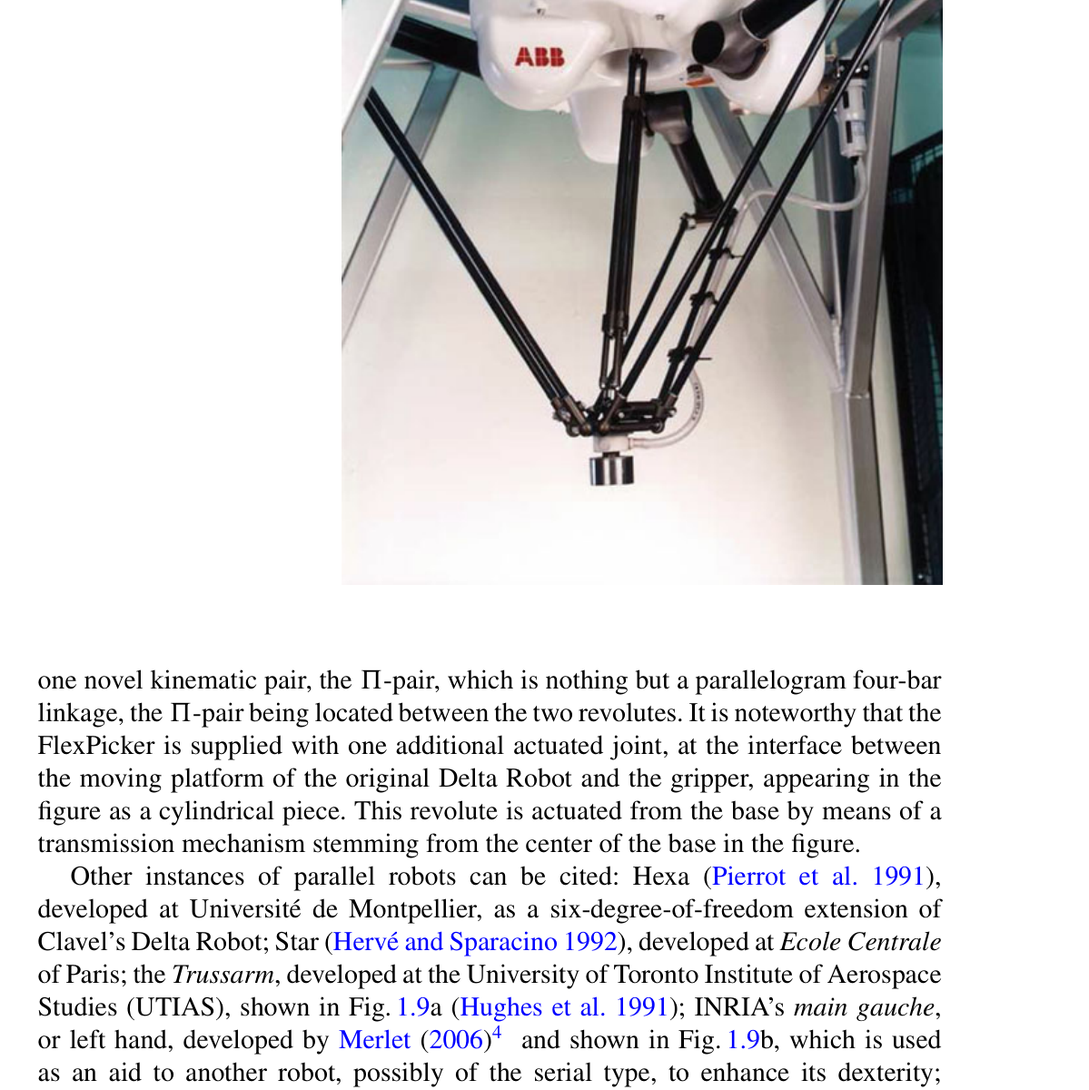
STRUCTURAL PHYSICS • MOMENT OF INERTIA
JARVIS ROBOTICS
BEAM DEFLECTION
WHY THICKNESS MATTERS 8× MORE THAN ALLOY
When a robot arm carries a payload, it deflects like a diving board under a swimmer:
• The Intuitive Ruler Experiment:
- Try to bend a plastic ruler when it is flat: It bends effortlessly.
- Now turn the ruler 90° onto its narrow edge and try to bend it: It is virtually impossible to bend!
• The Physics (Stiffness scales with height cubed: h³):
- Doubling the vertical height of an aluminum tube makes it 8× stiffer (800% stiffness gain) with almost zero added weight!
Key Takeaway: Geometry and cross-section shape beat heavy solid metal every single time.
[Reference: Jorge Angeles, Ch. 9 • Mechanics of Manipulator Beams]
ROBOTICS FUNDAMENTALS • SESSION 01 / 04 • THURSDAY, 10 SEPT 2026
Notes:
PRESENTER NOTES:
1. Explain L³ Simply:
- "Double the reach = 8x the bend. That is why industrial robot arms look stocky and thick."
Reference: Prof. Jorge Angeles (2014), Ch. 9 (Cantilever Beam Deflection, Moment of Inertia Scaling & Structural Rigidity).

Slide 24
⚡ QUICK CHALLENGE 04 • STRUCTURAL RIGIDITY
JARVIS ROBOTICS
ELIMINATING ARM DEFLECTION
Your robot arm sags 8 mm downward under a heavy payload. You want to make it significantly stiffer without adding heavy weight. What is the smartest fix?
[A] Switch to a taller hollow rectangular tube (Stiffness scales with height cubed: h³)
[B] Replace aluminum with a heavy solid steel rod
[C] Increase motor holding current to maximum
[D] Increase the baud rate of the serial bus
✓ CORRECT ANSWER: [A]
Beam stiffness scales with height cubed (h³)! Doubling the vertical thickness of a hollow tube makes it 8× stiffer with almost zero added weight. [Ref: Jorge Angeles Ch. 9 • Diving Board Deflection]
ROBOTICS FUNDAMENTALS • SESSION 01 / 04 • THURSDAY, 10 SEPT 2026
Notes:
PRESENTER NOTES:
1. Maker Strategy:
- "3D print brackets on Friday night, but use aluminum tubes for long structural arms!"

Slide 25
THERMAL ENGINEERING • RELIABILITY
MOTOR THERMAL MANAGEMENT
KEEPING ACTUATORS COOL UNDER CONTINUOUS LOAD
1. CONDUCTION PATHS
2. PLASTIC CREEP
Bolt motors directly to thick aluminum structural plates. The chassis acts as a large heatsink to conduct stator heat away.
💡 Example: Electric go-kart motor mounts.
Steppers running at 80°C will soften PLA mounts, causing belt tension to loosen and motor shafts to misalign!
💡 Use PETG, ABS, or aluminum mounts.
3. IDLE CURRENT SLEEP
Winding heat scales with current squared (P = I²R). Drop holding current to 40% when stationary.
💡 Cuts stationary heat generation by 84%!
Notes:
PRESENTER NOTES:
1. The Iron Law:
- "You cannot build a NASA precision robot for 100 dollars. Great engineering is choosing the right compromise."

Slide 26
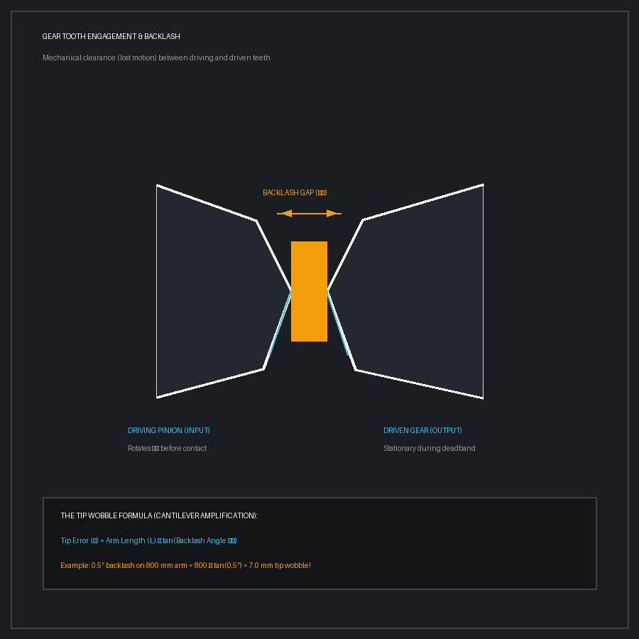
PRECISION MECHANICS • HYSTERESIS
JARVIS ROBOTICS
GEAR BACKLASH: LOST MOTION
THE ENEMY OF ROBOTIC POSITIONING
Backlash is the mechanical clearance gap between mating gear teeth needed to prevent jamming and allow lubrication.
• The Lost Motion Problem: When a motor reverses direction, the input gear turns through an empty angle before touching the opposite tooth face.
• The Tip Amplification: A tiny 0.5° gear play at the base joint swings the tip of an 800 mm arm by 7 millimeters!
💡 Real-World Example: Steering Wheel Play in an Old Car:
Turning the wheel 2 inches before the car's wheels actually respond.
Solutions: Spring-loaded anti-backlash split gears, pre-tensioned timing belts, or zero-backlash harmonic drive gearboxes.
[Reference: SITAMS Unit 2, p. 96 & Jorge Angeles 2nd Ed. Ch. 8]
ROBOTICS FUNDAMENTALS • SESSION 01 / 04 • THURSDAY, 10 SEPT 2026
Notes:
PRESENTER NOTES:
1. The Tuning Fork:
- "When Arm B stops, it vibrates like a guitar string for 1.5 seconds. Always design arms compact."
Reference: Prof. Jorge Angeles (2002), Ch. 8 (Backlash Elimination, Lost Motion, and Pre-loaded Gear Systems). Ref: D:\down\252.pdf

Slide 27
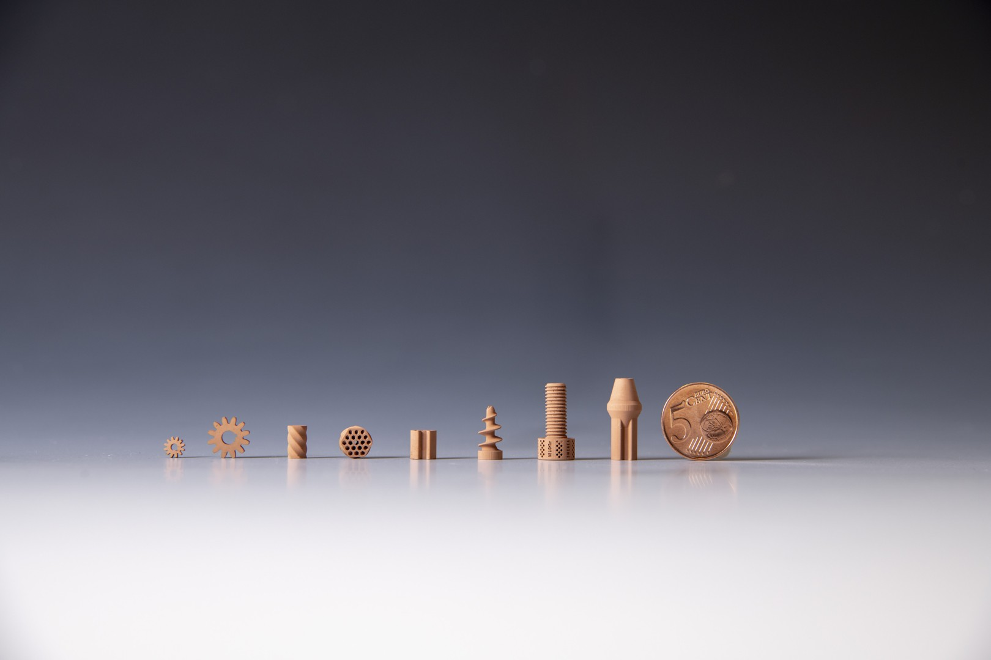
⚡ QUICK CHALLENGE 05 • 3D PRINTING FORCES
JARVIS ROBOTICS
3D PRINTED HARDWARE FAILURE
A 3D-printed robot bracket snaps cleanly in half along a shiny, flat horizontal surface under moderate pull force. What caused the fracture?
[A] The motor wire gauge was too thin
[B] Tensile pull separated the plastic layer lines (Z-axis delamination); FDM prints are anisotropic
[C] Gear backlash induced high-frequency vibration
[D] Microcontroller brownout released the joint
✓ CORRECT ANSWER: [B]
FDM 3D prints are anisotropic: layer-to-layer bonding is only 30–50% of continuous filament strength. Always orient parts so pull stresses travel along continuous XY lines! [Ref: SITAMS Unit 5]
ROBOTICS FUNDAMENTALS • SESSION 01 / 04 • THURSDAY, 10 SEPT 2026
Notes:
PRESENTER NOTES:
1. 3-Minute Sprint:
- "Drop your choices in chat: Aluminum or plastic? Stepper or servo?"

Slide 28
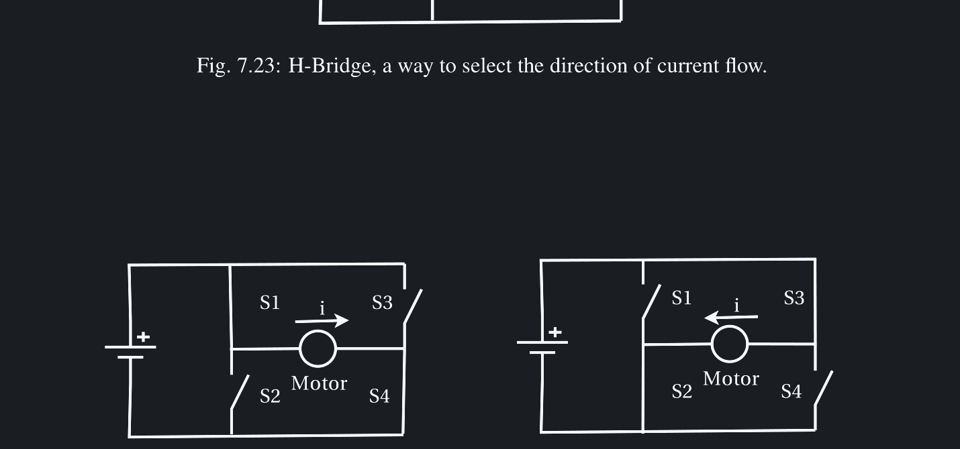
MODULE TRACK • 04 / 06
JARVIS ROBOTICS
ELECTRICAL ARCHITECTURE & CONTROL
Microcontrollers, motor drivers, power distribution, and communication buses.
• Microcontrollers (Reflexes) vs Single-Board Computers (Brain)
• Motor Driver Physics: MOSFET H-bridges & shoot-through protection
• Stepper open-loop pulses vs Brushless closed-loop FOC control
• Power Delivery: Battery discharge C-ratings, ESR, and voltage sag
• Preventing Brownouts: Dedicated DC-DC buck regulators & capacitors
• Noise Immunity: Star grounding and ground loops
[Ref: Jeff McGough, Robotics: Concepts & Simulation, Ch. 7]
ROBOTICS FUNDAMENTALS • SESSION 01 / 04 • THURSDAY, 10 SEPT 2026
Notes:
PRESENTER NOTES:
1. Section Intro:
- "Part 04: Power and Electrical Systems. A robot without power is an expensive paperweight."
Reference: Prof. Jeff McGough (2019), "Robotics: Concepts, Simulation and System Integration", Ch. 7 (Electrical Concepts and High-Current Actuation).

Slide 29
COMPUTATION • EMBEDDED HARDWARE
JARVIS ROBOTICS
MCU VS SINGLE-BOARD COMPUTER
SEPARATION OF CONCERNS: REFLEXES VS BRAIN
MICROCONTROLLER (STM32 / ESP32 / ARDUINO)
• Role: The Spinal Cord & Reflexes (Hard Real-Time)
• Execution: Microsecond-deterministic C/C++ without an operating system
• Tasks: 20 kHz motor PWM, encoder interrupt counting, PID loops, E-stop monitoring
• Crucial Advantage: Never freezes, misses a clock tick, or lags from background OS tasks!
💡 Real-World Example: Touching a hot stove and pulling your hand back in 10 milliseconds.
[Ref: Jeff McGough Ch. 7 • Microcontrollers]
SINGLE-BOARD COMPUTER (JETSON / PI / LINUX)
• Role: The Strategic Cerebrum Brain (High-Level Autonomy)
• Execution: Linux (Ubuntu) + ROS 2 middleware + Python AI nodes
• Tasks: Camera vision (YOLO), LiDAR SLAM mapping, trajectory path planning (MoveIt)
• Rule of Thumb: Never toggle motor pins directly from Linux user space!
💡 Real-World Example: Deciding which route to navigate across a college campus.
[Ref: Jeff McGough Ch. 3 • Embedded Linux]
ROBOTICS FUNDAMENTALS • SESSION 01 / 04 • THURSDAY, 10 SEPT 2026
Notes:
PRESENTER NOTES:
1. Remember This:
- "Voltage gives you SPEED. Current gives you TORQUE. Multiply them for Watts."

Slide 30
POWER ELECTRONICS • MOTOR DRIVERS
JARVIS ROBOTICS
H-BRIDGES & MOSFETS
HOW WEAK LOGIC CONTROLS POWERFUL MOTORS
Microcontroller pins output 3.3V at 20 milliamps. A robot motor needs 24V at 10 amps. An H-Bridge bridges the gap:
• The H-Formation (4 MOSFET Switches):
- Forward: Switches Q1 and Q4 turn ON → Current flows left to right.
- Reverse: Switches Q2 and Q3 turn ON → Current flows right to left.
- Speed Control: Pulsing the switches on and off at 20 kHz (PWM) modulates motor speed smoothly!
Critical Rule: Shoot-Through Prevention. Never turn Q1 and Q2 ON at the same time! That connects battery positive directly to ground, exploding the transistors in milliseconds!
[Reference: Jeff McGough, Ch. 7 • Power Control & Motor Drivers]
ROBOTICS FUNDAMENTALS • SESSION 01 / 04 • THURSDAY, 10 SEPT 2026
Notes:
PRESENTER NOTES:
1. Real Competition Story:
- "Robots reboot on the starting line because the 0.5-second acceleration spike trips the battery protection."
Reference: Prof. Jeff McGough (2019), Ch. 7 (MOSFET H-Bridge Motor Drivers & Shoot-Through Protection). Diagram: Fig. 7.23.

Slide 31
MOTOR COMPARISON • SYSTEM TRADEOFFS
JARVIS ROBOTICS
STEPPER VS BRUSHLESS DC
MATCHING MOTOR CHARACTERISTICS TO THE MISSION
STEPPER MOTOR (NEMA 17 / 23)
• Control: Simple step & direction pulses; no encoder required for basic positioning
• Torque Curve: Massive torque at 0 RPM; falls off sharply above 600 RPM
• Efficiency: Low (draws full current even when holding stationary; runs hot)
• Cost: Very inexpensive ($15–$30 with driver)
• Best For: 3D printers, CNC linear axes, fixed-reach tabletop arms
💡 Real-World Example: Ender 3 3D printer axis motors.
[Ref: SITAMS Unit 2]
BRUSHLESS DC + FOC (FOC SERVO)
• Control: High-speed 3-phase Field-Oriented Control with magnetic encoder feedback
• Torque Curve: Smooth, wide torque-speed envelope up to 5,000+ RPM
• Efficiency: High (90%+; only draws current proportional to external load)
• Cost: Moderate to High ($80–$250 with FOC driver)
• Best For: Dynamic quadruped legs, robot arm joints, mobile AMR wheel hubs
💡 Real-World Example: Boston Dynamics Spot robot dog leg joints.
[Ref: McGough Ch. 7]
ROBOTICS FUNDAMENTALS • SESSION 01 / 04 • THURSDAY, 10 SEPT 2026
Notes:
PRESENTER NOTES:
1. Field Truth:
- "Sales sheet: 2 hours. Lab test: 42 minutes before safety shutoff. Plan accordingly."

Slide 32
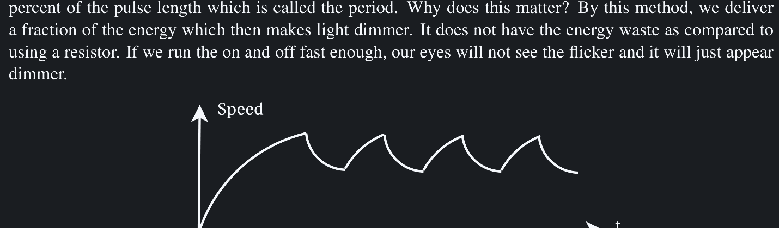
⚡ QUICK CHALLENGE 06 • ELECTRICAL INTEGRITY
JARVIS ROBOTICS
POWER SURGE & MCU BROWNOUTS
Your robot crawls smoothly at low speed, but the microcontroller reboots instantly whenever both drive motors accelerate hard. What is happening?
[A] The Python code encountered a syntax error
[B] Motor surge current caused battery voltage to sag below the MCU 3.3V logic threshold
[C] Optical encoders reversed their direction
[D] The ambient room temperature dropped
✓ CORRECT ANSWER: [B]
Motors draw high stall current during acceleration, sagging battery voltage. If logic and motors share an unfiltered rail, the MCU suffers a brownout reset. Always use a dedicated DC-DC regulator! [Ref: McGough Ch. 7]
ROBOTICS FUNDAMENTALS • SESSION 01 / 04 • THURSDAY, 10 SEPT 2026
Notes:
PRESENTER NOTES:
1. Debugging Detective:
- "'It worked on my desk!' On the desk, wheels spun freely. On carpet, friction triggered the brownout."

Slide 33
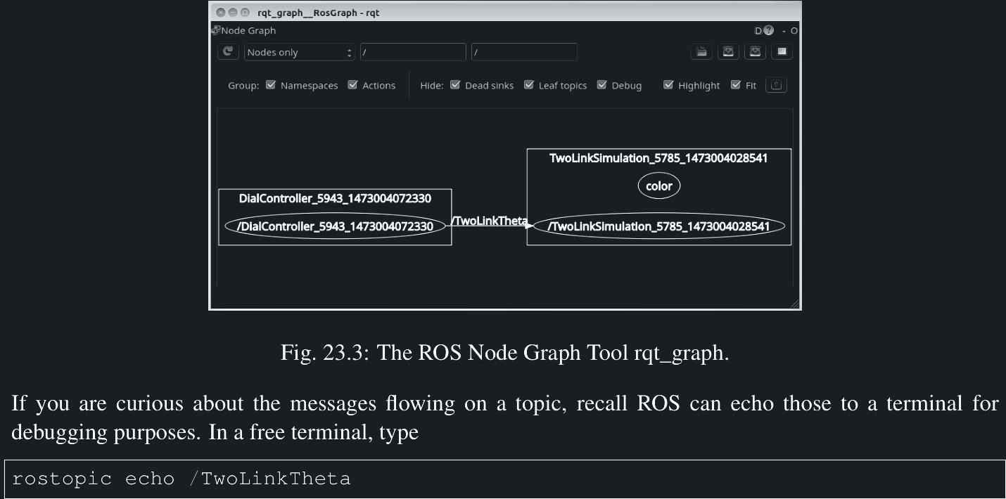
MODULE TRACK • 05 / 06
JARVIS ROBOTICS
SOFTWARE INTEGRATION & DIGITAL TWIN
ROS 2 middleware, URDF modeling, and physics-accurate simulation.
• ROS 2 Architecture: Nodes, Topics, Publishers, and Subscribers
• Hardware Abstraction (ros2_control): Decoupling algorithms from physical motors
• URDF / XACRO: Mathematical kinematics and collision tree definition
• Physics Engines: Simulating mass, friction, contacts, and gravity
• Sim-to-Real: Validating control loops in Gazebo before touching hardware
• Sensor Emulation: Generating synthetic depth cameras, LiDAR scans, and IMU data
[Ref: Jeff McGough, Ch. 3 • Simulation Architecture]
ROBOTICS FUNDAMENTALS • SESSION 01 / 04 • THURSDAY, 10 SEPT 2026
Notes:
PRESENTER NOTES:
1. Section Intro:
- "Part 05: Software, Tools & Simulation. Where does code actually live in a robot?"
Reference: Prof. Jeff McGough (2019), Ch. 3 (Software and Simulation - ROS 2 & Gazebo Architecture). Diagram: Fig. 23.3.

Slide 34
SOFTWARE ARCHITECTURE • STACK LAYERS
THE ROBOT SOFTWARE STACK
MODULAR SEPARATION OF EMBEDDED CONCERNS
1. AUTONOMY & AI (PYTHON)
2. MIDDLEWARE (ROS 2)
High-level mission planning, object recognition (YOLO), SLAM mapping, and user web interface.
💡 Example: Deciding to navigate toward a red cup.
The message bus: Publish/Subscribe architecture connecting disparate software nodes across network sockets.
💡 Example: Publishing /cmd_vel velocity packets.
3. HARD REAL-TIME (C/C++)
Microsecond motor drivers, PID position loops, encoder interrupt handlers, and safety hardware watchdogs.
💡 Example: Pulsing 20 kHz PWM to motor H-bridges.
Notes:
PRESENTER NOTES:
1. Layer Rule:
- "Never pulse motor pins from desktop Python, and never run heavy AI on an Arduino. Respect the layers."
Reference: Prof. Jeff McGough (2019), Ch. 3 (Software Architecture, ROS Nodes, Topics, and Real-Time Control).

Slide 35
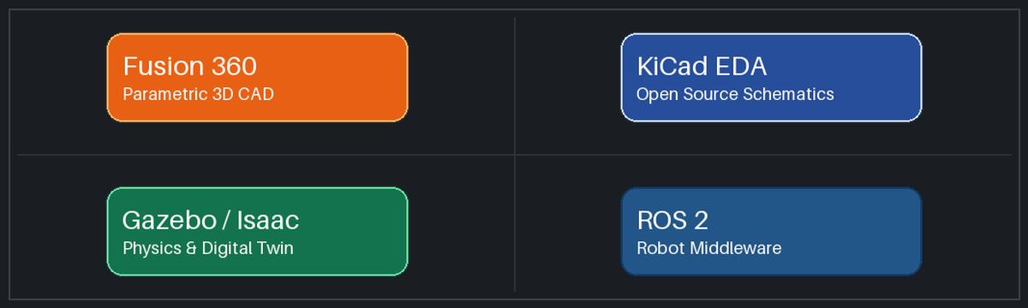
TOOLCHAIN • OPEN-SOURCE ECOSYSTEM
FREE ROBOTICS STARTER KIT
WORLD-CLASS PROFESSIONAL TOOLS AT ZERO LICENSE COST
MECHANICAL: FUSION 360
ELECTRONICS: KiCad EDA
Parametric 3D CAD modeling, clearance checks, assembly joint kinematics, and STL export for 3D printing.
(Official Autodesk Fusion 360 tool)
100% free open-source schematic capture and multi-layer PCB layout. Design custom motor driver hats without paywalls.
(Official KiCad EDA tool)
SIMULATION: GAZEBO & ROS 2
Physics simulation environment. Test navigation and obstacle avoidance in virtual 3D worlds without risking broken hardware.
(Official Gazebo & ROS 2)
Notes:
PRESENTER NOTES:
1. Democratizing Robotics:
- "You do not need $10,000 corporate licenses. Everything you need to build world-class robots is free."
Reference: Prof. Jeff McGough (2019), Ch. 3 & Ch. 12 (System Integration & Open Source Toolchain: CAD, EDA, and Gazebo).

Slide 36
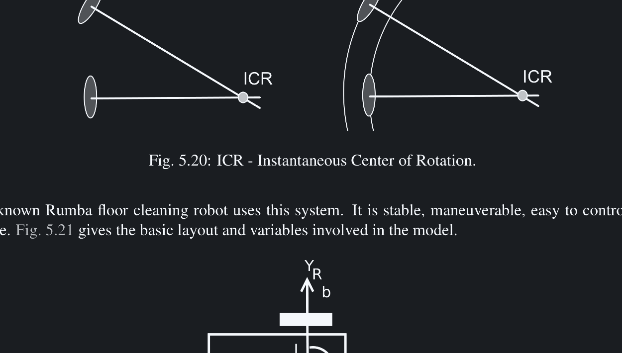
SIMULATION • RISK MITIGATION
JARVIS ROBOTICS
SIM-TO-REAL DEVELOPMENT
WHY SIMULATING FIRST SAVES THOUSANDS OF DOLLARS
In software, a bug causes a harmless error screen. In robotics, a bug sends a 5 kg steel arm crashing into a concrete floor at 2 m/s!
• Zero Broken Hardware: Crash your robot 10,000 times in Gazebo physics simulation at zero financial cost.
• Parallel Development: Software engineers can develop navigation and manipulation algorithms months before the physical machine is machined.
• Synthetic Sensor Data: Simulate virtual camera feeds, LiDAR rays, and encoder pulses with artificial noise.
💡 Real-World Example: NASA Mars rovers and warehouse AMRs test every autonomy update in digital twins before uploading to real machines.
Takeaway: If your kinematics and control loop don't work in simulation, they will never work in reality.
[Reference: Jeff McGough, Ch. 3 • Software and Simulation]
ROBOTICS FUNDAMENTALS • SESSION 01 / 04 • THURSDAY, 10 SEPT 2026
Notes:
PRESENTER NOTES:
1. Quote:
- "'Installing ROS doesn't make your robot autonomous—just like installing Photoshop doesn't make you Leonardo da Vinci!'"
Reference: Prof. Jeff McGough (2019), Ch. 3 (Physics Simulation, Sensor Emulation & Sim-to-Real Validation). Diagram: Fig. 5.21.

Slide 37
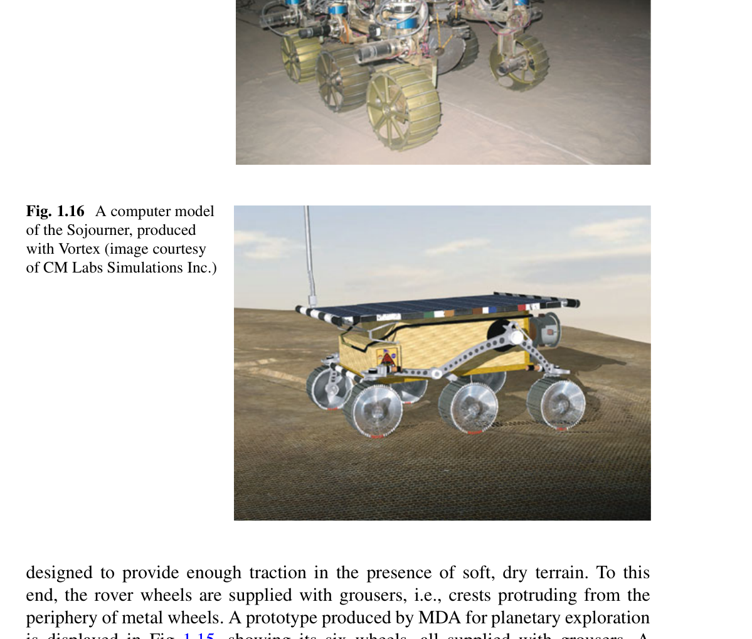
MODULE TRACK • 06 / 06
JARVIS ROBOTICS
REAL-WORLD ENGINEERING & CASES
Debugging, prototyping lessons, and common beginner engineering traps.
• Hardware Debugging: Oscilloscope measurements, ground loops, and vibration analysis
• 'It Worked in CAD!': Accounting for real-world manufacturing tolerances and flex
• Rapid Prototyping: 3D printing vs laser cut acrylic vs CNC machining
• Case Study Analysis: Prototype V1 structural failure → V2 engineered redesign
• Capstone Challenge: Sizing a campus delivery AMR from scratch
• Key Takeaways: The engineering mindset to build functioning robots
[Ref: McGough Ch. 12 & SITAMS 18MEC325 Unit 5]
ROBOTICS FUNDAMENTALS • SESSION 01 / 04 • THURSDAY, 10 SEPT 2026
Notes:
PRESENTER NOTES:
1. Section Intro:
- "Part 06: Prototyping and Reality. This is where engineers are forged."

Slide 38
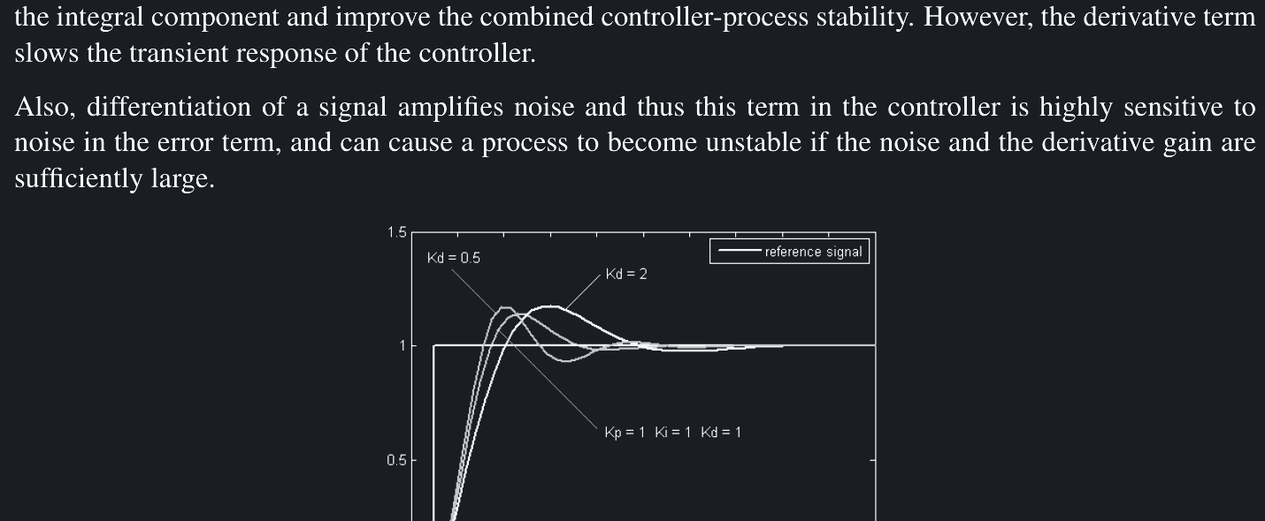
⚡ QUICK CHALLENGE 07 • HARDWARE DEBUGGING
JARVIS ROBOTICS
DIAGNOSING VIOLENT OSCILLATIONS
Your newly assembled robot arm shakes violently when trying to hold still, buzzing loudly at 15 Hz with rapidly heating motors. What is the root cause?
[A] Gear backlash play combined with excessive PID proportional gain (Kp)
[B] The LiPo battery capacity (mAh) is too large
[C] The CAD model was exported in millimeters instead of meters
[D] The ROS 2 topic queue size is set to 10
✓ CORRECT ANSWER: [A]
Gear teeth play creates a deadband. If Kp is too aggressive, the motor violently overshoots across the gear gap, strikes the opposite tooth, and enters a limit-cycle oscillation. Lower Kp! [Ref: McGough Ch. 10]
ROBOTICS FUNDAMENTALS • SESSION 01 / 04 • THURSDAY, 10 SEPT 2026
Notes:
PRESENTER NOTES:
1. Mindset:
- "If your first prototype doesn't break, you didn't test it hard enough. Breaking on your workbench is how you find your real safety boundaries."

Slide 39
PRACTICAL LESSONS • CAD VS REALITY
JARVIS ROBOTICS
IT WORKED IN CAD!
BRIDGING THE GAP BETWEEN IDEAL 3D MODELS AND PHYSICS
In 3D CAD software, links are infinitely rigid, bearings have zero friction, gears have zero backlash, and fasteners never loosen. Real life is different:
• 1. 3D Print Shrinkage: A 3D-printed hole designed for a 10 mm bearing will print at 9.7 mm due to plastic cooling shrinkage! The bearing will not fit without reaming.
• 2. Wire Harness Stiffness: Wires have mass, bend radius, and stiffness. A tight cable bundle can stall a joint motor mid-swing!
• 3. Fastener Vibration: Real robot vibration shakes nuts loose in minutes. Always use nylon-insert locknuts (Nyloc) or threadlocker (Loctite)!
💡 Real-World Pro Tip: Always design 0.3 mm clearances on 3D prints, and leave dedicated conduits for wire routing.
ROBOTICS FUNDAMENTALS • SESSION 01 / 04 • THURSDAY, 10 SEPT 2026
Notes:
PRESENTER NOTES:
1. Relatable Humor:
- "Every engineer laughs at this slide because every engineer has lived it. Leave room for cables from day one."

Slide 40
CASE STUDY • HARDWARE ITERATION
JARVIS ROBOTICS
PROTOTYPE V1 TO V2
A REAL ENGINEERING POST-MORTEM & REDESIGN
The Lifecycle of an Engineering Prototype:
• Prototype V1 (The Novice Build - Failed): 3D-printed PLA joints, direct motor drive without gearboxes, single shared 5V power bus. Result: Gripper sagged 15 mm, motors overheated in 4 minutes, and the microcontroller rebooted whenever the gripper closed.
• Prototype V2 (The Engineered Redesign - Succeeded): Upgraded to 6061 aluminum plate chassis, 10:1 planetary gearboxes, split power rails with dual buck converters, and pre-tensioned timing belts.
• Result: Tip deflection dropped to 0.8 mm, continuous run time exceeded 2 hours, and positioning repeatability reached ±0.2 mm!
💡 Key Lesson: Great robots are never built on attempt #1. Engineering is an iterative cycle of building, testing, and improving.
ROBOTICS FUNDAMENTALS • SESSION 01 / 04 • THURSDAY, 10 SEPT 2026
Notes:
PRESENTER NOTES:
1. Don't Hide Failures:
- "In your portfolio, document your failures and how you solved them. That is what top engineering companies hire for."

Slide 41
⚡ QUICK CHALLENGE 08 • CAPSTONE ARCHITECTURE
JARVIS ROBOTICS
CAPSTONE DRIVETRAIN SELECTION
You are building an outdoor campus delivery rover that must navigate sidewalks, climb 2-inch curb ramps, and run in light rain. Which drivetrain should you choose?
[A] 4-wheel omnidirectional Mecanum drive
[B] Differential drive with large pneumatic rubber tires and rocker suspension
[C] Single-steered caster tricycle drive with hard plastic rollers
[D] 3-wheel holonomic omni-drive
✓ CORRECT ANSWER: [B]
Mecanum and omni wheels slip on wet surfaces, get jammed with outdoor debris, and cannot climb curbs. Large pneumatic tires with differential drive provide superior outdoor traction. [Ref: Angeles Ch. 1 & McGough Ch. 5]
ROBOTICS FUNDAMENTALS • SESSION 01 / 04 • THURSDAY, 10 SEPT 2026
Notes:
PRESENTER NOTES:
1. Team Sprint:
- "You are the chief engineers. Drop your drive topology and battery choice in chat!"

Slide 42
BEST PRACTICES • PITFALLS TO AVOID
JARVIS ROBOTICS
COMMON BEGINNER TRAPS
3 MISTAKES TO AVOID AND HOW TO ENGINEER AROUND THEM
THE 3 BIGGEST HARDWARE TRAPS
1. Direct Motor Drive: Connecting arms directly to motor output shafts without gearboxes or bearings. Destroys motor bearings from radial bending loads!
2. Sizing Motors by Mass Alone: Forgetting that torque is Force × Distance. A tiny 100g gripper at 1-meter reach demands huge torque!
3. Floating Grounds: Failing to tie all logic, driver, and battery grounds together, causing floating signals and erratic noise.
💡 Real-World Trap: Spending 3 weeks debugging firmware when the issue was an ungrounded battery rail!
THE ENGINEERING SOLUTIONS
1. Dual Bearing Support: Always isolate motor shafts from radial bending loads using pillow block or deep-groove ball bearings.
2. 2.5× Safety Factor: Calculate worst-case static torque (τ = F × L) and multiply by 2.5 to overcome joint friction and acceleration inertia.
3. Solid Star Ground: Tie all battery negatives, driver grounds, and MCU ground pins to a single central star-point grounding plane.
💡 Engineering Rule: Hardware reliability begins with solid electrical and mechanical grounding.
ROBOTICS FUNDAMENTALS • SESSION 01 / 04 • THURSDAY, 10 SEPT 2026
Notes:
PRESENTER NOTES:
1. The Lesson of the Ramp:
- "One small change in terrain ripples through motor torque, battery runtime, tire material, and center of gravity."

Slide 43
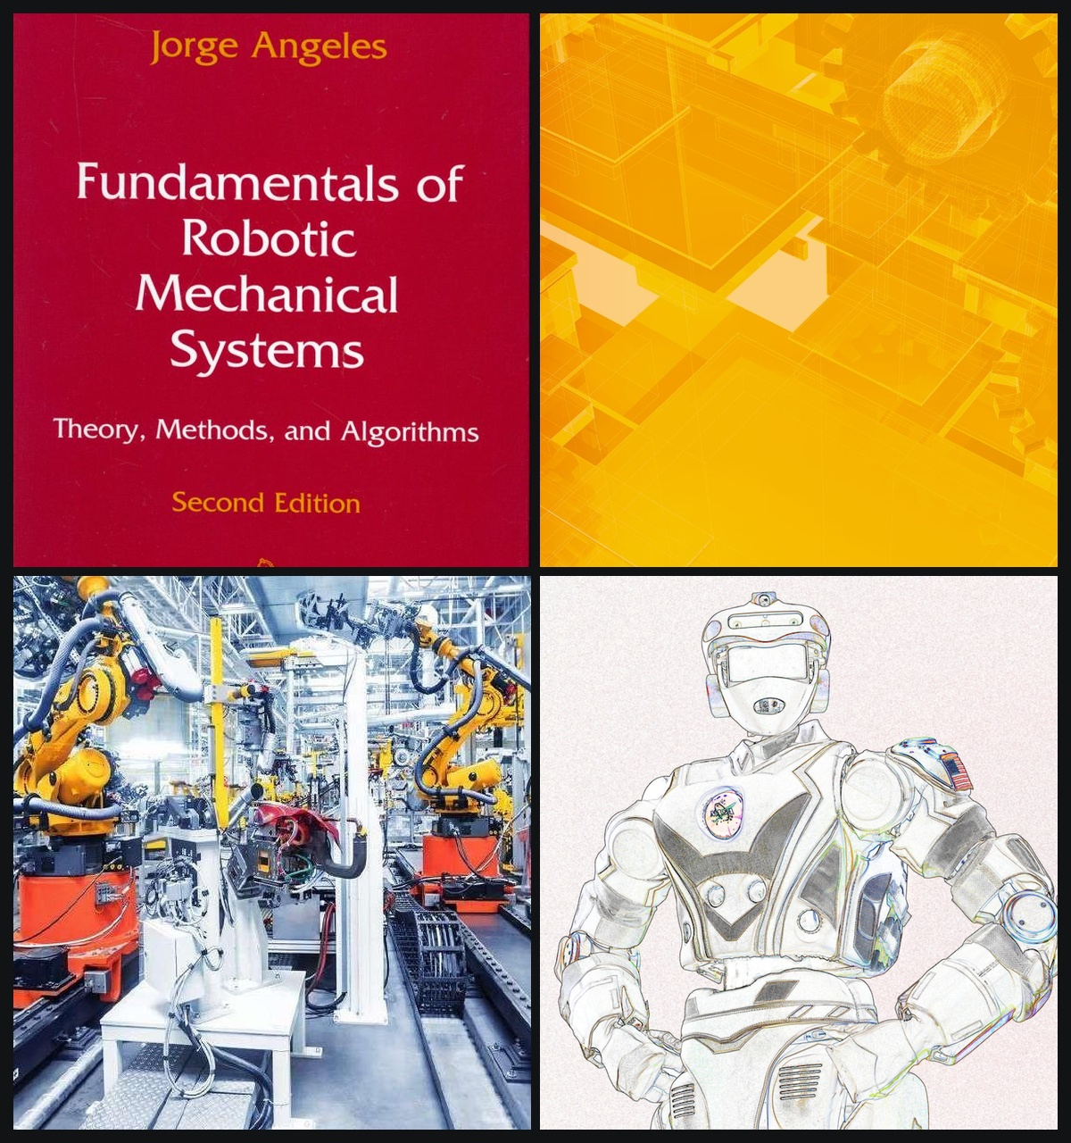
⚡ ACADEMIC REFERENCES & RECOMMENDED LITERATURE
JARVIS ROBOTICS
COURSE REFERENCES & LITERATURE
4 CURATED FOUNDATIONAL TEXTS SUPPORTING THIS WORKSHOP
1. Prof. Jorge Angeles — 4th Edition (Springer, 610 pp.)
"Fundamentals of Robotic Mechanical Systems: Theory, Methods, and Algorithms"
• Core Reference: Kinematic chains, forward/inverse matrix transforms, Jacobians & trajectory.
2. Prof. Jorge Angeles — 2nd Edition (Springer-Verlag, Ref: 252.pdf)
"Fundamentals of Robotic Mechanical Systems: Theory, Methods, and Algorithms"
• Core Reference: Rigid-body rotations, degree-of-freedom theory, gear ratios & cantilever torque.
3. Prof. K. Santhosh Priya — SITAMS Autonomous (2025, 197 pp.)
"Automation and Robotics (18MEC325 Course Lecture Notes)"
• Core Reference: Industrial manipulator anatomy, SCARA/Articulated joints & actuators.
4. Prof. Jeff McGough — Release 1.4 (SDSMT, 582 pp.)
"Robotics: Concepts, Simulation and System Integration"
• Core Reference: Embodied AI loops, H-bridge motor drivers, Gazebo digital twins & sim-to-real.
ROBOTICS FUNDAMENTALS • SESSION 01 / 04 • THURSDAY, 10 SEPT 2026
Notes:
PRESENTER NOTES:
1. The Cheatsheet:
- "Take a screenshot of this slide and put it above your workbench."
=== COMPREHENSIVE COURSE BIBLIOGRAPHY & REFERENCES ===
1. Angeles, Jorge. Fundamentals of Robotic Mechanical Systems: Theory, Methods, and Algorithms (4th Edition). Springer Mechanical Engineering Series, 2014, 610 pp. https://asutp.org/Skills/ROBOT/FundamentalsOfRoboticMechanica.pdf
2. Angeles, Jorge. Fundamentals of Robotic Mechanical Systems: Theory, Methods, and Algorithms (2nd Edition). Springer-Verlag New York, 2002. File: D:\down\252.pdf
3. Santhosh Priya, K. Automation and Robotics (18MEC325 Course Lecture Notes). Department of Mechanical Engineering, Sreenivasa Institute of Technology and Management Studies (SITAMS Autonomous), 2025, 197 pp. https://sitams.ac.in/wp-content/uploads/2025/02/11.18MEC325-Automation-and-Robotics-Lecture-notes.pdf
4. McGough, Jeff. Robotics: Concepts, Simulation and System Integration (Release 1.4). South Dakota School of Mines and Technology, 2019, 582 pp. https://visjasola-ucilnica.sclj.si/pluginfile.php/32773/mod_resource/content/1/Robotics.pdf

Slide 44
SUMMARY • SESSION 01 ACTION PLAN
KEY TAKEAWAYS
THE 3 GOLDEN RULES OF ROBOTICS ENGINEERING
1. TORQUE GOVERNS ALL
2. GEOMETRY BEATS ALLOY
Always calculate τ = F × L at maximum horizontal reach with a 2.5× safety margin before purchasing any motors.
💡 Never size by motor mass alone!
Stiffness scales with height cubed (h³). A large hollow aluminum tube is 8× stiffer than a heavy solid steel rod.
💡 Optimize profile shape first!
3. CLOSED-LOOP IS MANDATORY
Feed real sensor data back to microcontrollers. Open-loop robots fail in changing real-world conditions.
💡 Close the loop with encoders & PID!
Notes:
PRESENTER NOTES:
1. Inspiring Close:
- "Define. Design. Calculate. Build. Test. Break. Improve. That is the true path of robotics."
2. Teaser:
- "Next week in Session 02: We give our robot eyes and ears with LiDAR, depth cameras, and Kalman filtering."
3. Q&A:
- "I'll now open the floor for questions! Drop them in the chat or unmute."

Slide 45
SESSION FINALE • 01 / 04 COMPLETE
JARVIS ROBOTICS
DEFINE • DESIGN • BUILD
TEST • BREAK • IMPROVE
THAT'S ROBOTICS.
See you next Thursday for Session 02: Sensors & Perception!
SESSION 01 COMPLETE
10.09.2026
ROBOTICS FUNDAMENTALS • SESSION 01 / 04 • THURSDAY, 10 SEPT 2026

