Slide 1

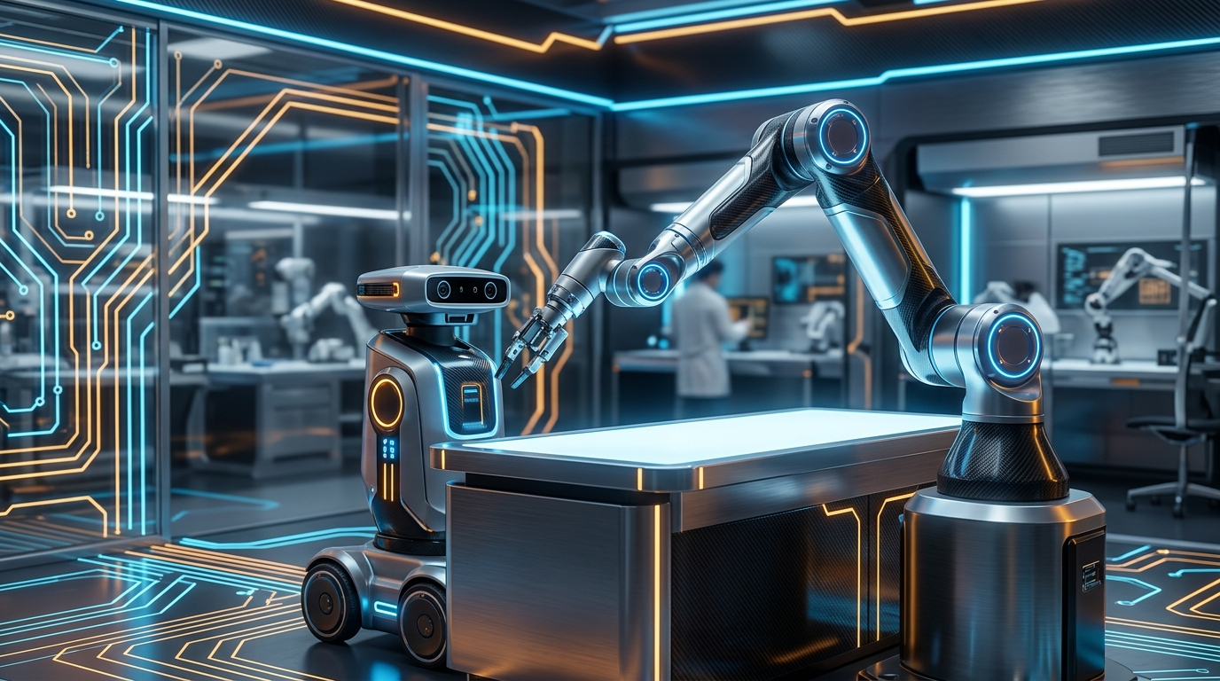
ROBOTICS MASTERCLASS • SESSION 01 / 04
ROBOTICS
FUNDAMENTALS
Session 01 / 04: Mechanical, Electrical Systems & Design
How a robot becomes a real, functioning physical system.
Thursday, 10 September 2026 • 20:00 GMT+3
Online Interactive Workshop for Beginners & Makers
Notes:
PRESENTER NOTES:
1. Welcome & Energy:
- "Good evening and welcome to Session 01 of Robotics Fundamentals!"
- "Whether you are an engineering student, an enthusiast, or a maker, this workshop is designed for YOU."
2. The Session Goal:
- "This is not a boring calculus lecture. We are here to understand how a robot actually becomes a working physical system—from the motors and bones to the batteries and code."
3. Logistics:
- "Keep your chat window open! We will have live polls, design sprints, and Q&A throughout."

Slide 2
INTERACTIVE POLL • 💬 DROP ANSWER IN CHAT
What Actually Makes a Robot Move?
A. THE MOTORS
B. THE ELECTRONICS
Strong & fast muscles
that turn electrical currents into mechanical force.
The power & nerves:
Motor drivers, clean wiring, and batteries supplying peak surges.
C. THE SOFTWARE
D. THE SKELETON
The intelligent mind:
Path planning, sensor feedback, and real-time control loops.
The rigid structure:
Links, bearings, and gears that bear loads without flexing.
ROBOTICS FUNDAMENTALS • SESSION 01 / 04 • THURSDAY, 10 SEPT 2026
Notes:
PRESENTER NOTES:
1. Audience Poll:
- "Vote in chat: A, B, C, or D! Which part is the most critical for a great robot?"
2. The Big Reveal:
- "Most people vote Software. But think about it: If your muscles are strong and your brain is a supercomputer, but your bones are made of wet spaghetti... can you sign your name with a pen?"
- "Robotics is the harmony of all four."

Slide 3
SYSTEM PHILOSOPHY • 🧠 THE 4 PILLARS
Robotics = Integration (The 4 Pillars)
01. MECHANICS
02. ELECTRONICS
The Physical Skeleton:
Bones (Links), Hinges (Joints), and Gears. Gives the robot reach, strength, and stiffness.
The Nerves & Power:
Converts gentle microcontroller logic into heavy physical muscle power without brownouts.
03. CONTROL
04. SOFTWARE
The Reflexes:
The closed-loop math (PID) that keeps joints stable and stops shaking or ringing oscillations.
The Mind:
ROS 2, computer vision, and mapping: 'Where am I, and what task do I execute next?'
ROBOTICS FUNDAMENTALS • SESSION 01 / 04 • THURSDAY, 10 SEPT 2026
Notes:
PRESENTER NOTES:
1. Human Body Metaphor:
- "Keep this metaphor in your head all evening: Skeleton, Nerves, Reflexes, and Mind."
- "Real robotics engineering happens at the intersections."

Slide 4
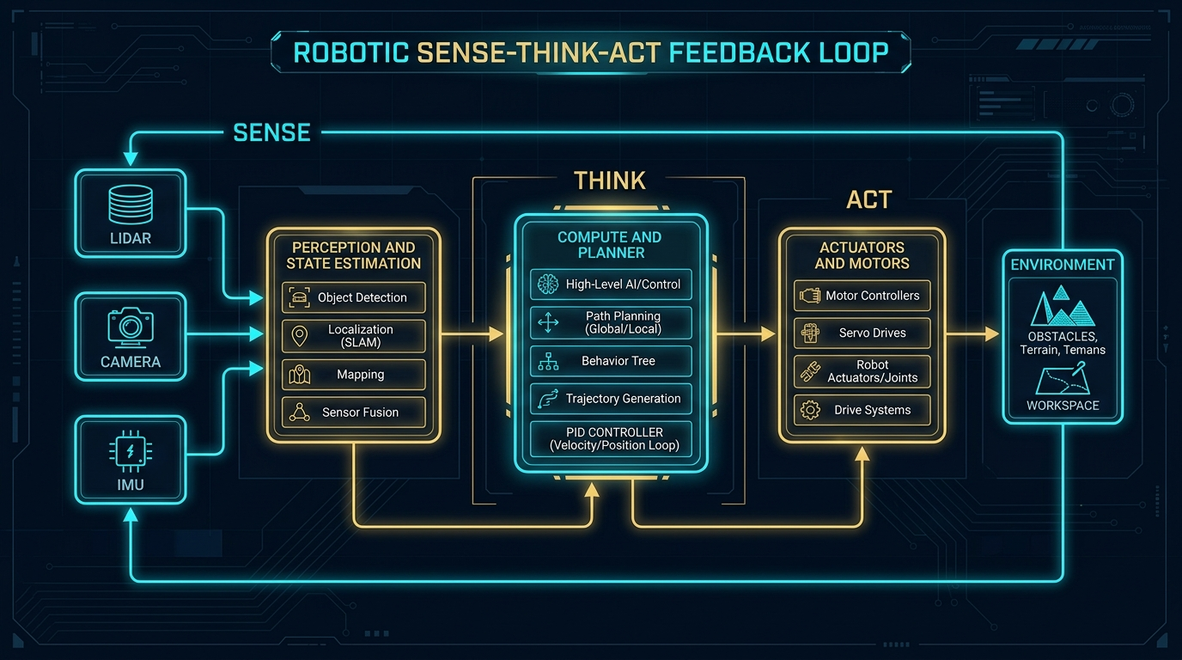
CORE ROBOTIC LOOP • SENSE ➔ DECIDE ➔ ACT
The Robotic System:
Sense ➔ Decide ➔ Act
How does a machine become autonomous?
1. SENSE (Inputs):
Encoders, cameras, LiDAR, and current sensors measure reality.
2. DECIDE (Compute):
Computes error between target position and actual position.
3. ACT (Outputs):
Motor drivers push current to wheels and joints to correct the error!
⚡ Loop Rate: This happens 100 to 1,000 times every single second!
ROBOTICS FUNDAMENTALS • SESSION 01 / 04 • THURSDAY, 10 SEPT 2026
Notes:
PRESENTER NOTES:
1. Walkthrough the Loop:
- "Sense, Decide, Act. If any one of these three steps breaks, the robot is blind, paralyzed, or out of control."
2. Speed Matters:
- "A quadcopter drone must run this loop at 500 Hz (500 times a second) or gravity wins."

Slide 5
FIRST PRINCIPLES • 📐 3 SIMPLE QUESTIONS
Before Building: Three Simple Questions
01. WHERE REACH?
02. HOW HEAVY?
03. WHAT LIMITS?
• How far must the arm stretch?
• Working on a flat table (2D) or full 3D space?
• Rule: Keep joints to the bare minimum needed!
• Lifting a 10g feather or a 2kg bottle of water?
• What motor torque is required?
• ⚠️ Don't forget: The arm must lift its OWN weight too!
• Will the battery die in 10 minutes?
• Will 3D printed links bend like rubber?
• Will loose gear teeth (backlash) destroy accuracy?
ROBOTICS FUNDAMENTALS • SESSION 01 / 04 • THURSDAY, 10 SEPT 2026
Notes:
PRESENTER NOTES:
1. The First Principles:
- "Notice what is NOT on this slide: 'What programming language should I learn?'"
- "First define reach, payload, and physical constraints."

Slide 6
CONTROL THEORY • 🔄 OPEN VS CLOSED LOOP
The Closed Feedback Loop:
What Happens Without Sensors?
OPEN LOOP (Blind Walking):
• Sending commands to motors without feedback.
• If a wheel slips on tile, the robot has NO IDEA it drifted off course!
CLOSED LOOP (Eyes Open):
• Encoders continuously report wheel revolutions.
• If motor slows under load, controller increases current instantly.
👉 Takeaway: Sensors turn dumb blind motion into smart, adaptable robotics!
ROBOTICS FUNDAMENTALS • SESSION 01 / 04 • THURSDAY, 10 SEPT 2026
Notes:
PRESENTER NOTES:
1. Interaction:
- "Close your eyes and try to walk 10 steps in a straight line. You will inevitably drift. That is open-loop control."
2. Encoders:
- "Closing the loop with encoders is what separates an electric toy from a real robot."

Slide 7
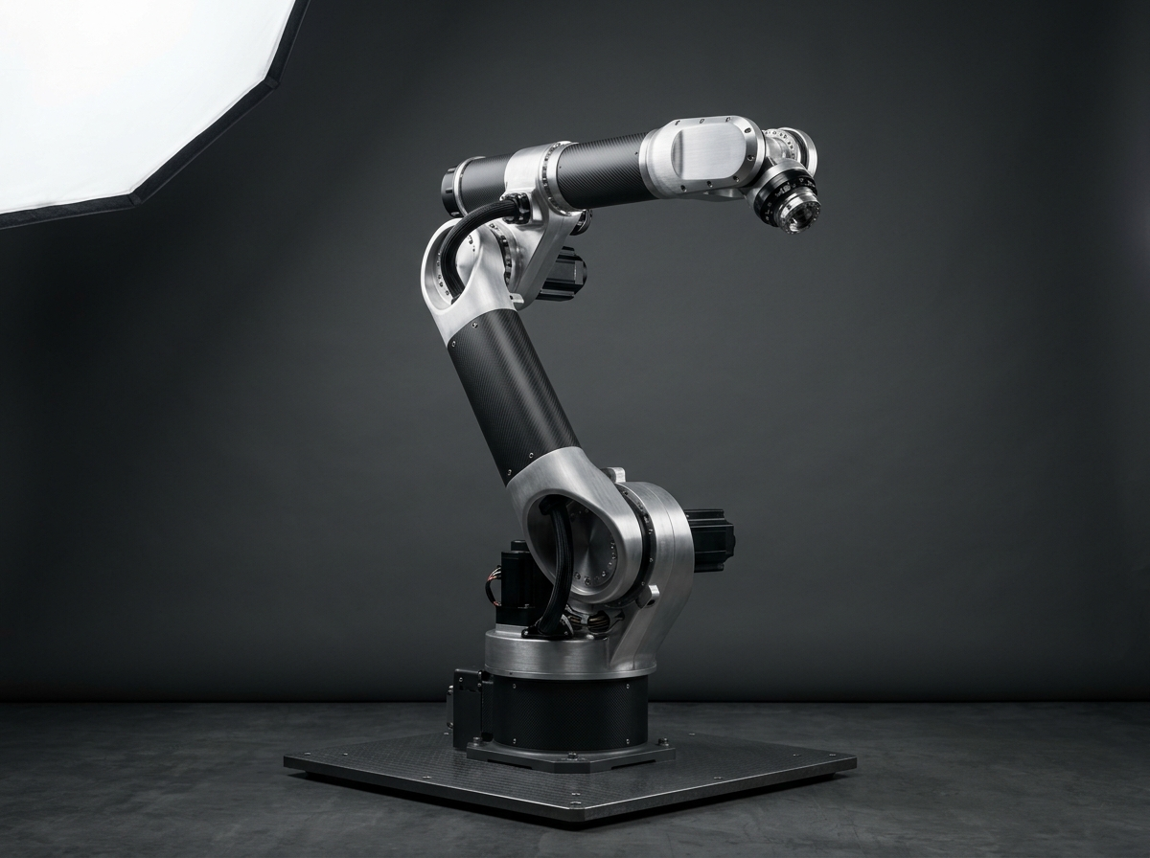
SECTION 01 • MECHANICAL FUNDAMENTALS
PART 01
MECHANICAL
FUNDAMENTALS
Links • Joints • Degrees of Freedom • The 6 Axes of Motion
ROBOTICS FUNDAMENTALS • PART 01 / 06
Notes:
PRESENTER NOTES:
1. Section Intro:
- "Part 01: Mechanical Fundamentals. How does geometry become movement?"
2. Takeaway:
- "Understand links, joints, and why 6 axes are the magic number."

Slide 8
CORE ANATOMY • 🔗 LINKS & JOINTS
CORE CONCEPT
Links & Joints: The Kinematic Chain
A robot arm is simply a chain of rigid bones and hinges:
• LINKS = The Rigid Bones
Beams, extrusions, and brackets that maintain fixed distance between joints.
• JOINTS = The Hinges & Sliders
The precise points where controlled motion occurs, powered by motors.
🔗 Kinematic Chain: Base ➔ Link 1 ➔ Joint 1 ➔ Link 2 ➔ Joint 2 ➔ Tool
ROBOTICS FUNDAMENTALS • SESSION 01 / 04 • THURSDAY, 10 SEPT 2026
Notes:
PRESENTER NOTES:
1. Keep it Concrete:
- "Look at your own arm: Shoulder = Joint 1, Upper arm = Link 1, Elbow = Joint 2, Forearm = Link 2, Wrist = Joint 3, Fingers = End-Effector."

Slide 9
KINEMATICS • ⚙️ REVOLUTE VS PRISMATIC
The Two Fundamental Joint Types
REVOLUTE (R) — ROTATIONAL
PRISMATIC (P) — LINEAR
• Like an elbow, knee, or door hinge
• Motion: Rotation around an axis (Angle θ in degrees)
• 90% of robotic arms are built purely of Revolute joints!
• Like an elevator, syringe, or 3D printer rail
• Motion: Pure straight sliding (Distance d in millimeters)
• Powered by lead screws, timing belts, or rack & pinion.
SCARA ROBOT (R-R-P)
CARTESIAN (P-P-P)
• 2 Revolute joints for superfast horizontal sweeps
• 1 Prismatic vertical slider for pick-and-place
• High speed, ultra-rigid vertical assembly.
• 3 Orthogonal sliding axes (X, Y, Z)
• Used in 3D printers and CNC milling machines
• Super simple kinematics (X=d1, Y=d2, Z=d3).
ROBOTICS FUNDAMENTALS • SESSION 01 / 04 • THURSDAY, 10 SEPT 2026
Notes:
PRESENTER NOTES:
1. Simplify Joints:
- "Almost every joint in the universe is either a Hinge (Revolute) or a Slider (Prismatic)."
- "Combine them, and you get Cartesian, SCARA, or articulated robot arms."

Slide 10
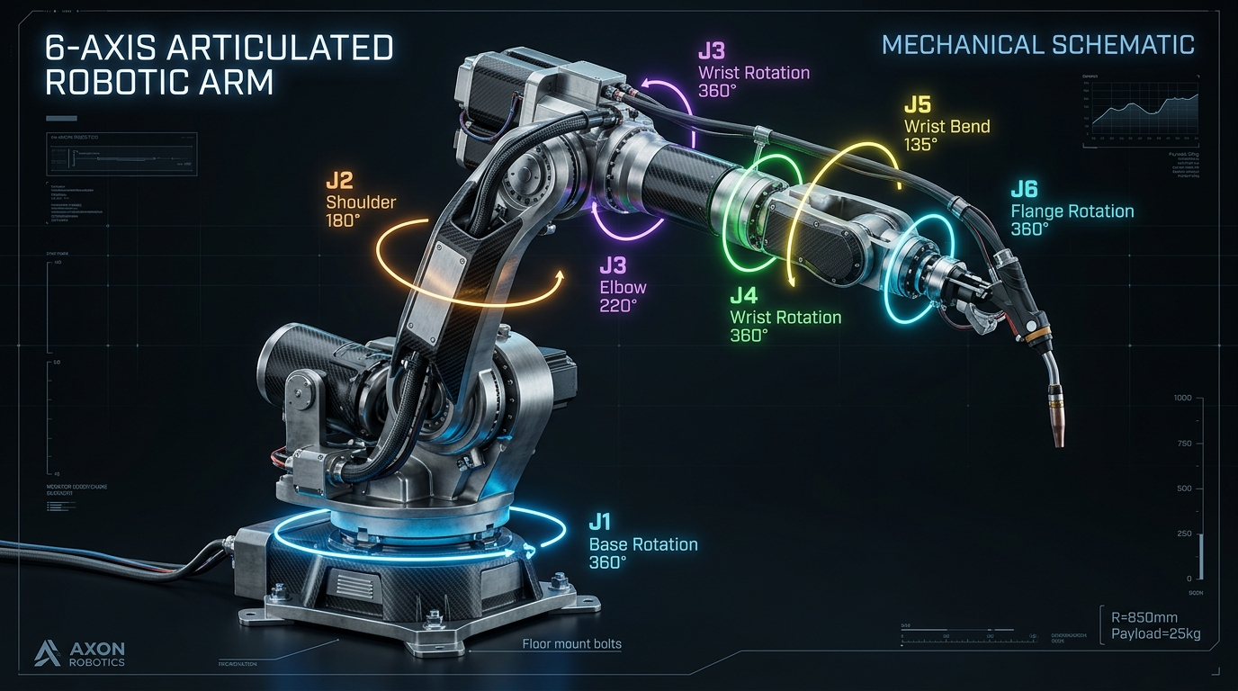
DEGREES OF FREEDOM • 🌐 SPATIAL MOTION
What is Degrees of Freedom (DOF)?
DOF = Number of independent directions a robot can move.
• 1 DOF: A train on a straight track (Forward / Backward)
• 2 DOF: A computer mouse on a mousepad (X and Y)
• 3 DOF: A drone in air without turning (X, Y, Z translation)
• 6 DOF: Complete spatial freedom! Can reach ANY position (X, Y, Z) and ANY orientation (Roll, Pitch, Yaw)!
ROBOTICS FUNDAMENTALS • SESSION 01 / 04 • THURSDAY, 10 SEPT 2026
Notes:
PRESENTER NOTES:
1. The 6-DOF Goal:
- "In 3D space, any rigid object has exactly 6 degrees of freedom: 3 to position it, and 3 to orient it."

Slide 11
ENGINEERING TRUTH • ⚠️ MORE DOF ≠ BETTER
Engineering Truth: More DOF ≠ Better!
1. COMPOUNDING MASS
2. MULTIPLIED COST
Every extra motor adds weight. Joint 1 at the base must now lift the heavy motor of Joint 2, 3, 4, and 5!
Each joint requires a precision motor, driver, gearbox, bearings, encoder, and machined brackets.
3. BACKLASH ACCUMULATION
4. WIRING FATIGUE
0.5° of loose gear play in 6 consecutive joints compounds into a massive 15 mm wobble at the gripper!
Passing 30 copper wires through 6 twisting joints is the #1 cause of broken wires and field failures.
ROBOTICS FUNDAMENTALS • SESSION 01 / 04 • THURSDAY, 10 SEPT 2026
Notes:
PRESENTER NOTES:
1. The Golden Rule:
- "Use the MINIMUM number of joints to accomplish the mission. If your 3D printer only needs 3 axes, do not build a 6-axis arm!"

Slide 12
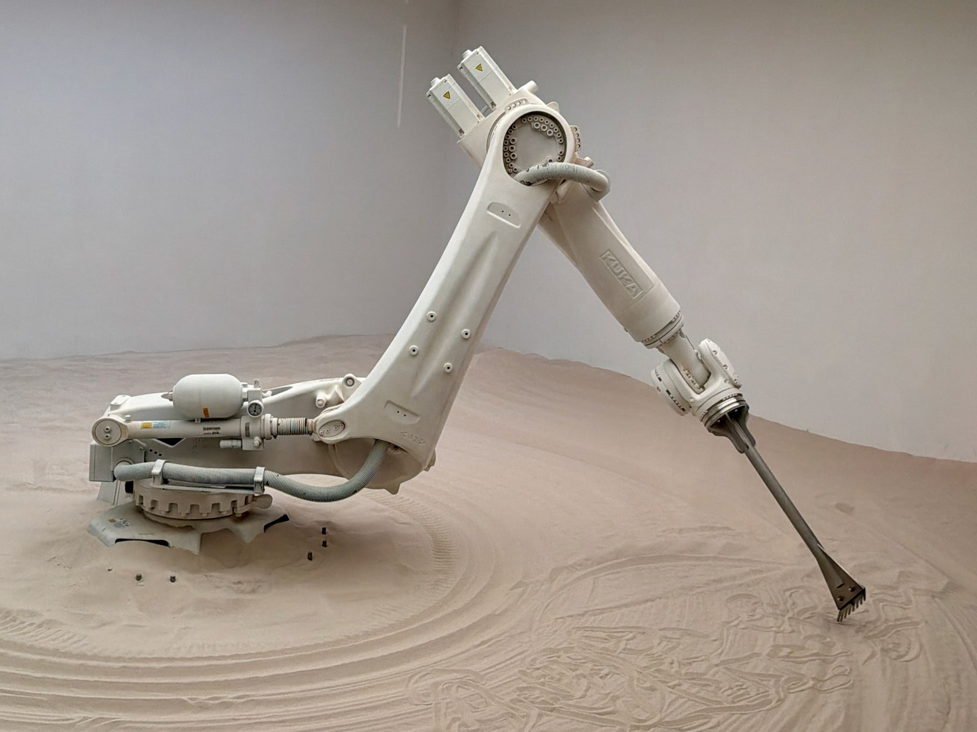
INDUSTRIAL ROBOTICS • 🦾 WHY 6 AXES?
Real Robot Anatomy: Why 6 Axes?
Why is the 6-Axis Industrial Arm (KUKA / ABB / FANUC) the king of factory automation?
• AXES 1, 2, 3 (The Arm Base):
Position the wrist anywhere in 3D space (X, Y, Z).
• AXES 4, 5, 6 (The Spherical Wrist):
Orient the tool in any direction: Roll, Pitch, and Yaw!
👉 Result: Can weld a car door seam from any angle!
ROBOTICS FUNDAMENTALS • SESSION 01 / 04 • THURSDAY, 10 SEPT 2026
Notes:
PRESENTER NOTES:
1. Industrial Arm Anatomy:
- "Axes 1 to 3 are the crane: they put the wrist in position."
- "Axes 4 to 6 are the hand: they orient the welding torch or spray gun."

Slide 13
HANDS-ON AUDIT • 🔍 INSPECT THIS ROBOT
Audit This Robot: What Do You See?
01. Count Links
02. Identify Joints
03. Calculate DOF
04. Locate Motors
05. Spot Wire Stress
ROBOTICS FUNDAMENTALS • SESSION 01 / 04 • THURSDAY, 10 SEPT 2026
Notes:
PRESENTER NOTES:
1. Interactive Exercise:
- "Look at any robot in your lab or online. Break it down using these 5 lenses."
- "Where do the wires bend? That's where it will fail in 6 months."

Slide 14
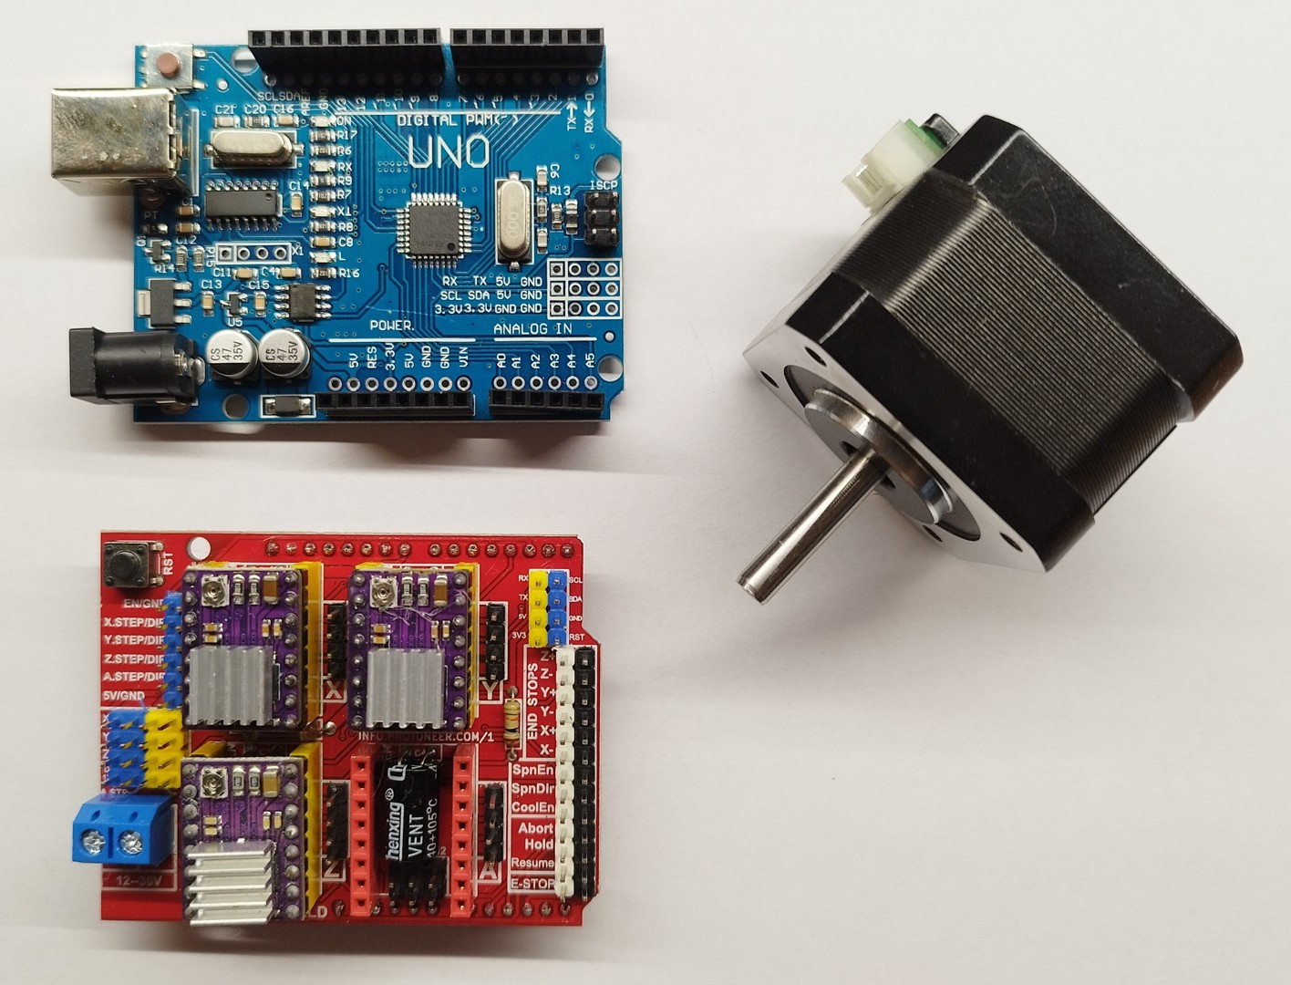
SECTION 02 • ACTUATION & MOTORS
PART 02
ACTUATION &
MOTORS
Motors • Torque • Speed • Backlash • Choosing the Right Drive
ROBOTICS FUNDAMENTALS • PART 02 / 06
Notes:
PRESENTER NOTES:
1. Section Intro:
- "Part 02: Actuation and Power Transmission. The muscles of the robot!"

Slide 15
SELECTION MATRIX • ⚡ WHICH MOTOR TO PICK?
Which Motor for Which Job?
BRUSHED DC + GEARS
RC HOBBY SERVO
• Cheap, simple 2-wire control
• High speed, moderate torque
• Perfect for mobile robot driving wheels.
• All-in-one: Motor + Potentiometer + Driver
• Easy PWM angle control (0°-180°)
• Great for small camera gimbals & grippers.
STEPPER MOTOR (NEMA)
BLDC + PLANETARY GEARS
• Precise discrete steps (e.g. 1.8°/step)
• High holding torque at low speed
• The gold standard for 3D printers & CNCs.
• Supreme power-to-weight density & efficiency
• High speed, quiet, zero brush wear
• Used in Boston Dynamics quadrupeds & drones.
ROBOTICS FUNDAMENTALS • SESSION 01 / 04 • THURSDAY, 10 SEPT 2026
Notes:
PRESENTER NOTES:
1. Quick Guide:
- "Wheels? Geared DC. 3D printer? Stepper. High-performance arm? Brushless (BLDC)."

Slide 16
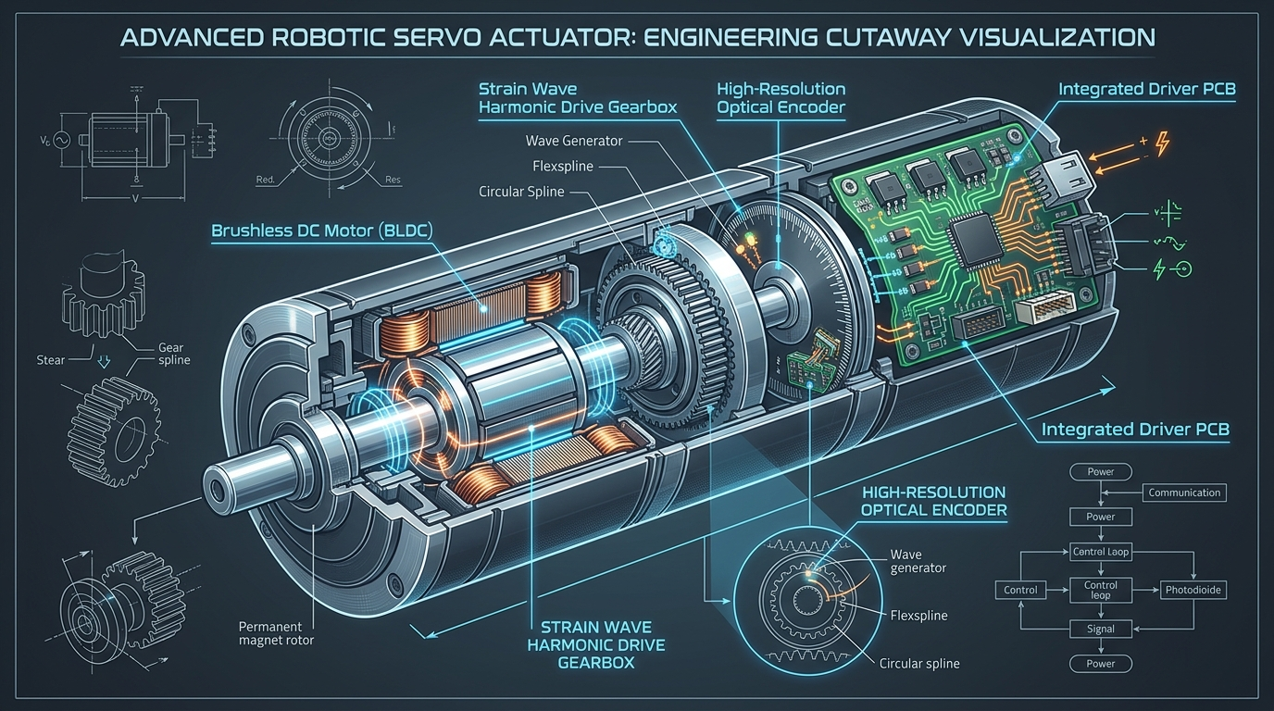
PHYSICS LAW • 📐 TORQUE & LEVERAGE
Torque: The Shopping Bag Principle
TORQUE = FORCE × DISTANCE
Holding a 2 kg bag against your hip is easy.
Now hold that exact same bag straight out horizontally: Your shoulder burns within seconds!
The weight didn't change—the DISTANCE changed! Distance multiplies rotational effort.
QUICK WORKED EXAMPLE
1 kg payload (~10 N) at 20 cm reach (0.2 m) = 2.0 N·m torque.
At 40 cm reach (0.4 m) = 4.0 N·m torque (Doubled!).
THE 2× SAFETY FACTOR RULE
Beginner Mistake: 'My static math says 2 N·m, so I bought a 2 N·m motor.'
Why it stalls: You forgot the arm's own weight, acceleration torque, and bearing friction!
Always multiply static torque by 2.0×.
ROBOTICS FUNDAMENTALS • SESSION 01 / 04 • THURSDAY, 10 SEPT 2026
Notes:
PRESENTER NOTES:
1. Real-World Analogy:
- "Have everyone in the audience imagine holding that shopping bag. That burning feeling in your shoulder is what your joint motor feels every second."

Slide 17
PERFORMANCE SPECS • 📊 KEY MOTOR METRICS
A Motor is More Than Just Torque!
TORQUE (N·m)
SPEED (RPM)
Rotational strength. Can it lift the payload from a dead stop?
Rotational velocity. How fast can the joint travel?
RESOLUTION (Counts/Rev)
BACKLASH (Arcmin / Degrees)
How finely the encoder divides a circle. (e.g. 4096 pulses per turn).
Mechanical wiggle between gear teeth when reversing direction.
ROBOTICS FUNDAMENTALS • SESSION 01 / 04 • THURSDAY, 10 SEPT 2026
Notes:
PRESENTER NOTES:
1. Don't Just Look at Torque:
- "A winch motor has tons of torque, but takes 10 minutes to turn once. You need the right balance of torque and speed."

Slide 18
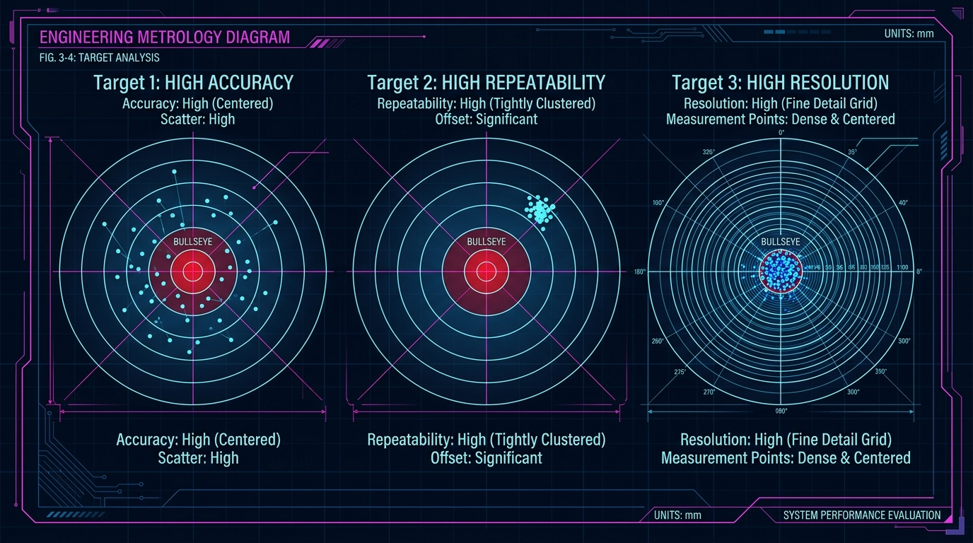
METROLOGY TARGET • 🎯 ACCURACY VS REPEATABILITY
Resolution ≠ Accuracy ≠ Repeatability
THE ARCHER ANALOGY:
• RESOLUTION: The finest tick mark on the sight.
Can measure tiny moves, but doesn't guarantee hitting bullseye!
• ACCURACY: Hitting near the center on average.
• REPEATABILITY: Hitting the exact same spot 100 times in a row!
👉 Industrial Secret: Factories care more about REPEATABILITY than absolute accuracy. If an arm is repeatable, software can calibrate the offset!
ROBOTICS FUNDAMENTALS • SESSION 01 / 04 • THURSDAY, 10 SEPT 2026
Notes:
PRESENTER NOTES:
1. Archer Metaphor:
- "High resolution without repeatability is useless. Always check repeatability on robot datasheets."

Slide 19
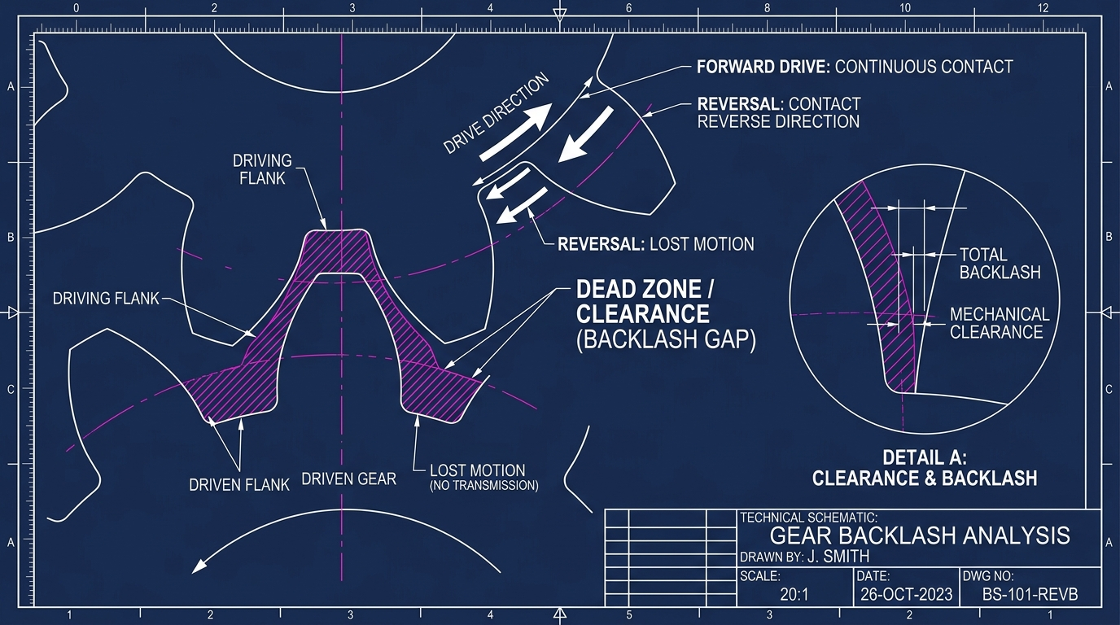
MECHANICAL DANGER • ⚠️ GEARBOX BACKLASH
Backlash: The Loose Steering Wheel
WHAT IS BACKLASH?
The tiny clearance gap between gear teeth so they don't bind.
When you reverse motor direction, the motor turns slightly before the output gear engages!
THE DEAD ZONE DANGER
Inside the backlash gap, the arm floats freely with ZERO resistance from the motor! Your controller becomes blind and the arm shakes.
HOW TO BEAT IT
• Timing belts with tensioners
• Harmonic strain-wave drives (zero backlash!)
• Dual output encoders placed after the gearbox.
ROBOTICS FUNDAMENTALS • SESSION 01 / 04 • THURSDAY, 10 SEPT 2026
Notes:
PRESENTER NOTES:
1. Steering Wheel Analogy:
- "Have you ever driven an old car where you turn the wheel 2 inches before the tires react? That is backlash."

Slide 20
LIVE VOTE • 🗳️ CHOOSE YOUR MOTOR
Which Motor Would You Choose? [VOTE]
MOTOR A
MOTOR B
MOTOR C
• Torque: 0.5 N·m
• Speed: 3000 RPM
• Price: €25
• High speed, low torque
• Torque: 10.0 N·m
• Speed: 50 RPM
• Price: €120
• Massive torque, slow
• Torque: 4.0 N·m
• Speed: 1000 RPM
• Price: €60
• Balanced specs
ROBOTICS FUNDAMENTALS • SESSION 01 / 04 • THURSDAY, 10 SEPT 2026
Notes:
PRESENTER NOTES:
1. Trick Question Reveal:
- "Trick question! None of them until you know your task requirements!"
- "Never fall in love with motor specs before defining your payload."

Slide 21
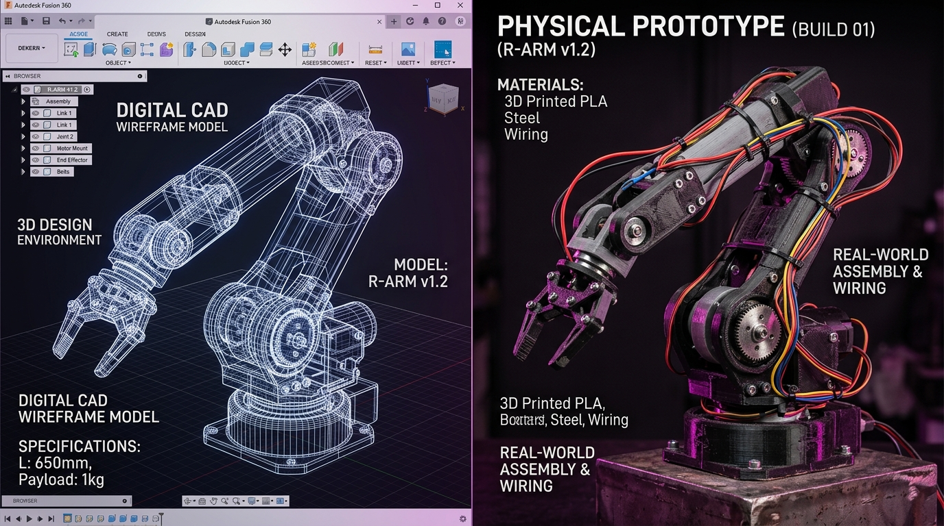
SECTION 03 • MECHANICAL DESIGN & STIFFNESS
PART 03
MECHANICAL
DESIGN
Structure • Materials • Stiffness • Real-World Trade-Offs
ROBOTICS FUNDAMENTALS • PART 03 / 06
Notes:
PRESENTER NOTES:
1. Section Intro:
- "Part 03: Mechanical Design. The skeleton that bears the load."

Slide 22
STRUCTURAL ANALYSIS • 🧱 THE LOAD PATH
The Load Path: Where Does Force Really Go?
01. THE MOTOR
02. THE BEARINGS
03. THE STRUCTURE
• Generates spinning torque only!
• ⚠️ NOT built to hold bending side weight!
• Never bolt an arm directly to a motor shaft.
• The unsung heroes of robotics!
• Soak up massive bending loads so the motor shaft doesn't snap.
• Dual ball or cross-roller bearings.
• The rigid bones: Tubes and gussets.
• If the arm bends even 2 millimeters under load, the gripper misses its target completely!
ROBOTICS FUNDAMENTALS • SESSION 01 / 04 • THURSDAY, 10 SEPT 2026
Notes:
PRESENTER NOTES:
1. Human Bone Metaphor:
- "Muscles generate pull, but bones and cartilage take the load. Separate torque generation from structural load bearing."

Slide 23
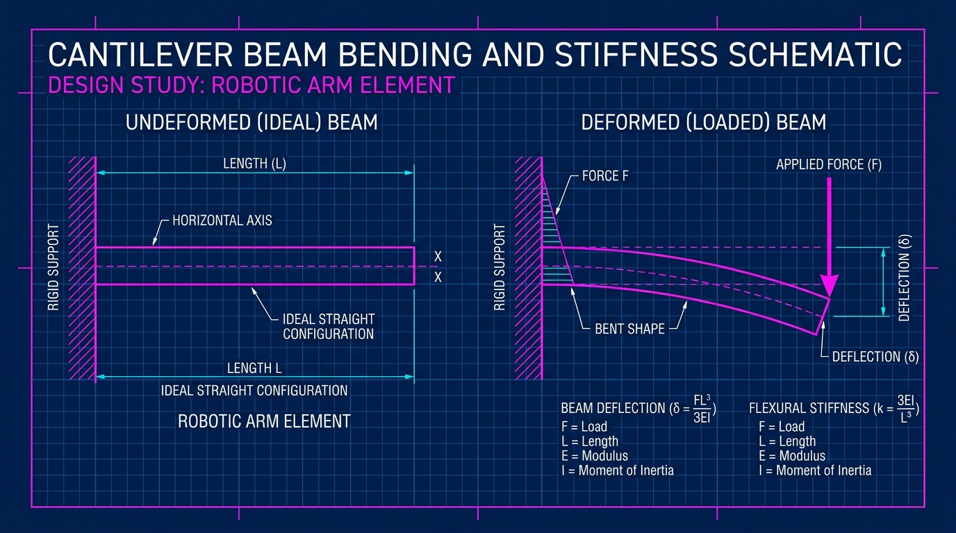
PHYSICS LAW • 📏 CUBIC DEFLECTION (L³)
Why Do Robot Arms Bend? (The Diving Board Effect)
THE DIVING BOARD ANALOGY
Stand near the pool wall on a diving board: Feels solid as rock.
Walk out to the tip: It bounces dramatically!
Robot arms behave the exact same way.
⚠️ THE L³ CUBIC DANGER!
Deflection ∝ (Force × Length³) / Stiffness.
Length is CUBED (L³)! If you double the arm length (2×), it bends EIGHT TIMES as much (2³ = 8)!
Small reach increases destroy stiffness.
THE TUBE SECRET
Use hollow square tubes or cylinders instead of solid flat bars!
Material far from the center axis gives 10× more stiffness without added weight.
ROBOTICS FUNDAMENTALS • SESSION 01 / 04 • THURSDAY, 10 SEPT 2026
Notes:
PRESENTER NOTES:
1. Explain L³ Simply:
- "Double the reach = 8x the bend. That is why industrial robot arms look stocky and thick."

Slide 24
MATERIAL MATRIX • 🔬 ALUMINUM VS PLA VS CF
Choosing Materials: What Should You Build With?
PLA (3D Print): Cheap & fast, but sags at 55°C
PETG / ABS: Tougher prints, great for brackets
ALUMINUM 6061: 20× stiffer than plastic! (Winner)
STEEL: Maximum strength, great for heavy base plates
CARBON FIBER: Featherweight rigidity, but expensive
ROBOTICS FUNDAMENTALS • SESSION 01 / 04 • THURSDAY, 10 SEPT 2026
Notes:
PRESENTER NOTES:
1. Maker Strategy:
- "3D print brackets on Friday night, but use aluminum tubes for long structural arms!"

Slide 25
DESIGN TRADEOFF • ⚖️ THE TRIANGLE (PICK 2)
The Engineering Triangle: Pick Any Two!
HIGH PRECISION
LIGHT WEIGHT
LOW COST
• Sub-millimeter accuracy
• Zero gear backlash
• Machined joints & harmonic drives
• Rigid steel rails
• Carbon fiber links
• High power density motors
• Featherweight agility
• Fast acceleration
• 3D printed brackets
• Hobby timing belts
• Standard hardware fasteners
• Under €300 budget
ROBOTICS FUNDAMENTALS • SESSION 01 / 04 • THURSDAY, 10 SEPT 2026
Notes:
PRESENTER NOTES:
1. The Iron Law:
- "You cannot build a NASA precision robot for 100 dollars. Great engineering is choosing the right compromise."

Slide 26
LEVERAGE COST • 💥 DOUBLING THE REACH
What Happens When You Double the Reach?
ARM A: 25 CM (COMPACT)
ARM B: 50 CM (2× DOUBLED!)
• Payload: 1.0 kg
• Joint Torque: 2.5 N·m (Small motor)
• Tip Sag: 1.0 mm (Barely noticeable)
• Settling Time: 0.15s (Rock steady!)
• Payload: 1.0 kg (Exact same payload!)
• Joint Torque: 5.0 N·m (2× bigger motor)
• Tip Sag: 8.0 mm! (8× worse sag!)
• Settling: Shakes for 1.5s like tuning fork!
ROTATIONAL INERTIA (4×)
DESIGN TAKEAWAY
Inertia = Mass × Radius².
Doubling arm length quadruples rotational resistance to stopping!
Keep your robot arms as short and compact as humanly possible!
Every extra centimeter costs motor torque and stiffness.
ROBOTICS FUNDAMENTALS • SESSION 01 / 04 • THURSDAY, 10 SEPT 2026
Notes:
PRESENTER NOTES:
1. The Tuning Fork:
- "When Arm B stops, it vibrates like a guitar string for 1.5 seconds. Always design arms compact."

Slide 27
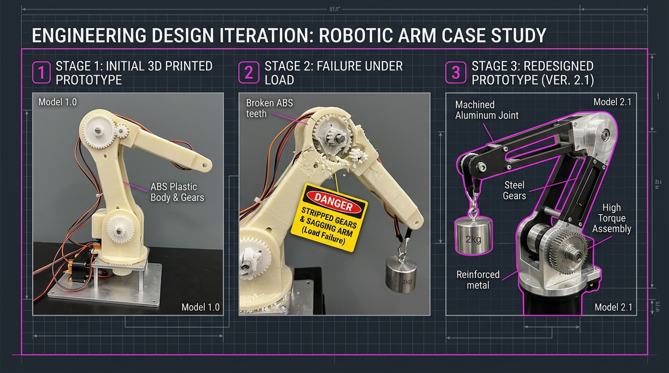
DESIGN SPRINT • ⏱️ 5-MIN SPEC CHALLENGE
Design Challenge: Specify This Arm! [5-MIN]
CLIENT REQUIREMENTS
• Payload: 2.0 kg
• Reach: 60 cm (0.60 m)
• Accuracy: < 1.5 mm
• Budget: €400 total parts
What material? What motor? What transmission?
ROOKIE TRAPS
❌ Trap 1: 'Print the 60 cm arm in PLA!' (Will sag 12 mm!)
❌ Trap 2: 'Direct drive servo!' (Plastic gears strip instantly!)
WINNING PRO SPEC
• Hollow square aluminum tube links
• NEMA 23 stepper with 15:1 planetary gearbox
• Dual preloaded ball bearings on main pivot.
ROBOTICS FUNDAMENTALS • SESSION 01 / 04 • THURSDAY, 10 SEPT 2026
Notes:
PRESENTER NOTES:
1. 3-Minute Sprint:
- "Drop your choices in chat: Aluminum or plastic? Stepper or servo?"

Slide 28
SECTION 04 • POWER & ELECTRICAL
PART 04
POWER &
ELECTRICAL
Voltage • Current • Batteries • The Dreaded Brownout Mystery
ROBOTICS FUNDAMENTALS • PART 04 / 06
Notes:
PRESENTER NOTES:
1. Section Intro:
- "Part 04: Power and Electrical Systems. A robot without power is an expensive paperweight."

Slide 29
INTUITIVE ANALOGY • 🚰 THE WATER PIPE MODEL
Electrical Fundamentals: The Water Pipe Analogy
VOLTAGE (Volts)
CURRENT (Amps)
POWER (Watts)
• Water Pressure in the pipe
• Electrical push driving electrons
• Higher Voltage = Higher maximum motor RPM (Speed)!
• Water Flow Volume per second
• Actual amount of electrons moving
• More Current = STRONGER MOTOR TORQUE (Strength)!
• Total Work Done (P = V × I)
• Pressure × Volume = Power washing force!
• 12V × 2A = 24 Watts continuous.
ROBOTICS FUNDAMENTALS • SESSION 01 / 04 • THURSDAY, 10 SEPT 2026
Notes:
PRESENTER NOTES:
1. Remember This:
- "Voltage gives you SPEED. Current gives you TORQUE. Multiply them for Watts."

Slide 30
ELECTRICAL TRAP • ⚠️ THE 4-MOTOR TRAP
The 4-Motor Trap: Why Robots Shut Down on Startup
PAPER CALCULATION (96W)
THE STARTUP SURGE (480W!)
• 1 Motor: 12V × 2A = 24 Watts
• 4 Motors: 4 × 24W = 96 Watts
• Beginner buys a '100W' power pack: 'Looks plenty!'
• At 0 RPM, a motor is a direct short circuit!
• Starting draws 5× stall current (10A per motor)!
• 4 Motors × 10A = 40 AMPS (480 Watts) peak burst!
THE COLLAPSE
GOLDEN POWER RULE
The 100W battery pack cannot deliver 480W. Voltage crashes to 8V, and the robot instantly reboots!
Always size batteries, wires, and fuses for PEAK SURGE, never for gentle average cruising speed!
ROBOTICS FUNDAMENTALS • SESSION 01 / 04 • THURSDAY, 10 SEPT 2026
Notes:
PRESENTER NOTES:
1. Real Competition Story:
- "Robots reboot on the starting line because the 0.5-second acceleration spike trips the battery protection."

Slide 31
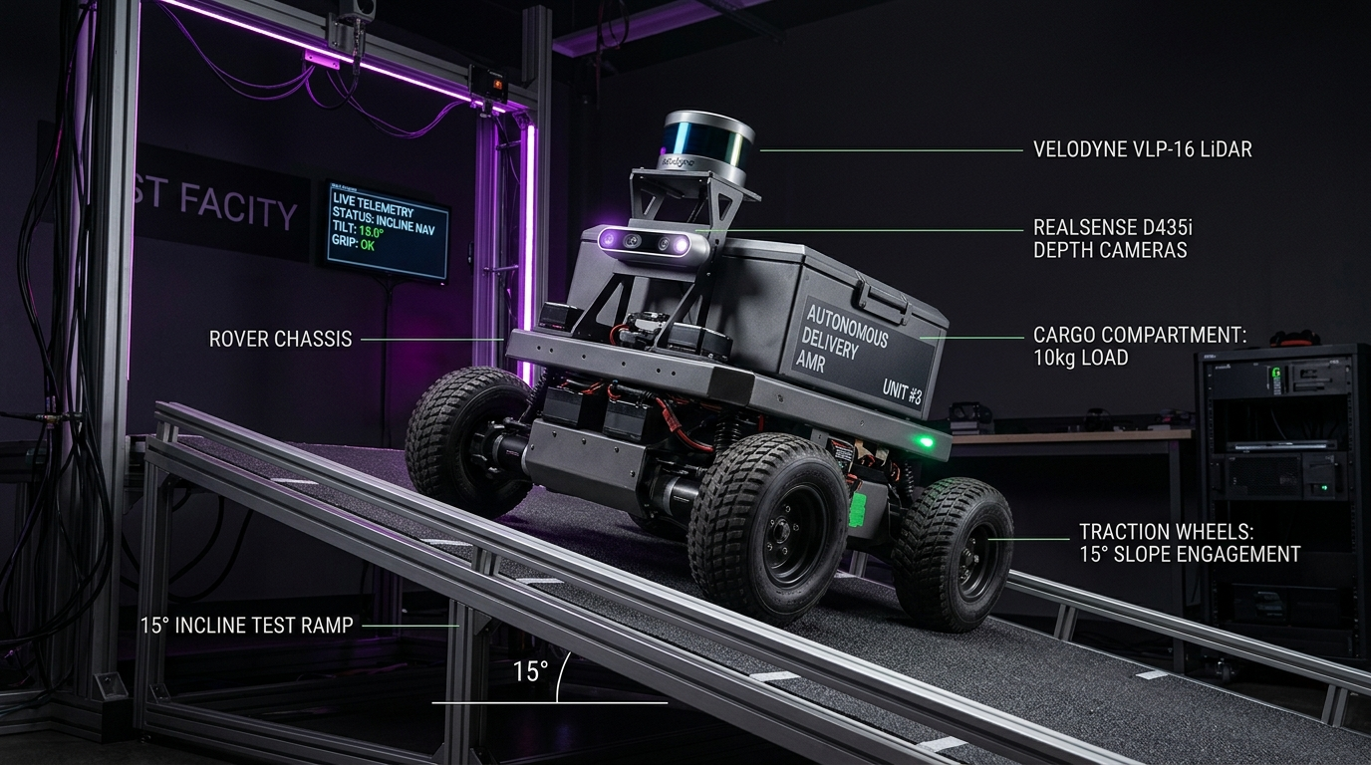
ENERGY MATH • 🔋 BATTERY RUNTIME CALC
Battery Runtime: Why Does 1 Hour Become 38 Mins?
THEORY (Watt-Hours)
• Battery: 12V × 10Ah = 120 Watt-Hours (Wh)
• Robot draws: 120 Watts continuous
• Ideal Runtime: 120 Wh ÷ 120 W = 1.0 Hour (60 mins)
THE 4 RUNTIME THIEVES
1. Usable Depth: Discharging lithium below 20% damages cells (lose 20% capacity).
2. Heat Sag: Fast discharge wastes energy as heat.
3. Regulators: DC-DC step-down converters waste 12%.
4. Sensors: LiDAR & Jetson draw steady base power.
THE 70% DERATING RULE
Always multiply theoretical paper runtime by 0.65× to 0.70× for real mission planning!
ROBOTICS FUNDAMENTALS • SESSION 01 / 04 • THURSDAY, 10 SEPT 2026
Notes:
PRESENTER NOTES:
1. Field Truth:
- "Sales sheet: 2 hours. Lab test: 42 minutes before safety shutoff. Plan accordingly."

Slide 32
DETECTIVE STORY • 🕵️ THE BROWNOUT MYSTERY
The Brownout Mystery: Why Did My Robot Reboot?
1. ACCELERATION BURST
2. VOLTAGE DROOPS
Motors demand high current (30A+) to overcome carpet friction and accelerate.
Battery internal resistance causes terminal voltage to sag from 12V down to 9V.
3. REGULATOR DROPOUT
4. HOW TO FIX IT
The 5V regulator dips to 4.2V for just 2 milliseconds. Microcontroller triggers reset!
• Isolate brain power rail from motor rail
• Add 1000 µF bulk capacitor at motor drivers
• Separate signal grounds to prevent noise.
ROBOTICS FUNDAMENTALS • SESSION 01 / 04 • THURSDAY, 10 SEPT 2026
Notes:
PRESENTER NOTES:
1. Debugging Detective:
- "'It worked on my desk!' On the desk, wheels spun freely. On carpet, friction triggered the brownout."

Slide 33
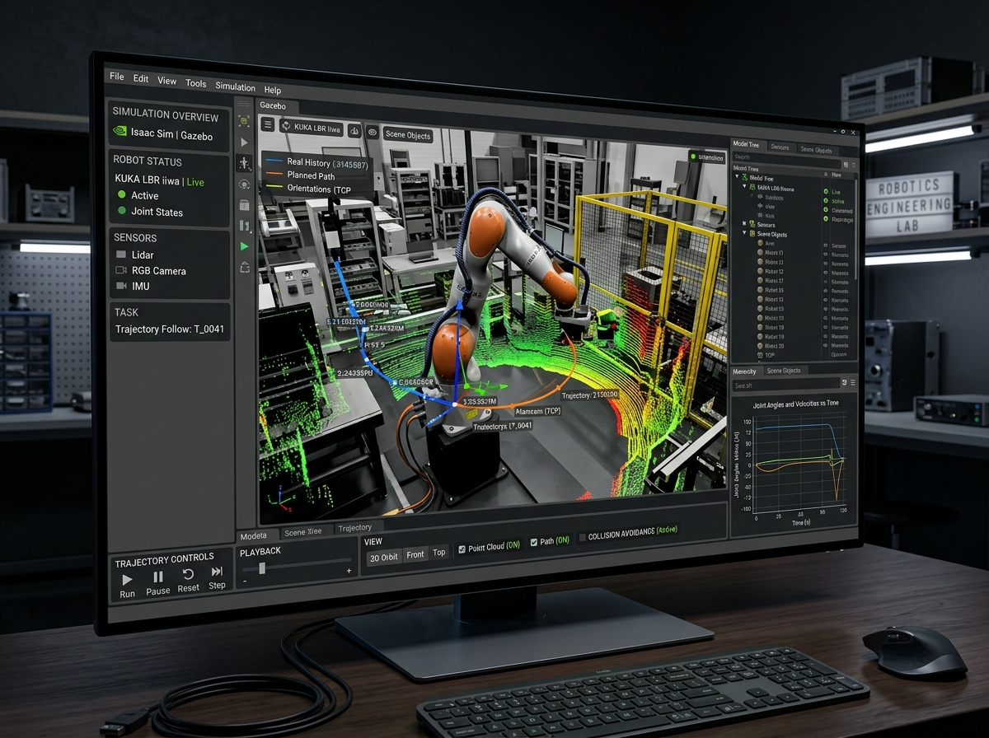
SECTION 05 • SOFTWARE & SIMULATION
PART 05
SOFTWARE &
SIMULATION
Software Stacks • Free Tools • Firmware • ROS 2 Architecture
ROBOTICS FUNDAMENTALS • PART 05 / 06
Notes:
PRESENTER NOTES:
1. Section Intro:
- "Part 05: Software, Tools & Simulation. Where does code actually live in a robot?"

Slide 34




SYSTEM LAYERS • 🧠 THE ROBOT SOFTWARE STACK
The Robot Software Stack: Separation of Layers
AI & AUTONOMY
ROS 2 MIDDLEWARE
High-level planning: Object detection (YOLO), SLAM mapping, speech recognition, and mission logic.
The telephone network: Lets modular software nodes communicate via Publish/Subscribe topics.
MOTION PLANNING
EMBEDDED FIRMWARE
Calculates smooth trajectories (Nav2, MoveIt) so arms and wheels move without hitting walls.
Hard real-time C/C++ on microcontroller (STM32/ESP32) reading encoders and pulsing motor PWM pins.
ROBOTICS FUNDAMENTALS • SESSION 01 / 04 • THURSDAY, 10 SEPT 2026
Notes:
PRESENTER NOTES:
1. Layer Rule:
- "Never pulse motor pins from desktop Python, and never run heavy AI on an Arduino. Respect the layers."

Slide 35




OPEN SOURCE TOOLS • 🛠️ FREE STARTER KIT
Your Free Robotics Starter Kit (Zero License Cost!)
3D CAD MODELING
CIRCUITS & PCBS
Autodesk Fusion (Free Hobbyist) or FreeCAD. Model parts, check clearances, and export 3D STL files.
KiCad (100% Free & Open-Source). Draw schematics and route real motor driver boards without paywalls.
PHYSICS SIMULATION
ROBOT MIDDLEWARE
Webots or Gazebo. Test navigation and obstacle avoidance in 3D worlds without paying for broken hardware!
ROS 2 (Humble / Jazzy). The industry framework used by NASA and autonomous car companies.
ROBOTICS FUNDAMENTALS • SESSION 01 / 04 • THURSDAY, 10 SEPT 2026
Notes:
PRESENTER NOTES:
1. Democratizing Robotics:
- "You do not need $10,000 corporate licenses. Everything you need to build world-class robots is free."

Slide 36
ROOKIE TRAP • ⚠️ CAD VS SIM VS REALITY
The Rookie Trap: Don't Confuse CAD, Sim & Reality!
IN CAD DESIGN
IN SIMULATION
IN REALITY
• The ideal fantasy world
• Zero friction & infinite stiffness
• Perfect zero-clearance bearings
• Ambient temperature: 20.00°C!
• Physics is simulated
• Friction is just an estimated number
• ⚠️ Wheels never get dust or wires caught around axles!
• Screws vibrate loose
• Batteries sag under load
• Carpet has 3× more friction than tile
• Real physical floor truth!
ROBOTICS FUNDAMENTALS • SESSION 01 / 04 • THURSDAY, 10 SEPT 2026
Notes:
PRESENTER NOTES:
1. Quote:
- "'Installing ROS doesn't make your robot autonomous—just like installing Photoshop doesn't make you Leonardo da Vinci!'"

Slide 37
SECTION 06 • FROM IDEA TO WORKING ROBOT
PART 06
FROM IDEA TO
WORKING ROBOT
The Engineering Loop • Why Prototypes Fail • The Capstone Challenge
ROBOTICS FUNDAMENTALS • PART 06 / 06
Notes:
PRESENTER NOTES:
1. Section Intro:
- "Part 06: Prototyping and Reality. This is where engineers are forged."

Slide 38
ENGINEERING PROCESS • 🔄 THE 6-STEP CYCLE
The Real Engineering Loop: Failure is Step 5!
1. DEFINE: Specs, reach, payload, and budget limit
2. CAD MODEL: 3D assembly, check gear clearance
3. BENCH PROTOTYPE: 3D print brackets & wire drivers
4. TEST TO LIMITS: Load with 100% full payload on floor
5. THE BREAK 💥 ➔ 6. REDESIGN V2 IN METAL & WIN!
ROBOTICS FUNDAMENTALS • SESSION 01 / 04 • THURSDAY, 10 SEPT 2026
Notes:
PRESENTER NOTES:
1. Mindset:
- "If your first prototype doesn't break, you didn't test it hard enough. Breaking on your workbench is how you find your real safety boundaries."

Slide 39
REALITY CHECK • ⚡ PHYSICAL CONSTRAINTS
"It Worked in CAD!" — Reality Has Entered the Room
Left: Pristine CAD rendering (Zero gravity, zero wire clutter) • Right: Physical reality (3D print layer lines, zip ties, hot glue, and real floor friction!) Always leave room for cables and tolerances.
Notes:
PRESENTER NOTES:
1. Relatable Humor:
- "Every engineer laughs at this slide because every engineer has lived it. Leave room for cables from day one."

Slide 40
CASE STUDY • 🛠️ V1 FAILURE ➔ V2 REDESIGN
Case Study: 3D-Printed V1 Failure ➔ Metal V2
WHAT FAILED IN V1
• 100% printed in ABS plastic
• Under 2 kg load, gear teeth sheared clean off!
• Joint deflected 15° sideways without bearings.
THE V2 REDESIGN
• Hardened steel planetary gears (15:1)
• CNC aluminum pivot bracket with dual ball bearings
• Easily holds 2.5 kg with zero deflection!
ENGINEERING LESSON
V1 failed so V2 could fly. Document your failure, calculate the missing margin, and engineer the fix.
ROBOTICS FUNDAMENTALS • SESSION 01 / 04 • THURSDAY, 10 SEPT 2026
Notes:
PRESENTER NOTES:
1. Don't Hide Failures:
- "In your portfolio, document your failures and how you solved them. That is what top engineering companies hire for."

Slide 41
CAPSTONE MISSION • 🚀 CAMPUS DELIVERY ROBOT
Capstone Challenge: Campus Robot
• Mission: Autonomous book delivery on campus corridors
• Target Payload: 5.0 kg package capacity
• Cruising Speed: 1.0 m/s (Brisk walking pace)
• Target Runtime: 1.0 Hour continuous driving
• Environment: Flat indoor linoleum hallways
• Hardware Budget Limit: €300
👉 ASSEMBLE YOUR SPEC IN THE CHAT:
1. Drive: Differential 2WD + Caster vs 4WD Skid-Steer?
2. Motors: Geared DC vs Steppers vs Brushless?
3. Battery: 12V 5Ah vs 12V 10Ah LiFePO4?
ROBOTICS FUNDAMENTALS • SESSION 01 / 04 • THURSDAY, 10 SEPT 2026
Notes:
PRESENTER NOTES:
1. Team Sprint:
- "You are the chief engineers. Drop your drive topology and battery choice in chat!"

Slide 42
THE TWIST • 🏔️ 15° RAMP INCLINE CHALLENGE
New Client Requirement: The 15° Ramp Twist! 🚨
GRAVITY PULLS BACKWARD
Climbing a 15° slope adds 26% of robot weight as direct backward drag! Flat-ground motors will stall.
WHEEL SLIP & TRACTION
Smooth plastic or omni-wheels will spin out without high-grip rubber treads on the incline!
BACKWARD FLIP & CURRENT
If the battery is mounted high/rearward, the robot flips backward! Climbing draws 3× current (runtime drops to 20m).
ROBOTICS FUNDAMENTALS • SESSION 01 / 04 • THURSDAY, 10 SEPT 2026
Notes:
PRESENTER NOTES:
1. The Lesson of the Ramp:
- "One small change in terrain ripples through motor torque, battery runtime, tire material, and center of gravity."

Slide 43
WORKSHOP RECAP • 📜 10 GOLDEN RULES
Session Summary: The 10 Rules of Robotics
RULES 1 TO 3
RULES 4 TO 6
1. Define task before buying motors
2. Minimize degrees of freedom
3. Always add 2× safety factor on torque
4. Resolution on paper ≠ physical accuracy
5. Beware gear backlash—it ruins precision
6. Hollow aluminum tubes beat plastic 3D prints
RULES 7 TO 8
RULES 9 TO 10
7. Size batteries for peak acceleration surge
8. Isolate computer power from noisy motors
9. Test with real physical loads, not just sim
10. Failure is step 5—build, test, break, and iterate!
ROBOTICS FUNDAMENTALS • SESSION 01 / 04 • THURSDAY, 10 SEPT 2026
Notes:
PRESENTER NOTES:
1. The Cheatsheet:
- "Take a screenshot of this slide and put it above your workbench."

Slide 44
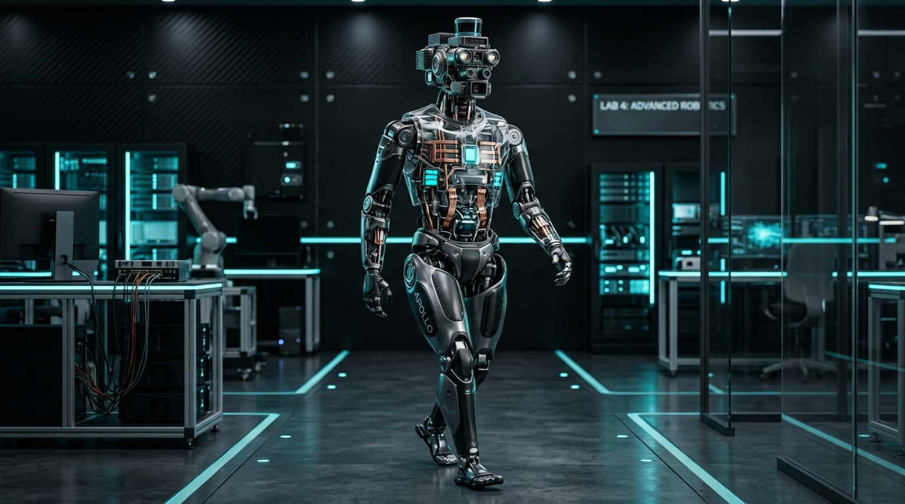
SESSION FINALE • ❓ OPEN Q&A SESSION
DEFINE • DESIGN • BUILD
TEST • BREAK • IMPROVE
THAT'S ROBOTICS.
See you next Thursday for Session 02: Sensors, Perception & State Estimation!
Thank you for attending! Let's open the floor for Q&A.
ROBOTICS FUNDAMENTALS • SESSION 01 / 04 COMPLETE
Notes:
PRESENTER NOTES:
1. Inspiring Close:
- "Define. Design. Calculate. Build. Test. Break. Improve. That is the true path of robotics."
2. Teaser:
- "Next week in Session 02: We give our robot eyes and ears with LiDAR, depth cameras, and Kalman filtering."
3. Q&A:
- "I'll now open the floor for questions! Drop them in the chat or unmute."

