Slide 1
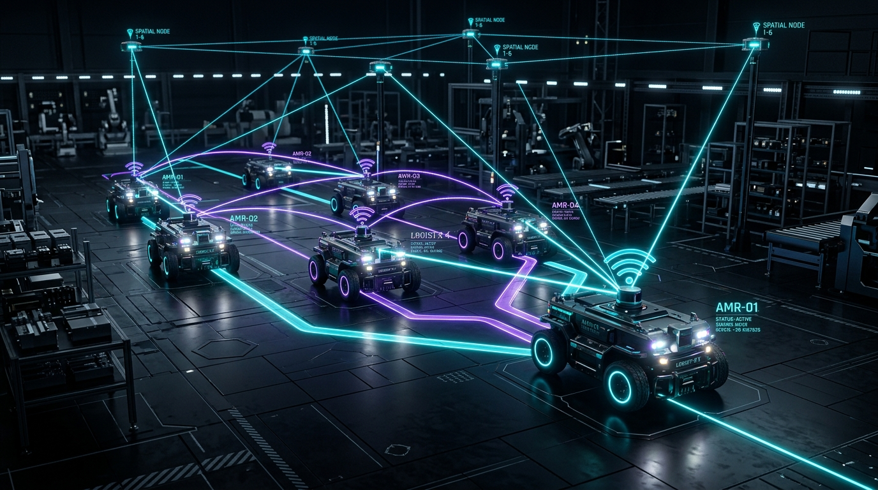
ROBOTICS BOOTCAMP SERIES • SESSION 04 / 04 (CAPSTONE)
ROBOT COMMUNICATION,
BEACONS & SPATIAL MEMORY
Synthesizing Multi-Robot Coordination and Persistent World Models
From single-agent kinematic navigation to distributed multi-agent swarm consensus. Learn how industrial AMRs communicate via ROS 2 DDS, triangulate millimeter poses using UWB beacons, and fuse dynamic spatial memory for coordinated fleet autonomy.
PRESENTER & TECHNICAL LEAD
Mouhamed Boughrara
Tech Lead & Autonomous Systems Engineer | Founder, Jarvis PCB
CO-HOSTED BY: IEEE FSB RAS SBC (Tunisia) × IEEE AESS (Jordan)

Slide 2
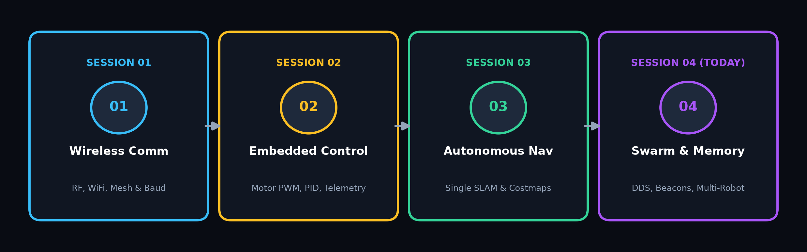
ROBOTICS BOOTCAMP • SESSION 04 / 04
⚡ CAPSTONE ROADMAP
BOOTCAMP SYNTHESIS & SESSION 04 OBJECTIVES
01. INTER-ROBOT DDS COMM
Distributed P2P Telemetry
• Eliminates single-point-of-failure brokers via DDS Domain segmentation.
• High-rate state sharing: /robot_state pose, velocities, and operational modes.
• Dynamic QoS: Throttled reliable state delivery vs. best-effort raw sensor lines.
02. BEACON-BASED LOCALIZATION
Drift-Free Global Ranging
• Sub-nanosecond UWB Time-of-Flight ranging for absolute indoor reference.
• Visual fiducials (ArUco / AprilTags) for high-precision 6-DOF docking.
• Non-linear trilateration optimization fused with wheel odometry via EKF.
03. DISTRIBUTED SPATIAL MEMORY
Persistent World Models
• Persistent global occupancy grids shared across heterogeneous fleets.
• Topological graph networks of traversable edges and key waypoints.
• Multi-robot origin frame alignment & cooperative map merging algorithms.
💡 Bootcamp Synthesis Goal
Transitioning robotics students from single-agent kinematic silos into modern, scalable swarm autonomy. Today we connect individual actuators, sensors, and SLAM pipelines into a unified, collaborative swarm architecture capable of collective spatial reasoning.

Slide 3
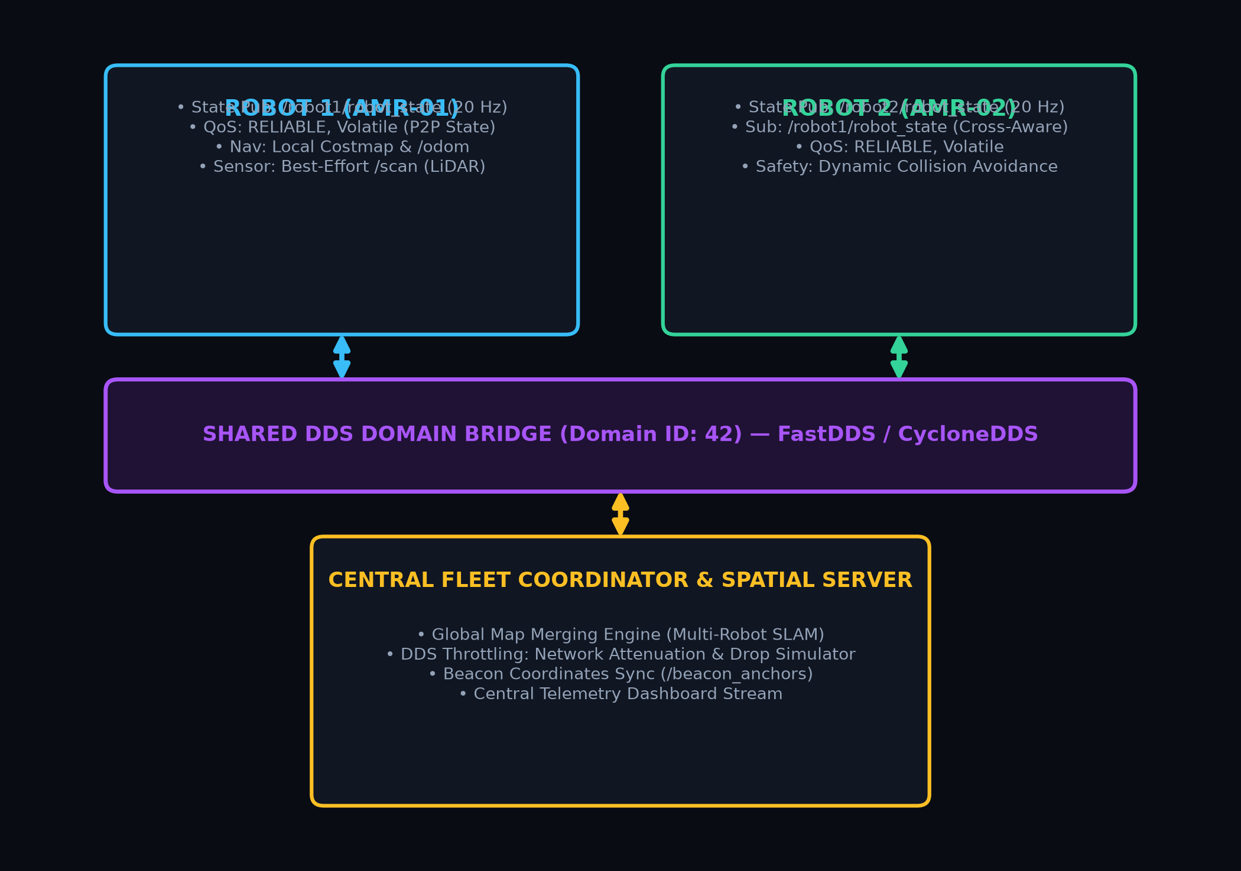
ROBOTICS BOOTCAMP • SESSION 04 / 04
⚡ DDS MIDDLEWARE
MULTI-ROBOT COMMUNICATION INFRASTRUCTURE (ROS 2 & DDS)
DDS ARCHITECTURE & QUALITY OF SERVICE (QoS)
Peer-to-Peer Discovery Without Master Node Bottlenecks
• Middleware Standard: OMG DDS (FastDDS / CycloneDDS) leveraging UDP multicasting with distinct ROS_DOMAIN_ID partitions.
• Reliable QoS Profile: History=KEEP_LAST(10), Reliability=RELIABLE, Durability=TRANSIENT_LOCAL for state & waypoints.
• Best-Effort QoS Profile: Reliability=BEST_EFFORT for 15-30 Hz raw LiDAR & depth clouds to eliminate network queue lag.
• Topic Throttling: High-frequency internal loops (100 Hz) downsampled to 20 Hz /robot_state payloads to conserve RF spectrum.
SWARM TOPOLOGY & BANDWIDTH CONSTRAINTS
Managing Network Attenuation, Packet Drops & Jitter
• Topic Isolation: Namespace separation (/amr_01, /amr_02) with dynamic cross-subscription to peer poses.
• Custom Swarm Payload: Compact struct transmitting [x, y, theta, vx, vy, omega, battery_pct, active_task_id].
• Latency Modeling: Simulated Rayleigh fading & packet loss (1-5%) testing swarm consensus degradation.
• Heartbeat Guard: 250 ms timeout triggers emergency stop / degraded standalone fallback mode.

Slide 4
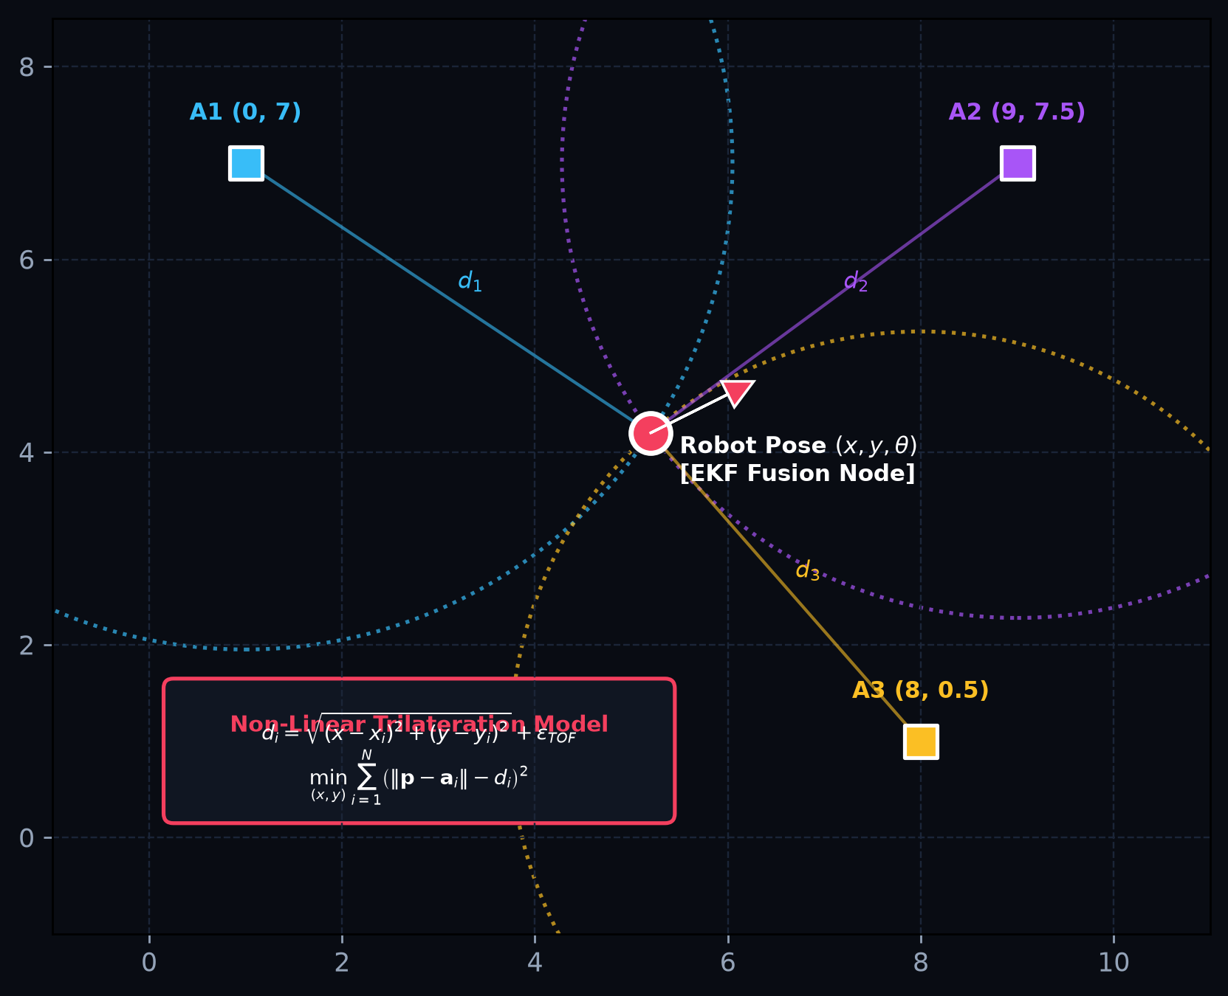
ROBOTICS BOOTCAMP • SESSION 04 / 04
⚡ SENSOR FUSION
BEACON-BASED RELATIVE & ABSOLUTE LOCALIZATION
UWB RANGING & VISUAL FIDUCIAL POSE
Time-of-Flight Ranging + 6-DOF Optical Tags
• Ultra-Wideband (UWB) Anchors: Sub-nanosecond two-way ranging (TWR) provides absolute distance di (< 10 cm error), penetrating smoke, dust, and optical occlusions.
• Visual Tags (ArUco / AprilTag): Perspective-n-Point (PnP) solves full 6-DOF transformation matrix T_tag^cam for precision docking and inter-robot visual tracking.
• Complementary Strengths: UWB provides global distance anchors; visual tags provide orientation (theta) and zero-backlash docking alignment.
TRILATERATION OPTIMIZATION & EKF FUSION
Non-Linear Least Squares + Odometry State Estimation
• Measurement Model: di = sqrt((x - xi)^2 + (y - yi)^2) + epsilon_TOF, where (xi, yi) are anchor coords.
• Non-Linear Solver: Gauss-Newton / Levenberg-Marquardt minimizes residual norm: min_p sum(||p - ai|| - di)^2.
• Extended Kalman Filter (EKF): Fuses high-rate wheel odometry prediction (x_dot = v*cos(theta)) with asynchronous UWB beacon range updates.
• Drift Elimination: Completely bounds unbounded dead-reckoning drift in warehouse environments.

Slide 5
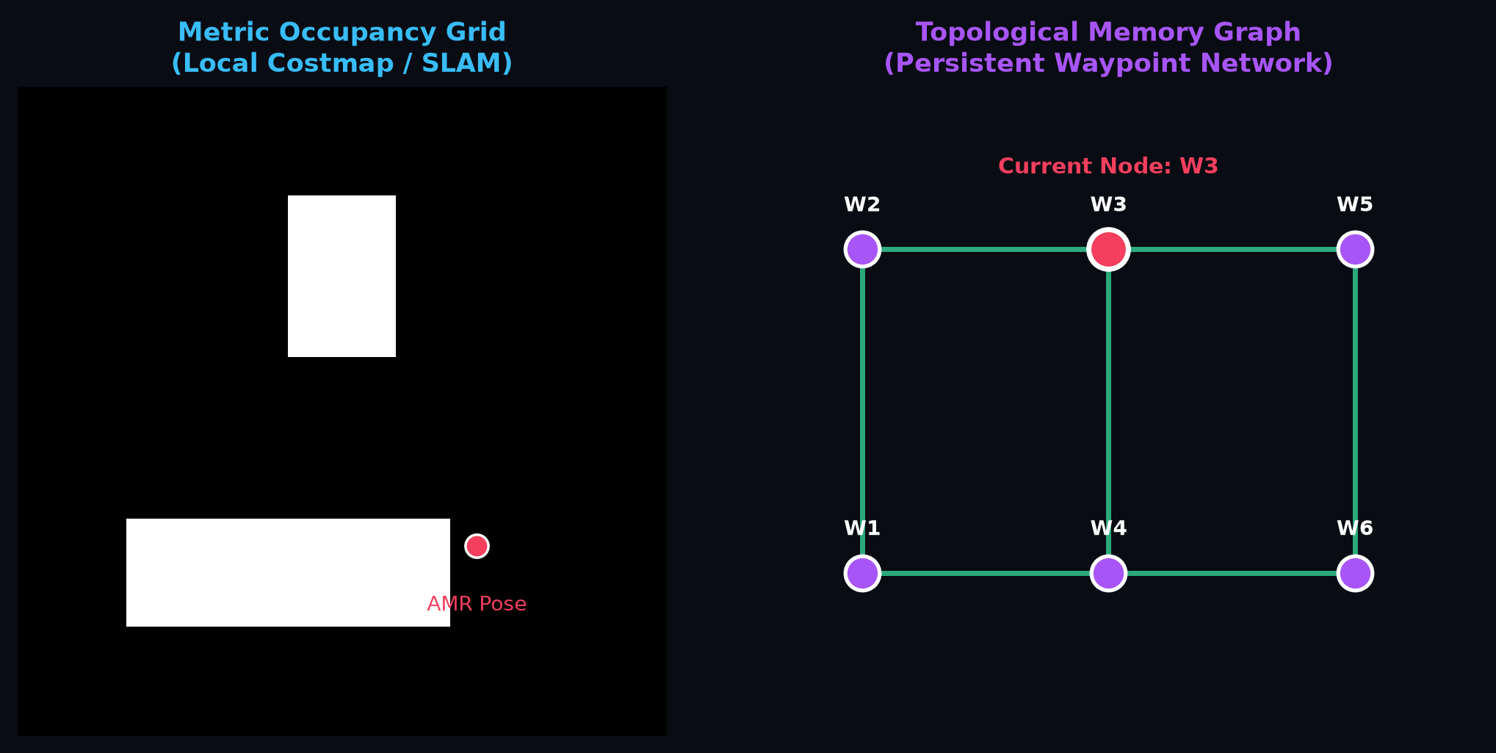
ROBOTICS BOOTCAMP • SESSION 04 / 04
⚡ SHARED MAPPING
SPATIAL MEMORY & PERSISTENT WORLD MODELS
LOCAL ROLLING MEMORY (DYNAMIC)
High-Rate Tactical Costmap (20-50 Hz)
• Ephemeral rolling grid (e.g., 4m x 4m) centered on robot base_link.
• Voxel ray-clearing: Immediately wipes dynamic obstacles (pedestrians, forklifts).
• Feeds reactive path execution (TEB / DWA local planner) with zero disk persistence.
GLOBAL & TOPOLOGICAL MEMORY (PERSISTENT)
Shared Multi-Session World Models
• Global Occupancy Grid: Trinary states (Free=0, Occupied=100, Unknown=-1) stored in SQLite / PGM.
• Topological Waypoint Graph: Nodes V = {Charging, Docking, Waypoint} & edges E with traversability costs.
• Cross-Fleet Map Alignment: Resolves frame offsets T_A^B using iterative closest point (ICP) scan matching.
💡 Spatial Memory Invariant
Robots cannot rely purely on reactive sensor buffers. By decoupling short-term dynamic obstacle costmaps from long-term topological waypoint graphs, a fleet can persist knowledge of warehouse topography across reboots, shift changes, and network outages.

Slide 6
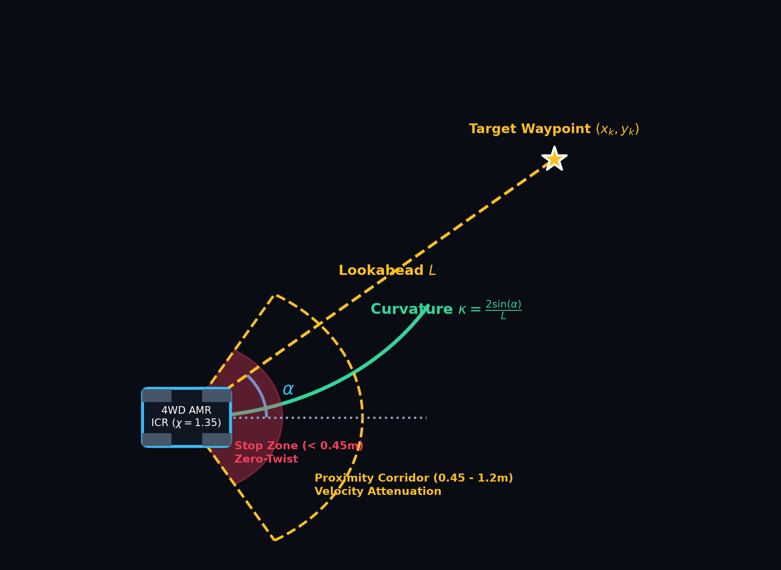
ROBOTICS BOOTCAMP • SESSION 04 / 04
⚡ MOTION CONTROL
ALGORITHMIC LOGIC: PURE PURSUIT & SAFETY ENVELOPES
PURE PURSUIT KINEMATICS & SKID-STEER SLIP
Curvature Calculation & Wheel Scrub Compensation
• Arc Curvature Formula: kappa = (2 * sin(alpha)) / L, steering robot toward goal at lookahead distance L.
• Velocity-Adaptive Lookahead: L(v) = k_v * v + L_min, dynamically contracting for tight turns and expanding at speed.
• 4-Wheeled Skid-Steer ICR: Due to lateral tire scrub, effective track width B_eff = chi * B (with chi = 1.35).
• Corrected Yaw Command: omega = chi * (v_right - v_left) / B prevents understeer during sharp warehouse pivots.
DUAL-STAGE ACTIVE SAFETY ENVELOPES
Deterministic Collision Mitigation on Hardware
• Emergency Stop Zone (< 0.45 m): Immediate zero-twist command dispatch (v=0, omega=0) and mechanical e-brake latch. Completely overrides high-level planners.
• Proximity Corridor (0.45 m to 1.20 m): Linear velocity scaling v = v_cmd * ((r - 0.45)/0.75) accompanied by an artificial lateral repulsion bias away from obstacle normal.
• Deadzone Latching: Hysteresis band prevents high-frequency actuator chatter at corridor boundaries.

Slide 7
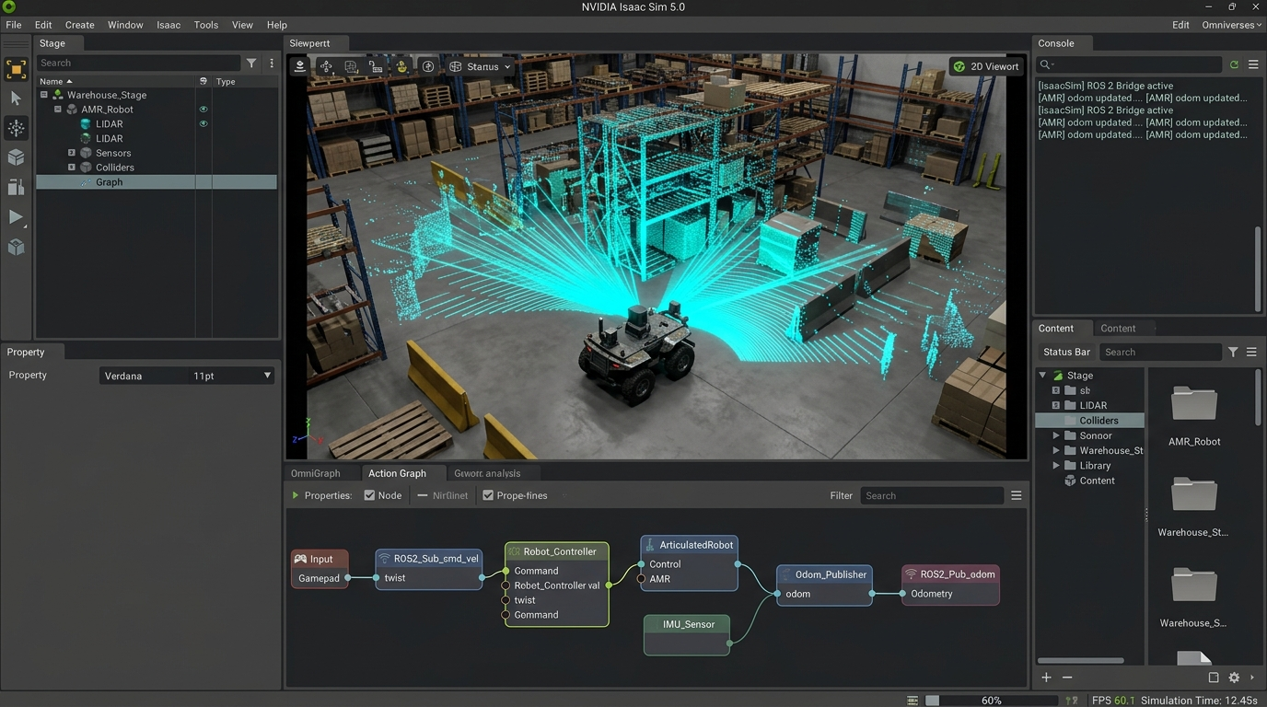
ROBOTICS BOOTCAMP • SESSION 04 / 04
⚡ DIGITAL TWIN
SIMULATION ARCHITECTURE IN NVIDIA ISAAC SIM 5.0
USD STAGE ENGINEERING & PHYSX 5 DYNAMICS
Modular Hierarchy & Micro-Physics Fidelity
• Universal Scene Description (USD): Clean stage segregation separating Environment, UWB Anchors, Robot Articulations, and RTX Sensor Prims.
• PhysX 5 Rigid Body Engine: Surface material friction parameters (mu_static=0.85, mu_kinetic=0.65) matching physical warehouse concrete.
• Continuous Collision Detection (CCD): Eliminates mesh pass-through artifacts during high-speed AMR maneuvers.
OMNIGRAPH ROS 2 PIPELINE & OPTIMIZATION
Zero-Copy GPU Sensors to ROS 2 Topics
• OmniGraph Visual Action Nodes: Direct binding of ROS 2 Context, Twist subscriber, Odometry publisher, and TF tree broadcasters.
• RTX Synthetic LiDAR: GPU-accelerated raytracing generates 360-degree point clouds and 2D laser scans (/scan) at 60 FPS with zero CPU overhead.
• Physics Update Decoupling: Running physics sub-stepping at 120 Hz while rendering at 60 Hz to ensure real-time factor (RTF >= 1.0) on workstation GPUs.

Slide 8
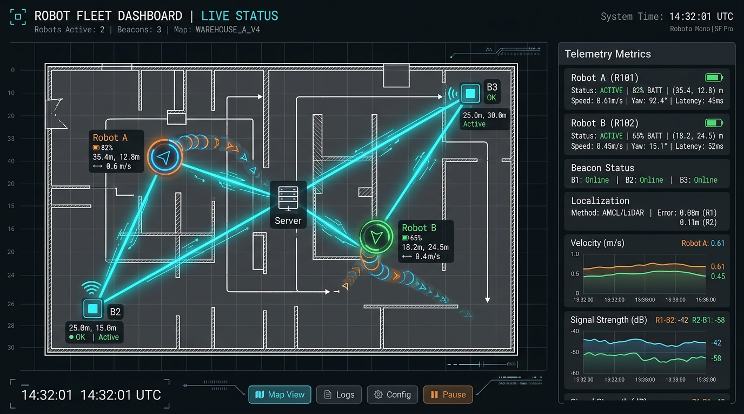
ROBOTICS BOOTCAMP • SESSION 04 / 04
⚡ SWARM MONITOR
REAL-TIME NETWORK & MAP OVERLAY DASHBOARD
LIVE TELEMETRY COMPANION NODE
Asynchronous Python / WebSocket Telemetry Engine
• Dynamic Robot Markers: Real-time tracking of AMR (x, y, theta) coordinates with oriented velocity vectors and battery SOC status.
• Static Beacon Overlay: Visual anchors displaying active UWB ranging rays, estimated trilateration confidence, and anchor health.
• Active Inter-Robot Links: Animated glowing links indicating active DDS packet exchange between robots and base coordinator.
• Dual Map Canvas: Simultaneous rendering of static occupancy grid and dynamic rolling costmap obstacle layers.
FLEET HEALTH & DIAGNOSTICS STREAM
Real-Time Telemetry Panels & Mission Logging
• Telemetry Metrics: Real-time velocity strip charts (v_x, omega_z) and signal RSSI (dBm) per robot.
• Localization Error Monitor: Discrepancy metric between raw wheel odometry and filtered UWB pose (|p_odom - p_ekf|).
• Emergency Fleet Intervention: One-click global e-stop command broadcasting /fleet/e_stop over DDS Reliable topic.
• Mission Logs: Rolling FIFO console displaying node discovery, route completion, and network warnings.

Slide 9
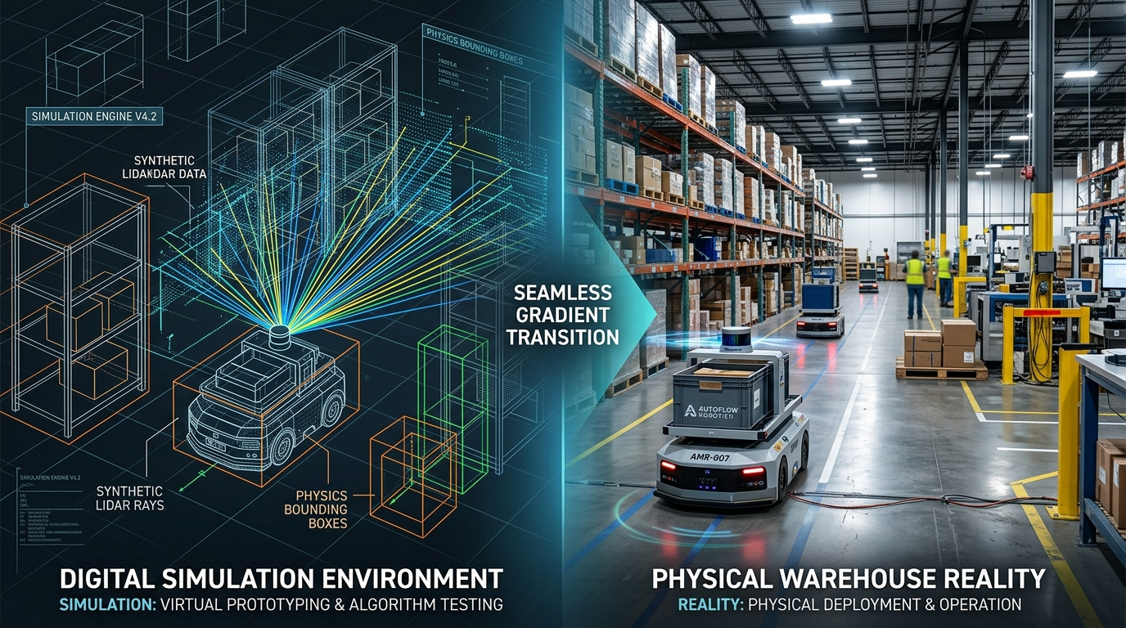
ROBOTICS BOOTCAMP • SESSION 04 / 04
⚡ SIM-TO-REAL
REAL-WORLD DEPLOYMENT & HARDWARE CONSIDERATIONS
BRIDGING THE GAP
Simulation vs. Physical Physics
• Wheel Slip & Floor Transitions: Uneven warehouse floors, linoleum-to-concrete transitions alter friction coefficient mu.
• RF Multipath Interference: Steel racks reflect UWB pulses, requiring robust outlier rejection filters (Mahalanobis gating).
• Gear Backlash & Wear: Mechanical gear play creates unmodeled deadbands during rapid pure pursuit reversals.
HARDWARE INTEGRITY
Power & Failsafe Architecture
• Power Domain Isolation: Optocouplers and isolated DC-DC converters prevent motor surge brownouts on compute boards.
• Hardware Watchdog: STM32 co-processor cuts motor H-bridge power if ROS 2 heartbeat stops for > 200 ms.
• Thermal Dissipation: Workstation compute and motor drivers require active fan cooling in closed industrial chassis.
INDUSTRIAL DEPLOYMENTS
From Bench to Swarm Operations
• Automated Fulfillment Fleets: Kiva/Ocado-style grid navigation coordinating 50+ AMRs in high-density corridors.
• Search-and-Rescue Teams: Collaborative ad-hoc RF mesh mapping collapsed or GPS-denied environments.
• Agriculture & Environmental: Coordinated multi-robot soil mapping and continuous canopy inspection.

Slide 10

ROBOTICS BOOTCAMP • SESSION 04 / 04
⚡ IEEE OPEN FLOOR
BOOTCAMP FINALE: CONCLUSION, RESOURCES & Q&A
KEY TAKEAWAYS — SESSION 04
The Autonomous Swarm Blueprint
1. DDS Middlewares: Domain ID isolation and tailored QoS policies enable robust P2P inter-robot state passing without centralized brokers.
2. Absolute Beacon Fusion: Combining UWB Time-of-Flight trilateration with local odometry bounds drift and enables reliable multi-robot origin alignment.
3. Spatial Memory Hierarchy: Decoupling short-term dynamic costmaps from persistent topological graphs provides multi-session fleet intelligence.
4. Physics Validation First: Isaac Sim 5.0 GPU pipelines expose kinematics and network bottlenecks before burning hardware on the floor.
OPEN SOURCE RESOURCES & CODE REPOSITORIES
Production Code, Isaac Sim Stages & IEEE Guides
• GitHub Repository: Complete ROS 2 swarm packages, custom OmniGraph action nodes, and telemetry visualizer code.
• Isaac Sim 5.0 Assets: Pre-configured USD warehouse environment with UWB beacon anchor markers and 4WD AMR models.
• IEEE Student Chapters: Full access to recorded sessions, slide decks, and hardware BOMs for IEEE FSB RAS SBC & IEEE AESS Jordan.
• Discord & Telegram Channels: Join our engineering discussions for peer design reviews and project guidance.
SCAN FOR CODE & ASSETS
Mouhamed Boughrara
Tech Lead & Autonomous Systems Engineer
GitHub: github.com/medboughrara
LinkedIn: linkedin.com/in/mouhamed-boughrara
Portfolio: jarvis-pcb.ai
💬 Let's Open the Floor for Q&A!
IEEE FSB RAS SBC (Tunisia) × IEEE AESS (Jordan)

