Slide 1
Matrix Definitions and Terminology
&
Special Matrices and Vectors
By Hurles

Slide 2
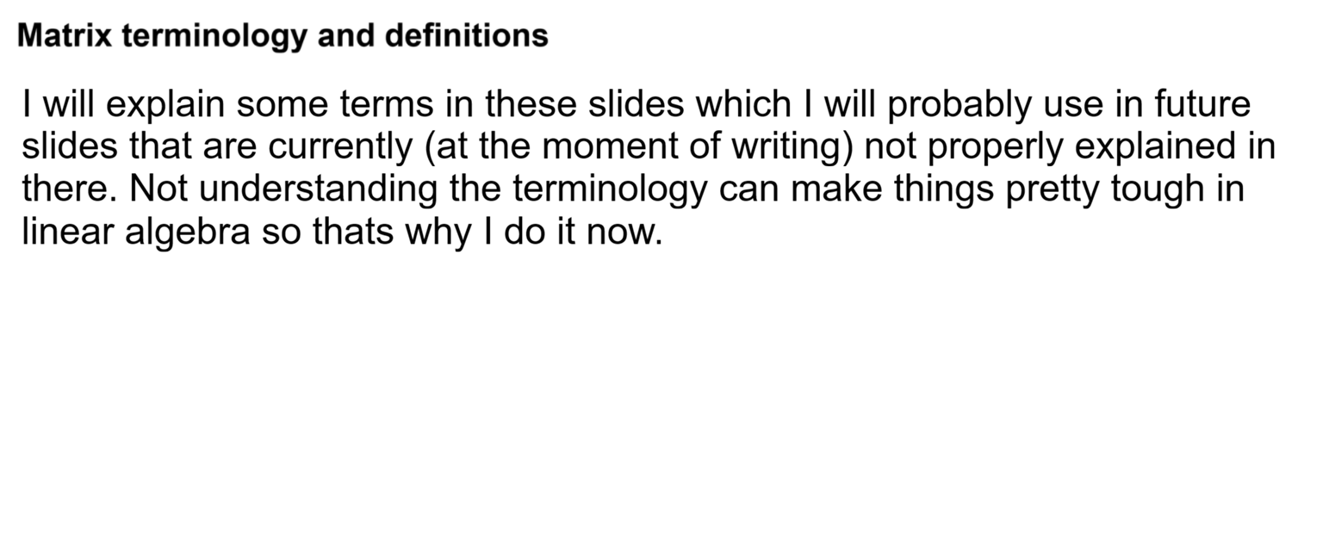

Slide 3
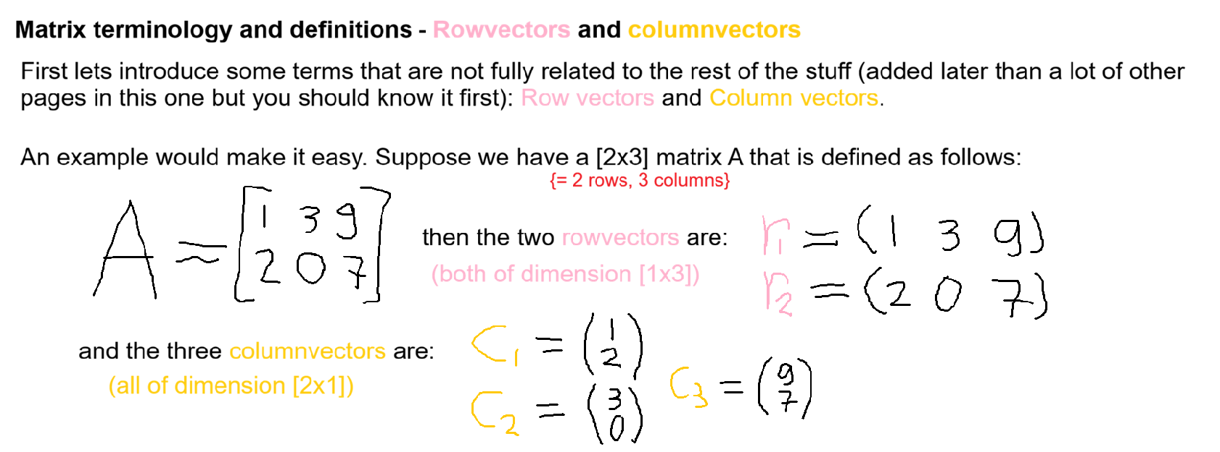

Slide 4
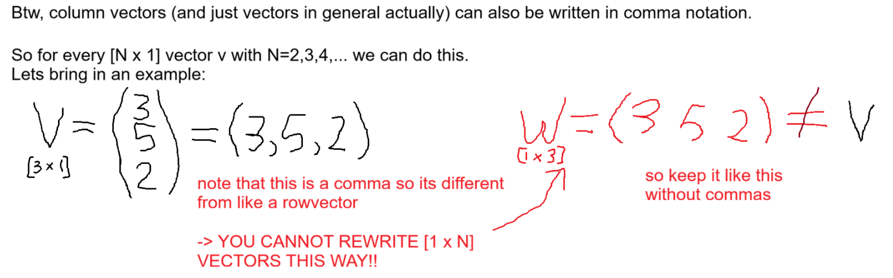

Slide 5
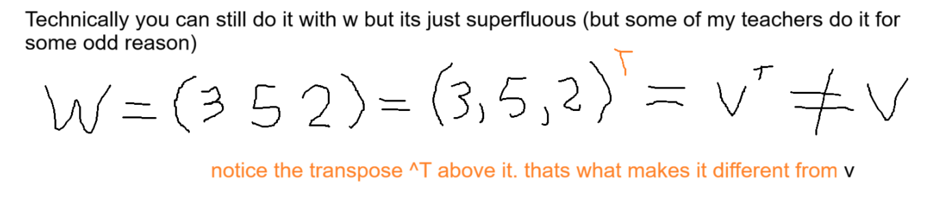

Slide 6
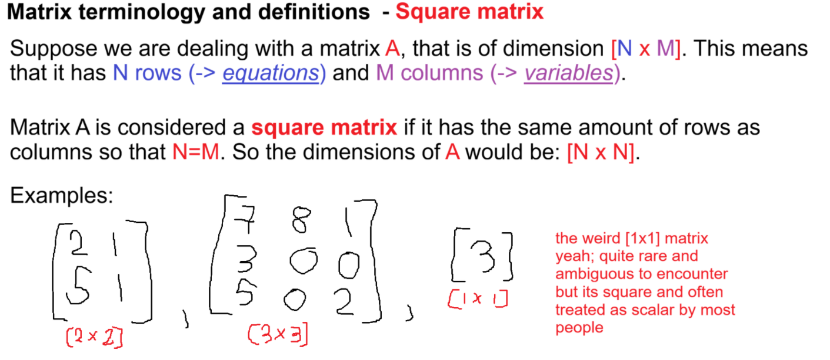

Slide 7
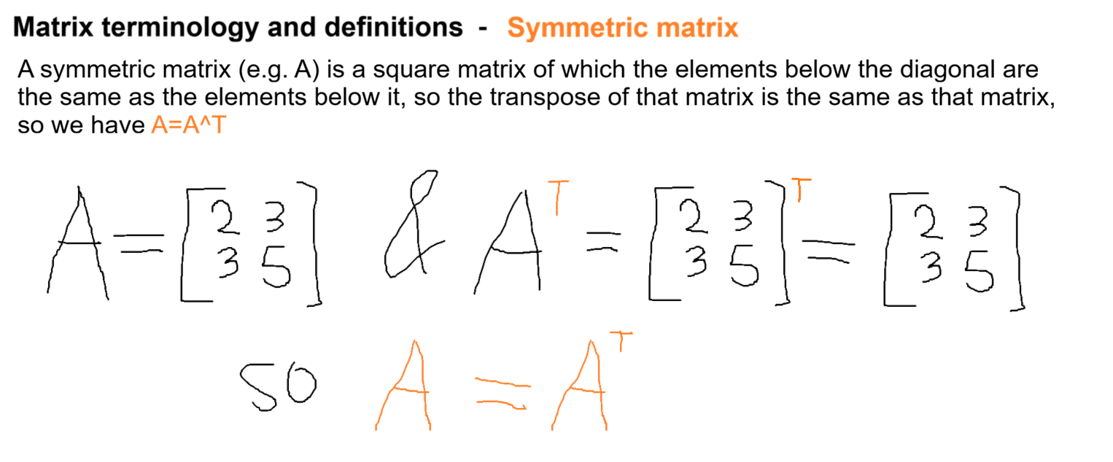

Slide 8
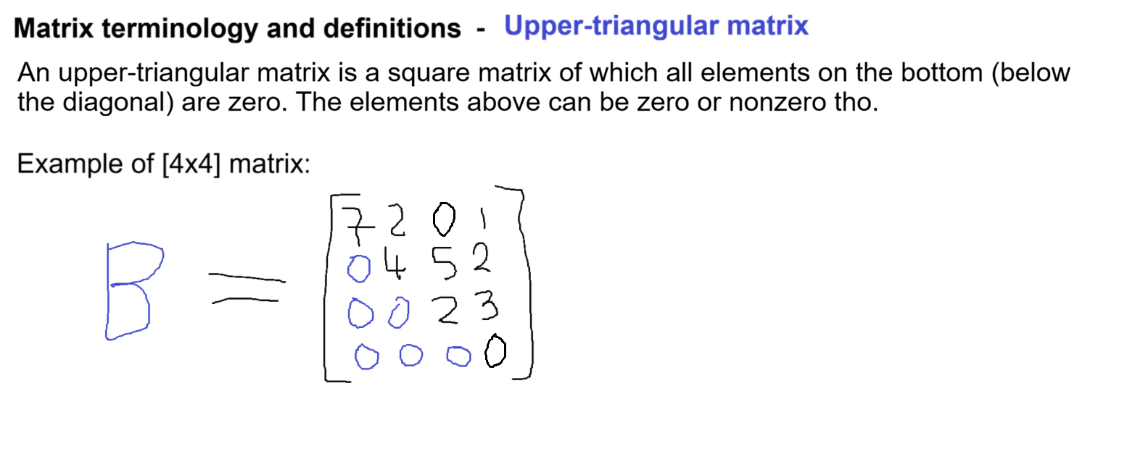

Slide 9
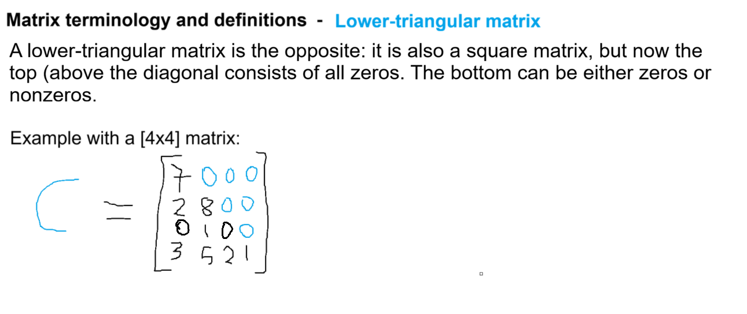

Slide 10
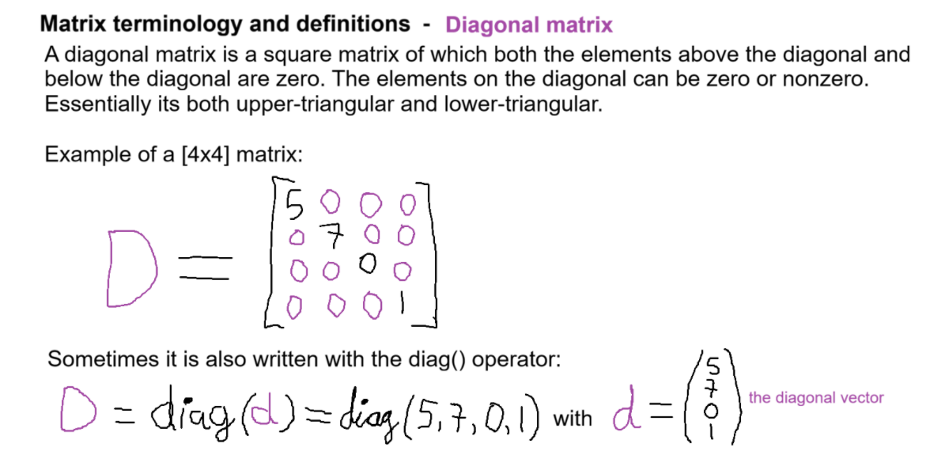

Slide 11
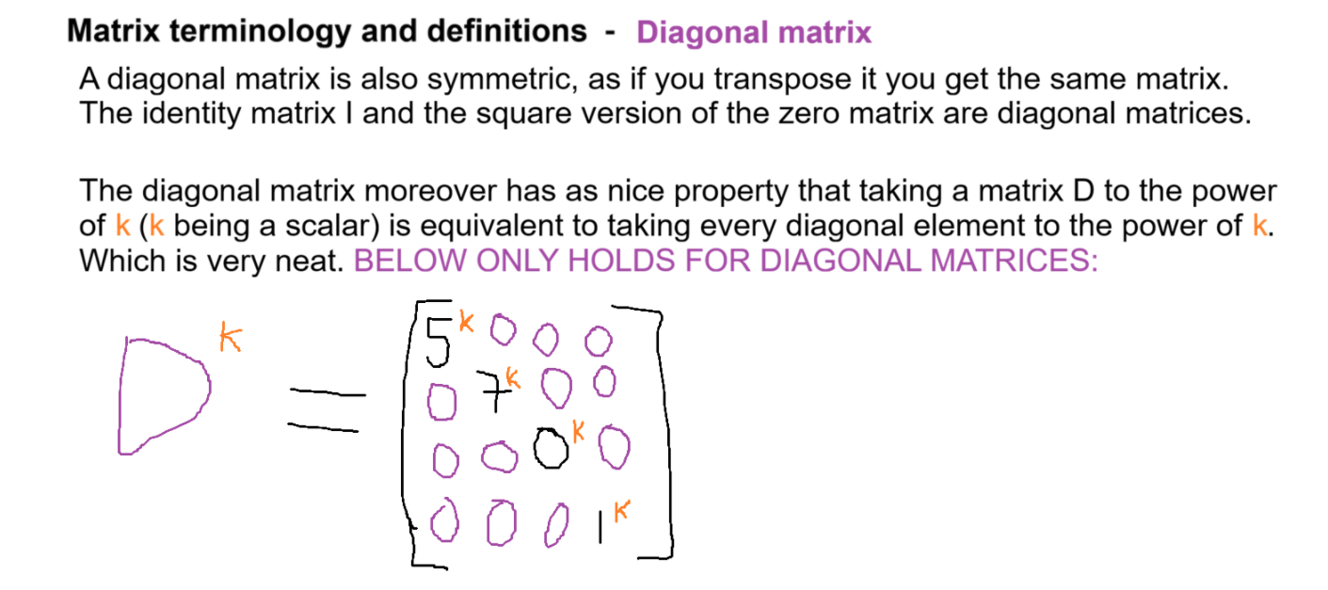

Slide 12
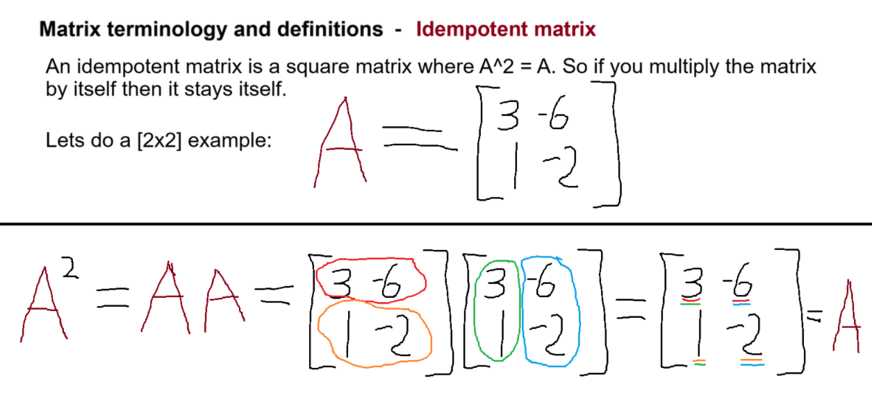

Slide 13
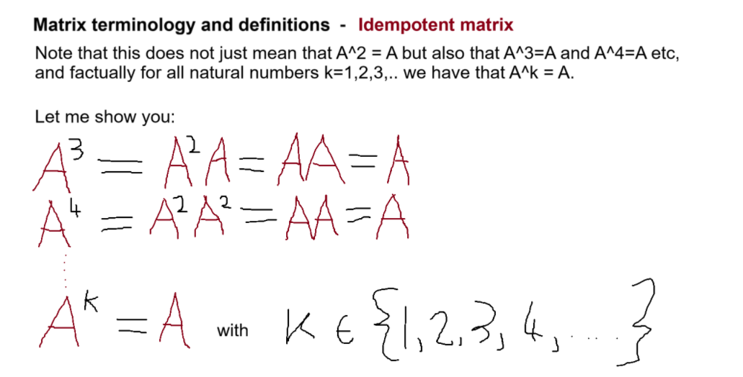

Slide 14
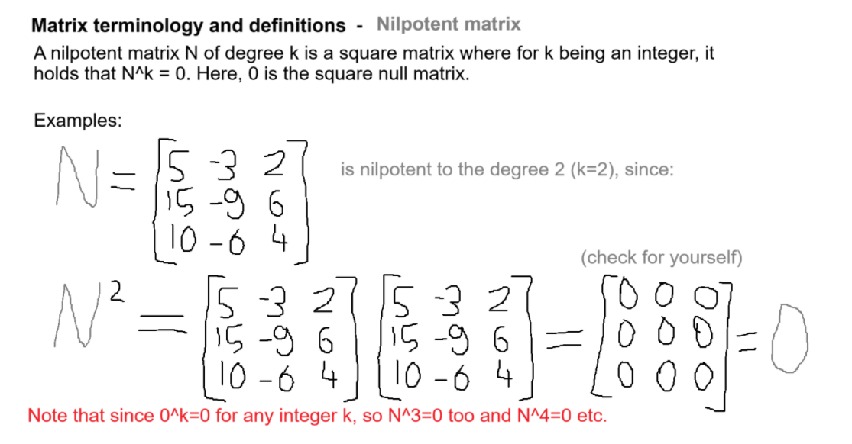

Slide 15
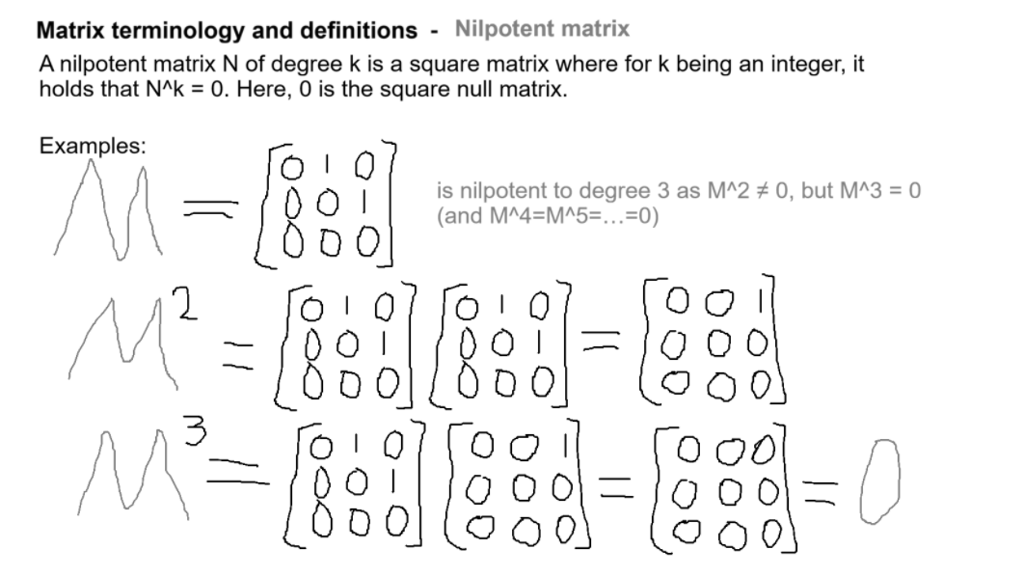

Slide 16
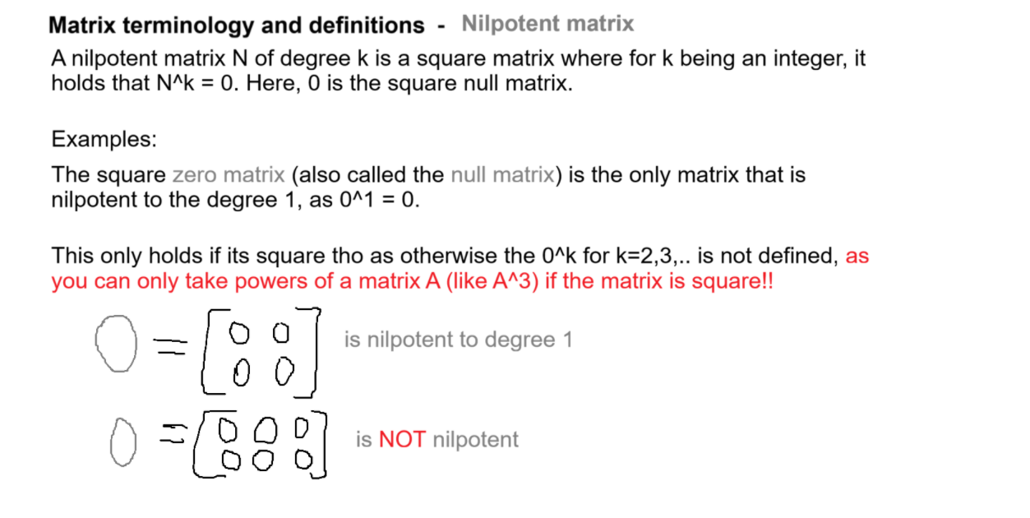

Slide 17
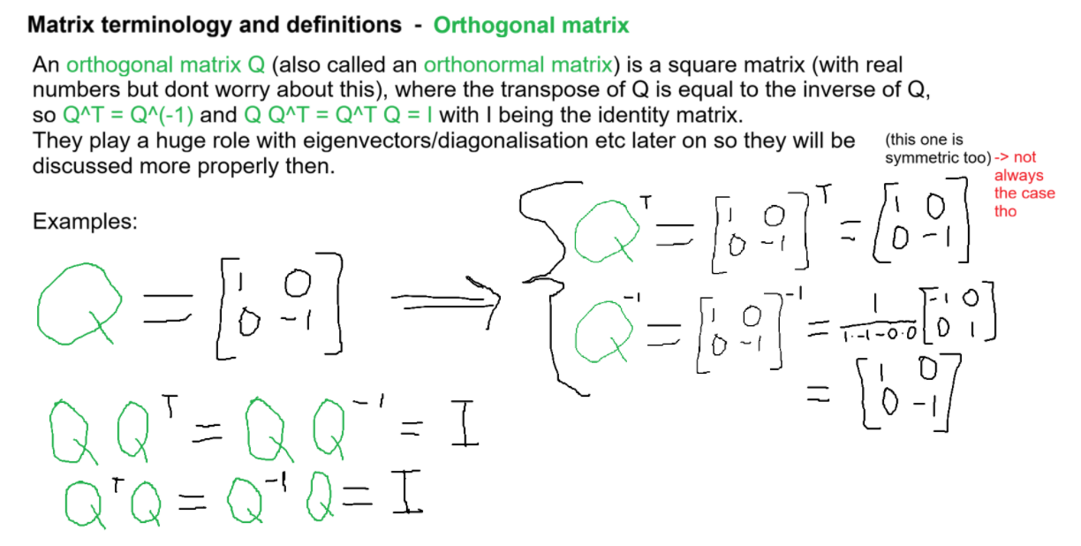

Slide 18
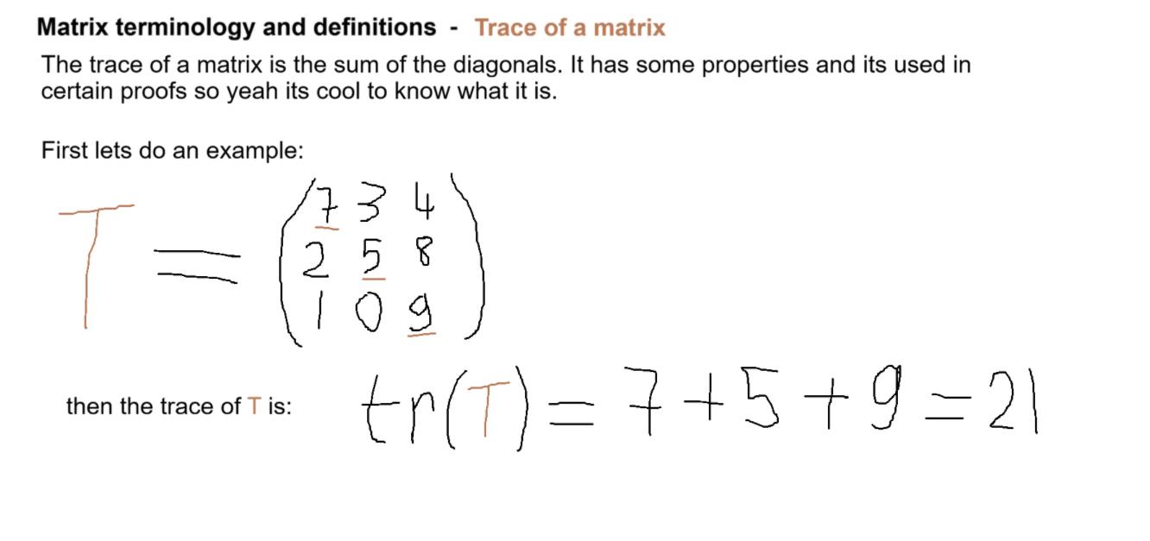

Slide 19
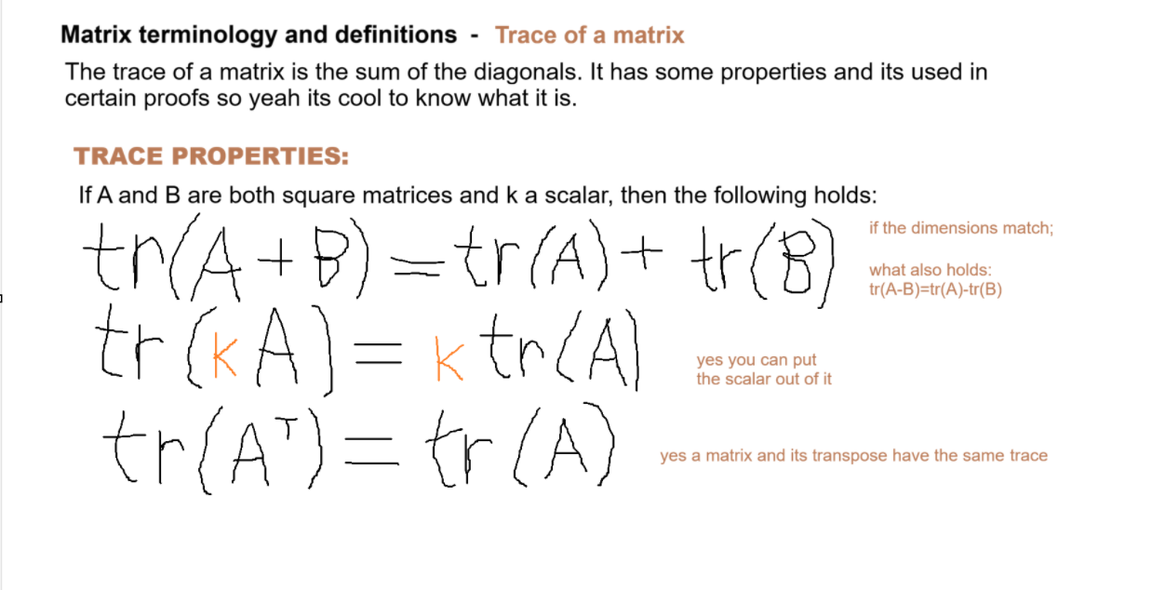

Slide 20
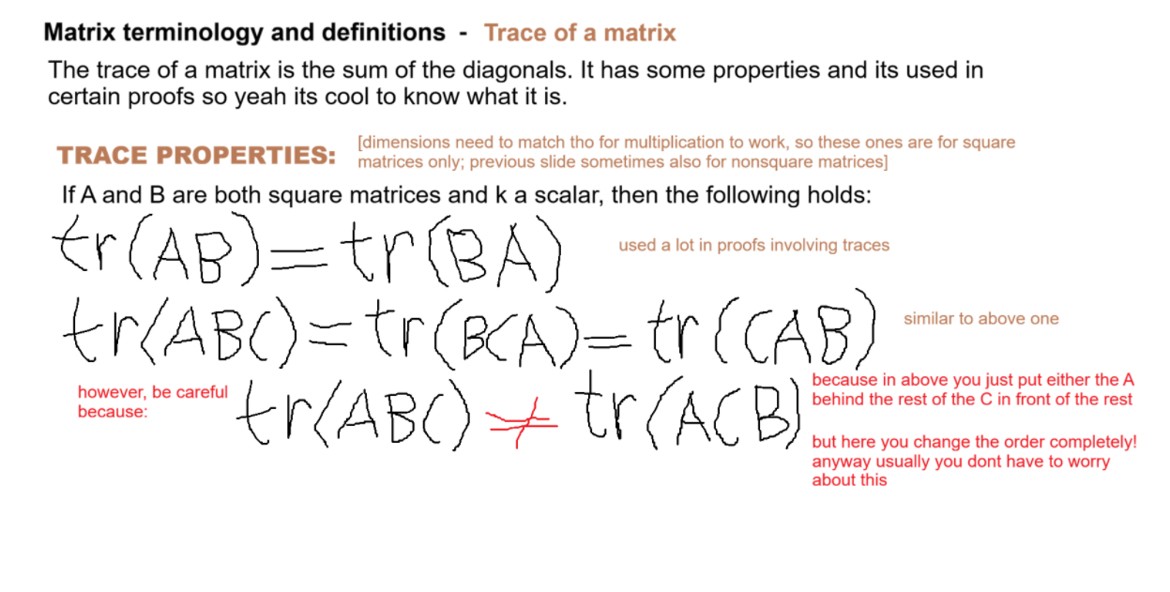

Slide 21
Special matrices and vectors
Now I will show you a few important special matrices and vectors that are fairly common in linear algebra and its applications (some more than others).
So give it a good read.

Slide 22
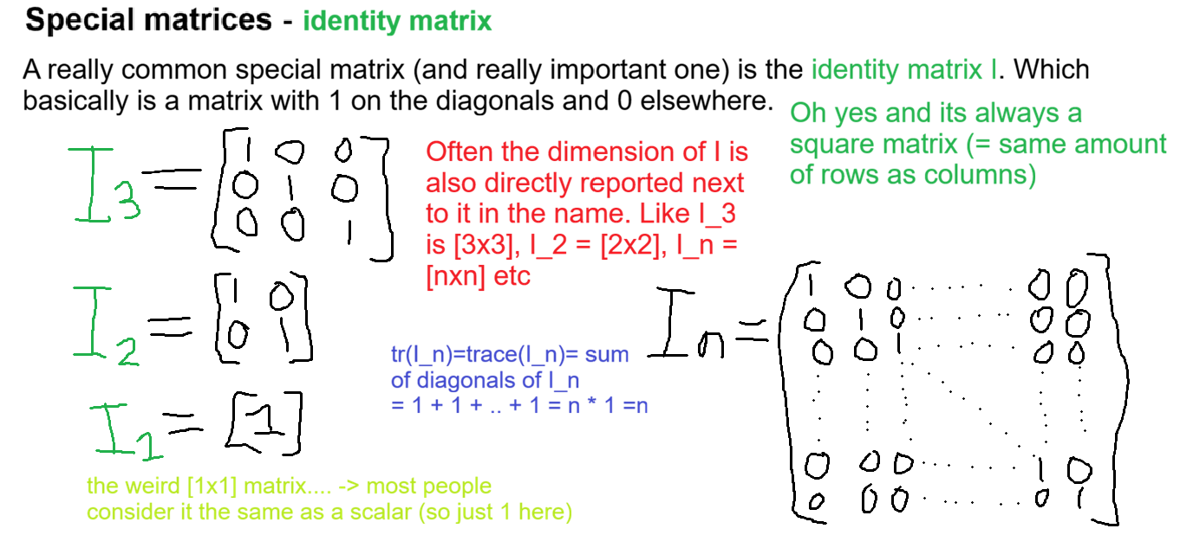

Slide 23
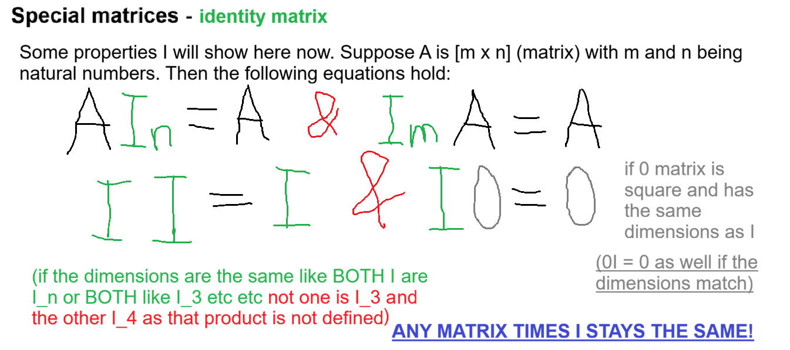

Slide 24
Special matrices – Identity matrix
The identity matrix I is moreover:
Square
Diagonal
Symmetric
Idempotent
Orthogonal

Slide 25
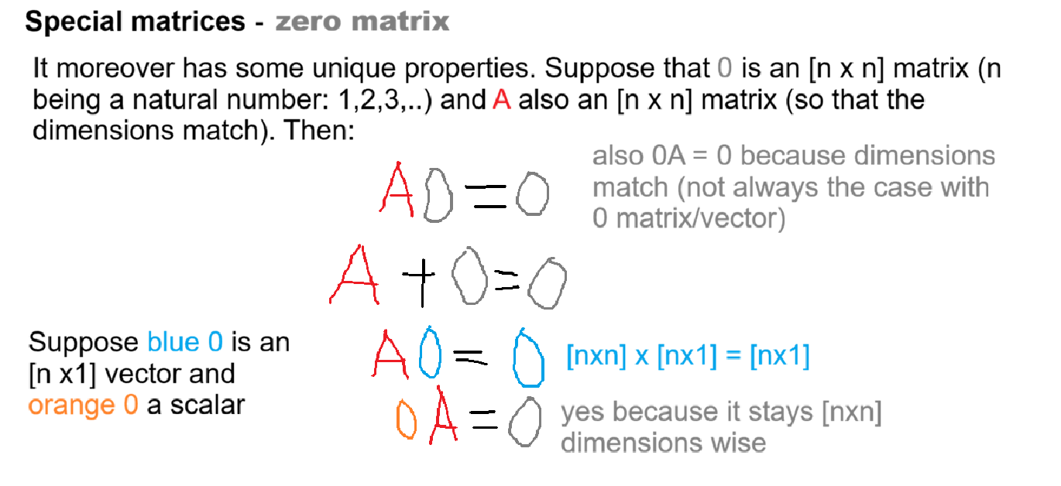
A

Slide 26
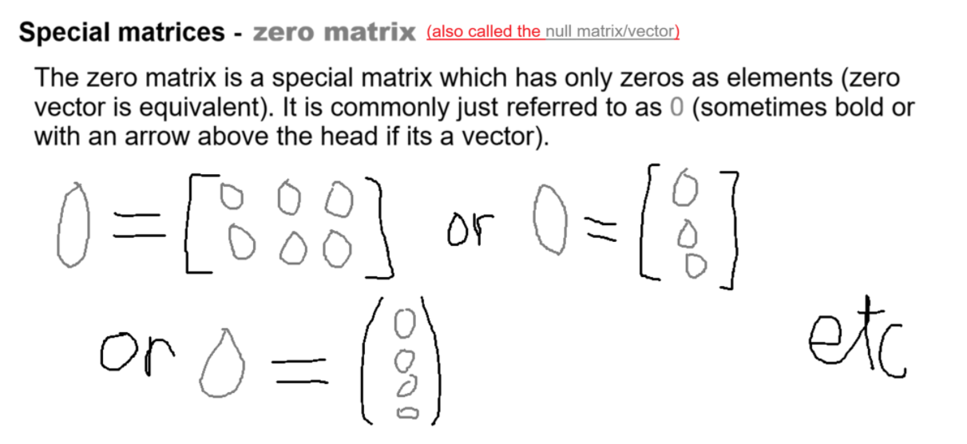

Slide 27
Special matrices – Zero/null matrix
The zero/null matrix is moreover:
Diagonal (if its the square version)
Symmetric (if square)
Idempotent (if square)
Nilpotent (of degree 1) (if square this holds more properly as 0^k for k=2,3,4,.. is only defined for square null matrices)

Slide 28
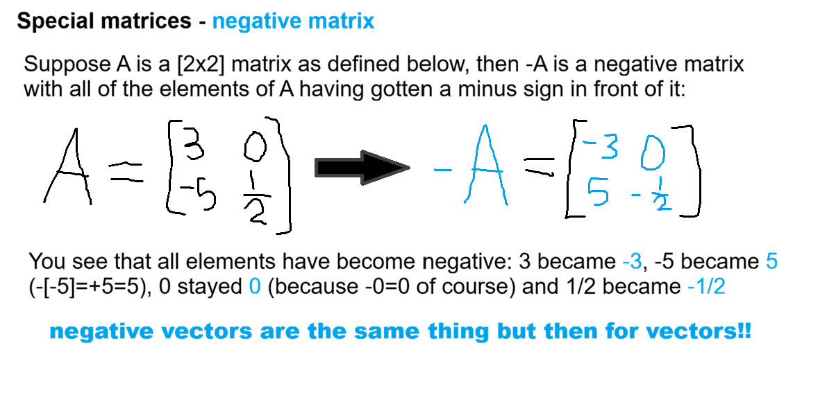

Slide 29
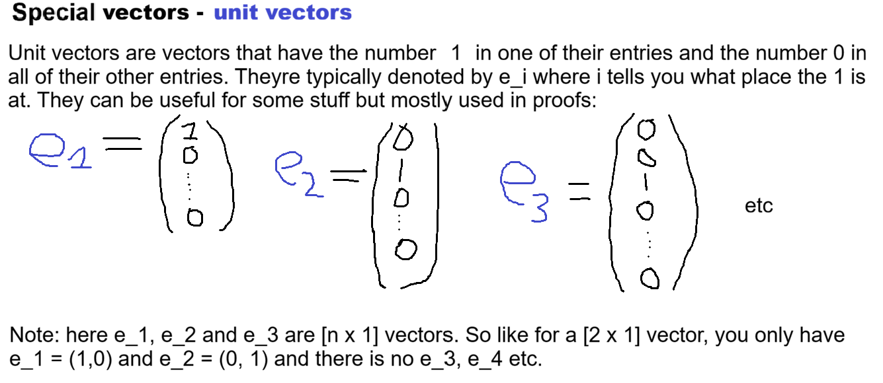

Slide 30
