Slide 1
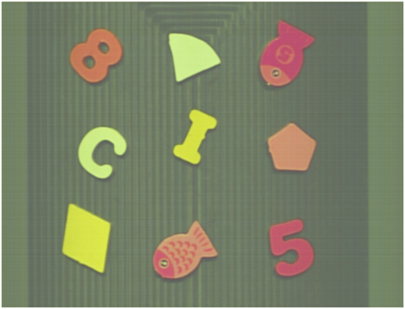
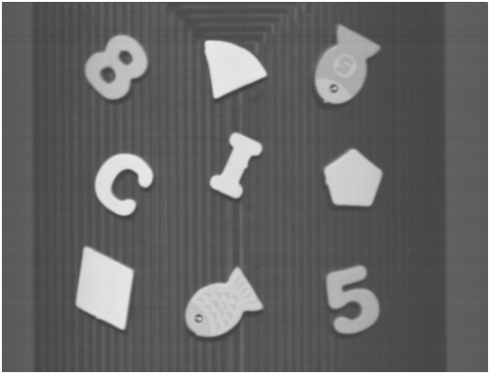

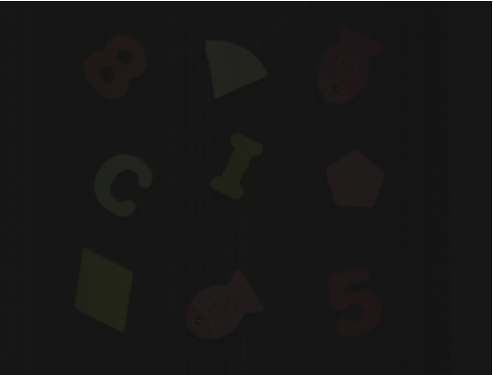



$$R_{low}$$
Conv
Conv
ReLU
Conv
ReLU
Conv
ReLU
Conv
Conv
Sigmoid
Conv
ReLU
Conv
ReLU
Concat
Concat
$$S$$
$$I_{low}$$
Conv
ReLU

Slide 2
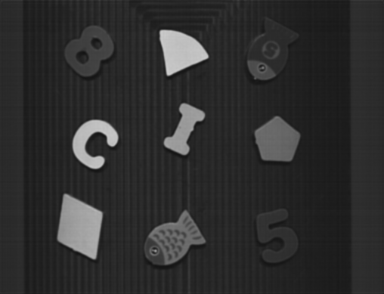



$$R_{low}$$
Conv
Conv
ReLU
Conv
Conv
Conv
ReLU
Conv
ReLU
$$I_{δ}$$
Conv
ReLU
Transformer
Upsample
Conv
ReLU
Upsample
Upsample
Conv
ReLU
Concat
$$I_{low}$$
Resize
Resize

Slide 3
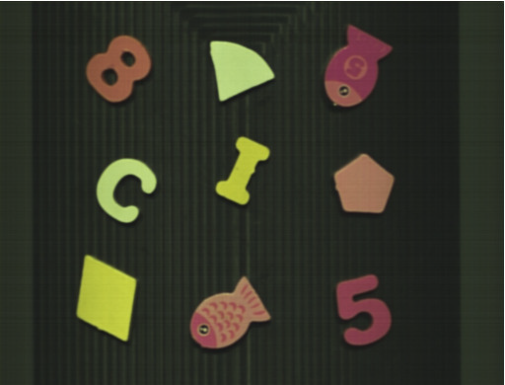





$$R_{low}$$
$$S$$
$$I_{δ}$$
$$Ŝ$$
Decomposition Network
Illumination Adjustment Network
$$I_{low}$$

Slide 4
$$R_{low}$$
$$S$$
$$I_{δ}$$
$$Ŝ$$
Ayrıştırma
Ağı
Aydınlatma
Düzenleme
Ağı
$$I_{low}$$

