Slide 1
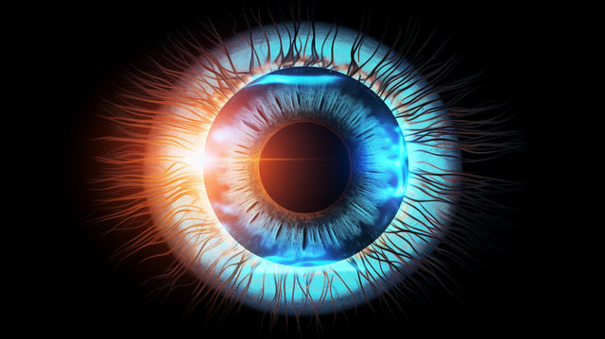

Binary Ocular Disease Classification Using ODIR-5K
TEAM PHOENIX
BITS Pilani Hyderabad Campus

Slide 2


01
Executive Summary & Clinical Objective
Goal: Automated binary classification of fundus images into Healthy vs. Defective categories using deep transfer learning.
Core Challenge: Diagnosing retinal pathologies from unstandardized clinical notes while handling class imbalance and preventing data leakage.
Solution Architecture: An end-to-end medical imaging pipeline combining CLAHE enhancement, patient-stratified data splits, EfficientNetV2S feature extraction, and Test-Time Augmentation (TTA).

Slide 3
02
Data Engineering & Preprocessing Pipeline
Ground Truth Extraction: Processed free-text diagnostic notes into structured binary labels using targeted regular expressions.
Patient-Level Splitting: Implemented a 70/15/15 train/validation/test split grouped strictly by Patient_ID to eliminate inter-eye data leakage.
Image Contrast Enhancement: Auto-cropped black borders, converted images to LAB color space, and applied CLAHE on the L-channel at 384x384 resolution.
Performance Optimization: Utilized ThreadPoolExecutor and disk caching to remove CPU input bottlenecks during training execution.

Slide 4
03
Network Architecture & Two-Phase Training
Model Backbone: EfficientNetV2S initialized with ImageNet weights, powered by TensorFlow's MirroredStrategy and mixed_float16 precision.
Classification Head: Global Average Pooling layer coupled with Dropout (0.4/0.3), Dense(256, ReLU), label smoothing (0.08), and a 1-unit Sigmoid classifier.
Phase 1: Trained head layers for 4 epochs with a frozen backbone using AdamW.
Phase 2 (Fine-Tuning): Unfroze the top 80% of backbone layers for 18 epochs while keeping Batch Normalization layers frozen, using Cosine Decay learning rate scheduling.
.

Slide 5
04
Inference Strategy & Evaluation Protocol
Test-Time Augmentation (TTA): Averaged prediction probabilities across 3 image views (Original, Horizontal Flip, Vertical Flip) to minimize prediction variance.
Threshold Tuning: Scanned classification decision boundaries on validation predictions to balance sensitivity and specificity.
Primary Metrics: Evaluated overall diagnostic reliability using ROC-AUC, Accuracy, F1-Score, Sensitivity (Recall), Specificity, and Confusion Matrices.
ROC-AUC : 85.01% Accuracy: 78.53% F1 Score: 78.20%
Sensitivity : 70.78% Specificity: 87.78%
.

Slide 6
05
Key Technical Results & System Strengths
Reduced False Negatives: Dynamic decision thresholding significantly improved disease detection sensitivity on minority classes compared to standard 0.50 boundaries.
Enhanced Visual Features: CLAHE pre-processing isolated subtle retinal structures like microaneurysms and vascular abnormalities for better feature learning.
Resource Efficiency: Mixed-precision execution halved memory consumption, enabling larger batch sizes and faster convergence.
.

Slide 7
06
Limitations, Failure Modes & Future Work
Resolution Bottlenecks: Downsampling high-resolution fundus scans to 384x384 pixels risks losing micro-vascular details.
Artifact Sensitivity: Scans with severe lens glare, cataracts, or extreme underexposure can cause CLAHE to amplify background noise.
Clinical Generalizability: Class weights addressed dataset imbalance, but multi-hospital external validation is required to ensure robustness across different camera hardware.
.

Slide 8
Key Performance Metrics
ROC-AUC
Accuracy
85.01%
78.53%
F1 Score
Sensitivity & Specificity
78.20%
Sensitivity: 70.78%
Specificity: 87.78%

Slide 9
We confirm that the work presented in this project was carried out by the team members. The project results and analysis are presented accurately to the best of our knowledge. Team Mentor:
Ronil Borah ronilborah@gmail.com
Team Members:
Hrishikesh V f20250919@hyderabad.bits-pilani.ac.in
Medha Srishti Abboju f20250250@hyderabad.bits-pilani.ac.in
Shriya Mahesh f20251290@hyderabad.bits-pilani.ac.in

