Slide 1
CHIRP
Bird species classification on Stanford campus
Milestone 3 — Preliminary Results
20
5,966
0.671
6 / 20
Stanford species
samples (3 sources)
best val macro-F1 (RF)
species at 1.00 test F1
github.com/medha156/CHIRP · 2026-05-29

Slide 2
What we built
20-class bird classifier from short video clips, deployable on Stanford campus
Dual-backbone ensemble
Pipeline milestones
Video Swin-T
Data pipeline: VideoDataset, preprocess, augment, optical flow
Models: Swin-T, EB3, fusion head, classical baselines (KNN/RF/XGB)
Training: AdamW + cosine warm-up + early stop + WandB
Eval: confusion matrix, per-class F1, SHAP, GradCAM + rollout
Experiments: ablation sweep + picture-vs-video temporal sweep
Infra: 75 unit tests + GitHub Actions CI + REPORT.md
16 frames → [B, 768]
Kinetics-400 pretrained
EfficientNet-B3
1–16 keyframes → [B, 1536]
ImageNet pretrained
Fusion MLP
concat → 2304 → 512 → 20
CHIRP · Milestone 3
2 / 9

Slide 3
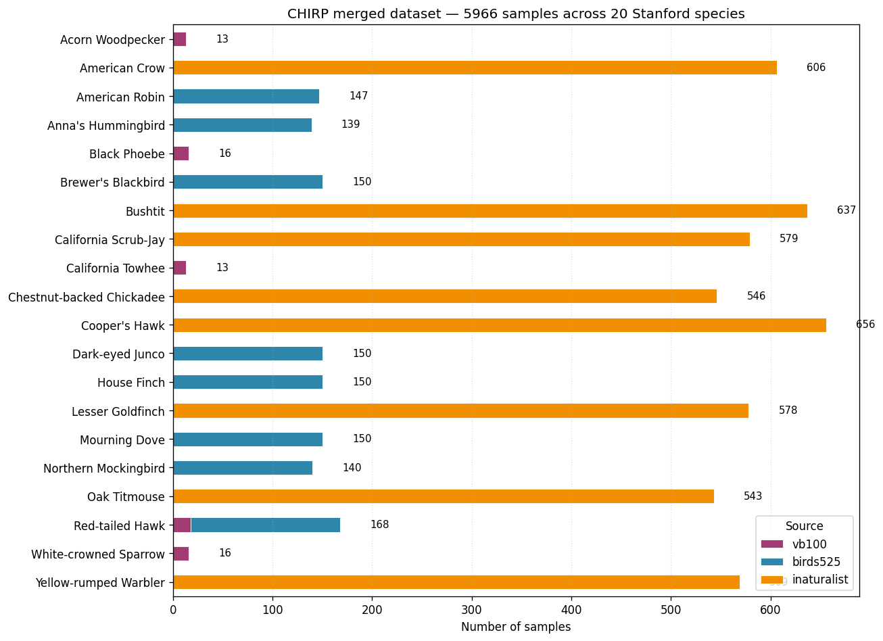
Dataset — built from 3 free public sources
Original plan (FBD-SV-2024 + VB100) had to be rebuilt: FBD has no species labels, iNat has no videos
20 / 20
5,966
76
5,890
Stanford species covered
total samples
real video clips (VB100)
photos (Birds-525 + iNat)
Sources & coverage
VB100 (Zenodo, CC BY-NC-SA): 5 species, ~14 video clips each
Birds-525 (HuggingFace, CC0): 8 species, ≤150 photos each
iNaturalist (API, CC*): 8 gap species, ~590 Bay Area photos each
For Milestone 3 we subsampled to 538 (30/class) so the sweep would fit on CPU.
CHIRP · Milestone 3
3 / 9

Slide 4
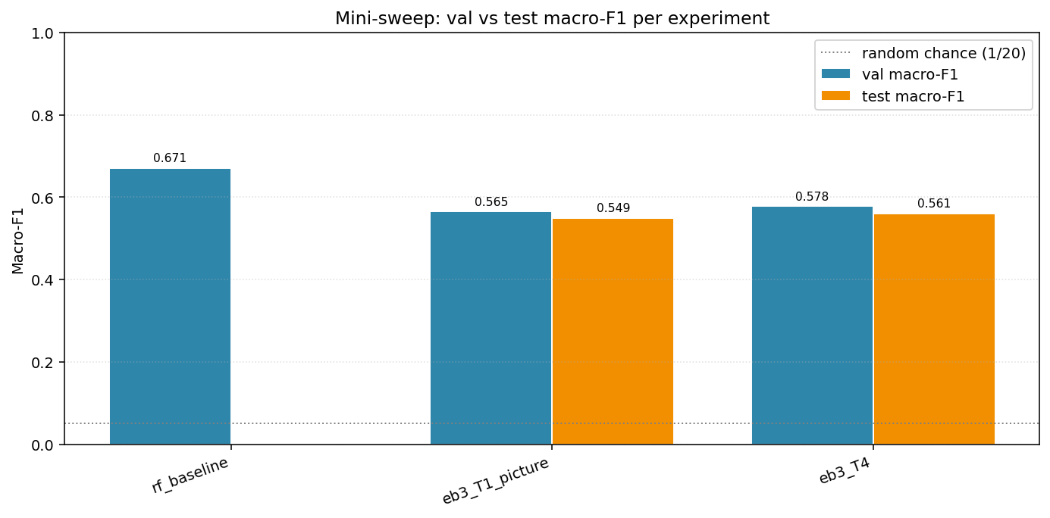
Results — Random Forest leads on the mini-sweep
3 experiments completed on CPU; Swin-T + Fusion deferred to GPU
0.671
best val macro-F1
Random Forest on frozen EB3 features (one-shot fit)
13× above 20-class chance (0.050)
+0.11 over linear-probe EB3 (0.549)
6 / 20 species at perfect 1.00 test F1 (EB3)
CHIRP · Milestone 3
4 / 9

Slide 5
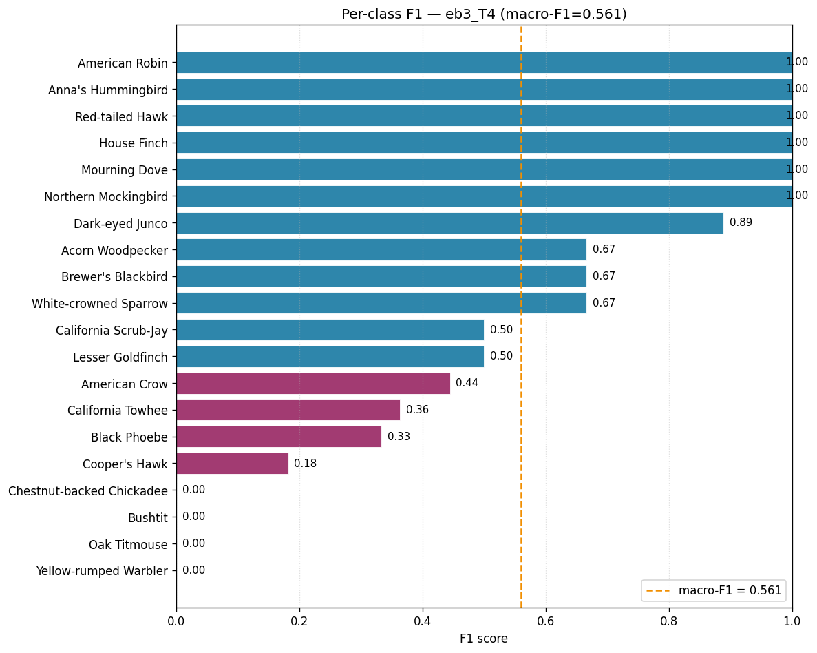
Per-class F1 reveals the real story
EB3 T=4 linear-probe, test split (81 samples) — performance correlates with data source
Insights
6 perfect-F1 species (1.00)
ALL from Birds-525 — curated single-bird photos. ImageNet features transfer perfectly here.
Middle tier (0.18 – 0.89)
VB100 video species + a few iNat species — model partially generalizes.
4 zero-F1 species (0.00)
ALL from iNaturalist — cluttered citizen-science photos. Frozen ImageNet features don't generalize without fine-tuning.
Takeaway: data source dominates model architecture at this scale.
CHIRP · Milestone 3
5 / 9

Slide 6
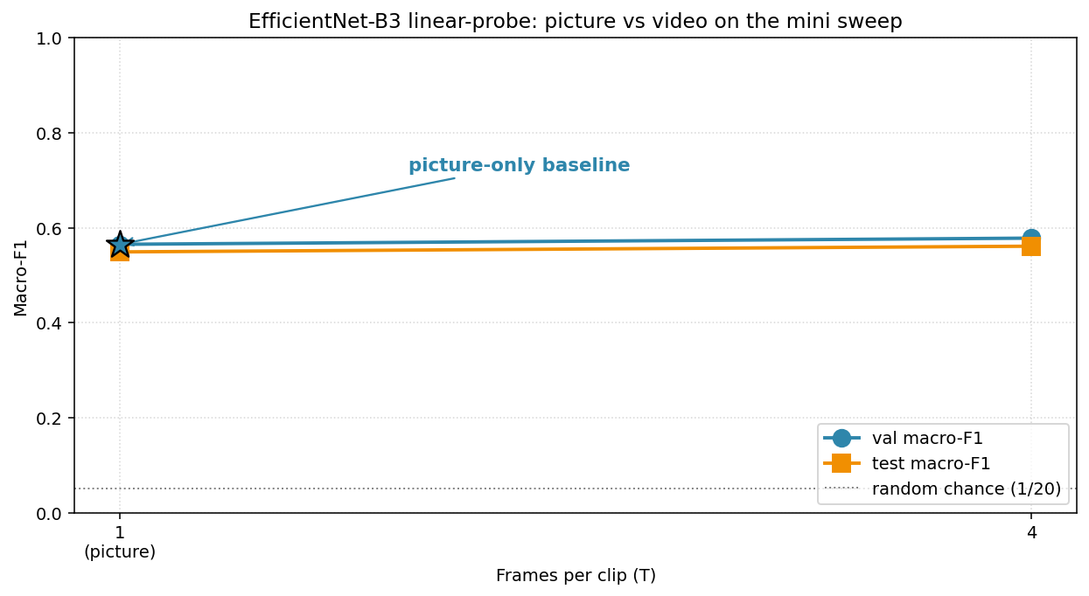
Picture vs video — small lift, explainable
EfficientNet-B3: T=1 (picture) → T=4 (frames) on the mini sweep
Why the lift is small
Only 5 of 20 species have actual video clips (the VB100 subset).
The other 15 species are photos. At T=4 the model sees 4 augmented copies of the same image — no real temporal information.
So the +0.013 F1 reflects mostly augmentation noise, not temporal learning.
Cleaner experiment would restrict to the 5 VB100 species, OR request Macaulay Library videos for the missing 15.
Picture-vs-video lift on the mini sweep: +0.013 F1 — bounded by dataset composition, not architecture.
CHIRP · Milestone 3
6 / 9

Slide 7
Analysis — what's working, what isn't
Reading between the per-class numbers
✓ What's working
✗ What isn't (yet)
Pipeline produces real learning
iNaturalist photo classes are completely missed
All 3 experiments land 10-13× above random chance.
4 species (Chickadee, Bushtit, Oak Titmouse, Yellow-rumped Warbler) at 0.0 F1 — frozen ImageNet doesn't generalize to cluttered citizen-science photos.
ImageNet features transfer on curated photos
Picture-vs-video lift is tiny
6 Birds-525 species hit perfect F1 with zero gradient updates to the backbone.
Only +0.013 F1 — because 15 of 20 species are photos with no real temporal info.
Random Forest is a strong baseline on frozen features
Video / Fusion experiments couldn't complete
0.671 val F1 beats the linear probe (0.565) by +0.11 — non-linear head matters.
Swin-T at T=8 hits 25+ sec/batch on CPU. Deferred to GPU.
Mixed video + photo input flows end-to-end
Backbone fine-tuning untested
Same training loop handles VB100 mp4, Birds-525 JPGs, iNat JPGs without per-source branching.
All ran with frozen backbone. Full fine-tune likely closes the iNat gap but needs GPU.
CHIRP · Milestone 3
7 / 9

Slide 8
Limitations — what you should not over-read
Honest caveats on the 0.671 headline
1
Sample size
538-sample subset of the 5,966 we have. Full-data numbers should match or improve. Test split = 81 samples; per-class noise is non-trivial.
2
Class imbalance
5 VB100-only classes have 13–18 samples vs 30 elsewhere. WeightedRandomSampler helps but the per-class variance is still meaningful.
3
CPU compute ceiling
Only frozen-backbone experiments completed. Full fine-tune + Swin-T + Fusion all need GPU. No multi-frame results beyond T=4.
4
Picture-vs-video story is incomplete
Only 5 of 20 species have real video. The +0.013 F1 lift between T=1 and T=4 is not a clean test of temporal modelling.
5
Train / test domain mix
Birds-525 (clean) and iNaturalist (cluttered) photos have different distributions. The model is strongest on its training distribution.
CHIRP · Milestone 3
8 / 9

Slide 9
Next steps
In priority order — pipeline is ready, compute is the bottleneck
1
Rent a GPU window (~$5 on Lambda Labs / AWS spot, ~6 hrs)
Full fine-tuning of EB3, Swin-T baseline, Fusion ensemble — fills every TBD cell in the results table.
2
Train on full 5,966 samples instead of the 538 subset
Better-calibrated F1; less noisy per-class numbers; full-data confusion matrix.
3
Request Macaulay Library video access
Free for research. Would give real video for the 15 photo-only species and enable a clean picture-vs-video test.
4
GradCAM + SHAP analysis on the trained model
Diagnose the iNaturalist zero-F1 species at the pixel level.
5
Optical-flow + Swin ablation on the 5 video species
Test whether 5-channel input justifies the 1.5× compute cost.
github.com/medha156/CHIRP · REPORT.md has the full numbers + reproduction commands

