Slide 1
GlycoTwin
Personalized Post-Meal Glucose Digital Twin
Digital Twin Challenge 2026
A stateful, uncertainty-aware Digital Twin that forecasts post-meal glucose risk, learns from each person's own eligible outcomes, and reports its evidence honestly — rather than issuing a single prediction and forgetting it.
FORECAST
↓
OBSERVE
↓
UPDATE
FORECAST
OBSERVE
UPDATE
with uncertainty
eligible outcome
new twin version
↻ next forecast
Team: NeuralForge — Medha Choudhari (solo)
Institution: Bapuji Institute of Engineering and Technology (BIET), Davangere, Karnataka
Incubator: [Pending confirmation]
github.com/medhachoudhari/GlycoTwin · Investigational research prototype — not a medical device
GlycoTwin

Slide 2
Problem Statement
THE PROBLEM
CURRENT LIMITATION
Post-meal glucose responses vary from person to person — age, body composition, recent activity and individual metabolism all matter. A single population-average forecast misses this variation entirely.
A one-time prediction does not automatically adapt when new, person-specific observations become available. Most tools also present an estimate without reporting how confident they are.
CENTRAL RESEARCH QUESTION
Can a stateful, personalized Digital Twin connect forecasts with eligible observations, and use them to update itself for the next forecast?
Personalization and honest communication of uncertainty are both important research considerations — not optional extras for GlycoTwin's design.
Prior single-shot predictors treat every forecast as independent; GlycoTwin treats each forecast as one step in a continuing, evidence-linked loop.
GlycoTwin — problem statement
GlycoTwin

Slide 3
Proposed Solution
GlycoTwin keeps a persistent, versioned Digital Twin for each person and runs it through one continuous workflow:
Meal & context
inputs
Forecast
Observe
Update state
Next forecast
Carbs, pre-meal glucose,
recent activity
Probability + 90%
interval for the
glucose maximum
Real outcome recorded
once the window closes
Eligible outcomes
trigger a Bayesian
update
Starts from the updated,
personalized state
The twin's state carries forward — the next forecast starts from the updated parameters, not from scratch. Each stage above is logged, so any forecast can be traced back to the twin version that produced it.
The prediction target is the maximum glucose reached within the 120-minute post-meal window — not necessarily a complete glucose-over-time curve. GlycoTwin forecasts a single risk value with uncertainty, not a simulated trajectory. This keeps the modelling problem well-posed even when continuous glucose readings are noisy or sparse.
GlycoTwin — proposed solution
GlycoTwin

Slide 4
Innovative Features
★
Forecast → Observe → Update — the core loop
Connects every prediction with its eligible observed outcome and the state update that follows — a forecast is never a dead end. This is the project's central contribution.
1
Uncertainty-aware forecasting
2
Bayesian-style personalization
Reports a 90% interval and a threshold probability — never presents an estimate as a guarantee.
Model B updates a personal carbohydrate-response parameter from each person's own eligible observations.
3
Persistent Digital Twin state
4
Explainability & model comparison
Retains model state and full version history, carried into every subsequent forecast.
Lets researchers inspect outputs and compare Models B and C side by side, honestly.
The project's contribution is the integrated, working loop — not any single technique in isolation. Each supporting feature above strengthens the same forecast→observe→update cycle shown at the top of this slide.
GlycoTwin — innovative features
GlycoTwin

Slide 5
Dataset and Research Methodology
CGMacros dataset — 45 participant files audited. Figures below trace one pipeline, stage by stage:
1,706
1,697
1,262
963 / 34
logged meal rows
valid 120-min windows
(extraction-valid)
core-eligible events
(leakage-safe modelling set)
activity-eligible events / participants
(Model B vs C)
Meal event anchored at the logged meal row (t0); outcome window is (t0, t0+120 min].
Features use only information available before the meal; activity measured strictly before t0.
Leakage safeguards: participant-level folds, sequential (online) evaluation.
Not every model used every event — 963/34 is the activity-eligible subset used specifically for Model B vs C.
No participant-level health data or the dataset itself is included in this repository — aggregate, de-identified figures only. All counts above are reproducible from the audited pipeline in data/audit.
GlycoTwin — dataset and methodology · Source: data/audit, docs/data_validity_rules.md, docs/primary_channel_decision.md
GlycoTwin

Slide 6
System Architecture and Technical Stack
Frontend
Backend API
Database
React 19 · TypeScript · Vite
7 pages, calls /api endpoints
FastAPI, bound to 127.0.0.1 only
Session cookie + ownership check on
every twin route · scrypt password hashing
SQLite — 11 tables
users, twins, forecasts,
observations, reconciliations…
LIVE APPLICATION — research engine (shared)
OFFLINE — CGMacros research pipeline
Bayesian Models B & C — closed-form update, forecast + uncertainty. The live twin and offline research experiments call the exact same functions, so a result validated offline reflects the engine actually serving users.
Runs on the researcher's own machine — never reached by the website. Only aggregate priors and evaluation reports cross over into the live application, never raw participant data.
Technical stack, grouped by layer:
pandas, NumPy, SciPy, scikit-learn, XGBoost (Model A) — src/glycotwin/models/
FastAPI, Pydantic v2, SQLAlchemy 2, Uvicorn, SQLite — src/glycotwin/backend/
pytest, httpx for testing (815 Python tests recorded)
Separating the live and offline paths keeps the deployed application simple and auditable, while still letting the same Bayesian engine be stress-tested against a full retrospective dataset.
GlycoTwin — architecture and stack
GlycoTwin

Slide 7
ML Models and Personalization
Model | Role | Formula | Personalizes / updates?
A | Population baseline (XGBoost) | tree ensemble on pooled data | No — trained once, no personal history
B | Personalized carb-sensitivity model | rise = β · carbs + noise | Yes — β updates after each eligible meal
C | Model B + activity conditioning | rise = (β + γ·activity) · carbs + noise | Yes — same update, plus γ term
In plain English: β ("beta") is how much this person's glucose typically rises per gram of carbohydrate; γ ("gamma") adjusts that for recent activity.
Both parameters start from a population prior and are refined per person as eligible meals accumulate.
After an eligible outcome, a closed-form Bayesian update moves β (and γ, for Model C) toward what that meal suggests and narrows its uncertainty.
Model A serves as the fixed, non-personalized baseline that B and C are compared against.
This is a parameter update, not retraining a neural network — no model is retrained from scratch after each meal.
GlycoTwin — models, uncertainty, personalization · Source: docs/model_a.md, model_b.md, model_c.md
GlycoTwin

Slide 8
Research Results and Evaluation
Model B vs Model C — 963 meals, 34 participants, Libre channel, out-of-fold + sequential evaluation:
Metric | Model B | Model C | C − B | 95% interval (illustrative)
ROC-AUC | 0.7943 | 0.8059 | +0.0116 | [−0.0084, +0.0479]
Brier score | 0.1391 | 0.1379 | −0.0012 | [−0.0064, +0.0030]
Rise MAE (mg/dL) | 29.40 | 29.51 | +0.11 | [−0.52, +0.68]
8 of 9 paired intervals include zero → the comparison is INCONCLUSIVE
Model B does not demonstrably outperform every baseline; Model C's activity term has not been shown to help. No universal superiority is claimed for either model — the honest reading of this evidence is "not yet distinguishable," not "Model C wins." Reporting this plainly, rather than rounding it up to a win, is itself part of the project's evidence discipline.
Three different kinds of evidence:
this retrospective CGMacros result is research evidence — not the same as the live application working (shown next slide), and neither is the same as clinical validation, which has not been done. All three are necessary; none substitutes for another.
GlycoTwin — research evidence · Source: docs/model_b_vs_c_report.md (not recomputed for this deck)
GlycoTwin

Slide 9
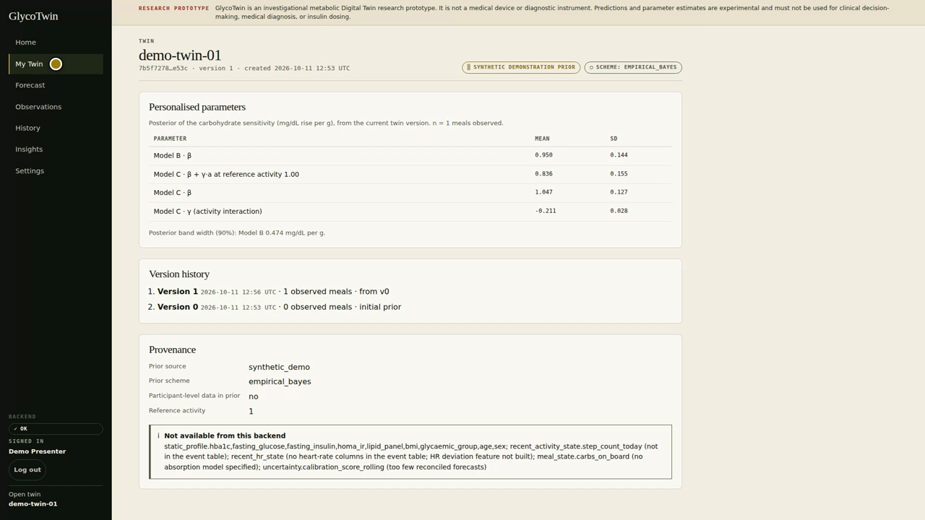
Demonstration, Limitations and Safety
VERSION 0 (before)
VERSION 1 (after)
7.7%
21.0%
P(max ≥ 180 mg/dL)
P(max ≥ 180 mg/dL)
Observe: eligible outcome recorded after the 120-min window closes
Update: Model B β moves from 0.747 → 0.950 (twin version 0 → 1)
Next forecast, same inputs: probability rises to 21.0%
Same inputs, different twin state, different forecast.
Real application screenshot — My Twin page after one eligible update (version 0 → 1)
Limitations and safety
Investigational research prototype — not a clinically validated diagnostic or treatment system.
Not intended for insulin dosing or any clinical decision.
Further evaluation and independent validation are required before any real-world use.
GlycoTwin — live demonstration and limitations
GlycoTwin

Slide 10
Conclusion and Future Work
PROBLEM
KEY CONTRIBUTION
One-off glucose predictions cannot adapt to the individual, and most tools do not report how confident they are.
A persistent, versioned Digital Twin linking forecasting, uncertainty and sequential Bayesian personalization in one working loop.
RESEARCH EVIDENCE
NEXT STEPS
Retrospective CGMacros evaluation — inconclusive for activity-conditioning, but the pipeline and leakage safeguards are validated.
Run the full prespecified key experiment on real data with baseline controls; test whether an activity effect depends on activity level.
Repository: github.com/medhachoudhari/GlycoTwin
Team / Institution: NeuralForge — Medha Choudhari, BIET Davangere
GlycoTwin connects forecasting, observation, and personalization into one honest, auditable research workflow — reporting what the evidence shows, not more.
Investigational research prototype — not a medical device, not clinically validated.

