Slide 1
GlycoTwin
Personalized Post-Meal Glucose Digital Twin
Digital Twin Challenge 2026
A stateful, uncertainty-aware Digital Twin that forecasts post-meal glucose risk, learns from each person's own eligible outcomes, and reports its evidence honestly.
FORECAST
↓
OBSERVE
↓
UPDATE
Team: [Team / member names — to be filled in]
Institution: [College / university — to be filled in]
Incubator: [Incubator name, or "Not applicable" — to be filled in]
github.com/medhachoudhari/GlycoTwin · Investigational research prototype — not a medical device
GlycoTwin

Slide 2
Problem Statement
Post-meal glucose responses vary from person to person — a single population-average forecast misses this.
A one-time prediction does not automatically adapt when new, person-specific observations become available.
Personalization and honest communication of uncertainty are both important research considerations, not optional extras.
Central research question
Can a stateful, personalized Digital Twin connect forecasts with eligible observations, and use them to update itself for the next forecast?
GlycoTwin — problem statement
GlycoTwin

Slide 3
Proposed Solution
GlycoTwin keeps a persistent, versioned Digital Twin for each person and runs it through one workflow.
Meal &
context
inputs
Forecast
(+ uncertainty)
Observe
(eligible outcome)
Update
personalized state
Next
forecast
The twin's state carries forward — the next forecast starts from the updated parameters, not from scratch.
The model predicts the maximum glucose reached within the 120-minute post-meal window — not necessarily a complete glucose-over-time curve.
GlycoTwin — proposed solution
GlycoTwin

Slide 4
Innovative Features
1
Forecast–Observe–Update
4
Persistent Digital Twin state
Connects predictions with eligible observed outcomes and subsequent state updates.
Retains model state and full version history for every subsequent forecast.
2
Uncertainty-aware forecasting
5
Explainability & model comparison
Communicates prediction uncertainty — never presents an estimate as a guarantee.
Lets researchers inspect outputs and compare modelling approaches side by side.
3
Bayesian-style personalization
Model B updates a personalized carbohydrate-response parameter from eligible observations.
The project's contribution is the integrated, working loop — not any single technique in isolation.
GlycoTwin — innovative features
GlycoTwin

Slide 5
Dataset and Research Methodology
CGMacros dataset (45 participants audited) — figures below refer to different stages of the same pipeline:
1,706
1,697
1,262
963 / 34
logged meal rows
extraction-valid 120-min windows
core-eligible events
(leakage-safe modelling set)
activity-eligible events / participants
(Model B vs C comparison)
Meal event anchored at the logged meal row (t0); outcome window is (t0, t0+120 min].
Features use only information available before the meal; activity measured strictly before t0.
Leakage safeguards: participant-level folds, sequential (online) evaluation — no participant or future value leaks into a forecast.
Not every model used every event — e.g. the 963/34 figure is the activity-eligible subset used for the Model B vs C comparison.
No participant-level health data or the dataset itself is included in this repository — aggregate, de-identified figures only.
GlycoTwin — dataset and methodology · Source: data/audit, docs/data_validity_rules.md, docs/primary_channel_decision.md
GlycoTwin

Slide 6
System Architecture and Technical Stack
Frontend
Backend API
Database
React 19 · TypeScript
Vite — 7 pages, calls /api
FastAPI, 127.0.0.1 only
Session + ownership on every
twin route · scrypt hashing
SQLite — 11 tables
(users, twins, forecasts,
observations, reconciliations…)
Research engine (shared): Bayesian Models B & C — closed-form update, forecast + uncertainty. The live twin and offline research experiments call the exact same functions.
Offline CGMacros research pipeline runs on the researcher's own machine — never reached by the website; only aggregate priors and reports cross over.
Technical stack (from the repository configuration):
pandas, NumPy, SciPy, scikit-learn, XGBoost (Model A) — src/glycotwin/models/
FastAPI, Pydantic v2, SQLAlchemy 2, Uvicorn, SQLite — src/glycotwin/backend/
pytest, httpx for testing (815 Python tests recorded)
GlycoTwin — architecture and stack
GlycoTwin

Slide 7
ML Models and Personalization
Model A
Model B
Model C
Population baseline (XGBoost). Trained once on the population; no personal history used.
Personalized Bayesian carbohydrate-sensitivity model. Its parameter β updates after each eligible observed meal.
Model B plus an activity-conditioning term γ — evaluated as a research comparison against Model B.
Model B: rise = β · carbs + noise
Model C: rise = (β + γ · activity) · carbs + noise
In plain English: β ("beta") is how much this person's glucose typically rises per gram of carbohydrate; γ ("gamma") adjusts that for recent activity.
After an eligible outcome, a closed-form Bayesian update moves β toward what that meal suggests and narrows its uncertainty.
This is a parameter update, not retraining a neural network — no model is retrained from scratch after each meal.
GlycoTwin — models, uncertainty, personalization · Source: docs/model_a.md, model_b.md, model_c.md
GlycoTwin

Slide 8
Research Results and Evaluation
Model B vs Model C — 963 meals, 34 participants, Libre channel, out-of-fold + sequential evaluation:
Metric | Model B | Model C | C − B | 95% interval
ROC-AUC | 0.7943 | 0.8059 | +0.0116 | [−0.0084, +0.0479]
Brier score | 0.1391 | 0.1379 | −0.0012 | [−0.0064, +0.0030]
Rise MAE (mg/dL) | 29.40 | 29.51 | +0.11 | [−0.52, +0.68]
8 of 9 paired intervals include zero → the comparison is INCONCLUSIVE
Model B does not demonstrably outperform every baseline; Model C's activity term has not been shown to help.
Three different kinds of evidence:
this retrospective CGMacros result is research evidence — not the same as the live application working (shown next slide), and neither is the same as clinical validation, which has not been done.
GlycoTwin — research evidence · Source: docs/model_b_vs_c_report.md (not recomputed for this deck)
GlycoTwin

Slide 9
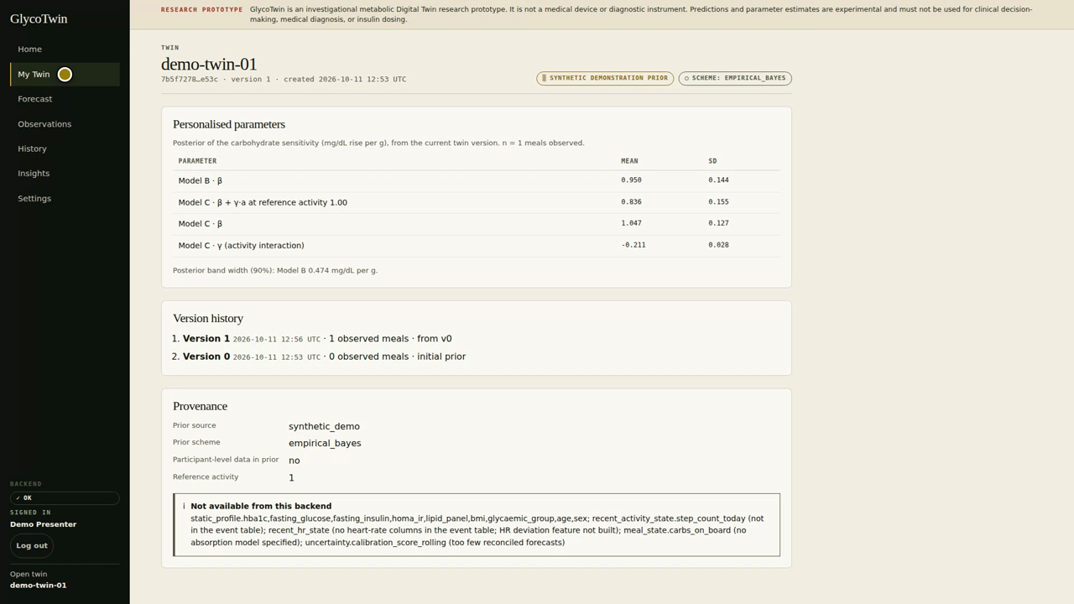
Demonstration, Limitations and Safety
Forecast (version 0): P(max ≥ 180 mg/dL) = 7.7%
Observe: an eligible outcome is recorded after the 120-min window closes
Update: Model B β moves from 0.747 → 0.950 (new twin version 1)
Next forecast, same inputs: P(max ≥ 180 mg/dL) = 21.0%
Same inputs, different twin state, different forecast.
Real application screenshot — My Twin page after one eligible update (version 0 → 1)
Limitations and safety
Investigational research prototype — not a clinically validated diagnostic or treatment system.
Not intended for insulin dosing or any clinical decision.
Further evaluation and independent validation are required before any real-world use.
GlycoTwin — live demonstration and limitations
GlycoTwin

Slide 10
Conclusion and Future Work
Problem: one-off glucose predictions cannot adapt to the individual.
Central innovation: a persistent, versioned Digital Twin that links forecasting, uncertainty, and sequential Bayesian personalization in one working loop.
The retrospective CGMacros research gives early, honest evidence — inconclusive for the activity-conditioning hypothesis, but the pipeline and safeguards are validated.
Next steps: run the full prespecified key experiment on real data with baseline controls; test whether an activity effect depends on activity level.
Repository: github.com/medhachoudhari/GlycoTwin
Team / Institution: [to be filled in — see title slide]
GlycoTwin connects forecasting, observation, and personalization into one honest, auditable research workflow.
Investigational research prototype — not a medical device, not clinically validated.

