Slide 1
What is WiMax?
WiMax (Worldwide Interoperability for Microwave Access) is a standards-based technology enabling the delivery of last mile wireless broadband access as an alternative to cable and DSL.
The technology is specified by the Institute of Electrical and Electronics Engineers Inc., as the IEEE 802.16 standard.

Slide 2
WiMax Forum
It is a non-profit industry body dedicated to promoting the adoption of this technology and ensuring that different vendors’ products will interoperate.
It is doing this through developing conformance and interoperability test plans and certification program.
WiMAX Forum Certified™ means a service provider can buy equipment from more than one company and be confident that everything works together.

Slide 3
WiMax Technology
WiMAX is expected to provide fixed , nomadic, portable and, eventually, mobile wireless broadband connectivity without the need for direct line-of-sight (LOS) with a base station.
In a typical cell radius deployment of three to ten kilometers, WiMAX Forum Certified™ systems can be expected to deliver capacity of up to 40 Mbps per channel, for fixed and portable access applications.
Mobile network deployments are expected to provide up to 15 Mbps of capacity within a typical cell radius deployment of up to three kilometers.

Slide 4
Relation of Wi-Fi and WiMax
WiMax eliminates the constraints of Wi-Fi.
Unlike Wi-Fi, WiMax is intended to work outdoors over long distances.
WiMax is a more complex technology and has to handle issues of importance such as QoS guarantees, carrier-class reliability, NLOS.
WiMax is not intended to replace Wi-Fi. Instead, the two technologies complement each other.

Slide 5
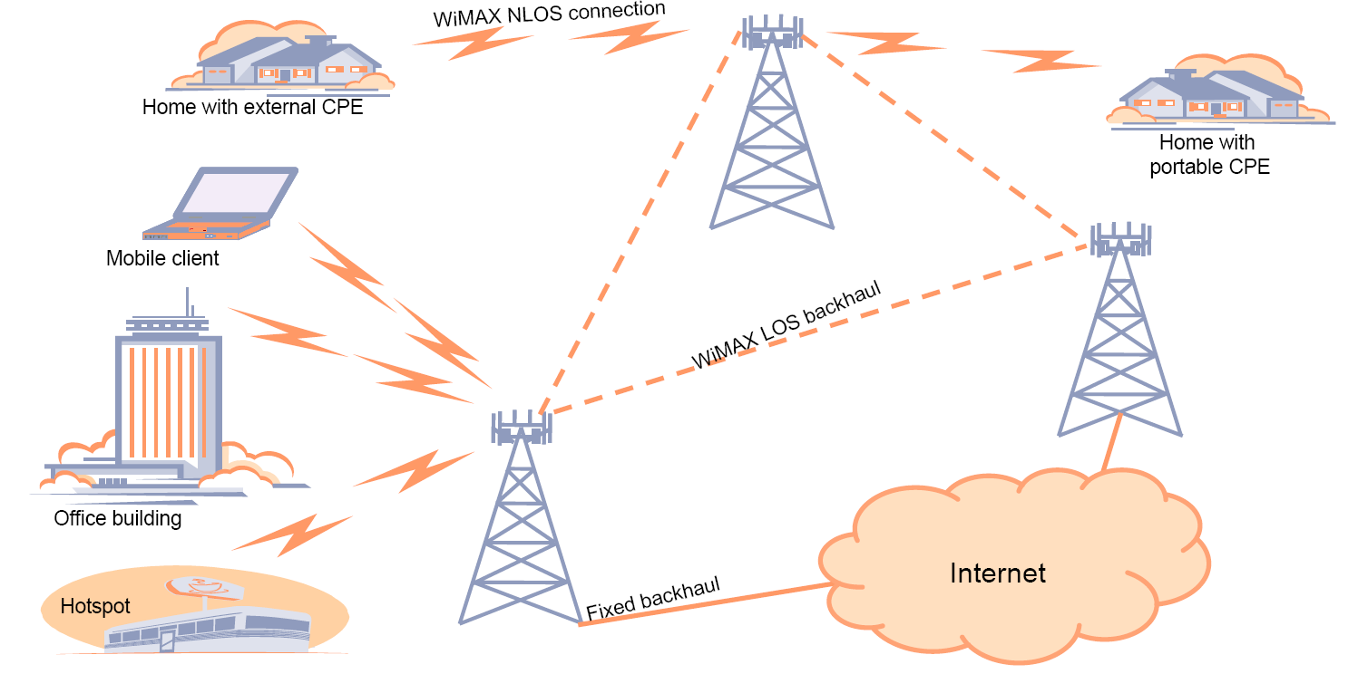
WiMax suited to both fixed and mobile access

Slide 6
How WiMax Works
WiMax can provide 2 forms of wireless service:
- Non-LOS, Wi-Fi sort of service, where a small antenna on a computer connects to the tower. Uses lower frequency range (2 to 11 GHz).
- LOS, where a fixed antenna points straight at the WiMax tower from a rooftop or pole. The LOS connection is stronger and more stable, so it is able to send a lot of data with fewer errors. Uses higher frequencies, with ranges reaching a possible 66 GHz.
Through stronger LOS antennas, WiMax transmitting stations would send data to WiMax enabled computers or routers set up within 30 (3,600 square miles of coverage) mile radius.

Slide 7
WiMax Applications
According to WiMax Forum it supports 5 classes of applications:
Multi-player Interactive Gaming.
VOIP and Video Conference
Streaming Media
Web Browsing and Instant Messaging
Media Content Downloads

