Slide 1
Applying MLP
Medhansh Sankaran, Conrad Haslauer

Slide 2
Introduction
Data: Demographic data covering working age adults across the world.
  Predictor variables included age, class, marital status, education level, and more.
  Target variable was a binary ‘income’ variable with two values: >50k and <=50k
All coding and programming was completed in Python through the Visual Studio Code interface.

Slide 3


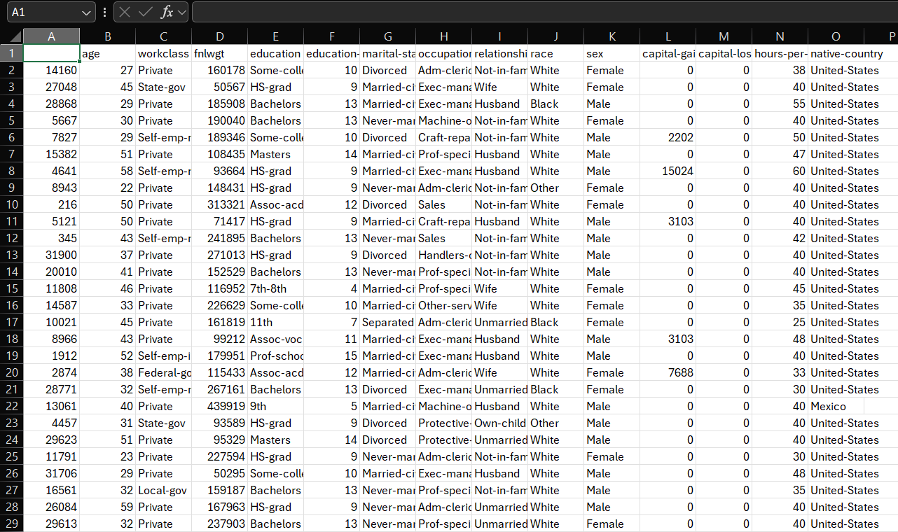
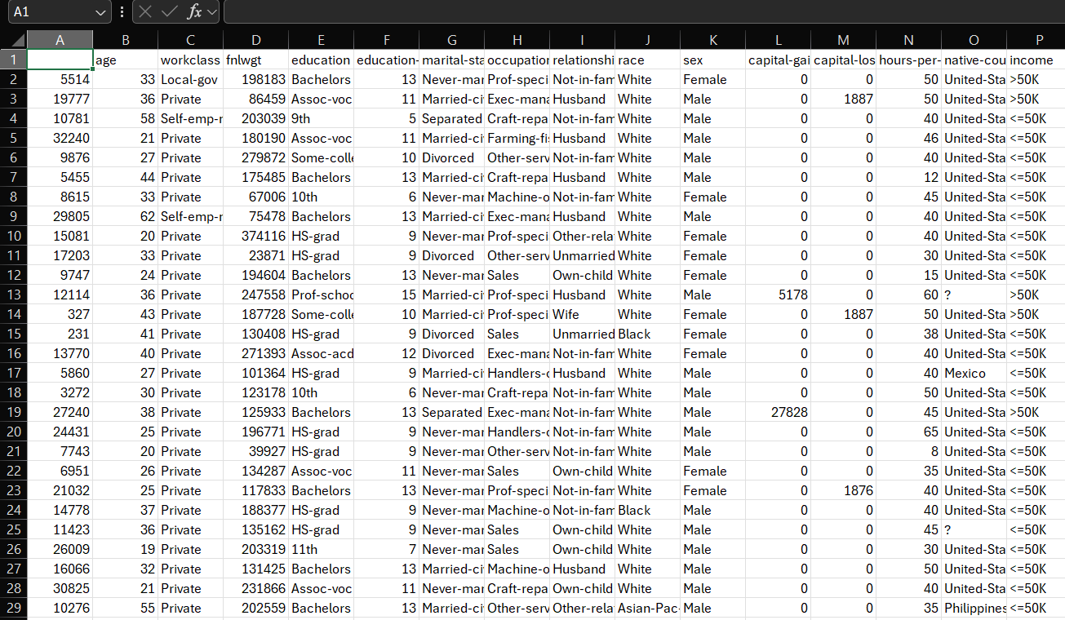
Stage 1: Data Preprocessing
Dropped ID column
Used label encoding on categorical variables.
Did not drop NaN and ? values.
  Previous project experience explains why.

Slide 4
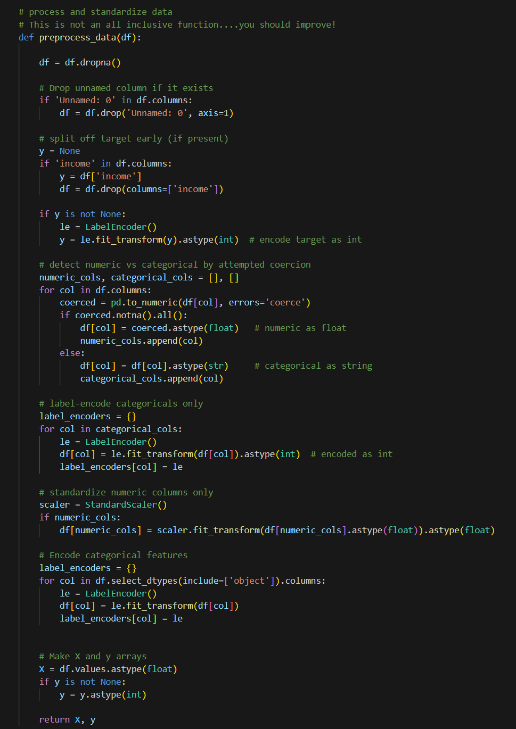
Stage 1: Data Preprocessing
Slightly altered existing code to ensure NaN and ? were not dropped.
Scaled numerical features to a standardized distribution to avoid overfitting.

Slide 5
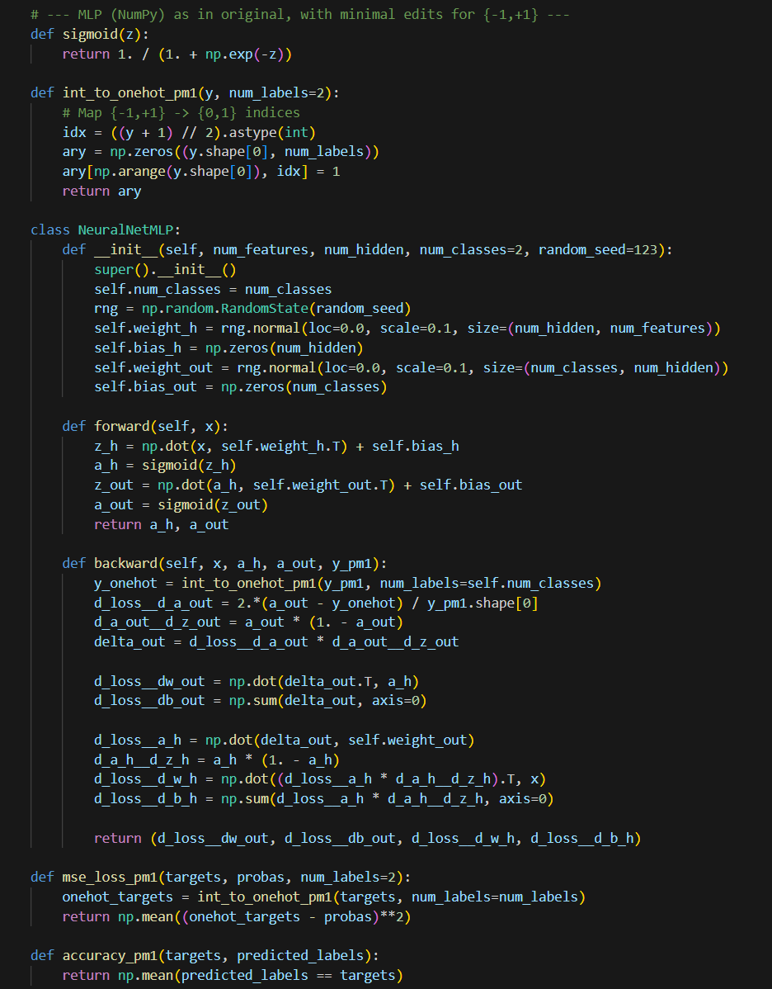
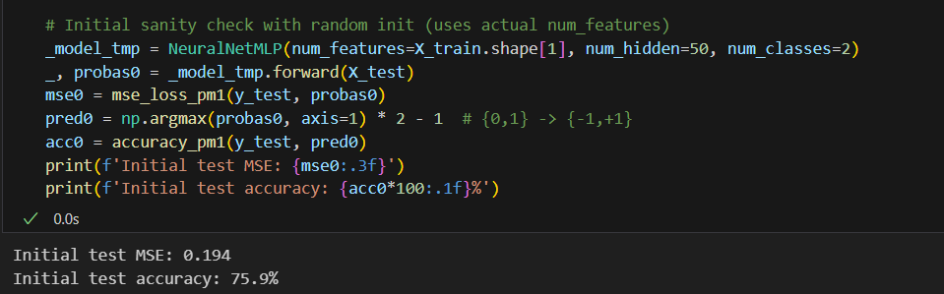
Stage 2: INITial Training

Slide 6
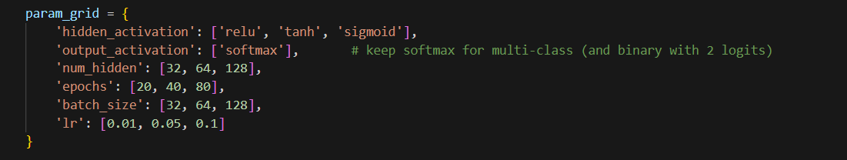
Stage 3: Model tuning
Utilized multiple combinations of parameters.
  Number of Hidden Layers
  Learning Rate
  Batch Size
  Number of Epochs
  Activation Function

Slide 7
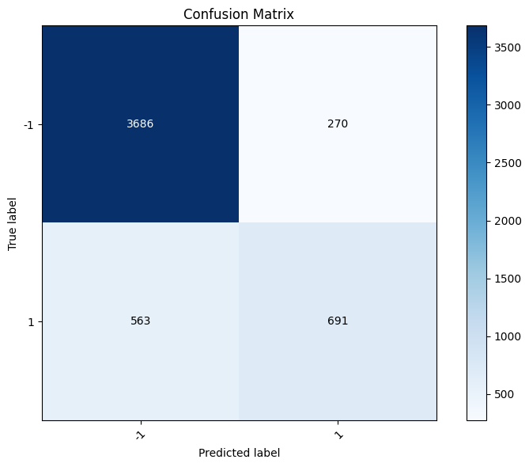
Final model
CV accuracy: 0.8431
Test Accuracy: 0.8401
  Best activation: sigmoid
  Best num Hidden Layers: 128
  Best learning rate: 0.05
  Best batch size: 32
  Best num epochs: 40
  Output activation: softmax

Slide 8
Stage 4: Reflection
How did we choose the architecture for the model?
  We selected a single hidden layer because the data was well structured and tabular. Excessive layers would have diminished the effectiveness of the model.
  We choose nonlinear activation functions like ReLU, TanH, and Sigmoid because they were able to capture the more complex nonlinear relationships that could exist between demographics and income.
How did we monitor and mitigate overfitting?
  We made sure to use GridSearchCV methods with validation sets to ensure that test accuracy and validation accuracy lined up well.
  We also employed some other techniques, such as limited epochs, regularization by architecture, and feature scaling to mitigate overfitting.

Slide 9
Stage 4: Reflection
What ethical concerns can arise from deploying models trained on these datasets?
  Since this dataset contains sensitive information on race, gender, and other descriptors, its use can cause algorithmic bias against certain groups.
  Model outputs could reinforce discrimination and bias, affect demographics disproportionately, and/or create privacy issues.
Why are activation functions necessary?
  They allow the model to make decisions based on criteria.
  More complex activation functions allow the model to learn complex decision boundaries and capture relationships between nonlinearly separable features in the data.

Slide 10
THANK YOU

