Slide 1
MS Classifiers
Medhansh Sankaran, Conrad Haslauer

Slide 2
Introduction
Data: Demographic data covering working age adults across the world.
Predictor variables included age, class, marital status, education level, and more.
Target variable was a binary ‘income’ variable with two values: >50k and <=50k
All coding and programming was completed in Python through the Visual Studio Code interface.

Slide 3


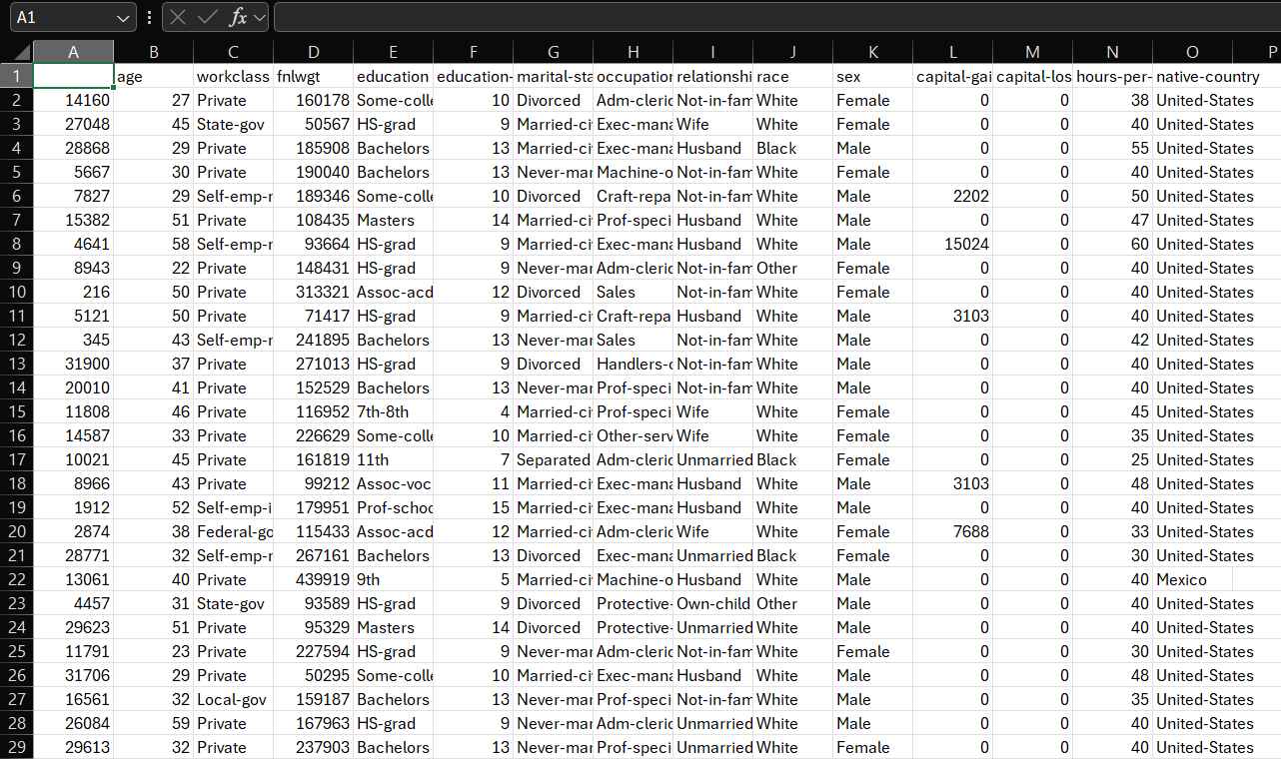
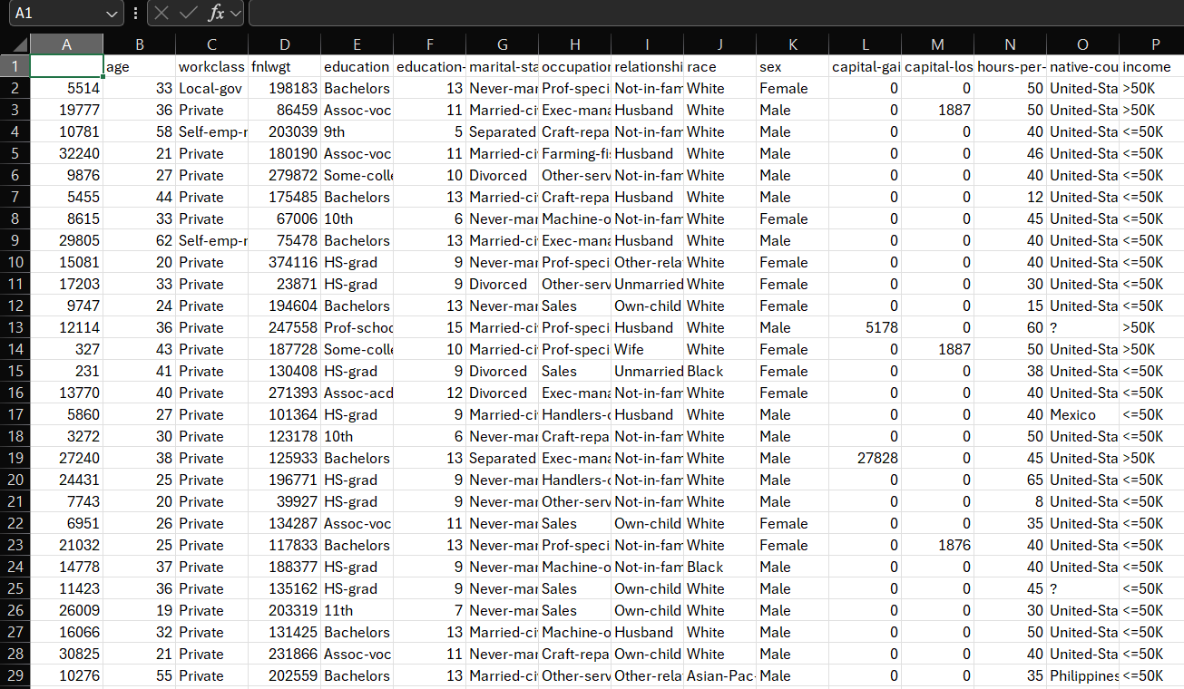
Stage 1: Data Preprocessing
Dropped ID column
Used label encoding on categorical variables
Dropped NaN and ? Values.

Slide 4
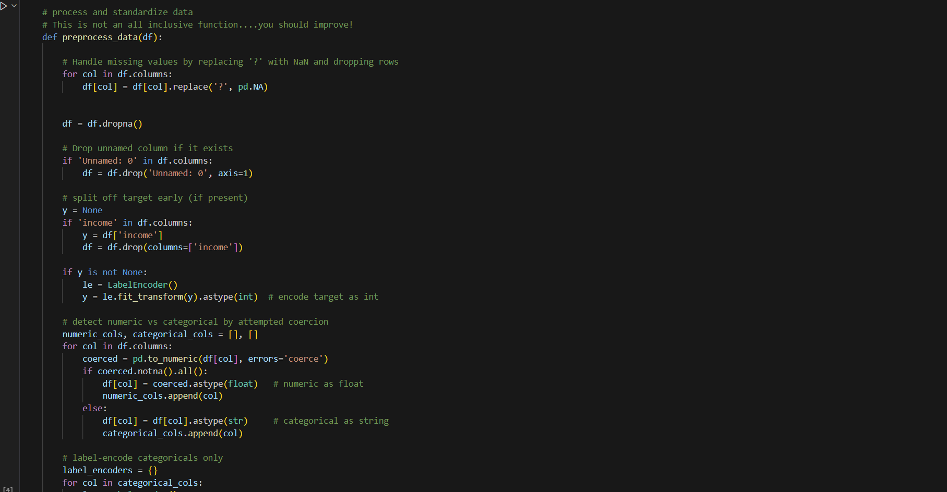
Stage 1: Data Preprocessing

Slide 5
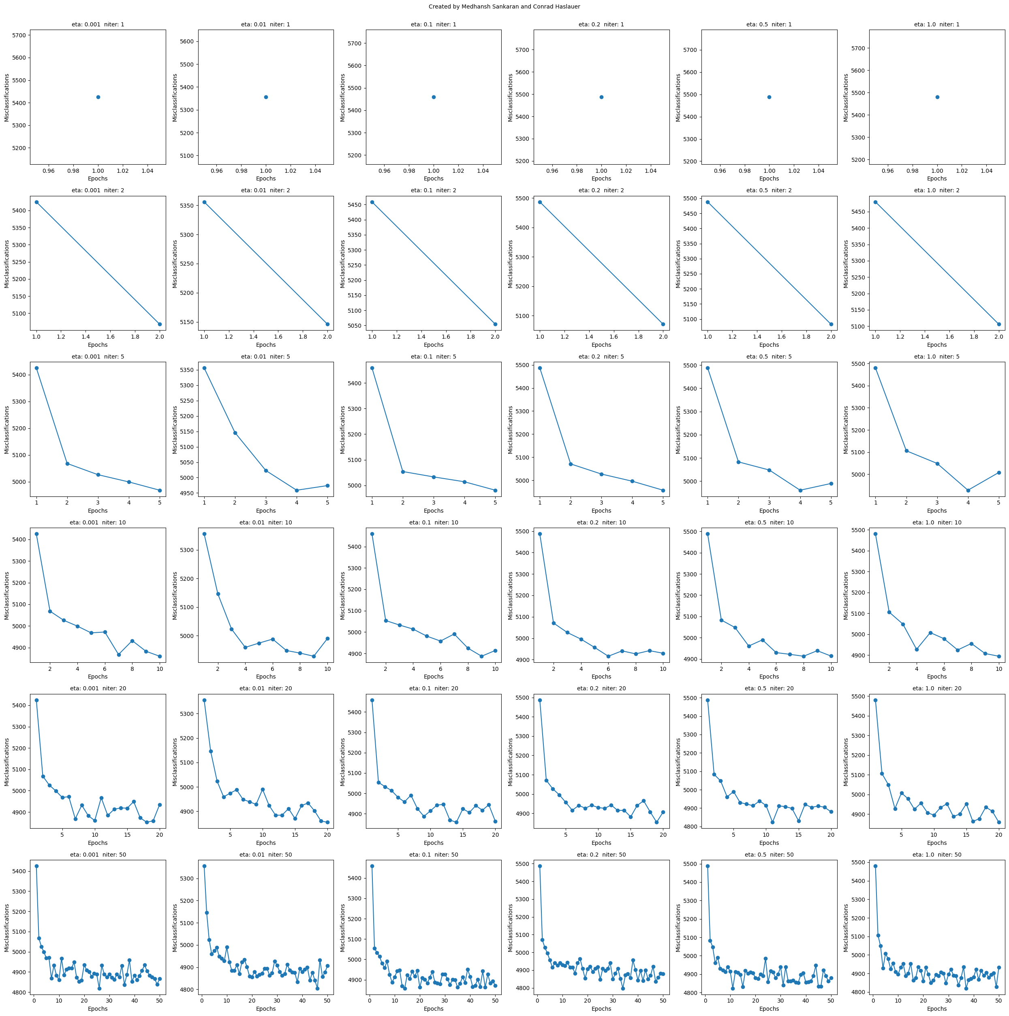
Stage 2: Perceptron Implementation
Best Accuracy: 0.8195
Best Eta: 1.0
Best N_iTER: 10

Slide 6
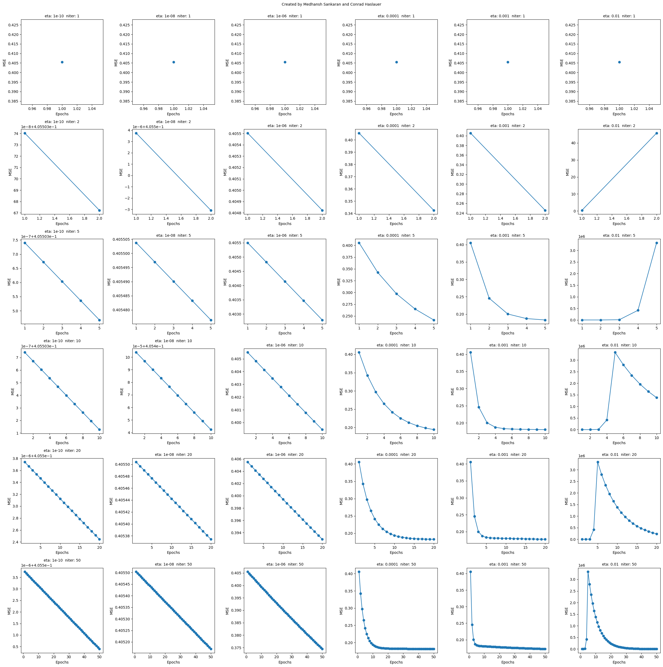
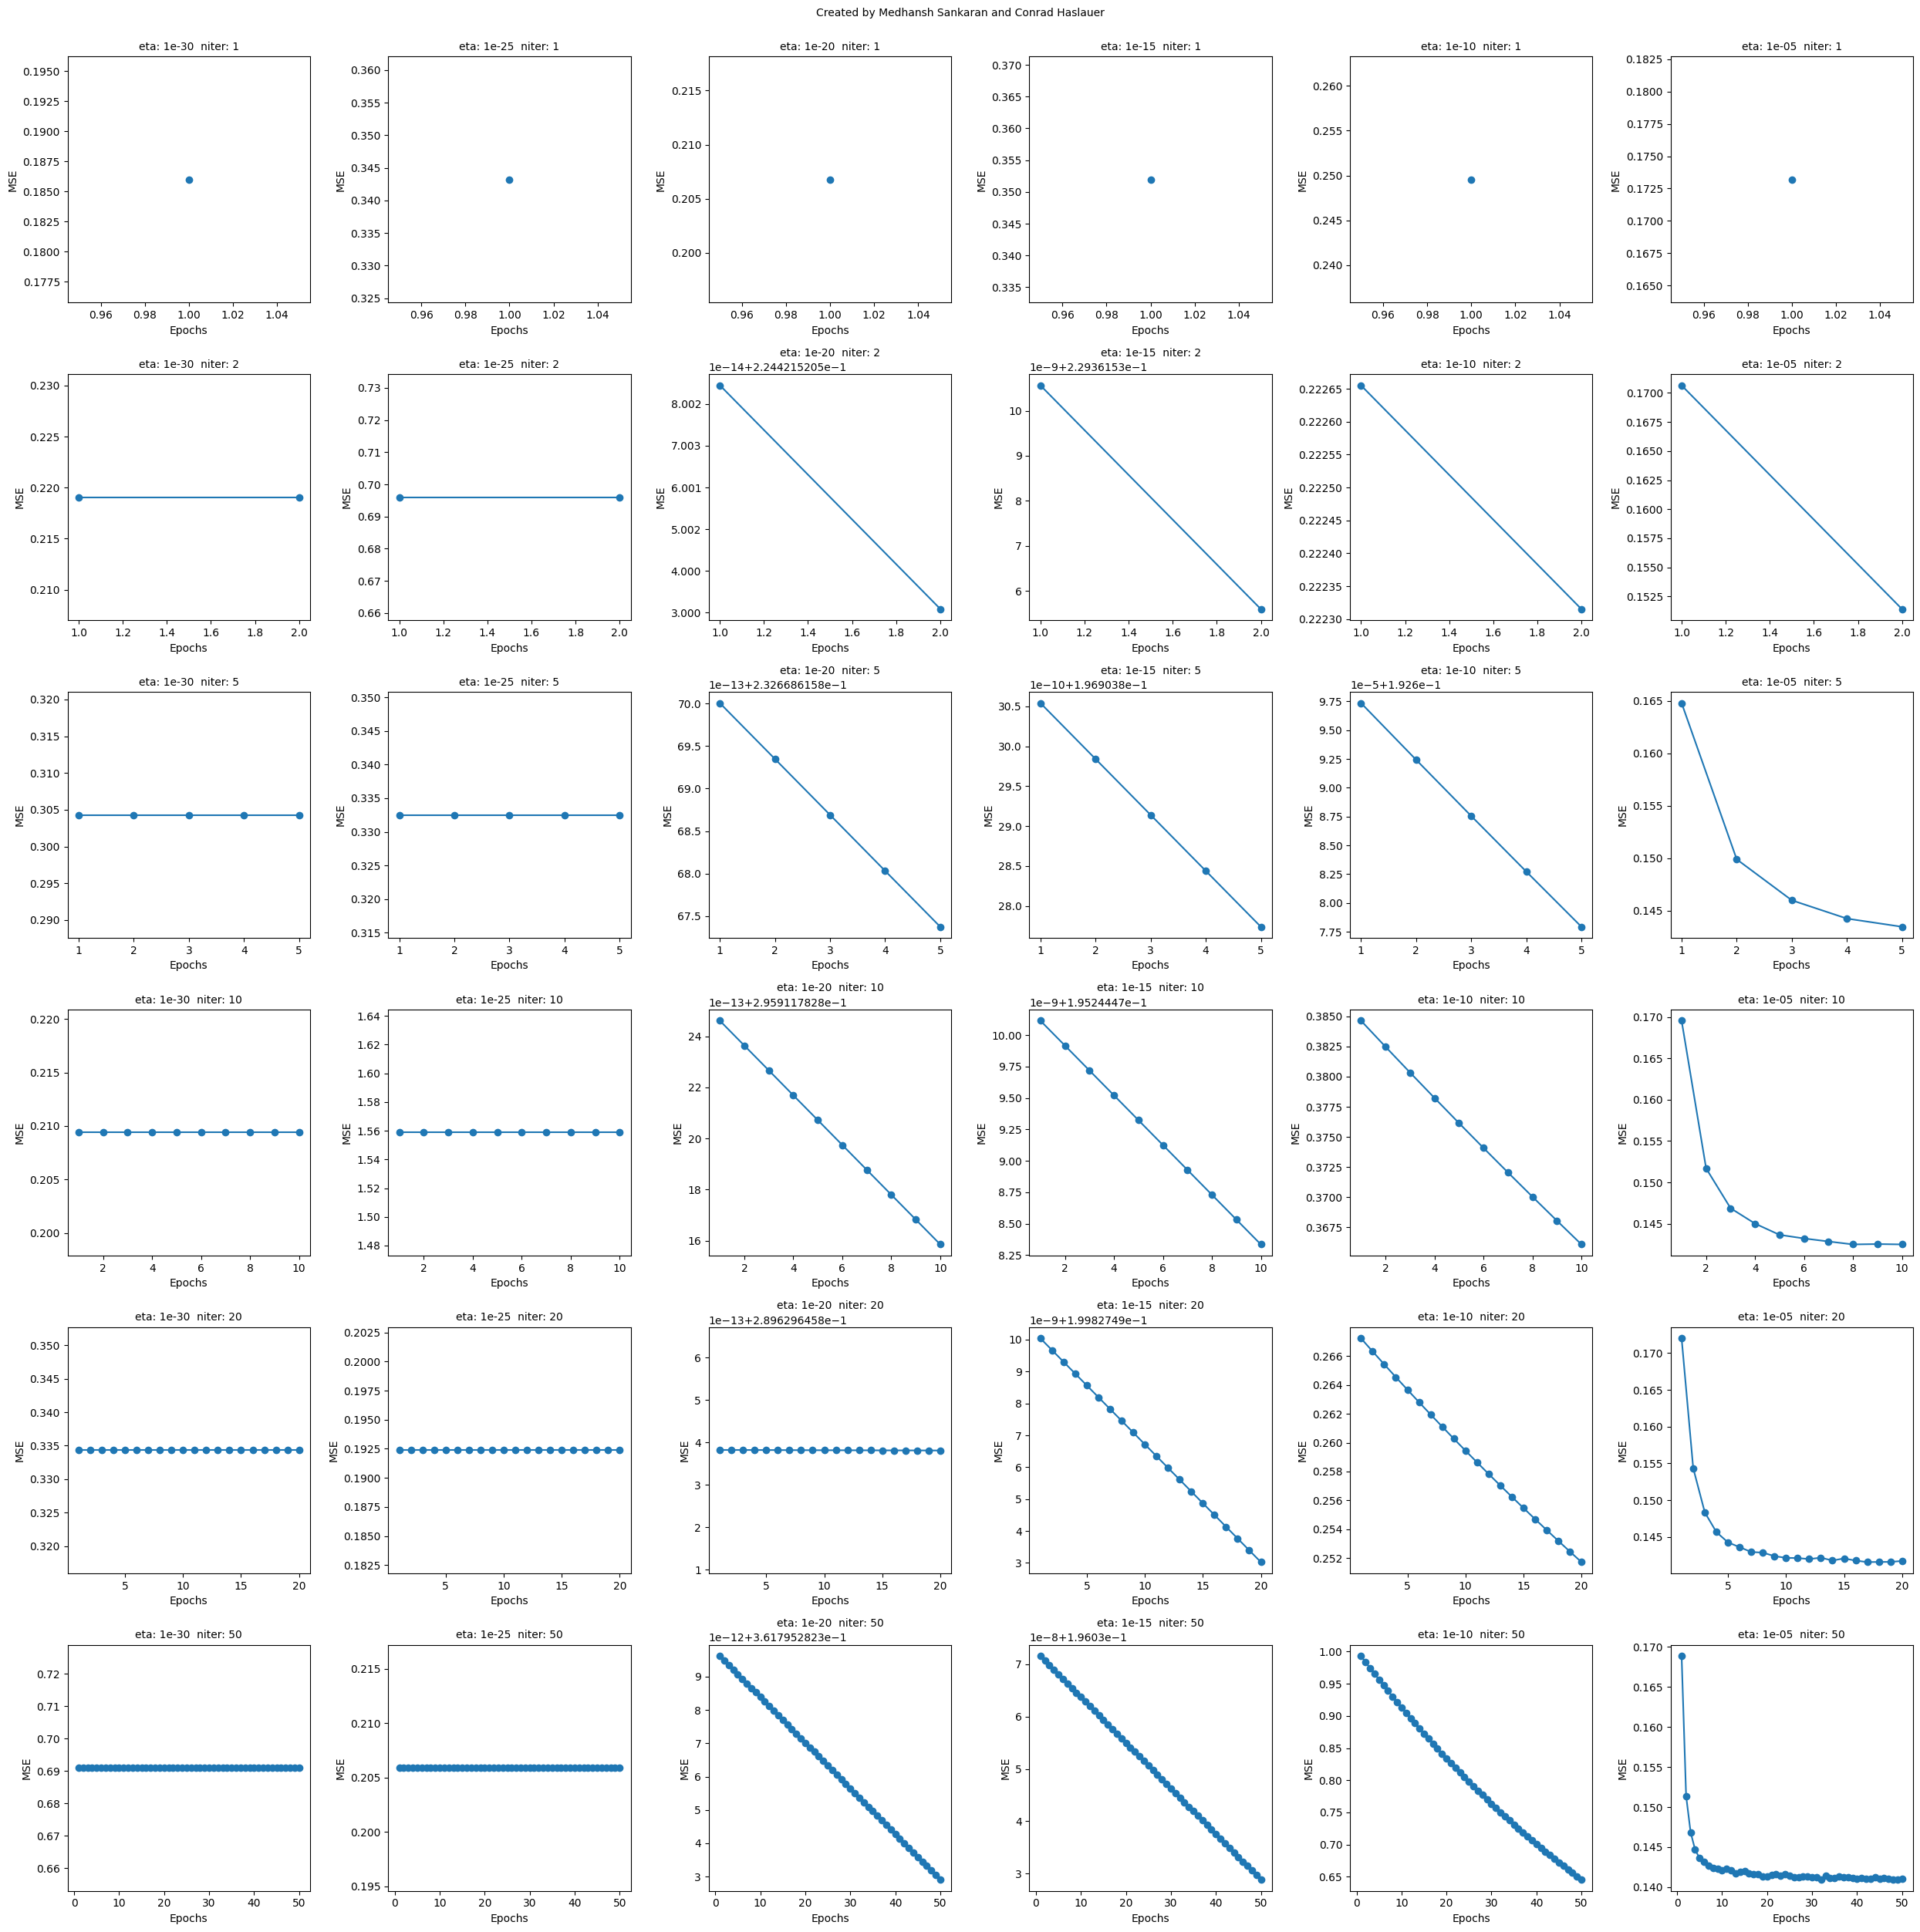
Stage 2: AdalineGD and SGD Implementation
Gradient Descent
Best Accuracy: 0.7630
Best Eta: 0.001
Best N_iTER: 50
Stochastic GD
Best Accuracy: 0.8042
Best Eta: 0.00001
Best N_iTER: 50

Slide 7
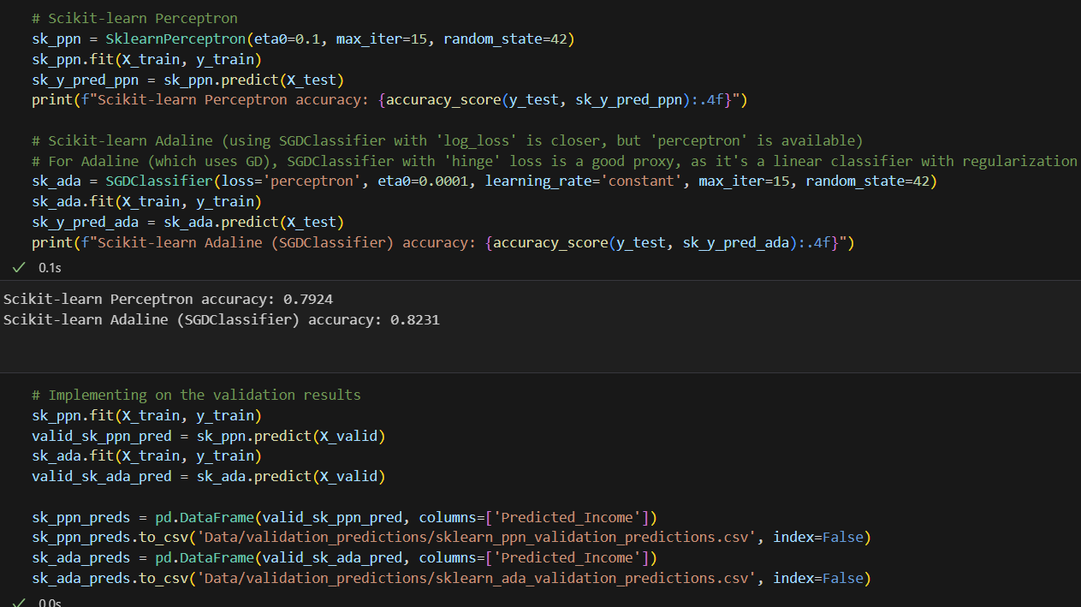
Stage 2: SKLearn Implementation

Slide 8
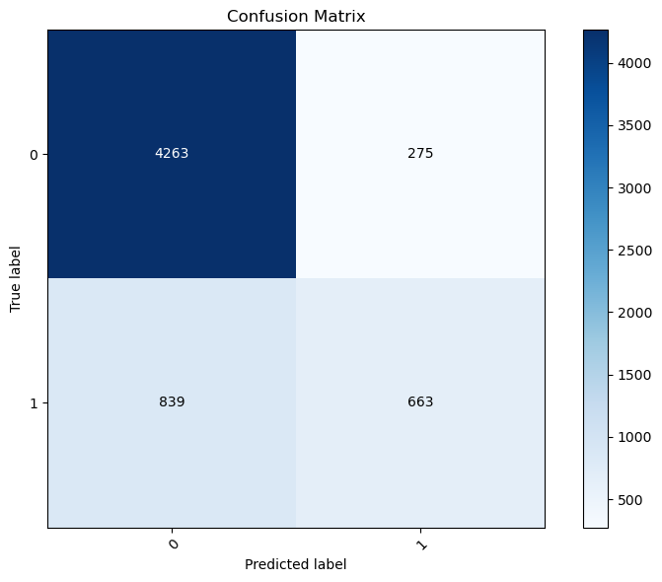
Stage 3: Logistic Regression
Best Cv Accuracy: 0.8221
Best test accuracy: 0.8156
Best c: 0.0336
Max_iter: 2000

Slide 9
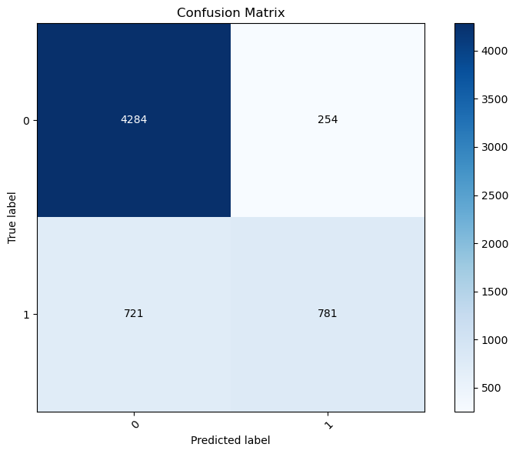
Stage 3: SVM
Best Cv Accuracy: 0.8372
Best test accuracy: 0.8386
Best c: 100.0
Best kernel: rbf

Slide 10
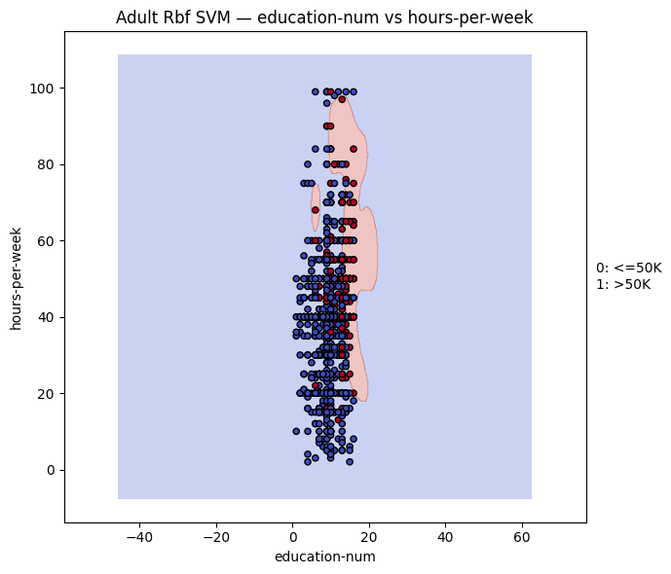
Stage 3: SVM
Due to the high volume and relative complexity of the data, the SVM decision boundary is not easily decipherable like it was in the Iris dataset.
It seems, from this plot, the largest factor is a high education-num value.

Slide 11
Stage 4: Reflection
Why is feature scaling important for gradient-descent based algorithms?
Feature scaling ensures that all input features contribute equally to the gradient updates. Algorithms like logistic regression, SVM, and neural networks may take longer to train or fail to converge altogether.
What is the difference between batch and stochastic gradient descent?
Batch gradient descent uses the entire dataset to compute each update, making it stable but slow.
Stochastic gradient descent updates weights using one data point at a time, making it faster and more noisy, but often better at escaping local minima.

Slide 12
Stage 4: Reflection
Why do SKLearn algorithms outperform book code?
Built-in regularization and hyperparameter tuning.
Efficient memory usage and parallel processing
How do the decision boundaries of logistic regression and SVM compare?
Logistic Regression: Linear decision boundary based on probability thresholds. It tries to model the likelihood of class membership.
SVM: Focuses on maximizing the margin between classes. It’s more robust to outliers and often better at separating classes when data is not perfectly linearly separable.

Slide 13
Stage 4: Reflection
What is the role of regularization in preventing overfitting?
By discouraging overly complex models, regularization helps generalize better to unseen data.
What is the impact of varying the values of C in SKLearn logistic regression and linear SVC?
C is the inverse of regularization strength.
Low C → Strong regularization → Simpler model → Less overfitting.
High C → Weak regularization → Complex model → Risk of overfitting.

Slide 14
THANK YOU

