Slide 1
Portfolio Optimization
4/22/2025
By Andrew Mendez, Jaxon Ham, Medhansh Sankaran

Slide 2
Background & Motivation
Investors must balance risk and return when allocating capital.
Choosing among hundreds of stocks requires a disciplined, data-driven method.
Modern Portfolio Theory (Markowitz, 1952) provides the foundation for optimal asset allocation.
The mean–variance framework seeks to maximize expected return for a given level of portfolio risk.
Demonstrates how quantitative optimization can guide smarter investment decisions over time.

Slide 3
Data Used
Attribute | Description
Data Collection from YFinance | Weekly Yahoo Finance data (only close prices used)
Frequency | Weekly time series
Columns Used | date, stock symbol, close
Filtering Criteria | Last 3 years, Only stocks with complete price history (no missing weeks)
Stocks Looked At | S&P 500 stocks

Slide 4
Harry Markowitz – Mean Variance Model
# | Assumption | Description
1 | Risk measured by variability | Portfolio risk is based on the standard deviation of returns.
2 | Risk aversion | Investors prefer lower risk for a given level of expected return.
3 | Consumption preference | Investors prefer more wealth or consumption to less.
4 | Concave utility function | Utility increases with wealth but at a decreasing rate (diminishing marginal utility).
5 | Single-period model (*) | The analysis assumes investment is made for a single time period only.
6 | Return-risk tradeoff | Investors aim to maximize return for a given risk or minimize risk for a given return.
7 | Rational behavior | Investors are rational and make consistent, utility-maximizing decisions.

Slide 5
Goal – To Maximize Portfolio Wealth
Symbol / Part | Description
𝑤ᵢ | Weight (fraction of capital) allocated to stock i
𝜇ᵢ | Expected return of stock i (based on trailing data)
Σᵢⱼ | Covariance between returns of stocks i and j
λ | Risk aversion coefficient — controls risk vs. return tradeoff
∑(𝜇ᵢ × 𝑤ᵢ) | Total expected return of the portfolio
∑∑(𝑤ᵢ × Σᵢⱼ × 𝑤ⱼ) | Portfolio variance (risk) — quadratic form
∑𝑤ᵢ = 1 | Fully invested — the sum of all weights equals 1
0 ≤ 𝑤ᵢ ≤ MAX_WEIGHT | Long-only allocation with a cap per stock
Objective
∑(μᵢ × wᵢ) − λ × ∑∑(wᵢ × Σᵢⱼ × wⱼ)

Slide 6
Parameters set for Model
Parameter | Value | Description
LOOKBACK_WEEKS | 28 | Number of trailing weeks used to calculate expected returns (μ) and covariance (Σ)
LAMBDA | 1.0 | Risk-aversion coefficient — controls the tradeoff between return and variance
MAX_WEIGHT | 0.05 | Maximum allocation per stock (5%) — prevents overconcentration
INITIAL_CASH | $10,000 | Starting capital for the backtest simulation

Slide 7
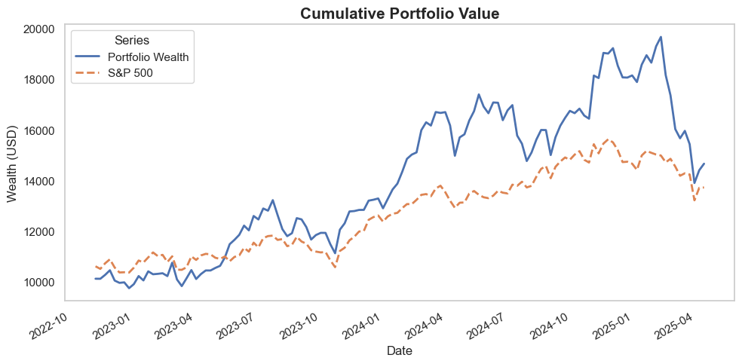
Results – Over Time With Weekly Rebalancing
Metric | Value
Final Portfolio Value (USD) | $14,657.95
Return on Investment (%) | 46.58%
S&P 500 Index Return on Investment (%) | 41.6%
Hit Rate (%) | 57.81%
Avg Weekly Turnover (%) | 42.80%
Total Buy Transactions | 692
Total Sell Transactions | 671

Slide 8
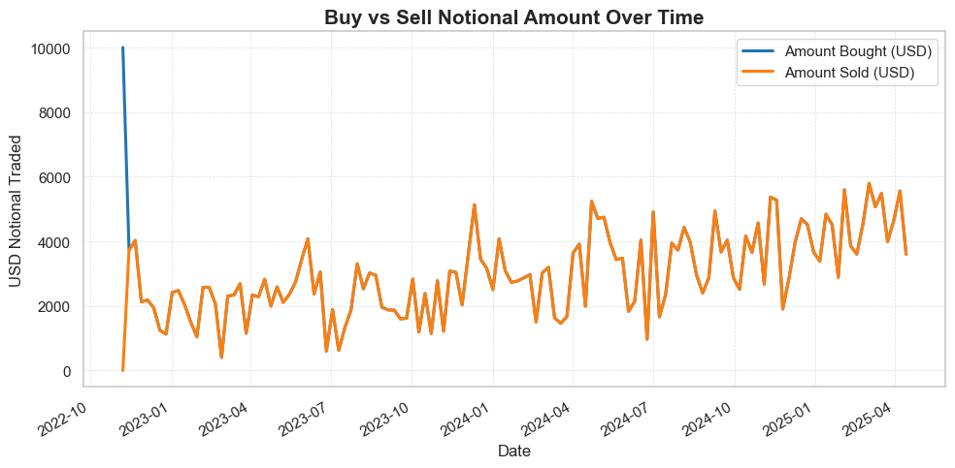
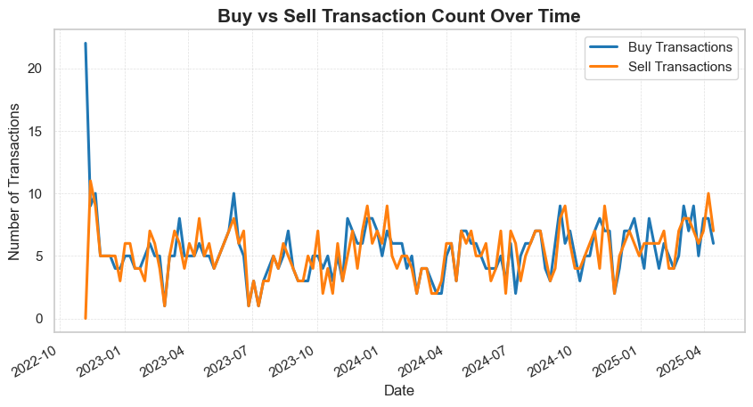
Transactions over time

Slide 9
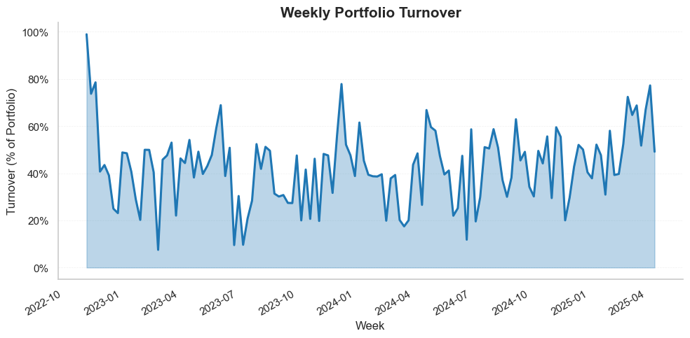
Weekly Portfolio Turnover

Slide 10
Overall Results
Key Points
Historical Performance | Returned 46.58% from the last 2.5 years S&P 500 Returned 41.3% over the last 2.5 years
Trading Activity | Averaged 42.80% Turnover week-to-week
Concerns | This model was not meant for week-by-week restructuring
Next Steps | Update Model for week-by-week restructuring Model transaction costs Test longer rebalance intervals Improve return forecasts Explore leverage/shorting Add penalties for big turnovers

Slide 11

Happy Investing

