Slide 1
Job Market Intelligence
Hive query analysis, data pipeline and skill velocity (SDVI)
Ashmi S N | 2023BCS0196 | CSE412 Big Data Lab | Hadoop 3.3.6, Hive 3.1.3, Pig 0.17.0 | 04 October 2026

Slide 2
Agenda
Problem and approach
Environment and Hive schema
Phase I: six Hive queries, run live (roles, skills, locations, salary, skill-role pairs, recency)
Skill-trend data scarcity and remedy
Phase II: HDFS > Pig > Hive pipeline and SDVI
Findings, dashboard and conclusion

Slide 3
Problem Motivation
Incumbent inertia
Percentage distortion
Ubiquitous skills (SQL, Python, Java) dominate raw counts; counts cannot show acceleration or decline.
1 to 3 mentions is +200% yet negligible demand; 200 to 300 is +50% yet far larger.
Phase I: 97,679 Indian postings, single snapshot: reliable current-market rankings
Phase II: 10,000 dated LinkedIn postings (Jan-Jun 2024): skill velocity via SDVI
Goal: separate genuinely emerging skills from merely dominant ones
Notes:
Explain incumbent inertia and the 1-to-3 mentions example, then lead into the two-phase approach.

Slide 4
Environment and Hive Schema
Component | Detail
Cluster host | LAPTOP-BR113UF8 (bigdata-lab), WSL 2 Ubuntu
Engine | Apache Hive 3.1.3 on MapReduce, Hadoop 3.3.6
Database | jobmarket
Invocation | hive -S -e "USE jobmarket; ..."
Table | Content
jobs | One row per cleaned posting
job_skills | (job, skill) pairs
job_locations | Postings per location
time_based | Postings per recency bucket
skill_trends | Period-level skill counts
97,679 cleaned postings, each with a unique job_id.

Slide 5
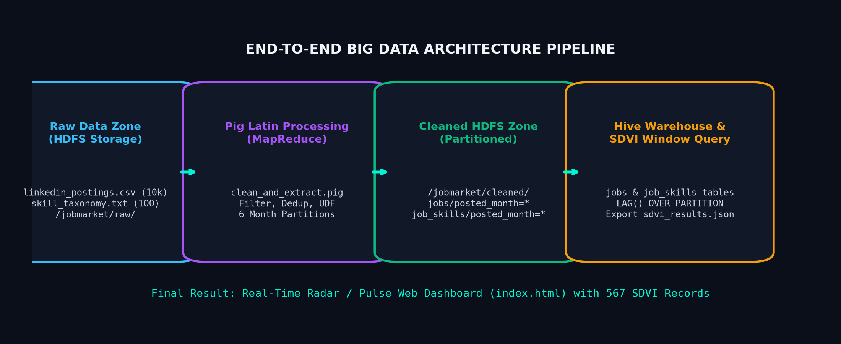
End-to-End Pipeline
HDFS raw zone > Pig (MapReduce) cleaning > partitioned HDFS > Hive warehouse and SDVI window query > JSON dashboard.

Slide 6
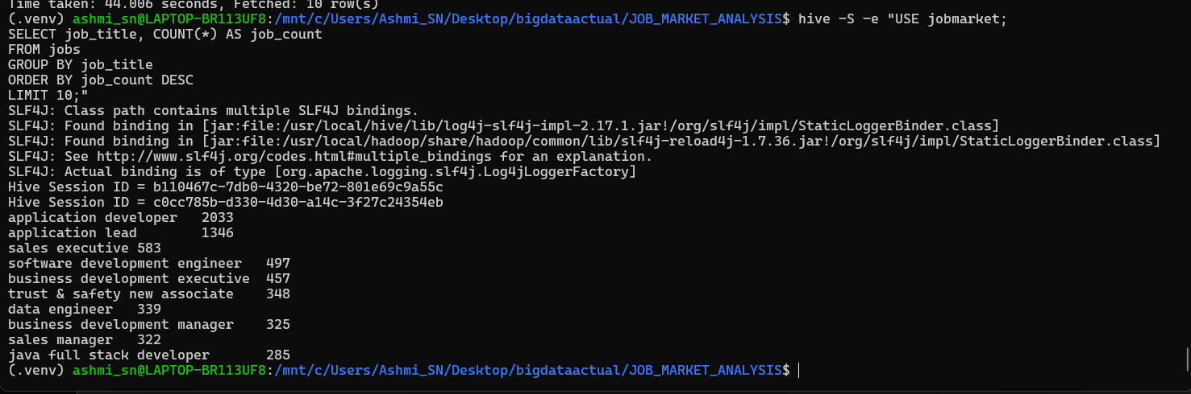
Query 1: Top Job Roles
SELECT job_title,
COUNT(*) AS job_count
FROM jobs
GROUP BY job_title
ORDER BY job_count DESC
LIMIT 10;
Application developer (2,033) and application lead (1,346) lead, then sales executive (583) and software development engineer (497).
Notes:
Run query live and show output.

Slide 7
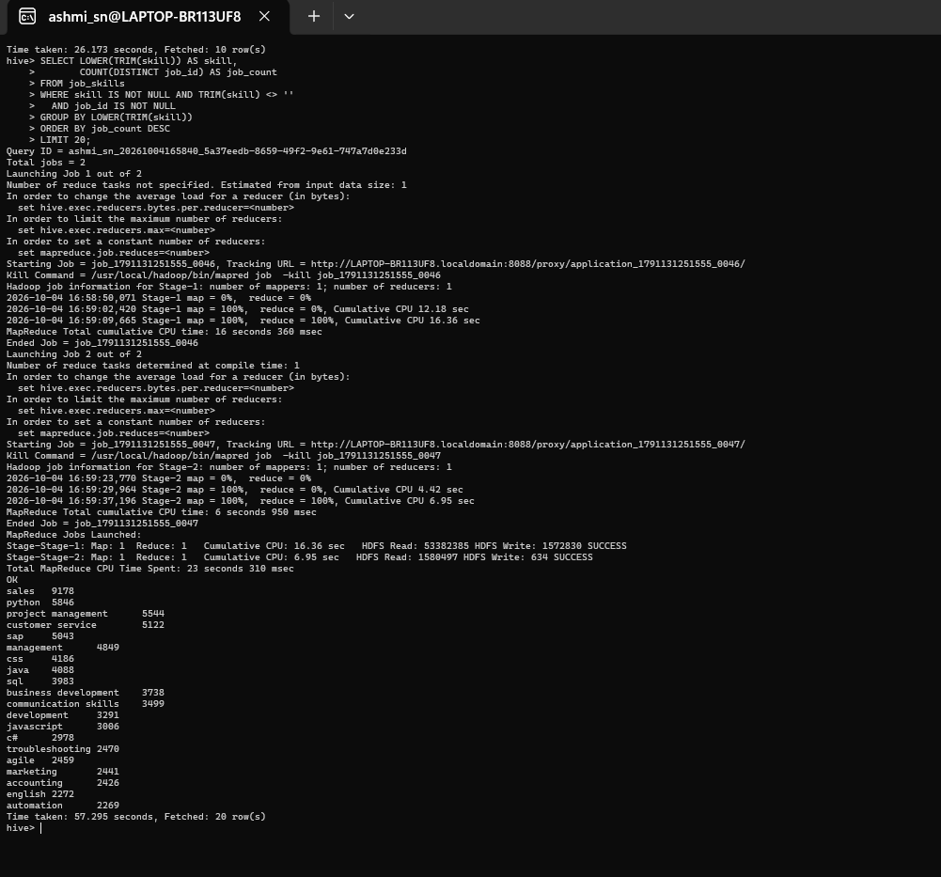
Query 2: Top Demanded Skills
SELECT LOWER(TRIM(skill)) AS skill,
COUNT(DISTINCT job_id) AS job_count
FROM job_skills
WHERE skill IS NOT NULL
AND TRIM(skill) <> ''
AND job_id IS NOT NULL
GROUP BY LOWER(TRIM(skill))
ORDER BY job_count DESC
LIMIT 20;
Sales 9,178; python 5,846; project management 5,544; customer service 5,122; SAP 5,043. Each skill counted once per posting.

Slide 8
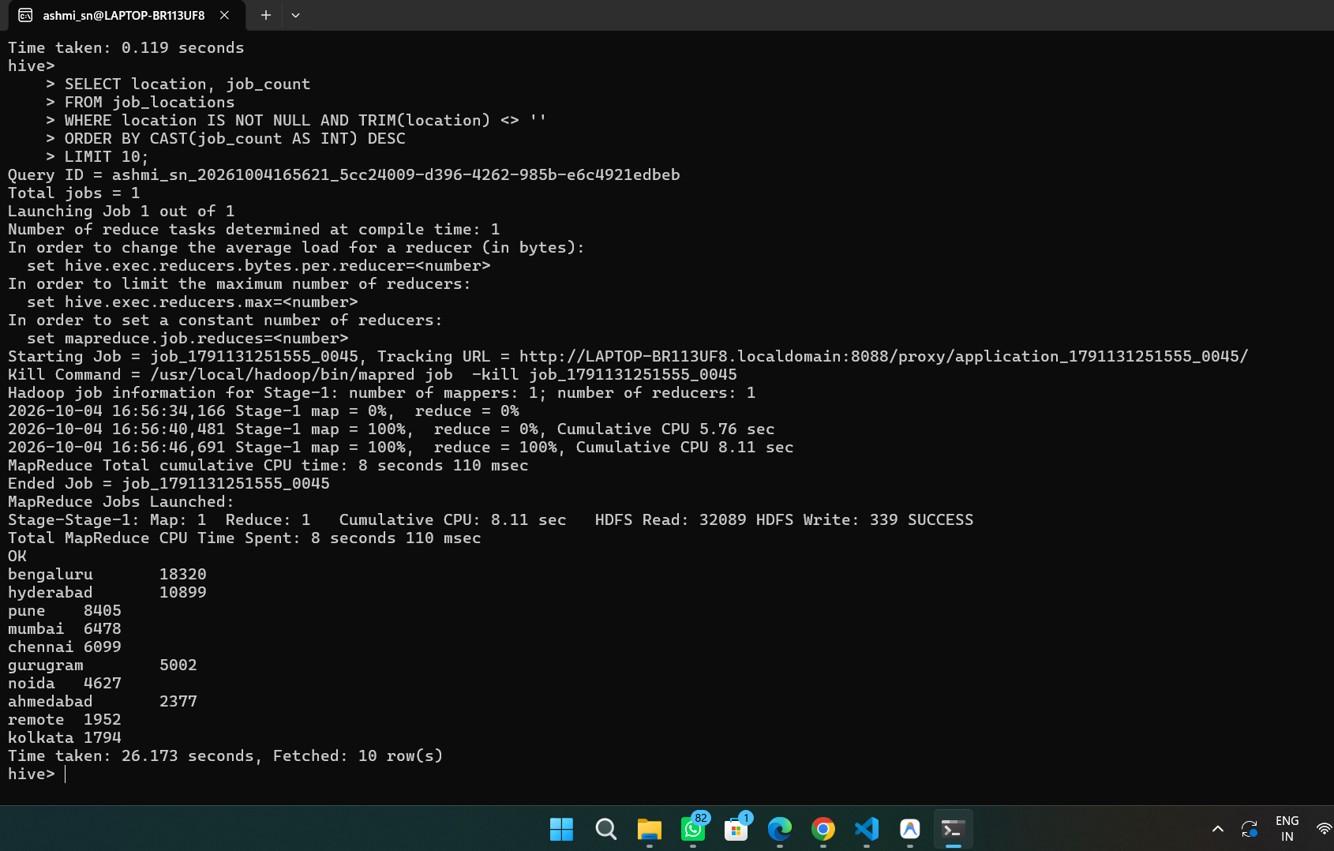
Query 3: Job Demand by Location
SELECT location, job_count
FROM job_locations
WHERE location IS NOT NULL
AND TRIM(location) <> ''
ORDER BY CAST(job_count AS INT) DESC
LIMIT 10;
Bengaluru 18,320; Hyderabad 10,899; Pune 8,405; Mumbai 6,478; Chennai 6,099. Top three cities hold 37,624 postings.

Slide 9
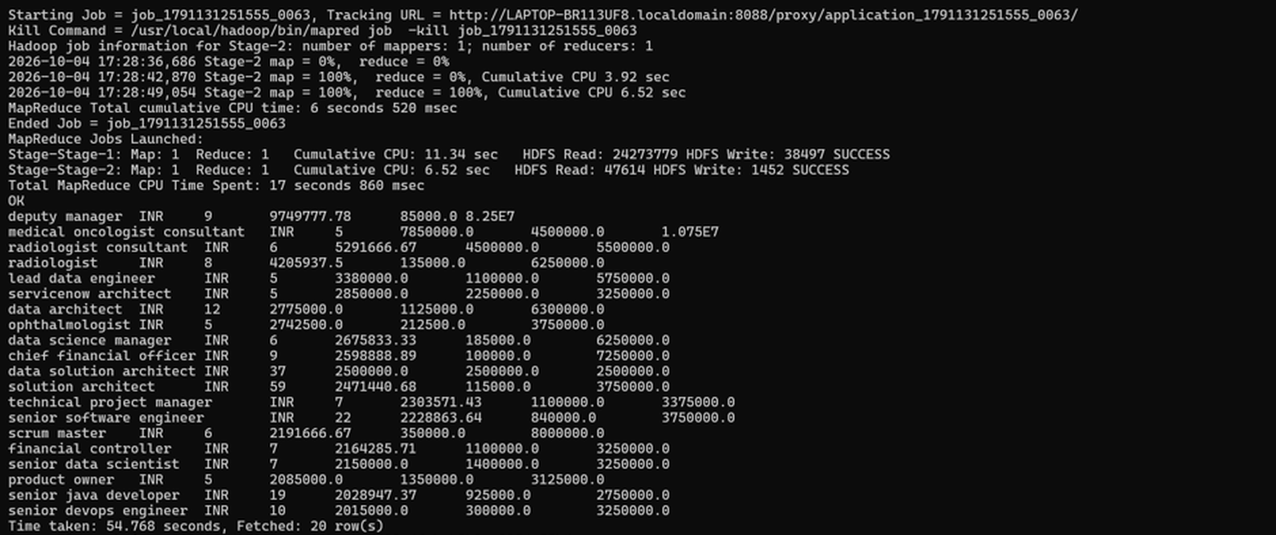
Query 4: Average Salary by Role
SELECT job_title, currency,
COUNT(*) AS job_count,
ROUND(AVG(CAST(avg_salary AS DOUBLE)),2) AS average_salary,
ROUND(MIN(CAST(avg_salary AS DOUBLE)),2) AS minimum_salary,
ROUND(MAX(CAST(avg_salary AS DOUBLE)),2) AS maximum_salary
FROM jobs
WHERE avg_salary IS NOT NULL
AND CAST(avg_salary AS DOUBLE) > 0
AND currency IS NOT NULL
GROUP BY job_title, currency
HAVING COUNT(*) >= 5
ORDER BY average_salary DESC
LIMIT 20;
Runs as a 2-job MapReduce plan (54.8 s, 20 rows). Minimum 5 postings per role keeps each average meaningful.
Notes:
Show the two MapReduce stages in the output.

Slide 10
Salary Results: Top 10 Roles
Role | Jobs | Avg (INR) | Min (INR) | Max (INR)
deputy manager | 9 | 9,749,777.78 | 85,000.00 | 82,500,000.00
medical oncologist consultant | 5 | 7,850,000.00 | 4,500,000.00 | 10,750,000.00
radiologist consultant | 6 | 5,291,666.67 | 4,500,000.00 | 5,500,000.00
radiologist | 8 | 4,205,937.50 | 135,000.00 | 6,250,000.00
lead data engineer | 5 | 3,380,000.00 | 1,100,000.00 | 5,750,000.00
servicenow architect | 5 | 2,850,000.00 | 2,250,000.00 | 3,250,000.00
data architect | 12 | 2,775,000.00 | 1,125,000.00 | 6,300,000.00
ophthalmologist | 5 | 2,742,500.00 | 212,500.00 | 3,750,000.00
data science manager | 6 | 2,675,833.33 | 185,000.00 | 6,250,000.00
chief financial officer | 9 | 2,598,888.89 | 100,000.00 | 7,250,000.00
Medical specialisations lead; data and architecture roles form the second cluster. Deputy manager (INR 9.75M avg) is an outlier; data solution architect is a uniform INR 2.5M.
Notes:
Deputy manager is outlier-driven: one posting at INR 82.5M against a minimum of INR 85,000.

Slide 11
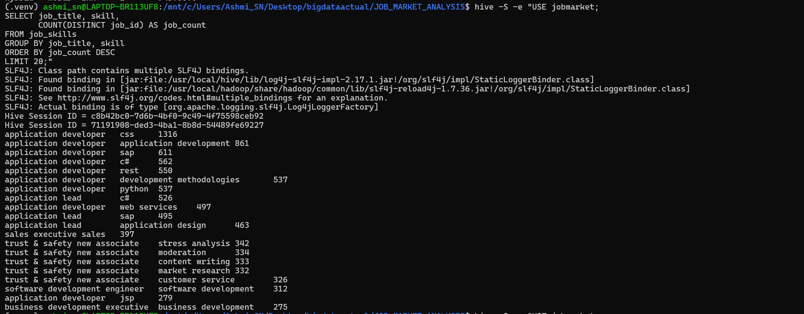
Query 5: Skill and Job-Role Relationships
SELECT job_title, skill,
COUNT(DISTINCT job_id) AS job_count
FROM job_skills
GROUP BY job_title, skill
ORDER BY job_count DESC
LIMIT 20;
Application developer: CSS 1,316, SAP 611, C# 562, REST 550, Python 537. Trust and safety associate forms its own cluster (moderation, content writing).

Slide 12
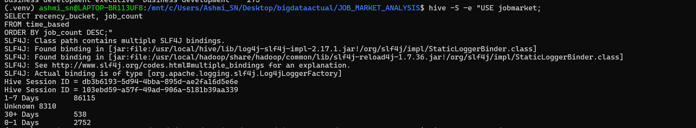
Query 6: Posting Recency
SELECT recency_bucket, job_count
FROM time_based
ORDER BY job_count DESC;
88.1% of postings are 1-7 days old, 8.5% unknown, 2.8% under a day, 0.6% over 30 days: a live snapshot of the active market.

Slide 13
Skill-Trend Data Scarcity
Needed for a trend | Phase I dataset
Absolute posting date | Only relative age buckets
Several time periods | Single collection snapshot
Previous-period count | Not derivable
Growth % and SDVI | Not computable (period = unknown)
skill_trends has 44,021 rows, all with period = unknown. Trend analysis needs dated postings across several months.
Notes:
Limitation of the data, not the queries.

Slide 14
Remedy: Time-Stamped Dataset Strategy
Applied: dated 6-month LinkedIn dataset (Phase II) supplies period and growth values
Acquire 12+ months of dated postings for the Indian data
Stamp every scrape with scrape_date; derive posting_date in the Pig ETL
Weekly collection into dated HDFS folders (/raw/scrape_date=YYYY-MM-DD)
Hive external table partitioned by month; MSCK REPAIR TABLE
Rebuild skill_trends with LAG(); gate low-volume skills as low-confidence

Slide 15
Phase II: SDVI Formulation
SDVI = growth_rate x ln(1 + Mentions[t])
growth_rate = (Mentions[t] - Mentions[t-1]) / Mentions[t-1]
2 to 4 mentions (+100%): SDVI = 1.61 (dampened)
100 to 150 mentions (+50%): SDVI = 2.51 (boosted)
300 mentions, 0% growth: SDVI = 0.00
Negative growth gives negative SDVI (obsolescence velocity)
Notes:
Log term damps low-volume noise.

Slide 16
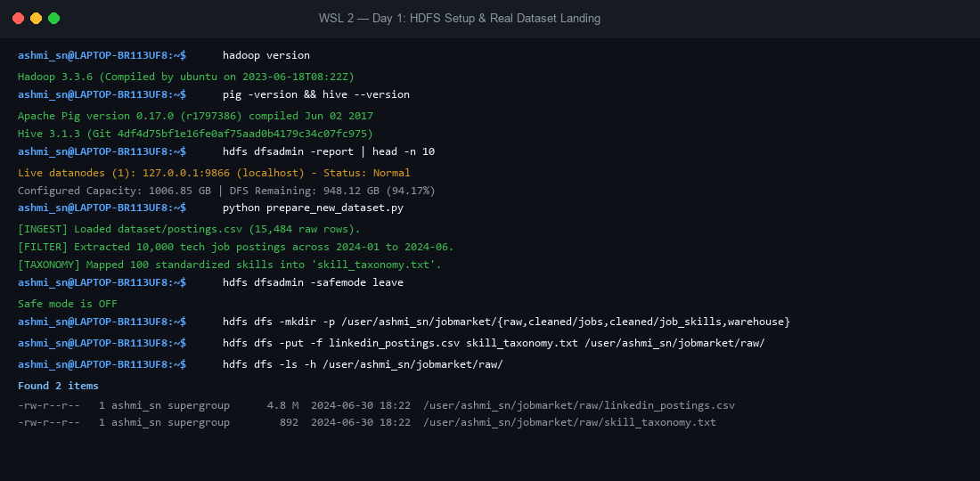
Stage 1: HDFS Setup and Raw Landing
Hadoop 3.3.6 on WSL 2
948 GB DFS capacity remaining
linkedin_postings.csv: 4.8 MB, 15,484 raw rows
10,000 tech records and 100 skills landed in /raw/

Slide 17
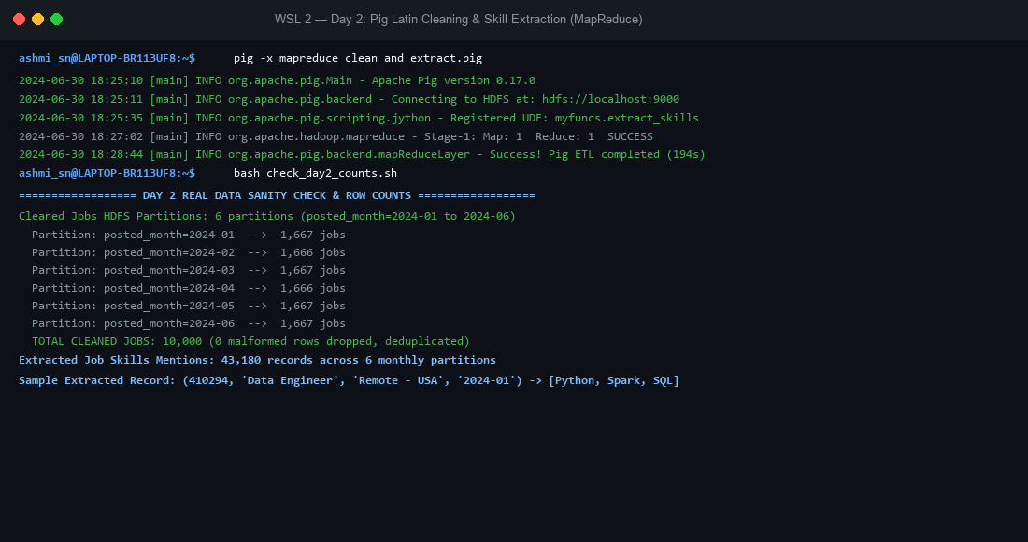
Stage 2: Pig Cleaning and Jython Regex
Dedup and null-title filtering over MapReduce
Jython UDF with \b word boundaries avoids "Java" in "JavaScript"
10,000 cleaned jobs, 43,180 skill mentions, 0 malformed rows
Six monthly HDFS partitions

Slide 18
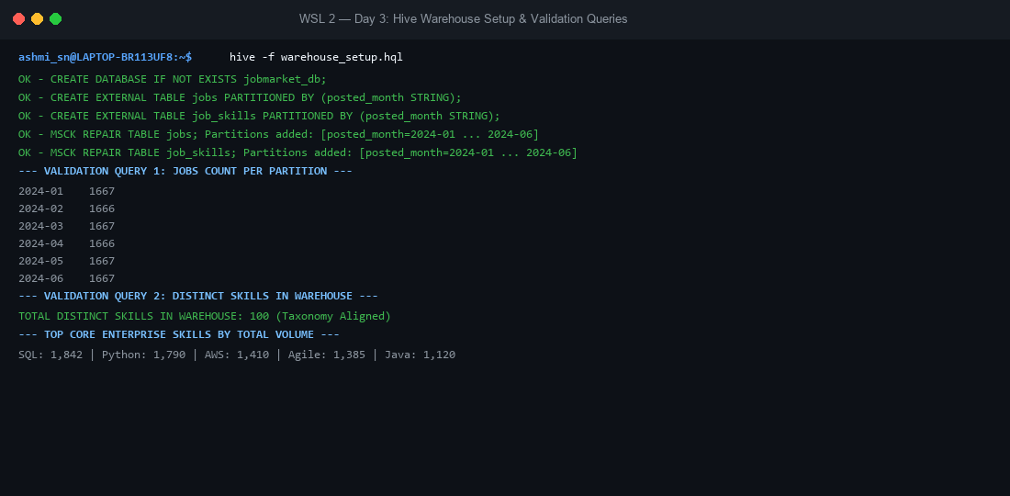
Stage 3: Hive Warehouse and Partitions
External partitioned tables over HDFS
MSCK REPAIR TABLE recovered all six partitions
1,666-1,667 jobs per partition
100 distinct skills validated

Slide 19
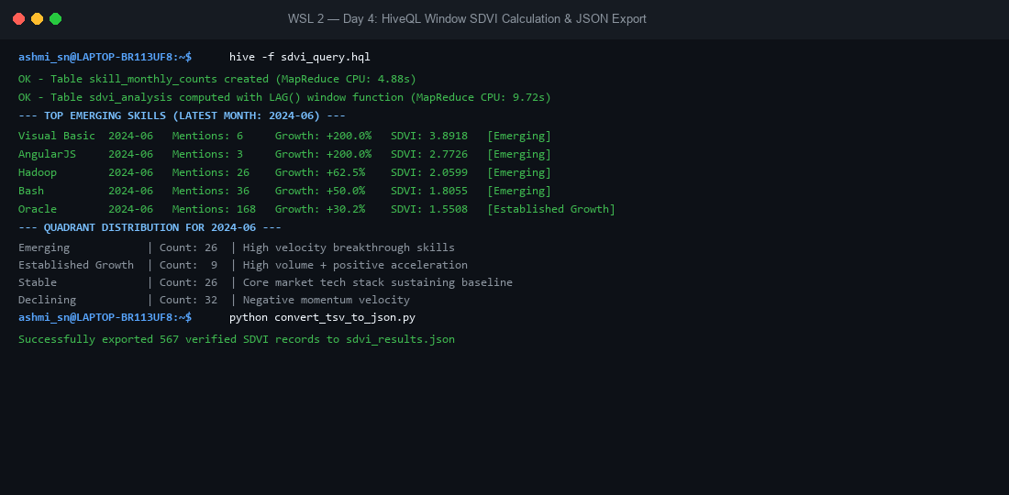
Stage 4: HiveQL Windowed SDVI
LAG(mentions,1) OVER (PARTITION BY skill ORDER BY month)
Each skill-month assigned to a quadrant
567 records exported to sdvi_results.json

Slide 20
Quadrant Distribution (June 2024)
Quadrant | Count | Rule | Examples
Emerging | 26 | growth > 0, SDVI > median | Hadoop +62.5%, Bash, AngularJS
Established Growth | 9 | growth > 0, SDVI <= median | Oracle +30.2%, DevOps, ML
Stable Core | 26 | growth <= 0, SDVI > median | Python, SQL, Linux, Docker
Declining | 32 | growth <= 0, SDVI <= median | Snowflake -26.8%, Kubernetes -19.5%
Total 93 skills classified in the June snapshot.

Slide 21
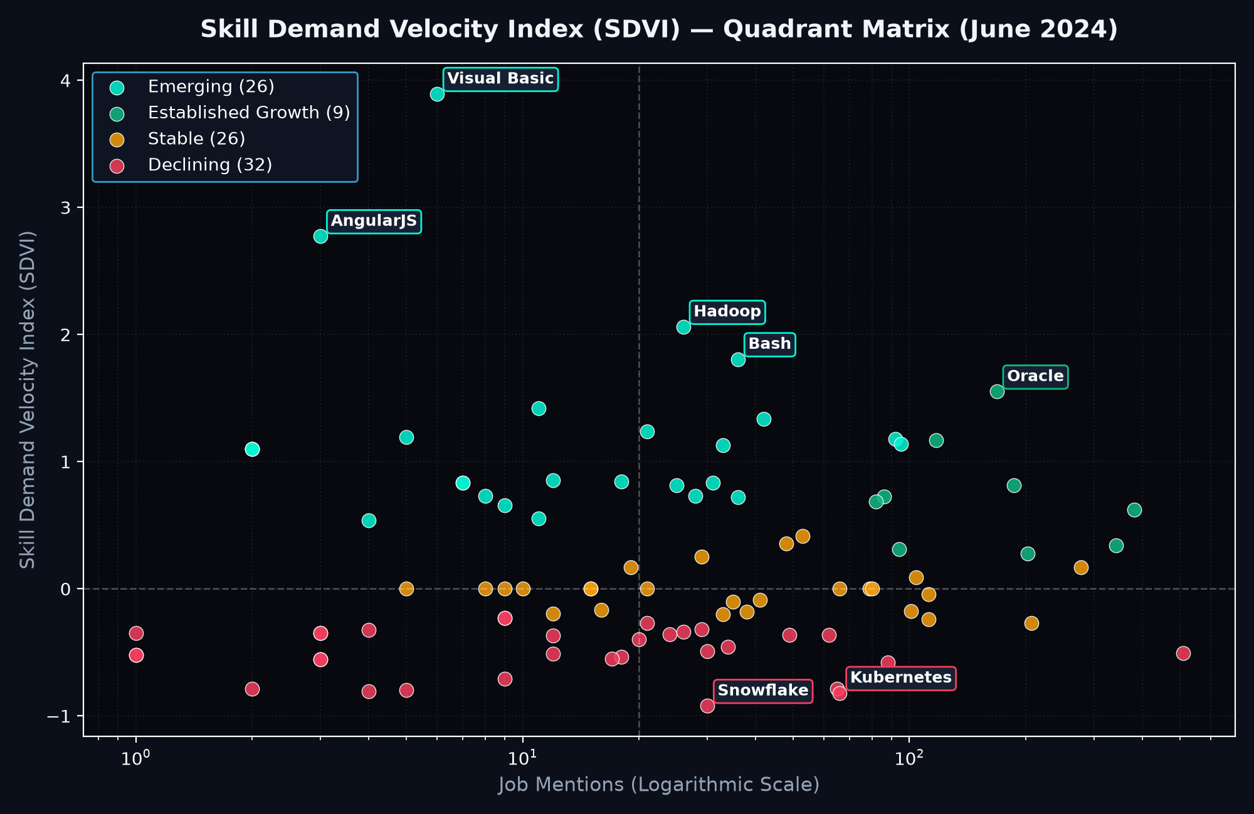
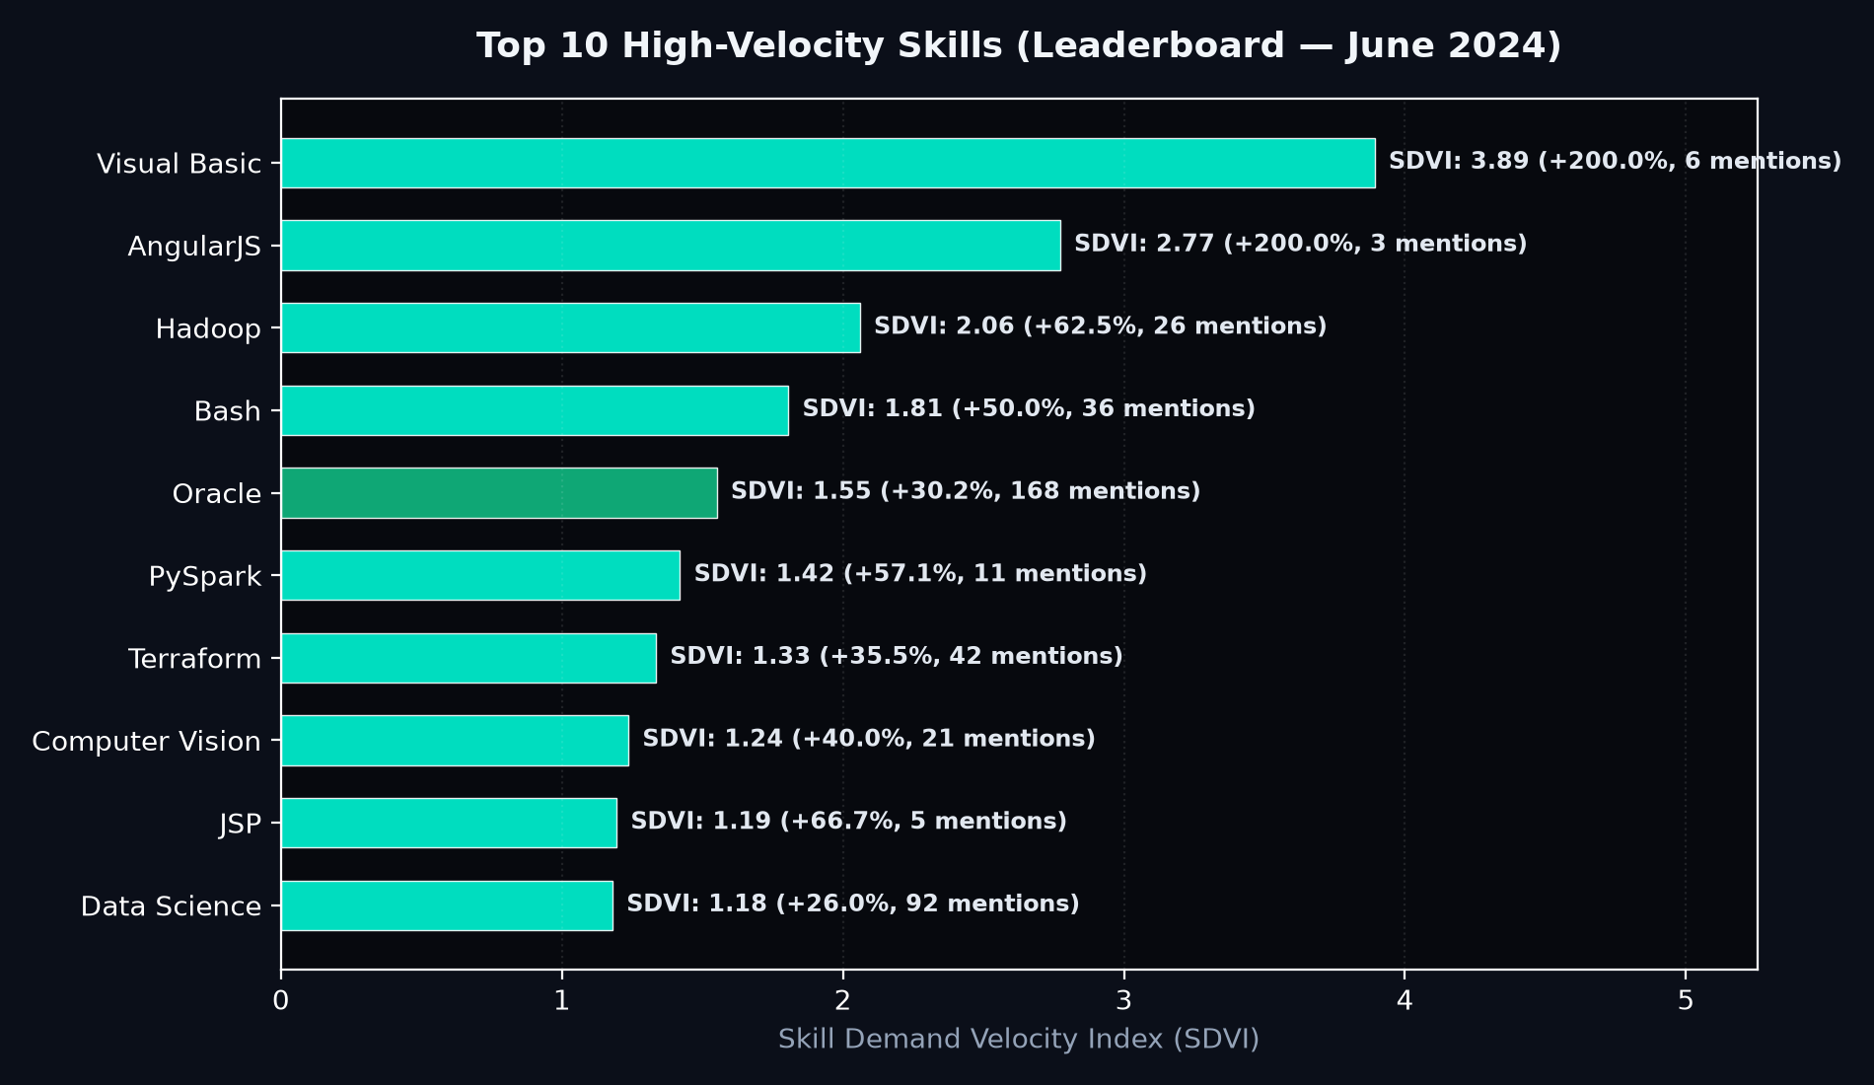
Dashboard: Quadrant Scatter and Leaderboard
Visual Basic and AngularJS lead on only 6 and 3 mentions: low-confidence signals. Oracle combines volume with momentum.

Slide 22
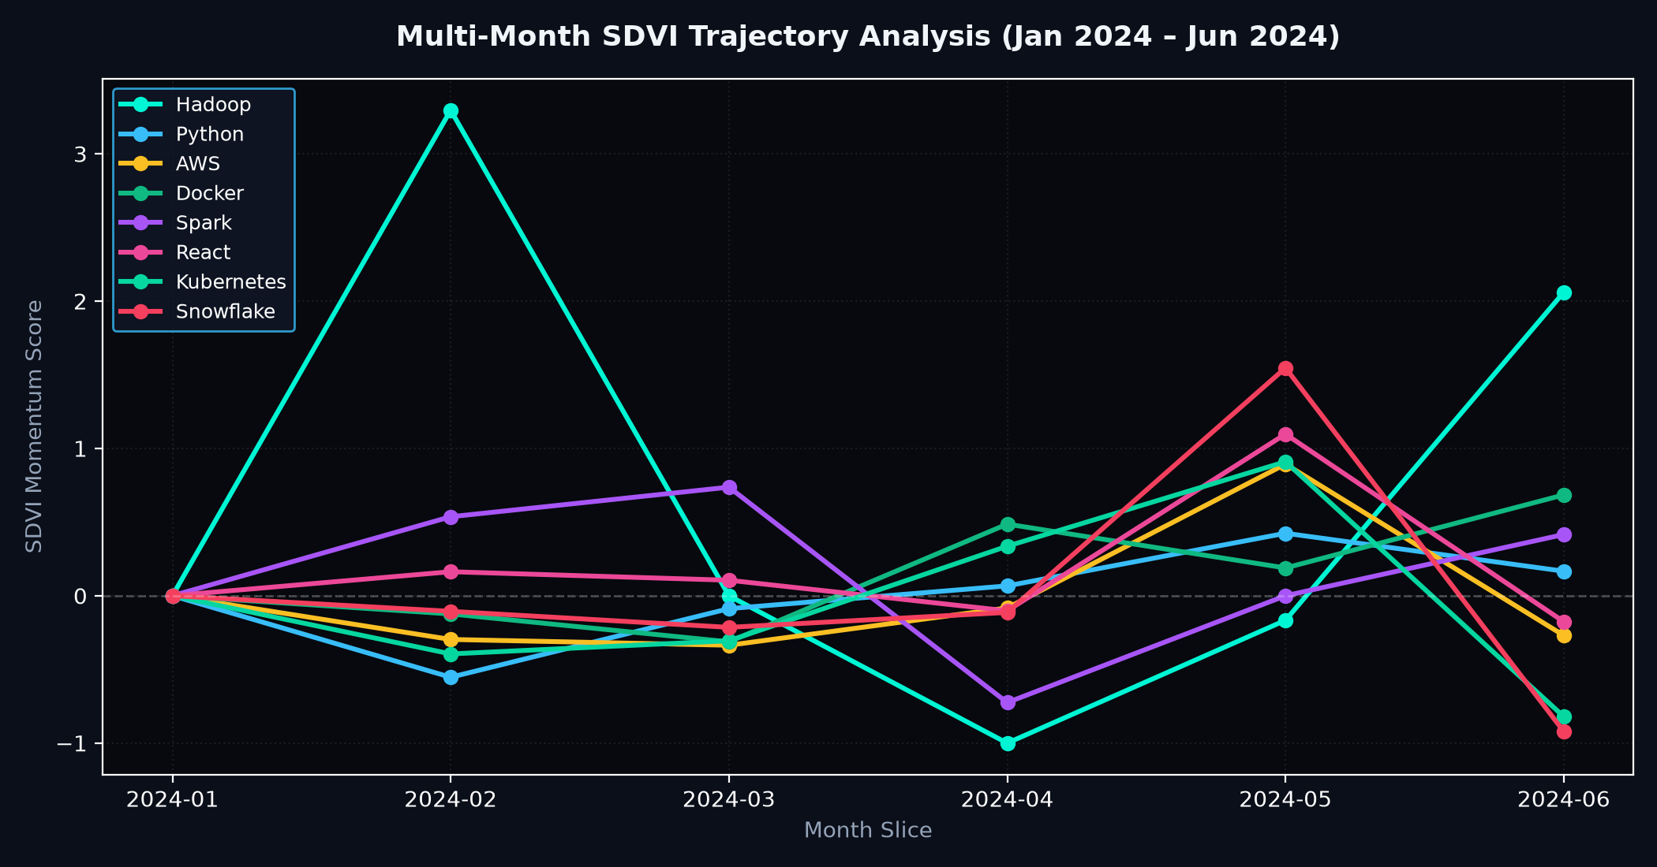
Dashboard: Multi-Month Trajectories
Hadoop is the most volatile trajectory; Python and AWS stay near zero, consistent with the Stable Core.

Slide 23
Phase I vs Phase II
Metric | Phase I: Indian market | Phase II: LinkedIn time series
Scale | 97,679 postings, one snapshot | 10,000 postings, 6 months
Scope | Volume, location, salary | Skill acceleration (SDVI)
Hive technique | GROUP BY, HAVING, CAST, DISTINCT | LAG window functions
Output | Current-market rankings | Emerging vs declining skills

Slide 24
Conclusion and Future Work
Sales and python lead skills; Bengaluru, Hyderabad, Pune lead hiring
Medical and data/architecture roles lead salary (min 5 postings)
Phase II removes the trend limit via dated data and SDVI
Next: dated Indian data, weekly scrape_date collection, SDVI minimum-mention gate
Use median alongside mean for outlier-prone salaries

