Slide 1
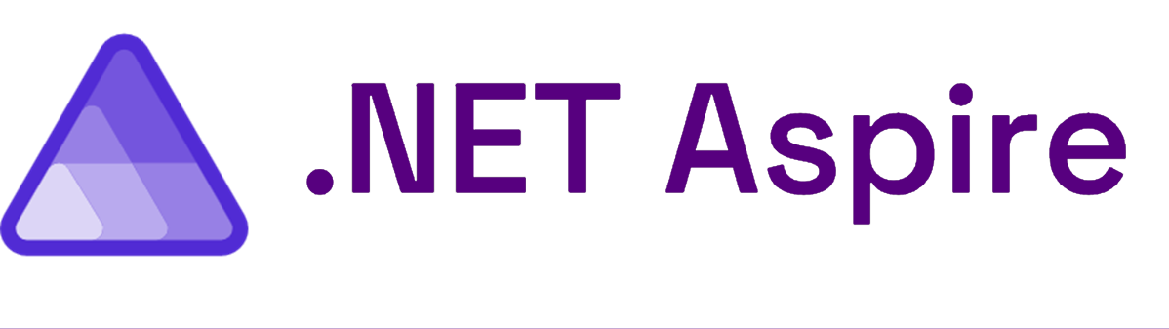
Introduction to
Medhat Elmasry
medhat@elmasry.ca

Slide 2
Medhat Elmasry
Instructor at BCIT
Independent Contractor
Microsoft MVP since 2017
Founded .NET BC in 2003
Speaker
https://blog.medhat.ca
medhat@elmasry.ca

Slide 3
Every App Needs
Observability
Resiliency
Scalability
Manageability
Notes:
No matter what type of application you're building every single application needs to be observable to get deep insights while you're debugging your application and while it's out into production. Additionally, they need to be resilient which means that no matter what the Internet connectivity is or the environment they need to be always up and running not only on the front end but also on the back end. They have to be scalable your application today much of serve a few 100 people but what happens when it serves 10s of thousands or hundreds of thousands of users. And finally, as a developer we want to be able to easily manage our application and easily deploy them so we can continuously and rapidly iterate on our apps.

Slide 4

It’s Still Not Easy
Complex
Getting Started
Choices
Paved Path
Notes:
And even though a lot of this is included directly into the SDK and additional packages, it doesn't mean it's necessarily easy because applications as we build them out and get more complex as they go So what this means is that as developers we have a lot of choices to pick we don't necessarily always have the best knowledge of where exactly to get started because of those choice options and as a .NET developer wouldn't it just be great if we had a paved path or a recommended path to do this with our applications.

Slide 5
What is .NET Aspire?
A cloud ready stack for building observable, production ready, distributed applications
Notes:
And that is why the team built .NET Aspire. It is a cloud ready stack for building observable, production ready, distributed applications and to help us be more productive as developers when we're developing and deploying our applications.

Slide 6
What does that mean? Who is it for? Should I use it?
Notes:
But what does this actually mean right those are some fancy words is this for me should I use? Do I have to convert my application? should every application use it?
The short answer is yes .NET Aspire is for every application no matter how big or how small let me explain.

Slide 7






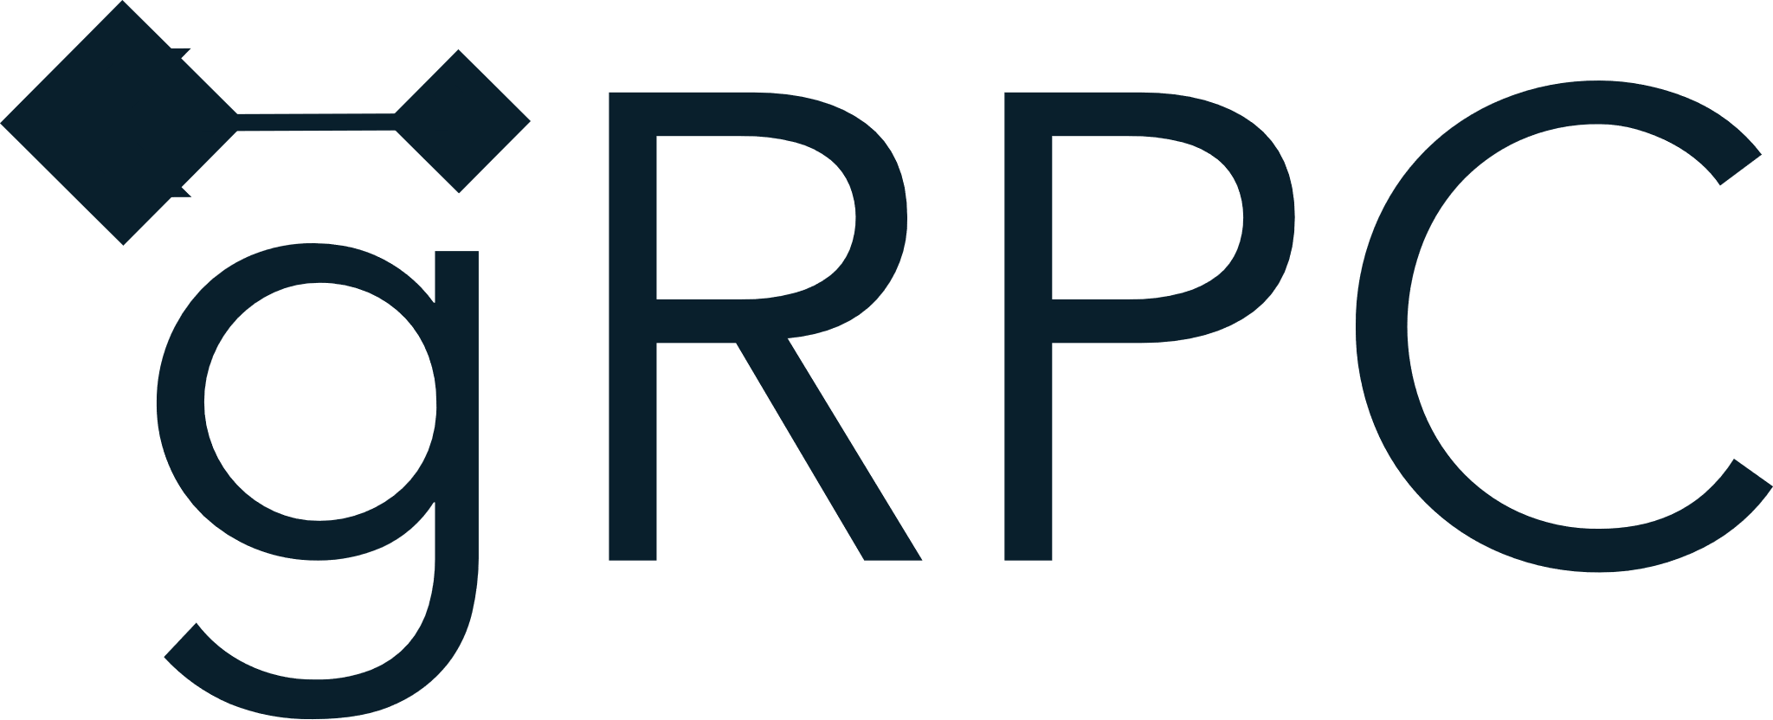
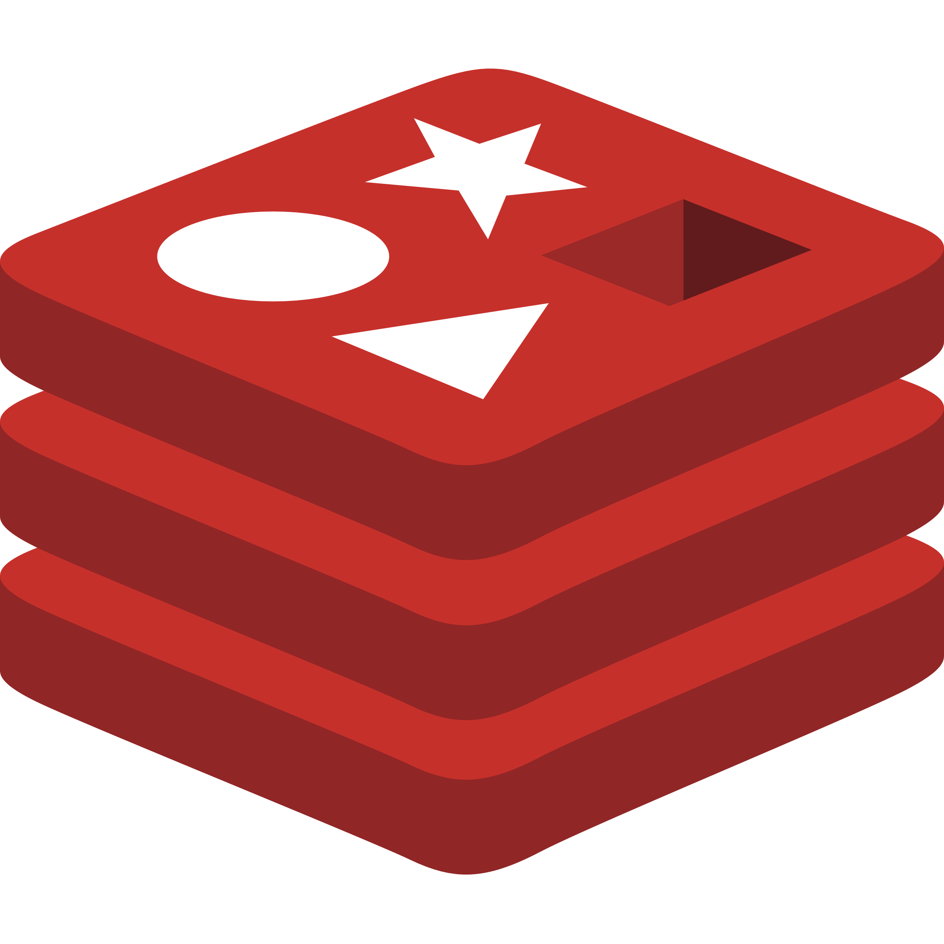
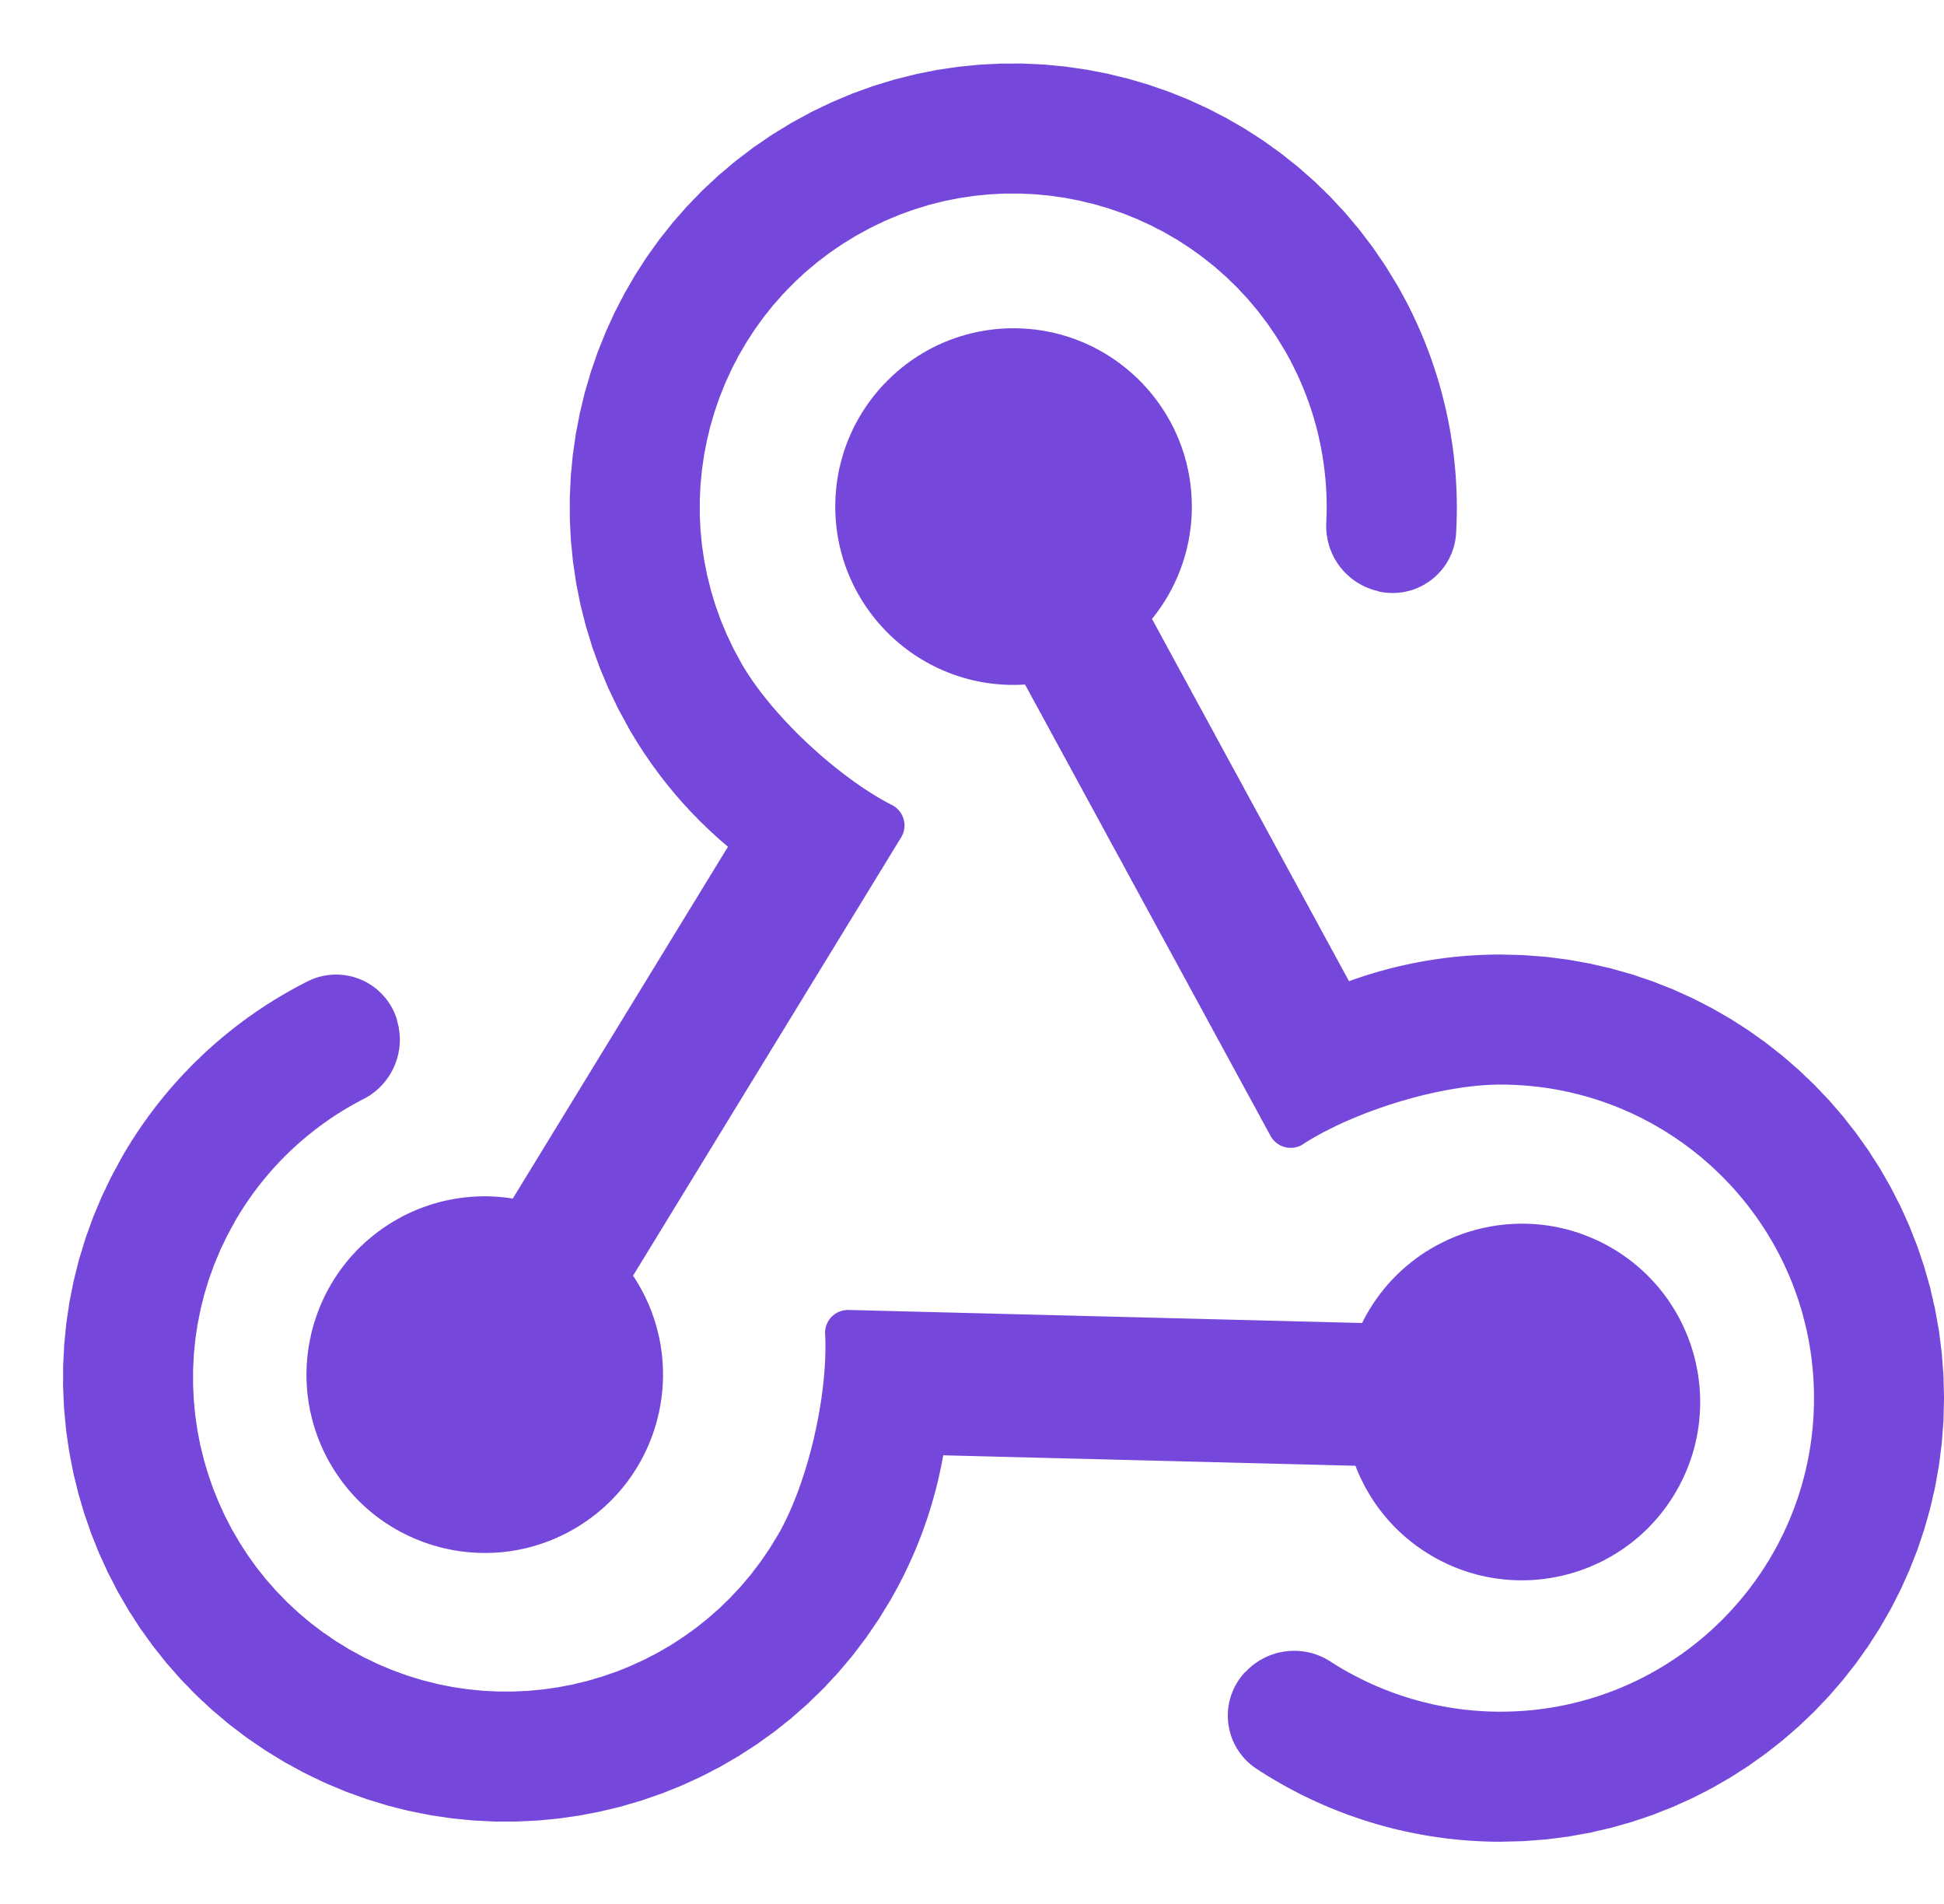

Full architecture reference
Cloud Services
Client Apps
Identity Service
Mobile BFF
Identity API
SQL Server
Mobile App
OpenAI
Mobile API
Catalog Service
Catalog API
SQL Server
Order Service
Ordering API
Web App
Ordering API
Order Processor
SQL Server
Event Bus
Browser
Blazor App
Basket Service
Basket API
Redis
Payment Service
Payment Processor
Admin Services
Webhook Client
Webhooks Service
Observability
Webhooks API
SQL Server
Notes:
At some point you may start to build out a fully distributed cloud-native architected project with lots of different dependences.
In each these scenarios whether your application is small as a single API with the front end and a back-end or a full cloud native distributed application .NET Aspire is a great use case for you.

Slide 8
.NET Aspire for every app
Works with ALL scale of applications and grows with you!
Notes:
What I like to say is every single application should have .NET Aspire added to it and I'm going to show and tell you why and by the end of this presentation and this demo as we follow along you're going to be wow at how developer productivity is boosted and I can get deep insights into my application

Slide 9
Smart Defaults
Developer Dashboard
Orchestration
Service Discovery
Integrations
Deployment
Notes:
So what's in .NET Aspire? There's a series of different features that help developers be more productive, build better observable production ready distributed applications, and ease the deployment in many scenarios for us. We're going to take a look at every single one of these different features from start to finish and integrate them into our application. Now a lot of people start with the developer dashboard because it's the fancy shiny thing that ships directly with .NET Aspire but we're going to start in a different area first which I think is one of the areas and features that every single application should integrate into our application today

Slide 10
DEMO
WebAPI ←→ Blazor solution
Notes:
Let’s take a look at the project we will be “Aspireify” today. This application is a weather hub that uses the United States national weather service API with a nice Blazor UI that allows you to select a weather station.
First, let’s clone the repo where you will find the source code for the app, these slides, and full walkthrough guides that you can follow along.
NOTE: Open up this github repo and do a walkthrough of the necessary setup steps

Slide 11
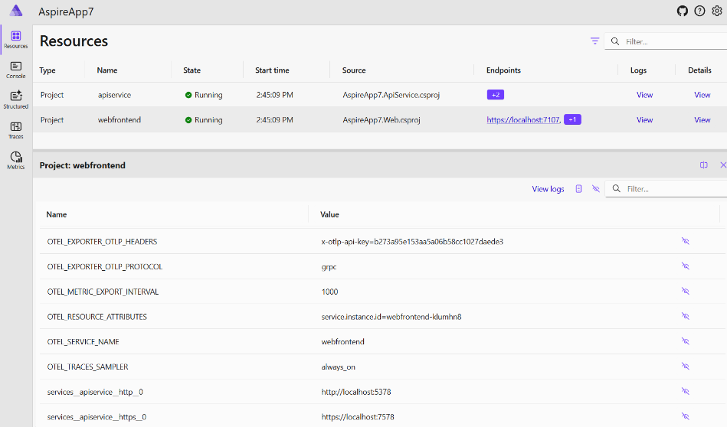
Environment variables & connection strings 😀
Notes:
Now this doesn't mean that we're getting rid of connection strings. In fact, a connection string is generated for us by the .NET Aspire App host and it is automatically set up when we run our application. This means that if we have our connection strings configured we can still set them on our back end when we have them deployed.

Slide 12
DEMO
Environment variables & connection strings
Notes:
Let's take our application that is orchestrated and let's go ahead and type in some service discovery and update our connection strings today to take advantage of it.

Slide 13
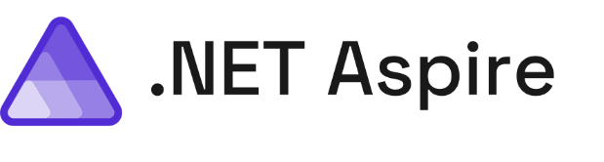
Learning Resources
.NET Aspire Videos
aka.ms/letslearn/dotnet/aspire
aka.ms/aspire/videos
Documentation
Engage with team on GitHub
aka.ms/dotnet-aspire
github.com/dotnet/aspire
Medhat Elmasry
medhat@elmasry.ca
Notes:
There you have it from start to finish no matter what size or scale your application you can easily get observability resiliency scalability and manageability and so much more by integrating ..NET Aspire into your application. On top of all of that we get a super productivity boost .NET developers in our local development day-to-day.

Slide 14
Questions?

Slide 15
Thanks

