Slide 2
ML.NET
Medhat Elmasry
BRK3203

Slide 3










Your platform for building anything
DESKTOP
WEB
CLOUD
MOBILE
GAMING
IoT
ML
.NET

Slide 4

Machine Learning “Programming the UnProgrammable”
{
Is this a face?
f(x)

Slide 5



Machine Learning “Programming the UnProgrammable”
Machine Learning creates a
Face
Face
f(x) Model
Not a face
Not a face
Using this data
Notes:
Create a function that takes an image as input and tells you whether or not an image is a face or not.

Slide 6
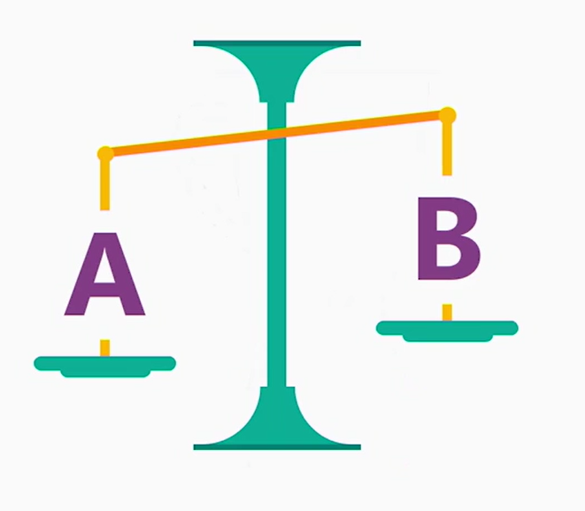
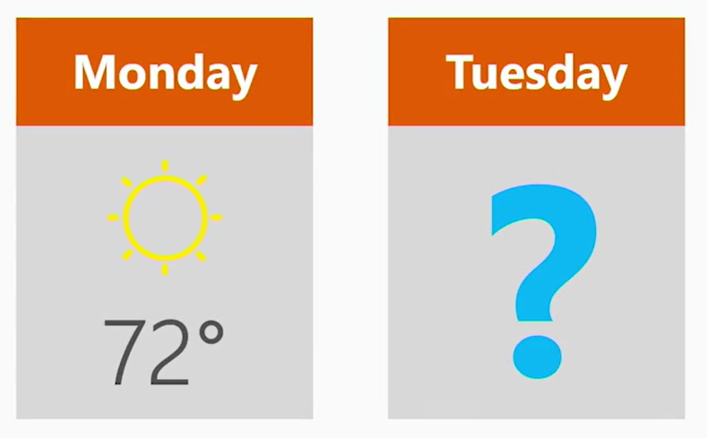
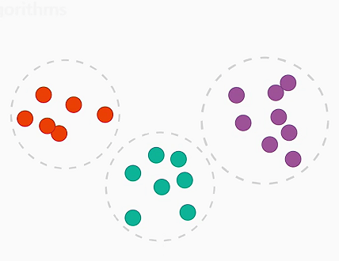
Many ML Tasks…
Is this A or B?
How much? How many?
How is this organized?
{
Classification
Regression
Clustering
Notes:
Classification: Is A or B.
Regression: How much or how many. Example: try and predict the temperature tomorrow.
Clustering: Group similar data points into one cluster

Slide 7

ML.NET is for building your own ML models
01
WHAT IS ML.NET?

Slide 8





Pre-built ML Models (Azure Cognitive Services)
e.g. Sentiment Analysis using Azure Cognitive Services
TextAnalyticsAPI client = new TextAnalyticsAPI();
client.AzureRegion = AzureRegions.Westus;
client.SubscriptionKey = "1bf33391DeadFish"; client.Sentiment(
new MultiLanguageBatchInput(
new List<MultiLanguageInput>()
{
new MultiLanguageInput("en","0", "This is a great vacuum cleaner")
}));
Vision
Speech
Language
Labs
Knowledge
Search
96% positive
Consume (C#, VB, F#)
Easy / Less Control
Full Control / Harder

Slide 9
Pre-built ML Models (Azure Cognitive Services)
e.g. Sentiment Analysis using Azure Cognitive Services
TextAnalyticsAPI client = new TextAnalyticsAPI();
client.AzureRegion = AzureRegions.Westus;
client.SubscriptionKey = "1bf33391DeadFish"; client.Sentiment(
new MultiLanguageBatchInput(
new List<MultiLanguageInput>()
{
new MultiLanguageInput("en","0", "This vacuum cleaner sucks so much dirt")
}));
Vision
Speech
Language
9% positive
Labs
Knowledge
Search
Consume (C#, VB, F#)
Easy / Less Control
Full Control / Harder

Slide 10
Build your own (custom) ML Models
Prepare Your Data
Build & Train
Run
Full Control / Harder
Easy / Less Control

Slide 11
Build your own (custom) ML Models
Existing Solutions
Python, R are great for ML and Data Science
ML.NET is another way to do it with familiar tools
.NET currently lacks ML libraries and ML essentials
ML.NET complements the experience that ‘Azure Machine Learning’ and ‘Cognitive Services’ provide
Build your own
Code First approach
AppLocal Model deployment
Less Control / Easy

Slide 12
ML.NET is a framework first
02
WHAT IS ML.NET?

Slide 13



ML.NET is a framework first
Developer friendly APIs for Machine Learning
Training
Consumption
Extensions
Transforms
Learners
Misc.
Natural Text
Linear
ML Data framework
Schema
Boosted Trees
Evaluators
Missing values
Svm
Calibrators
Categorical
K-Means
Data loaders
Normalization
Feature Selection
Notes:
ML.NET gives you:
a built-in set of transformations
state-of-the-art learners for classification, regression & clustering
The future plan is to make it all extensible

Slide 14
ML.NET has been proven in large scale Microsoft products
03
WHAT IS ML.NET?
Notes:
ML.NET has been used by Microsoft internally for almost a decade.
Made to support apps written in .NET and also .NET developers.

Slide 15


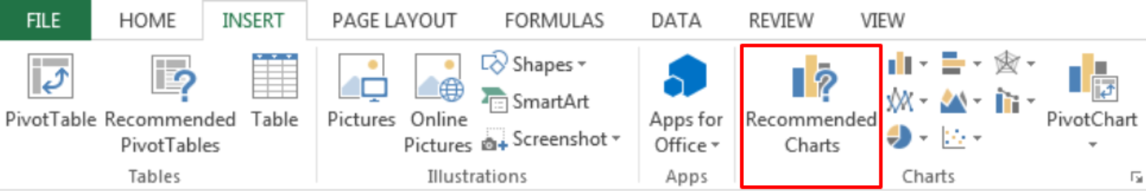

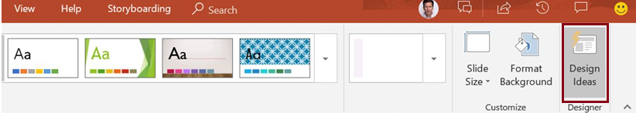

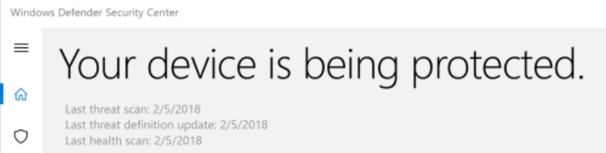
ML.NET Usage at Microsoft
Bing Ads
Excel
Power Point
Windows 10
+ more!

Slide 16
ML.NET is Open Source & Cross-Platform
04
WHAT IS ML.NET?

Slide 17




ML.NET 0.5 (Preview)
Machine Learning framework made for .NET developers
Supported on Windows, Linux, and macOS
Build your own
Developer Focused
Proven & Extensible
Open Source
https://github.com/dotnet/machinelearning
Resources?? : go to http://dot.net then click on ‘Machine Learning & AI’

Slide 18
All About Pipelines! (Taxi Fare)

Slide 19
Data
vendor_id | The ID of the taxi vendor is a feature.
rate_code | The rate type of the taxi trip is a feature.
passenger_count | The number of passengers on the trip is a feature.
trip_time_in_secs | The amount of time the trip took. You want to predict the fare of the trip before the trip is completed. At that moment you don't know how long the trip would take. Thus, the trip time is not a feature and you'll exclude this column from the model.
trip_distance | The distance of the trip is a feature.
payment_type | The payment method (cash or credit card) is a feature.
fare_amount | The total taxi fare paid is the label.

Slide 20
ML Models (GitHub Issue Classifier)
Training
Features
vendor_id
rate_code
passenger_count
trip_distance
payment_type
Train()
Model
Label
fare_amount

Slide 21
ML Models (GitHub Issue Classifier)
Prediction
Model.Predict()
Features
Predicted Label
vendor_id
rate_code
passenger_count
trip_distance
payment_type
fare_amount

Slide 22
End to End ML Workflow
Load Data
Extract Features
Train Model
Evaluate Model
Model consumption
ML Pipeline
labels + plain text
labels + feature vectors
model

Slide 23
End to End ML Workflow
Load Data
Extract Features
Train Model
Evaluate Model
Model consumption
ML Pipeline
labels + plain text
labels + feature vectors
model
Enter...
LearningPipelines!
in ML.NET

Slide 24
Pipeline Games !
var pipeline = new LearningPipeline();
pipeline.Add(new TextLoader<TaxiTrip> (DataPath, useHeader: true, separator: ","));
pipeline.Add(new CategoricalOneHotVectorizer ("vendor_id",
"rate_code",
"payment_type"));
pipeline.Add(new ColumnConcatenator("Features", "vendor_id", "rate_code", …);
pipeline.Add(new FastTreeRegressor());
pipeline.Train<TaxiTrip, TaxiTripFarePrediction>();

Slide 25
Load Data (Pipelines in ML.NET)
York City taxi data
vendor_id | rate_code | passenger_count | trip_time_in_secs | trip_distance | payment_type | fare_amount
CMT | 1 | 1 | 1271 | 3.8 | CRD | 17.5
CMT | 1 | 1 | 474 | 1.5 | CRD | 8
CMT | 1 | 1 | 637 | 1.4 | CRD | 8.5
Load Data
Extract Features
Train Model
Evaluate Model
Model consumption

Slide 26
Load Data (Pipelines in ML.NET)
var pipeline = new LearningPipeline();
Load Data
Extract Features
Train Model
Evaluate Model
Model consumption

Slide 27
Extract Features (Pipelines in ML.NET)
var pipeline = new LearningPipeline(); pipeline.Add(new TextLoader(_datapath).CreateFrom<TaxiTrip>(useHeader: true, separator: ','));
public class TaxiTrip {
[Column("0")]
public string VendorId;
[Column("1")]
public string RateCode;
[Column("2")]
public float PassengerCount;
[Column("3")]
public float TripTime;
[Column("4")]
public float TripDistance;
[Column("5")]
public string PaymentType;
[Column("6")]
public float FareAmount;
}
Load Data
Extract Features
Train Model
Evaluate Model
Model consumption

Slide 28
Extract Features (Pipelines in ML.NET)
var pipeline = new LearningPipeline(); pipeline.Add(new TextLoader(_datapath).CreateFrom<TaxiTrip>(useHeader: true, separator: ','));
vendor_id | rate_code | passenger_count | trip_time_in_secs | trip_distance | payment_type | fare_amount
CMT | 1 | 1 | 1271 | 3.8 | CRD | 17.5
Load Data
Extract Features
Train Model
Evaluate Model
Model consumption

Slide 29
Extract Features (Pipelines in ML.NET)
var pipeline = new LearningPipeline(); pipeline.Add(new TextLoader(_datapath).CreateFrom<TaxiTrip>(useHeader: true, separator: ','));
pipeline.Add(new ColumnCopier(("FareAmount", "Label")));
vendor_id | rate_code | passenger_count | trip_time_in_secs | trip_distance | payment_type | fare_amount | Label
CMT | 1 | 1 | 1271 | 3.8 | CRD | 17.5
CMT | 1 | 1 | 1271 | 3.8 | CRD | 17.5 | 17.5
Load Data
Extract Features
Train Model
Evaluate Model
Model consumption

Slide 30
Extract Features (Pipelines in ML.NET)
var pipeline = new LearningPipeline(); pipeline.Add(new TextLoader(_datapath).CreateFrom<TaxiTrip>(useHeader: true, separator: ','));
pipeline.Add(new ColumnCopier(("FareAmount", "Label")));
pipeline.Add(new CategoricalOneHotVectorizer("VendorId", "RateCode", "PaymentType"));
vendor_id | rate_code | passenger_count | trip_time_in_secs | trip_distance | payment_type | fare_amount | Label
CMT | 1 | 1 | 1271 | 3.8 | CRD | 17.5
CMT | 1 | 1 | 1271 | 3.8 | CRD | 17.5 | 17.5
<1> | <1,0> | 1 | 1271 | 3.8 | <1,0,0> | 17.5 | 17.5
Load Data
Extract Features
Train Model
Evaluate Model
Model consumption

Slide 31
Extract Features (Pipelines in ML.NET)
var pipeline = new LearningPipeline(); pipeline.Add(new TextLoader(_datapath).CreateFrom<TaxiTrip>(useHeader:true, separator: ','));
pipeline.Add(new ColumnCopier(("FareAmount", "Label"))); pipeline.Add(new CategoricalOneHotVectorizer("VendorId", "RateCode", "PaymentType"));
pipeline.Add(new ColumnConcatenator("Features", "VendorId", "RateCode", "PassengerCount", "TripDistance", "PaymentType"));
vendor_id | rate_code | passenger_count | trip_time_in_secs | trip_distance | payment_type | fare_amount | Label | Feature
CMT | 1 | 1 | 1271 | 3.8 | CRD | 17.5
CMT | 1 | 1 | 1271 | 3.8 | CRD | 17.5 | 17.5
<1> | <1,0> | 1 | 1271 | 3.8 | <1,0,0> | 17.5 | 17.5
<1> | <1,0> | 1 | 1271 | 3.8 | <1,0,0> | 17.5 | 17.5 | <1,1,0,1,3,8,1,0,0>
Load Data
Extract Features
Train Model
Evaluate Model
Model consumption

Slide 32
Train Model (Pipelines in ML.NET)
Train model takes ‘Labels + Features’ and produces a Model Object
pipeline.Add(new FastTreeRegressor());
PredictionModel<TaxiTrip,TaxiTripFarePrediction> model = pipeline.Train<TaxiTrip, TaxiTripFarePrediction>();
Load Data
Extract Features
Train Model
Evaluate Model
Model consumption

Slide 33
Model Evaluation
Model must be valuable on new data (generalization)
Evaluate on test data: labeled data not used for training
Micro-accuracy: what percent of examples in test data are predicted correctly?
var testData = new TextLoader(_testdatapath).CreateFrom<TaxiTrip>(useHeader: true, separator: ',');
var evaluator = new RegressionEvaluator();
RegressionMetrics metrics = evaluator.Evaluate(model, testData);
Console.WriteLine($"Rms = {metrics.Rms}");
Console.WriteLine($"RSquared = {metrics.RSquared}");
Load Data
Extract Features
Train Model
Evaluate Model
Model consumption

Slide 34
Model Consumption
TaxiTrip t = new TaxiTrip() {
VendorId = "VTS",
RateCode = "1",
PassengerCount = 1,
TripDistance = 10.33f,
PaymentType = "CSH",
FareAmount = 0 // predict it. actual = 29.5
};
TaxiTripFarePrediction prediction = model.Predict(t);
Console.WriteLine("Predicted fare: {0}, actual fare: 29.5", prediction.FareAmount);
Load Data
Extract Features
Train Model
Evaluate Model
Model consumption

Slide 35
Machine Learning is Iterative
Load Data
Extract Features
Train Model
Evaluate Model
Model consumption
ML Pipeline

Slide 36
Improving the model
More/different data
Larger dataset
User profiles
Different pipeline
Different learner
Different transforms
Different repositories
Different hyperparameters
“Programming the Unprogrammable” “Programming the Unprogrammable”

Slide 37
Road Ahead for ML.NET
API improvements
Additional ML Tasks and Scenarios
Deep Learning (TensorFlow, CNTK)
ONNX support for WinML
Scale-out on Azure
Better GUI to simplify ML tasks
Integration with VS Tools for AI
Language Innovation for .NET

Slide 38


