Slide 1
EF Core 3 Azure Cosmos DB Provider
Medhat Elmasry

Slide 2

Put your data where your users are

Slide 3
Introducing Azure Cosmos DB
A globally distributed, massively scalable, multi-model database service
Global distribution
Multi-model + multi API
Elastic scale-out
Choice of consistency
Guaranteed single-digit latency
Enterprise-level SLAs

Slide 4
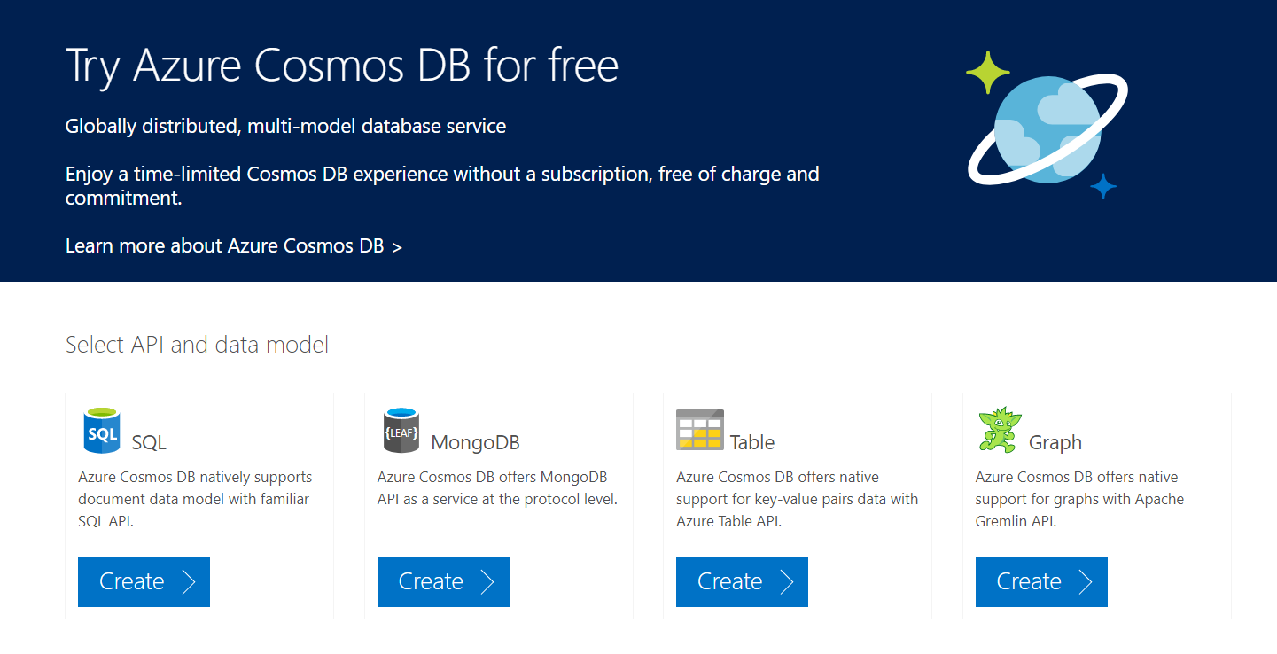
at https://azure.microsoft.com/en-us/try/cosmosdb/

