Slide 1
Secure Instant Messaging System Architecture and Design
By:
Medhavi Mahansaria
Naomi Joshi

Slide 2
ASSUMPTIONS
Registered users knows the public key of the server.
Server does not know the public keys of the clients until login.
The user account creation process is assumed to be complete and the server knows list of registered users and the hash of the users’ salted passwords.
The user only needs to remember a single password.

Slide 3
CONSTRAINTS
Messages between the users should not go through the server
The users only needs to remember a single password.
The client application should not remember the users passwords.
The client application cannot remember the private/public key of the users.

Slide 4
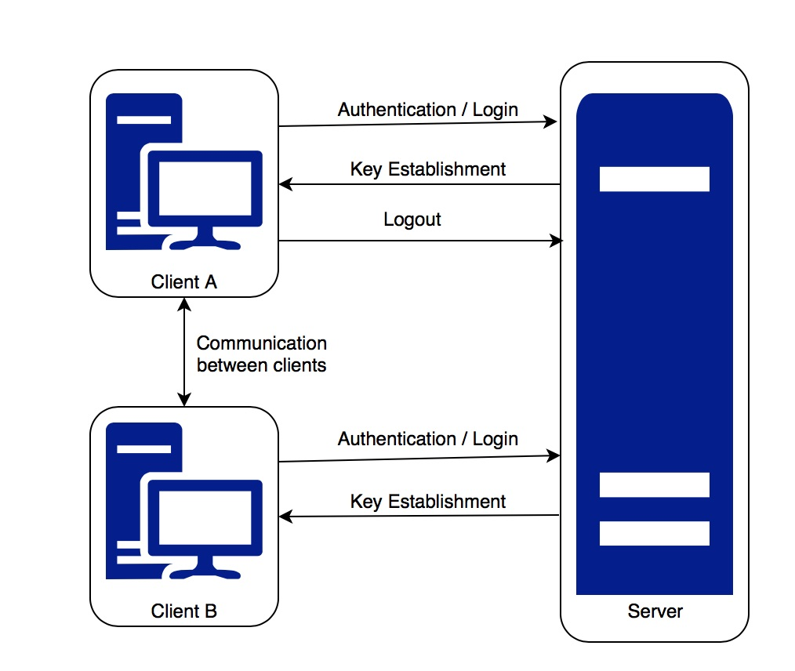
ARCHITECTURE

Slide 5
TERMINOLOGY
A: Client A’s identity, B: Client B’s identity
A_{PUB/PRIV}: Client A’s public/private key
{ }_{S}: Encrypt with server’s public key, [ ]_{S:} Sign with server’s private key
K_{AS}: Symmetric key shared between Client A and Server (Diffie-Hellman)
K_{AB}: Session shared key between Client A and B = g^{ab} mod p
N_{i:} Nonce, which is the timestamp
Encryption Algorithms: We will be using RSA asymmetric algorithm and AES with CBC mode symmetric algorithm.

Slide 6
LOGIN PROTOCOL
Client A
Server
<Login, USERNAME>
Challenge_{S}
{ <Response> || N₁ || PasswordHash || A_{PUB}||A || g || p }_{S}
{ N₁ || N₂, || g^{s} mod p }_{A}
{ gª mod p || N₂ || N₃}_{S}
Shared key for the session, K_{AS} : g^{as} mod p

Slide 7
LIST QUERY and KEY ESTABLISHMENT PROTOCOL
Client A
Server
K_{AS}{[<LIST>]_{A} ||N₃||N₄}
K_{AS}{[<LIST of USERS>]_{S} ||N₄||N₅}
K_{AS}{ [<Req for B>]_{A} || N₅ || N₆}
K_{AS}{ticket-to-B||B||N₆||N₇||N_{AB1}};ticket-to-B=K_{BS}{N_{AB1,}A,A_{PUB}}

Slide 8
MESSAGING PROTOCOL
Client A
Client B
ticket-to-B
{B_{PUB}, N_{AB1}, N_{AB2}}_{A}
{gª mod p, N_{AB2}, N_{AB3}}_{B}
{g^{b} mod p, N_{AB3}, N_{AB4}}_{A}
Shared key for the session, K_{AB} : g^{ab} mod p
K_{AB}{[Hash(M)]_{A}, M, N_{AB4}, N_{AB5}}
K_{AB}{[Hash(M)]_{B}, M, N_{AB5}, N_{AB6}}

Slide 9
LOGOUT PROTOCOL
Client A
Client B
K_{AB}{[Hash(“closing”)]_{A} ||N_{A}||”closing”}
K_{AB}{[Hash(“Acknowledged)]_{B}||N_{A}||”acknowledged”}
The session key is dropped and public keys of A and B are deleted from each other’s memory
Client A
Server
K_{AS}{[<LOGOUT>]_{A} ||A|| N_{A}}
K_{AS} {N_{A}}
All the data at A and Details of A at S are deleted except the mapping of username and PasswordHash

Slide 10
SERVICES
Mutual authentication
Perfect Forward Secrecy
DoS attack protection
Message integrity protection
Replay attack protection

Slide 11
Protection against weak passwords
To prevent online brute force attack, we will have a window of 3 attempts to login. Upon 3 incorrect login attempts, we will lock the username from logging in for the next 15 minutes.
Our system also protects against offline dictionary attacks because we will only store the hashed and salted version of the password if at all needed to store in the implementation during the active session

Slide 12
Denial of Service (DoS) Protections
To prevent DoS attacks the server presents a challenge to all the incoming login requests from the clients.
The client has to do some work before the connection establishment.
This way the server can discard any client that does not provide the correct response to the challenge.

Slide 13
Perfect Forward Secrecy and End Point Hiding
We will use Diffie-Hellman to establish the session key, which will be used as symmetric keys once authentication is complete. Thus, implementing Perfect Forward Secrecy.
Once a Logout request is sent, all the keys used in the process along with the constants will be dumped and therefore impossible to recover.
End point hiding is implemented in our design, since neither usernames nor passwords or their hashes are being transmitted without encryption.

Slide 14
Untrusted Server / Workstation
The role of the server in our design is only to authenticate a client and provide a ticket for another authenticated user.
There is a session key that is established between two clients using Diffie-Hellman, which will be used as symmetric keys for encryption.
Since the untrusted server cannot compute this key, and hence will not be able to decrypt any messages
Hence, even if the server is untrusted or compromised, the communication between two clients cannot be intercepted.
If the user was to trust the application on his workstation, it implies that he trusts the server, since the server is contacted by the application based on the config file residing inside it.
If the application is malicious, the attacker can modify it in a way that the client connects to malicious server and in which case the attacker can provide false details to A who wants to talk to B, thereby impersonating B as well.
So, the whole application depends on the premise that application running on client’s workstation is trustworthy.

Slide 15
Thank You.

