Slide 1
Image captioning project
Capture
Translate
interpret

Slide 2
Objective
Enable mobile app users to interpret and style-transfer their photos

Slide 3
MOBILE App functionality
App link: https://leaflet-project-app.herokuapp.com
Image processing
Neural Network captioning model
Run model VGG16
Style Transferring
Mobile application

Slide 4
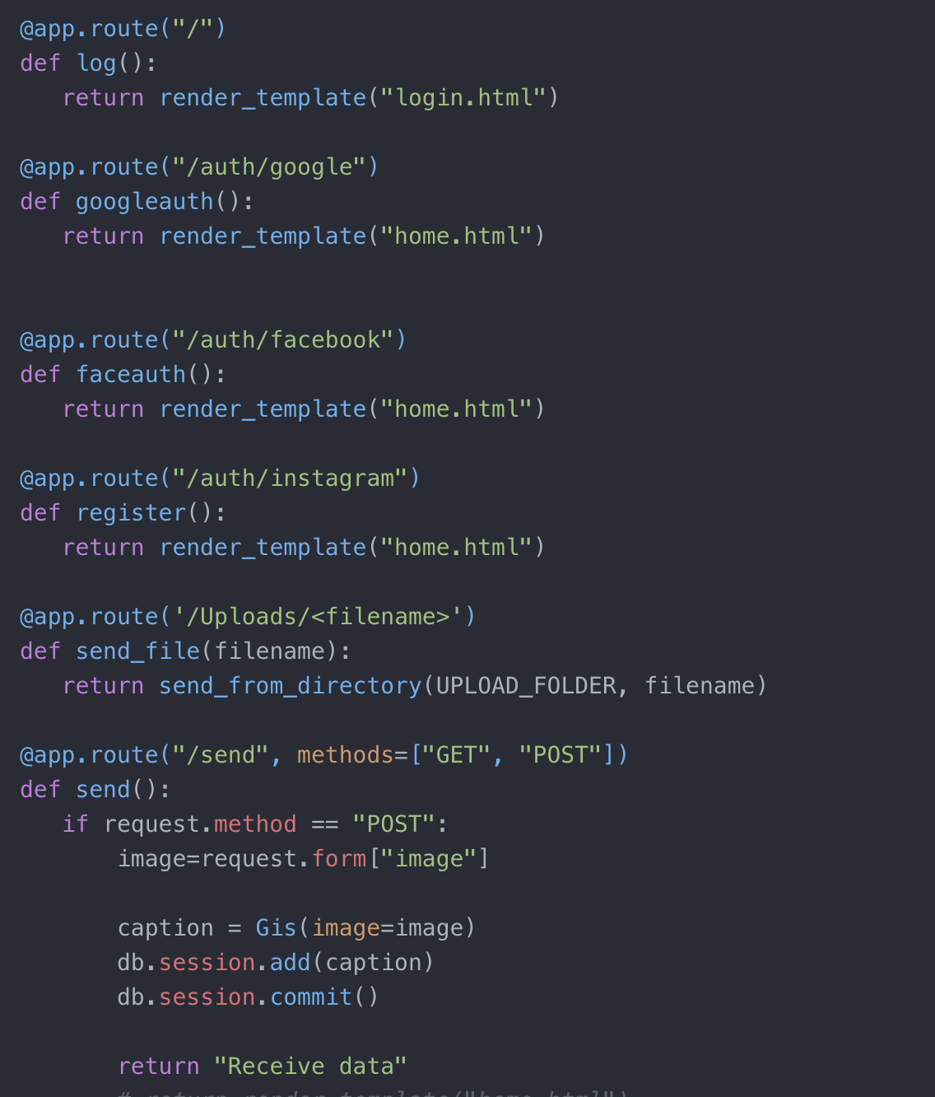


Create the app

Slide 5

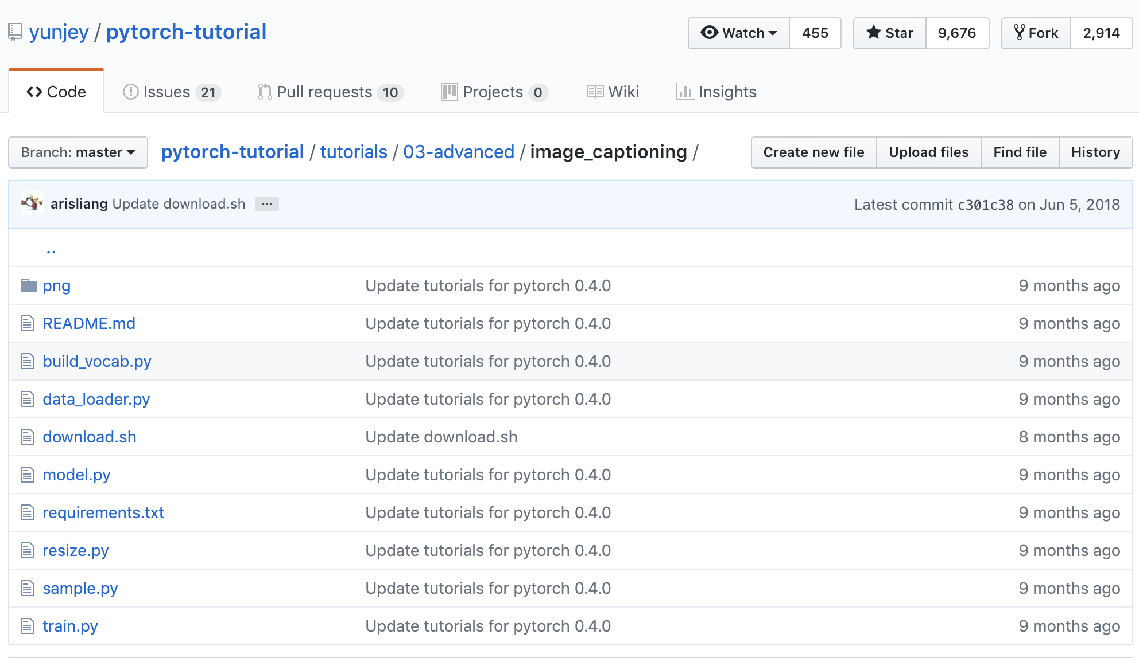
Setting up with tensorflow and Pytorch
https://github.com/yunjey/pytorch-tutorial/tree/master/tutorials/03-advanced/image_captioning

Slide 6
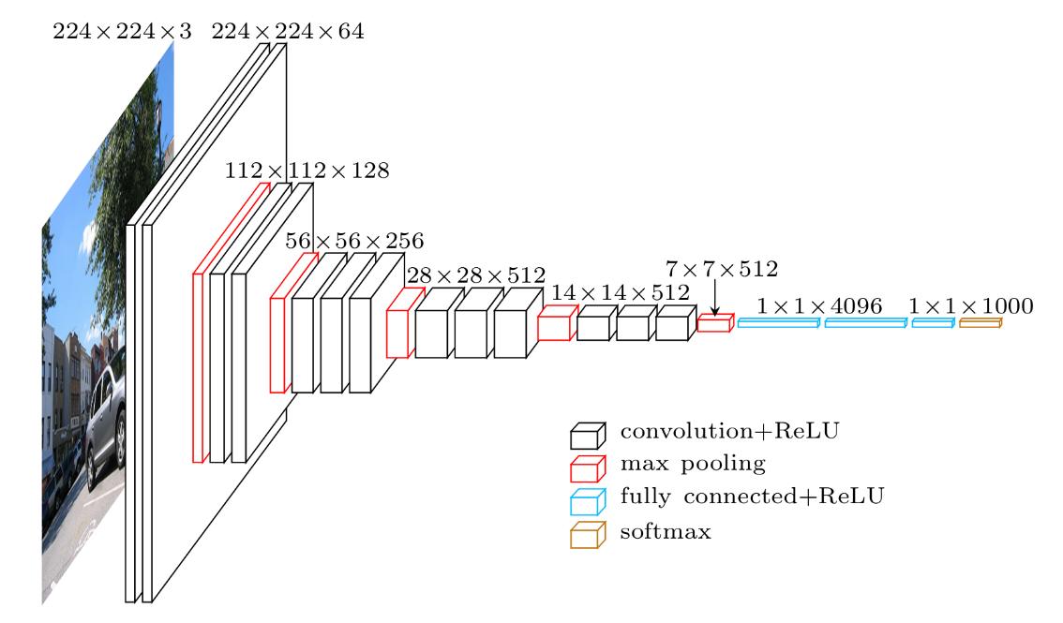
Using VGG16 for image classification
VGG:
High-performing Convolutional Neural Network (CNN) for image classification¹
Architecture
11-19 layers, adjustable weights
Advantages
Consistently performs very well on benchmarks
Several pre-trained versions exist
Refurbish Dr. Coop’s presentation
Figure 1
Deep Convolutional Neural Network (CNN) ²

Slide 7
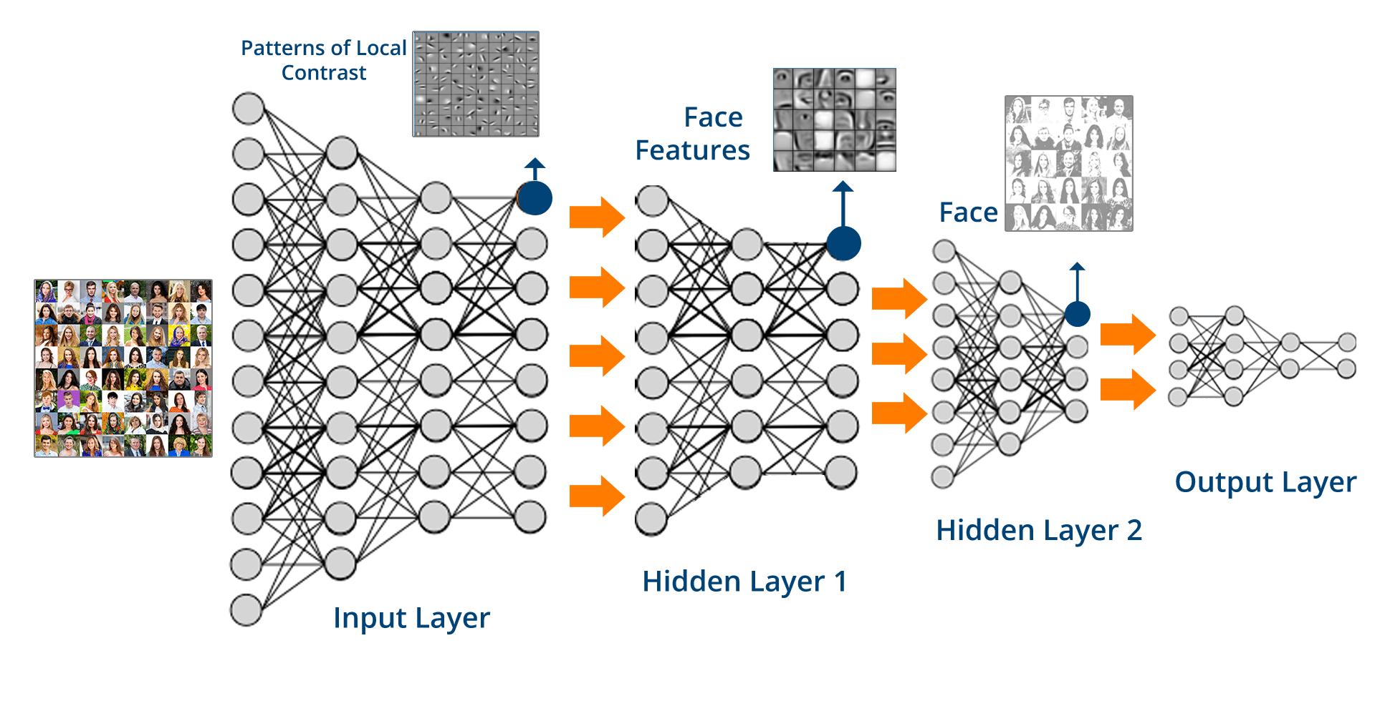
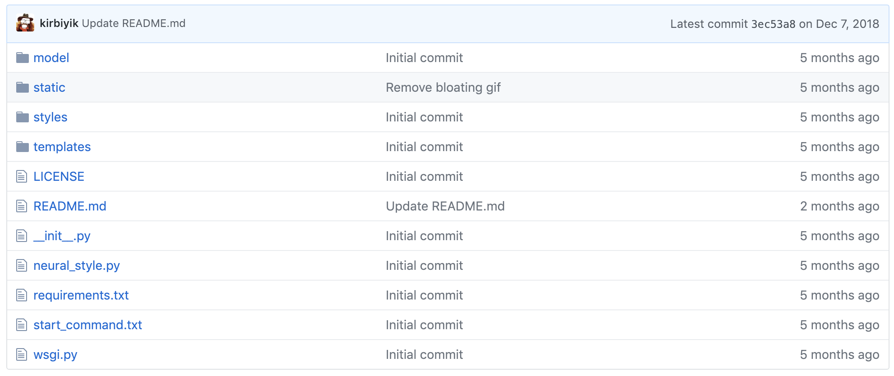
Neural artistic style transfer
Image from: https://cdn.edureka.co/blog/wp-content/uploads/2017/05/Deep- Neural-Network-What-is-Deep-Learning-Edureka.png
https://github.com/kirbiyik/neural-style

Slide 8
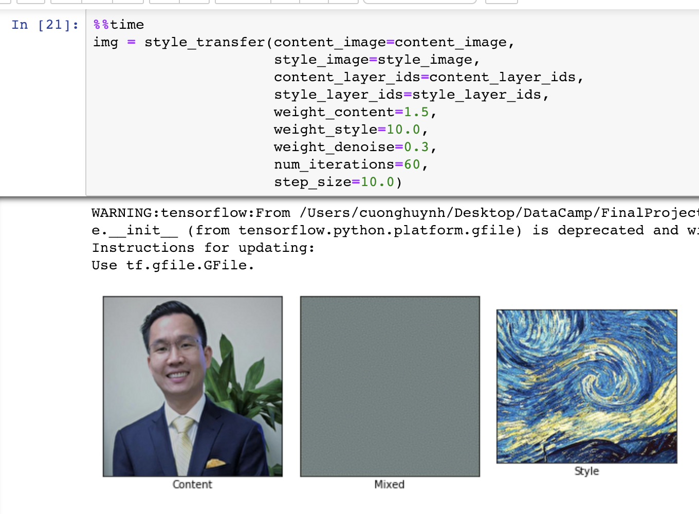
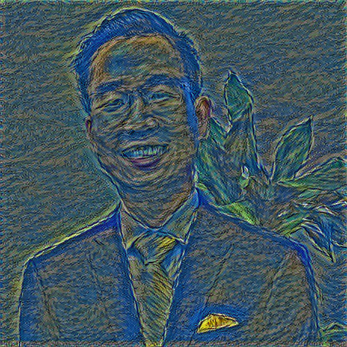
Image Style transferring

Slide 9
Q & A THANK YOU!

