Slide 1
Python OpenCV Lab
2022 Crash Course
NTU GIEE
Media IC & System Lab
楊凱翔
2022/08/01

Slide 2
Outline
Prerequisite
Lab1: basic image processing
- Image Filtering
- Image PCA Analysis
Lab2: Homography

Slide 3
Outline
Prerequisite
Lab1: basic image processing
- Image Filtering
- Image PCA Analysis
Lab2: Homography

Slide 4
Prerequisite
SSH Client: MobaXterm
Code editor: VS Code, Notepad++
Language: Python3
Library:
NumPy: array operation
OpenCV: computer vision task
Matplotlib: visualization in python

Slide 5
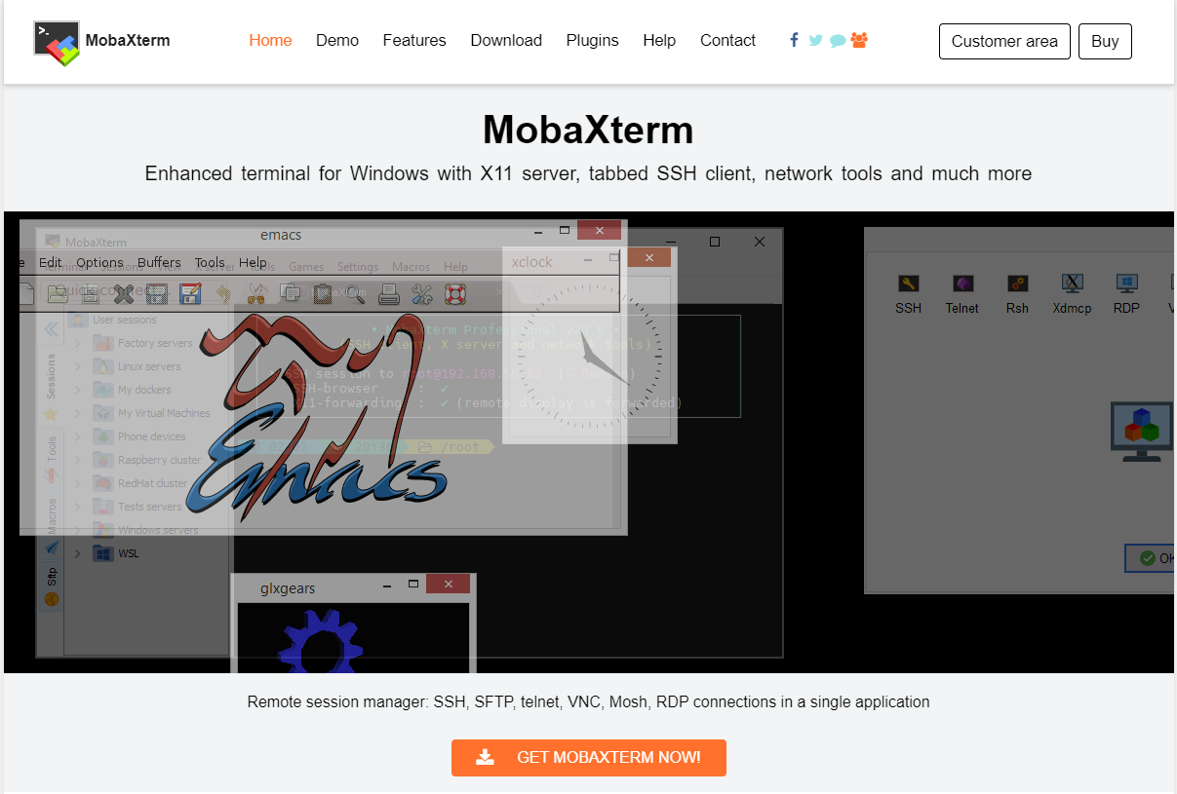
MobaXterm
Download from https://mobaxterm.mobatek.net/

Slide 6

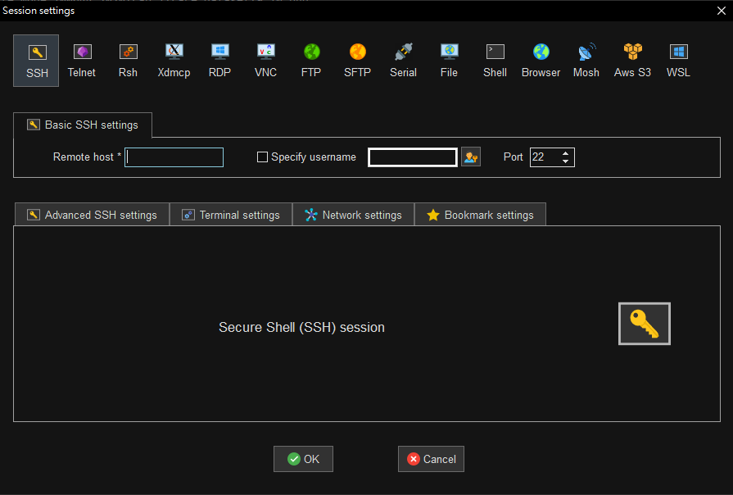
MobaXterm
Refer to 421 wiki to get remote host and port.
MediaGTi :
remote host: 140.112.48.127
port: 10800

Slide 7


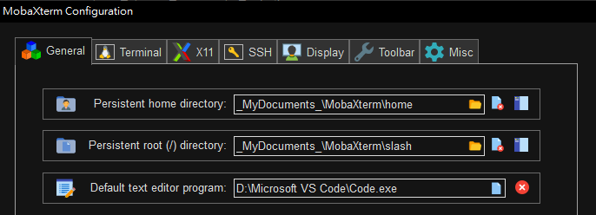
MobaXterm
Type $ passwd to change password
Change default text editor

Slide 8
Linux Commend
Tutorial: https://blog.techbridge.cc/2017/12/23/linux-commnd-line-tutorial/, Google
Basic
cd, ls, git, mkdir, mv, rm, …
Useful tool
tmux, nvidia-htop, nvidia-smi, jupyter notebook, anaconda, …

Slide 9
Python Grammar
Tutorial: http://cs231n.github.io/python-numpy-tutorial/, Google
Basic
print(), if else, for loop
Useful
List, indexing of list
Ex: a = [1,2,4]; a[0] = 1; a[-1] = 4; a[:2] = [1,2]
Optional
Function declaration (if some process is repeated)

Slide 10
NumPy
Tutorial: http://cs231n.github.io/python-numpy-tutorial/, Google
Import library:
import numpy as np
Basic:
Array initialization, basic property (shape, data type), indexing
Useful:
Build-in function for array operation: argmin, matmul

Slide 11
OpenCV
Tutorial: https://docs.opencv.org/4.5.2/, Google
Basic
Image read, write, resize, color conversion, …
Useful
Padding, filtering, other CV tasks

Slide 12
[Supplement] some tips for image read/write
All image read method
OpenCV
Pillow
Matplotlib
Scikit-image
Imageio
Scipy.misc (unavailable after 1.1.0)
Shape: (H, W, C)
In OpenCV, the default color order is BGR
Change to np.array and change dtype from uint8 to floatXX before some operations
More examples in ImageRead.ipynb

Slide 13
Outline
Prerequisite
Lab1: basic image processing
- Image Filtering
- Image PCA Analysis
Lab2: Homography

Slide 14
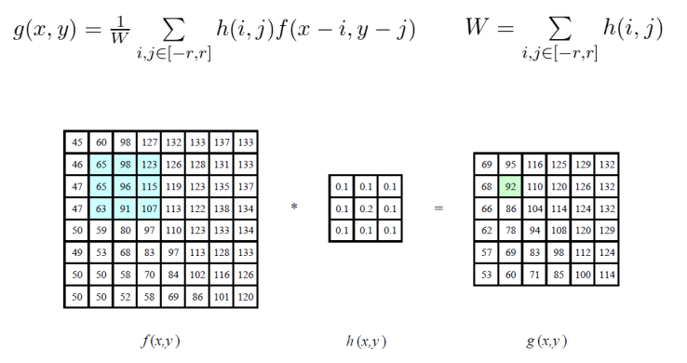
Image Filtering
Weighted sum of the region of the input

Slide 15
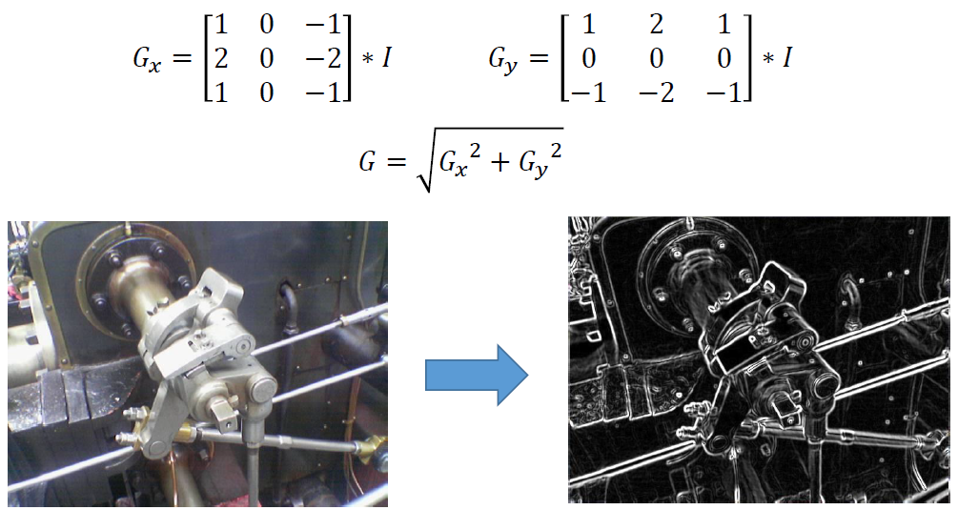
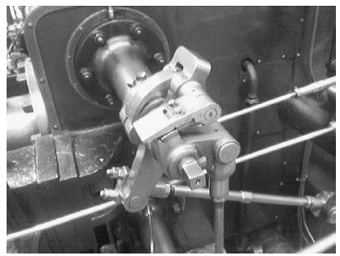
Lab1: Image Filtering
Sobel filter: used in edge detection
Input Gray-scale image
Output Gray-scale image

Slide 16
Principal Component Analysis (PCA)
Goal : determine the projection to maximize the variance of the projected data
Linear dimension reduction

Slide 17
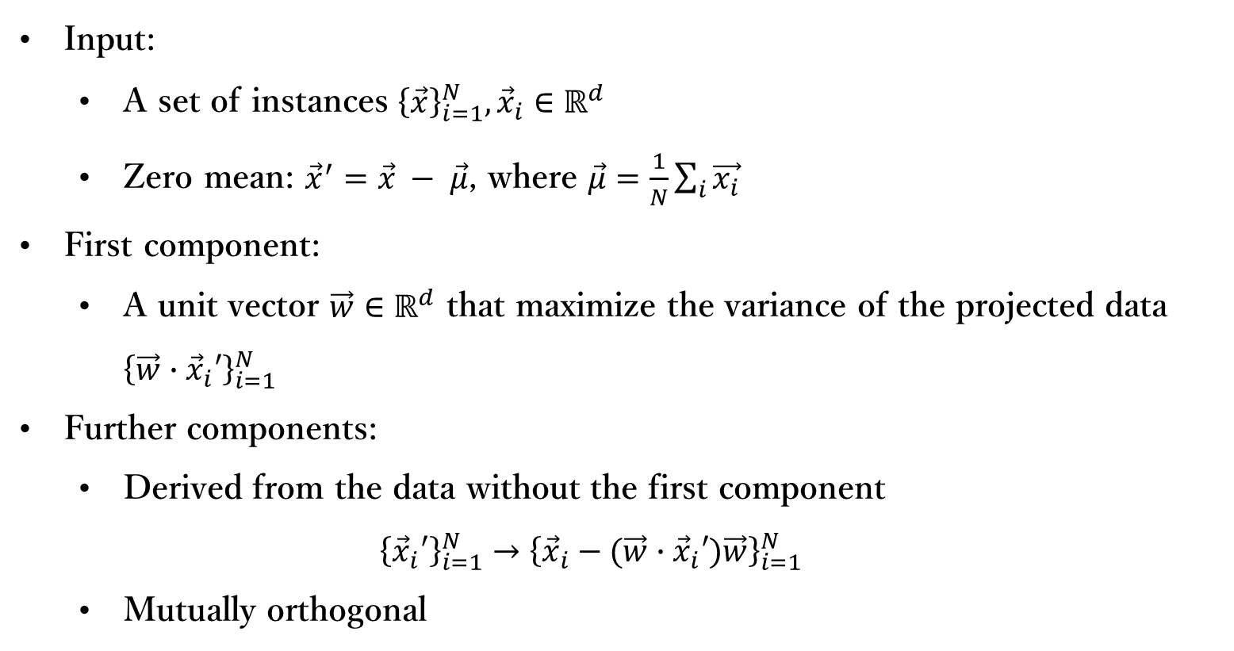
Principal Component Analysis (PCA)
Input:
A set of instances ${\left\{\vec{x}\right\}}_{i=1}^{N}, {\vec{x}}_{i}∈ℝ^{d}$
Zero mean: ${\vec{x}}^{′}=\vec{x} − \vec{μ}$, where $\vec{μ}=\frac{1}{N}\sum_{i}{\vec{x_{i}}}$
First component:
A unit vector $\vec{w}∈ℝ^{d}$ that maximize the variance of the projected data ${\left\{\vec{w}∙{\vec{x}}_{i}′\right\}}_{i=1}^{N}$
Further components:
Derived from the data without the first component
$${\left\{{\vec{x}}_{i}′\right\}}_{i=1}^{N}→{\left\{{\vec{x}}_{i}−(\vec{w}∙{\vec{x}}_{i}′)\vec{w}\right\}}_{i=1}^{N}$$
Mutually orthogonal

Slide 18

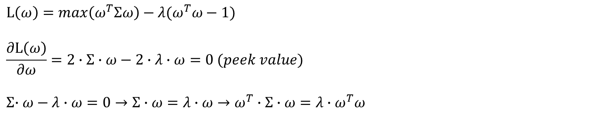

Principal Component Analysis (PCA)
$$var\left(ω^{T}x\right)→E\left\{\left(ω^{T}x−ω^{T}μ\right)∙{\left(ω^{T}x−ω^{T}μ\right)}^{T}\right\}=ω^{T}E\left\{\left(x−μ\right)∙{\left(x−μ\right)}^{T}\right\}ω$$
$$Σ$$
We need to maximize $var\left(ω^{T}x\right)$ with $\left\|ω\right\|=ω^{T}ω=1$
$$→max⁡(ω^{T}Σω)$$
$$L\left(ω\right)=\max\left(ω^{T}Σω\right)−λ(ω^{T}ω−1)$$
$$\frac{∂L\left(ω\right)}{∂ω}=2∙Σ∙ω−2∙λ∙ω=0 (peek value)$$
$$Σ{∙ω}−λ∙ω=0→Σ∙ω=λ∙ω→ω^{T}∙Σ∙ω=λ∙ω^{T}ω$$
$$solve SVD(Σ)$$

Slide 19
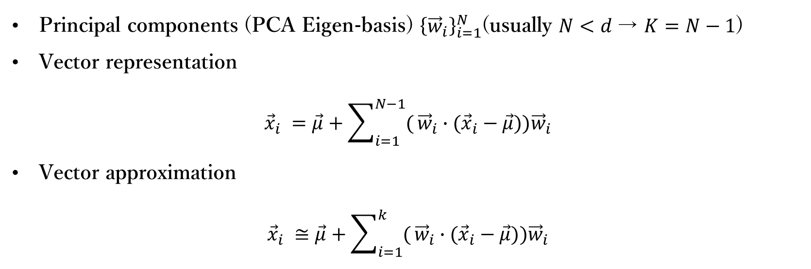
Principal Component Analysis (PCA)
Principal components (PCA Eigen-basis) ${\left\{{\vec{w}}_{i}\right\}}_{i=1}^{N}$(usually $N<d$→ $K=N−1$)
Vector representation
$${\vec{x}}_{i} =\vec{μ}+\sum_{i=1}^{N−1}{(}{\vec{w}}_{i}∙({\vec{x}}_{i}−\vec{μ})){\vec{w}}_{i}$$
Vector approximation
$${\vec{x}}_{i} ≅\vec{μ}+\sum_{i=1}^{k}{(}{\vec{w}}_{i}∙({\vec{x}}_{i}−\vec{μ})){\vec{w}}_{i}$$

Slide 20
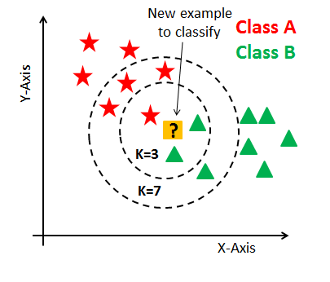
KNN Classifier
k nearest neighbors classifier

Slide 21
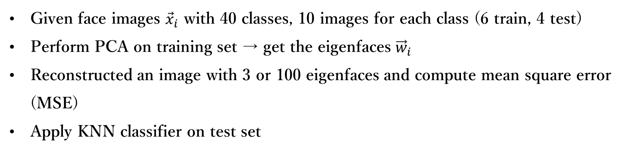
Lab1: Image PCA Analysis
Given face images ${\vec{x}}_{i}$ with 40 classes, 10 images for each class (6 train, 4 test)
Perform PCA on training set → get the eigenfaces ${\vec{w}}_{i}$
Reconstructed an image with 3 or 100 eigenfaces and compute mean square error (MSE)
Apply KNN classifier on test set

Slide 22
Outline
Prerequisite
Lab1: basic image processing
- Image Filtering
- Image PCA Analysis
Lab2: Homography

Slide 23








Lab2: Homography
$$u_{2}$$
$$v_{1}$$
$$v_{2}$$
$$u_{1}$$
Homography
(projective transformation)
H
$$u_{4}$$
$$v_{3}$$
$$v_{4}$$
$$u_{3}$$

Slide 24
Recap of Homography
Matrix form:
Equations:

Slide 25
Recap of Homography
Degree of freedom:
9 - 1 = 8 DoF
Constraint

Slide 26
Solution

Slide 27
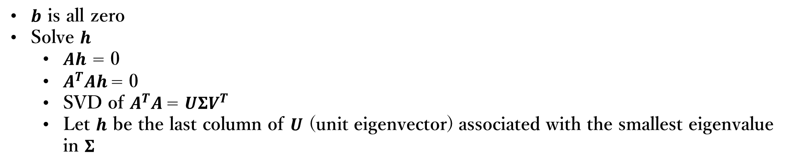
Solution
Construct a linear system using N vertices:
$b$ is all zero
Solve $h$
$Ah$ = 0
$A^{T}Ah$= 0
SVD of $A^{T}A$= $UΣV^{T}$
Let $h$ be the last column of $U$ (unit eigenvector) associated with the smallest eigenvalue in $Σ$

Slide 28
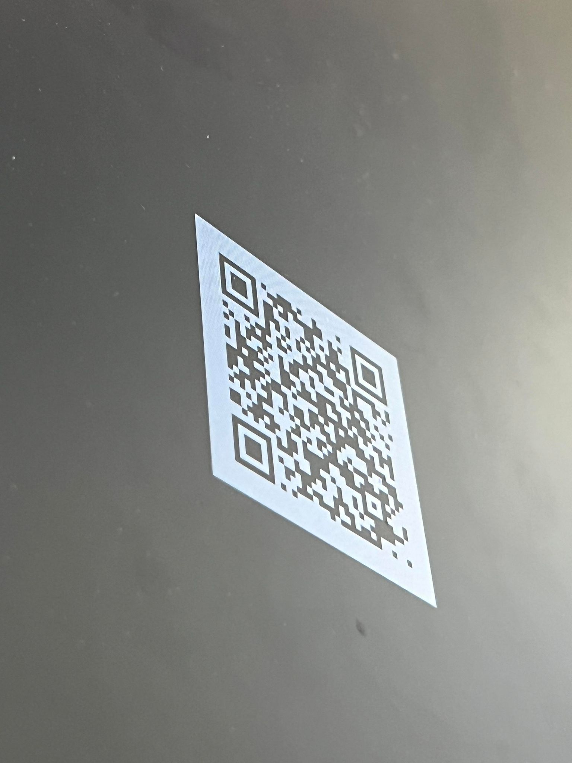
Lab2 Problem
Make the QR code frontal parallel
Calling function cv2.findHomography is FORBIDDEN!!!

Slide 29
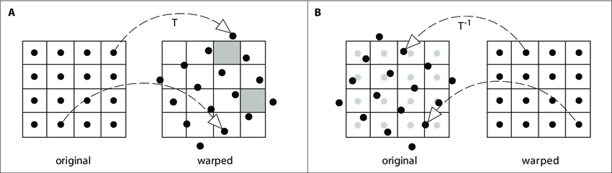
Backward Warping
Prevent holes in output space
Pixel value at sub pixel location like (30.21, 22.74)?
Bilinear interpolation
Nearest neighbor
Forward Warping
Backward Warping

