Slide 1
Chapter II Mathematics: Basics
All class materials including this PowerPoint file are available at
https://github.com/medialab-ku/openGLESbook

Slide 2
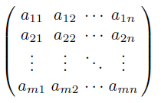
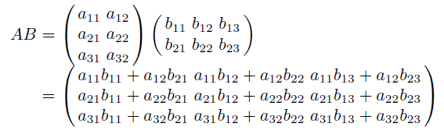
Matrices and Vectors
This chapter delivers an explicit presentation of the basic mathematical techniques, which are necessary throughout this book.
m×n matrix
If m = n, the matrix is called square.
Matrix-matrix multiplication
If A’s dimension is l×m and B’s dimension is m×n, AB is an l×n matrix.

Slide 3


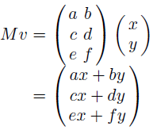


Matrices and Vectors (cont’d)
The typical representation of a 2D vector, (x,y), or a 3D vector, (x,y,z), is called a row vector. Instead, we can use a column vector:
Matrix-vector multiplication
Transpose denoted by M^{T}
A different way of matrix-vector multiplication
For matrix-vector multiplication, OpenGL uses the column vectors and the vector-on-the-right representation. In contrast, Direct3D uses the row vectors and the vector-on-the-left representation.
Notes:
A different way of matrix-vector multiplication을
(AB)^{T} = B^{T}A^{T} and (Mv)^{T} = v^{T}M^{T}
로 바꾸고, 아래처럼 설명하려고 했으나, 더 어려움. 따라서, 다시 위처럼.
(Mv)^{T} = v^{T}M^{T} → Mv의 전치가 뭐냐? → 바로 (ax+by, cx+dy, ex+fy)다. → v^{T}M^{T}가 이걸 만들어 내는 지 보자. → .. → 봐라 같지? → 그 결과가 열로 나오느냐 행으로 나오느냐 차이일 뿐, 행렬과 벡터의 곱셈은 두번째 bullet처럼 아니면 네번째 bullet처럼 표현할 수 있다는 것이다.

Slide 4


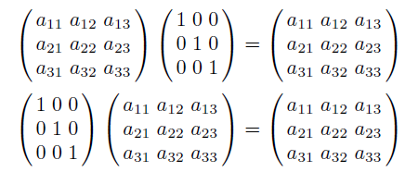
Matrices and Vectors (cont’d)
Identity matrix denoted by I
For any matrix M, MI = IM = M.
If two square matrices A and B are multiplied to return an identity matrix, i.e., AB = I, B is called the inverse of A and is denoted by A⁻¹. By the same token, A is the inverse of B.
Theorems
(AB)⁻¹ = B⁻¹A⁻¹ ←
(AB)^{T} = B^{T}A^{T} (Revisit Mv and v^{T}M^{T} presented in the previous page.)

Slide 5


Matrices and Vectors (cont’d)
Consider the coordinates of a 2D or 3D vector, v:
Its length denoted by ||v||
Dividing a vector by its length is called normalization.
Such a normalized vector is called the unit vector since its length is 1.

Slide 6
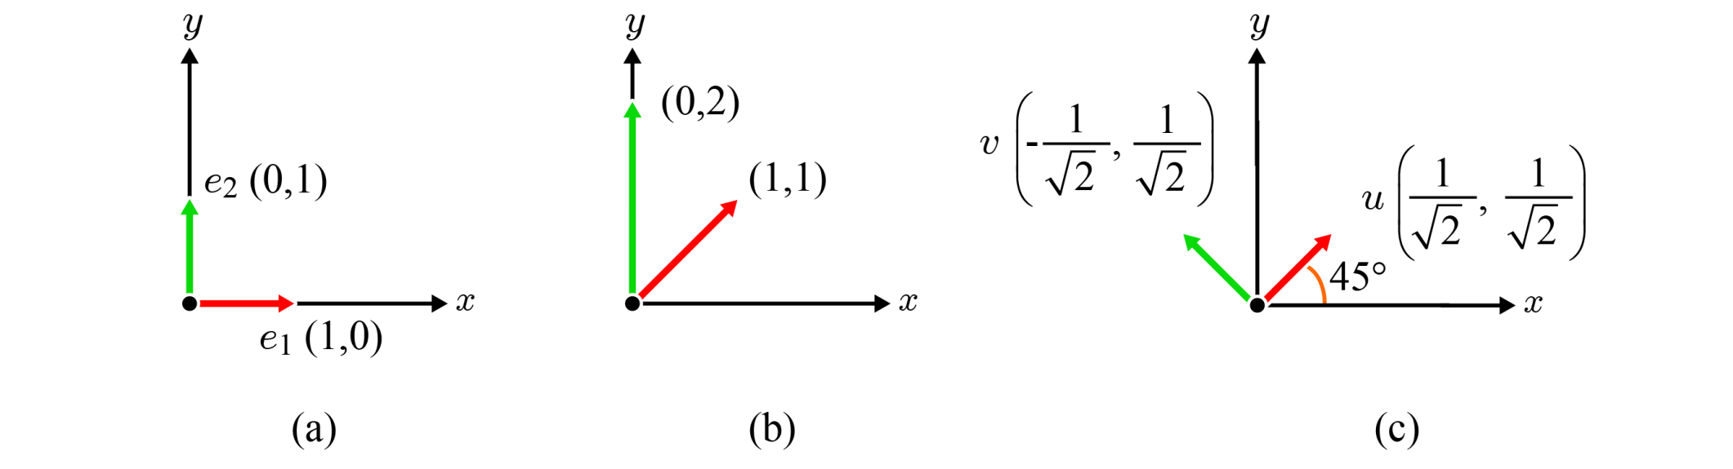
Coordinate System and Basis
Coordinate system = origin + basis
Throughout this book, we use two terms, coordinate system and space, interchangeably.
In the 2D space, every vector can be defined as a linear combination of basis vectors. Consider (3,5) for the following three examples.
An orthonormal basis is an orthogonal set of unit vectors.
standard
(orthonormal)
non-standard
non-orthonormal
non-standard
orthonormal

Slide 7
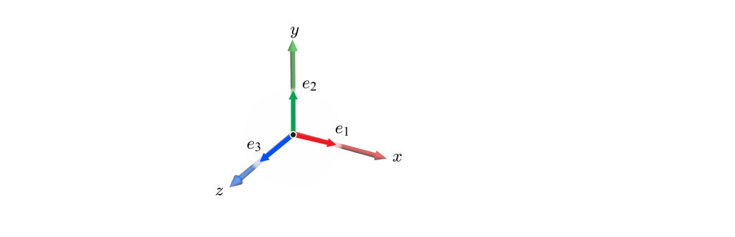
Coordinate System and Basis (cont’d)
3D standard basis, {e₁, e₂, e₃}, where e₁=(1,0,0), e₂=(0,1,0), and e₃=(0,0,1).
It is also orthonormal.
Of course, we can consider non-standard orthonormal bases in 3D space. You will see soon.
All 2D and 3D bases presented from now on will be orthonormal by default.

Slide 8
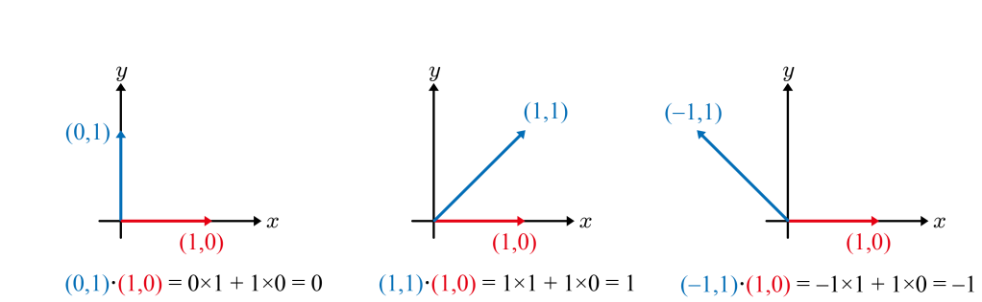
Dot Product
Given two n-dimensional vectors, a and b, whose coordinates are (a₁, a₂, .. , a_{n}) and (b₁, b₂, .. , b_{n}), respectively, their dot product a⋅b is defined to be a₁b₁+a₂b₂+ .. +a_{n}b_{n}. It is also called inner product.
Geometric interpretation of the algebraic formula: When the angle between a and b is denoted as θ, a⋅b can be also defined as ‖a‖‖b‖cosθ.
If a and b are perpendicular to each other, a⋅b = 0.
If θ is an acute angle, a⋅b > 0.
If θ is an obtuse angle, a⋅b < 0.

Slide 9
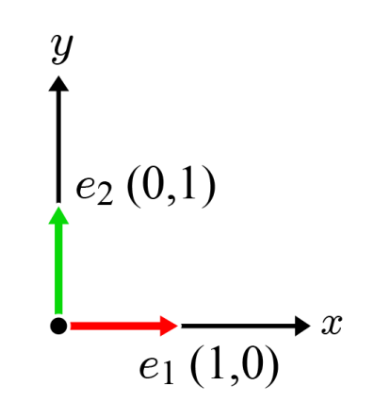
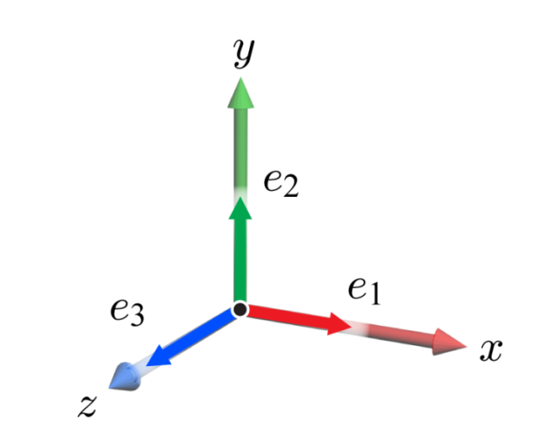
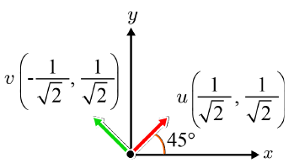
Dot Product (cont’d)
Note that if v is a unit vector, v·v = 1.
Every orthonormal basis has an interesting and useful feature. See two examples.
2D standard basis, {e₁, e₂}
e₁·e₁=1 and e₂·e₂=1
e₁·e₂=0 and e₂·e₁=0.
3D standard basis, {e₁, e₂, e₃}
If i=j, e_{i}·e_{j}=1.
Otherwise, e_{i}·e_{j}=0.
This feature applies to non-standard orthonormal bases.

Slide 10
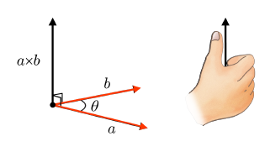
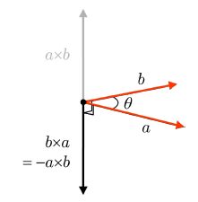
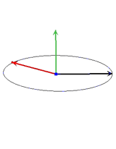
Cross Product
The cross product takes as input two 3D vectors, a and b, and returns another 3D vector which is perpendicular to both a and b. It’s denoted by a×b and its direction is defined by the right-hand rule.
The length of a×b equals the area of the parallelogram that a and b span: ‖a‖‖b‖sinθ.
If a=b, a×b returns the zero vector, often denoted as 0.
The right-hand rule implies that the direction of b×a is opposite to that of a×b, i.e., b×a = -a×b, but their lengths are the same.

Slide 11


Cross Product (cont’d)
In the book, [Note: Derivation of cross product] shows how the coordinates of a×b are derived from those of a and b. See below for an intuitive derivation.
If a=(a_{x}, a_{y}, a_{z}) and b=(b_{x}, b_{y}, b_{z}), a×b=(a_{y}b_{z}-a_{z}b_{y}, a_{z}b_{x}-a_{x}b_{z}, a_{x}b_{y}-a_{y}b_{x}).

Slide 12
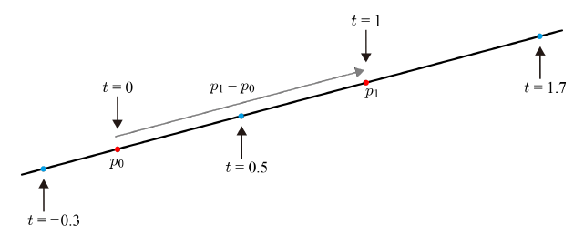
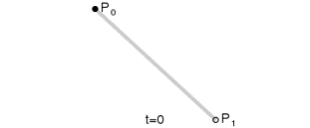
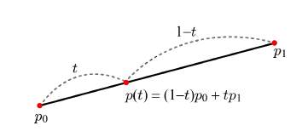
Line, Ray and Linear Interpolation
An infinite line is defined by two end points, p₀ and p₁: p(t) = p₀ + t(p₁ - p₀) where p₁ - p₀ is a vector and t is in [-∞,∞].
If [0,∞], p(t) is a ray, which starts from p₀ and is infinitely extended along p₁ - p₀ .
If [0,1], p(t) represents a line segment.
Note that p(t) = p₀ + t(p₁ - p₀) = (1-t)p₀ + tp₁. It is a weighted sum of p₀ and p₁ and corresponds to the linear interpolation of p₀ and p₁ if t is in [0,1].

Slide 13
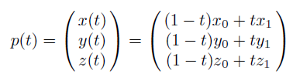



Line, Ray and Linear Interpolation (cont’d)
The coordinates defined by linear interpolation in 2D and 3D spaces
Whatever attributes are associated with the end points, they can be linearly interpolated. Suppose that the endpoints are associated with colors c₀ and c₁, respectively, where c₀ = (R₀, G₀, B₀) and c₁ = (R₁, G₁, B₁). Then, the color c(t) is defined as follows:

